Slide 1
WetWiFi Kickoff
11 January 2018

Slide 2

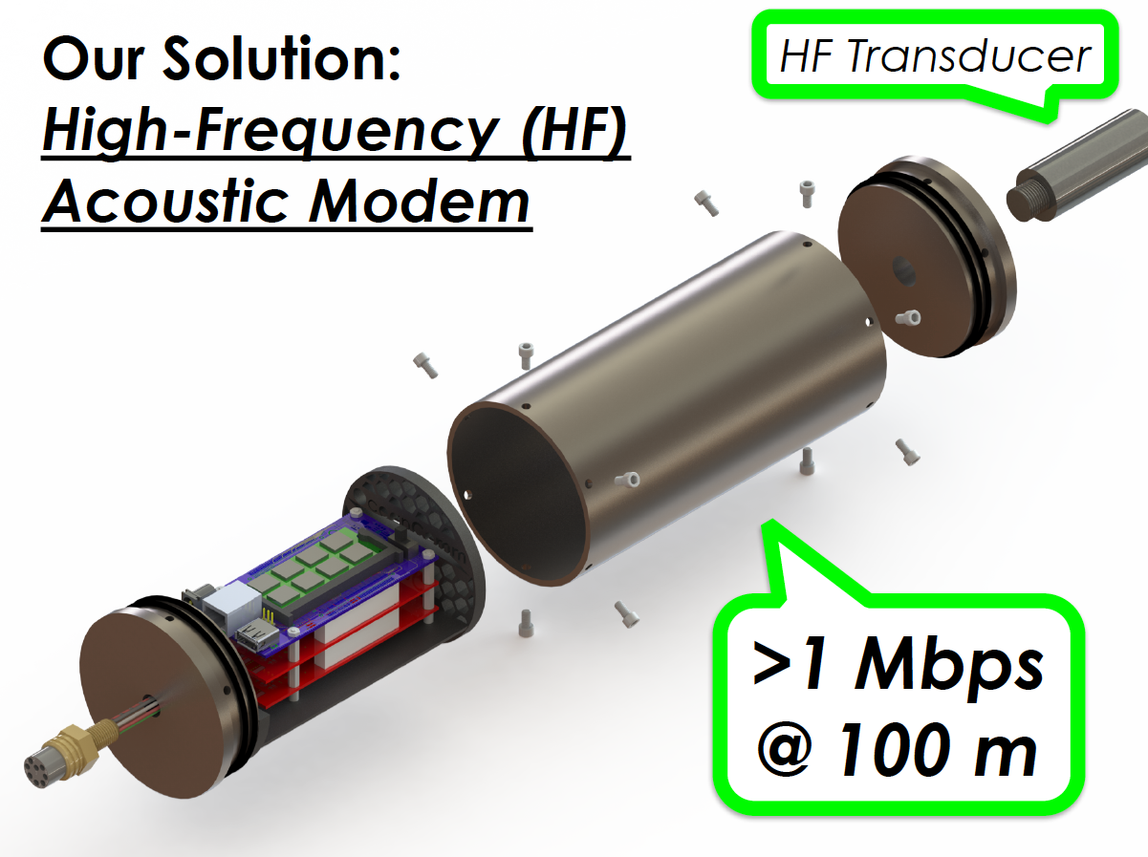
QUAD CHART SENT TO MBARI BOARD
PROBLEM: SLOW ACOUSTIC COMMUNICATION
IMPORTANCE: HIGH-SPEED ACOUSTIC COMMUNICATION IS AN ENABLING TECHNOLOGY
Radio communication - WiFi, Bluetooth, etc - does not work underwater.
Acoustic communication works but it is slow – of order 100 to 1,000 bits per second.
Large amounts of data can be accessed and analyzed without having to recover the asset:
Mapping AUV
Video data
Genomic data
Engineering diagnostic data
WHAT WE’RE DOING ABOUT IT: COLLABORATION WITH OCEAN COMM
2018 PLAN: IN-SITU TECH EVALUATION
Evaluate the modem in Monterey Bay:
Off the R/V Paragon
Session 1: vertical channel
Session 2: horizontal channel
If succcessful, a proposal for integration into one of our assets will be submitted in June 2018.

Slide 3
Timelines
Base: Jan to April
  100-300m vertical comms evaluation
  500m+ water depth, off the Paragon
  Metrics
    Data rate & BER vs depth
    Link stability
    Sensitivity to sea-state
    Availability (fraction of time the system was ready for a planned test)
    Reliability (fraction of tests that ended w/o malfunction)
  At-sea testing: 2 sets X 2 days
  Set # 1: February
    This Friday: set the test date
    31 January: set test protocol + nb of reps.
    TBD February: execute test
    TBD early March: MBARI test report
  Set # 2: April
    28 Feb: set the test date
    30 March: set test protocol + nb of reps.
    TBD April: execute test
    30 April: MBARI test report
Follow-on
  4 May: Go/NoGo
  11 May: Finalize Option objectives.
  11 May: Finalize 2019 proposal objectives
  17 May: deadline for 2019 abstract
  18 July: deadline for 2019 proposal.
Option: July to October
  Currently: horizontal comms evaluation
  Metrics: same as above
  At-sea testing: 2 sets X 2 days
    Set # 1: July/August
    Set # 2: September/October
  Testing off Paragon + R/V Rachel Carson
  MBARI summary report.
Discussion: bi-directionality

Slide 4
MBARI Budget (Base/Option)
Brent 80h/80h
MK 64h/64h
Captain 40h/40h
Tech 24h/24h
Materials $5,400/TBD
Ship 4d/4d + 1d/1d contingency

Slide 5
Next Steps
01/12 (this Friday) Finalize timing of Test #1
01/18 Finalize list of things provided by MBARI for Test 1.
01/26 Telcon on test protocol & test metrics
01/31 Finalize test protocol & test metrics.

