Slide 1
Wet WiFi Program

Slide 2
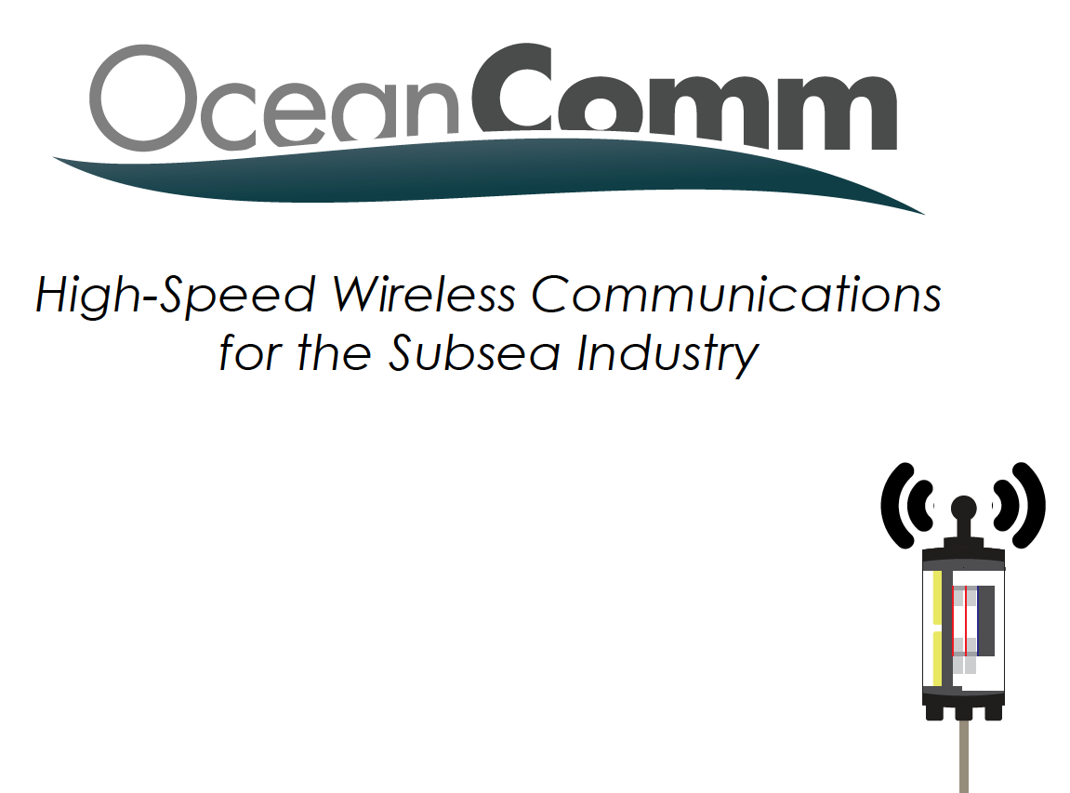
https://youtu.be/NM8DrZT_aeA

Slide 3
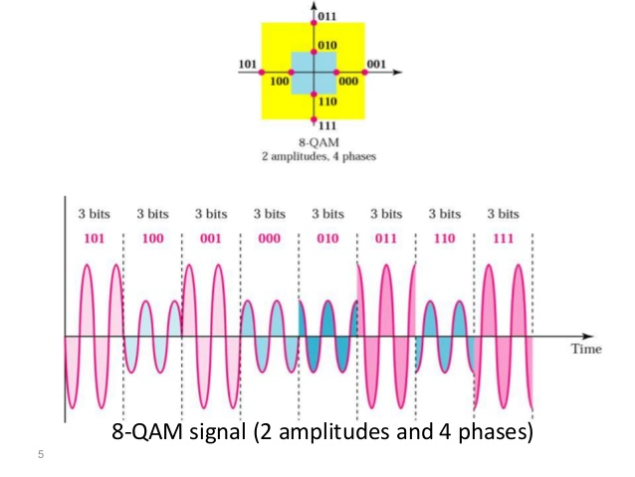
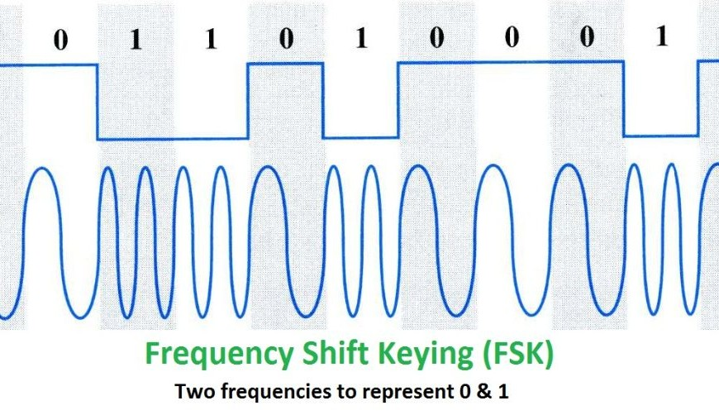
Why does it work?
they use QAM, not FSK
they figured out how to remove the Doppler distortion fast enough

Slide 4
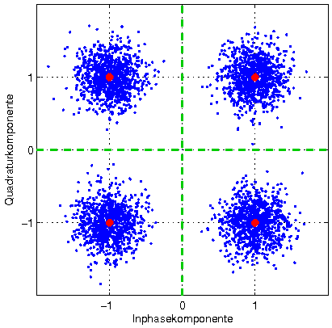
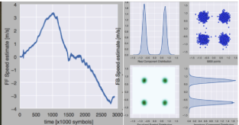
  DOPPLER DISTORTION
Receiver phase = transmitter phase + phase distortion
Doppler distortion is proportional to v/c:
  RF: C = 3x10⁸ m/s → Doppler at 2 knots ~ 10⁻⁹
  ocean: C = 1,500m/s → Doppler at 2 knots ~ 10⁻³
The “magic sauce”: symbol-by-symbol Doppler estimation:

Slide 5
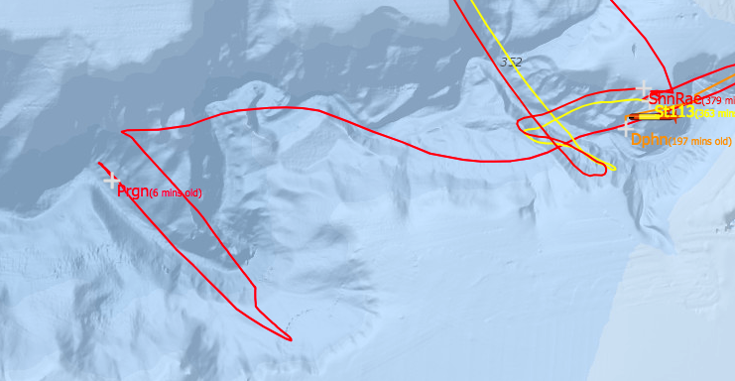
2018 TRL assessment ( on-going)
Goal: assess if the technology is ready for prime-time.
How:
  Measure BER vs depth and bandwidth
  As many times as possible, as many days as possible
  Figure out where it works well and where it breaks
Status:
  2 days last week, 2 days this week.
  Day 1:
    160 packets, 100Kbits each.
    Best: 1Mbps @ 240m
  Day 2:
    1Mb to 4Mb packets.
    Baffle test.
  July: streaming.
  Sept: horizontal re-acquisition.

Slide 6
Proposed Program
3-year program, leading to an at-sea demonstration of high-speed a-comms between an AUV and a surface asset.
PI: Kemp
PM: Chaffey
Tech Lead: Roman
2019
2020
2021
Requirements (MBARI)
2-way-comms (joint)
At-sea testing (joint)
Rendez-vous CONOPS (MBARI)
Platform integration (joint)
At-sea testing (joint)
At-sea testing (joint)
B. Roman 3 months
Kemp etc: 3 m-months
8-10 Paragon days
$30K materials
1 – 1.5 FTE
8-10 Paragon days
$50K materials
1 – 1.5 FTE
10-20 Paragon days
10-20 waveglider days
10-20 AUV days

