Slide 1

UAV
Machine Learning Overview
Danelle Cline, Software Engineer, dcline@mbari.org
Duane Edgington, Software Engineer duane@mbari.org
Notes:
Hello, my name is Danelle Cline. Today I'm going to talk to you about how we are applying machine learning to our UAV project.

Slide 2

Notes:
The goal is to find the objects that are useful to you, the community.
Just to be very clear, I'm going to introduce you to some machine-learning definitions which I hope will help guide you through the overview of our workflow
Machine learning can be confusing and words matter
I'm still a student, and a lifelong student so please help me make this as clear as possible

Slide 3
Machine Learning Definitions
Image Detection
Also known as object detection
Find and localize objects in an image or video
State of the art in image detection is two general categories:
  traditional computer vision methods
  and deep learning-based methods

Slide 4
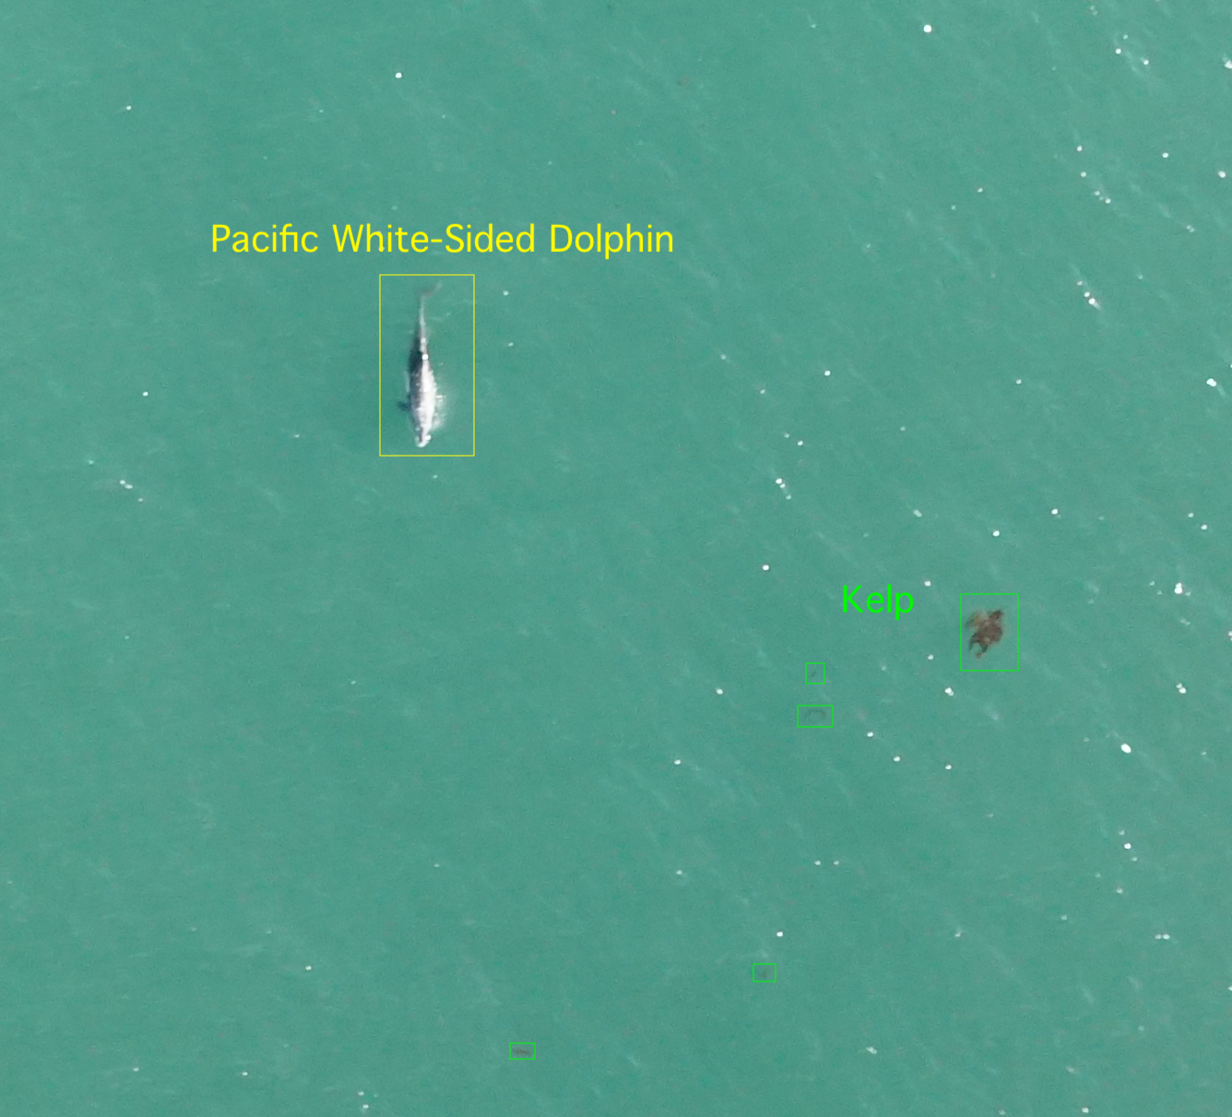

Slide 5
Small Object Detection
SAHI: Sliced Aided Hyper Inference
Generic solution that divides the image into overlapping patches
Predicts patches and combines the results
https://ieeexplore.ieee.org/document/9897990
Notes:
SAHI’s sliced predictions break down the input image into slightly overlapping patches, performs prediction on each patch and finally merges the annotations for each patch to visualize them on the original image.

Slide 6
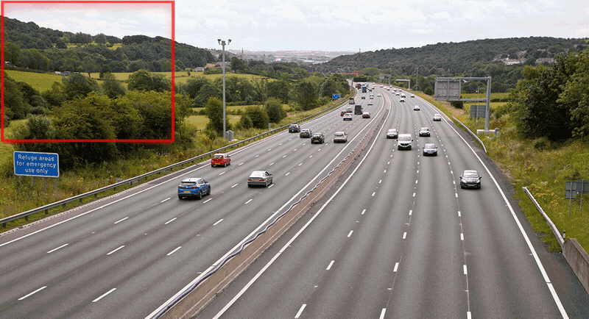
Small Object Detection - SAHI: Slicing Aided Hyper Inference
Notes:
SAHI’s sliced predictions break down the input image into slightly overlapping patches, performs prediction on each patch and finally merges the annotations for each patch to visualize them on the original image.

Slide 7
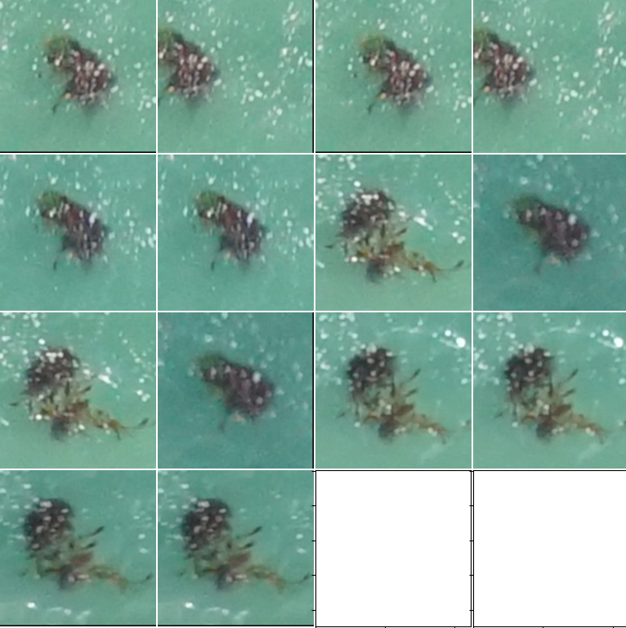
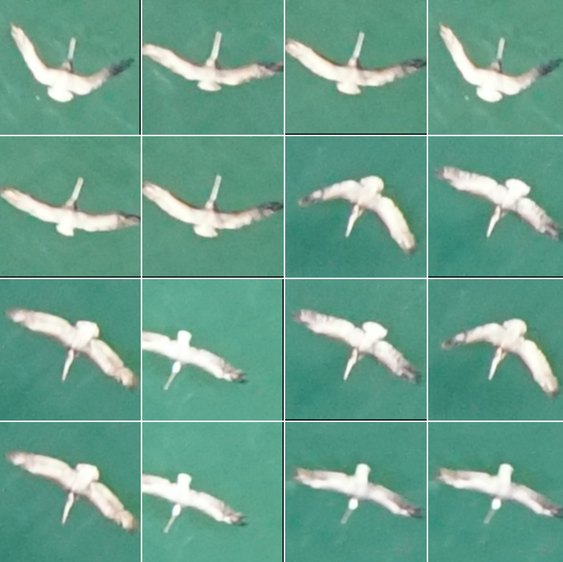
Machine Learning Definitions
Image Clustering
Grouping images into clusters based on their similarities in visual appearance or content
Unsupervised and supervised methods
Useful to assist with labeling
Useful to find duplicate detections
Notes:
c

Slide 8
What features to use to cluster?
Shape?
Color?
Eccentricity?
Size?
Etc.

Slide 9
State-of-the-art feature can be computed with
Vision Transformers (ViTS)
Initially designed for natural language processing (NLP) tasks in 2020
Breaks apart an image into patches
Understands both local and global image features

Slide 10
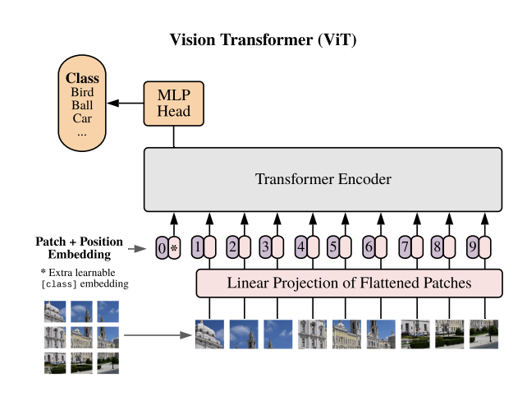
Notes:
In simple terms, a Vision Transformer takes an image as input and processes it in a unique way. Instead of using traditional convolutional layers like in other popular computer vision models (such as CNNs), a Vision Transformer divides the image into small patches, similar to breaking it into smaller puzzle pieces.
Each patch is then flattened and treated as a sequence of values. These patches are fed into a Transformer, which is a neural network architecture originally designed for processing sequences of words in natural language. The Transformer analyzes the relationships and dependencies between the patches to understand the image's content.
The key idea behind a Vision Transformer is that it can learn to recognize patterns and objects in the image by attending to different patches and understanding their relationships. By doing so, it captures global information about the image while still considering local details within each patch.

Slide 11
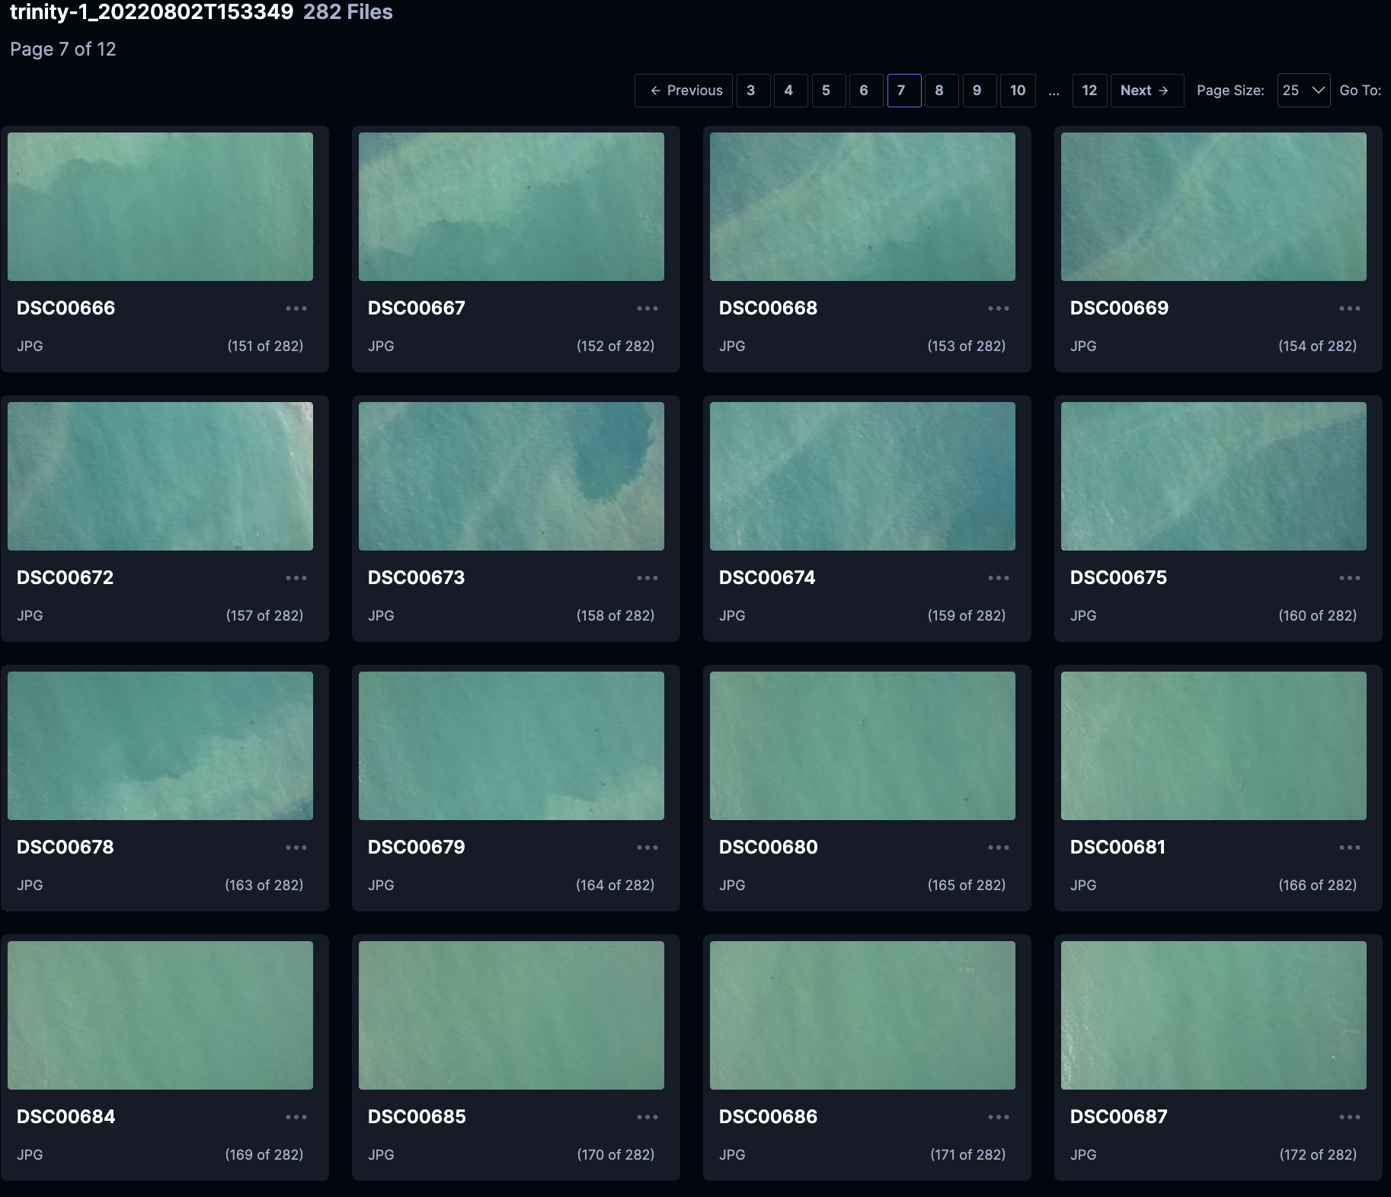
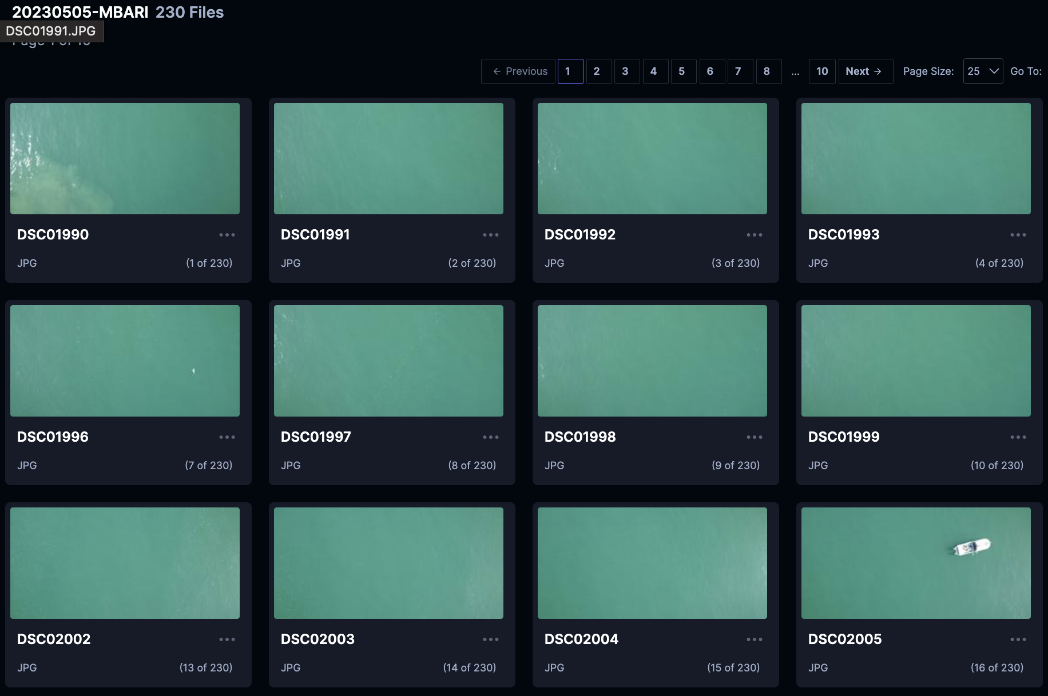
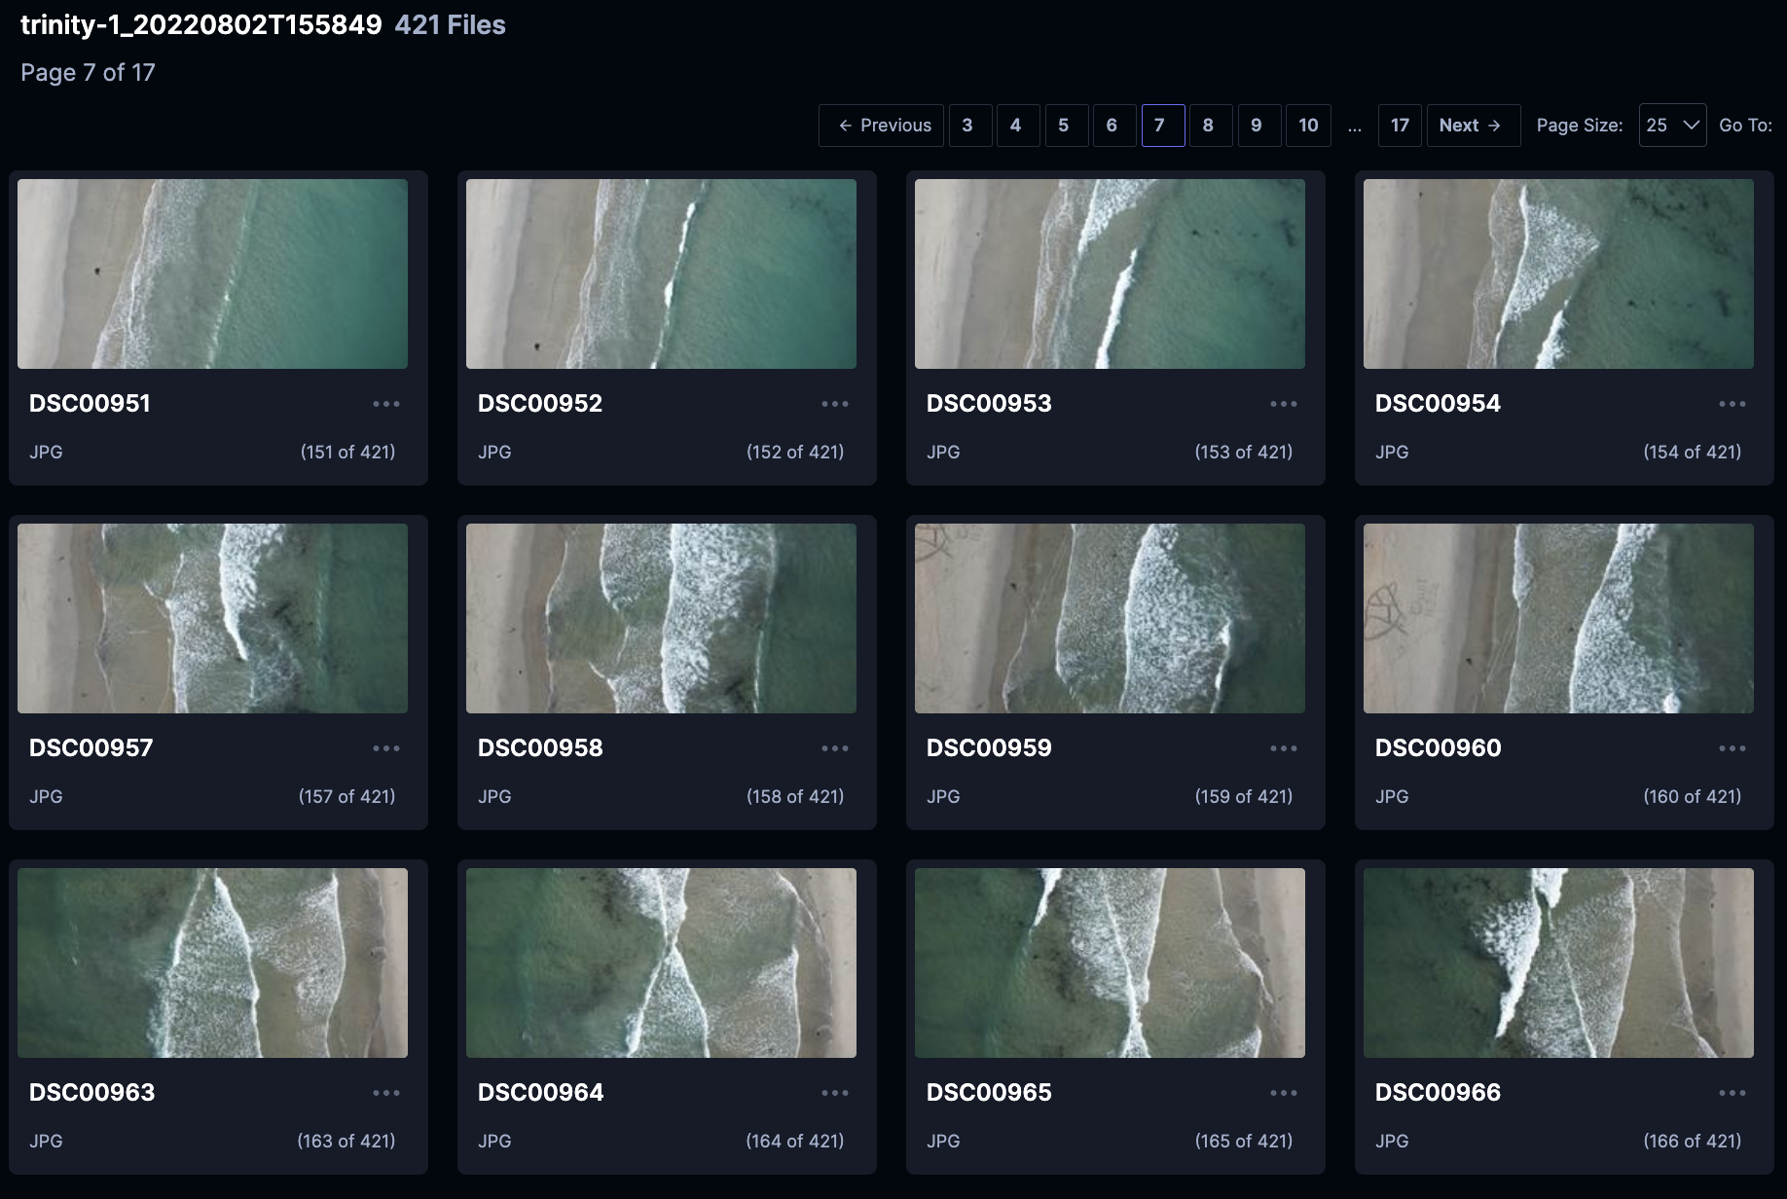
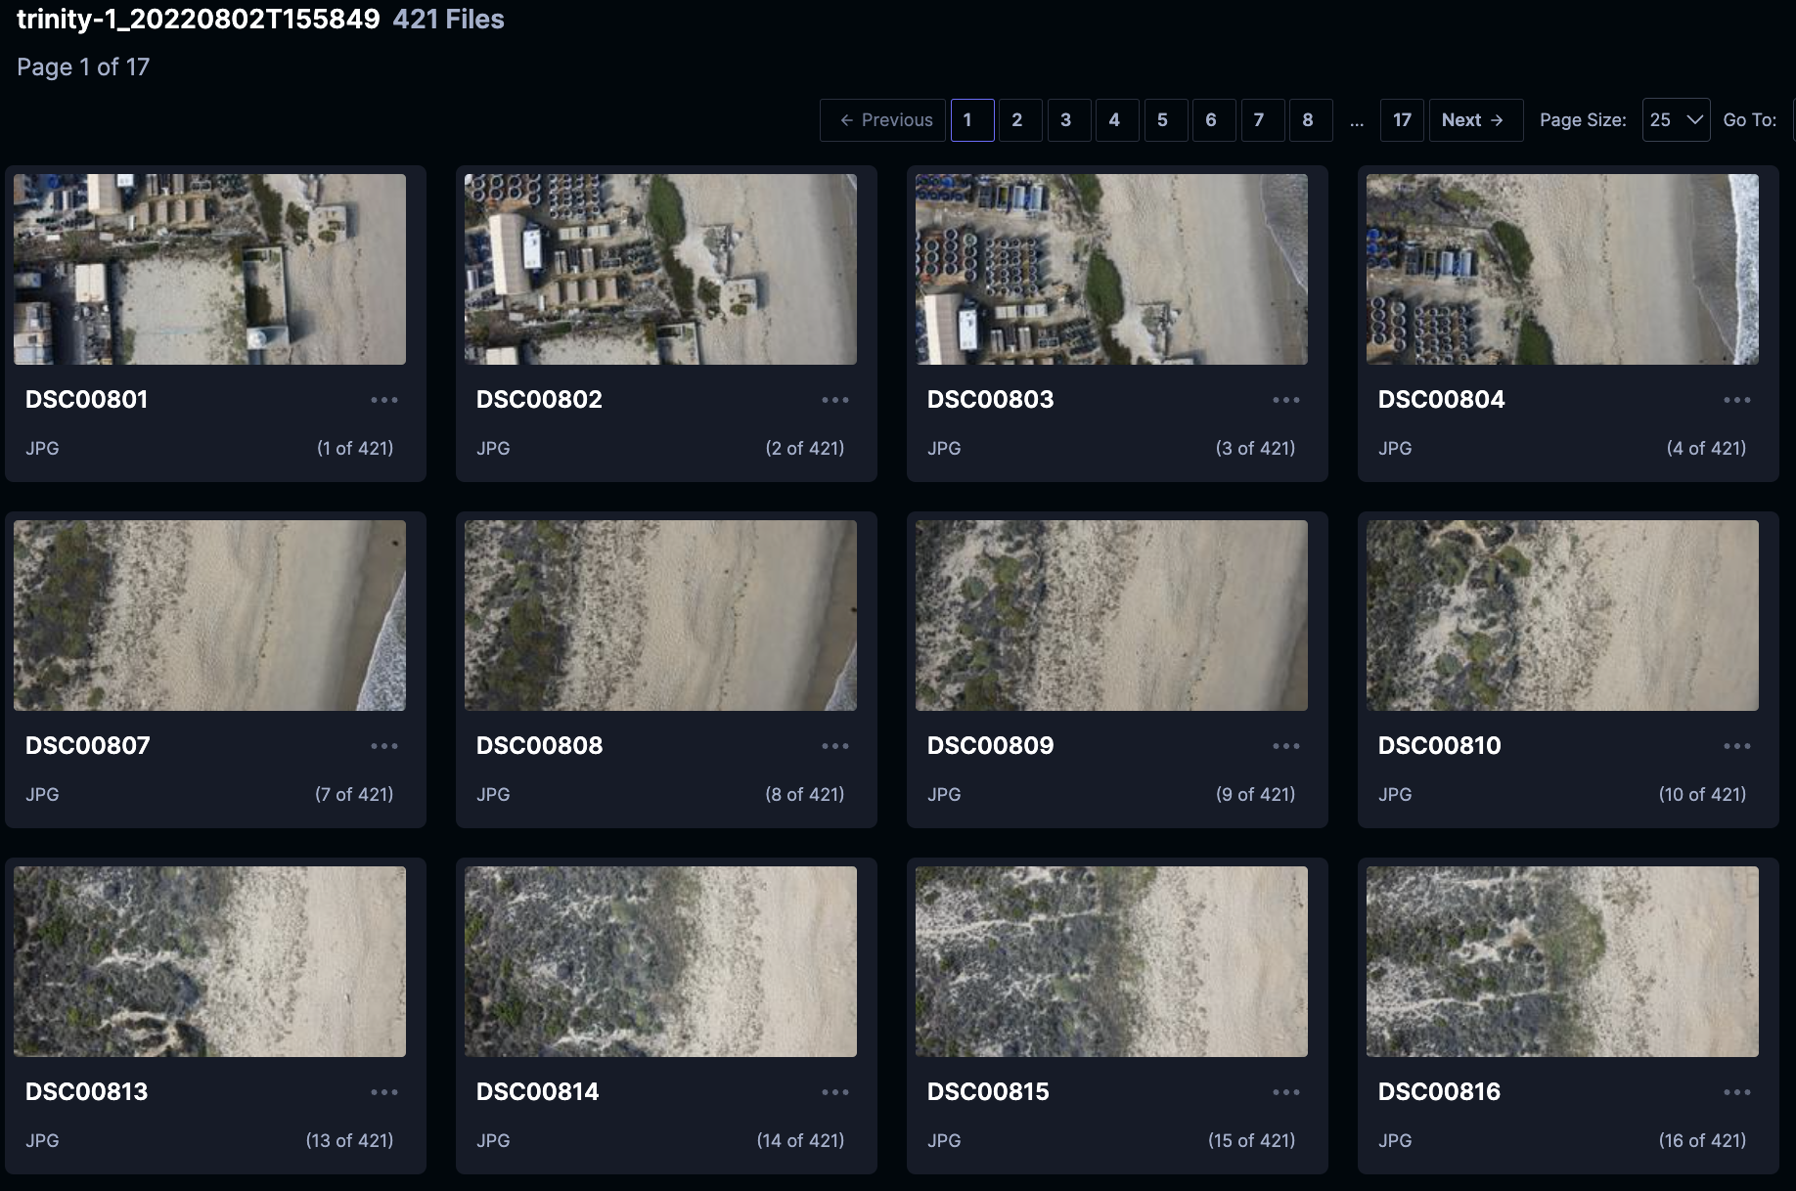
So many missions, so little time

Slide 12

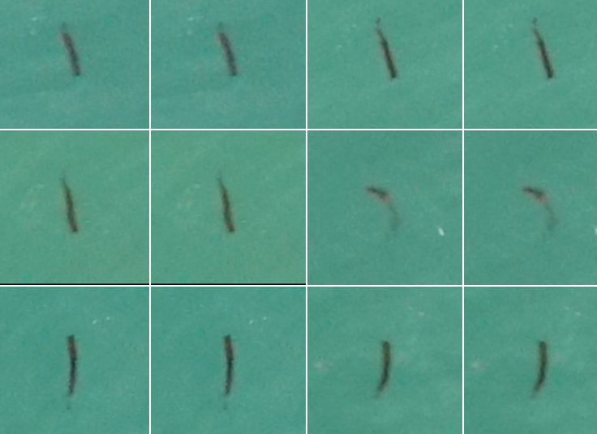
UAV Model Training
Label
Object
Detection and Clustering
Model Training
Train and Object Detector
Notes:
Non max suppression is a technique used mainly in object detection that aims at selecting the best bounding box out of a set of overlapping boxes. In the following image, the aim of non max suppression would be to remove the yellow, and blue boxes, so that we are left with only the green box.

Slide 13
UAV Model Prediction
Correct
Model Prediction
Object Detector
Notes:
Non max suppression is a technique used mainly in object detection that aims at selecting the best bounding box out of a set of overlapping boxes. In the following image, the aim of non max suppression would be to remove the yellow, and blue boxes, so that we are left with only the green box.

Slide 14

UAV Model Training – Step 1
Preprocessing Reduce Reflectance
Notes:
Non max suppression is a technique used mainly in object detection that aims at selecting the best bounding box out of a set of overlapping boxes. In the following image, the aim of non max suppression would be to remove the yellow, and blue boxes, so that we are left with only the green box.

Slide 15
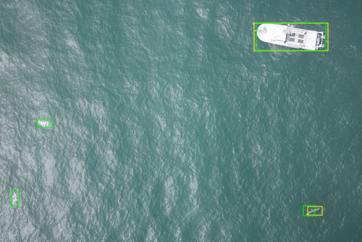
UAV Model Training – Step 2
Blob Detection
Low Confidence
Tradition Computer Vision Method
+
SAHI Object Detection
High Confidence
Deep-Learning Method
Notes:
Non max suppression is a technique used mainly in object detection that aims at selecting the best bounding box out of a set of overlapping boxes. In the following image, the aim of non max suppression would be to remove the yellow, and blue boxes, so that we are left with only the green box.

Slide 16
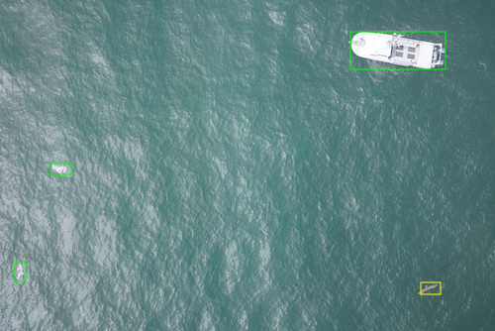
UAV Model Training – Step 3
Non Maximum Suppresion (NMS)
Find Best Box
Notes:
Non max suppression is a technique used mainly in object detection that aims at selecting the best bounding box out of a set of overlapping boxes.
It uses both the box location and the confidence that the box has something meaningful

Slide 17
UAV Model Training – Step 4
Model Training
Train and Object Detector
+ all the localized bounding boxes with labels
Notes:
Non max suppression is a technique used mainly in object detection that aims at selecting the best bounding box out of a set of overlapping boxes.
It uses both the box location and the confidence that the box has something meaningful

Slide 18
UAV Model Prediction
Correct
Model Prediction
Object Detector
Notes:
Non max suppression is a technique used mainly in object detection that aims at selecting the best bounding box out of a set of overlapping boxes. In the following image, the aim of non max suppression would be to remove the yellow, and blue boxes, so that we are left with only the green box.

Slide 19
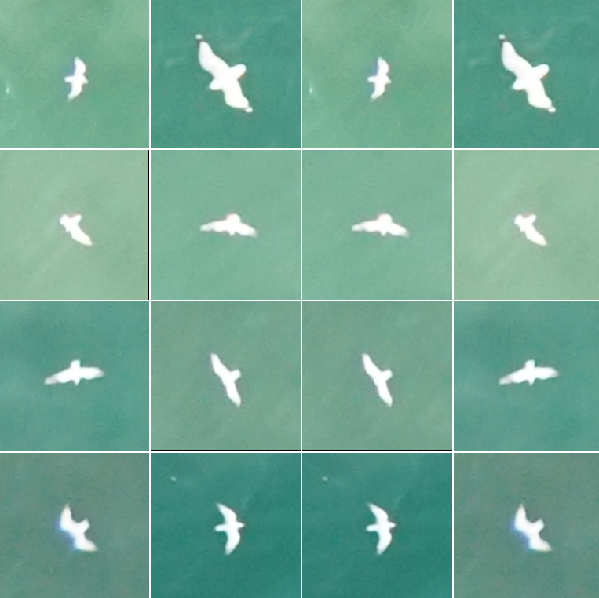
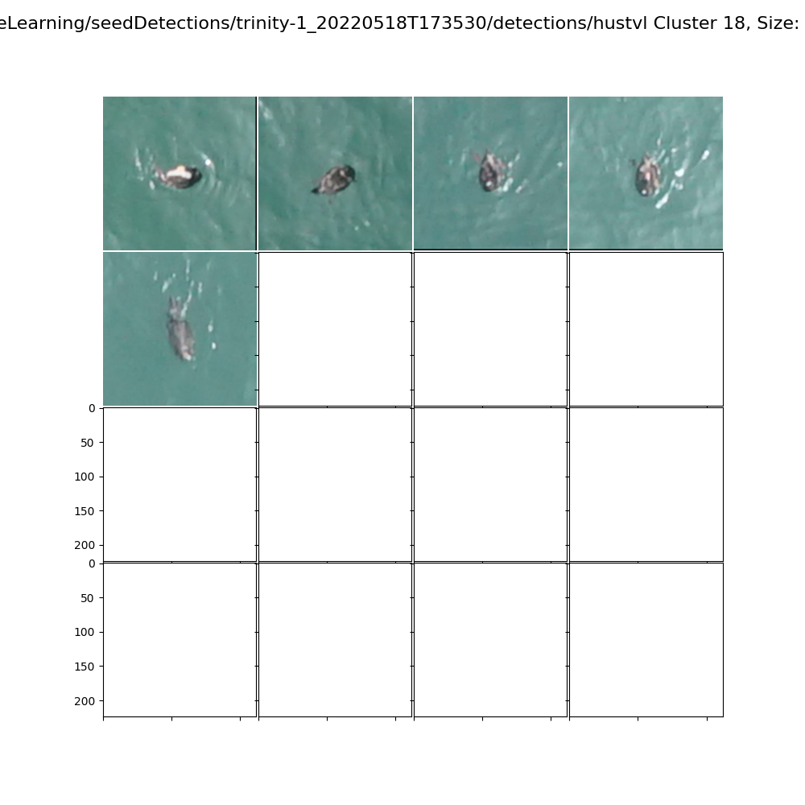
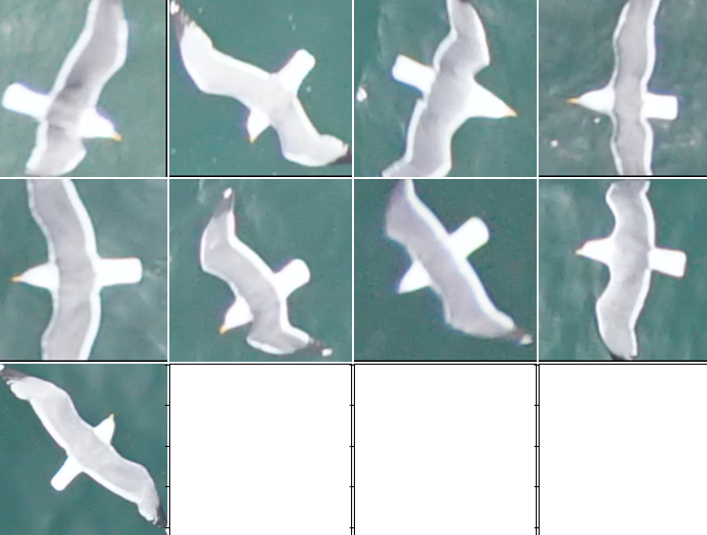
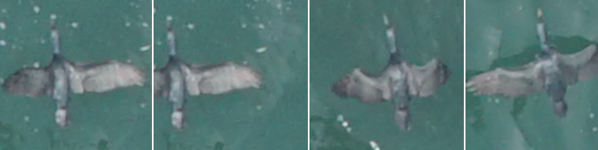
Example Bird Clusters

Slide 20
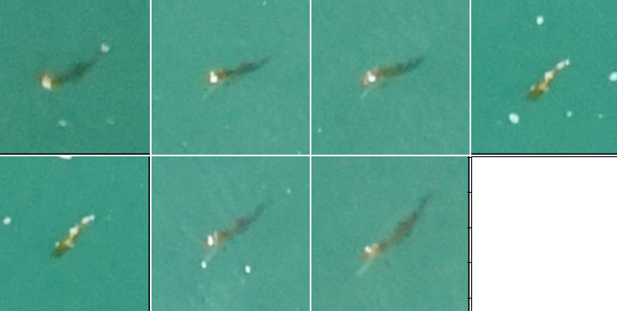
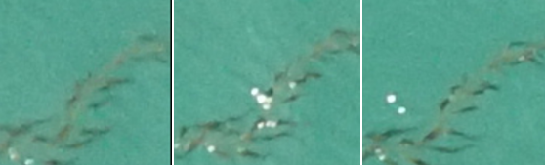
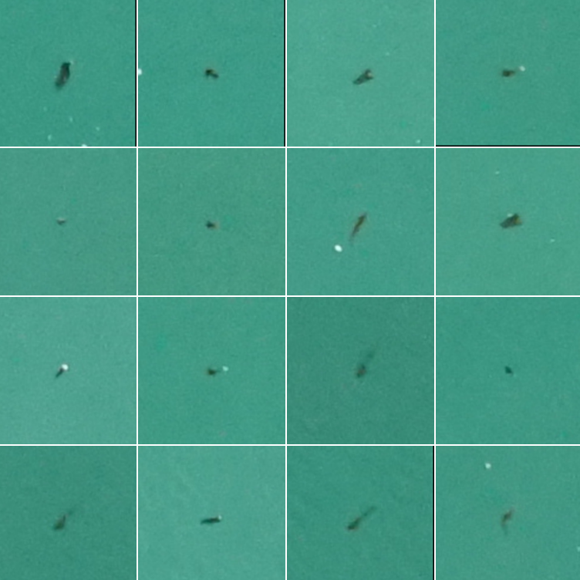
Example Kelp Clusters Based on Visual Similarity
6 cm
Facebook Research DINO model ViT-B/8 (Vision Transformer)

Slide 21
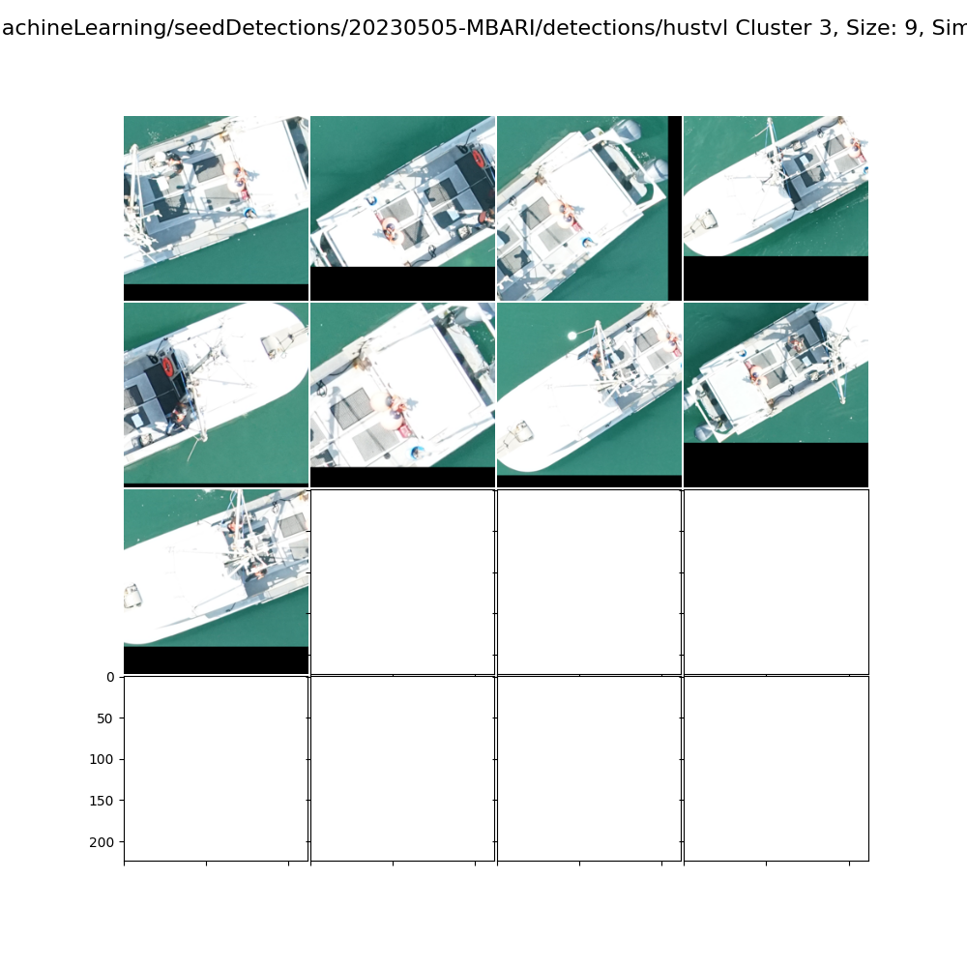
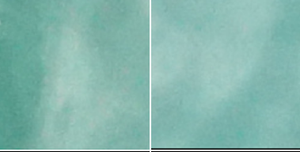
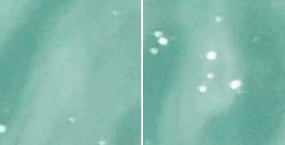
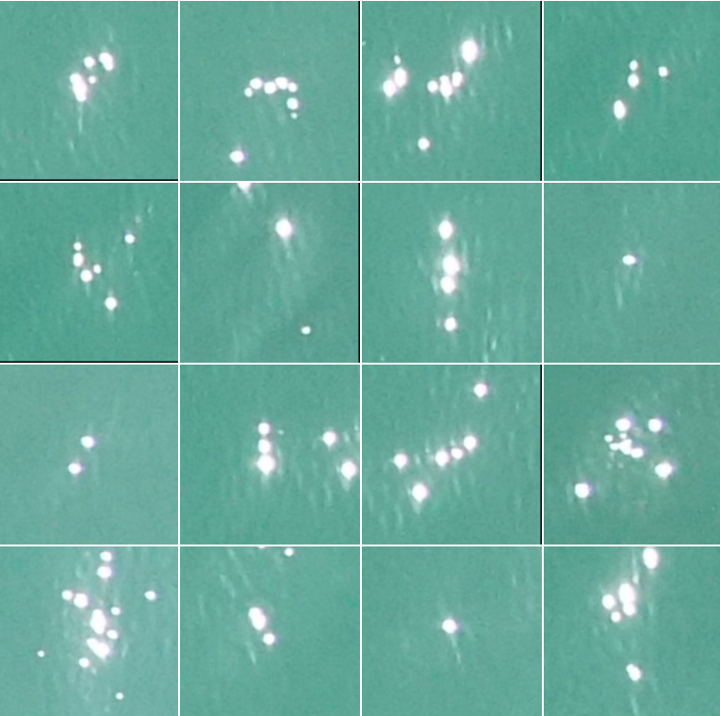
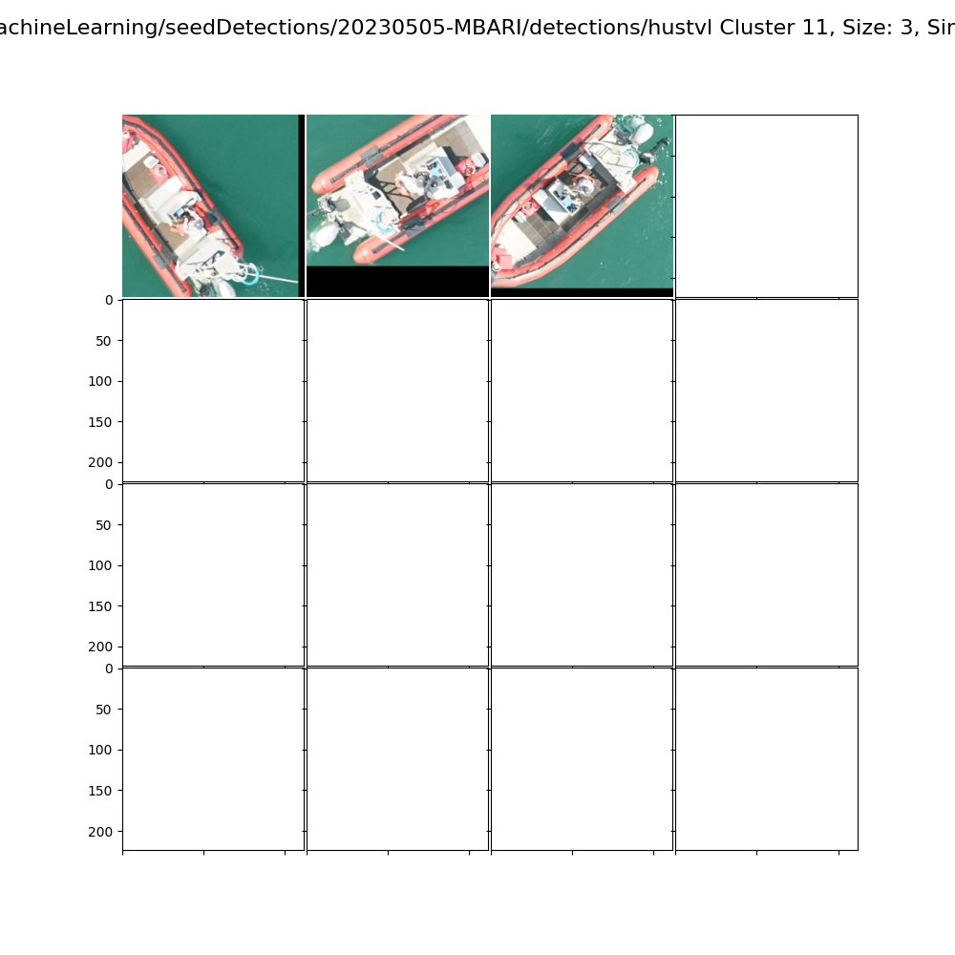
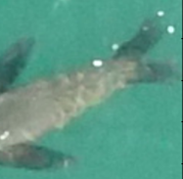
Any many others

Slide 22
TATOR https://www.tator.io
Open source (GNU AGPL v3) web-based tool for editing images and video
Used by National Geographic, MBA, and other partners
Supports custom analytics workflows
Runs on-premise or on most cloud providers
  Have this running (requires MBARI VPN)
  http://digits-dev-box-fish.shore.mbari.org/

Slide 23
TATOR https://www.tator.io
Open source (GNU AGPL v3) web-based tool for editing images and video
Used by National Geographic, MBA, and other partners
Supports custom analytics workflows
Runs on-premise or on most cloud providers
  Have this running (requires MBARI VPN)
  http://digits-dev-box-fish.shore.mbari.org/

Slide 24
Questions?
Additional slides on secci disc work if time permits…
Danelle Cline, Software Engineer, dcline@mbari.org
Duane Edgington, Software Engineer duane@mbari.org

Slide 25
Secchi Disc Testing
Can we find the target?
Know the depth
Challenges:
  Water reflectance
  Small target

Slide 26
