Slide 1
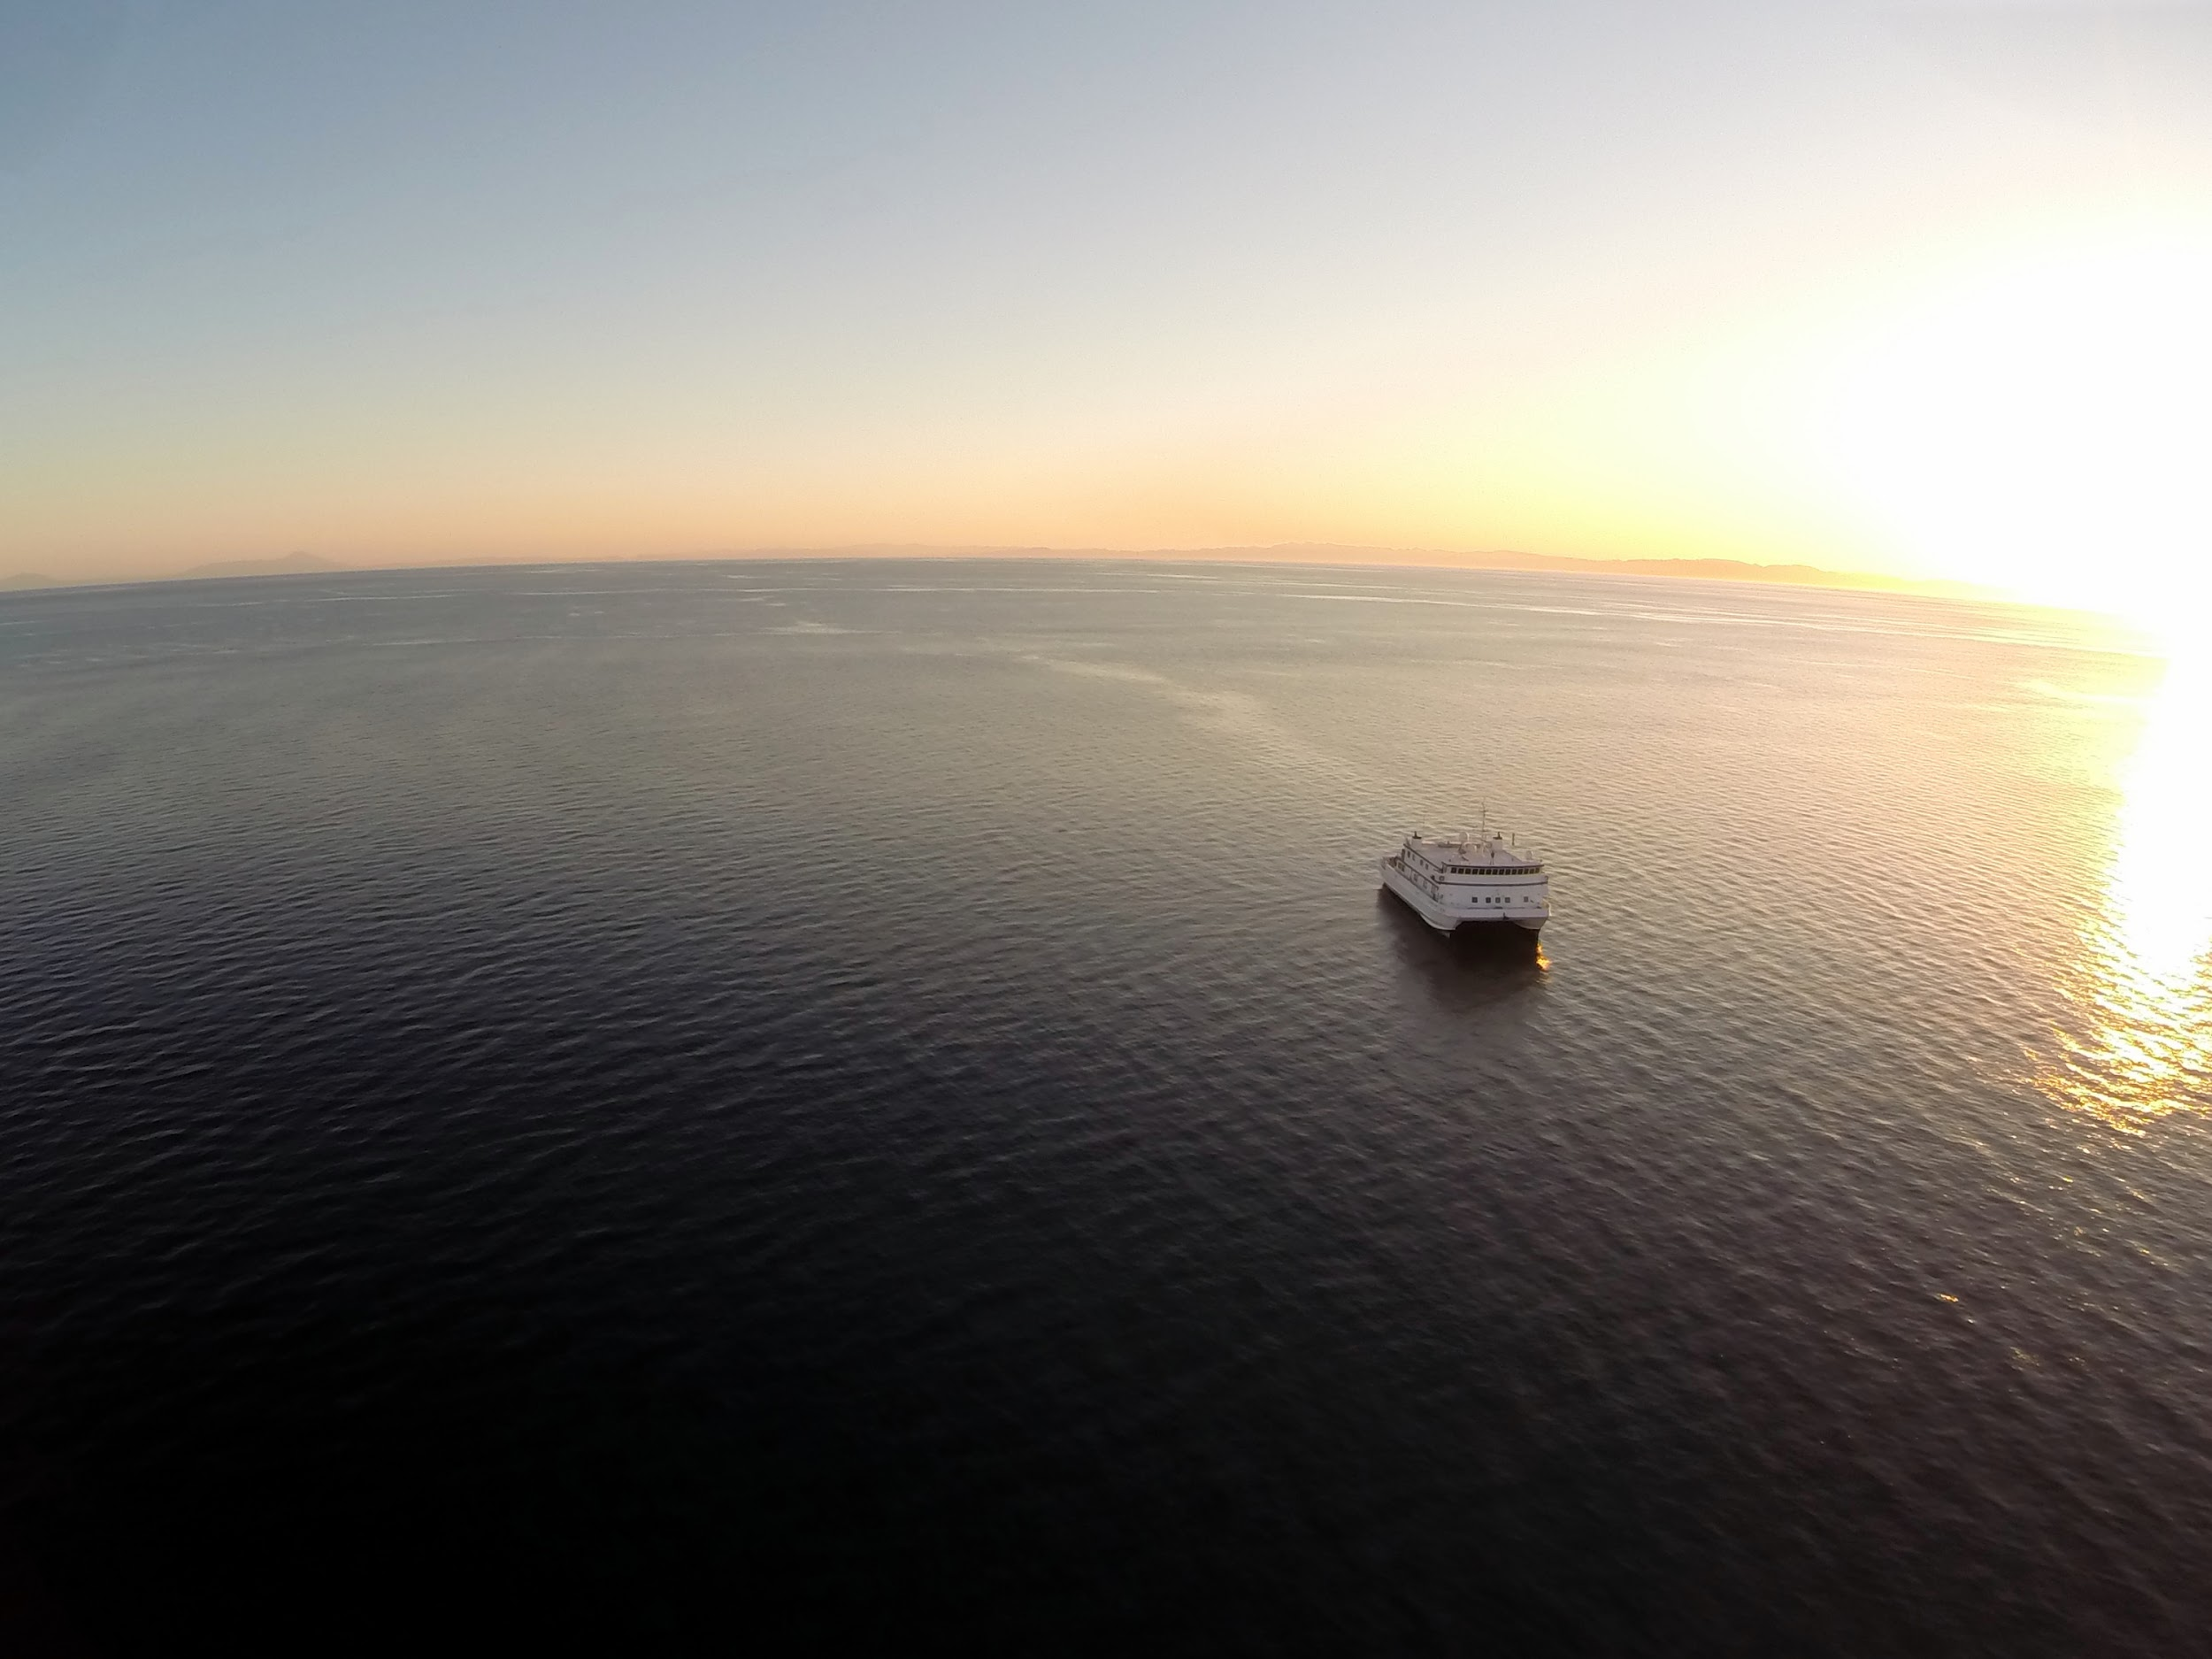
Science UAVs at MBARI
Project Update and Review of proposed fixed wing UAV build.

Slide 2
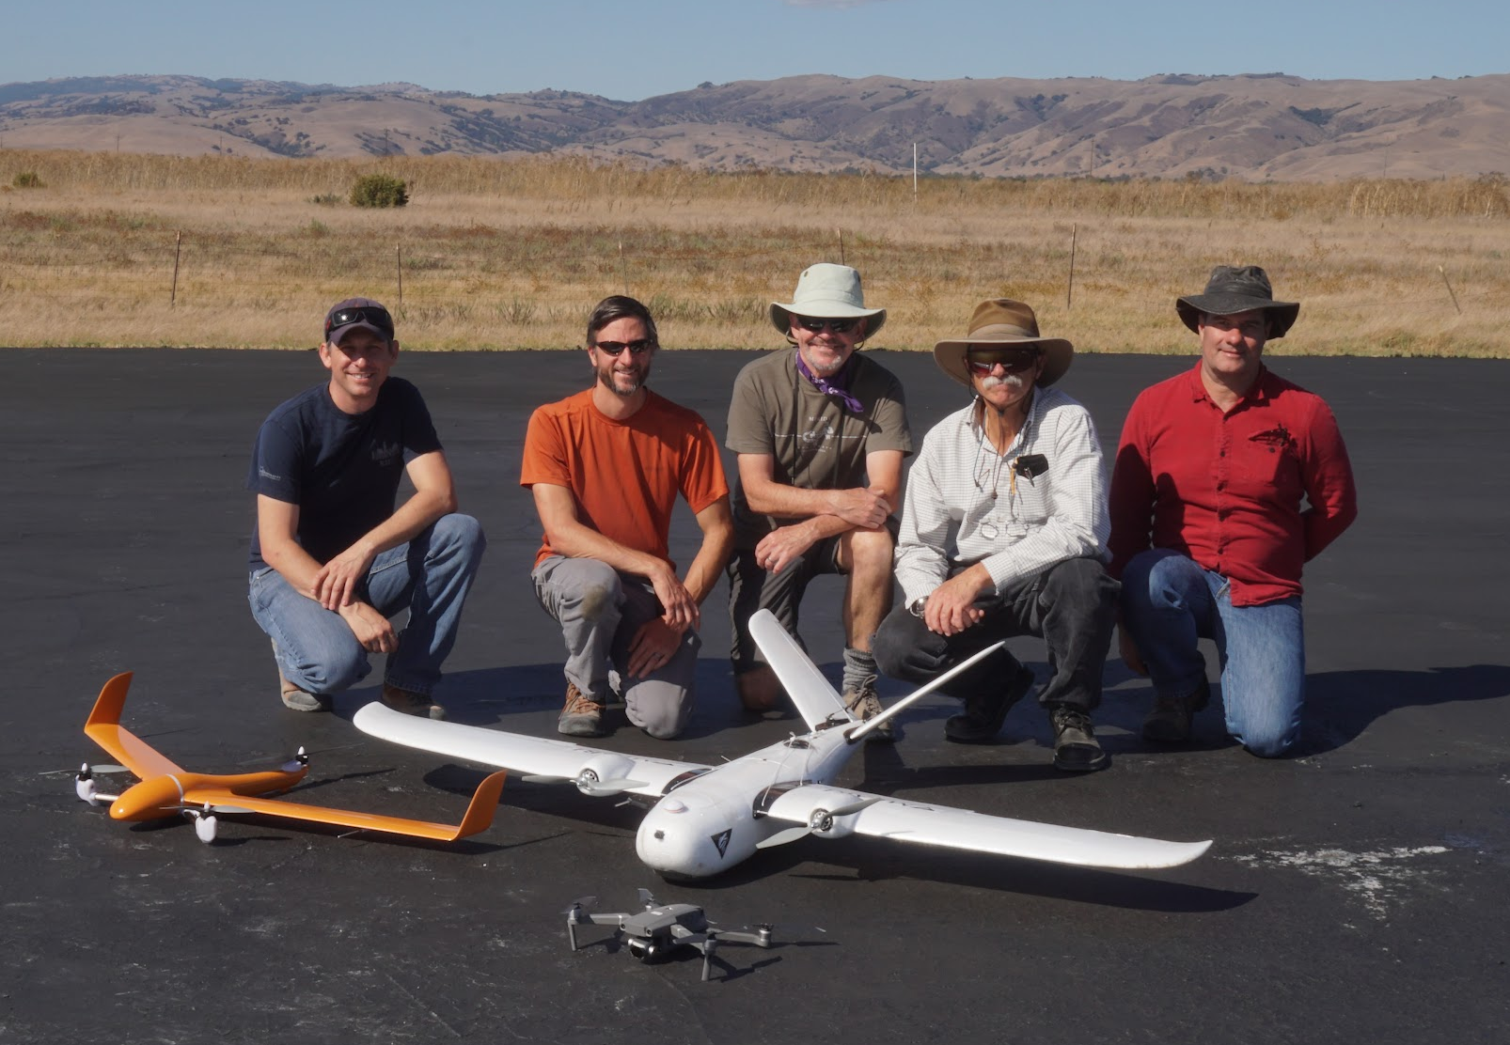
Goals of this review
Share designs, plans, concepts, and schedule
Identify any items we may have missed
Refine requirements, design, concept of operations
Priority topics:
  Landing
  Waterproofing
  Ground control station
Core Project team: Ben Erwin, Bryan Schaefer, Tom O’Reilly, Rob McEwen, Steve Haddock, & John Ryan
Notes:
Ben

Slide 3
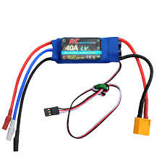
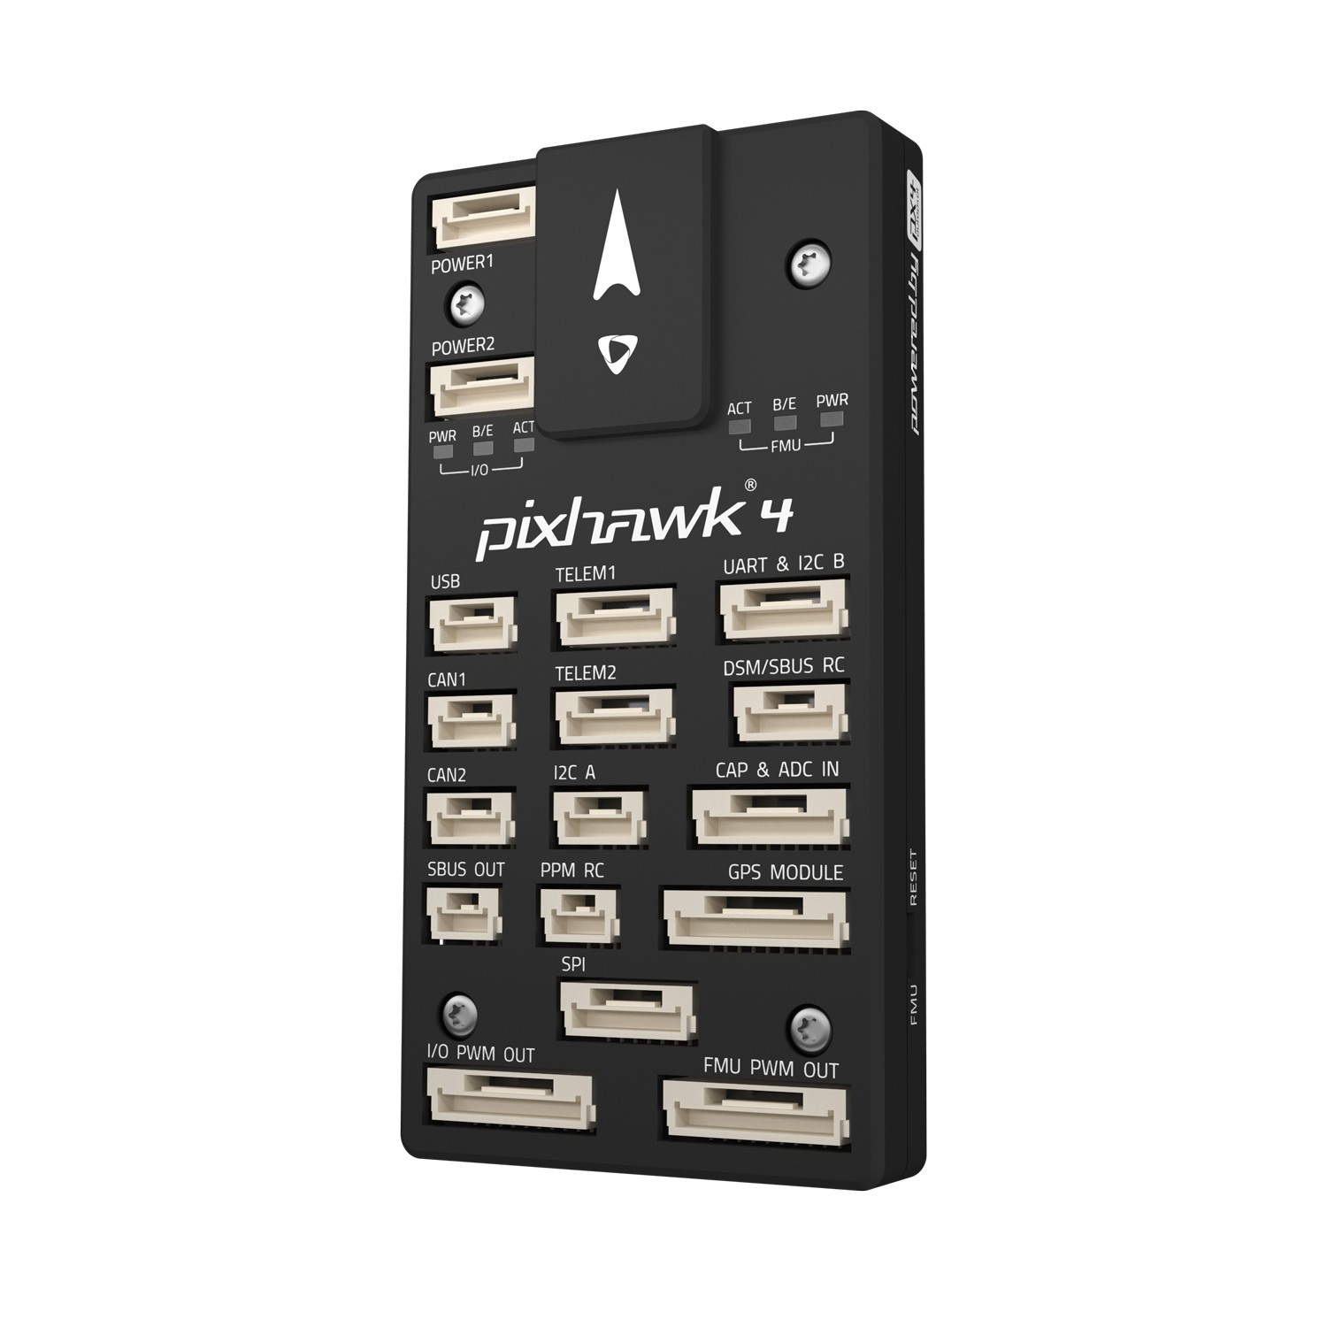
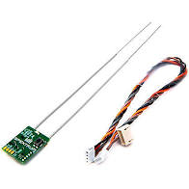
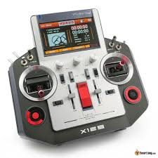
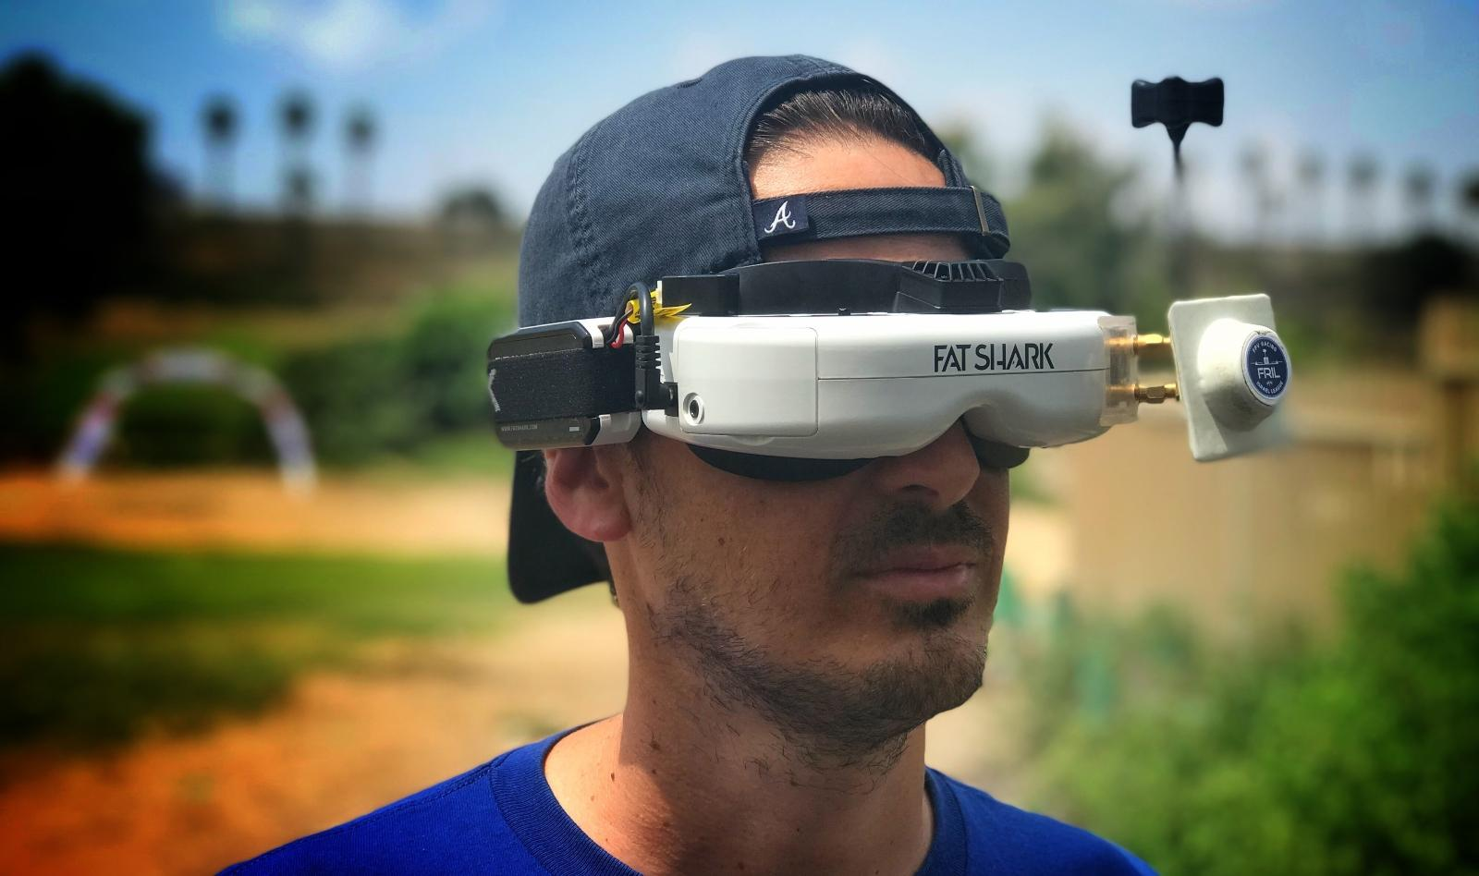
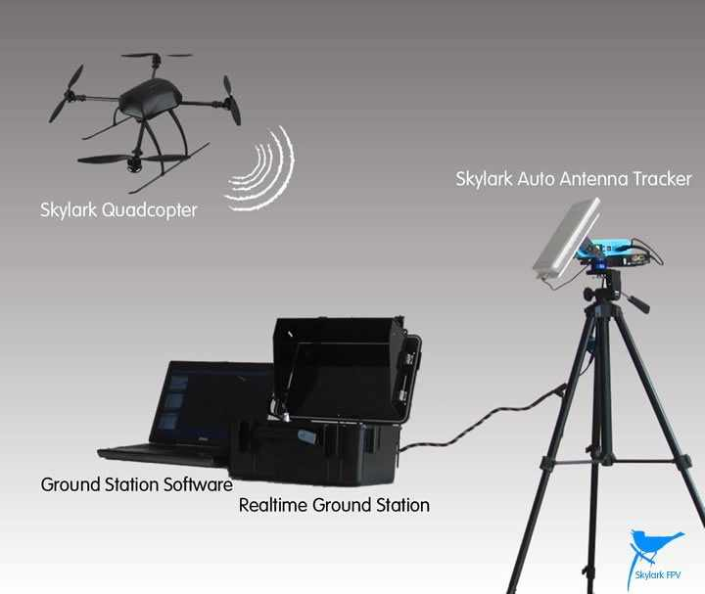
Terminology
VLOS = Visual Line of Sight
BVLOS = Beyond Visual Line of Sight
VTOL = Vertical take-off and landing
ESC = Electronic Speed Controller.
Receives speed signal from flight controller, and distributes corresponding power to the coils in each motor. Usually see’s full battery voltage.
BEC = Battery Eliminator Circuit: DC/DC power supply.
Flight Controller (FC) = UAV mounted flight computer
Utilizing onboard sensors, such as barometer, GPS, compass, accelerometers,
to provide fly-by-wire and autonomous control
FPV = First Person Video
Cameras transmit live video to a head mounted display or monitor.
Ground Station = All ground equipment at source of operations.
Ground stations typically incorporate all control equipment, computers, antennas, trackers,
and communication gear all in one streamlined space.

Slide 4
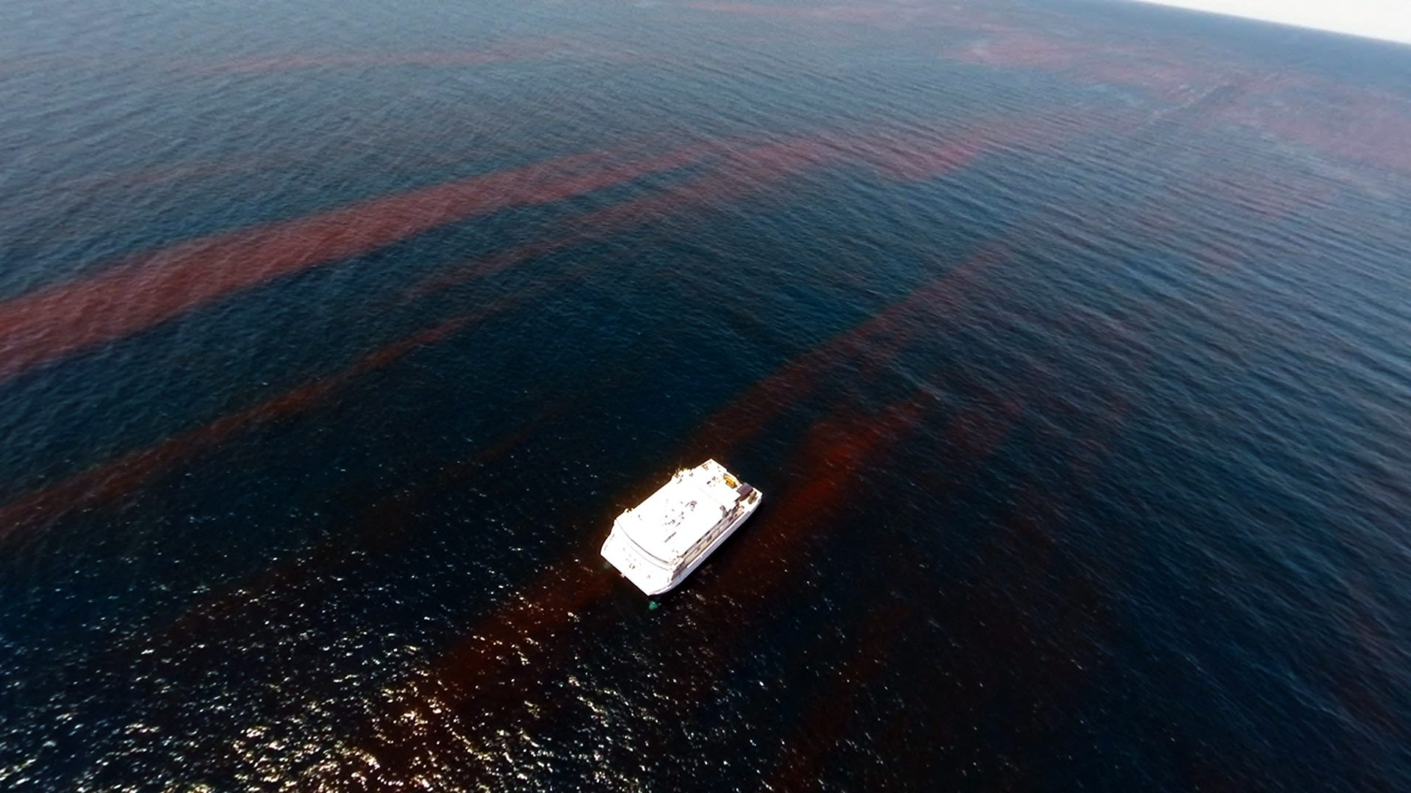
Applications and Motivation
Bio-oceanographic processes
  Phytoplankton, including Harmful Algal Blooms
  Animals – jellies, fish, birds, whales; behavior, population
  Thermal structure
  Ocean/atmosphere interactions (e.g. DMS)
  Bioluminescence
  Long (30+ km) monthly transects
Marine Debris
Entangled wildlife
Public outreach
Locate assets on surface
Data transfer relay
Water sampling (Potentially)

Slide 5
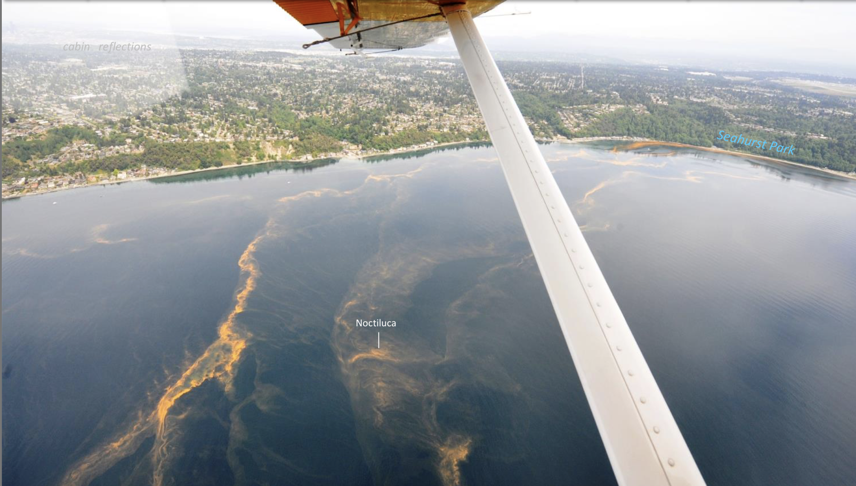
Example: Eyes over Puget Sound
Monthly manned flights by Washington State Government

Slide 6
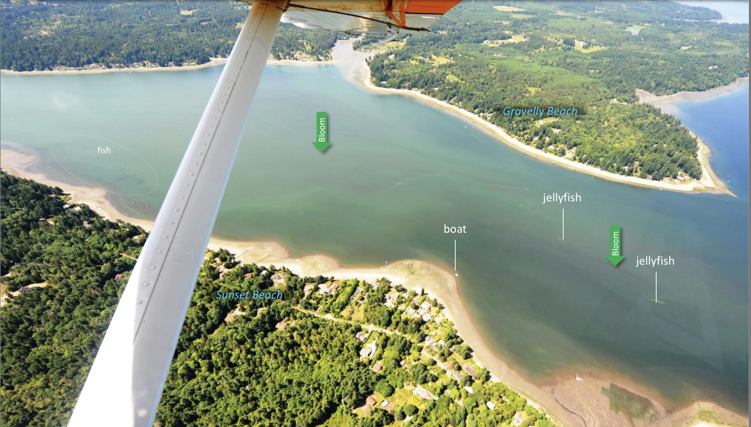
Example: Eyes over Puget Sound
Monthly manned flights by Washington State Government

Slide 7
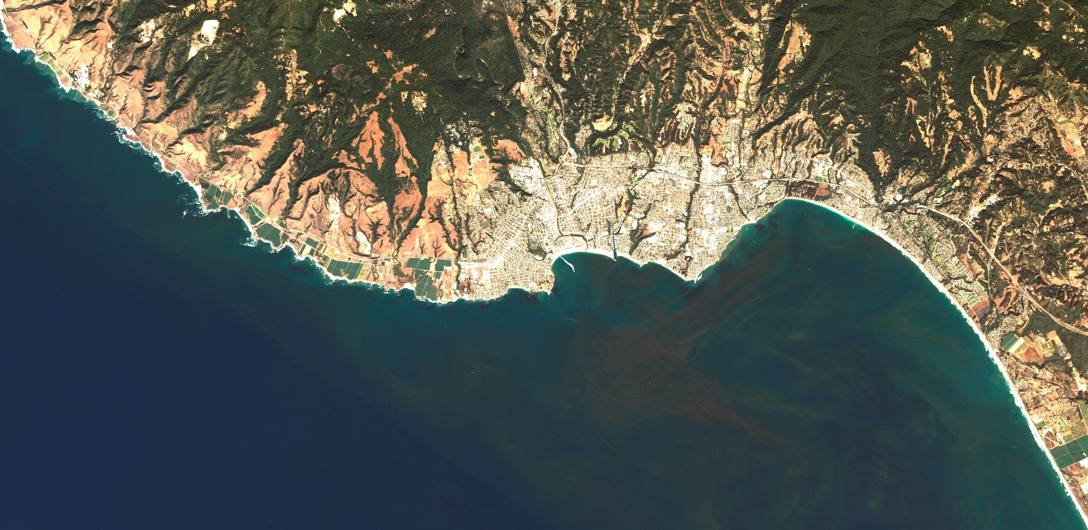
Applications in Monterey Bay

Slide 8
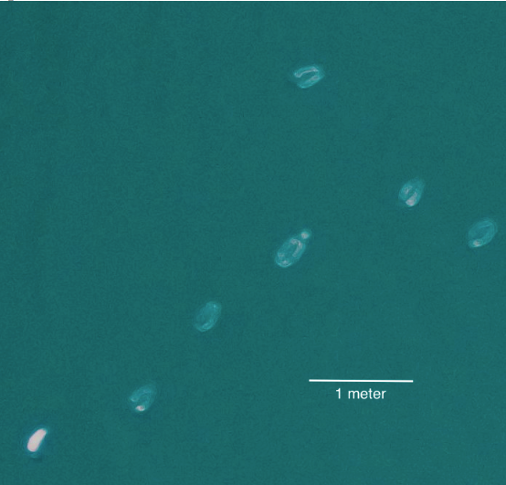
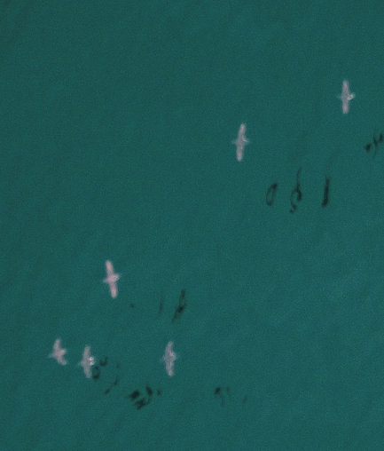
Jellies (likely Aurelia aurita)
Birds in flight

Slide 9
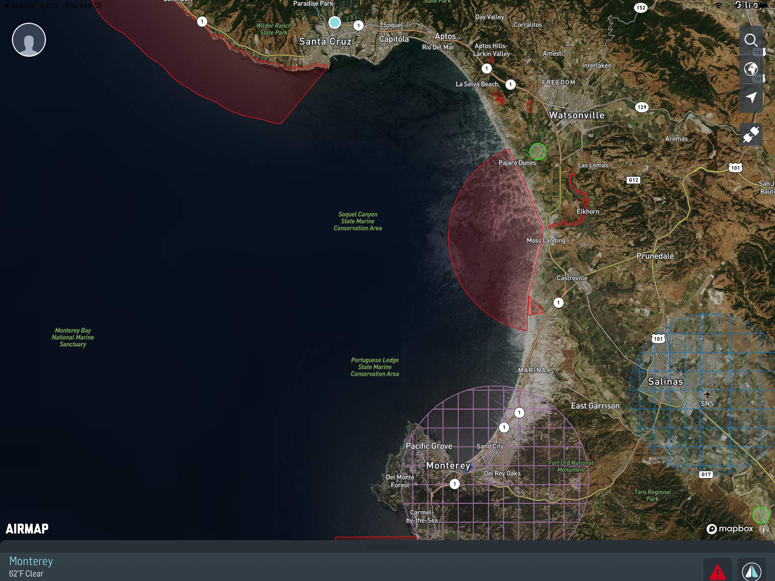
Monterey Bay is a UAV hotspot:
UCSC
USGS
MLML
CSUMB
Hopkins
Naval Postgraduate School
MBNM Sanctuary

Slide 10
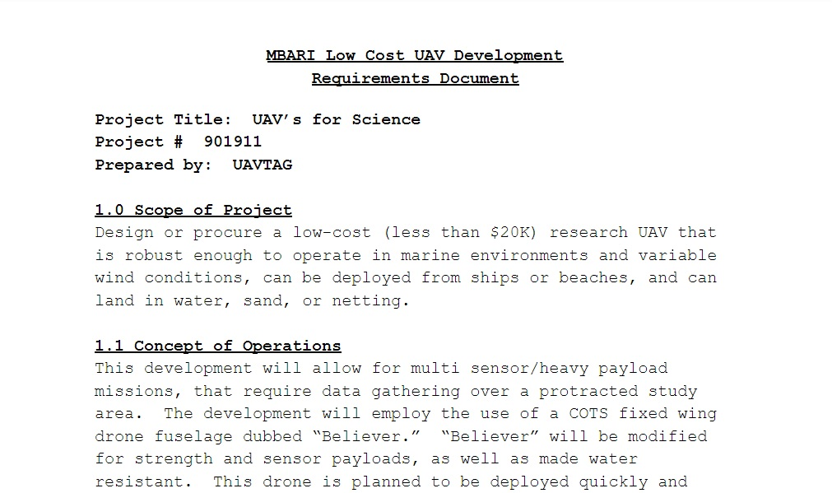
Design Derived Requirements

Slide 11
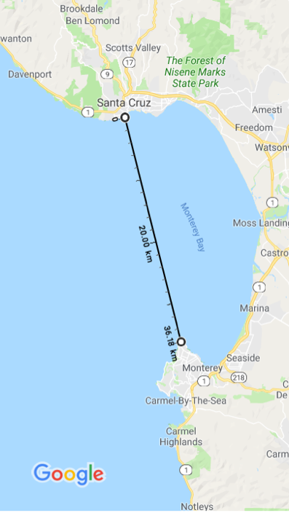
Design Derived Requirements
Suitable imaging payload
Range around the bay and back
(Cross-bay = 36km)
Do not need fully tiled images
(not stitched and overlapping)
Appropriate launch and especially recovery options.

Slide 12
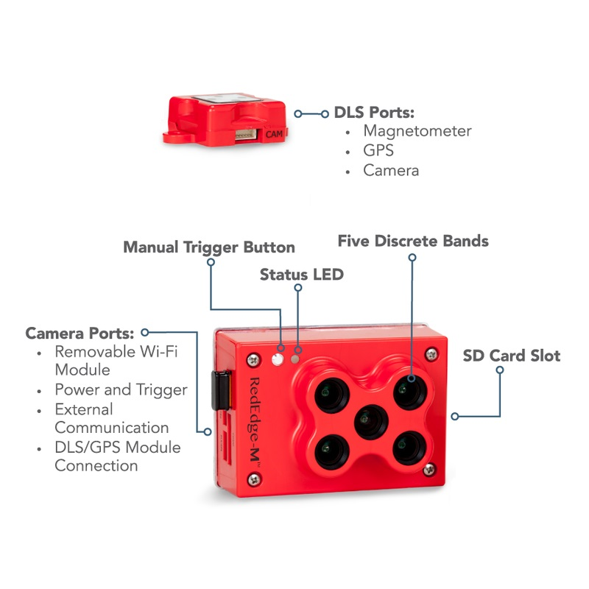
Payload Options
Payloads we are considering for near term science missions are:
Sony a6000
Sony RX1 (42 MP)
RedEdge Multispectral Imager
Hyperspectral Imagers
Directional Signal Tracking
Gimbaled HD Cams
Gimbaled Directional Antennas.
Hardware for data relays/DL
Thermal IR
Micasense RedEdge

Slide 13
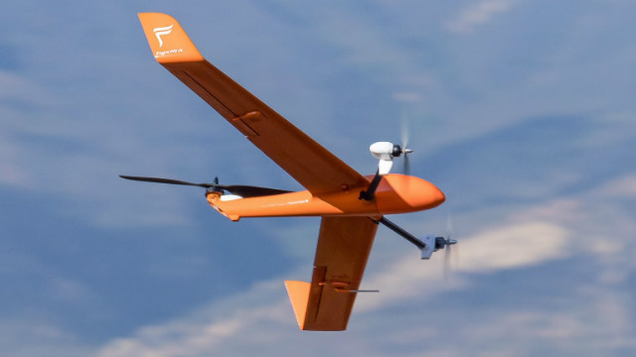
FlightWave Edge
VTOL with Tilt-pod rotors
Typical Endurance: 45 min/38 km
Payload: 300g
Max windspeed: 15kt
Biotransects, ship-launch
PLATFORM OPTIONS

Slide 14
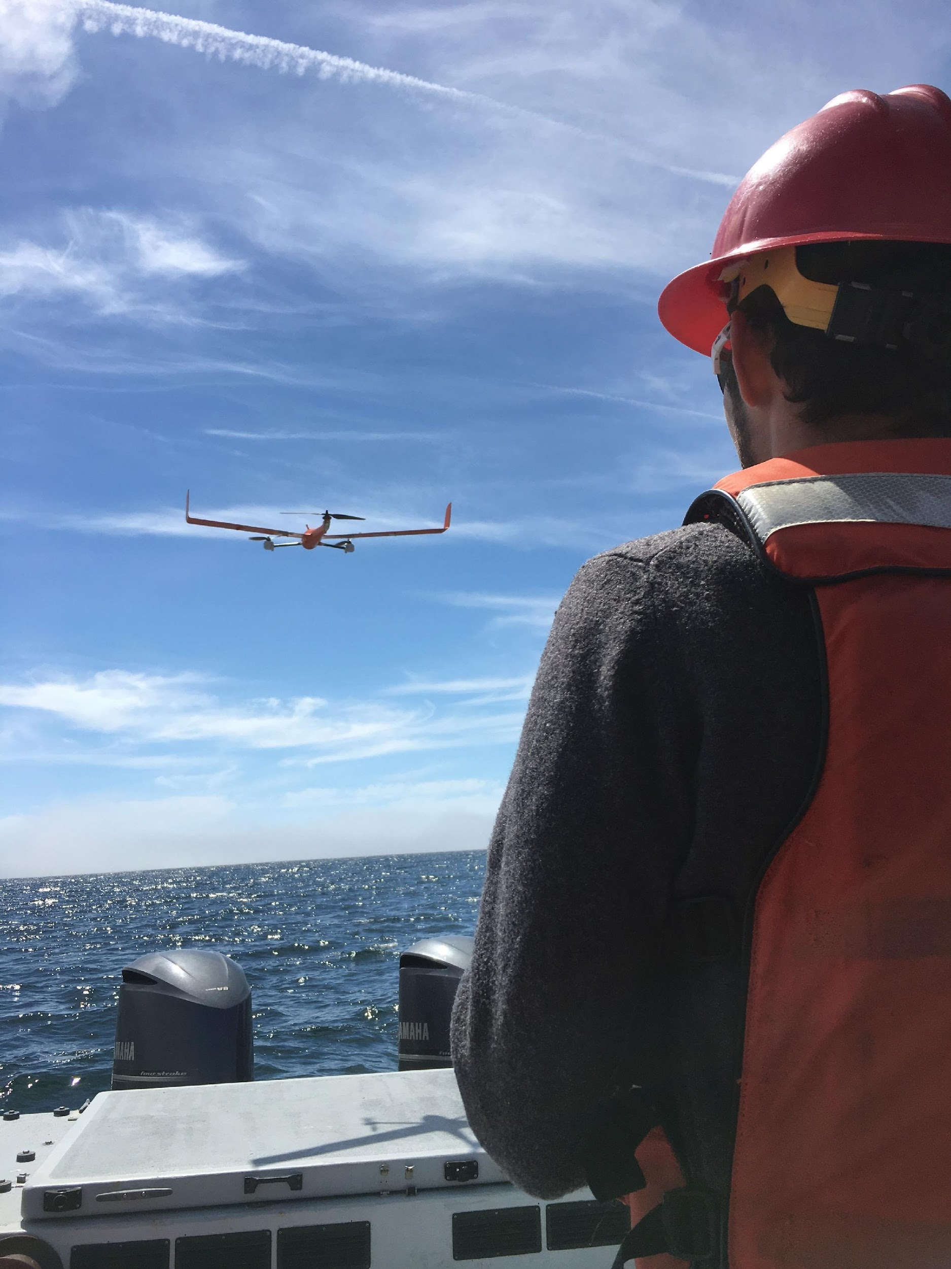
Flightwave Edge
Advantages:
VTOL, for landing on boat
Customizable fast swap
nose cone
Drawbacks:
payload, duration/range
cost, stability in wind.
repairability
visibility
slow support

Slide 15
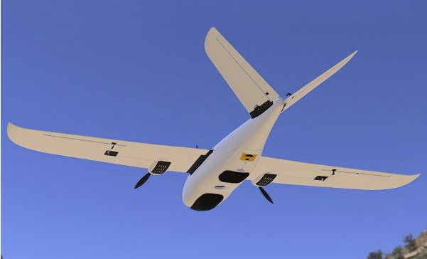
Fixed Wing: “Believer”
PLATFORM OPTIONS

Slide 16
Fixed-Wing: Believer
Expected range of 90 km with 670 g payload.
  Payload capacity up to 1.5kg possible, but decreases range.
  Inclusion of a Li-ion over a LiPo battery pack can significantly increases range (2x?)
Cost of the full build ~$1500 + ~12 Hours build time.
Easy access to all hardware and software.
  Customizable payloads.
Cost of structural repair is minimal. Entire body kit costs $250.
We plan to eventually have at least two operable fixed-wing UAVs
  This allows us to perform maintenance, repairs, or payload installations on a vehicle while another is operational.
Notes:
1-2 hour range Lipo, 4+ Li-ion

Slide 17
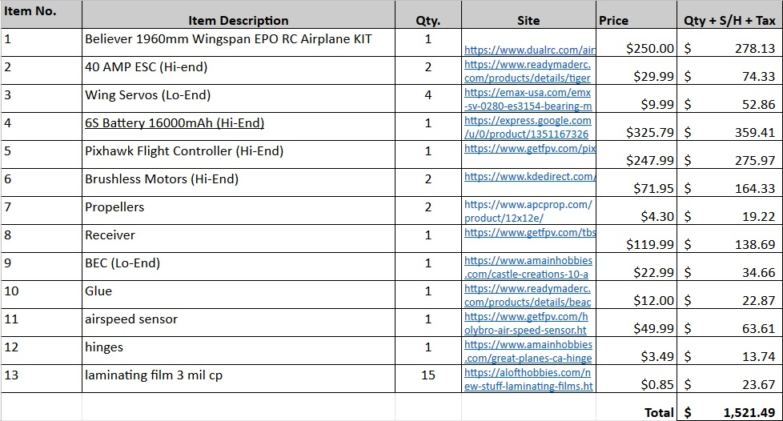
Believer Mark 1: Build List

Slide 18
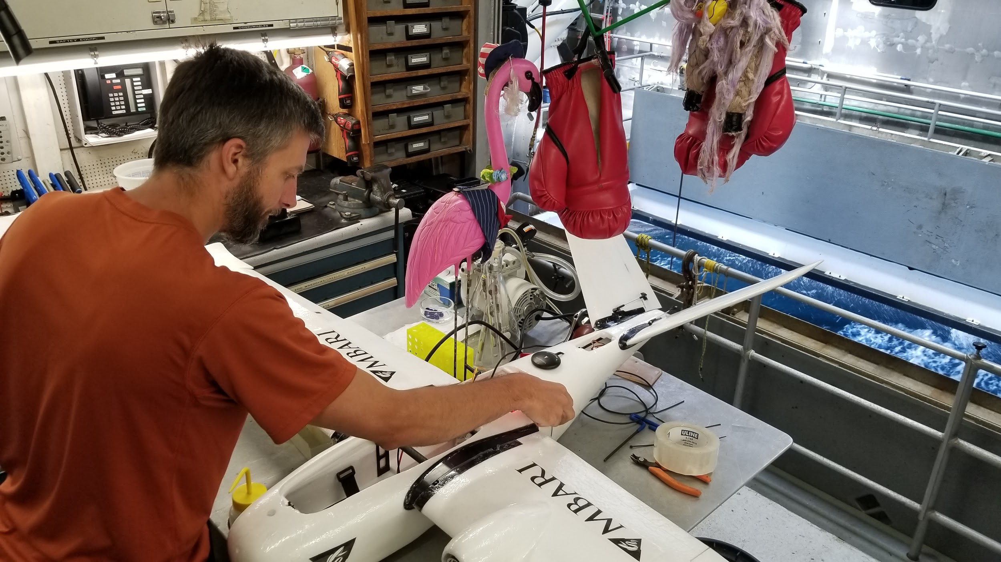
Prototype built aboard the W.Flyer while at sea.

Slide 19
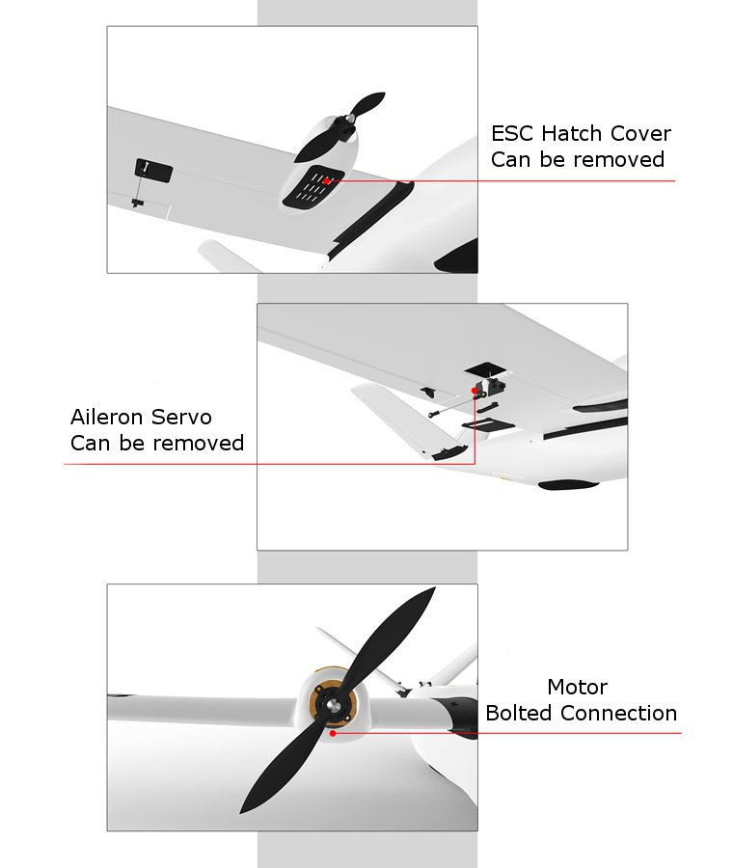
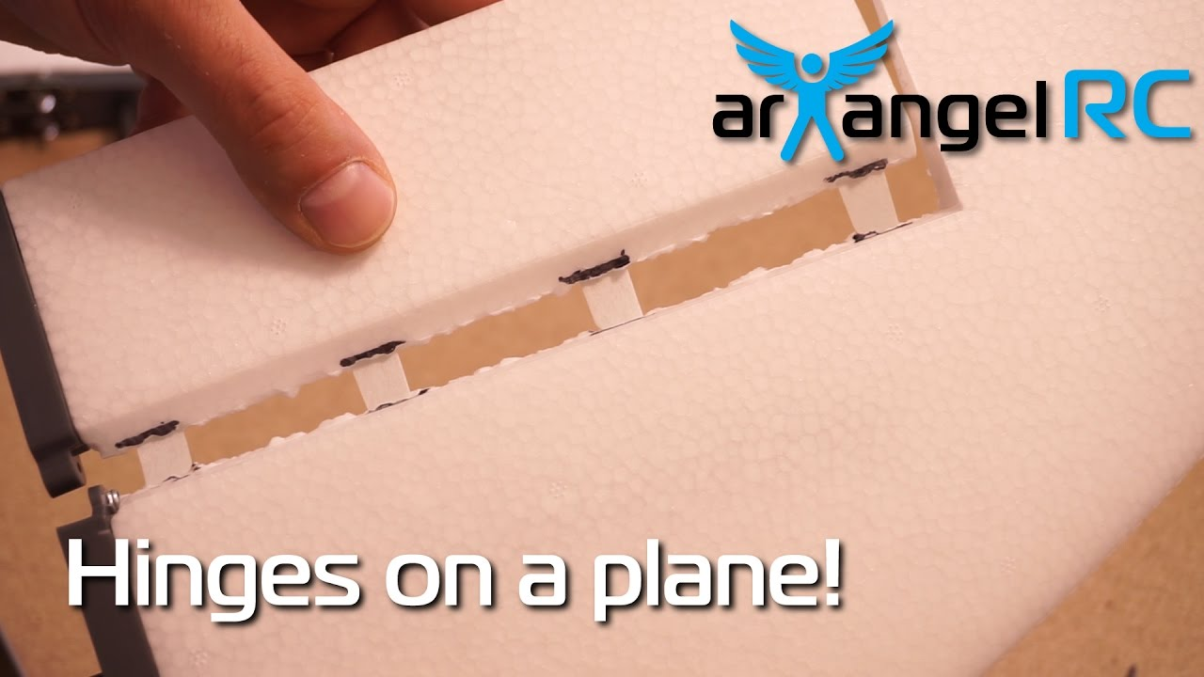
Believer Mechanical
  EPO Foam plane structure.
  Carbon fiber wing supports.
  Laminating film (Improves structural integrity throughout UAV)
  Reinforced Control Surface hinges
  Servo actuated control surfaces
Notes:
Mention forum presence

Slide 20
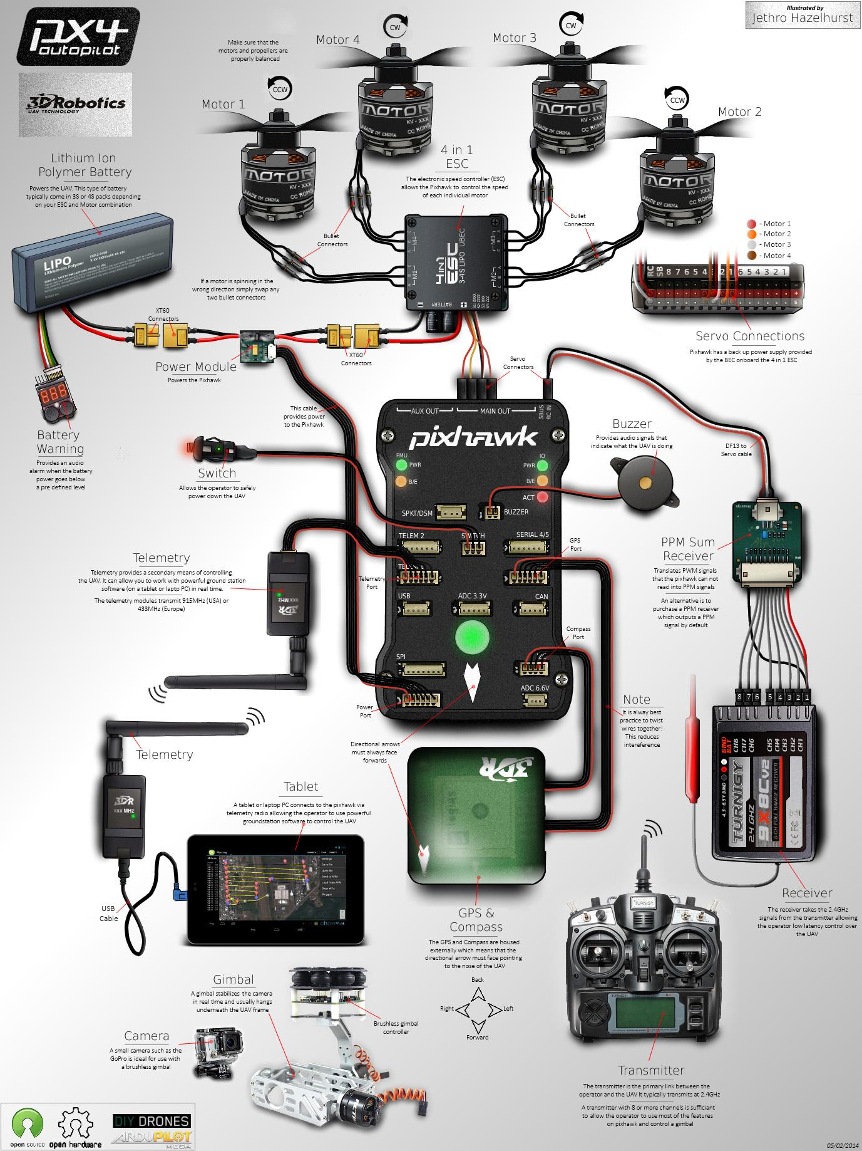
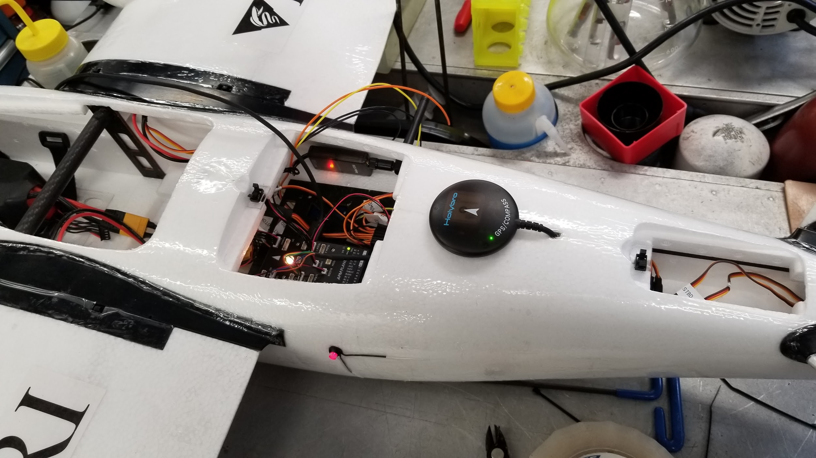
Pixhawk Flight Controller
Can support all UAV mounted electronics and drive components, as well as additional peripheral devices, such as Raspberry Pi.
Notes:
Telemetry data can be passed to external devices.

Slide 21
Believer Electronics

Slide 22
In addition to props, motors and ESCs, plane includes:
  Pixhawk flight controller.
  GPS
  915 MHz telemetry transceivers
  2.4 GHz spread spectrum flight control transceiver.
  5.8 GHz video transmitter.
  BEC’s and power distribution boards.
  Control Surface and Parachute bay servo’s
  Airspeed Sensor (Differential pressure pitot tube)
  Various diagnostic LED’s (Can include exterior ‘beacon’ illumination)
  Audible piezo speaker
  Manual “Arming” button
  OSD board (On screen Display)
  FPV and Payload Cameras
  Antenna tracking module
  TTL logic converter
  16000mAh LiPo Battery (will investigate Li-Ion to potentially double flight times for the same amount of weight)

Slide 23
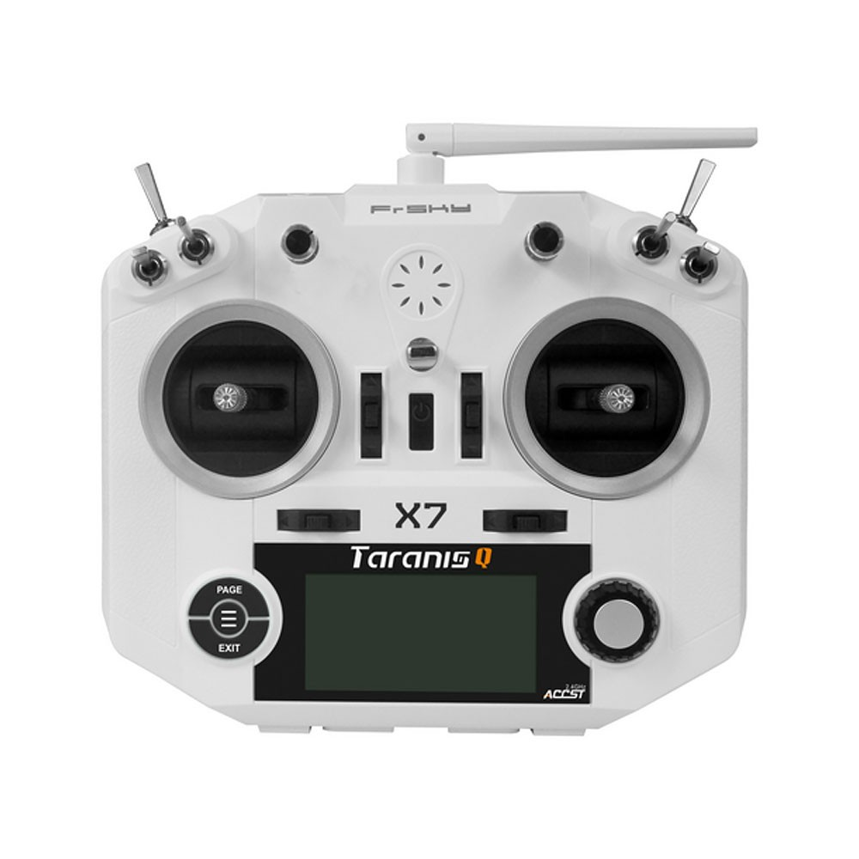
Control Software
Taranis X7 radio controller
Configurable switches, pots, joysticks, and control curves.
Receives 2.4 GHz telemetry data stream and displays flight metrics.
Notes:
Audible notifications

Slide 24
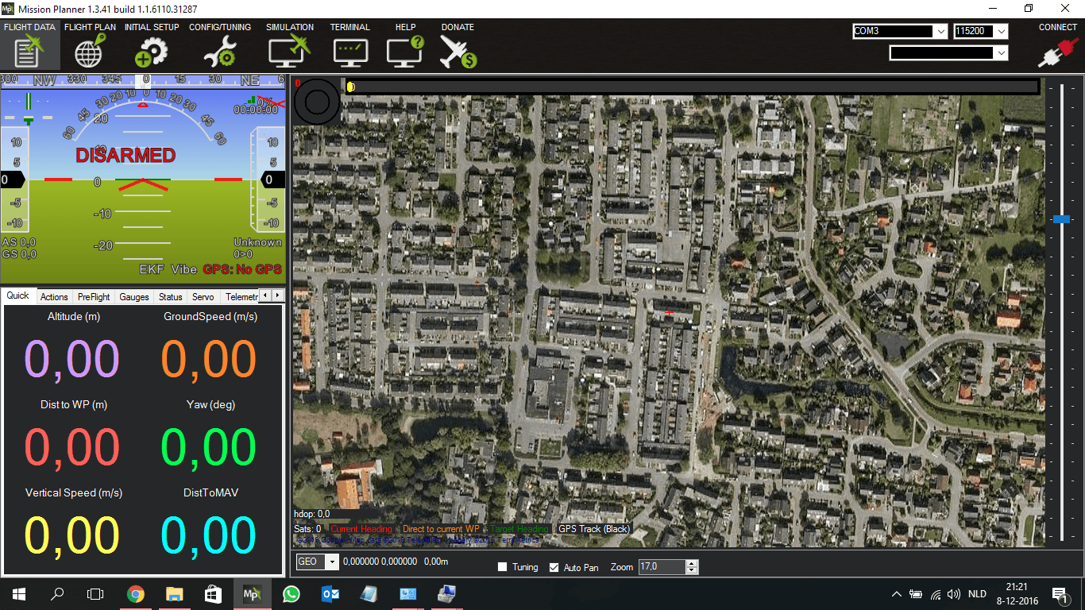
Control Software
Mission Planner:
Computer based tracking and configuration software.
Mission Planner Allows:
Direct interface and control of Pixhawk through independent radio link.
GPS status and ground track
FPV Video from nose mounted camera
Altitude
Orientation
Range from launch
Ground Speed
Battery state
Heading

Slide 25
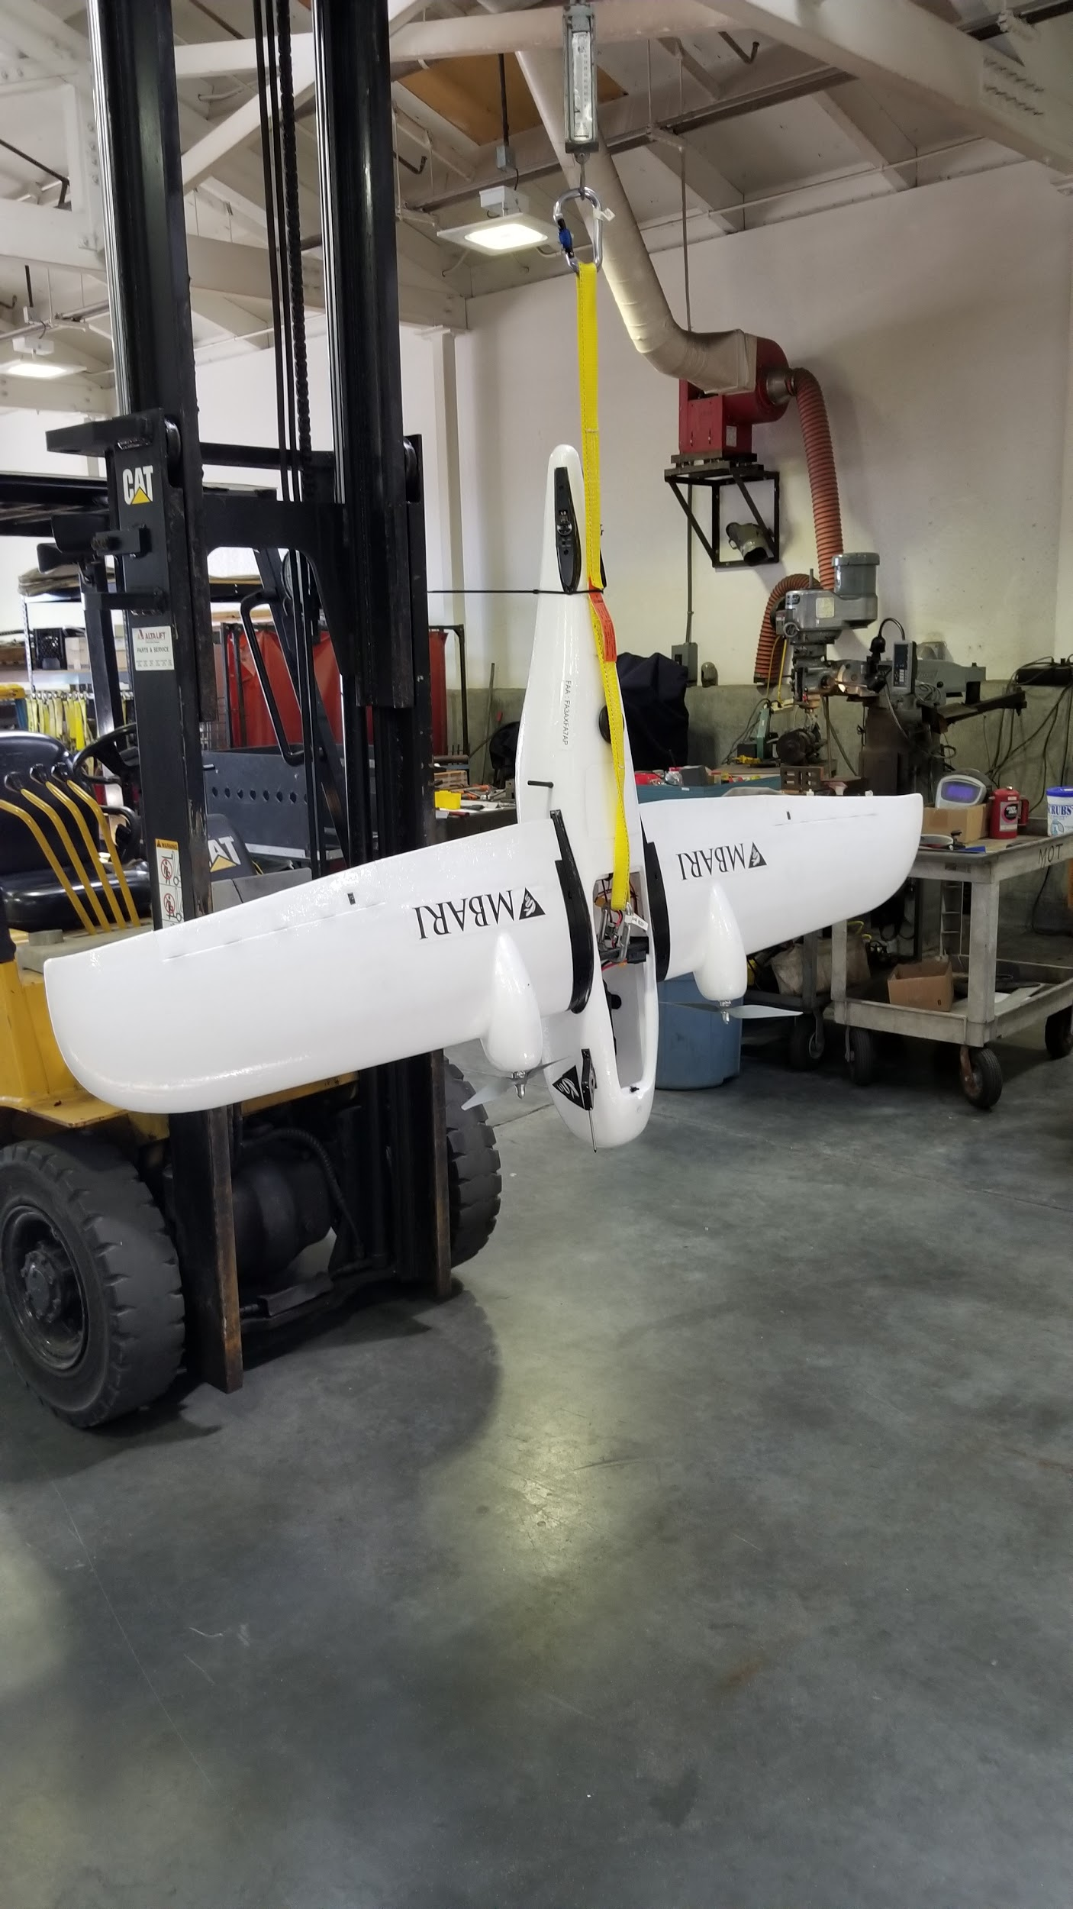
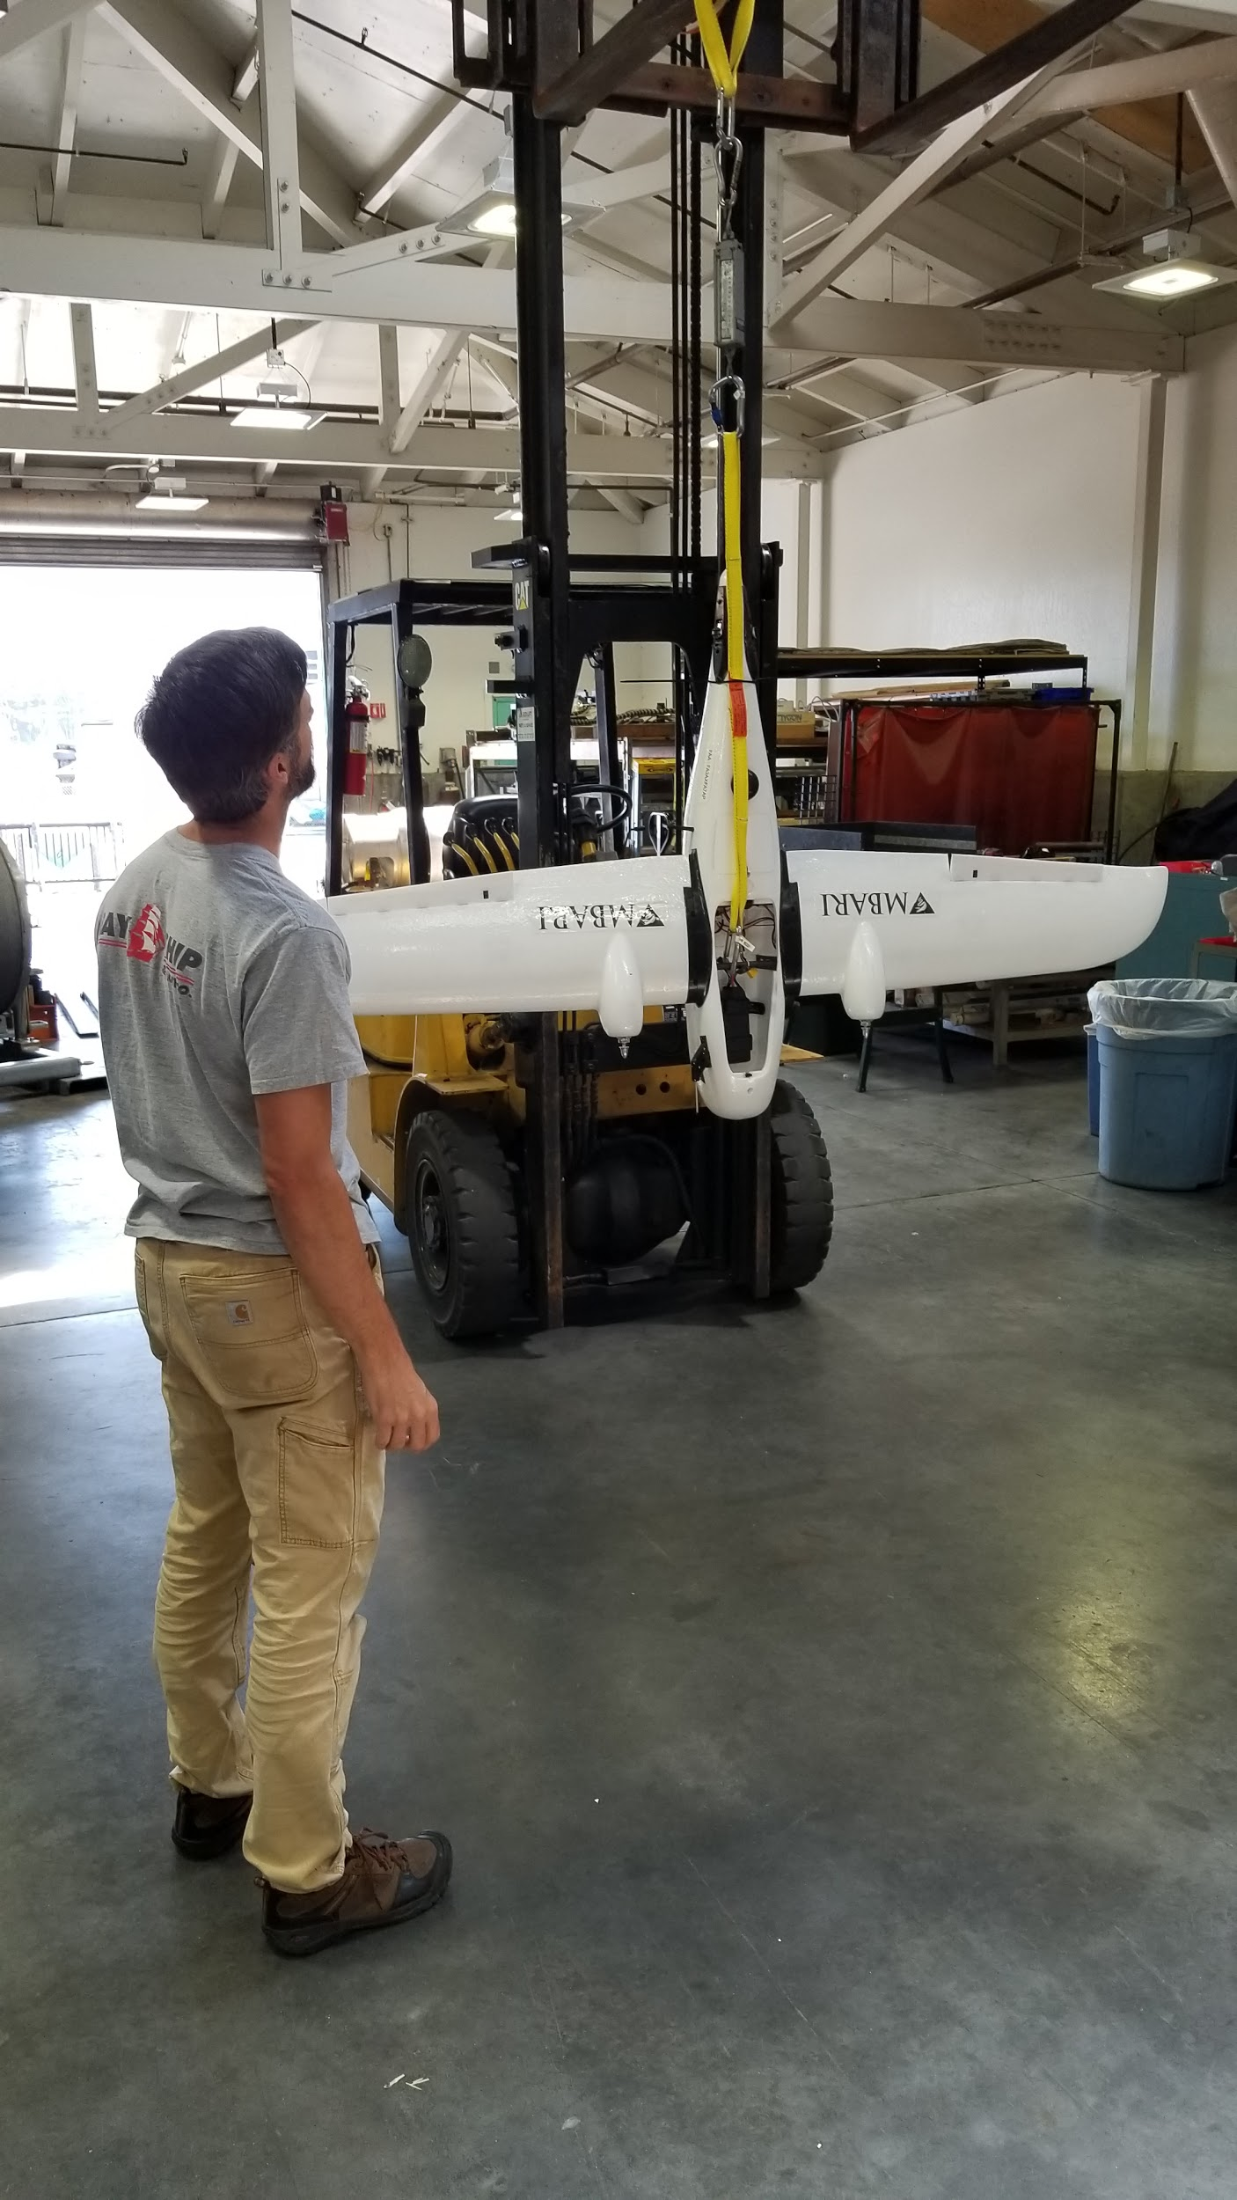
Thrust Test

Slide 26
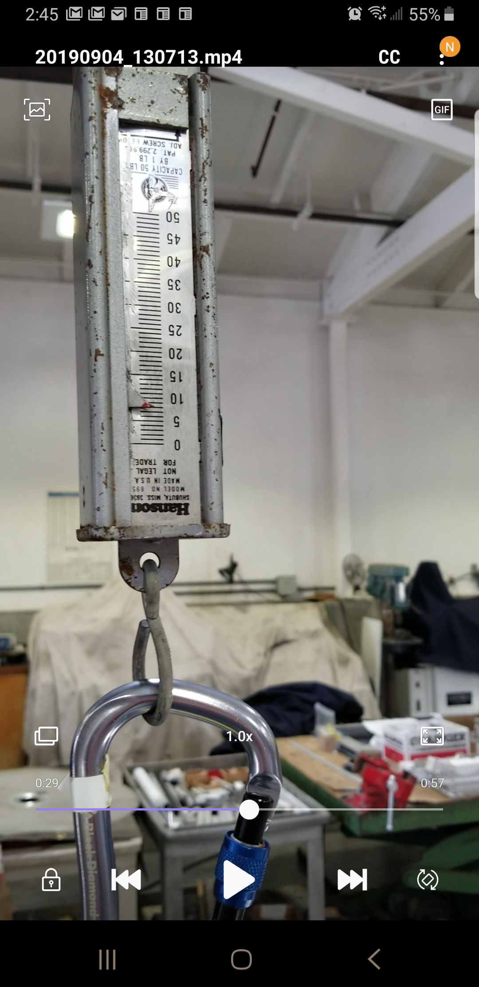
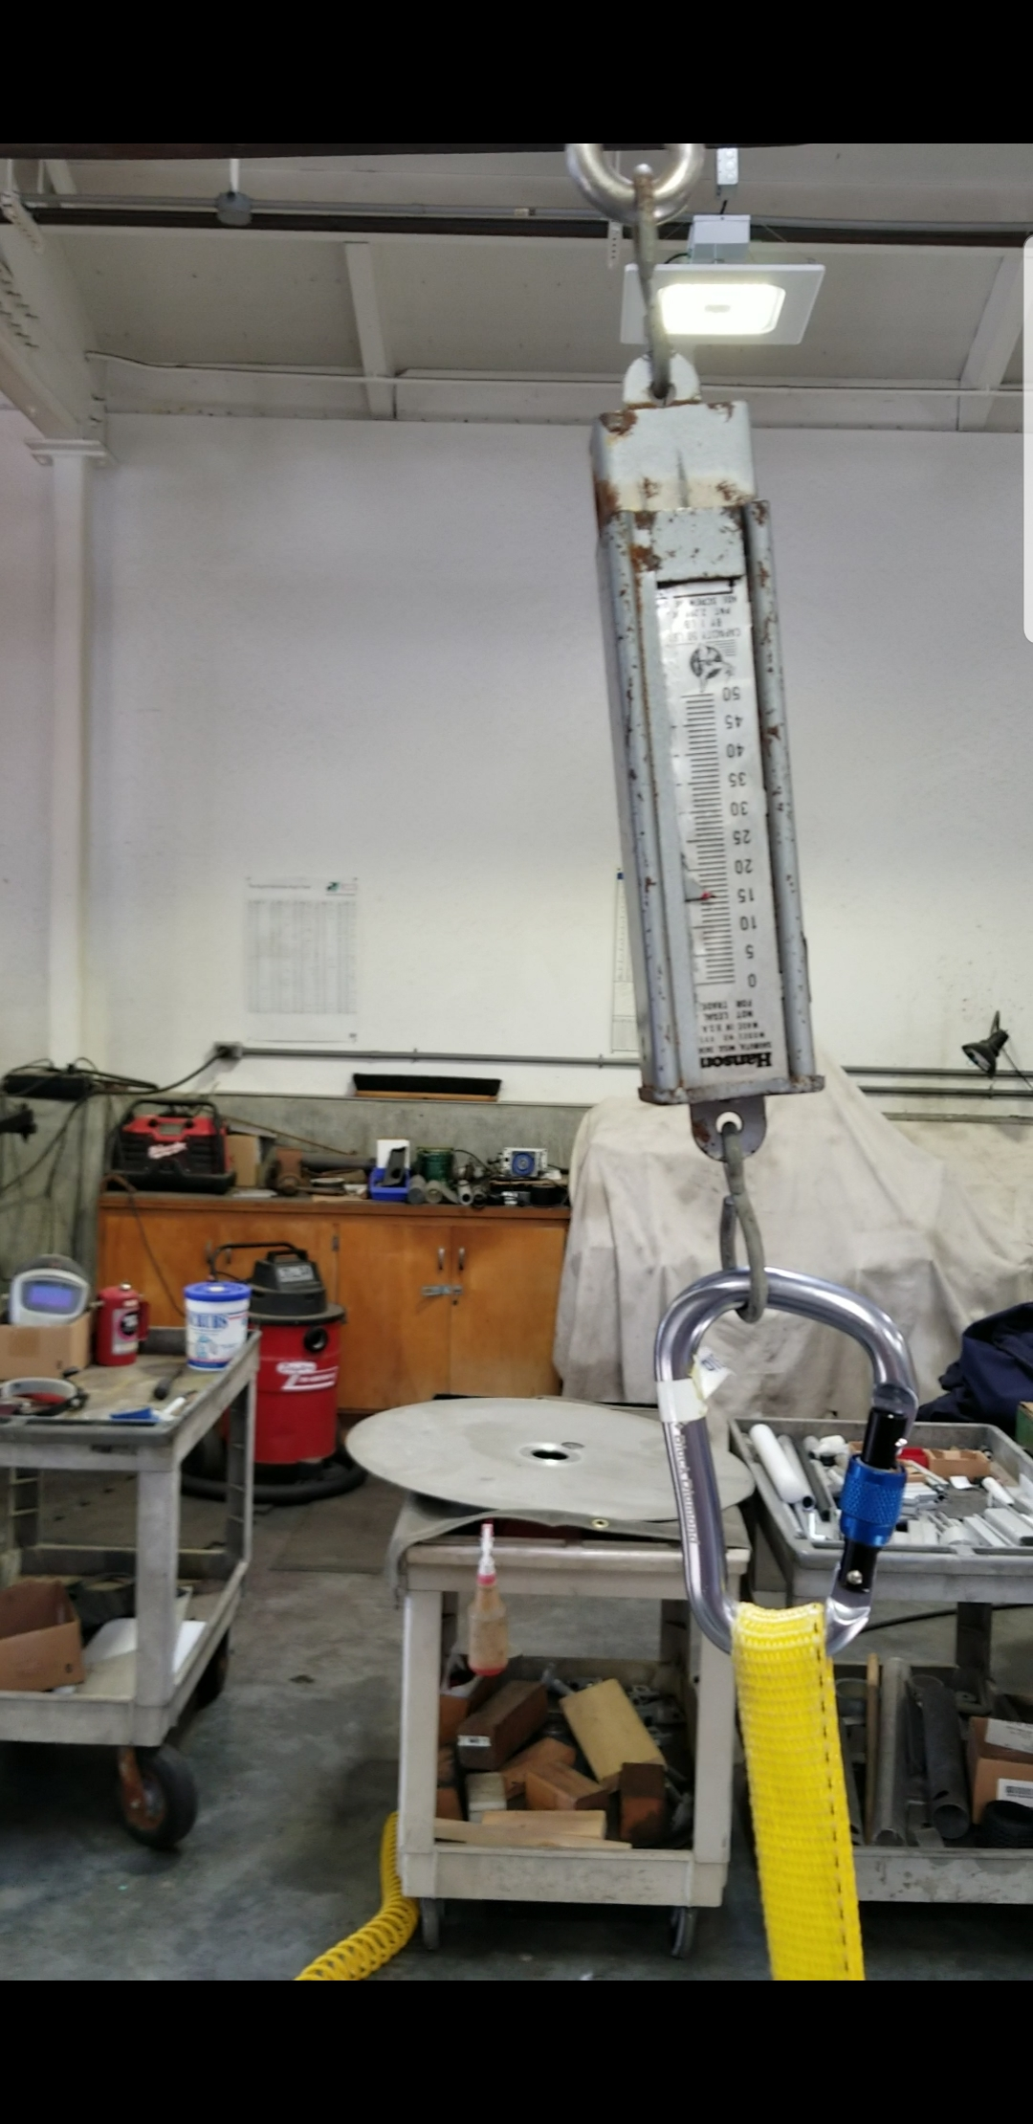
Thrust Test
Resting, the meter reads approx. 8 lbs
Under driven load, approx. 16 lbs
(Very Coarse) Test, yielded approximately 8 lbs (3.6kg) of thrust.

Slide 27
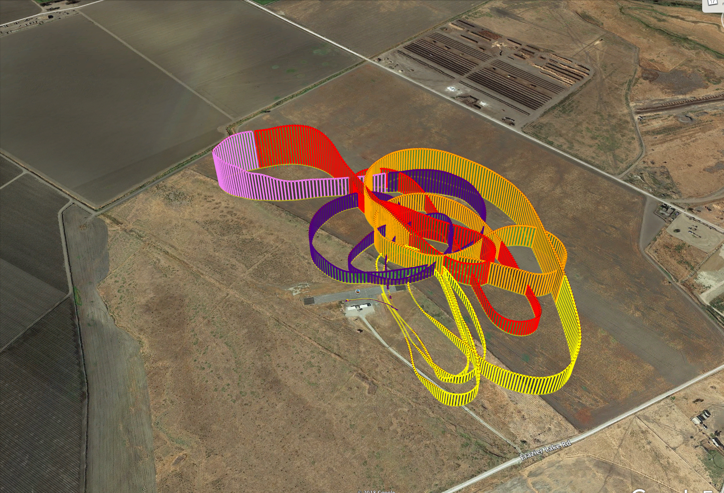
Believer: Test Flight
Track from first flight. Duration: 5m 40s - Total Distance: 7.2km

Slide 28
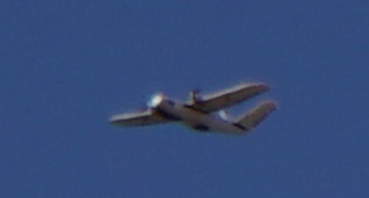
Believer: Test Flight
Completed 3 test flights:
  3 successful launch and recoveries
  Performed in-flight tuning calibrations
  Tested flight assist modes (Stabilize mode)
  Airspeed calibrations
  Traveled a total of 35km
  Average ground speed measured was 78kmh (48mph)
  Max ground speed measured was 126kmh (78mph)
  Rough numbers on maximum range in manual flight mode are ~75km, but this is expected to go up dramatically with proposed changes and autonomous flight modes.

Slide 29
Believer: Test Flight
Flight Performance was very smooth and controlled.
What we found:
  Plane is well-balanced and can fly and glide straight.
  Launch requires a strong throw or headwind.
  Belly landing requires ~100 meters of open space.
  Parachute landing works at speed and did not induce any damage to the craft.
Total weight of UAV was 3.5 kg in this configuration.
  This plane has capacity for an additional ~1 kg of science payload.

Slide 30
Concept of Operations: Ship Based/ Land Based
For 2019-2020, all operations are within visual line of sight (VLOS)
Planning
  Near-shore targets, no chase boat
  Offshore targets, chase boat required
Launch
Flight
Landing
  Water
  Parachute
  Net
Data processing

Slide 31
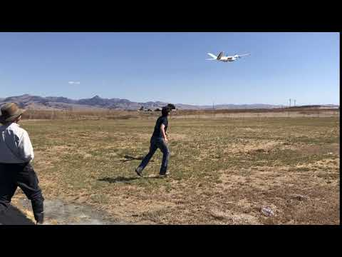
Believer Launch
Hand Launch

Slide 32
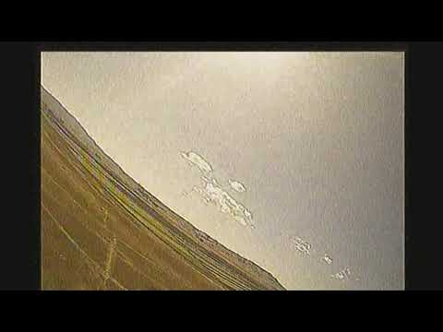
First person view (FPV) of launch

Slide 33
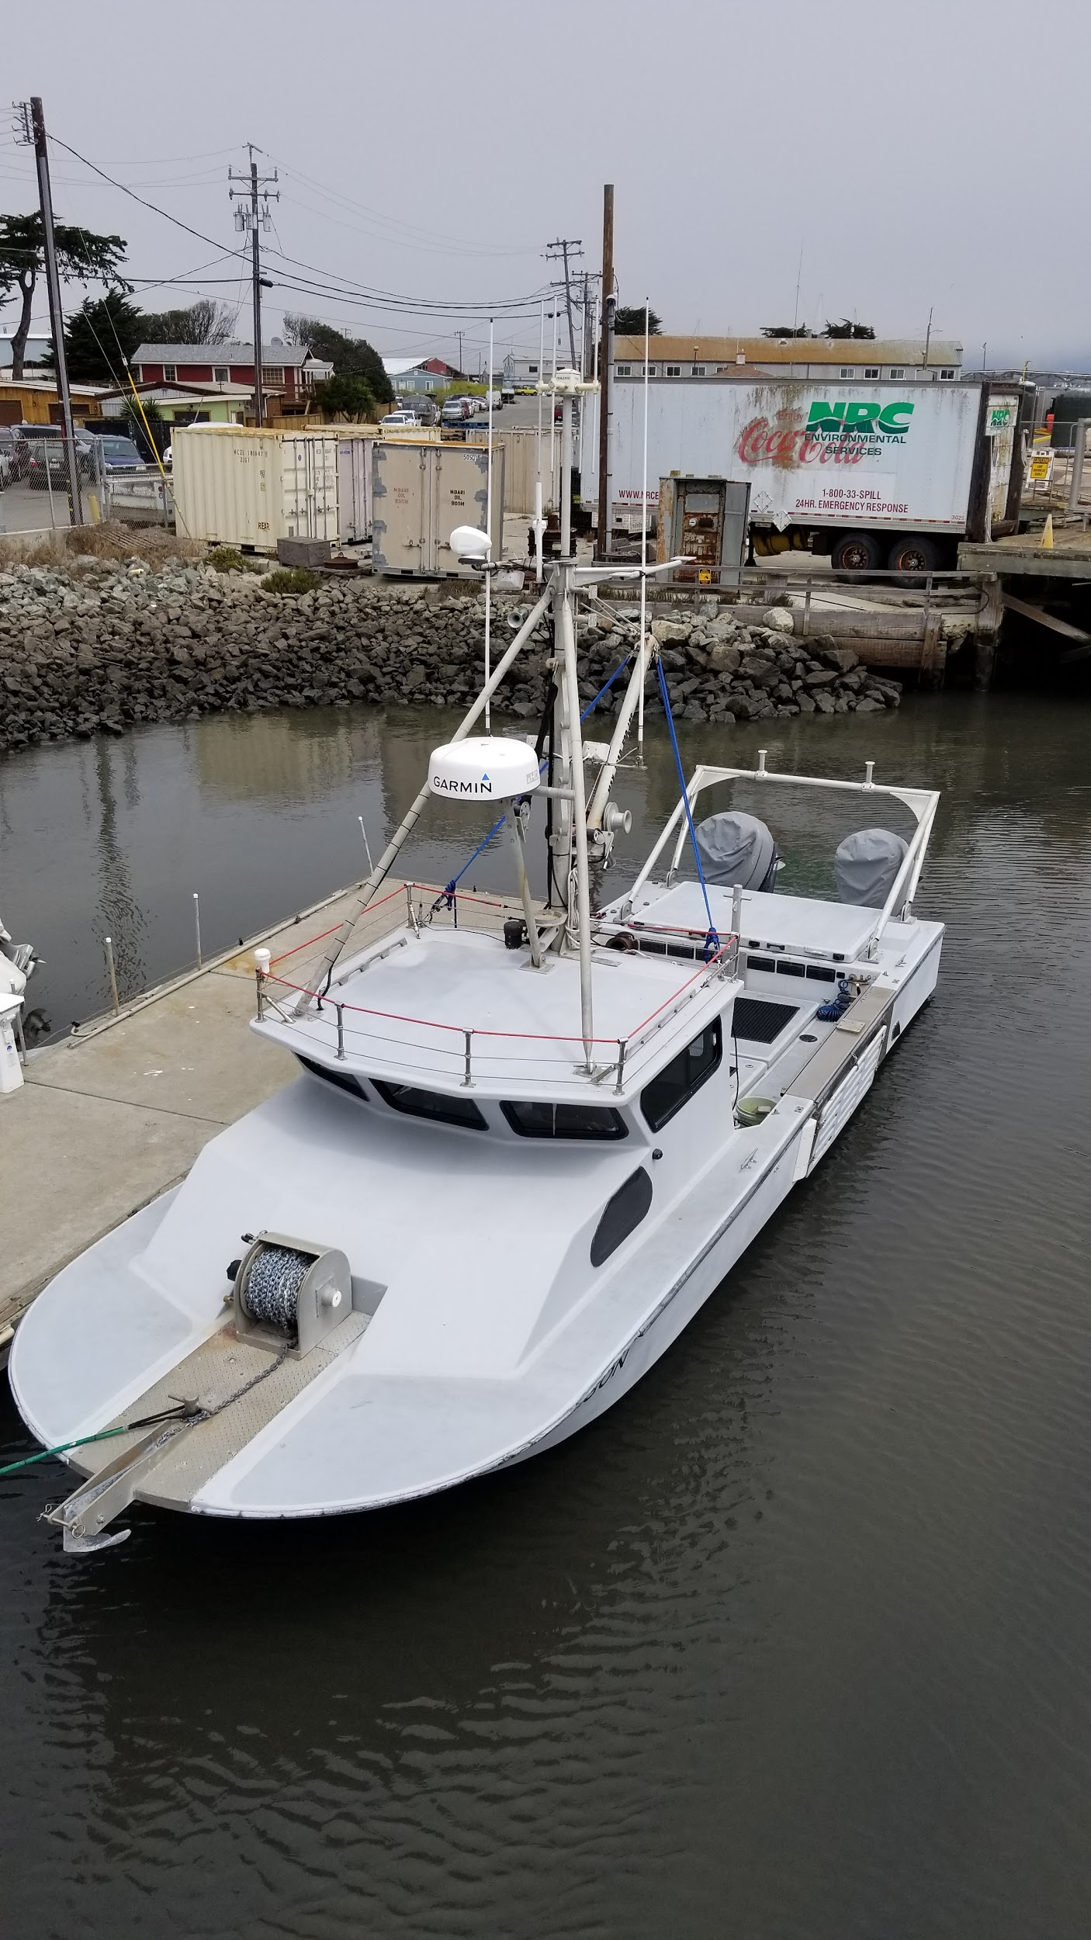
Launch options
Launch from Ship/Paragon
  If objective is offshore.
Launch from beach
  If objective is within VLOS of shore.
Currently manually flown at launch in stabilize mode.
  Configure for auto-launch and transition to mission mode without pilot intervention is possible.

Slide 34
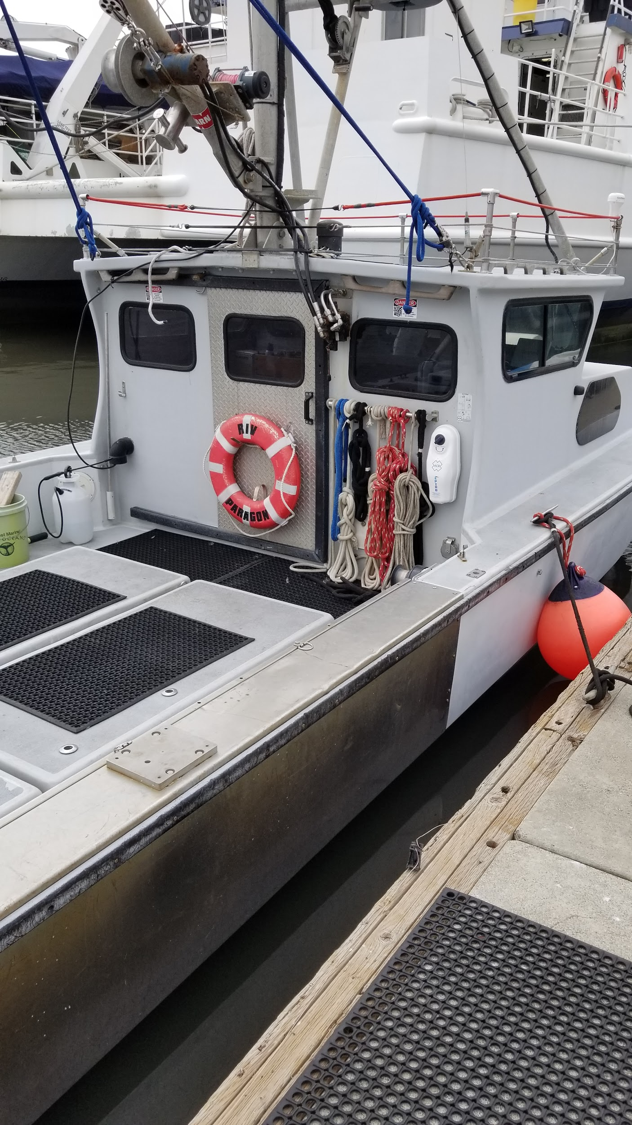
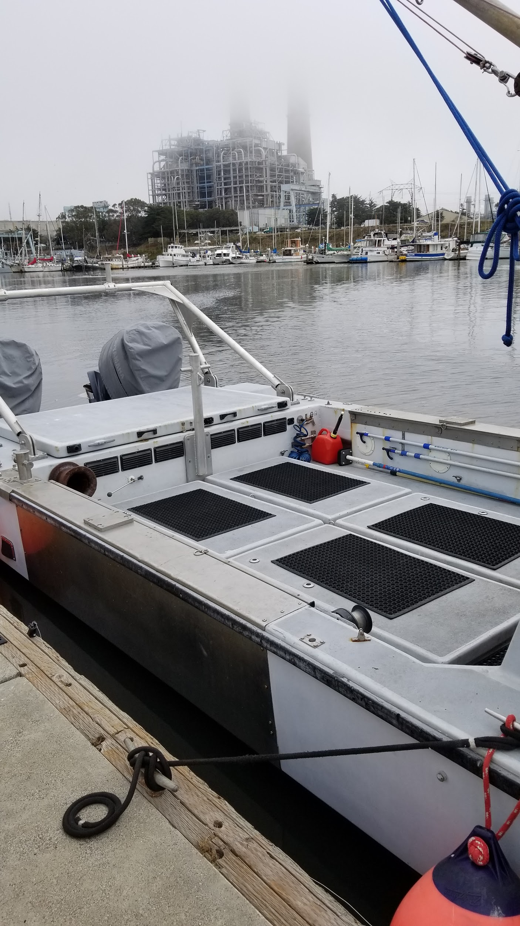
Launch options

Slide 35
VLOS Operation: Ship/Paragon Launch
Launched by hand.
  Room required for a strong throw or height above water.
  Possible hand launch from bridge of Paragon while motoring ahead.
  Wind, Sea, and Sun direction will determine ship heading.
  Pilot Control from back deck, bridge, or open area.
We will be performing further tests to determine launch characteristics versus payload weight.
Notes:
Test

Slide 36
VLOS Operation: Beach/Shore Launch
Launched by hand.
  Land use authorization.
  Measures for public intrusion, wildlife, safety, in the flight area.
  Room required for a strong throw.
  Wind, and Sun direction will determine launch heading.
Notes:
Test

Slide 37
VLOS In-Flight Operations: (Ship Based)
Ship must follow the UAV while pilot and spotter are monitoring the flight and ready to take control if a hazard appears.
  UAV must be able to fly slowly enough that it can be tracked by the spotter vessel.
Unpredictable hazards:
  Otters or animals in water
  Birds
  Fast ship or jet ski
  Increases in wind turbulence or sea state.
  Fog and low clouds
  Manned Aircraft

Slide 38
VLOS In-Flight Operations: (Shore Based)
Pilot/spotter are monitoring the flight and ready to take control if a hazard appears.
Unpredictable hazards:
  Public interactions
  Otters or animals in water
  Birds
  Fast ship or jet ski
  Increase in wind turbulence or sea state.
  Fog and low clouds
  Manned aircraft

Slide 39
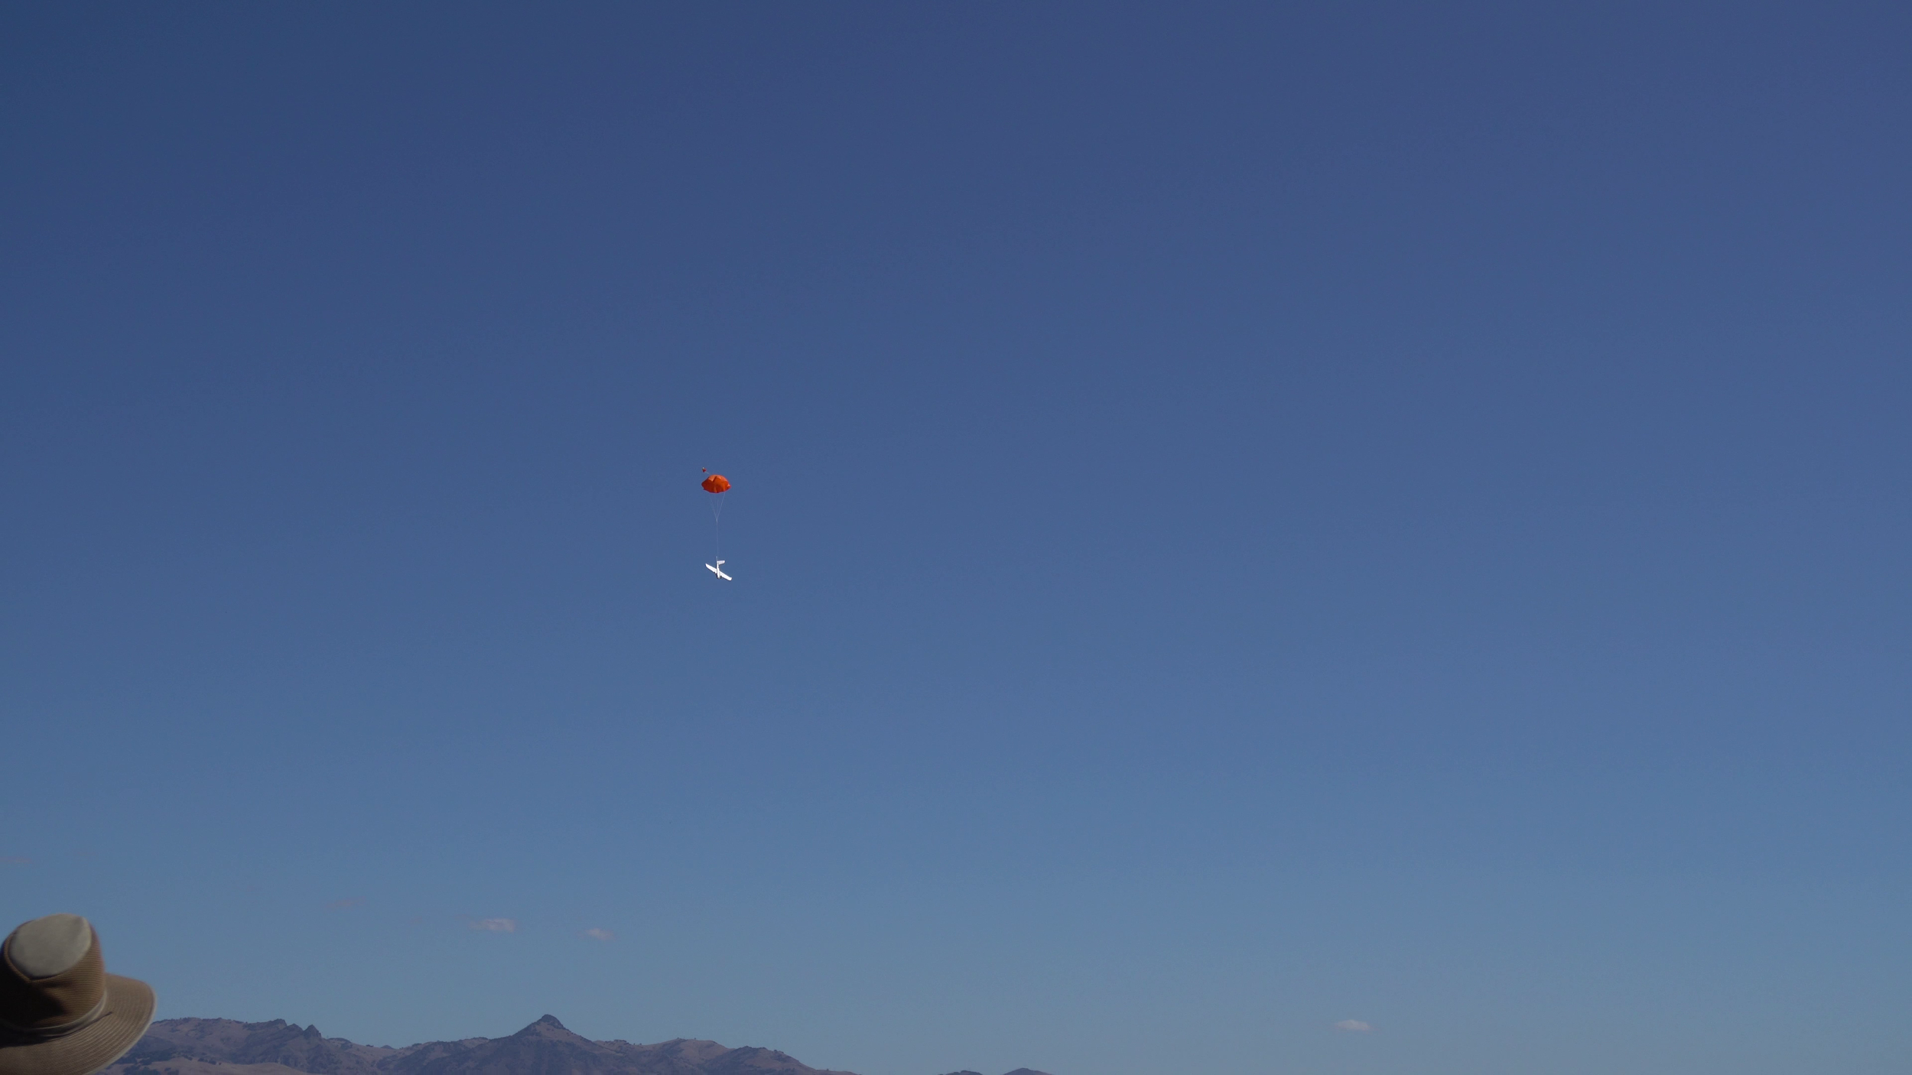
Believer: Landing Options
Parachute Deployment of MBARI Believer on October 1st

Slide 40
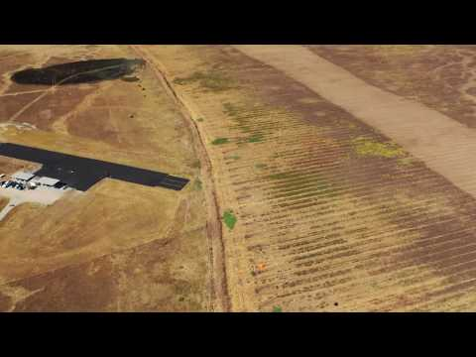
UAV Landing
Parachute Deployment of MBARI Believer on October 1st

Slide 41
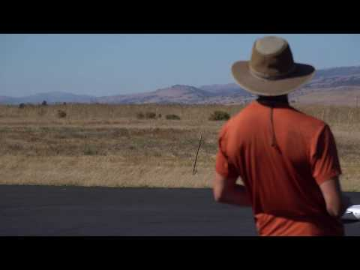
UAV Landing - “Belly Landing”
Pilot operated landing of current build

Slide 42
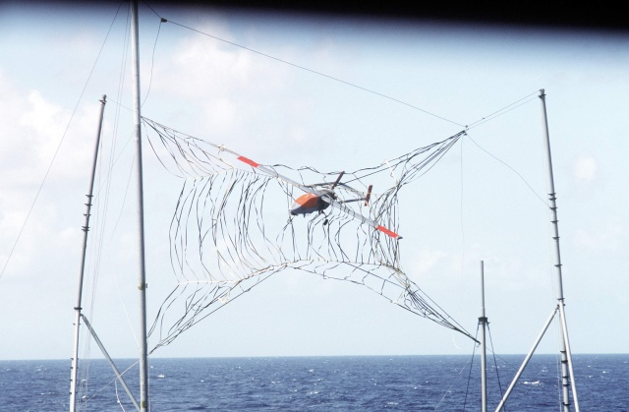
Landing options
Ship based or Shore based
  Water landing (Hand flown)
  Beach landing (Hand flown)
  Net landing (Hand flown)
  Parachute
    Can be triggered manually, autonomously, or as a failsafe action.

Slide 43
VLOS Operation: Landing
Ship/Paragon based flights,
  Manually piloted in water landings (Belly Landing).
  Parachute deploy to water, then recover.
  Method will depend on wind, sea state, sky conditions, etc.
  Net landings require advanced skill, present potential hazards.
Beach based flights,
  Manually piloted in water/shore landings (Belly Landing).
  Parachute deploy in water/shore, then recover.
  Method will depend on public safety conditions, and other regulatory constraints.
  Net landings require advanced skill, present less potential hazards than boat based operations.

Slide 44
VLOS Operation: Landing
Ship/Paragon will recover UAV.
  Parachute can potentially be used as pick point for a boat pole.
Net Landing Methods:
  Requires testing and practice on land first.
  Requires customized netting rig.
  Set up/Break down time.

Slide 45
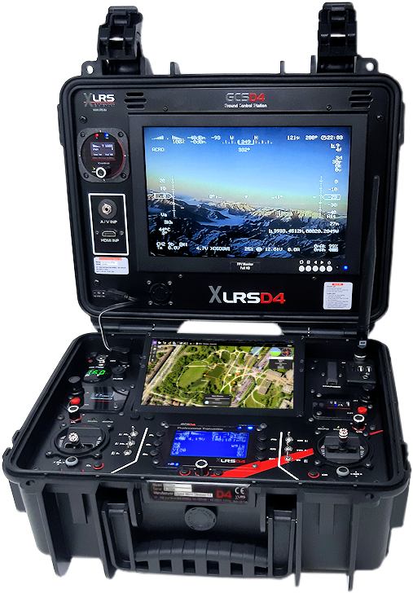
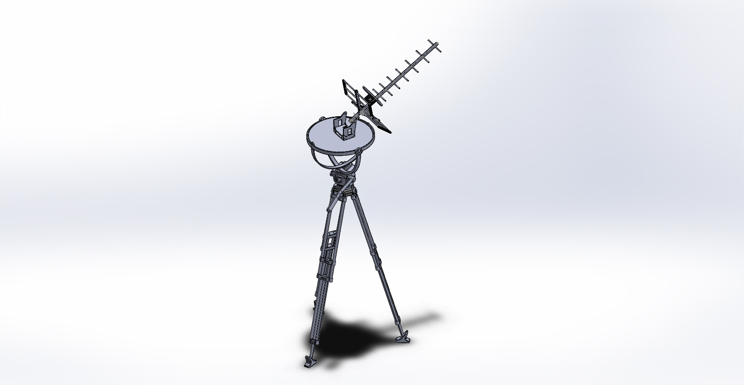
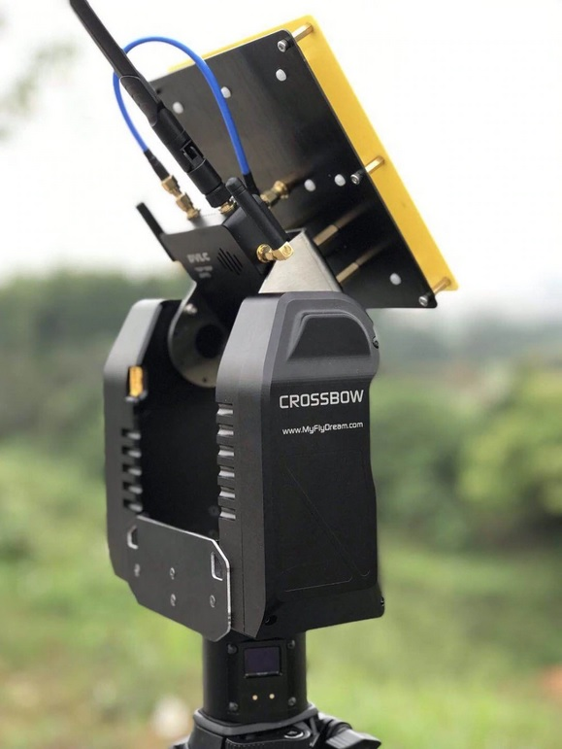
Proposed Ground Station
Gimbalized tripod
  Passive or Driven
  Driven using COTS gimbal gyro PCB and motors
Mount for Anemometer
FPV Monitor
Directional and omni-directional antennas for all relevant frequencies.
Power supplies - Battery Operated?
GPS
Telemetry computer
Autonomous antenna tracker
  MFD Crossbow system
Notes:
Topic for discussion

Slide 46
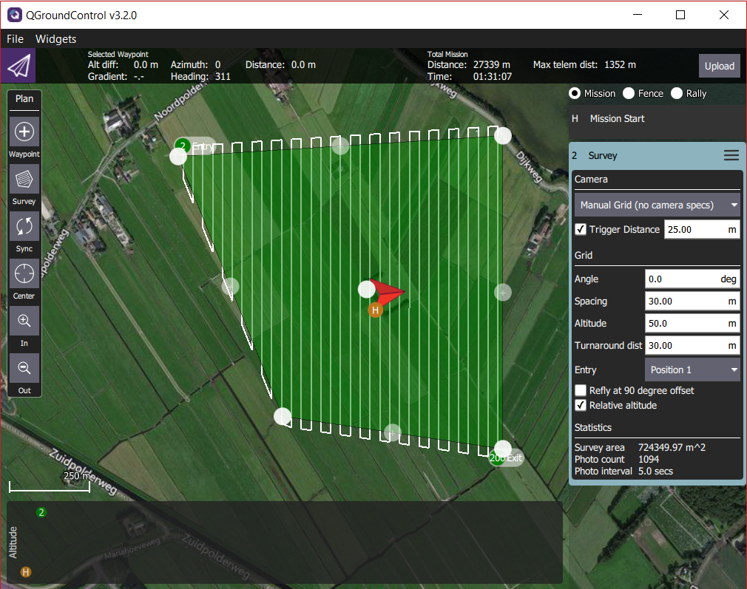
Autonomous Mission Planning
Mission Planner & QGroundControl.
Intuitive graphical mission programming
Auto payload triggering
Surveys based on time interval or distance.
Edits can be done on the fly in some cases.

Slide 47
Pixhawk Flight Controller and Missions
Can support all UAV mounted electronics and drive components, as well as additional peripheral devices, such as Raspberry Pi.
Has on board support for:
2 extra RS-232 serial channels
I2C
CANBUS
PWM
GPS
Analog to Digital converters
USB

Slide 48
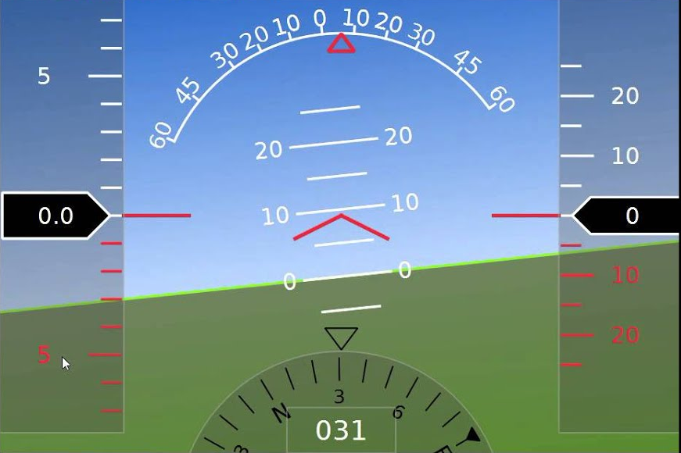
ArduPilot stack
Ground controller
Comms layer
MAVLink
ArduPilot
Vehicle-specific flight code
Shared libraries (drivers, EKF...)
Flight software
Hardware abstraction layer (HAL)
PX4 firmware
NuttX RTOS
Hardware
PixHawk-4 controller
SPI, I2C, serial
Sensors, peripherals
Notes:
Choose Open Source where appropriate, to control cost, improve expandability. ArduPilot is open source, lots of community support, frequent improvements.. MAVLink is open source “standard” protocol. In future we could add our own custom applications to flight code.

Slide 49
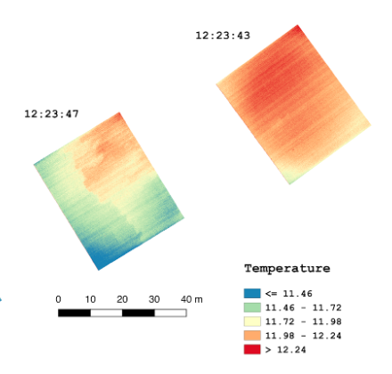
Software: post-flight data processing tools
Flight log play-back, analysis (desktop, online)
GDAL – image geo-referencing, reprojection
QGIS – open source GIS for data display, processing
Custom scripts, other applications (MATLAB, etc)
Paid proprietary end-to-end tools also available (Pix4D, DroneDeploy)
Notes:
Not clear that mapping tools DroneDeploy and Pix4D are useful over the ocean, will assess further

Slide 50

UAV data flow
UAV attitude and position logs
GeoServer,
ElasticSearch
Level-0
Raw images
Geolocate &
tag image
Level-1
GeoTIF images
Mission metadata
Additional
processing
Additional products
Notes:
GeoServer - open source geospatial database with web user interface. ElasticSearch augments search capability, e.g. based on mission date, vehicle name, camera serial#, etc.
Have developed some processes of this diagram, including image geolocation (using gdal utilities and custom Java application), GeoServer ingest

Slide 51
UAV data archive on atlas
Flight logs
Science video?
Level-0, Level-1, additional products
MBARI-wide read access
imager | Data rate GB/hr * | 2020 flight hours | GB in 2020
FoxTech Map-02 | 73.4 | 12 | 881
Foxeer Legend-2 | 47.0 | 12 | 564
FLIR Duo | 0.4 | 12 | 5
Total |  |  | 1450
Request total 2500 GB to include higher-level products, flight logs, test videos, etc.
* Combined Level-0 and Level-1

Slide 52


Waterproofing options
Remember this guy?

Slide 53
Waterproofing options
Need to seal multiple bays, multiple ports, and hatches.

Slide 54
Waterproof options
Degrees of waterproofing; spray, splash, immersion...
Weight penalty
Tradeoff between waterproofing cost, water impact risk, and water damage replacement
What to keep dry - payload versus motors, batteries, ESCs..
UAV must be buoyant
Verify solutions in MBARI test tank

Slide 55


Waterproofing options
Laminating film provides strength, and a surface to bond to.

Slide 56



Waterproofing options
Solutions need to be commonly accessible items, light weight, low cost.
3D printed compartments and Carbon Fiber are more complex, but not out of the question.
Perform fresh water, water-displacement treatment after flight

Slide 57
BVLOS - Beyond Visual Line of Sight
The ability to fly long range autonomous or FPV-only missions, without the need to maintain visual contact with the system.
Considered crucial to opening the door on low-cost long term repeatable surveys.
Difficult to achieve
  Regulatory hurdles - FAA 107.31 Waiver, MBNMS permits.
  Technological hurdles - Stable long distance control and monitoring, failsafes
  Safety hurdles - Automated Detect and avoid (DAA) capability.
Solutions are becoming more and more available
  ADS-B Receivers that interact with Mavlink, GPS.
  FAA regulated corridors
  Air-traffic radio station monitoring
  High speed low latency telecommunication networks
  HD Cameras and video transmitters, Computer vision, and control.
We are not ready to pursue BVLOS in 2019, but we will build towards that goal in 2020.

Slide 58
2019 goals
Schedule realism: Some team members are out of time in 2019
Refine requirements, conops, design based on this review, further research and tests.
Purchase ground control station components, assemble.
Add payloads to Believer
Conduct Believer and Edge test flights as time allows
Secure permit to fly in sanctuary
Work to streamline MBARI UAV policy and procedures

Slide 59
2020 goals
Build two new Believer planes
Integrate science payloads
Waterproofing.
Build Ground Control Station
Conduct Edge and Believer science missions from shore.
Conduct boat-based Edge and Believer test missions.
Test various launch and recovery options.
Work to streamline MBARI UAV policy and procedures
Work towards BVLOS

Slide 60
Goals of this review
Share designs, plans, concepts, and schedule
Identify any items we may have missed
Refine requirements, design, concept of operations
Priority topics:
  Landing
  Waterproofing
  Ground control station
Core Project team: Ben Erwin, Tom O’Reilly, John Ryan, Bryan Schaefer,
Steve Haddock, Rob McEwen
Notes:
Ben

Slide 61
Extras
https://youtu.be/v93s3RRx8ek - Hand Launch
https://youtu.be/Weo0sH8LbM8 - FPV of Launch
https://youtu.be/68pTYImfuq0 - Pilot Landing
https://youtu.be/jdu5b3vC1-s - Parachute Landing

Slide 62
Launch options
 | Launch from Ship/Paragon | Launch from beach
pros | Flexible launch point Able to chase the plane (Maintain LOS). Can recover plane at sea. | Pilot on shore, no boat needed when target within VLOS of beach
cons | Risk water-impact-on-launch, max waterproof needed? Requires extra planning/personnel. | Fixed launch point; longer transit to target if BVLOS of shore Pilot on boat when target BVLOS of beach; 2-way radio comms needed Intrusion by passers-by/tourists. Beach sand can damage motors/equipment
notes | Need to assess water impact risk on launch Sufficient run-up space on Paragon deck? Need to assess/refine launch techniques Launch from wheelhouse roof? | Investigate feasibility of pilot handoff during flight, e.g. one pilot on beach has control during launch, then hands off to pilot aboard Paragon. Identify viable beach launch sites
Notes:
Ask MBNMS collaborators about viable beach launch/landing sites

Slide 63
Landing options
 | Water landing with/without parachute | Parachute landing on beach, Paragon/pilot just offshore, recovery team on beach | Net landing on boat
pros | Min skill with chute Min safety issues | Min skill needed Min waterproof No boat required when target within VLOS of beach | Min waterproof Short turnaround time Less risk of water intrusion
cons | Max waterproof Moderate skill needed without chute. | 2-way radio pilot/beach team comms What if chute doesn’t deploy? Limited beach landing sites Wind drift Public intrusion | Real/perceived safety issues High skill needed; boat+net is moving target Superstructure assembly on boat Custom designed netting rig for the specific boat
notes | Must be buoyant in any case | Assess chute reliability Identify viable beach landing sites Investigate feasibility of pilot hand-off during flight | Possibly use first person video to aid in landing.
Notes:
Ask MBNMS collaborators about viable beach launch/landing sites

Slide 64

1 Oct Believer Test: First Flights
Composite view shows just how much ground was covered in 27 minutes of flight time (~35km).

Slide 65

There is an exclusion zone outside sanctuary bounds
for UAV purposes

Slide 66

Mission Planning
Alternatively, professional paid software suites such as Pix4D or DroneDeploy can be used with Pixhawks MAVlink protocol.
End to end solution
Mission Planning
Mission execution
Monitoring
Data Processing
Data Analysis
User tools for data visualisation
*We are aware of these services as potentially useful to science, but have not pursued them.

Slide 67
Data distribution
ElasticSearch database
  Extracts and organizes EXIF tags from submitted Level-2 images; camera position, attitude, coordinates, mission #, vehicle,.
  Executes GeoTIF search corresponding to user search criteria: e.g. display images from vehicle=“believer” acquired during October 2020
GeoServer – open-source geospatial database
  Standards-based; KML, GeoTIFF, OpenGL
  Displays map-projected GeoTIF images that meet user-specified criteria (location, time...)
  Working with Kevin Gomes to ingest images to MBARI GeoServer
  CENCOOS, others can link to MBARI’s GeoServer

Slide 68
Fixed-Wing: Believer
Damage and Repair
We expect occasional damage with routine flights.
  Excluding payload, total vehicle cost is < $1600.
  Parts are COTS and typically available and relatively inexpensive.
  UAV can be easily and quickly repaired in house.
  Electronics, if intact, can be re-used in repair builds.
After a recent crash, damage to an motor mount, foam section, and wing hardware has already been repaired.
  Repair to foam, and engine mount was practical, utilizing epoxies and glues, and done in a day.
  A broken carbon fiber rod was purchased for $3
  An entire new wing costs only $71. An entire body kit is $250.
  Additionally, parts can easily be reverse engineered in SolidWorks and 3D printed.

