Slide 1
Coral Macro Camera
Concept Design Review
September 2020

Slide 2
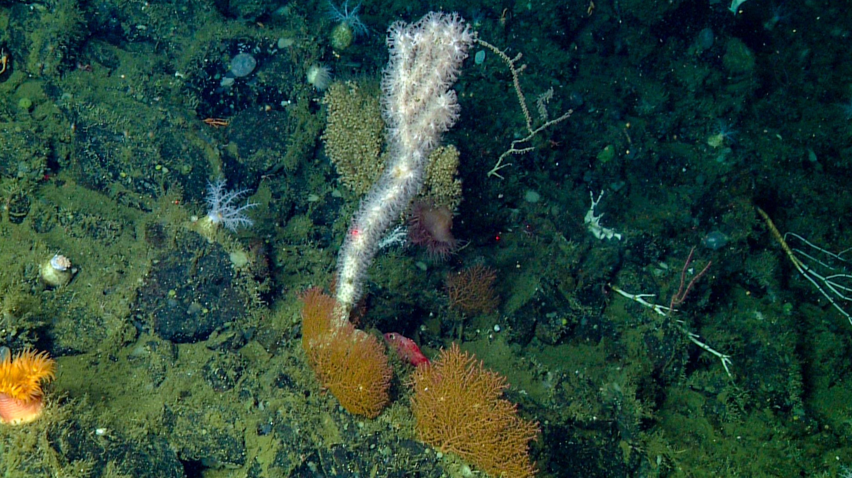
System Objective
Autonomously capture close-up images of coral and sponges at least once per hour for a 1 year duration deployment.

Slide 3
Concept Review Outline
System Requirements
System Concept
Block Diagram
Electrical Concept Design
Mechanical Concept Design
  Camera Housing
  Battery Housing
  Housings TBD
    Strobe Ballast
    Laser/Wifi Power and Control
Operational Considerations
Electrical Concept Details
  System Components
  Battery size calculations
  ROV comms concept
High Risk elements
Other
  Camera selection
    Resolution
    DOF
    FOV
    Image storage calcs

Slide 4
System Requirements
Depth rating: 3500 m
Deployment duration: 1 year
Minimum image frequency: 1 per hour
Still images only, no video required
Desired FOV: 20 cm x 20 cm
Smallest object to resolve: 250 um desired
Height of tallest target: 1 mab
Camera system must be positionable by ROV
Color images required
Max horizontal distance from target: 1 m
Must be deployable from both ships – prefer ROV deployed system vs. elevator

Slide 5
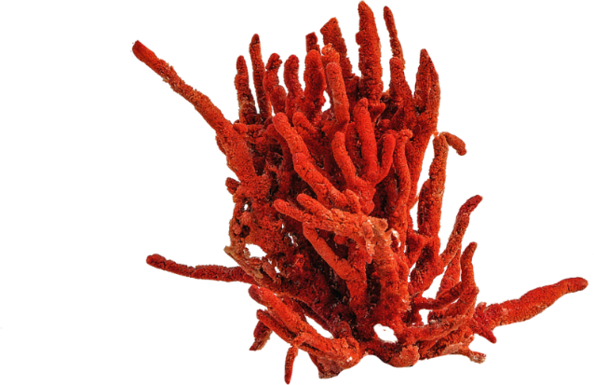
System Concept
Camera
Battery
Deepsea Connect

Slide 6
System Electrical Concept
Strobe 2
Camera Housing
Main Battery
+28V
Batt Pwr
Snappy
Controller
Power, Shutter, Sync
Strobe charge & trigger
Serial
Strobe
Ballast
Sony α7rIII
Serial Server
Eth
To Deck Cable
Eth
USB
Eth Hub
Eth
Eth to USB
Laser & Deepsea Connect
Batt & Electronics
Antenna
Strobe 1
Lasers

Slide 7
Mechanical System Concept

Slide 8
Battery Housing

Slide 9
Camera Housing

Slide 10
Tripod Concepts

Slide 11
Weights

Slide 12
Operational Scenario
Carry unit down on ROV
Place unit on seafloor and unfold as needed
Position unit with ROV in front of target with help of crossing lasers
Pull out wifi antenna and place on top of antenna from ROV
Talk to system and confirm operation, adjust camera parameters
Start time-lapse mission
Replace wifi antenna on/near frame

Slide 13
Electrical Concept

Slide 14
System Electrical Concept
Strobe 2
Camera Housing
Main Battery
+28V
Batt Pwr
Snappy
Controller
Power, Shutter, Sync
Strobe charge & trigger
Serial
Strobe
Ballast
Sony α7rIII
Serial Server
Eth
To Deck Cable
Eth
USB
Eth Hub
Eth
Eth to USB
Laser & Deepsea Connect
Batt & Electronics
Antenna
Strobe 1
Lasers

Slide 15
Component Details
Camera: Sony a7rIII
  Mirrorless digital camera
  35 mm full frame sensor
  42 Mpixel
  5” x 3.78” x 3”
Strobes:
  Paul Roberts custom LED strobes
  X lumen for X size puck
  Requires capacitor bank
Controller: Snappy
  PIC based board used in DiSCO and Smith time-lapse systems
Lasers – 2 crossing for positioning
  Ocean imaging systems DeepSea Lasers used on MBARI’s ROVs
  Paul M will develop flashing circuit to help position

Slide 16
Battery Pack Details
We will use a primary Li pack.
Energy required for 1 image per hour for 1 year (8760 images) = 1.93 kWHr
  Based on energy use for Cathyx strobe 100k lumen each, should be better with Paul R strobes
Minimum number of DD cells for 8760 images @ 28Vnom: 24 cells
We propose a 36 DD cell pack, which is 2/3 the size of our existing battery pack, this will give us extra capacity for the future
The positioning lasers and the deepsea connect will run off separate battery packs designed to last a couple days, as both functions will only be needed during deployment

Slide 17
Comms with ROV
We are looking into using Deepsea Connect as a way to communicate via Ethernet between the camera and the ROV
This would enable us to change shutter speed, aperture, and gain in situ
Bench testing with the camera will be conducted shortly
This will require an interface to the ROV and to the camera, but both should be straightforward

Slide 18
High Risk Elements
Positioning camera
Wifi comms with ROV
Lighting adequacy
Strobes, duration at depth?

Slide 19
Camera Selection and Specs

Slide 20
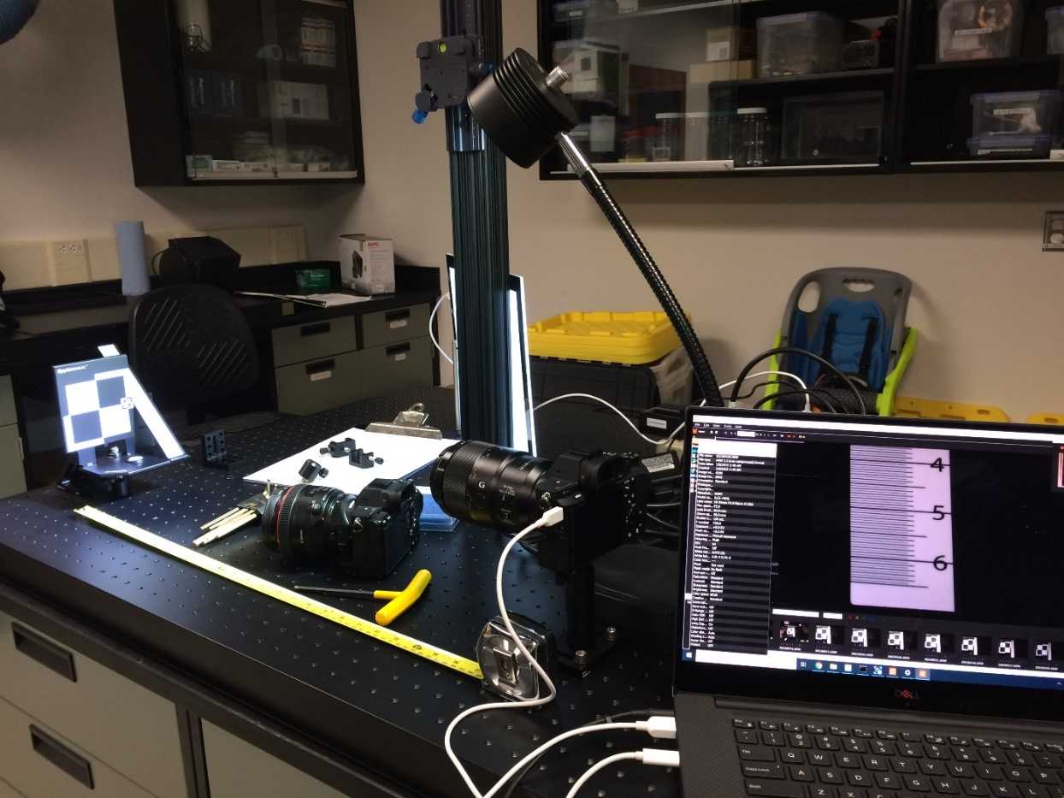
Camera Testing
Compared two cameras wrt to resolution, DOF, and image quality:
  Sony α7sII
  Sony α7rIII
Both were mirrorless digital cameras in house.
Other comparable models:
  Nikon Z7
  Canon EOS R5

Slide 21
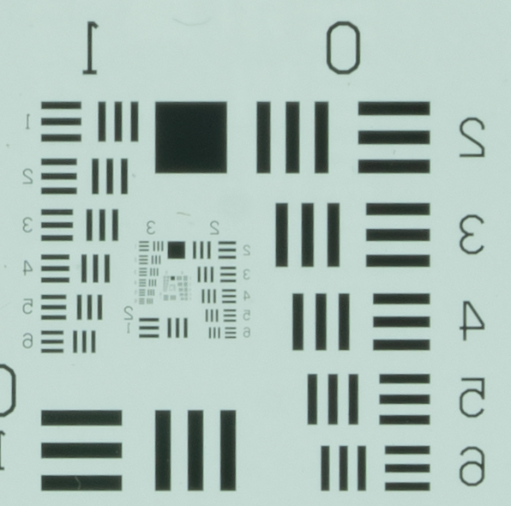
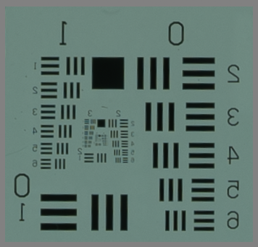
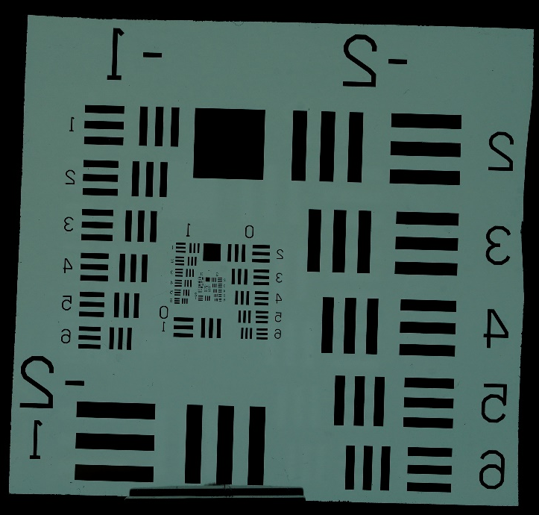
Resolution
A7RIII
1 mm
box
The bottom line is that resolution is a key factor. A7RIII has the resolution to discriminate smaller objects. Obvious in the images to left.
See the 1 mm box in both images. Easy to discriminate. In upper (A7R image, easy to see down to at least 0.1 mm. Great! Gets blurry in A7S at this scale
So, as long as we have the storage capacity, I’d vote for higher res. camera
A7S
2”
USAF Resolution Target

Slide 22
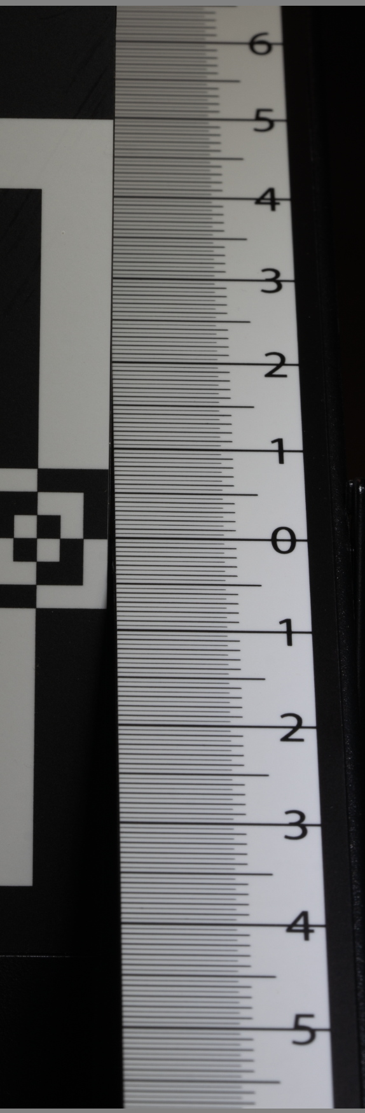
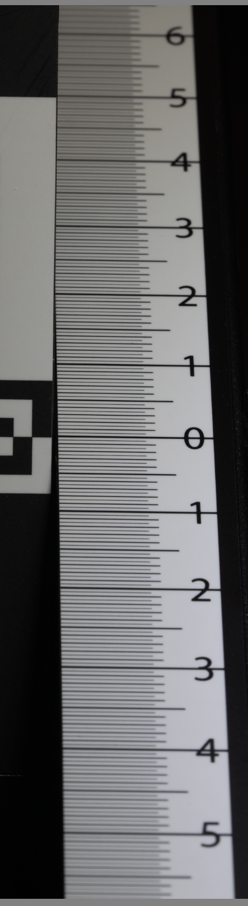
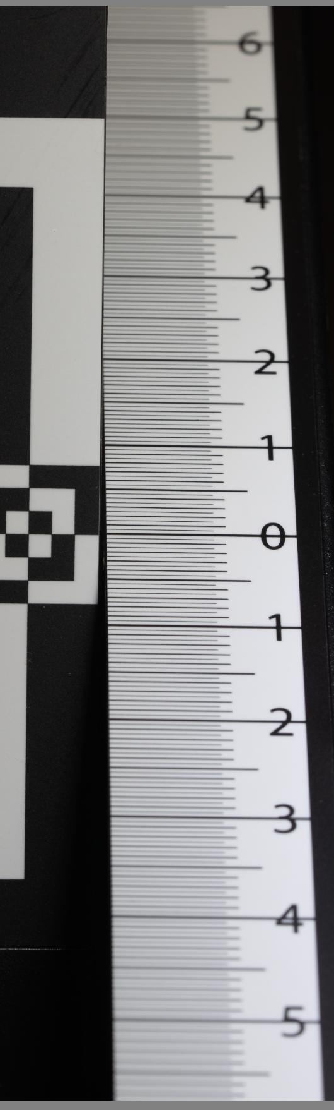
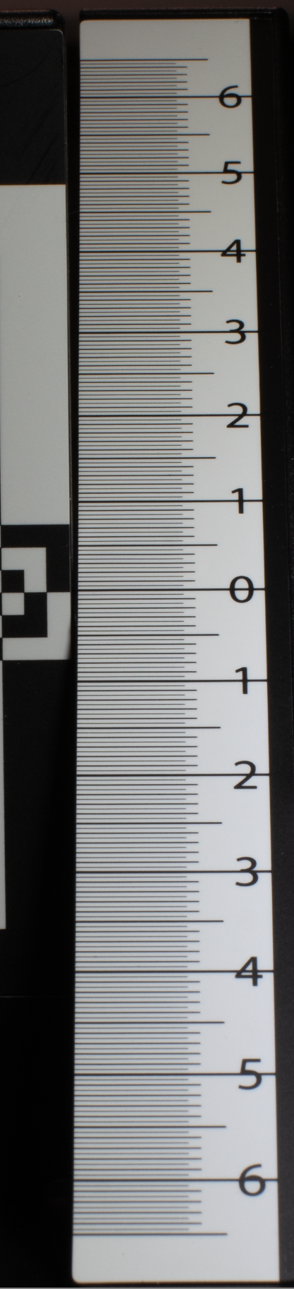
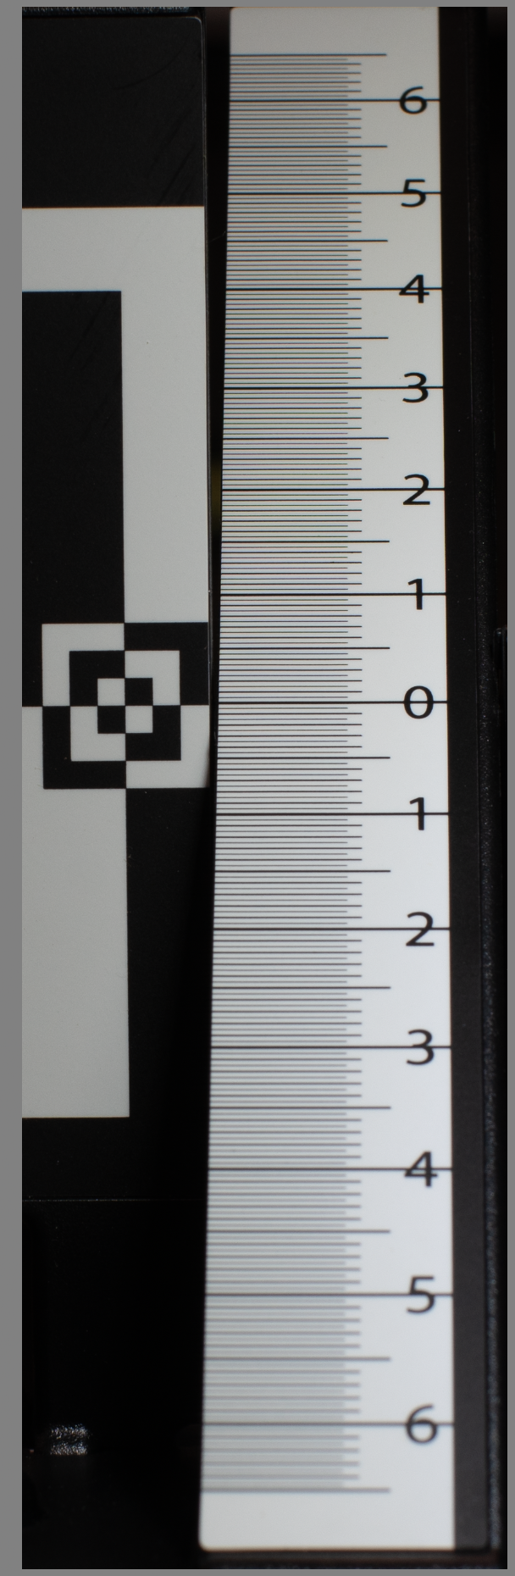
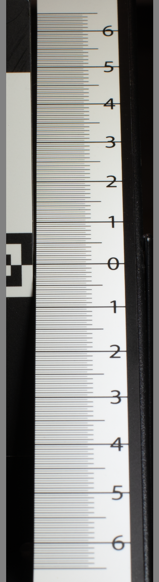
A7RIII 90 mm ISO 125
Depth of Field (cm)
A7RIII 50 mm ISO 125
F14
11.4 cm
F11
8.9 cm
F9
6.4 cm
F14
>13 cm
F11
>13 cm
F9
12 cm

Slide 23
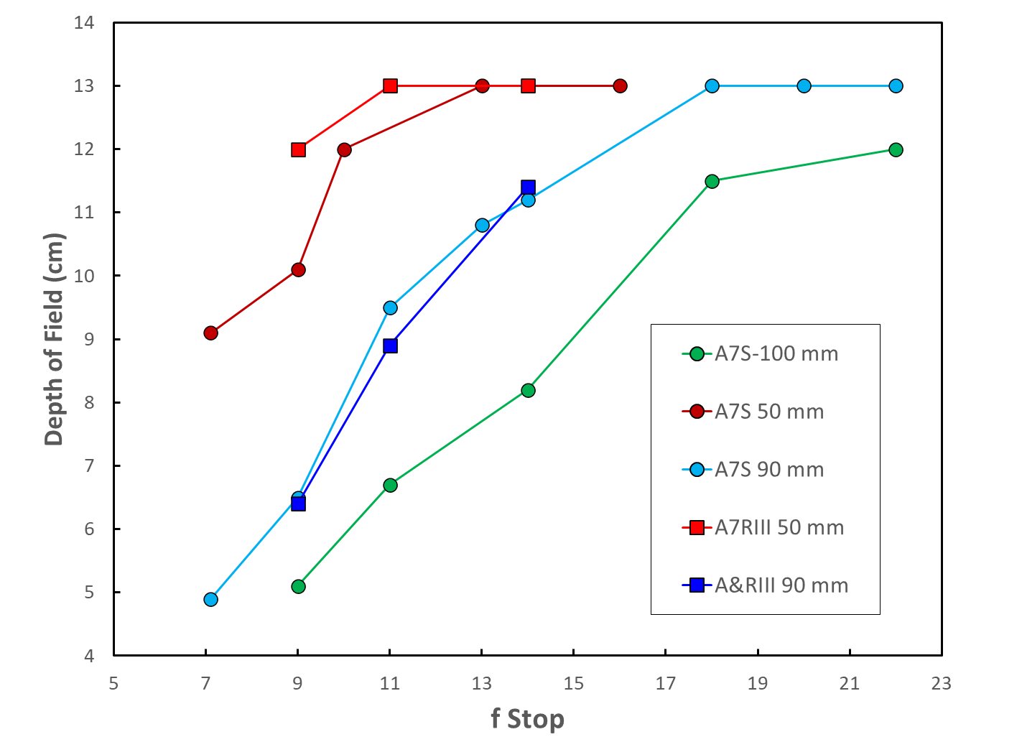
50 mm
100 mm
90 mm

Slide 24
Calculated FOV vs Target Distance

Slide 25
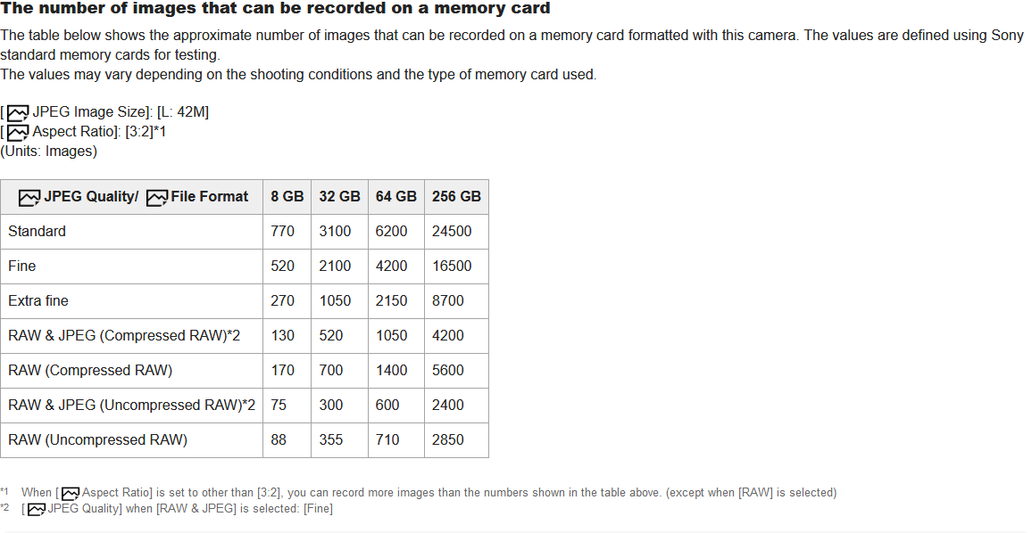
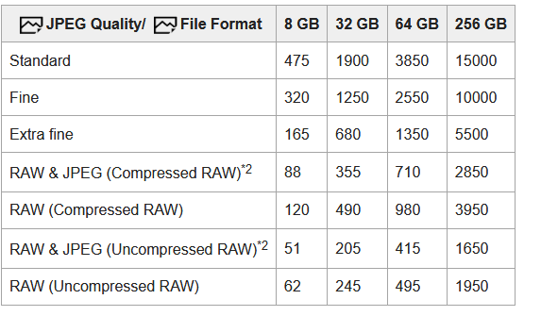
Memory card calcs (A7RIII vs A7RIV)
a7RIII
a7RIV
A 1 TB card or two 512 GB cards would yield > 11000 images, our goal is 8760 (one per hour for 1 year)

