Slide 1
Deep Sea Coral Observatory
Design Review

Slide 2
Project Goal
Design a time-lapse camera system that can observe changes in a coral community on a time scale of months

Slide 3
DiSCO Functional Requirements
The DiSCO shall image a fixed area of a chosen coral community. The area should be large enough to be relevant to abundance studies.
The DiSCO shall be capture images of substantial resolution to identify 10 cm organisms.
The DiSCO shall be engineered to operate without maintenance for up to one year.
The DiSCO shall be deployable at sites as deep as Sur Ridge. 4k preferable.

Slide 4
DiSCO Functional Requirements
The DiSCO shall capture images at the frequency necessary to study changes in community structure. Every hour sufficient.
The DiSCO shall be deployable as a free vehicle.
The DiSCO shall leverage to the extent possible from previously developed technology and COTS solutions.
The DiSCO shall be operated and maintained by non-engineering personnel.
The DisCO shall be deployable from the Western Flyer. Nice to have Rachel Carson.

Slide 5
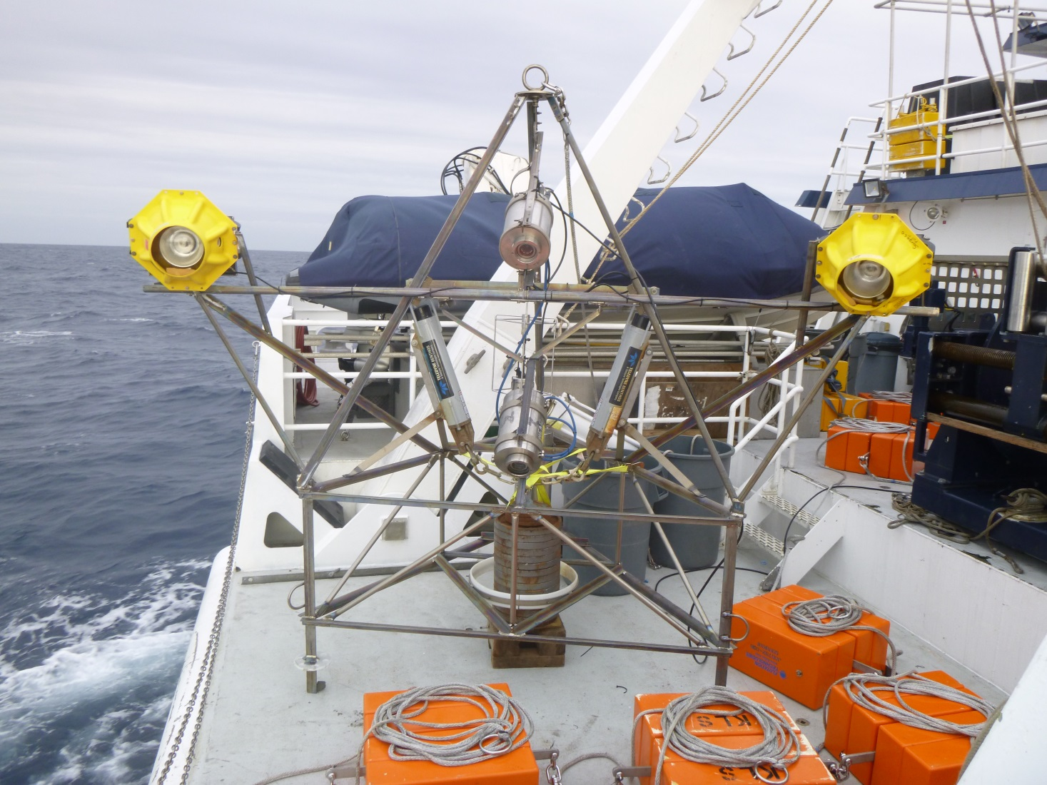
Smith Time-Lapse Camera Tripod
1 picture/hour
Images 20m2 of seafloor
Duration: 1 year
Successful in field for many years

Slide 6
Smith Dual Tripod FOV

Slide 7
Seafloor area viewed

Slide 9
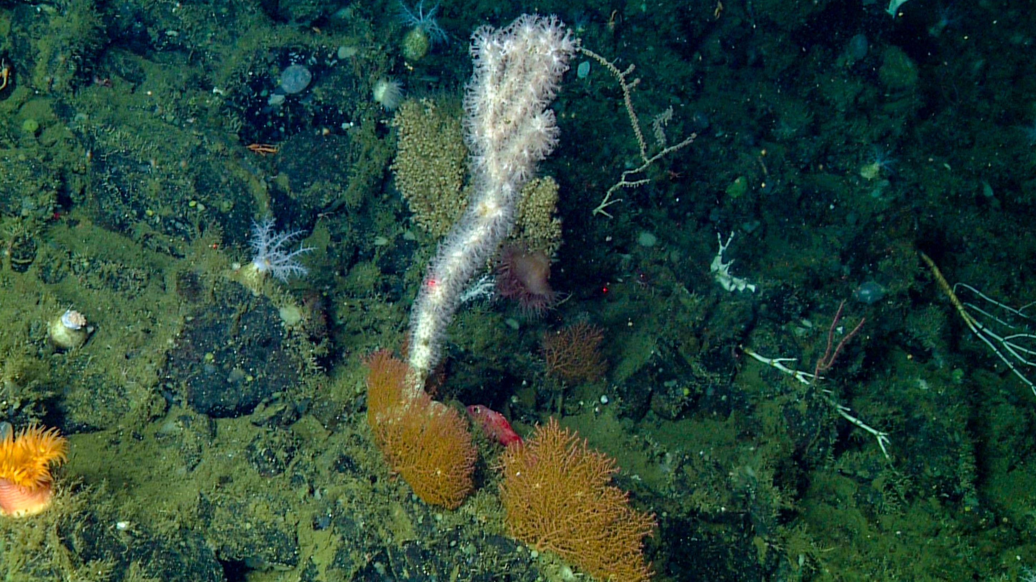
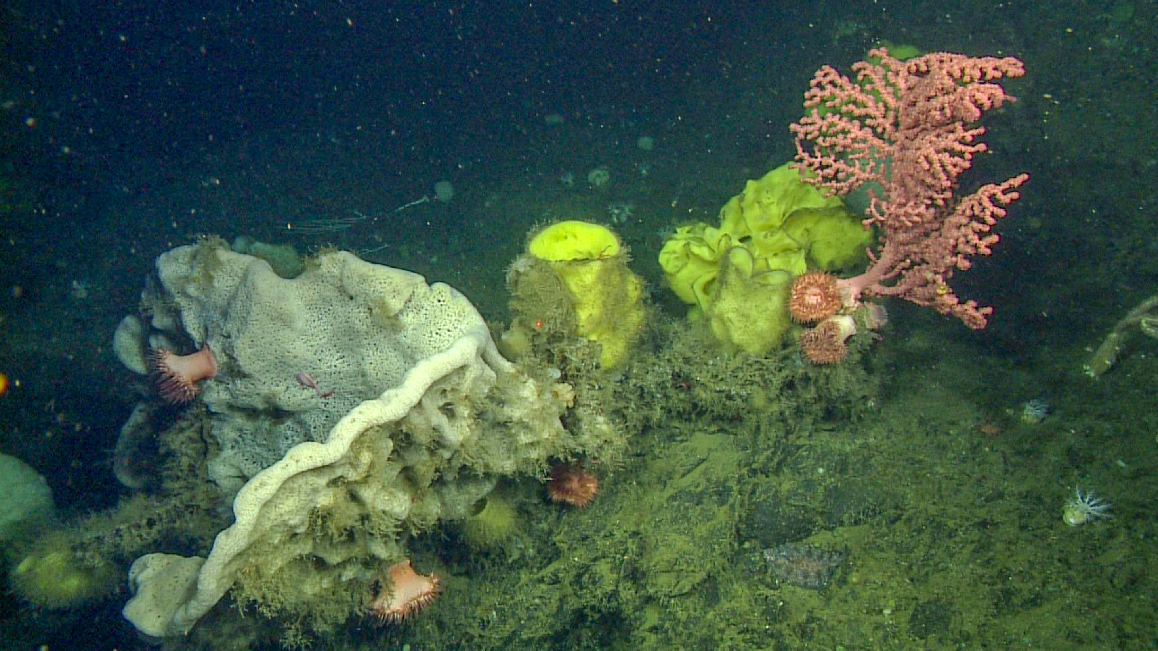
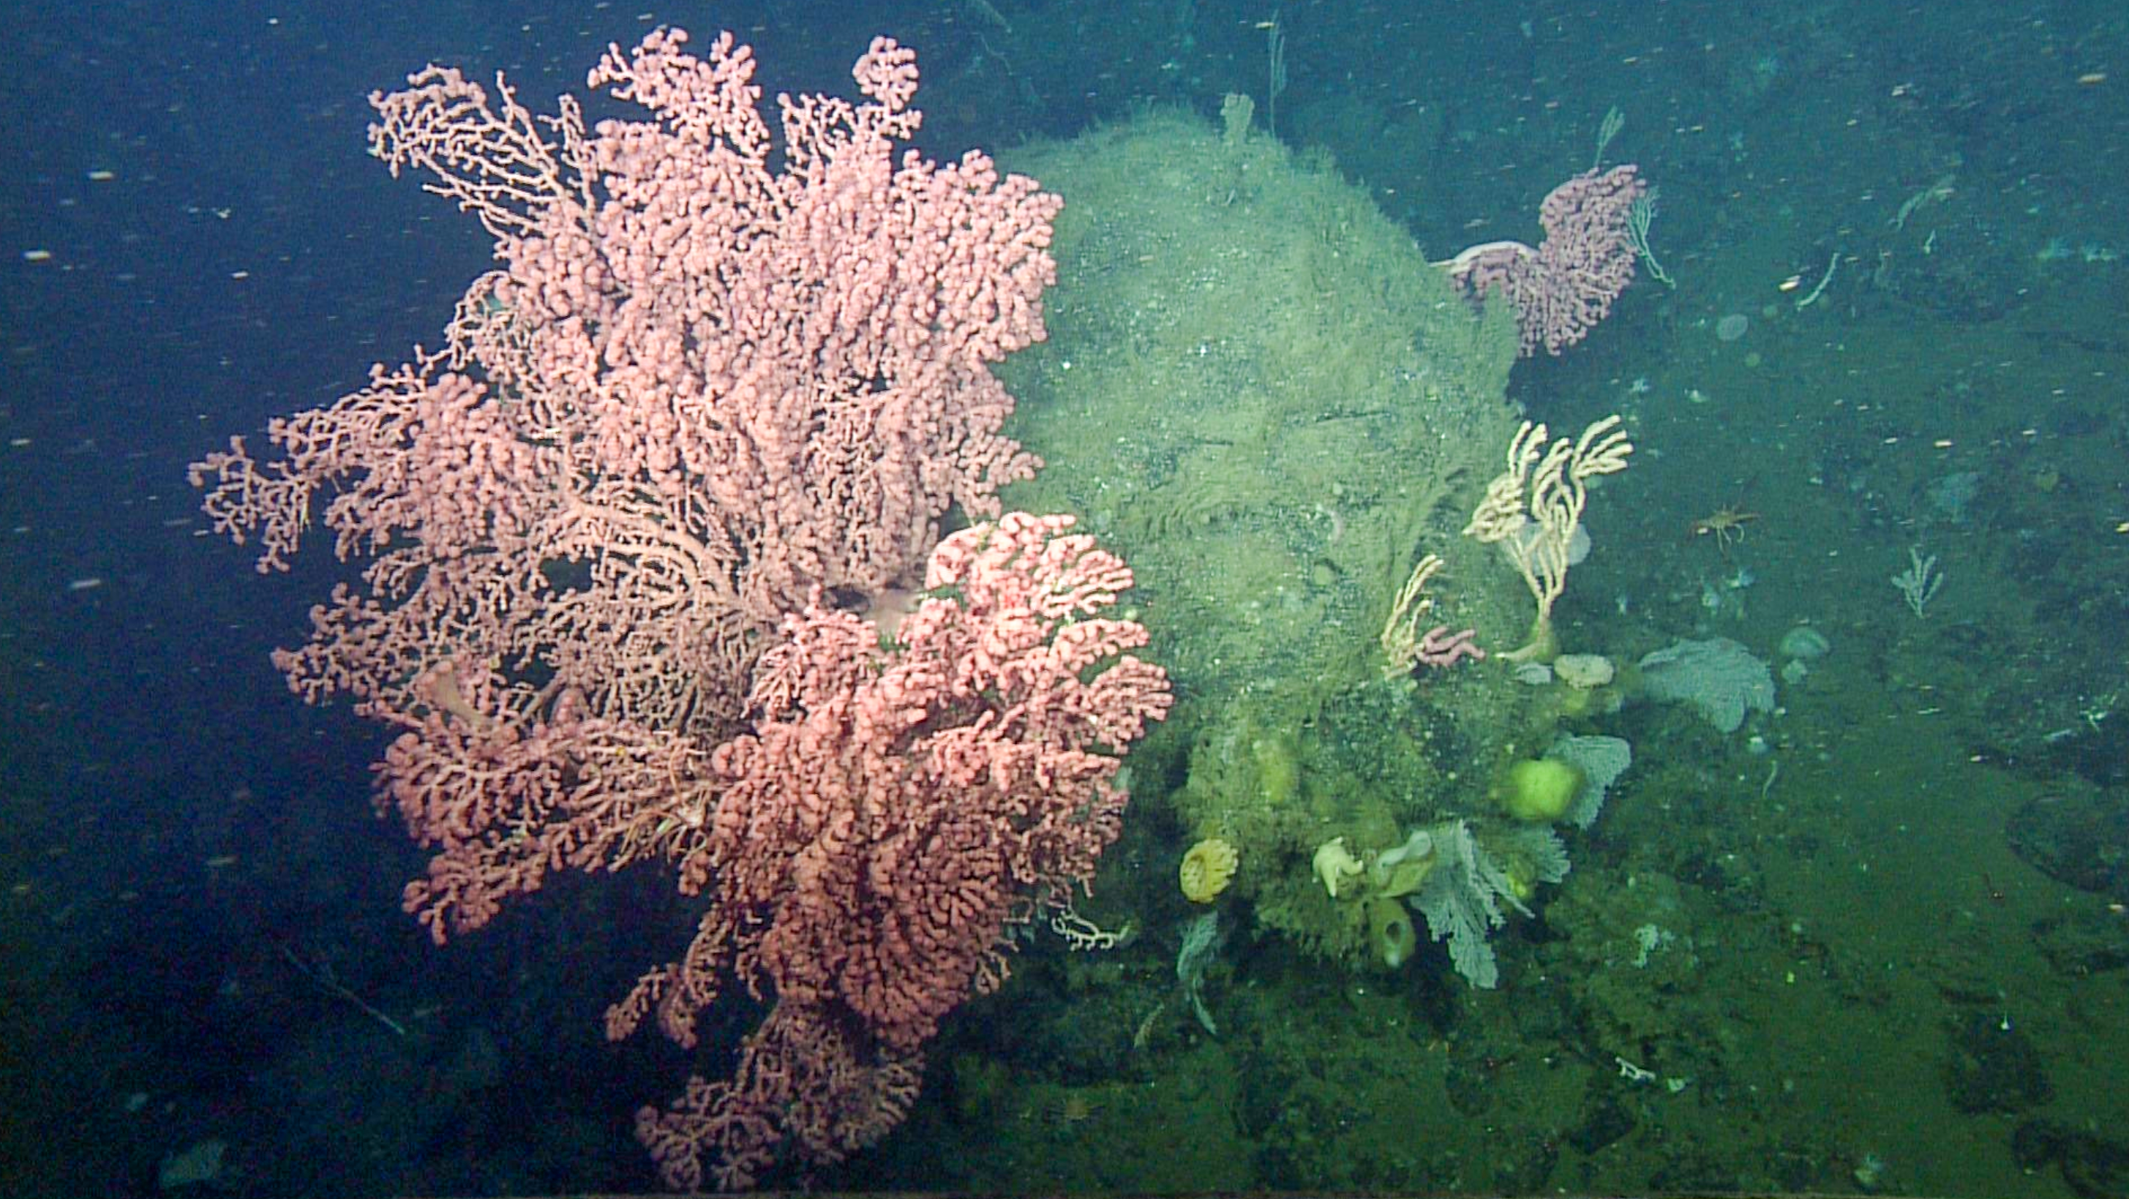
DiSCO Challenges
More topography
More visually dynamic targets
More active area- high currents
Must be positioned to area of interest

Slide 10
DiSCO Development
Reuse as much of the Smith system as possible
Enable real-time image feedback to optimize camera settings
Build frame that is ROV-moveable and optimized for imaging deepsea coral

Slide 11
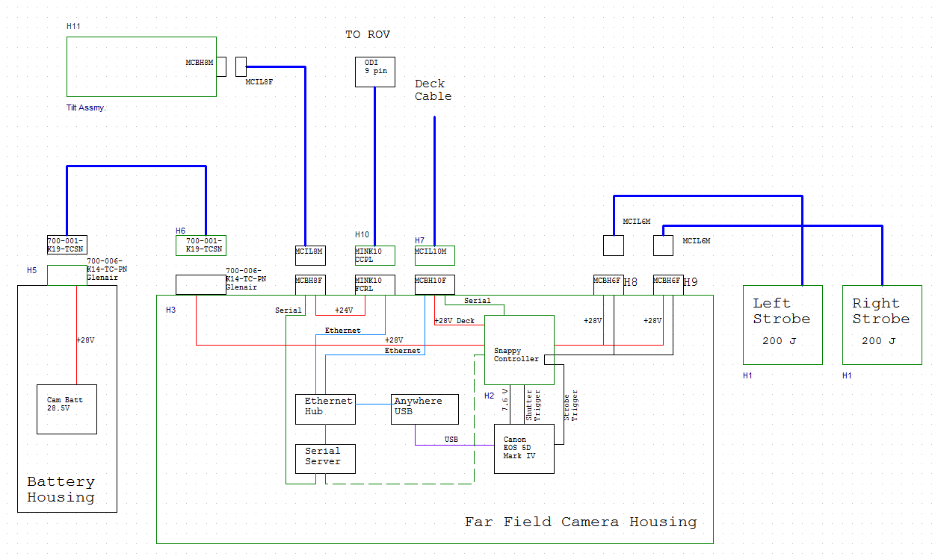
DiSCO Block Diagram

Slide 12
New Components

Slide 13
Real-time Comms with ROV
Talk Ethernet <-> USB to controller and camera
  Capture and view images
  Adjust camera settings at start of mission
Use tilt motor to adjust camera angle. Tilt motor powered from ROV, only on when ODI plugged in

Slide 14
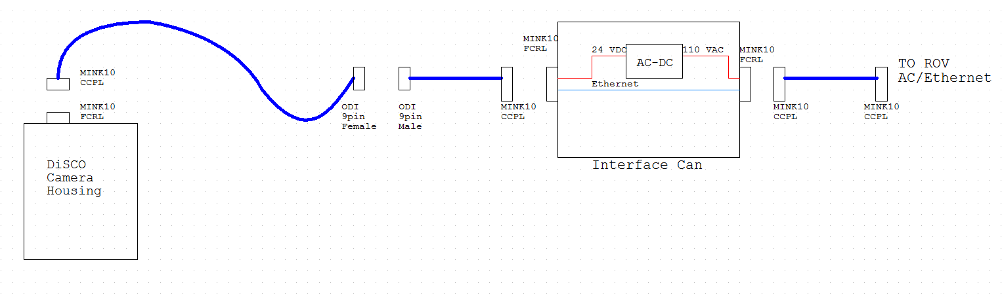
ROV Connection
On DiSCO
On ROV
Existing Pair
ODI on Disco will be on long enough leash to reach the front porch and be stowed in a dummy receptacle.

Slide 15
DiSCO Block Diagram

Slide 16
New Camera
EOS 5D Mark III now obsolete
EOS 5D Mark IV is same form factor
Bench testing has not yet revealed any significant issues interfacing with our existing electronics.
 | Mark III | Mark IV
Sensor | 22.3 Mpixel Full frame | 30.4 Mpixel Full frame
FOV

Slide 17
Energy budget
Energy Use Each Image
 | Energy per image (WHr)
Canon EOS 5D MarkIIII | 0.02
Strobes (2) | 0.446
SUM= | 0.466
Hotel power
 | Energy per year (WHr)
Snappy Controller | 17
Total Energy per year (WHr)
Canon + strobes | 4082.16
Snappy | 17
Sum= | 4099.16
Li pack derated | 4.2 kWHr

Slide 18
Mechanical Requirements:
Deploy & recover off the Flyer & Carson
2000 meter depth rating (4000 meter would be nice)
ROV able to move and manipulate position
Hold position on seafloor in up to 1 knot of current
Camera approximately 1.5 meters above seafloor
Acoustic release plus backup manual release by ROV
Capability to fine tune position of camera

Slide 19
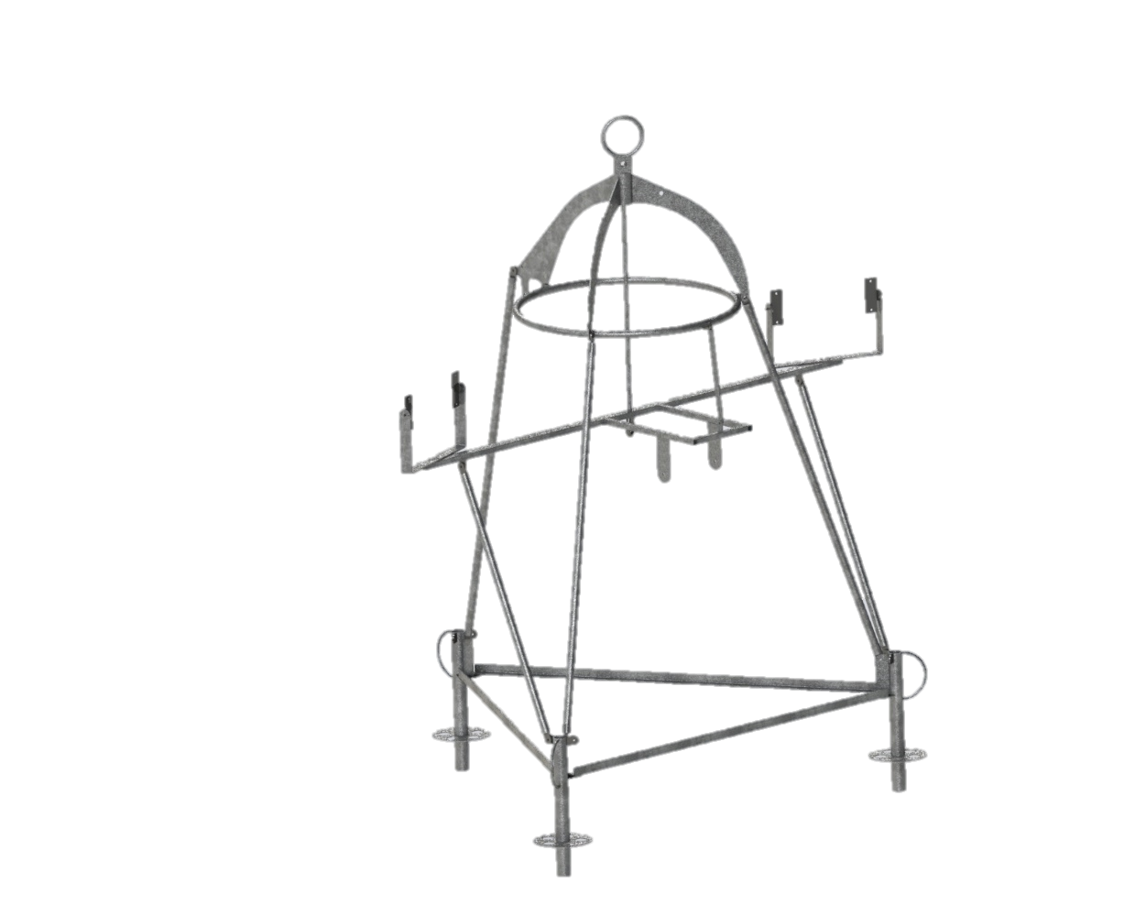
Tripod Frame
Make design flexible to adapt to future changes/requirements
Galvanize steel members to reduce cost
Bolt together frame
Frame dimensions a’ x b’ x c’

Slide 20
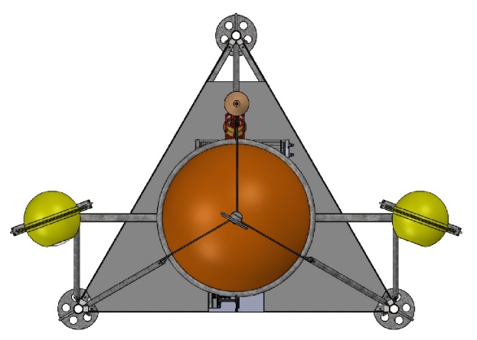
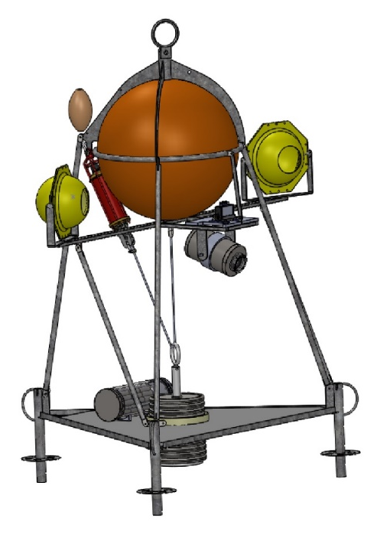
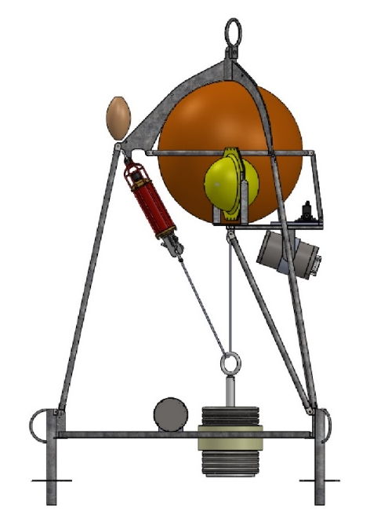
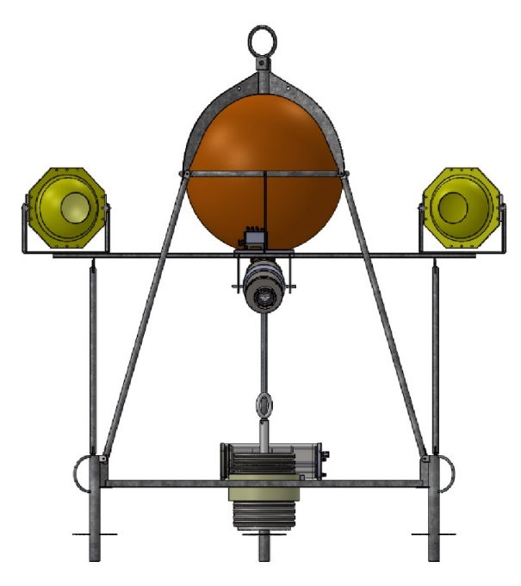
Floor grating
Syntactic float
Strobe w/swivel mounts
Recovery line float w/x? meters
of lift line attached to lift bail
ROV lift strap
Deployment/Rec. bail
Battery housing
Camera
Tilt unit
Acoustic
Release
Release weight (300 lbs)
Chain
Camera
ODI receptacle (not shown)
Manual pull
pin release
Tag line bails (X3)

Slide 21
Air/water weights w/2000 meter foam
In air weight = 1402
Drop weight = 300
In water weight w/drop weight = 111
In water weight wo/drop weight = -149
Note: 4000 meter foam loses 79 lbs of buoyancy and adds 77 lbs to in air weight

Slide 22
Supplemental Materials

Slide 23
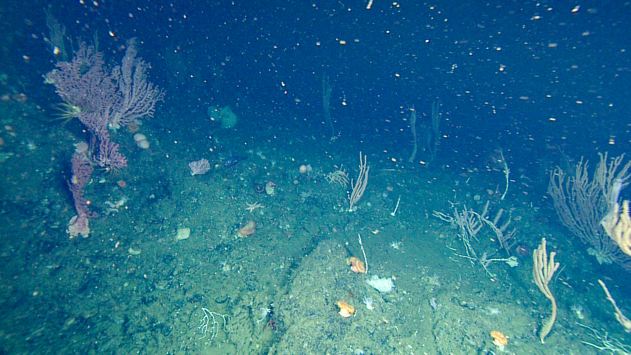
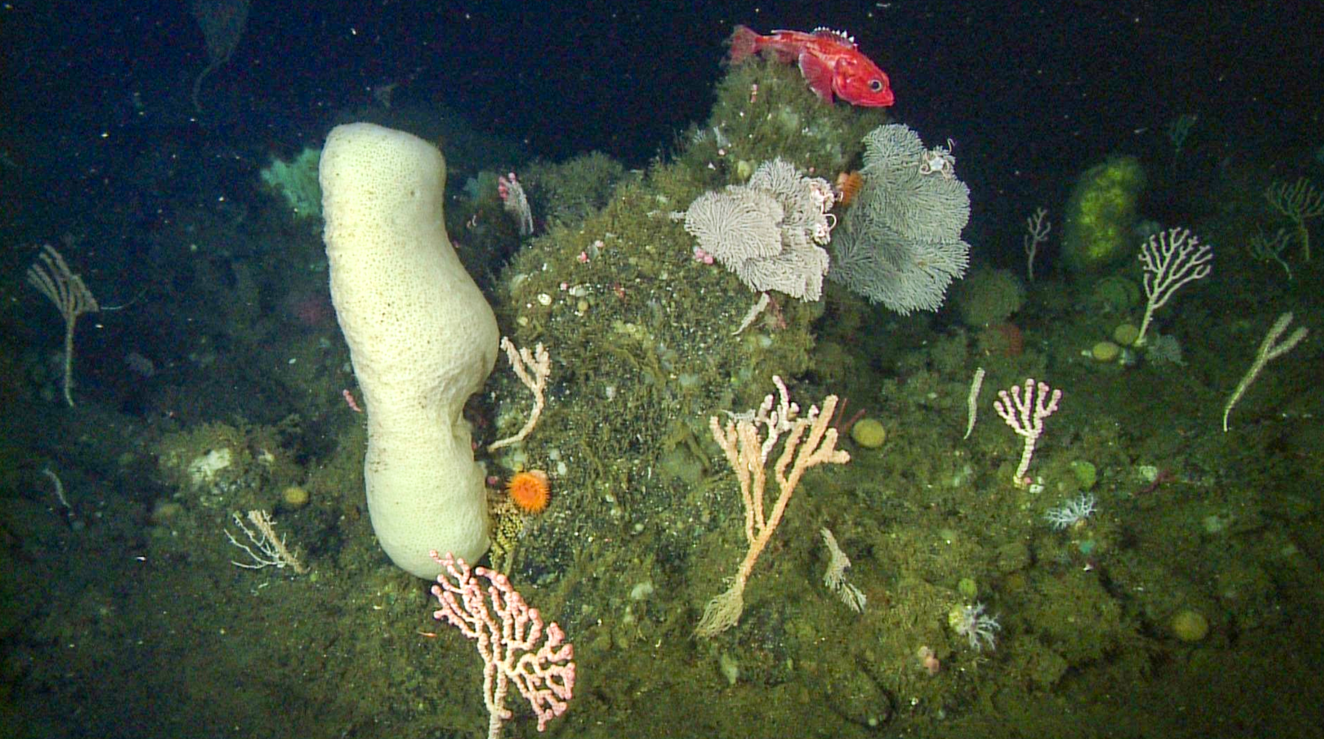

Slide 24
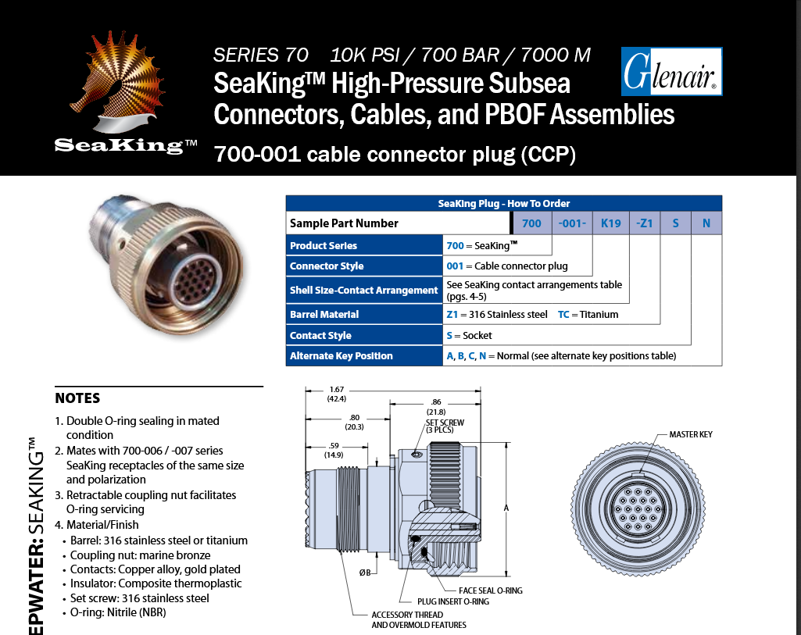

Glenair Ti Connectors
Pros: cheaper than Seacon Ti connectors
Cons: long lead times

Slide 25
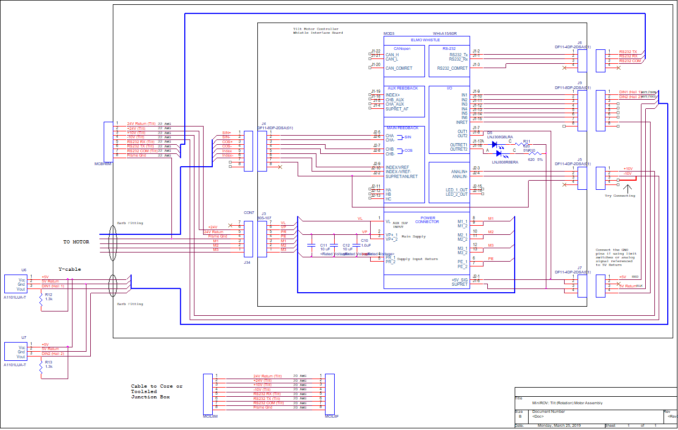
Tilt Motor

Slide 26
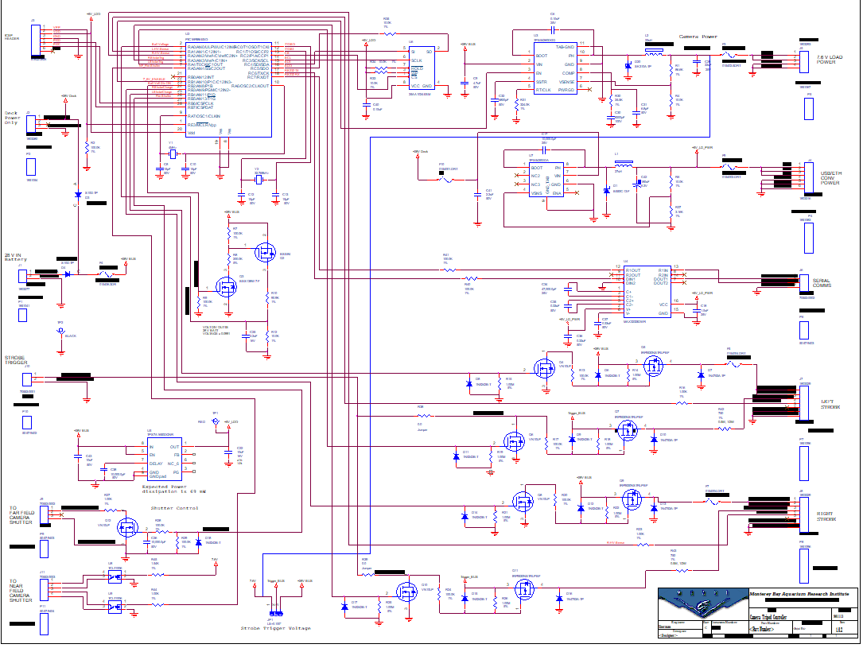
Snappy

Slide 27
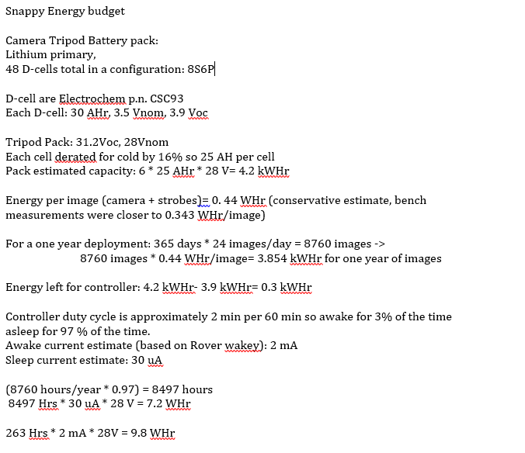

Slide 28
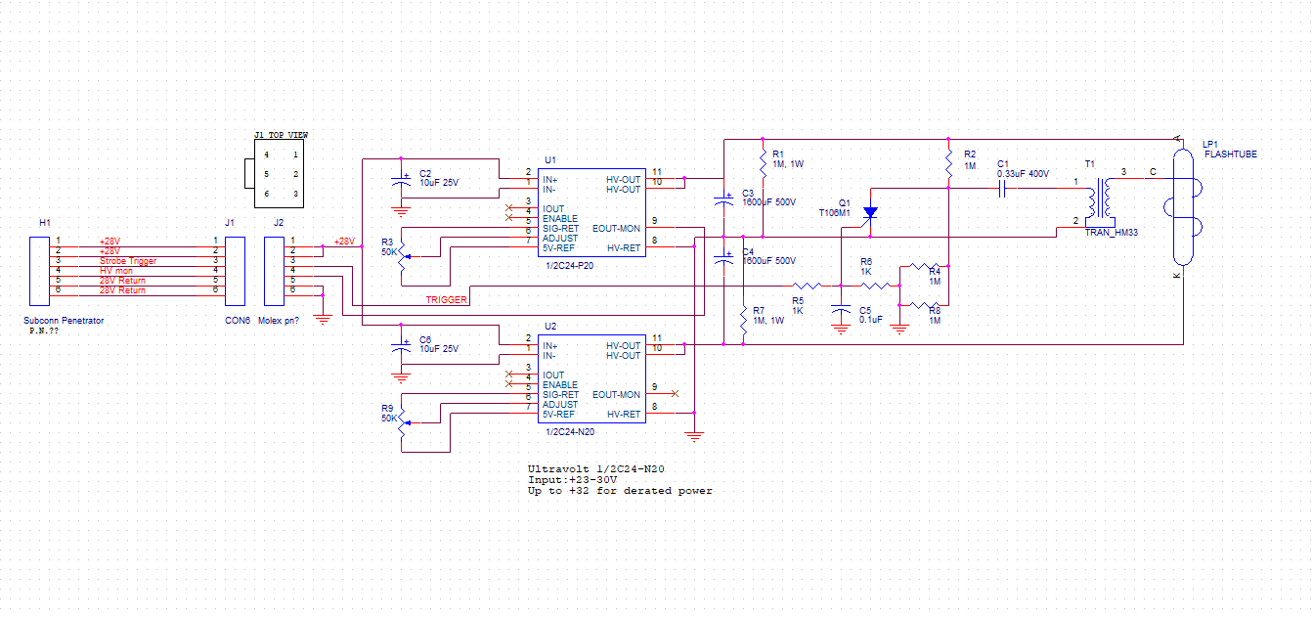
Strobe

Slide 29
