Slide 1
Coral Observatory
Camera Tripod
Mechanical Design Review

Slide 2
Mechanical Requirements:
Deploy & recover off the Flyer & Carson
2000 meter depth rating (4000 meter would be nice)
ROV able to move and manipulate position
Hold position on seafloor in up to 1 knot of current
Camera approximately 1.5 meters above seafloor
Acoustic release plus backup manual release by ROV
Capability to fine tune position of camera

Slide 3
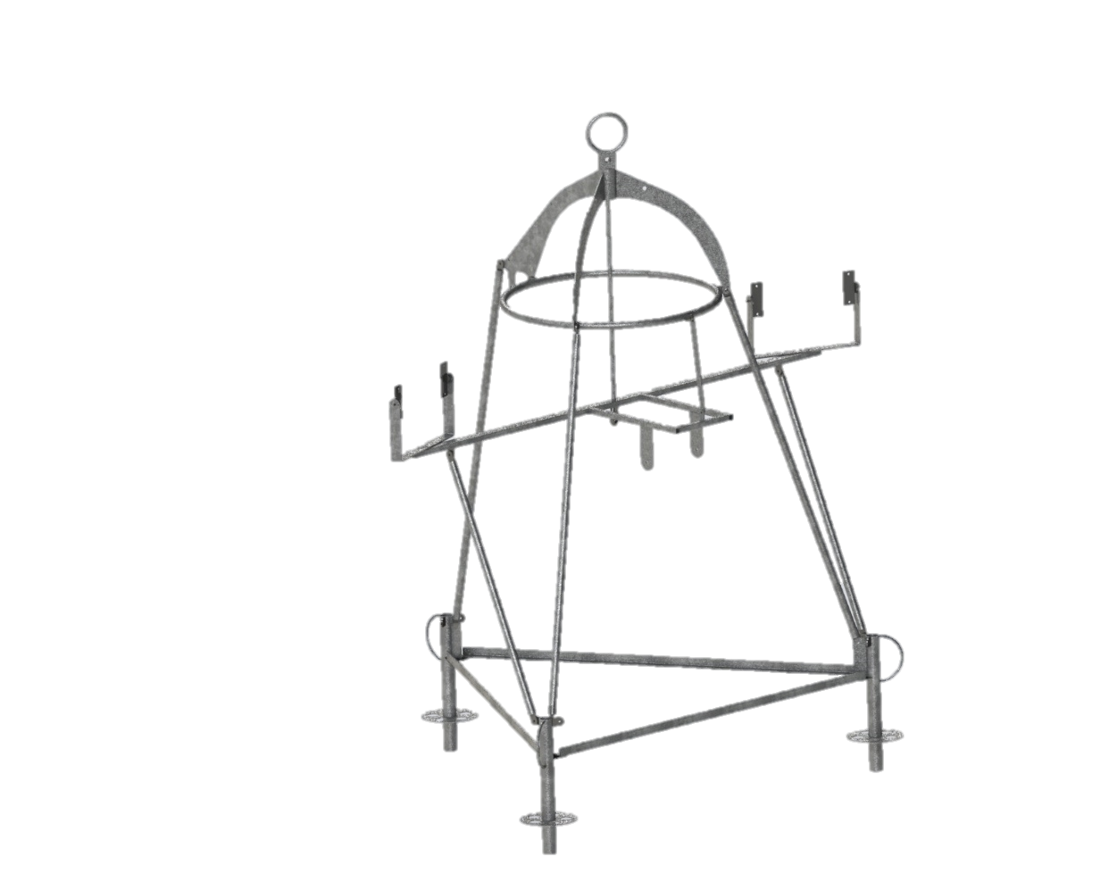
Tripod Frame
Make design flexible to adapt to future changes/requirements
Galvanize steel members to reduce cost
Bolt together frame
Frame dimensions a’ x b’ x c’

Slide 4
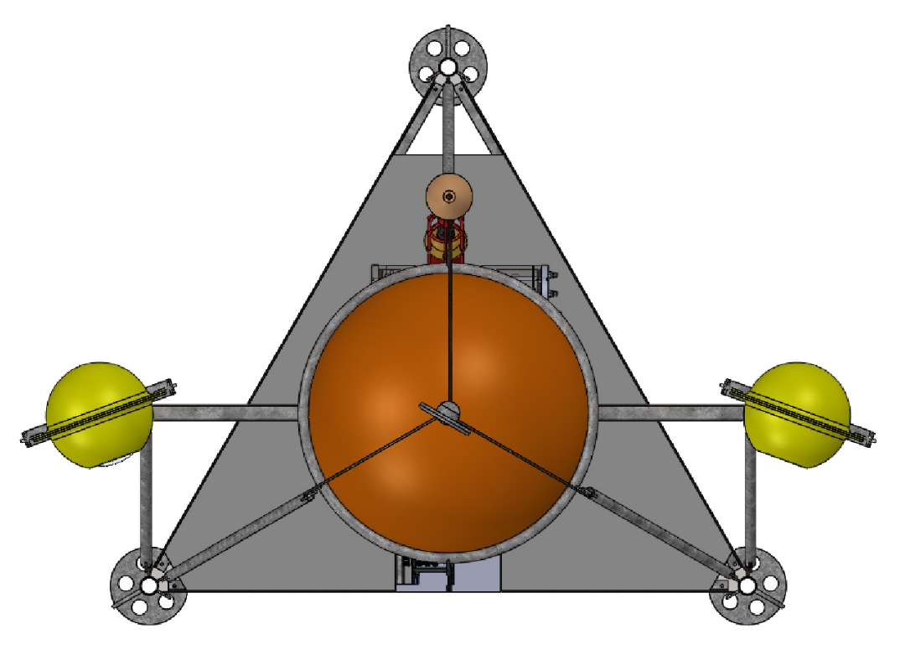
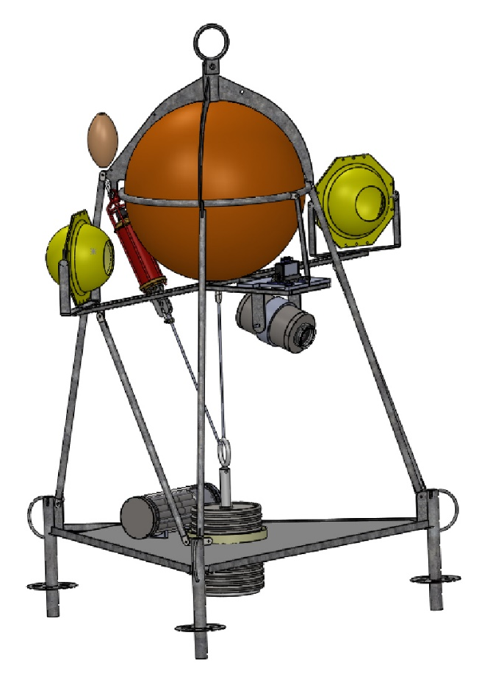
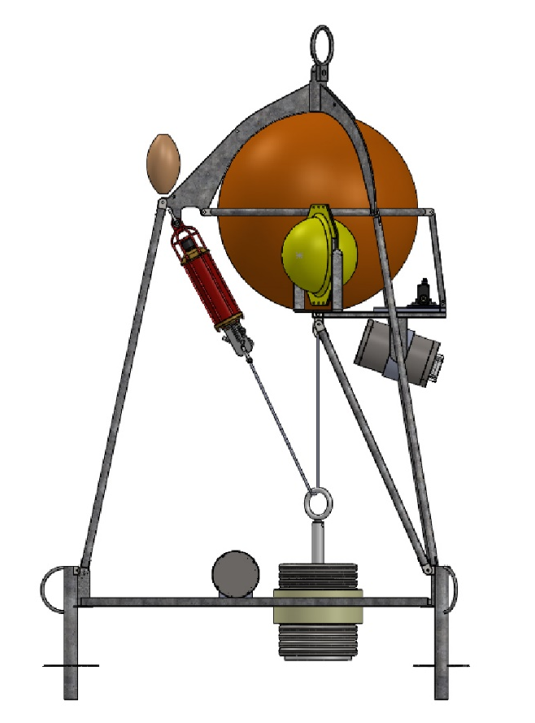
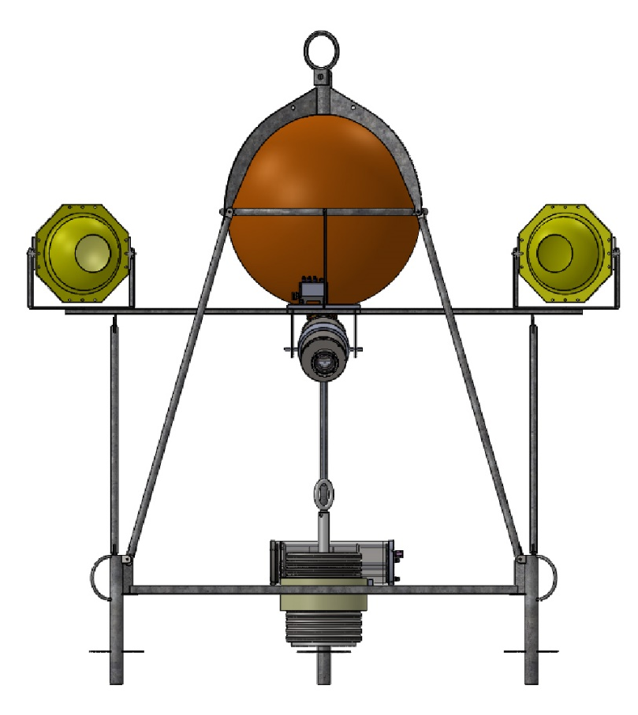
Floor grating
Syntactic float
Strobe w/swivel mounts
Recovery line float w/x? meters
of lift line attached to lift bail
ROV lift strap
Deployment/Rec. bail
Battery housing
Camera
Tilt unit
Acoustic
Release
Release weight (300 lbs)
Camera
ODI receptacle (not shown)
Chain
Manual pull
pin release
Tag line bails (X3)

Slide 5
Air/water weights w/2000 meter foam
In air weight = 1402
Drop weight = 300
In water weight w/drop weight = 111
In water weight wo/drop weight = -149
Note: 4000 meter foam loses 79 lbs of buoyancy and adds 77 lbs to in air weight

