Slide 1
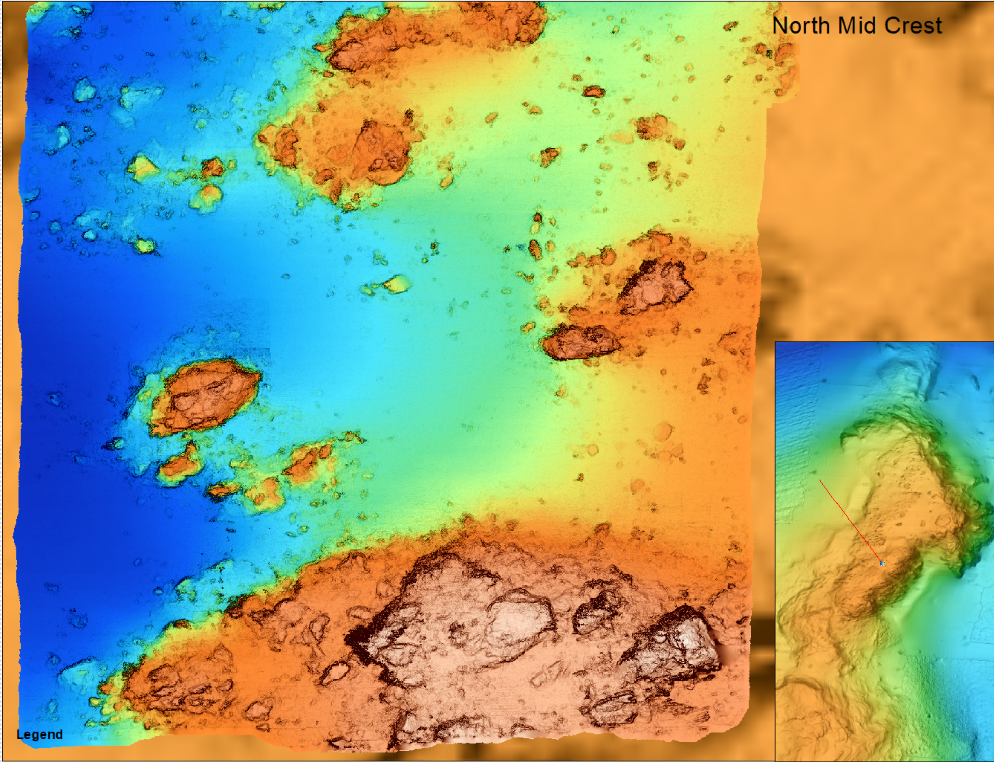
Bathymetry
834 – 845 m
65 m across

Slide 2
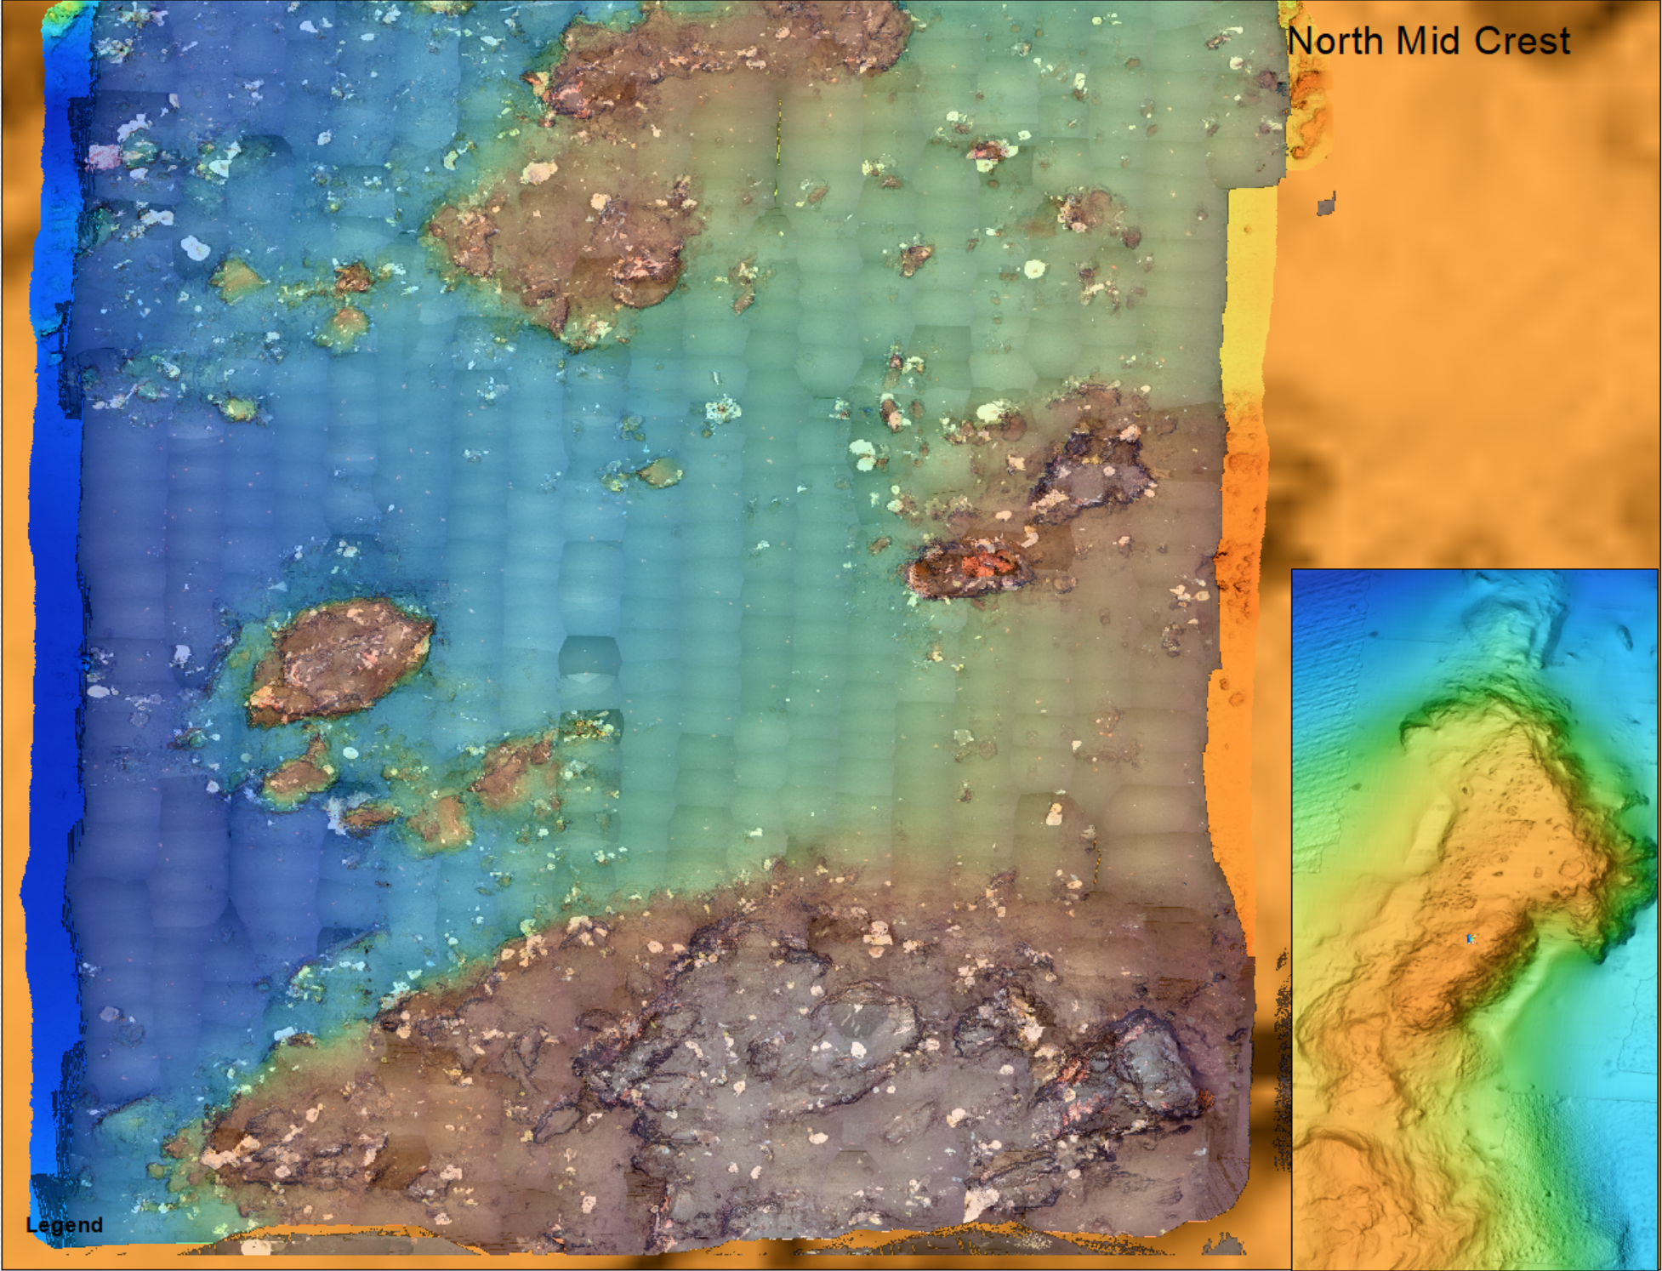
Overlain
Video mosaic

Slide 3
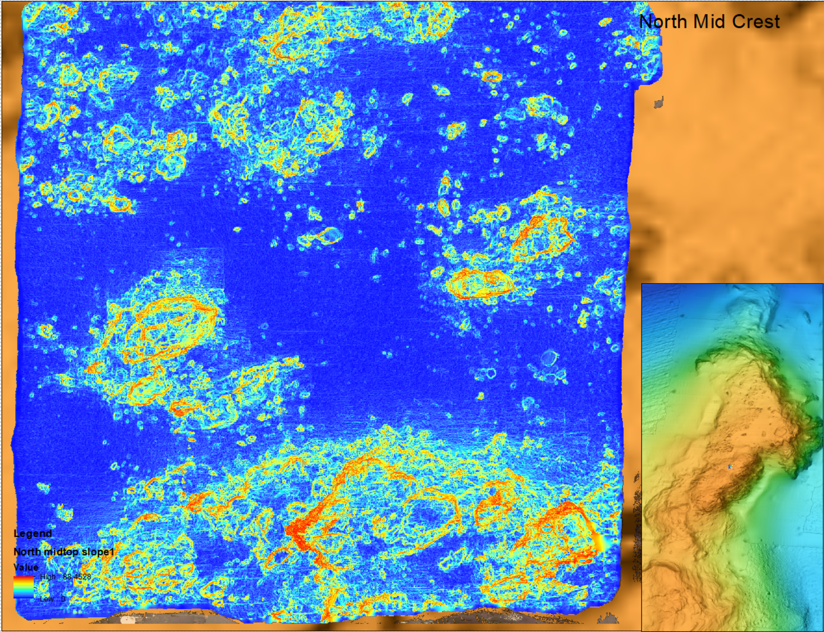
Coarse slope
(0-90) deg

Slide 4
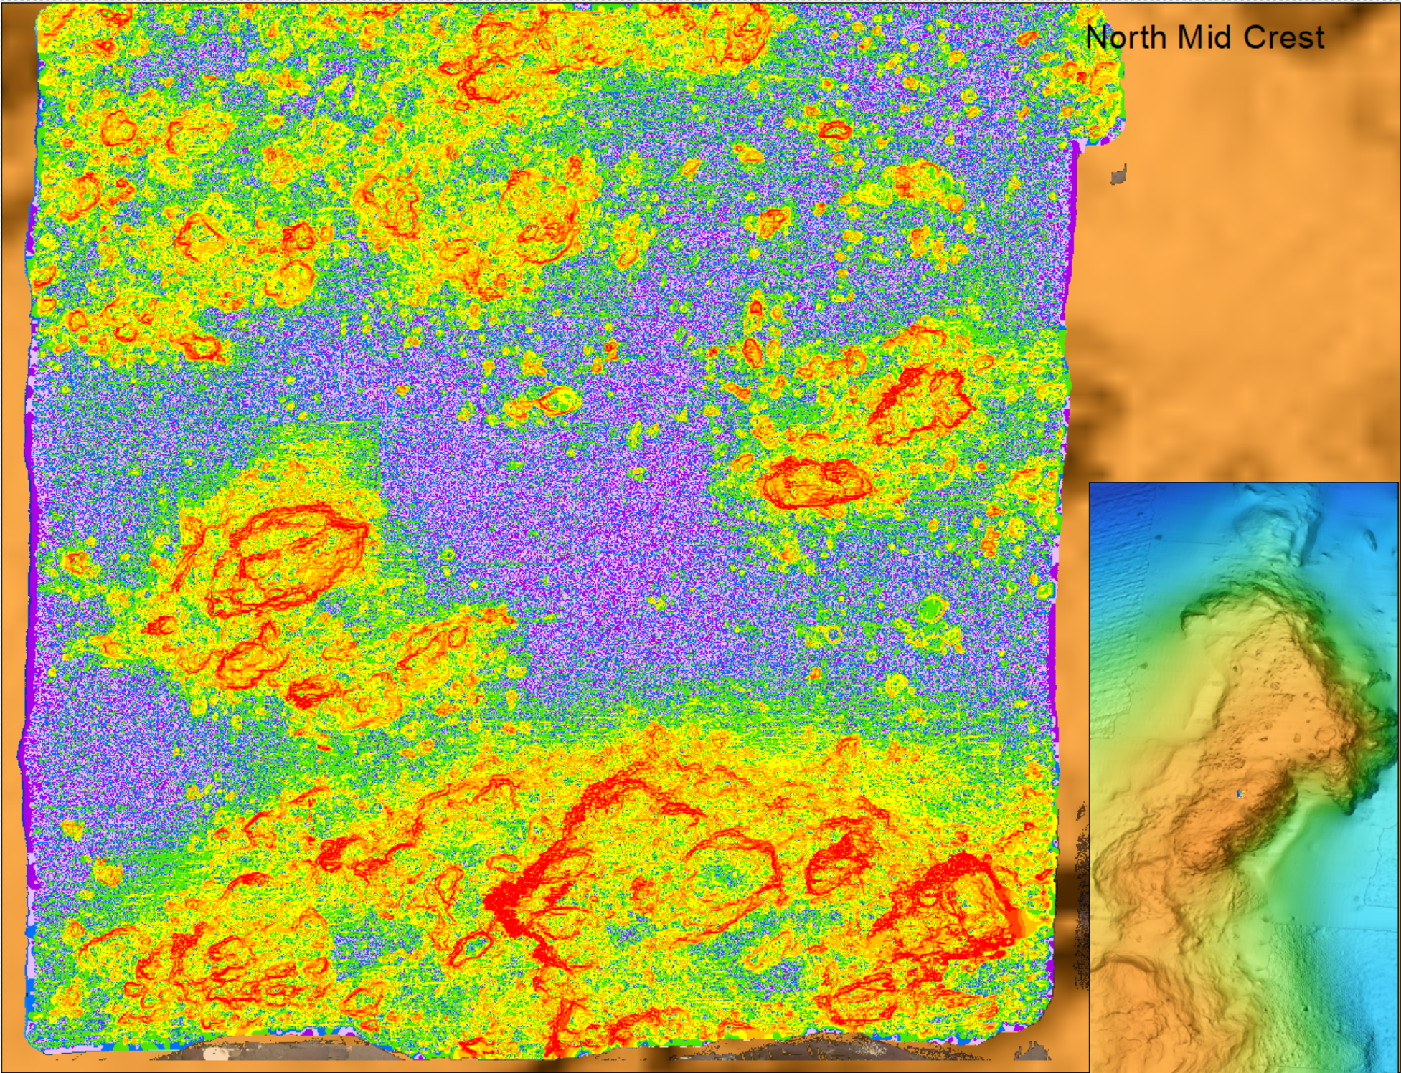
Fine slope
(0-90) deg
0-2-4
6

Slide 5
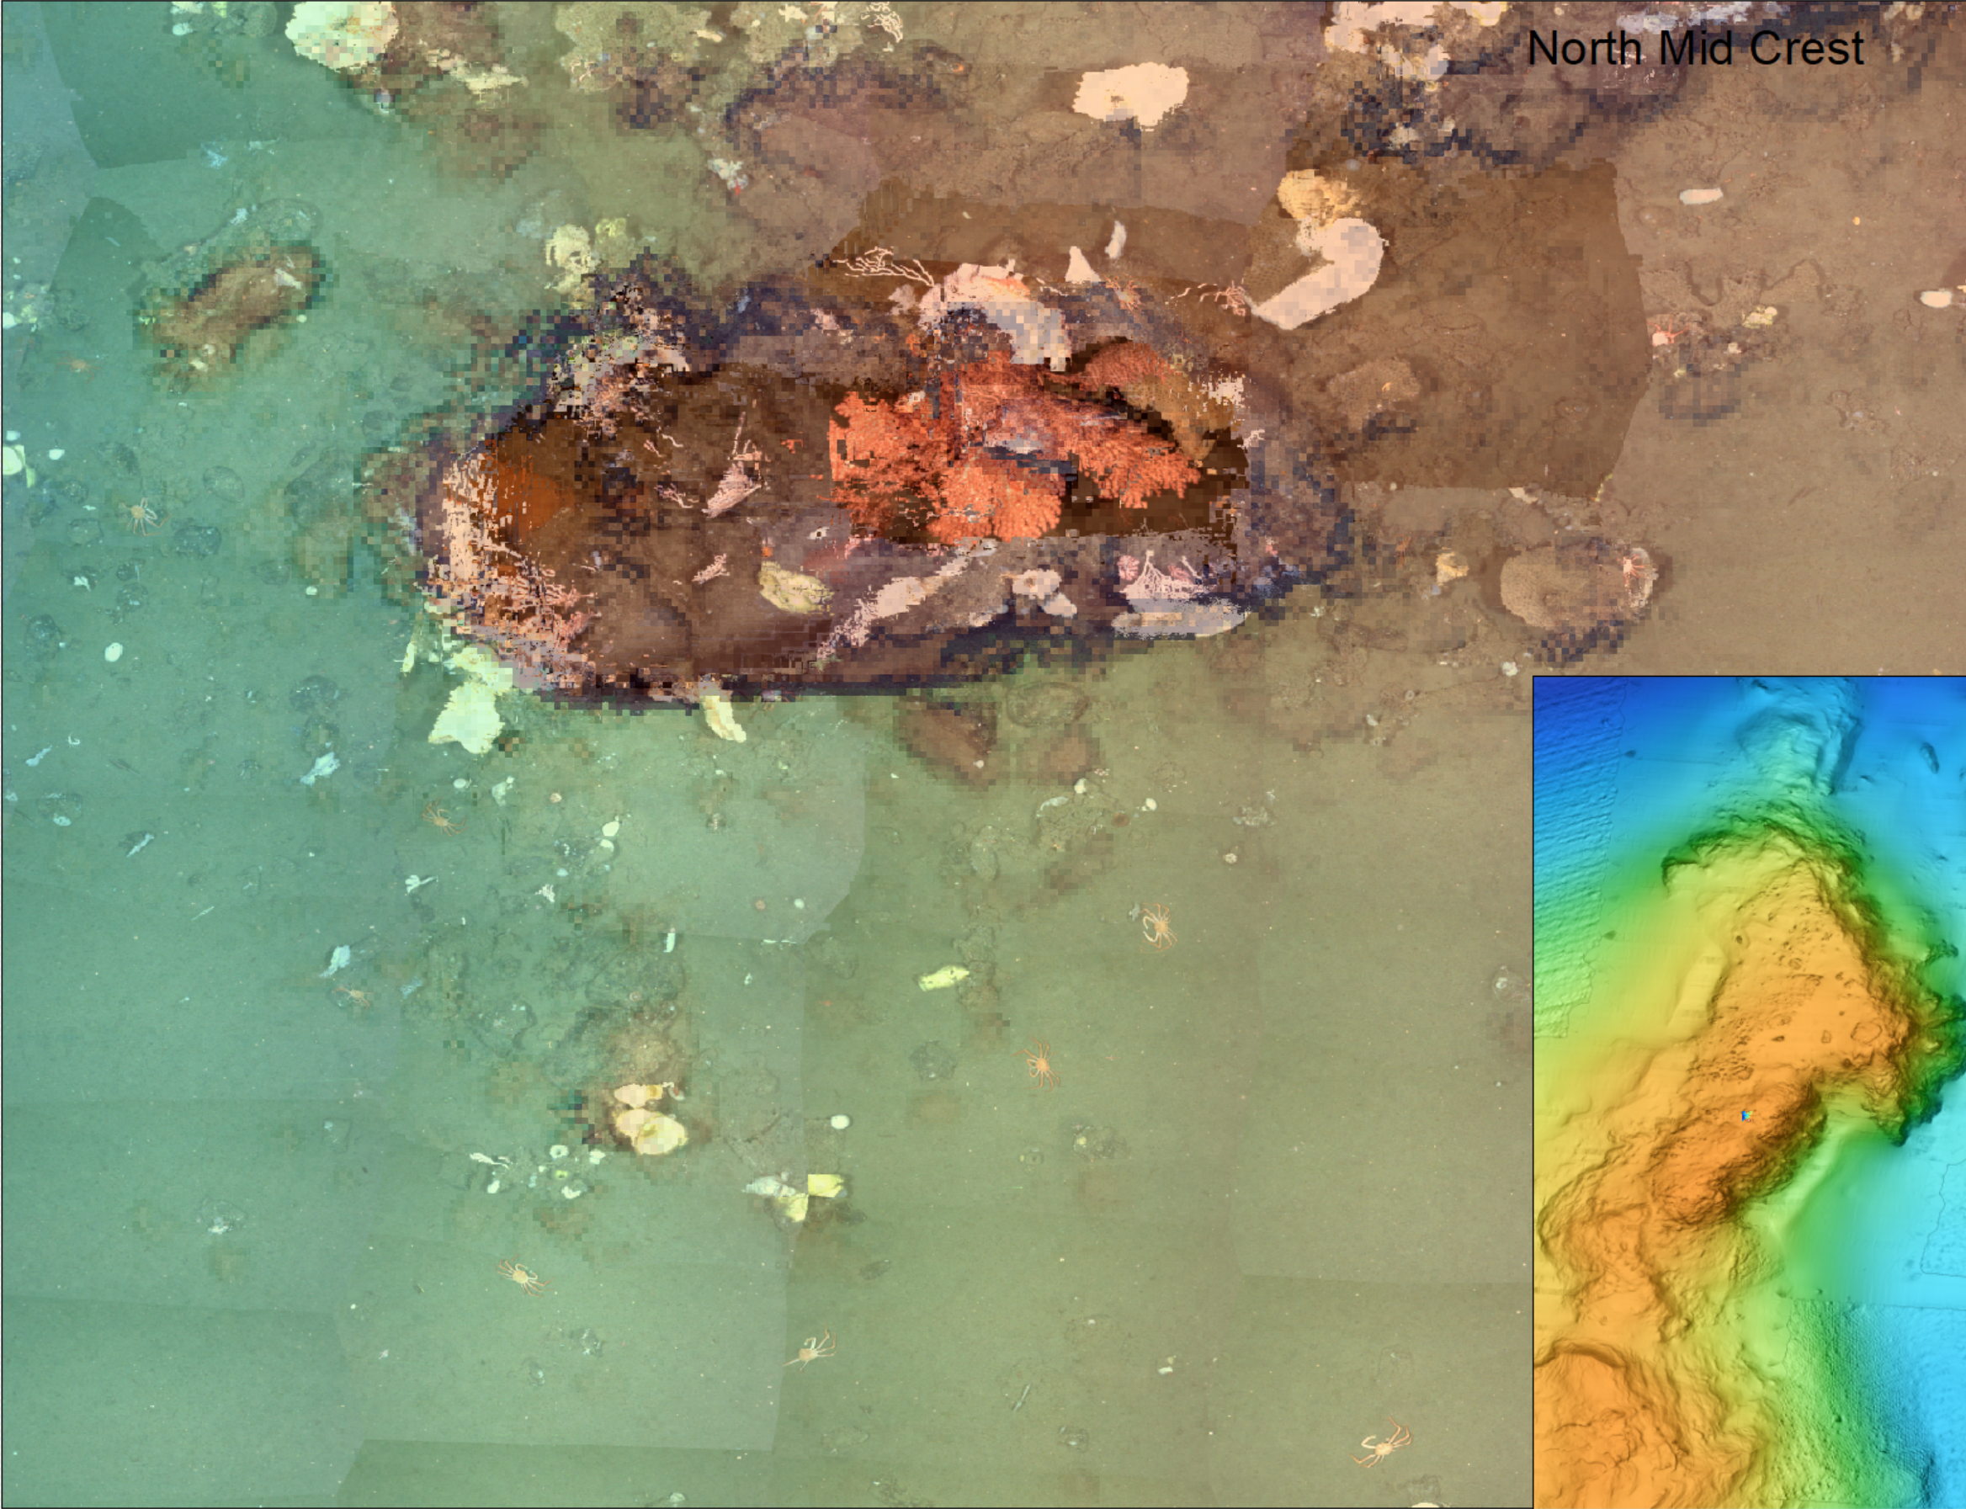
Close up
Rock is 7 m long

Slide 6
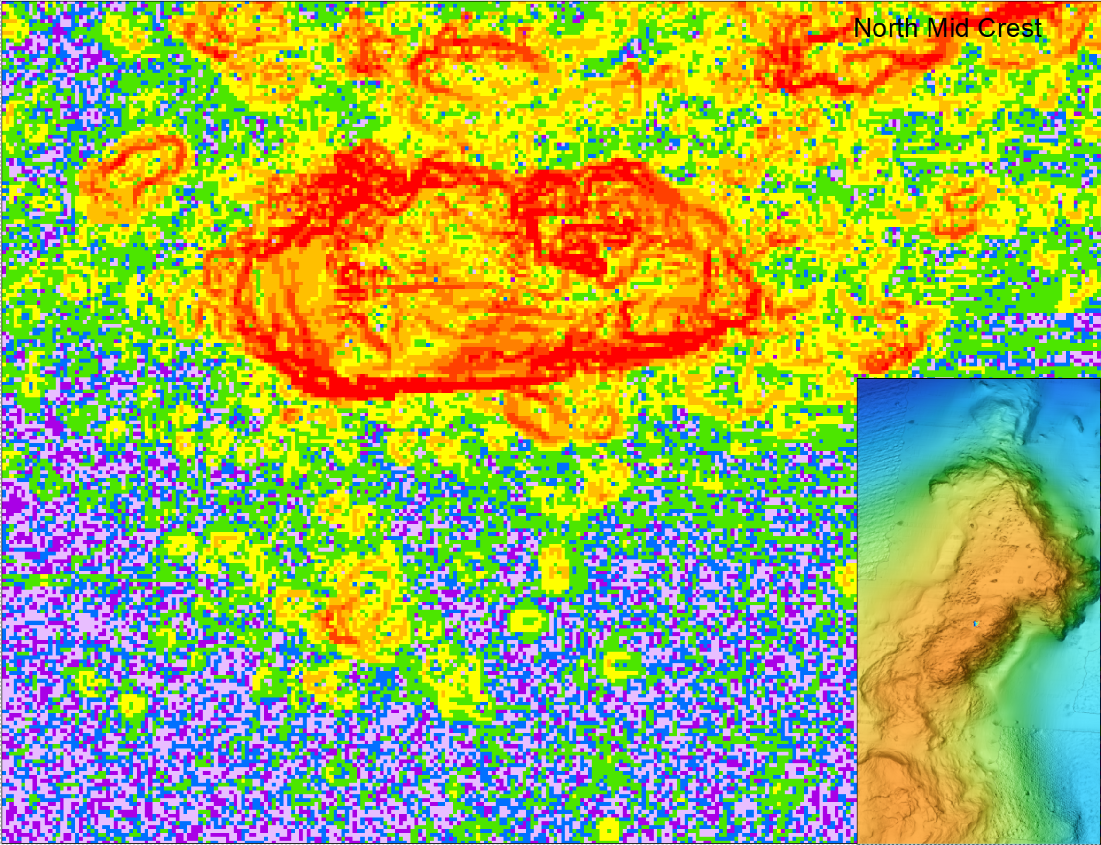
Close up
Slope
2
4
6
15

