Slide 1
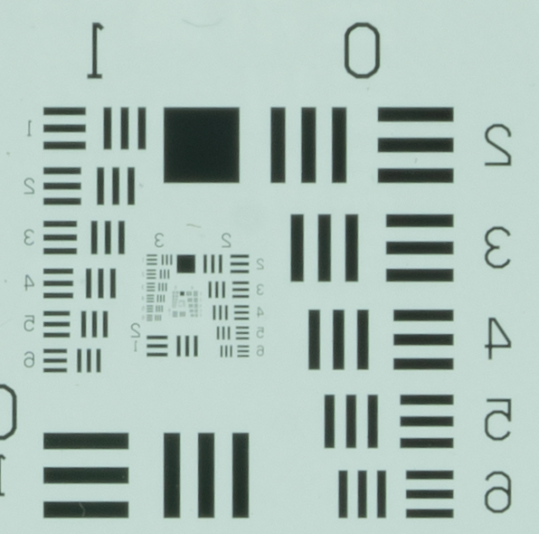
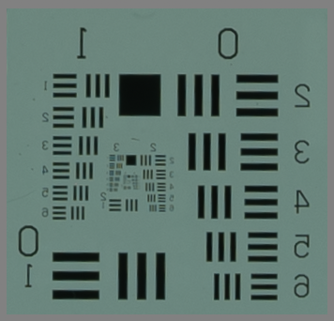
Resolution
A7RIII
1 mm
box
The bottom line is that resolution is a key factor. A7RIII has the resolution to discriminate smaller objects. Obvious in the images to left.
See the 1 mm box in both images. Easy to discriminate. In upper (A7R image, easy to see down to at least 0.1 mm. Great! Gets blurry in A7S at this scale
So, as long as we have the storage capacity, I’d vote for higher res. camera
A7S

Slide 2
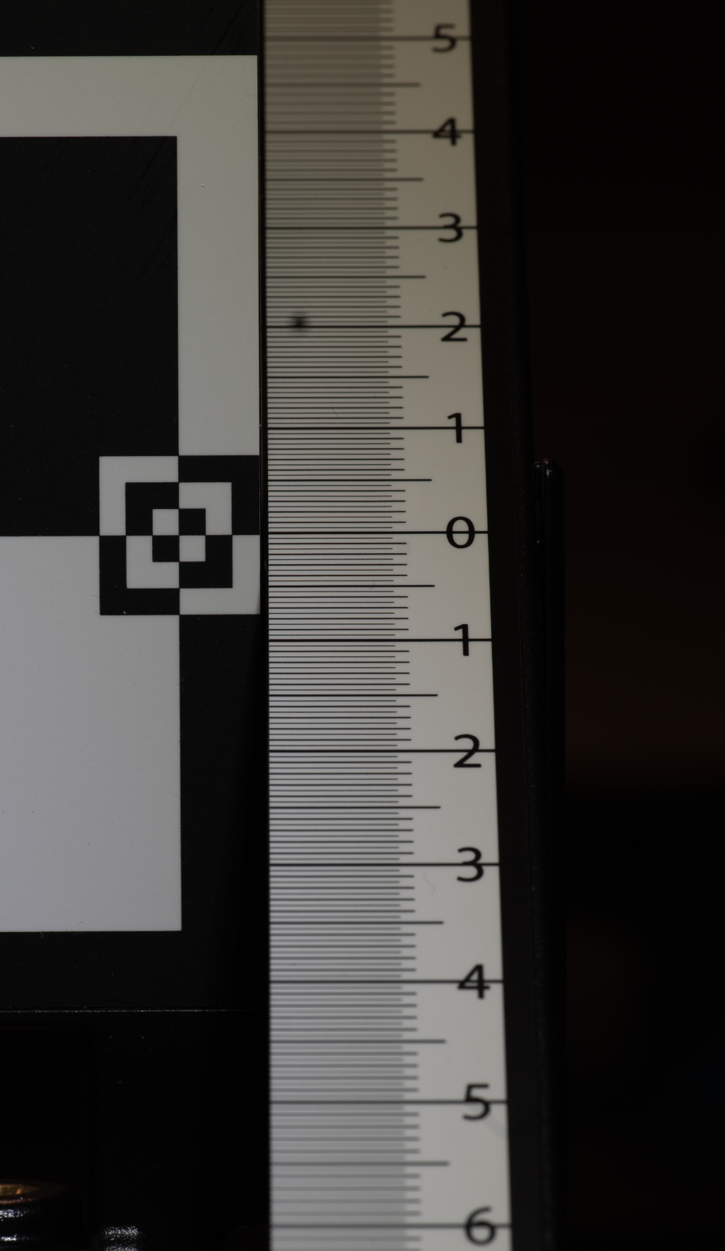
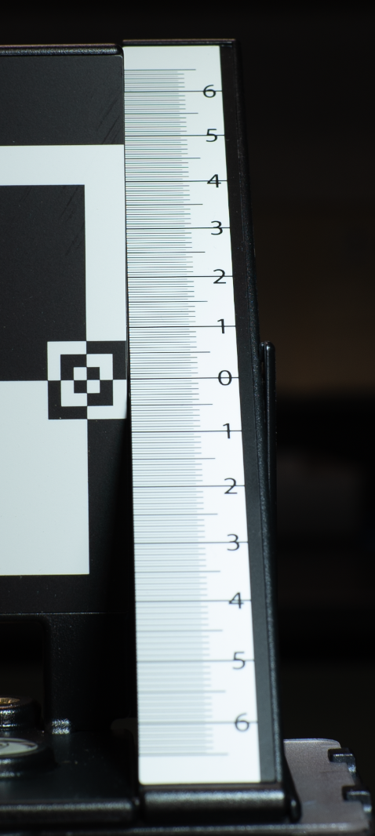
A7S
100 ml
A7S
50 ml
Depth of Field –
In order to evaluate this, we need the angle of the ruler from vertical to calculate the critical depth (horizontal) of focus

Slide 3
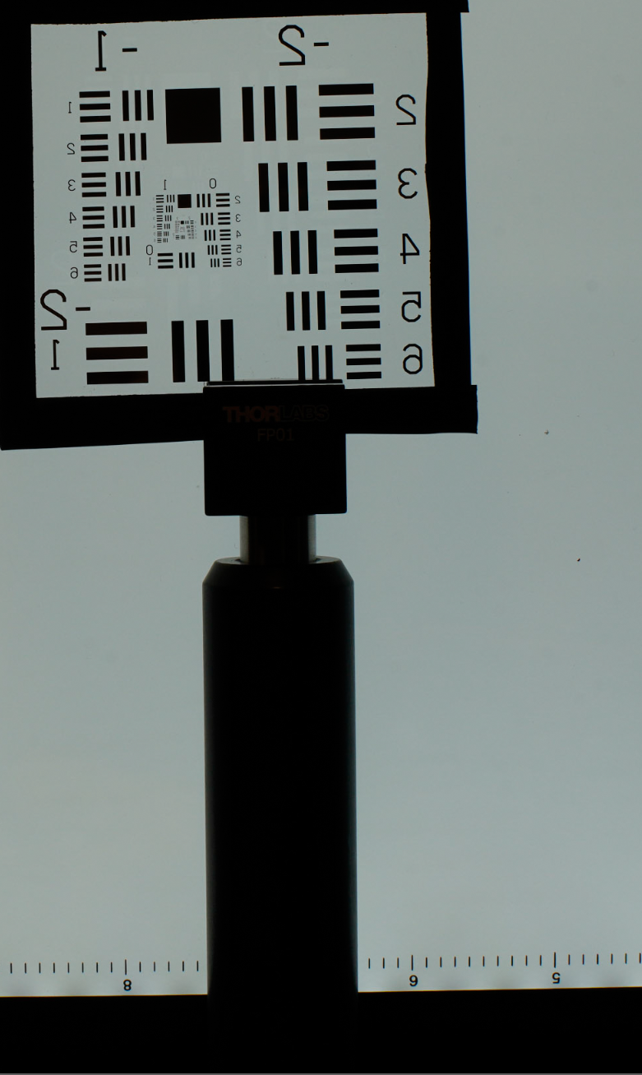

Slide 4
A7R, f14, 90 mm
(calculated DOF 5cm)
A7R, f14, 50 mm
Calculated 16 cm

