Slide 1
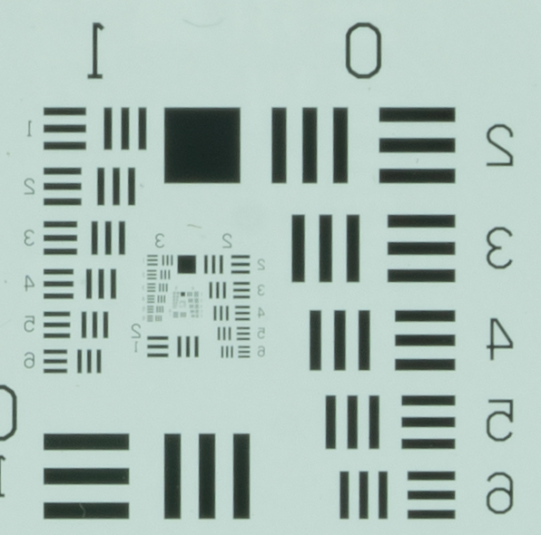
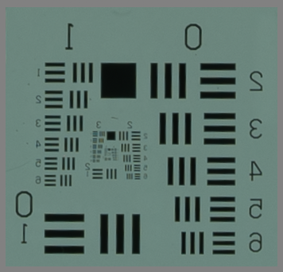
Resolution
A7RIII
1 mm
box
The bottom line is that resolution is a key factor. A7RIII has the resolution to discriminate smaller objects. Obvious in the images to left.
See the 1 mm box in both images. Easy to discriminate. In upper (A7R image, easy to see down to at least 0.1 mm. Great! Gets blurry in A7S at this scale
So, as long as we have the storage capacity, I’d vote for higher res. camera
A7S

Slide 2
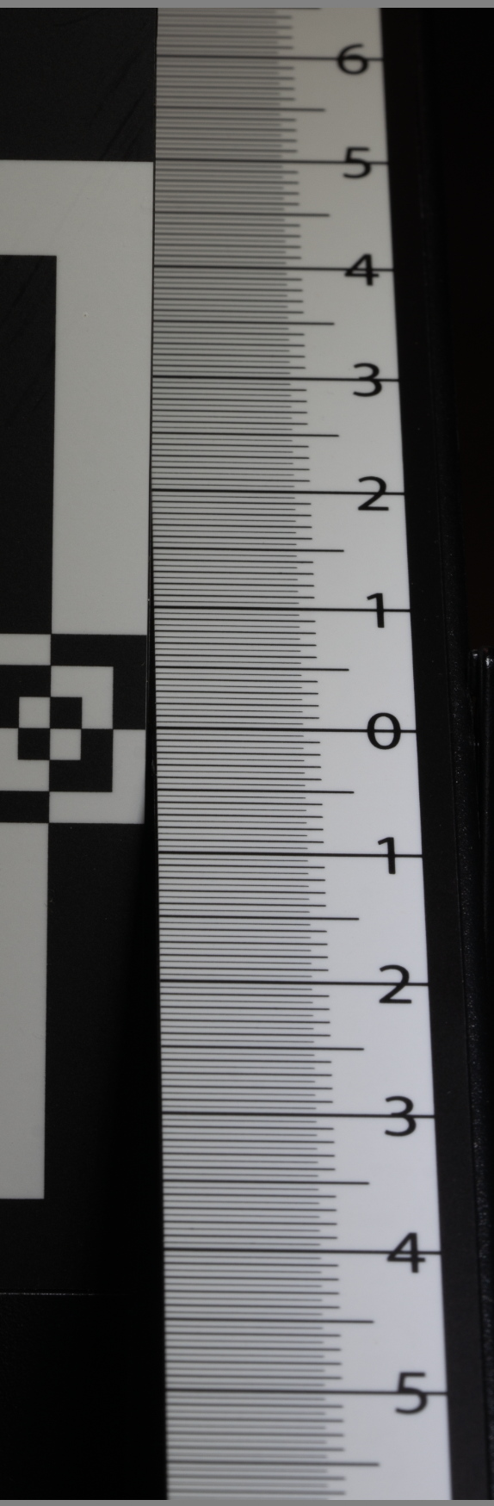
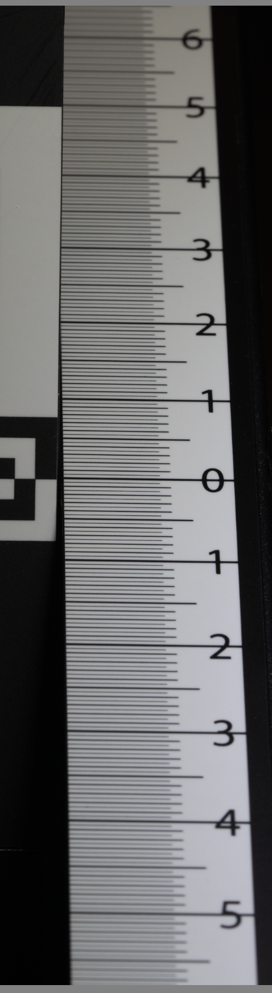
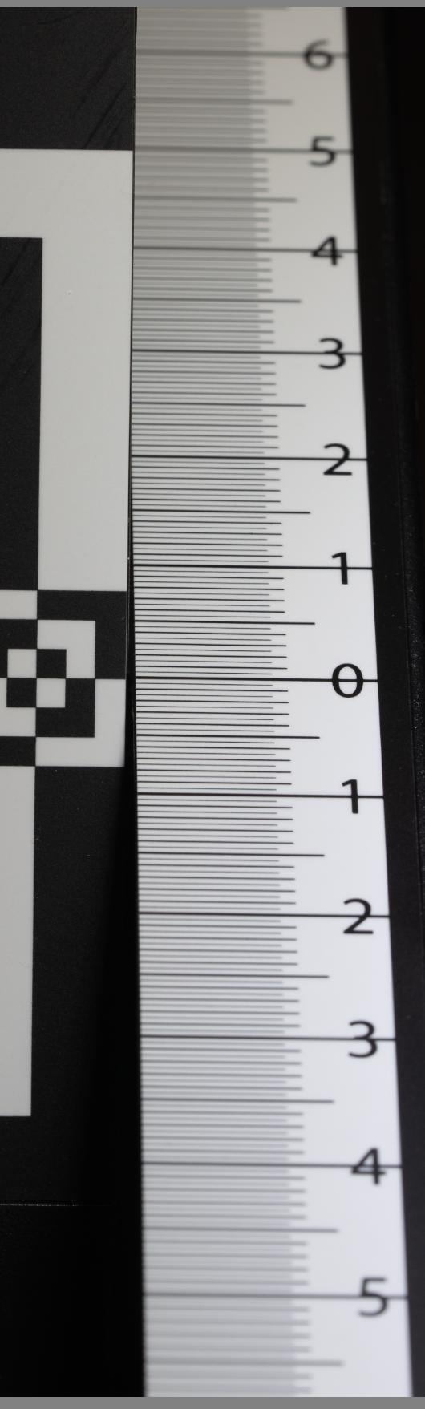
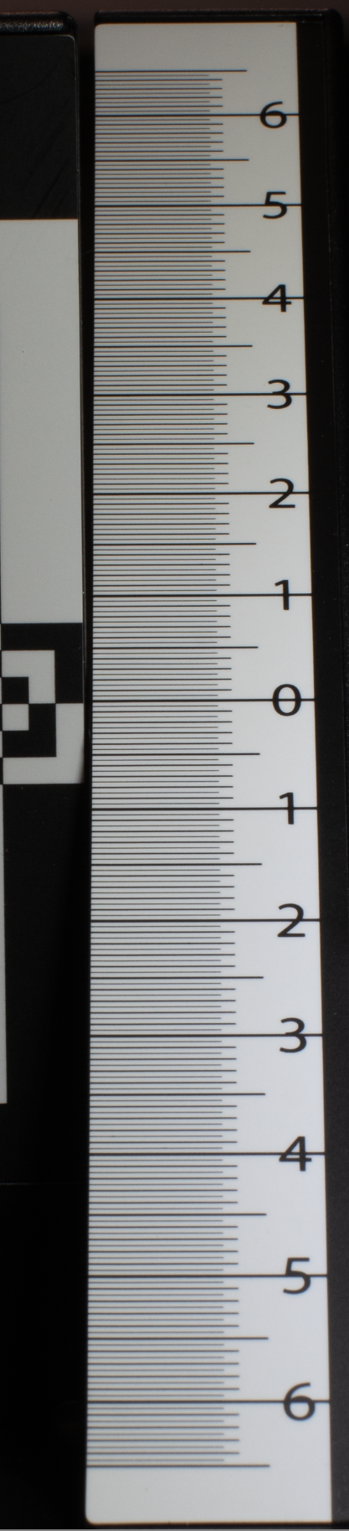
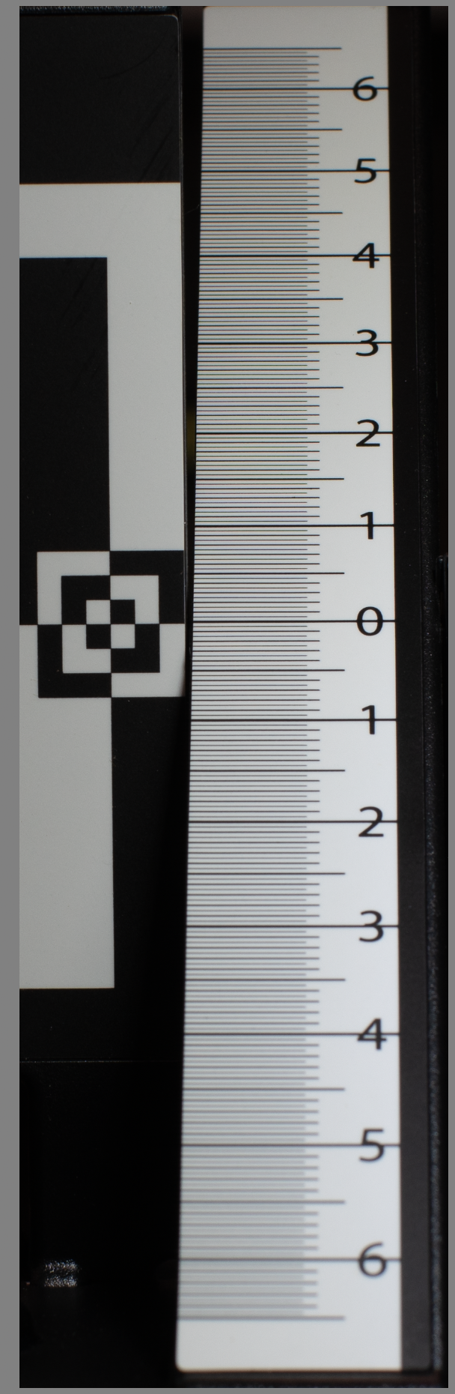
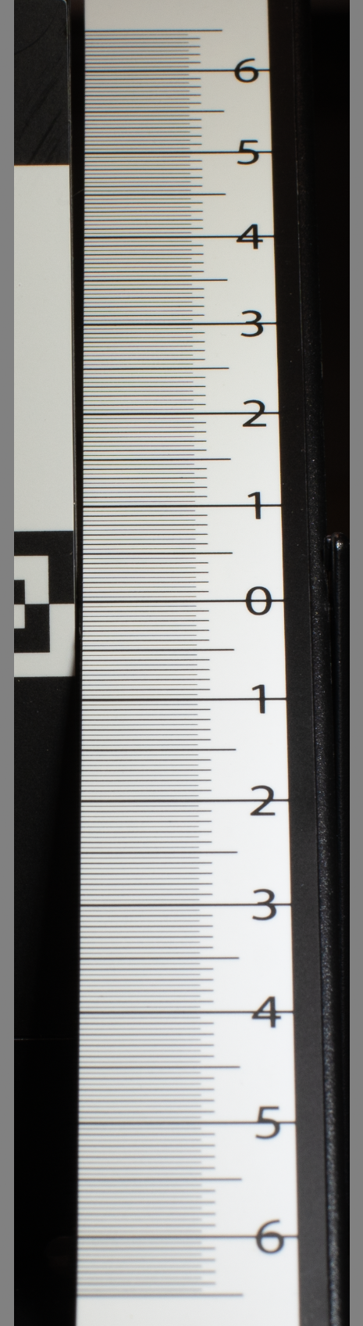
A7RIII 90 mm ISO 125
Depth of Field (cm)
A7RIII 50 mm ISO 125
F14
11.4 cm
F11
8.9 cm
F9
6.4 cm
F14
>13 cm
F11
>13 cm
F9
12 cm

Slide 3
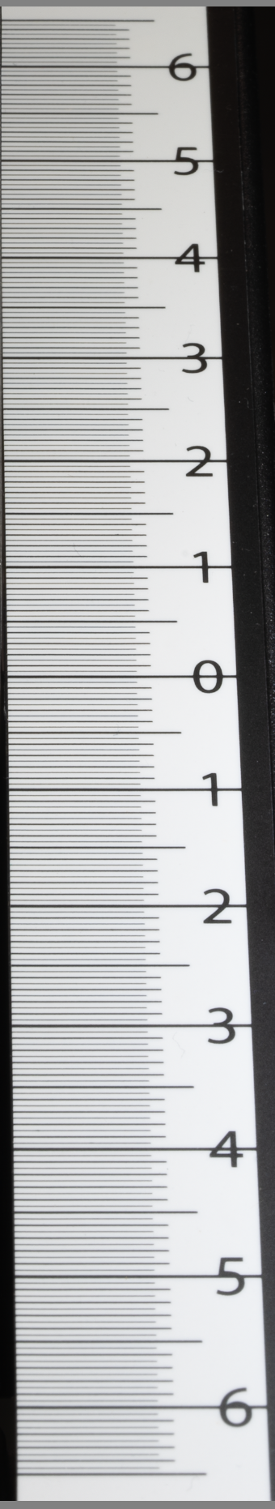
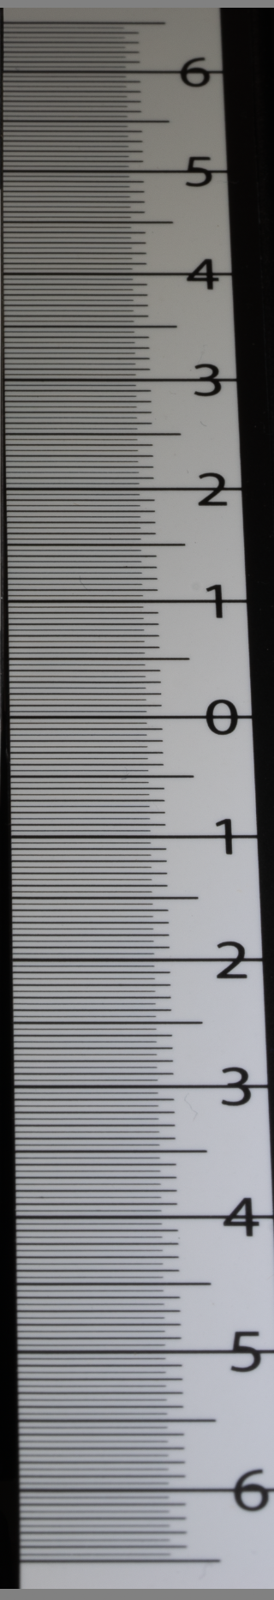
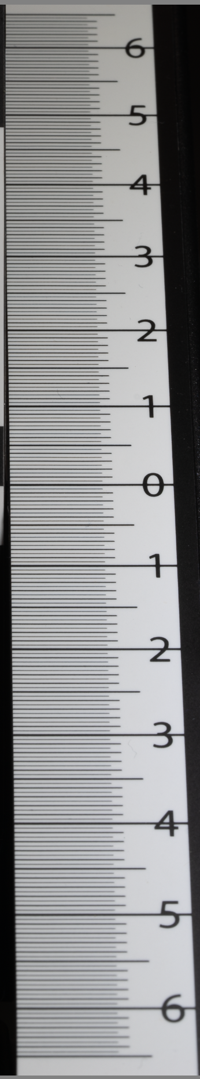
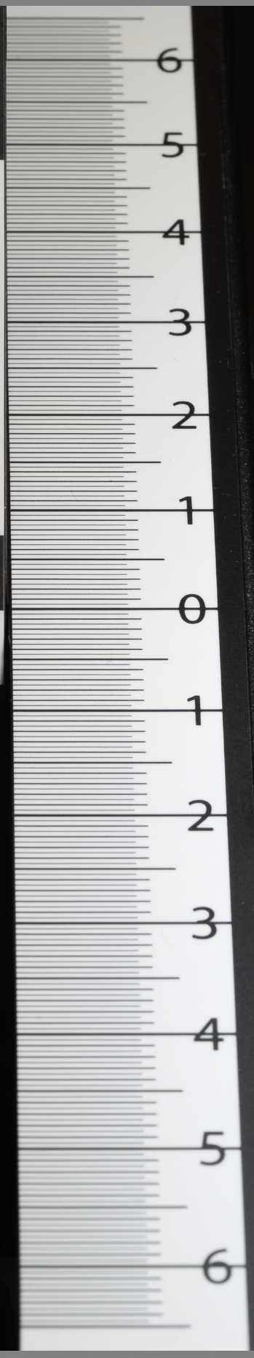
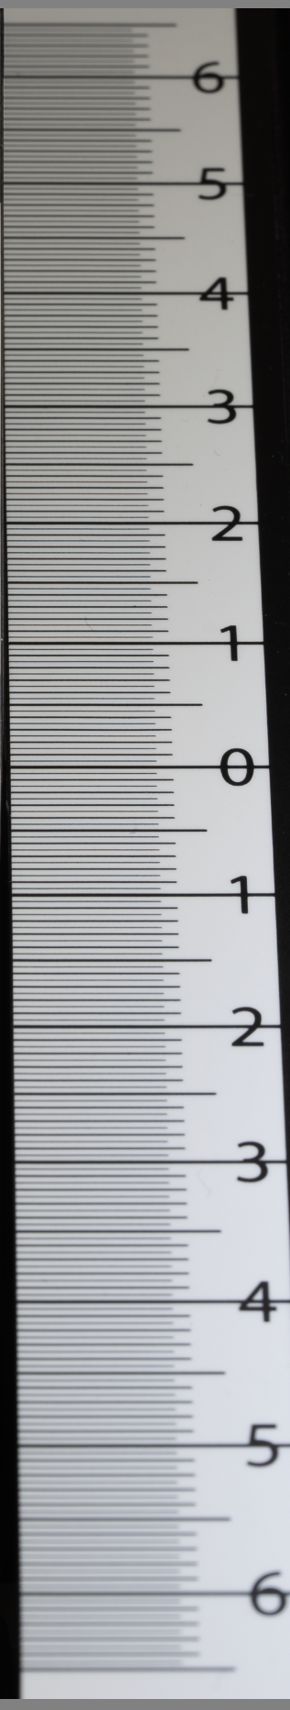
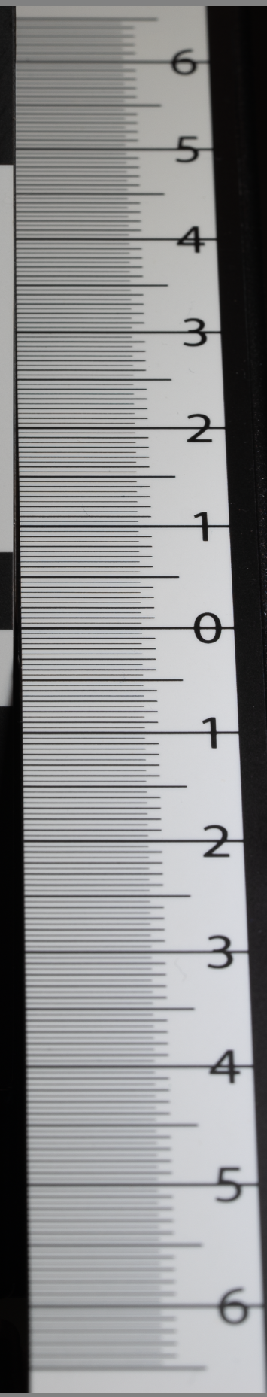
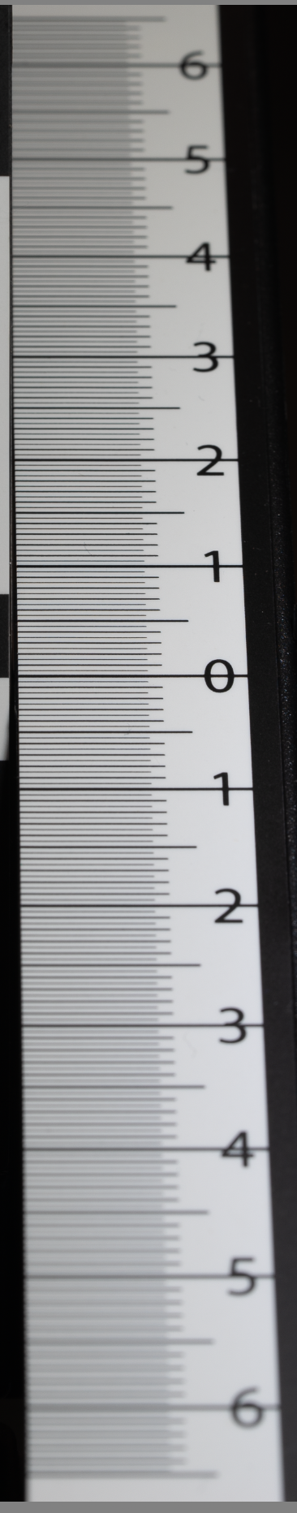
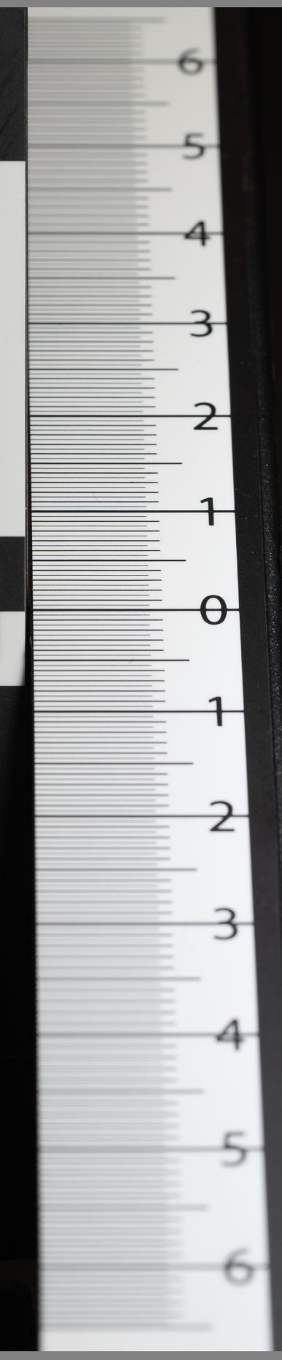
A7S 90 mm, ISO64
Depth of Field (cm)
F22
>13 cm
F20
>13 cm
F18
13 cm
F14
11.2 cm
F13
10.8 cm
F11
9.5 cm
F9
6.5 cm
F7.1
4.9 cm

Slide 4
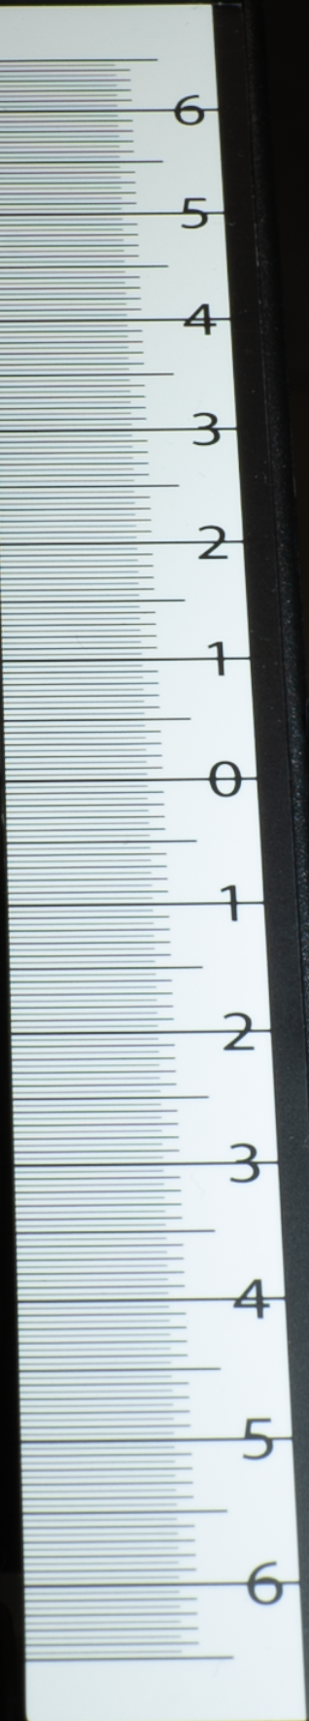
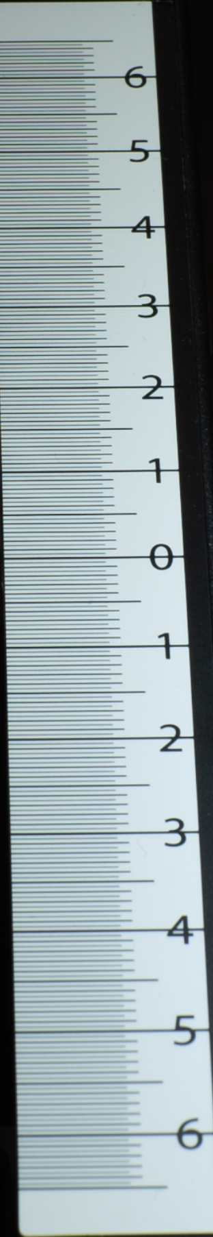
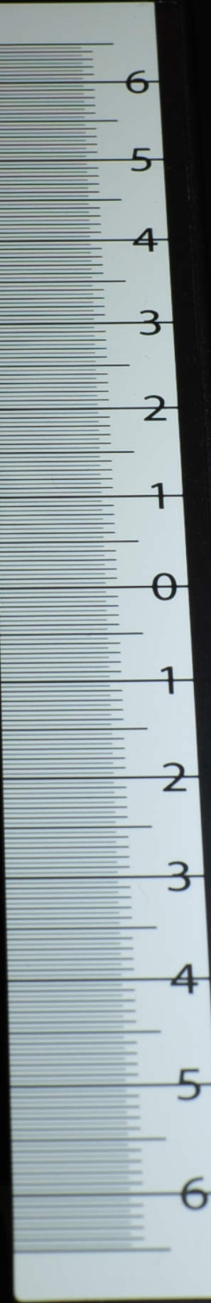
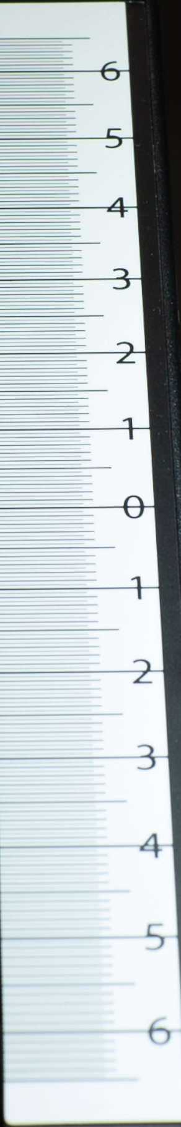
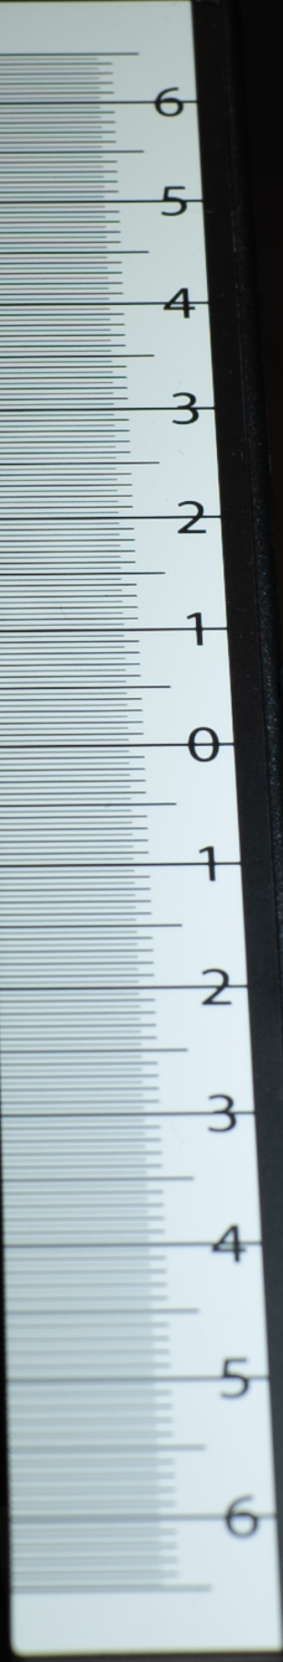
Depth of Field (cm)
A7S 50 mm, ISO64
F16
>13 cm
F13
13 cm
F10
12 cm
F9
10.1 cm
F7.1
9.1 cm

Slide 5
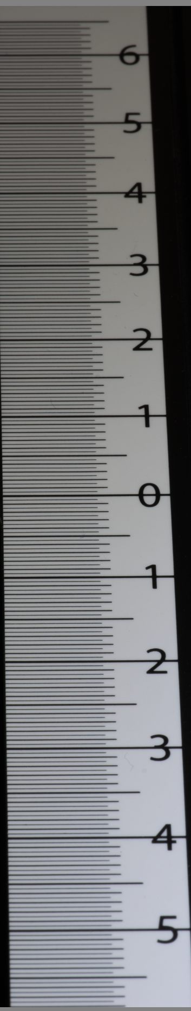
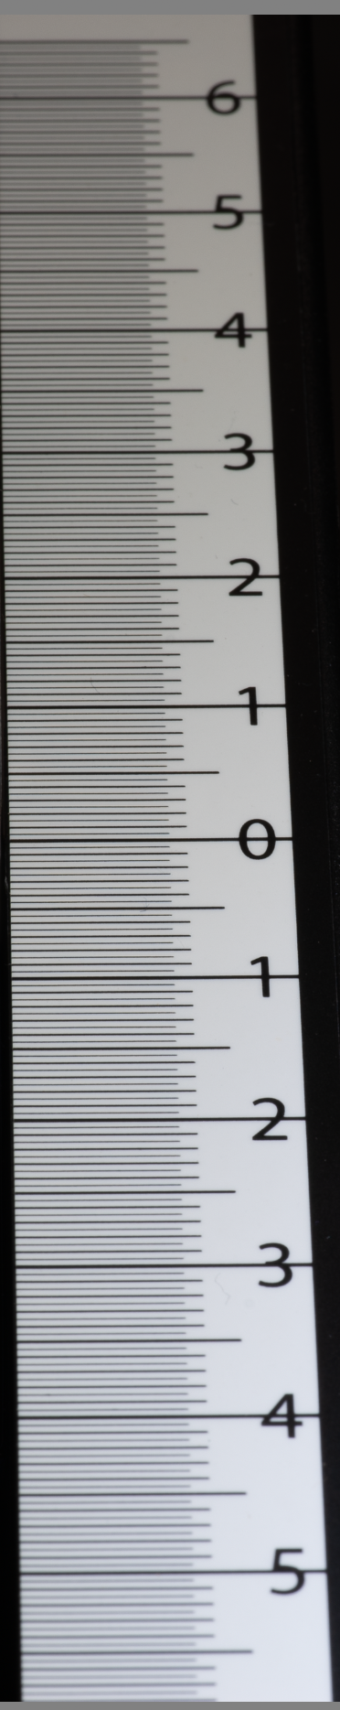
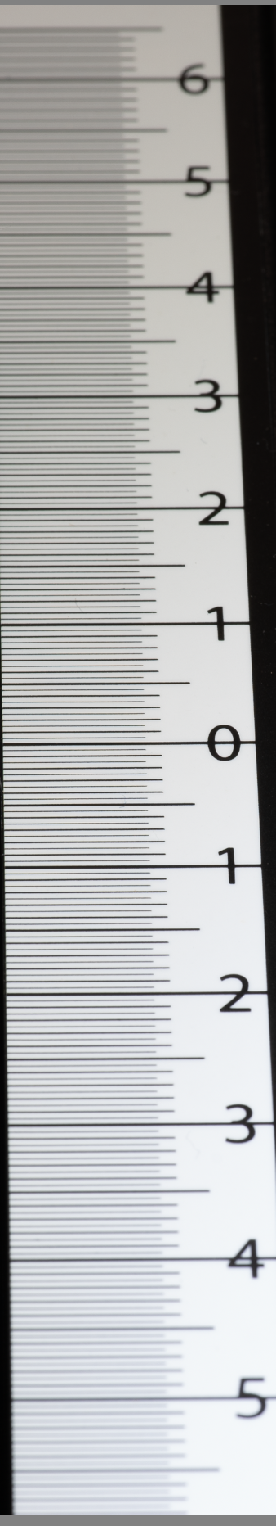
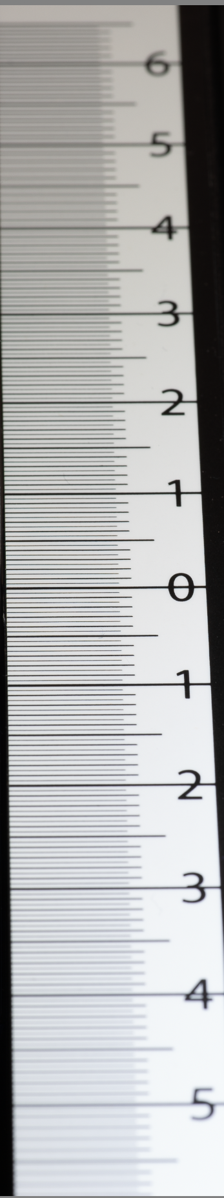
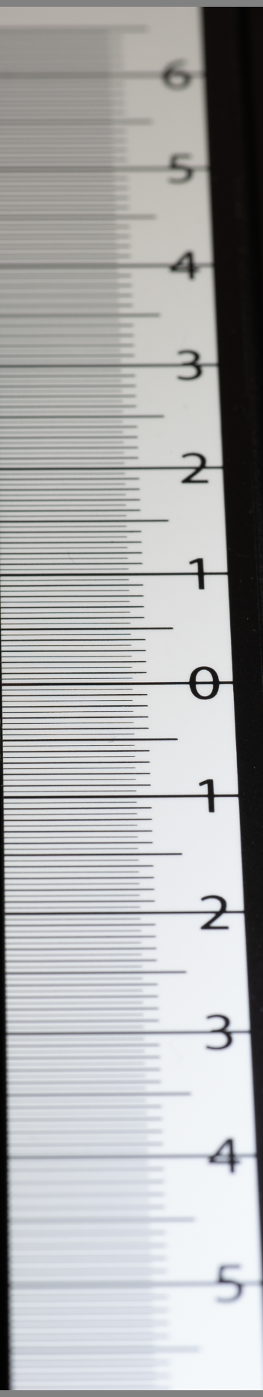
Depth of Field (cm)
A7S 100 mm, ISO64
F22
>12 cm
F18
11.5 cm
F14
8.2 cm
F11
6.7 cm
F9
5.1 cm

Slide 6
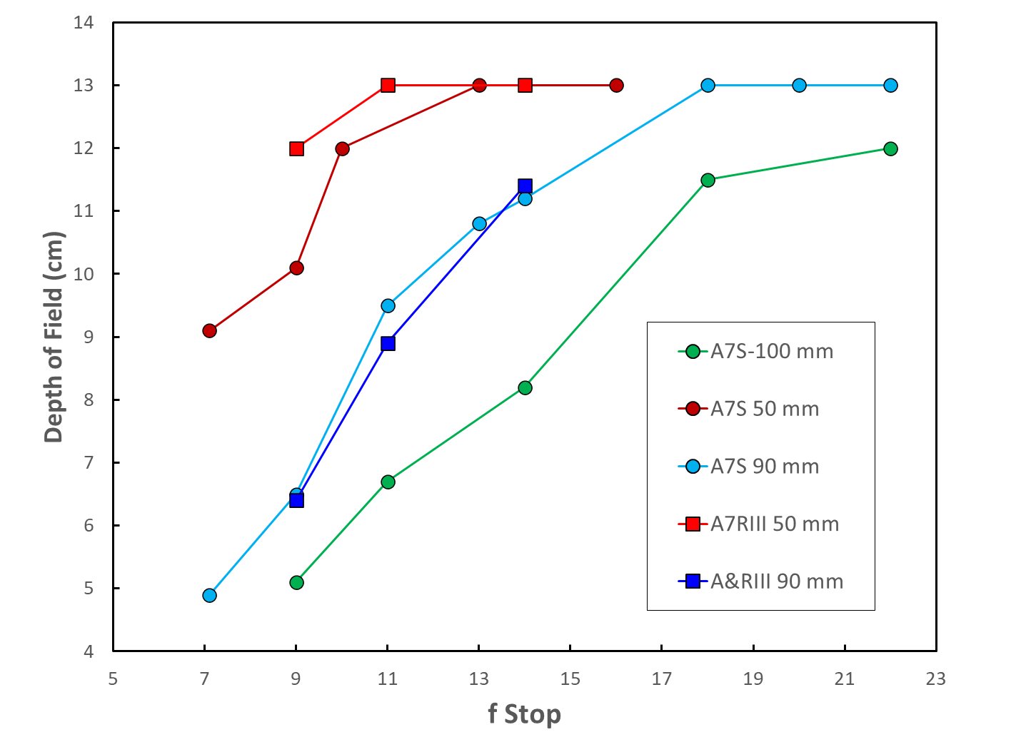
50 mm
100 mm
90 mm

Slide 7
