Slide 1
Sony A7RIII
Notes from manual
https://helpguide.sony.net/ilc/1710/v1/en/contents/TP0001653092.html

Slide 2
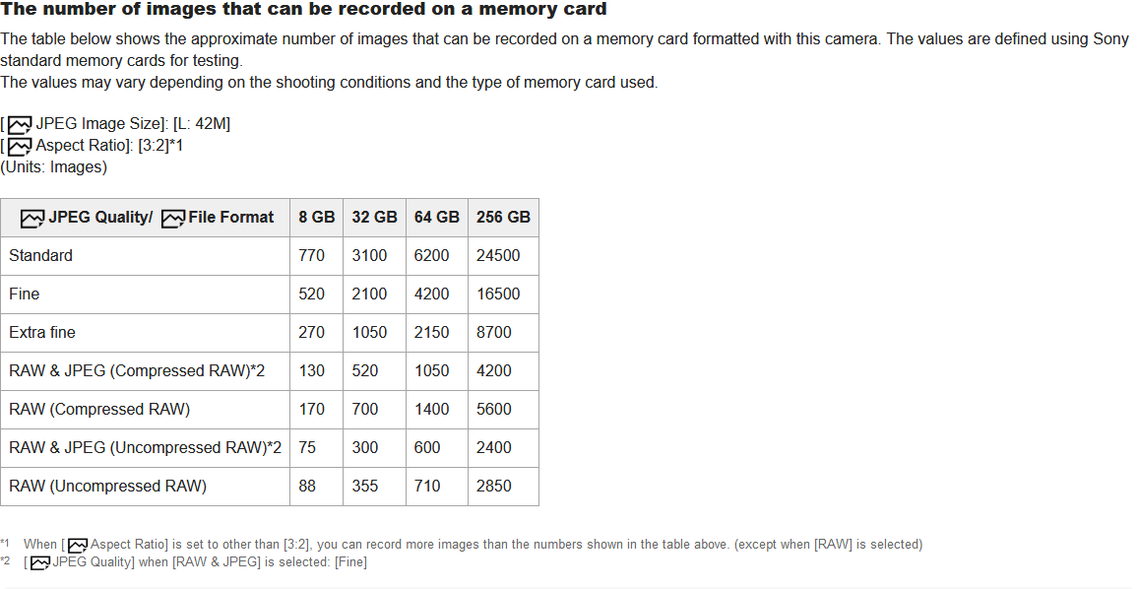
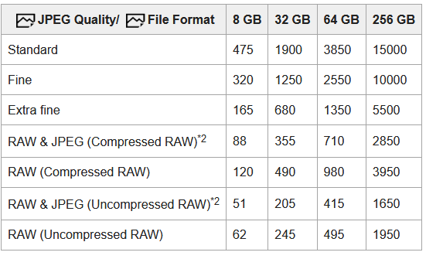
Memory card calcs (A7RIII vs A7RIV)
a7RIII
a7RIV
A 1 TB card or two 512 GB cards would yield > 11000 images, our goal is 8760 (one per hour for 1 year)

Slide 3
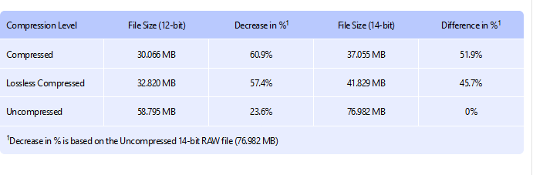
Notes on compression from https://photographylife.com/compressed-vs-uncompressed-vs-lossless-compressed-raw#sony-raw-file-options
This is not specific to a sony but shows how much you can reduce the file size as a percentage from RAW. Sony
Is 14 bit compression, there is no loseless compression

Slide 4
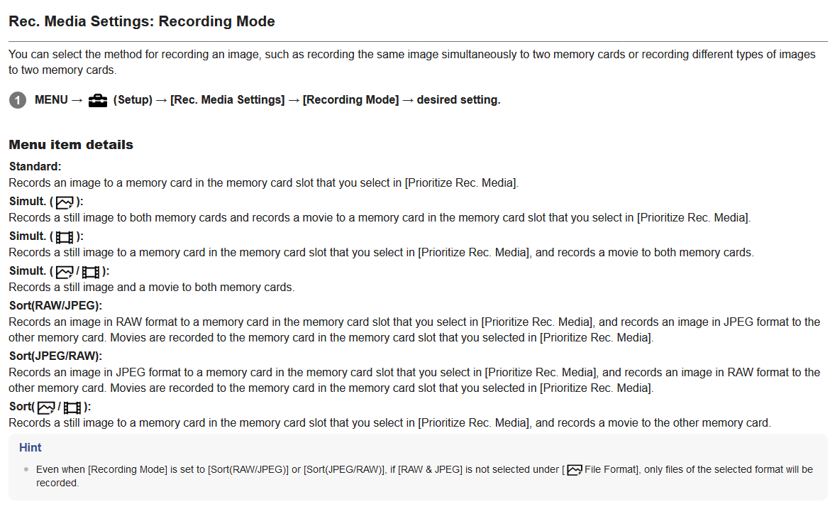
Notes on recording options from manual

Slide 5
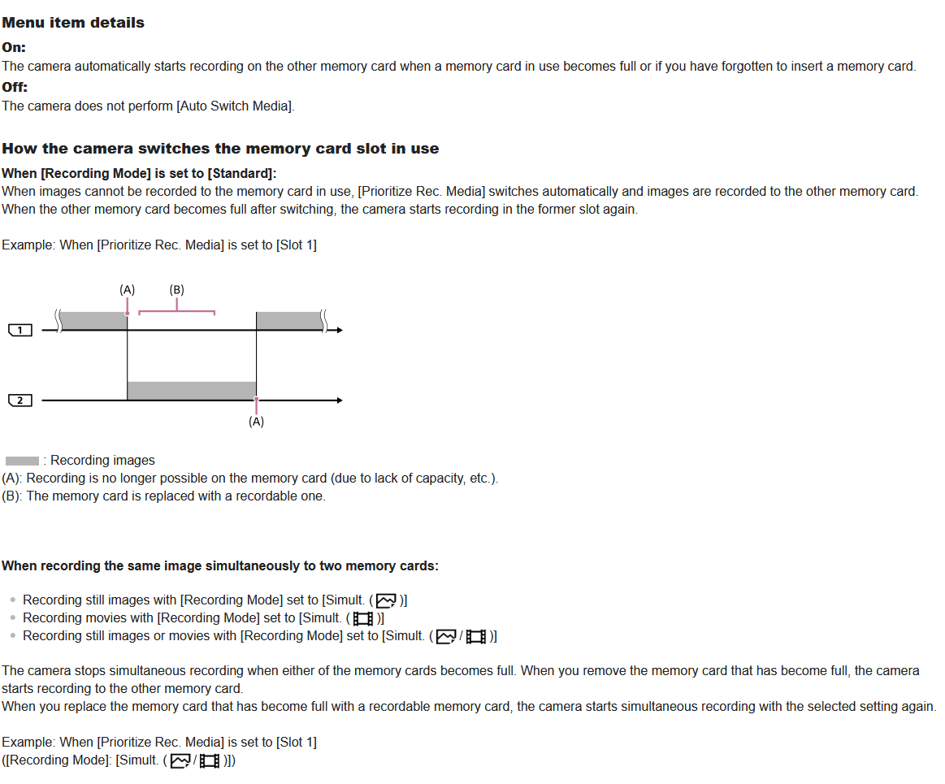
Notes on recording options from manual

Slide 6
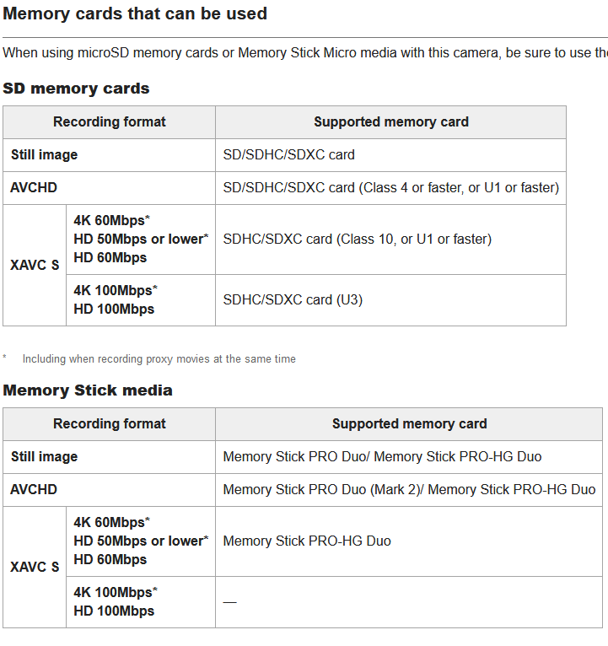
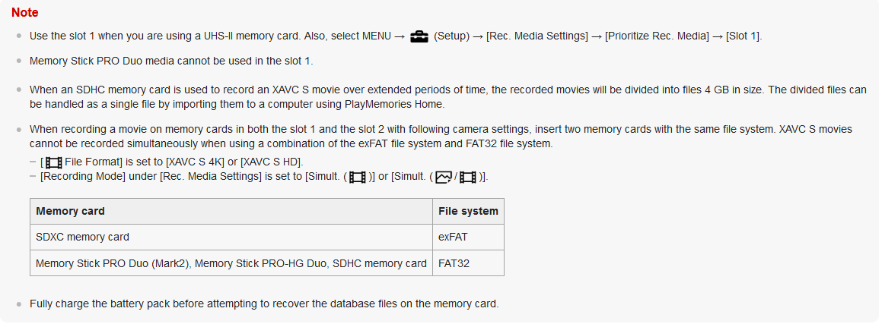
Memory Card details

