Slide 1
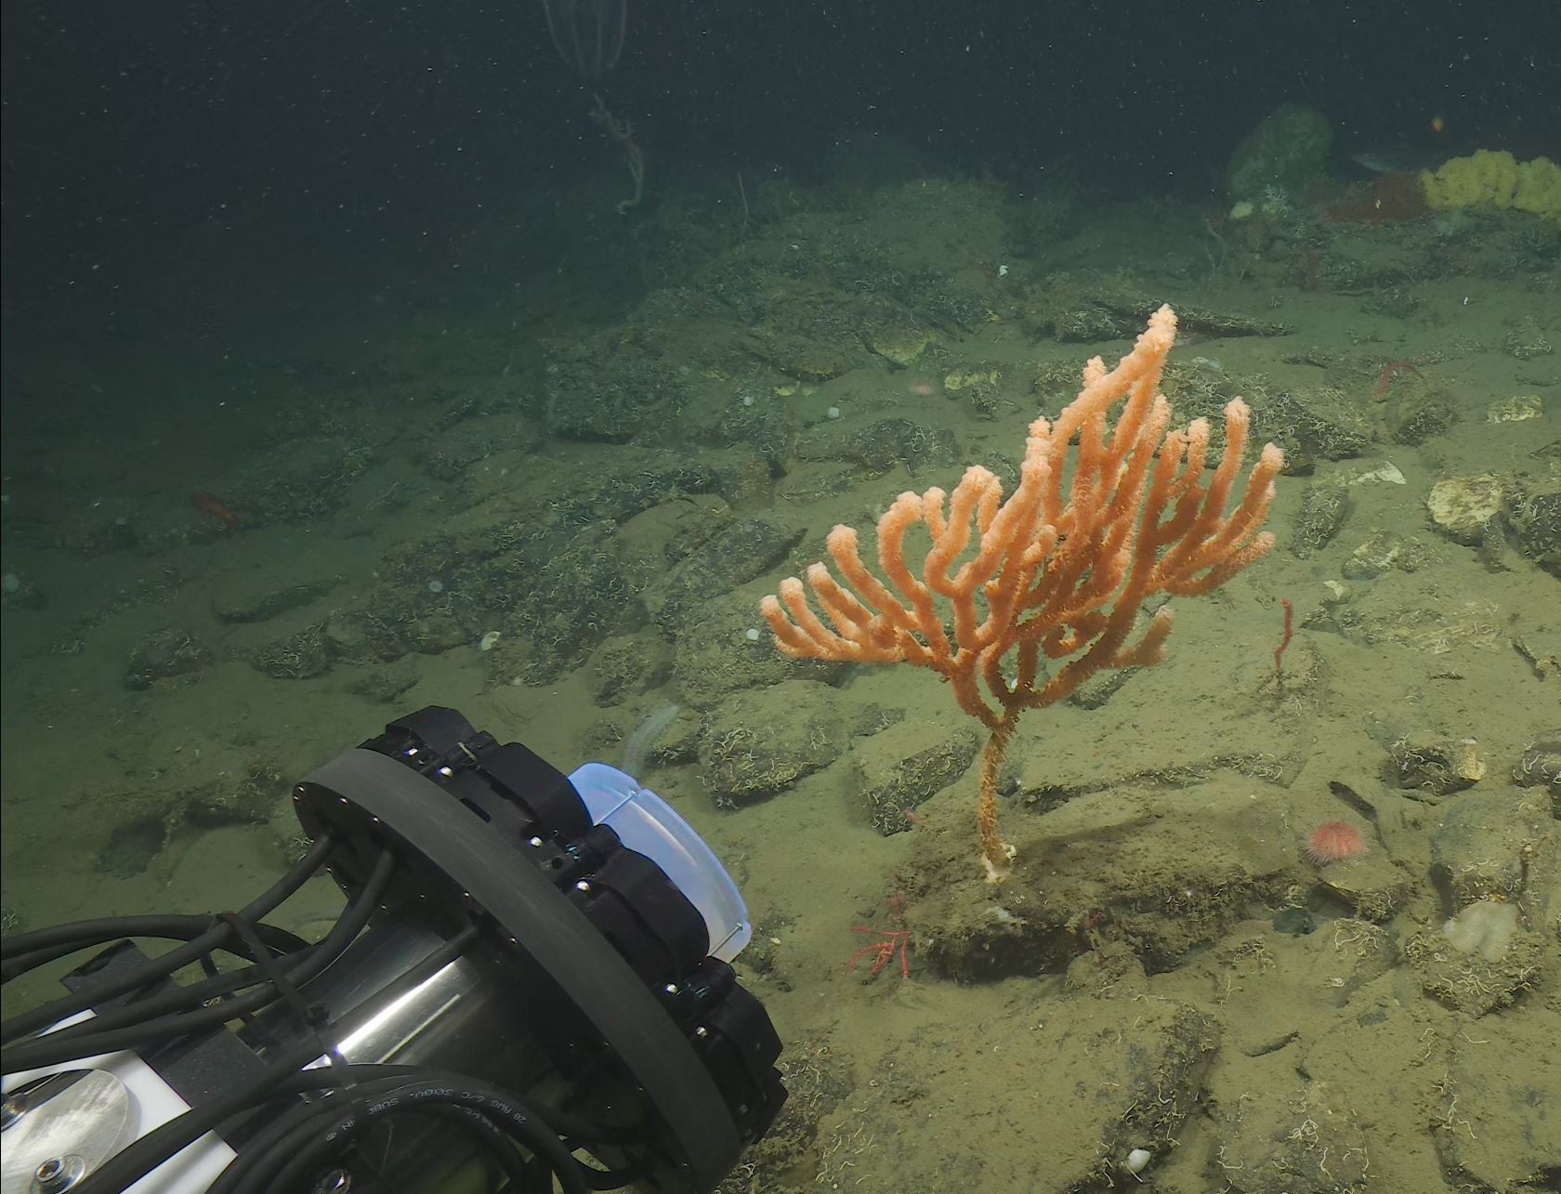

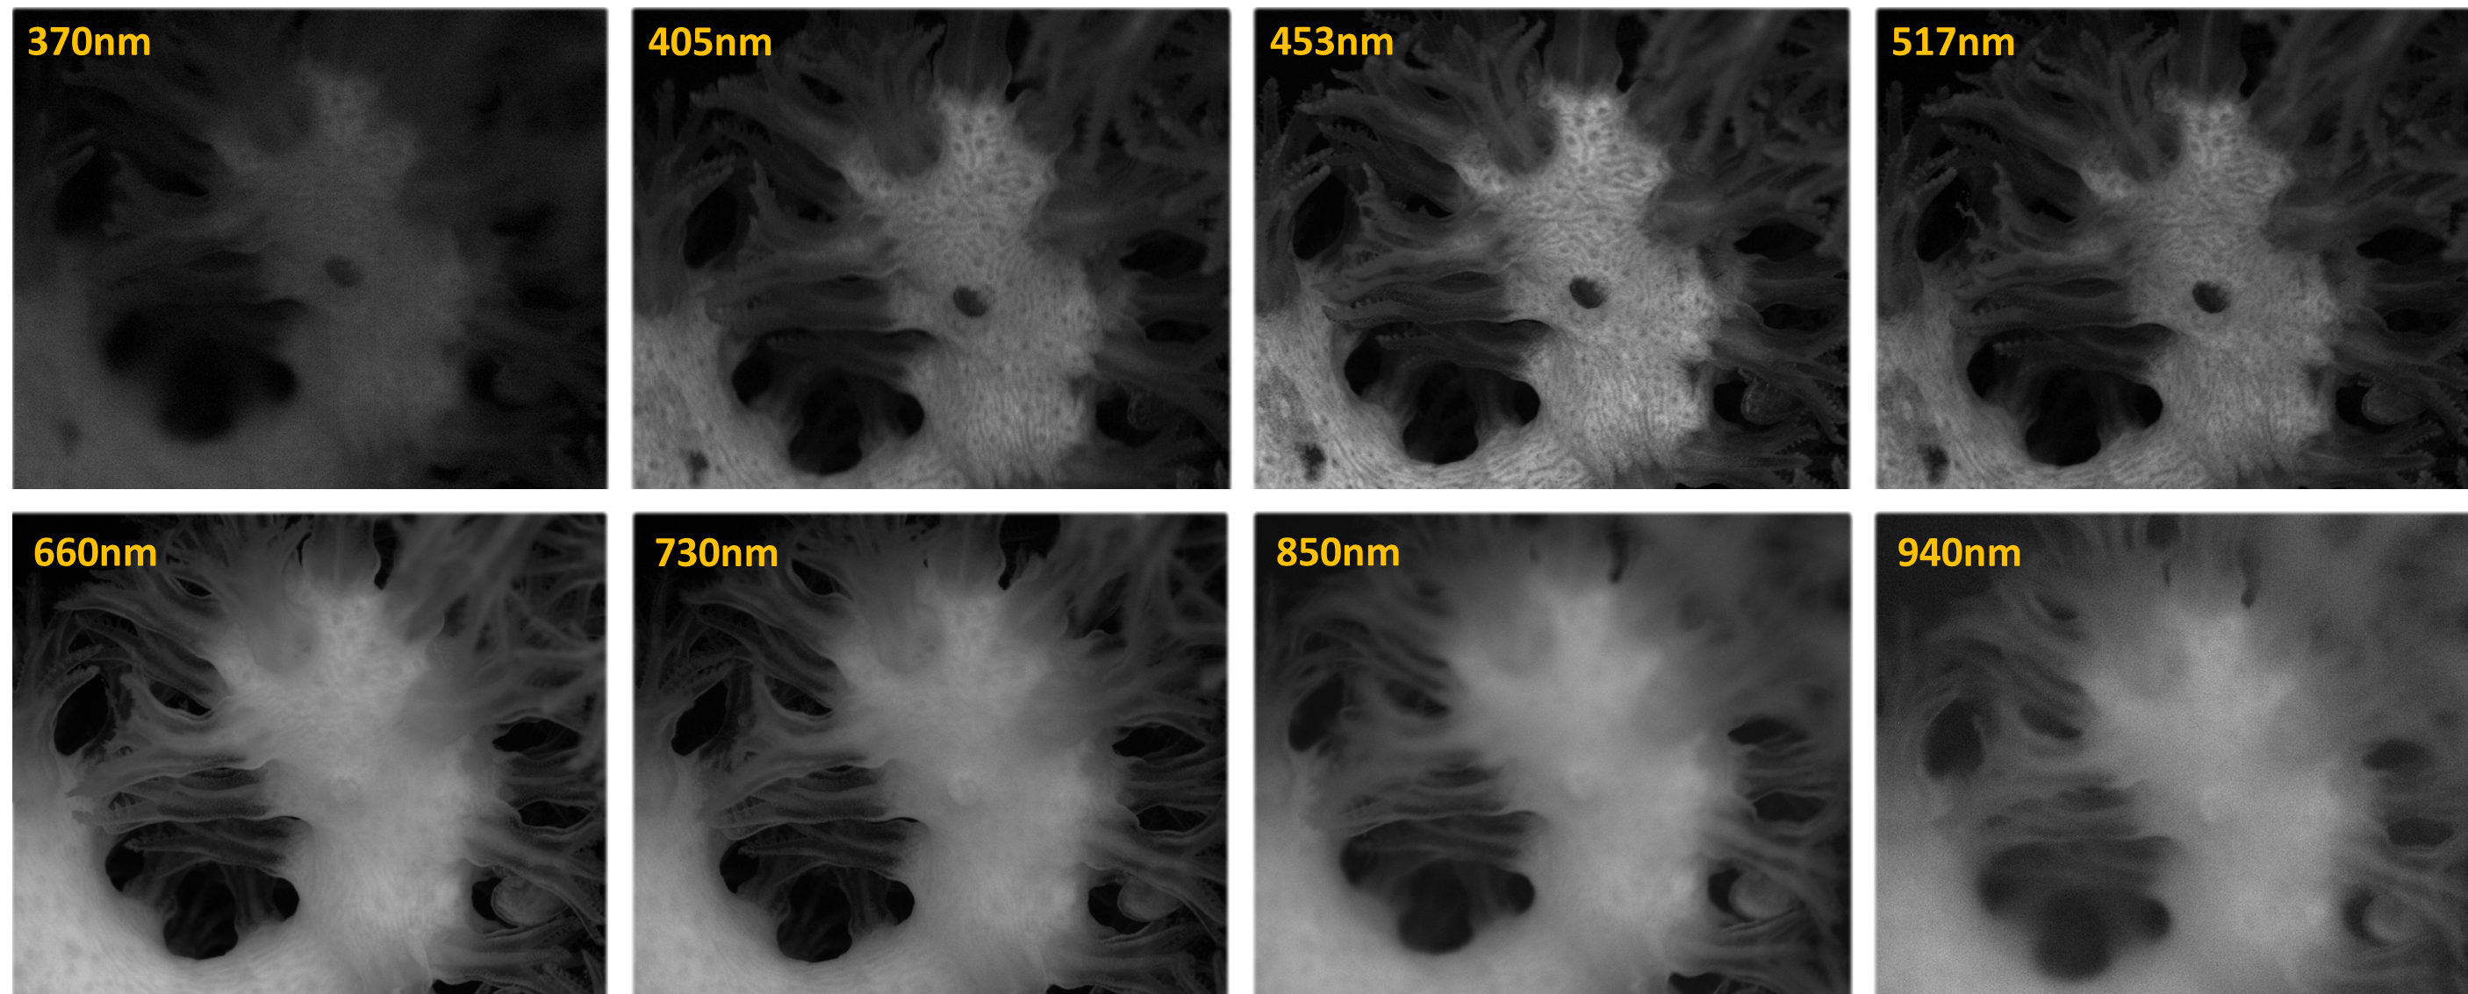
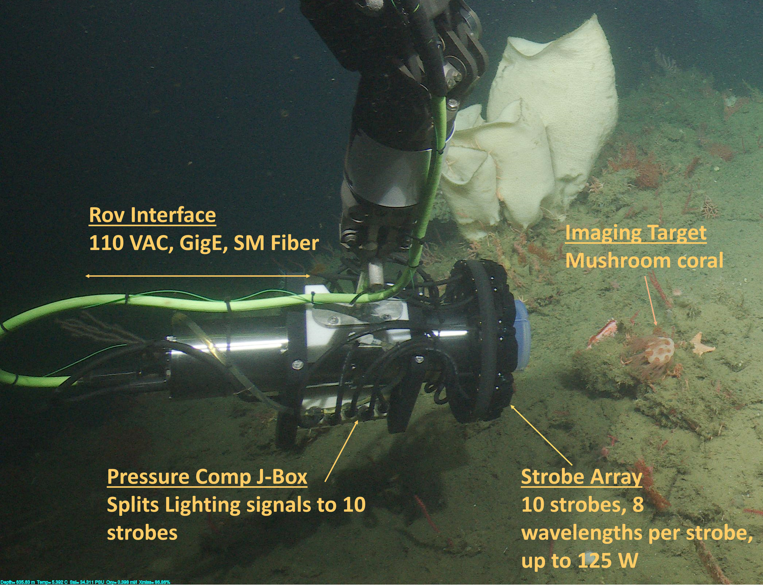
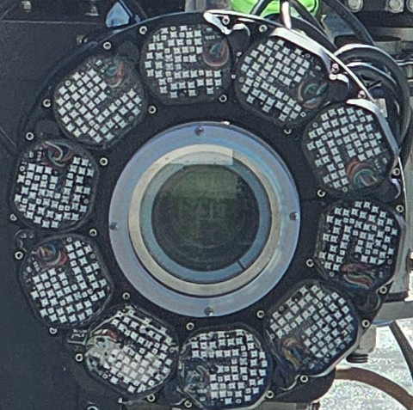
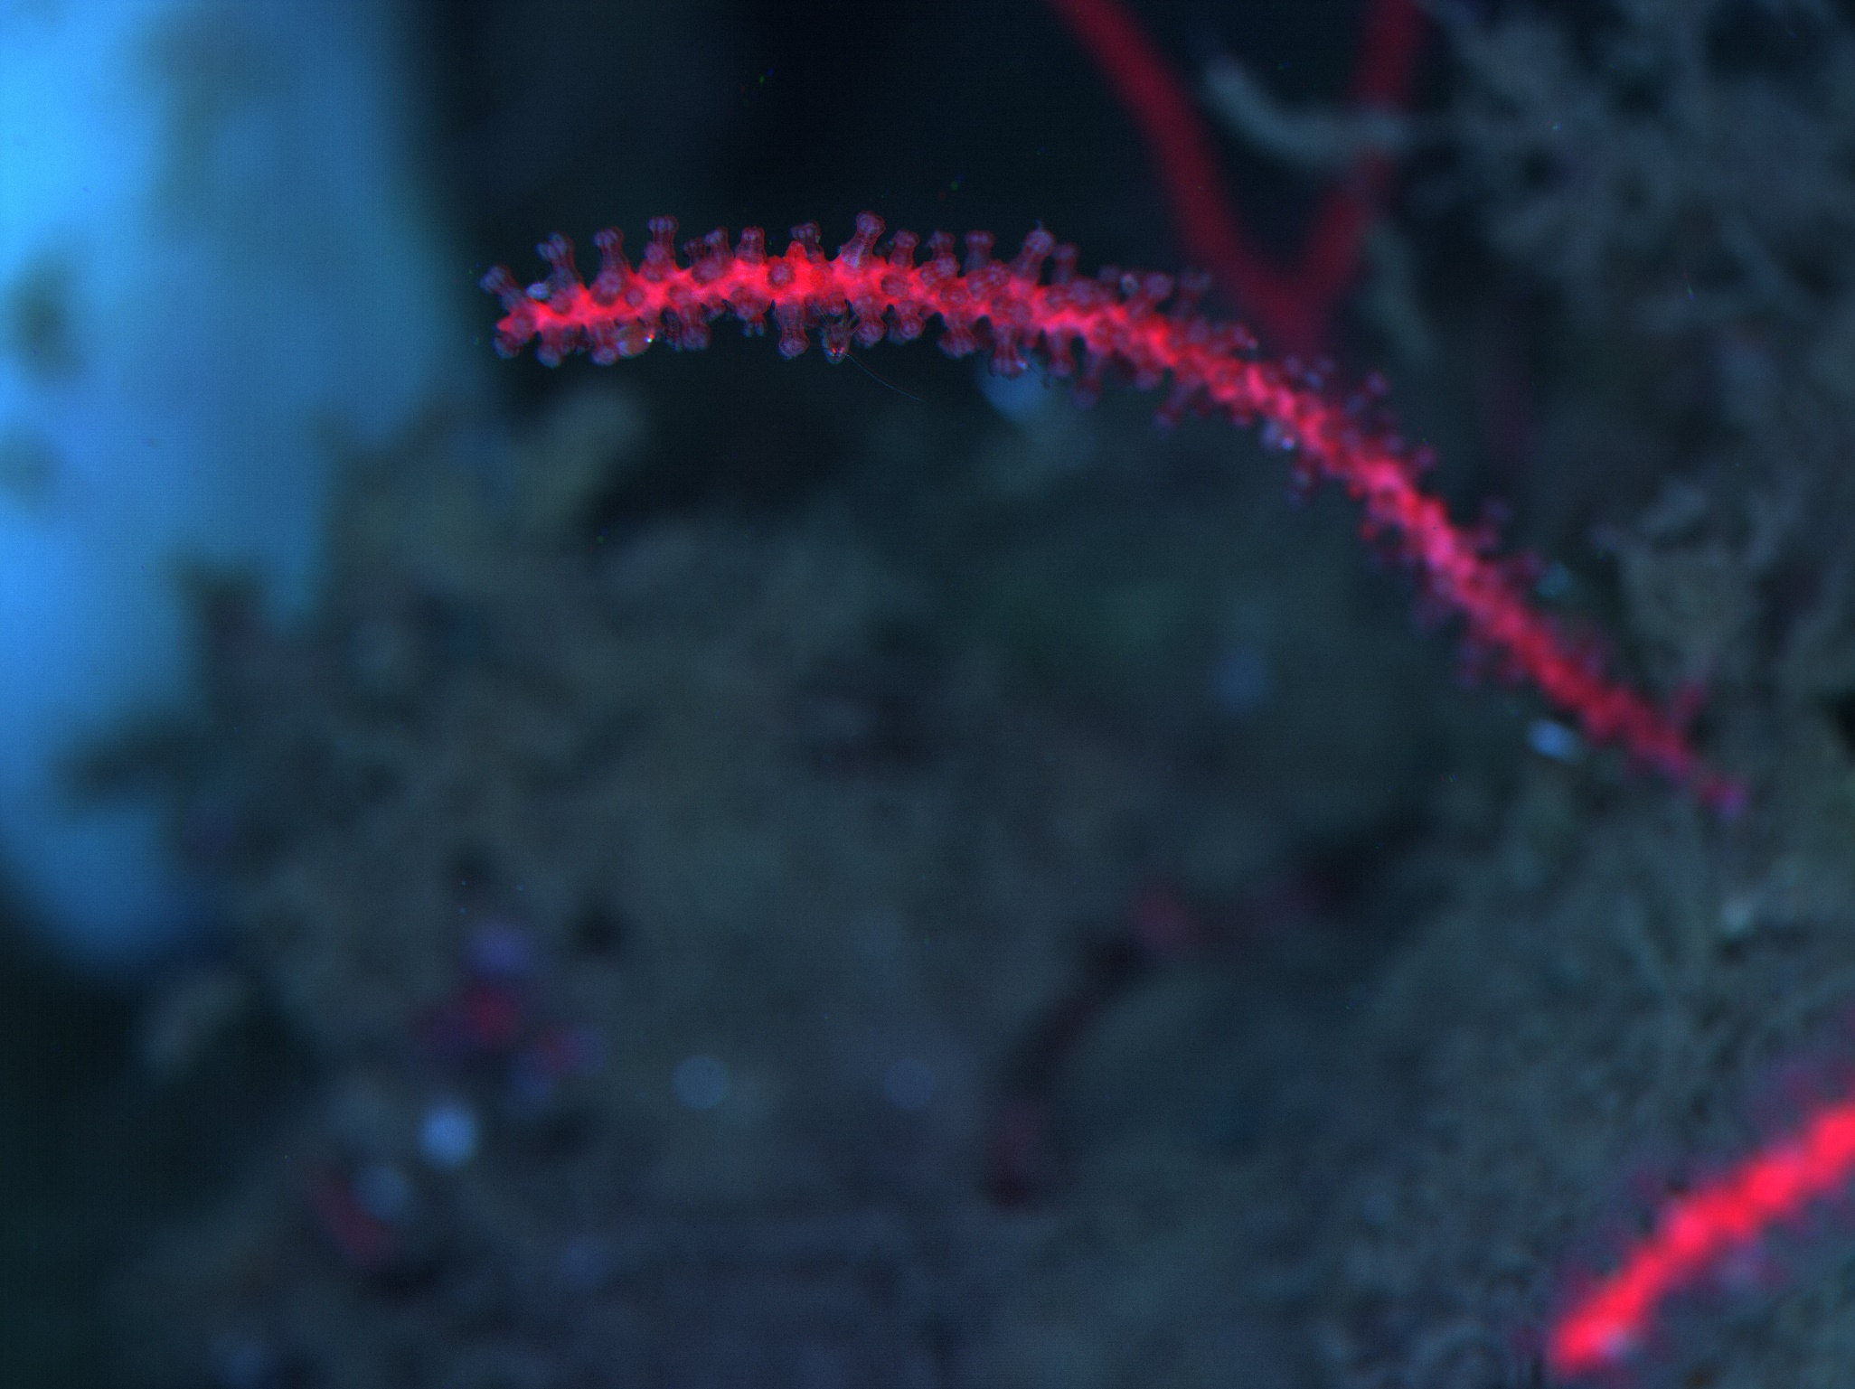
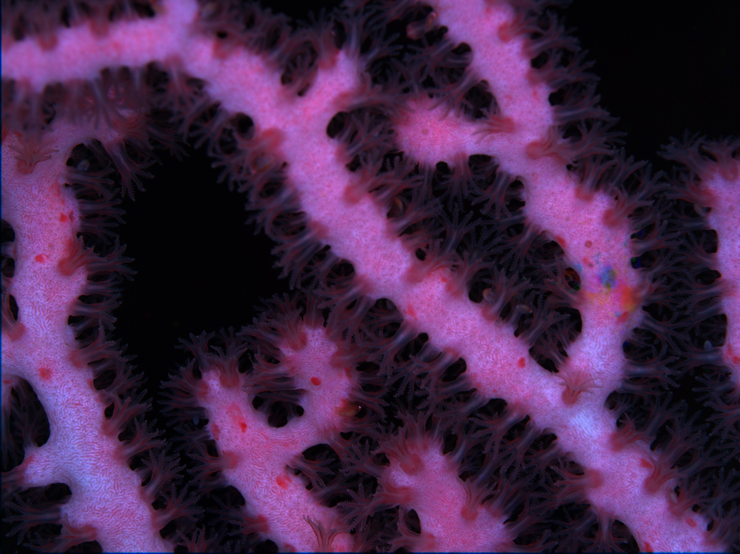
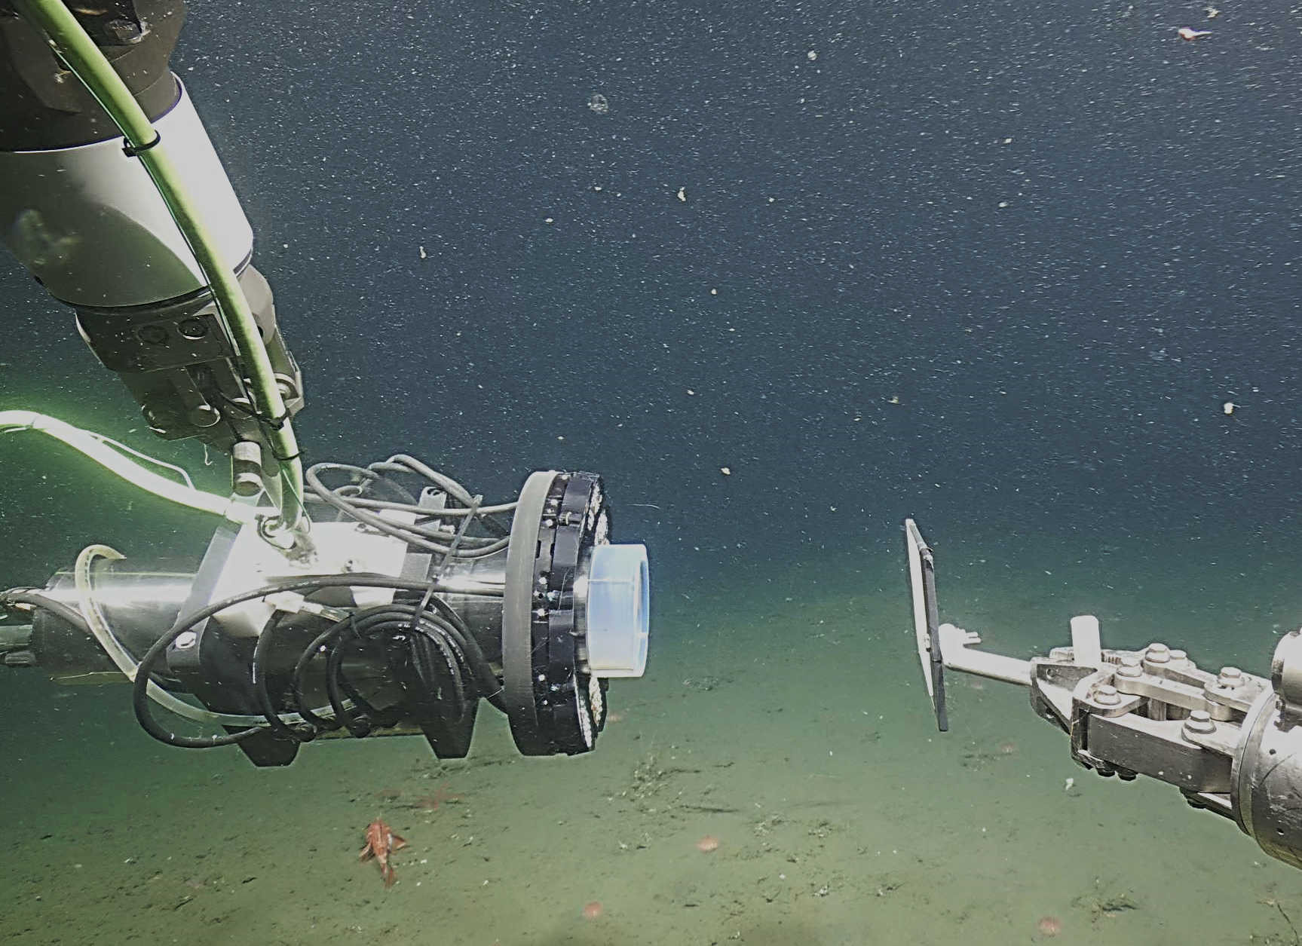
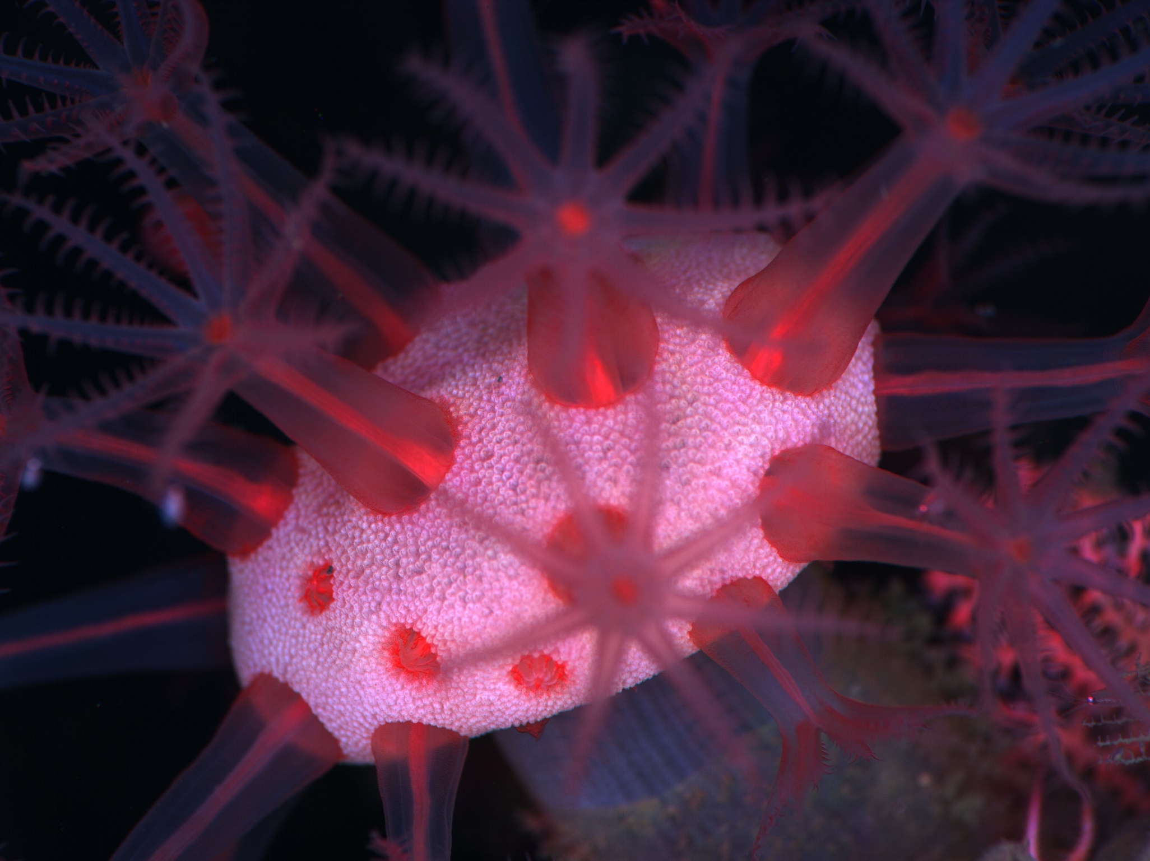
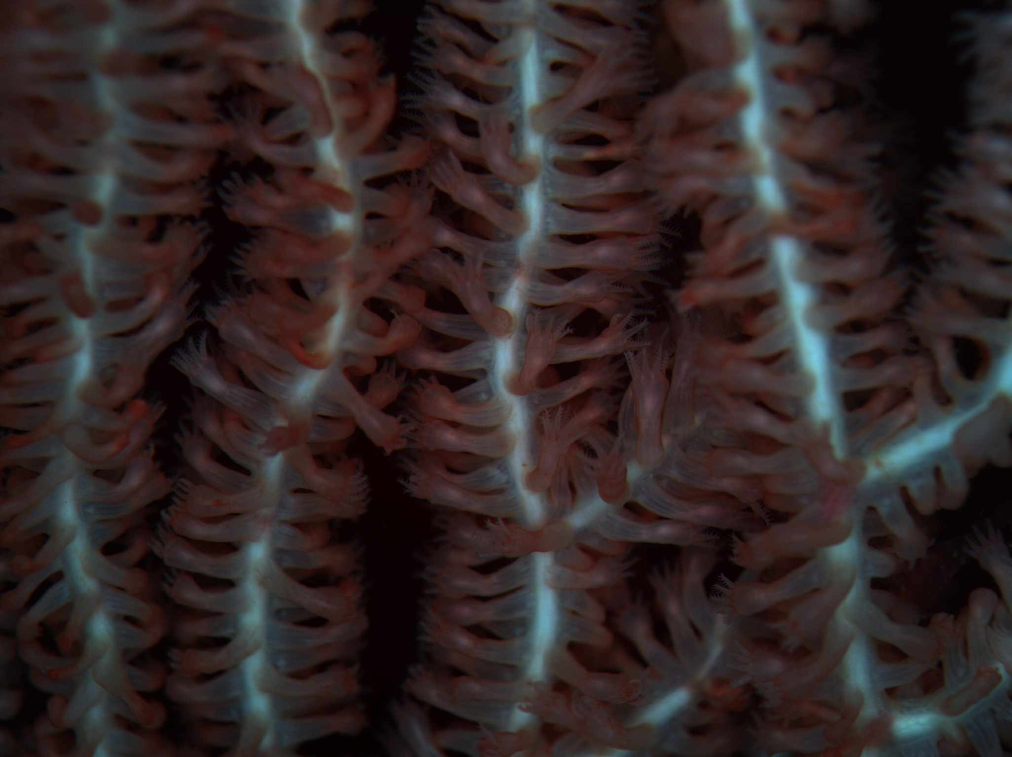
High-Resolution Multispectral Imaging of Deep Sea Corals
Irene Hu, Steven Y. Litvin, Paul Roberts, Aaron Schnittger, James P. Barry
Introduction
Hyper- and multi-spectral imaging approaches have been shown to be powerful, non-destructive, tools for studying stress, disease, and composition (e.g. moisture, lipid content) in agricultural applications. This approach has also been applied to assess stress and health of deep water corals in the laboratory (Letnes et al. 2019, Langenkämper et al. 2022). To explore the use of in situ multi-spectral imaging to study deep sea coral health, we have developed a prototype high-resolution ROV-based system. The system was deployed twice in Sept. 2024 in Monterey Bay.
Multi Spectral Coral Cam
Emergent Vision Tech Monochrome Camera
25G, 65 Megapixel, 30 Hz
Single Mode Fiber
EF lens control
Canon 70-200 mm EF mount Lens
+2 Diopter
Imaging Performance
30-35 cm working distance in water
11 cm x 8.5 cm FOM
12 um pixels, 27 um optical resolution
Front View of
Camera & Strobes
Above: Monochromatic images of Paragorgia arborea illuminated across 8 wavelengths. Below: False color (453, 517, 730nm) image, rendered as a RGB, of (clockwise from top left) Swiftia simplex, P. arborea, Isidella tentaculum and Heteropolypus ritteri
Spectral Balancing
Intensity at a given wavelength is a factor of object reflectance (target property), imaging system, illumination, environment, and user-controlled settings
To quantitatively compare object reflectance between wavelengths, other factors must be calibrated out
White balance card (Optopolymer® Optical PTFE) used for in-situ calibration:
  For each wavelength, normalize object images using image of white balance card
  Calculate adjustments for user-controlled settings
Future Directions
Future efforts may include increasing illumination to obtain better image quality with shorter exposure time, and the utilization of a camera with higher frame rates for shorter time between images. Increased speed may improve alignment between images from successive wavelengths, even as the deep sea corals move with the currents, which may pave the way for more automated processing. Ultimately, the project will utilize both the in situ and a similar lab based system to quantify the relationships between coral health and spectral features across species.
References
Langenkämper, Daniel, et al. "Exploring time series of hyperspectral images for cold water coral stress response analysis." Plos one 17.8 (2022): e0272408.
Letnes, Paul Anton, et al. "Underwater hyperspectral classification of deep sea corals exposed to 2-methylnaphthalene." PloS one 14.2 (2019): e0209960.

Slide 2
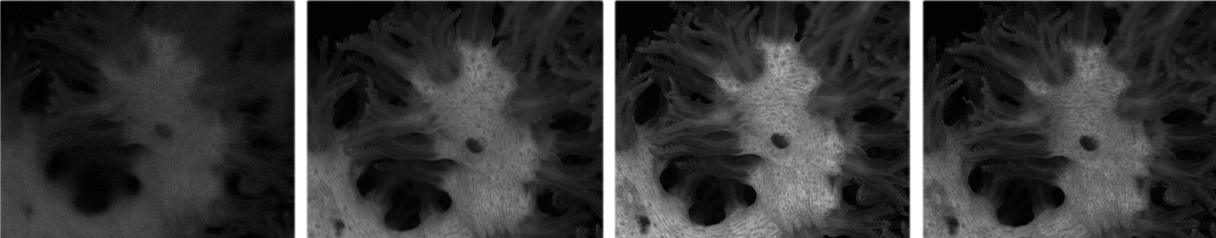

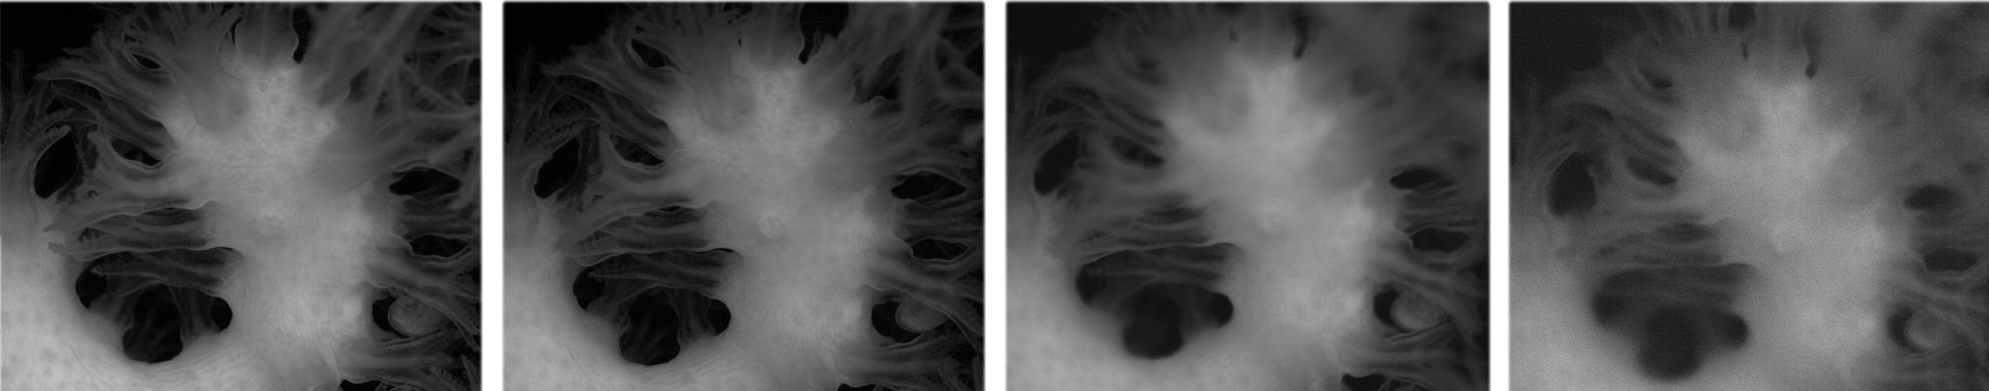
High-Resolution Multispectral Imaging of Deep Sea Corals
Irene Hu, Steven Y. Litvin, Paul Roberts, Aaron Schnittger, James P. Barry
Introduction
Hyper and multi imaging approaches have proven
370nm
405nm
453nm
517nm
Multi Spectral Coral Cam
Emergent Vision Tech Camera
25G, 65 Megapixel, 30 Hz
Single Mode Fiber
EF lens control
Canon 70-200 mm EF mount Lens
+2 Diopter
Imaging Performance
30-35 cm working distance in water
11 cm x 8.5 cm FOV12 um pixels
27 um optical resolution
Front View of
Camera & Strobes
660nm
730nm
850nm
940nm
Spectral Balancing
Future Directions

Slide 3
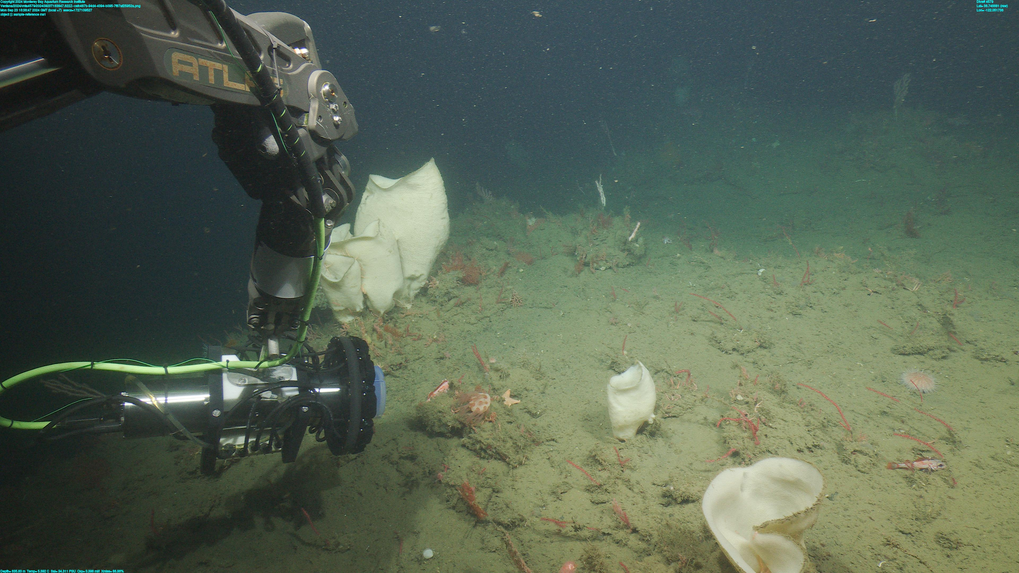
Rov Interface
110 VAC, GigE, SM Fiber
Imaging Target
Mushroom coral
Pressure Comp J-Box
Splits Lighting signals to 10 strobes
Strobe Array
10 strobes, 8 wavelengths per strobe, up to 125 W

Slide 4
System Specs
Emergent Vision Tech Camera
  25G, 65 Megapixel, 30 Hz
  Single Mode Fiber
  EF lens control
Canon 70-200 mm EF mount Lens
  +2 Diopter
Imaging Performance:
  30-35 cm working distance in water
  11 cm x 8.5 cm FOV
  12 um pixels, 27 um optical resolution
Imaging Target
Mushroom coral
Rov Interface
110 AC, GigE, SM Fiber
Front View of Camera/Strobes
Pressure Comp J-Box
Splits Lighting signals to 10 strobes
Strobe Array
10 strobes, 8 wavelengths per strobe, up to 125 W

Slide 5
Hyper and multi-spectral imaging approaches have been proven power non-distructive tools to access stress, disease and composition (e.g. moister, lipid content) in agriculture. In the laboratory, this approach has been applied to estimating the stress of health of deep water corals. We have recently (Sept. 2024) deployed a prototype high-resolution ROV based system to explore the use of in-situ multi-spectral imaging to explore deep sea coral health.
disease detection, weed detection, stress detection, crop monitoring, nutrient application, soil mineralogy, yield estimation, and sorting applications.
Towrds a quantitative analysis
•Goal: quantitatively compare reflectance of imaged objects between
wavelengths
•Intensity of any given pixel for any given wavelength depends on a variety of
factors:
oReflectance of object (property of interest)
oProperties of system and setup, e.g. intensity of LED excitation,
absorbance through water (depends on wavelength, path length,
water properties, etc)
oUser-controlled settings, e.g. exposure time, gain, aperture
•White balance card for calibration:
oMaterial determined to have roughly even reflectance for all
wavelengths of interest
oUse intensities observed with white balance card to normalize object
images
▪Calibrates out unknown system and setup properties
▪Requires calculated adjustments for user-controlled settings
Bray Curtis similarity
4th Root Transformed
Rarefied ASV Count
2D Stress: 0.2
14
1
Winter - 12/2020
11
2
Predominantly Anchovy
Upwelling - 3/2021
6
Upwelling - 6-7/2021
4
Winter - 12/2021
13
5
Oceanic 10-11/2022
21
15
33
Similarity
50
20
12
35
10
31
30
9
28
32
18
3
26
19
16
17
24
Predominantly
Other
34
23
22
25
29
7
8
27
Predominantly
Rattail
Fig 2. Non-metric multi-dimensional scaling plot of 4th root transformed ASV abundances across the 35 samples. The transition from a high proportion of anchovy ASVs in the early Upwelling season in 2021 to a high proportion of rattail ASVs is notable in driving differences between samples from these two periods.

Slide 6
