Slide 1
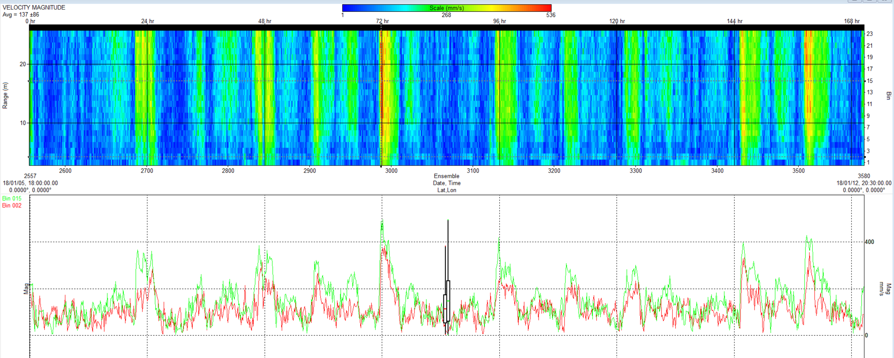
Flow data from Sur Ridge (ADCP mounted on seafloor looking up
Top panel is current speed (mm/s) – max speeds are over 1 kt, especially at spring tides.
Bottom panel is 2 bins (5 mab- red, 18 mab – green)
Mean is about 13 cm/s over this deployment (only a snip of data shown below)

Slide 2
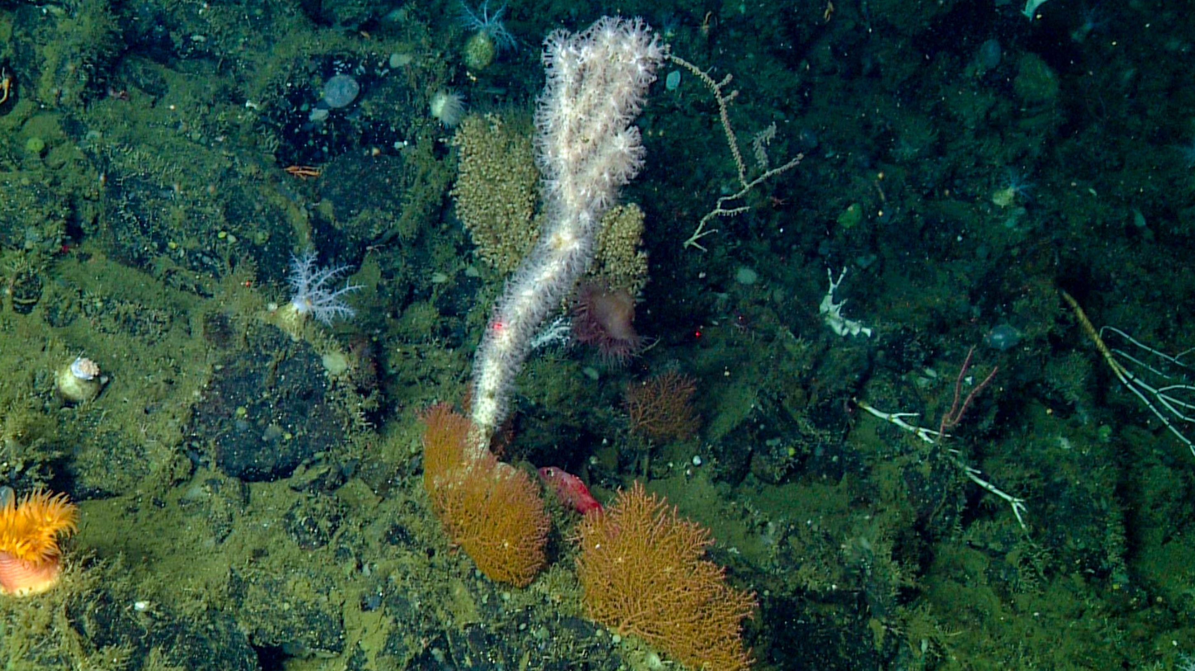
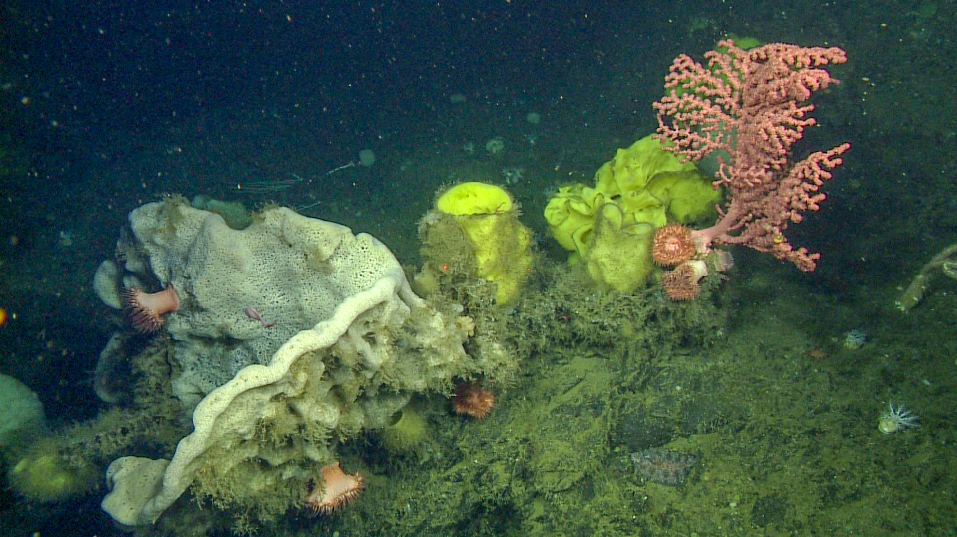
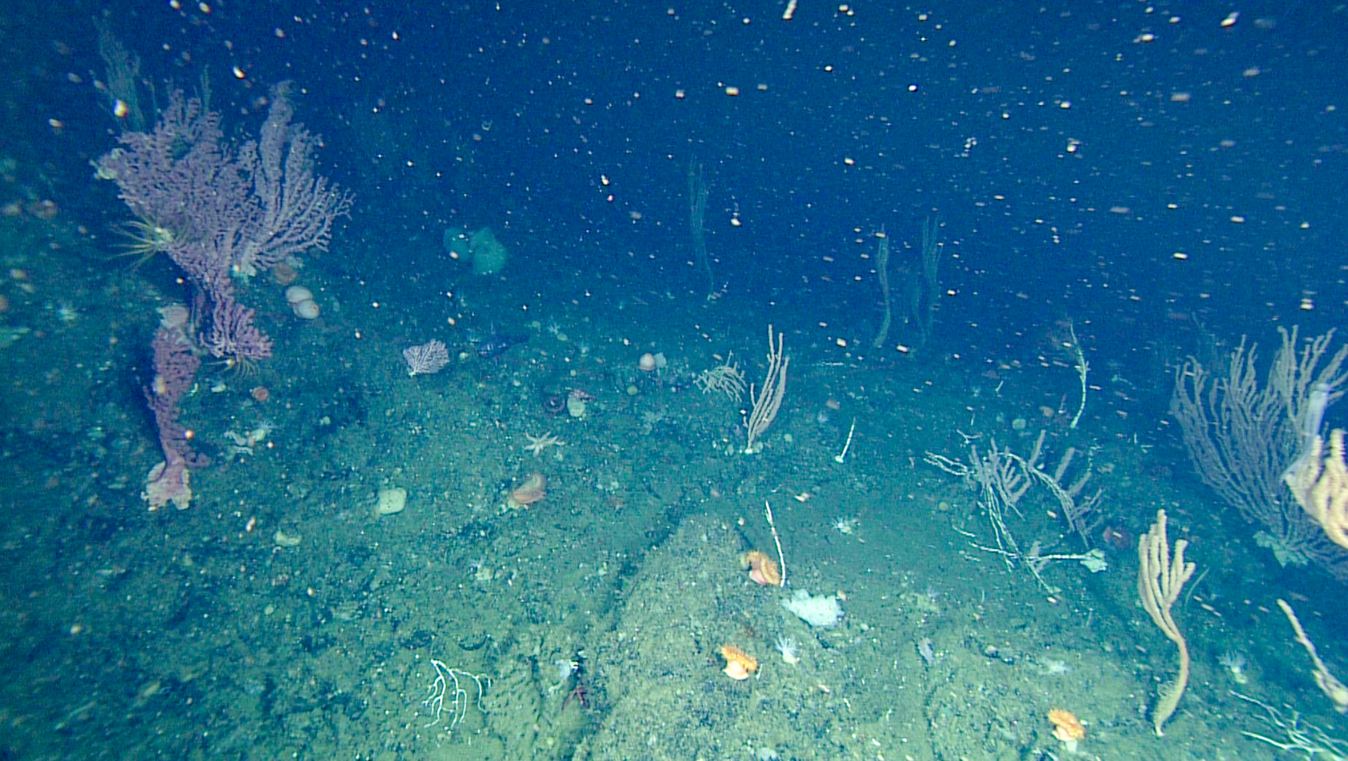
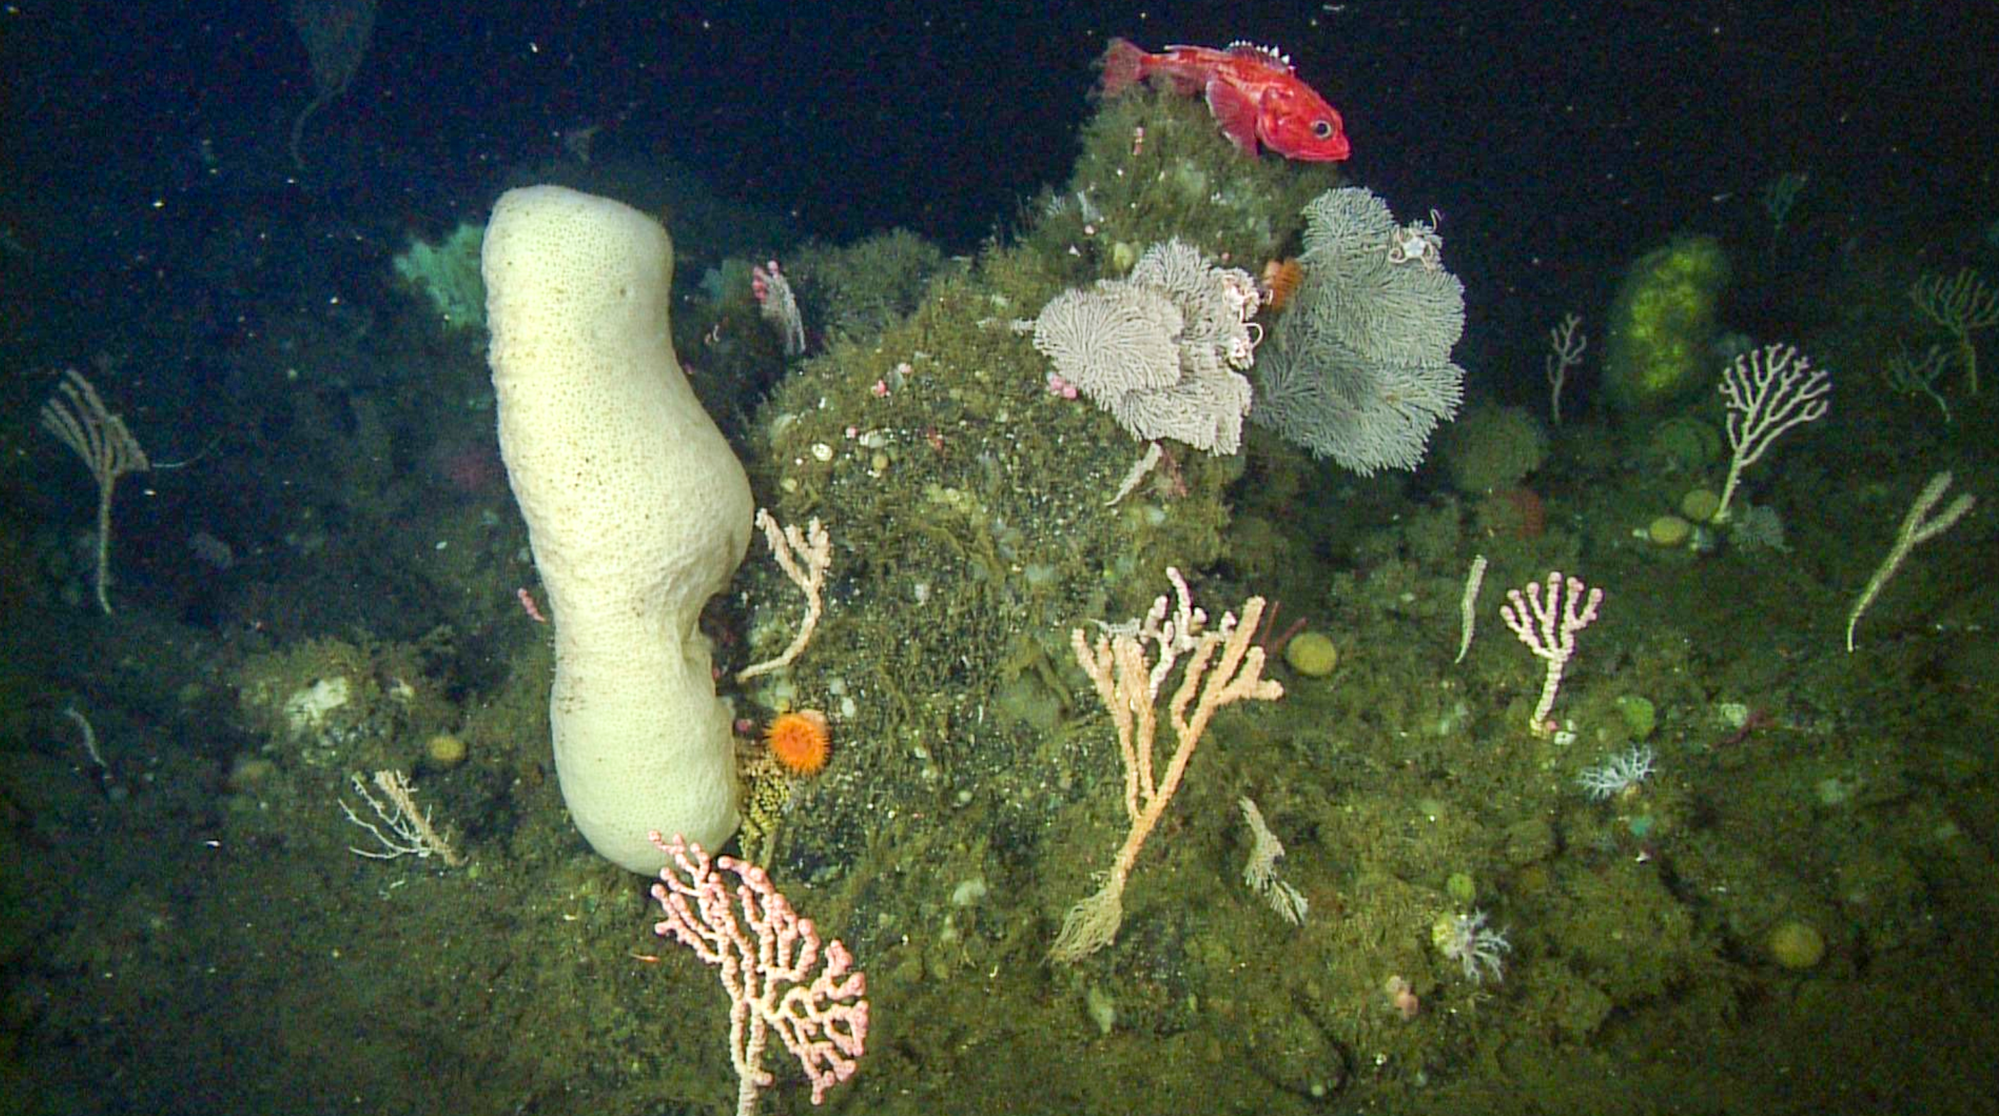
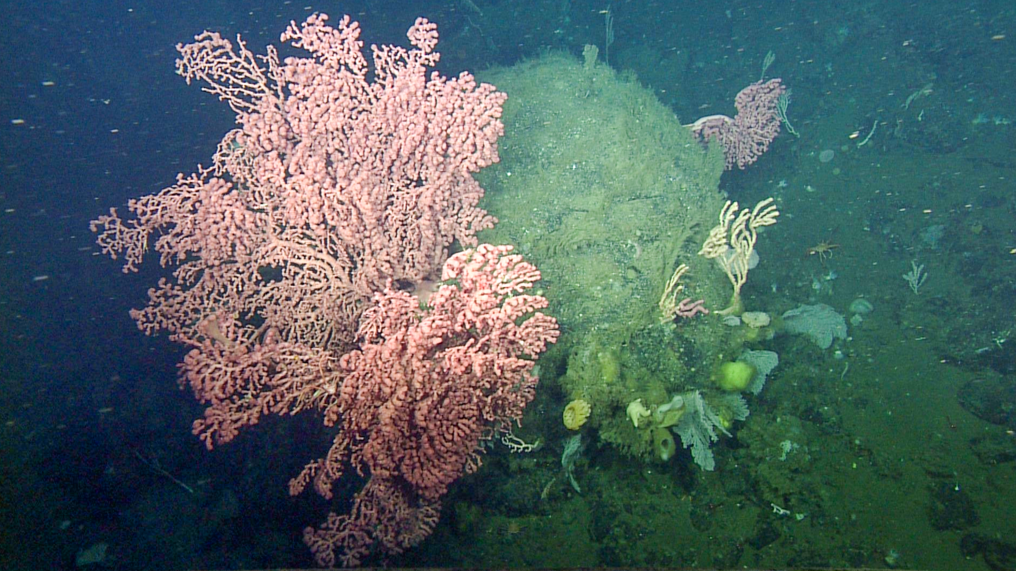

Slide 3
