Slide 1
Phytoplankton taxa proxies from satellite and autonomous sensors
Goals:
1- quickly review feasibility study results
2- plans for follow-up project

Slide 2
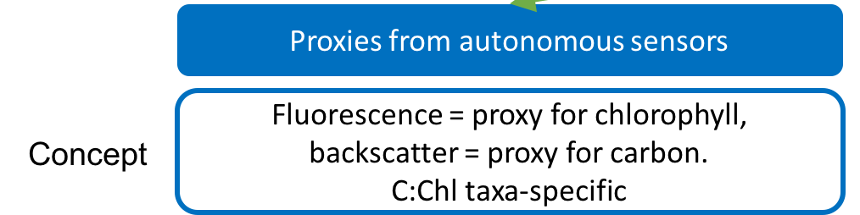
Proxies from autonomous sensors
Questions:
1) Is C:Chl taxa-specific?
(= relationship between Chl/POC and taxa from in situ samples)
1pre) Are samples taxa-specific? (can samples be attributed to one taxon?)
2) Are fluo / beamc / bbp proxies for Chl / C?
(= relationship between fluo/Chl and Cproxy/POC, where Cproxy = beamc or bbp)
2pre) Is the mooring dataset reliable? (QC / interdeployment calibration)
3) Can fluo / beamc or fluo / bbp be used to predict taxonomy?
(= relationship between fluo/Cproxy and taxa)
YES
only ~ 50%
YES for fluo,
NOT REALLY for beamc, NOT SURE for bbp
QC / calibration difficult → small dataset
MAYBE

Slide 3
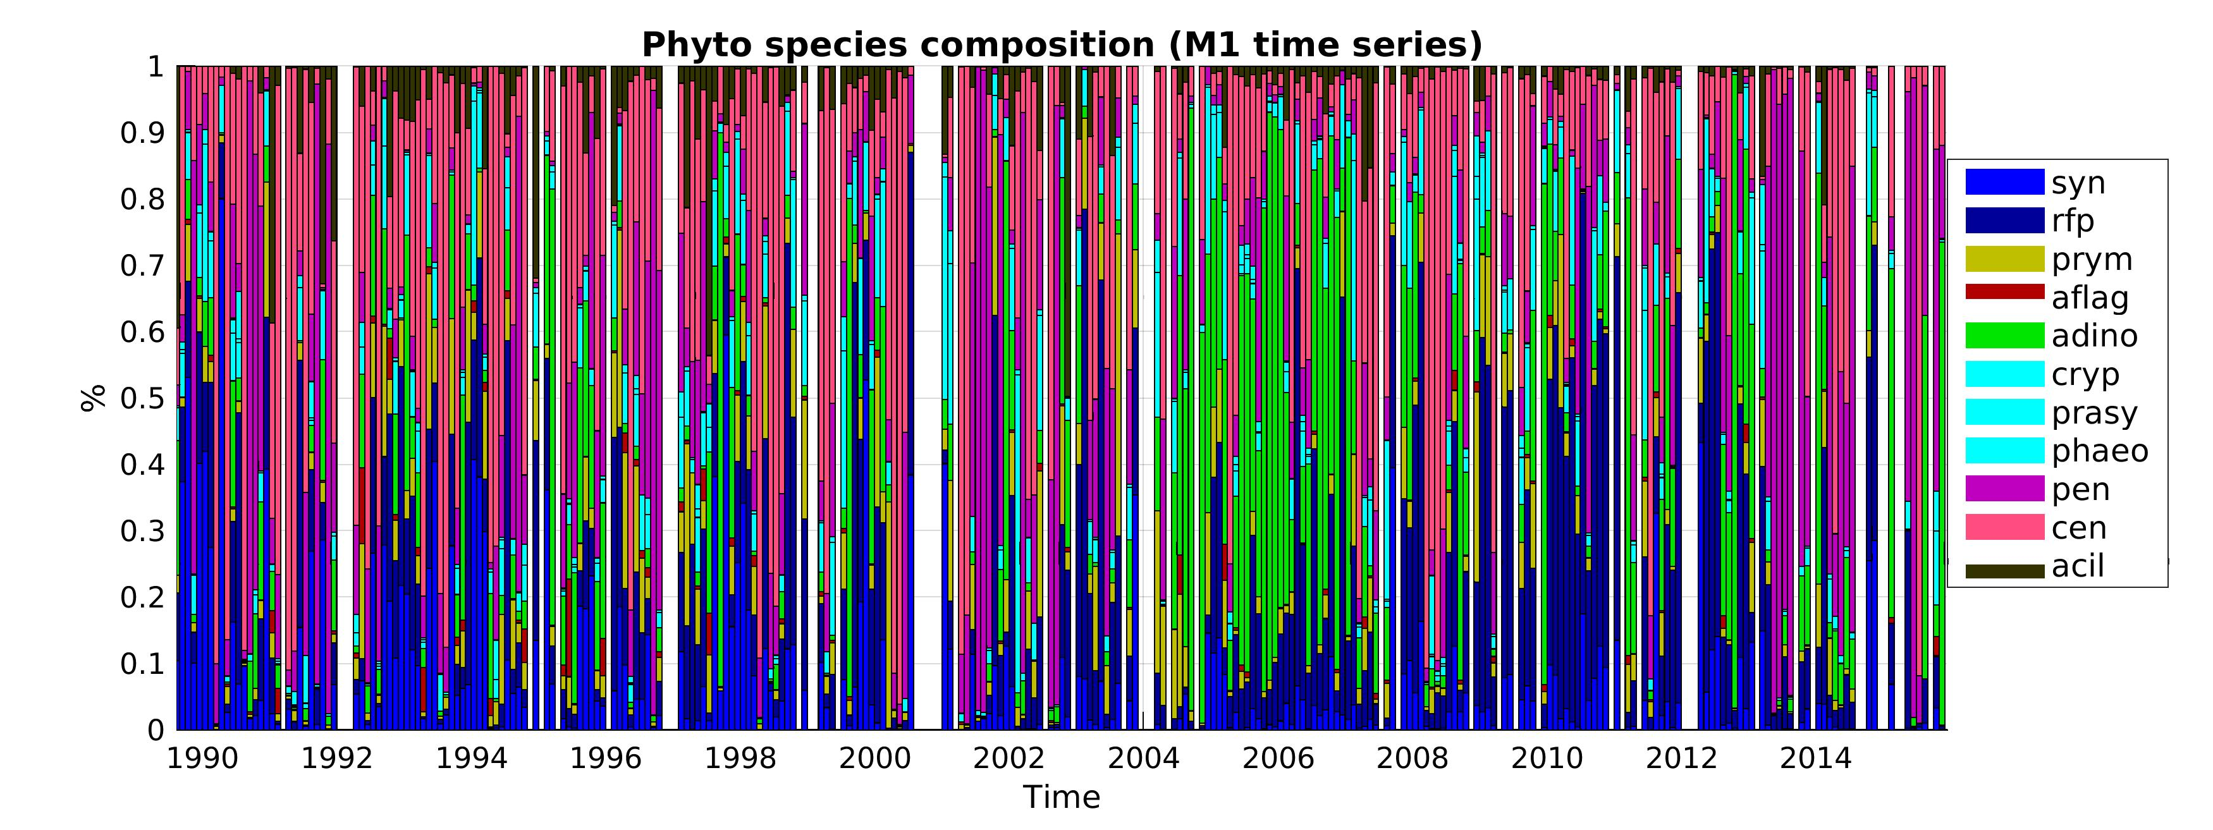
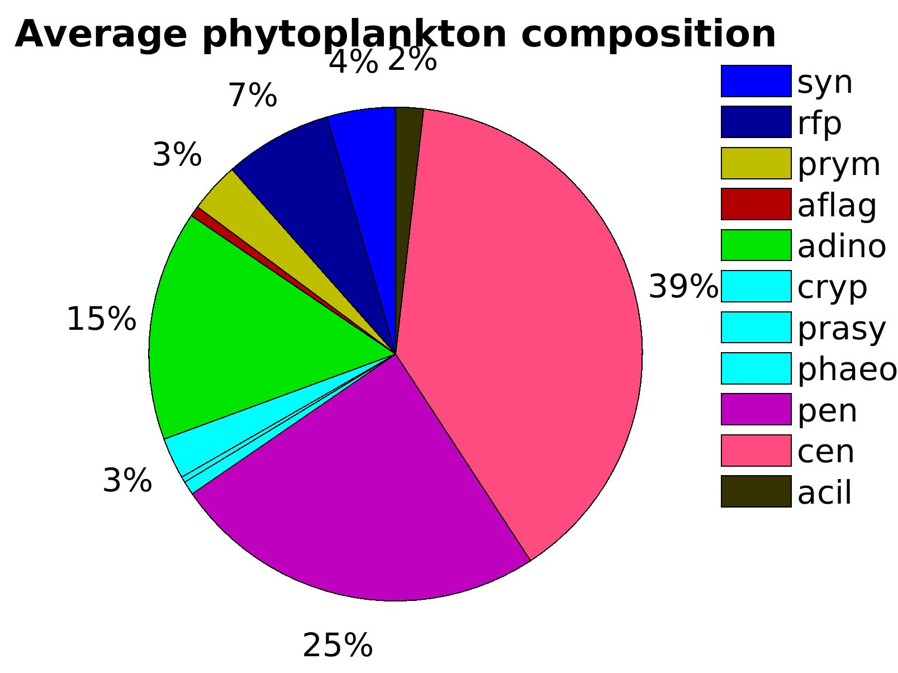
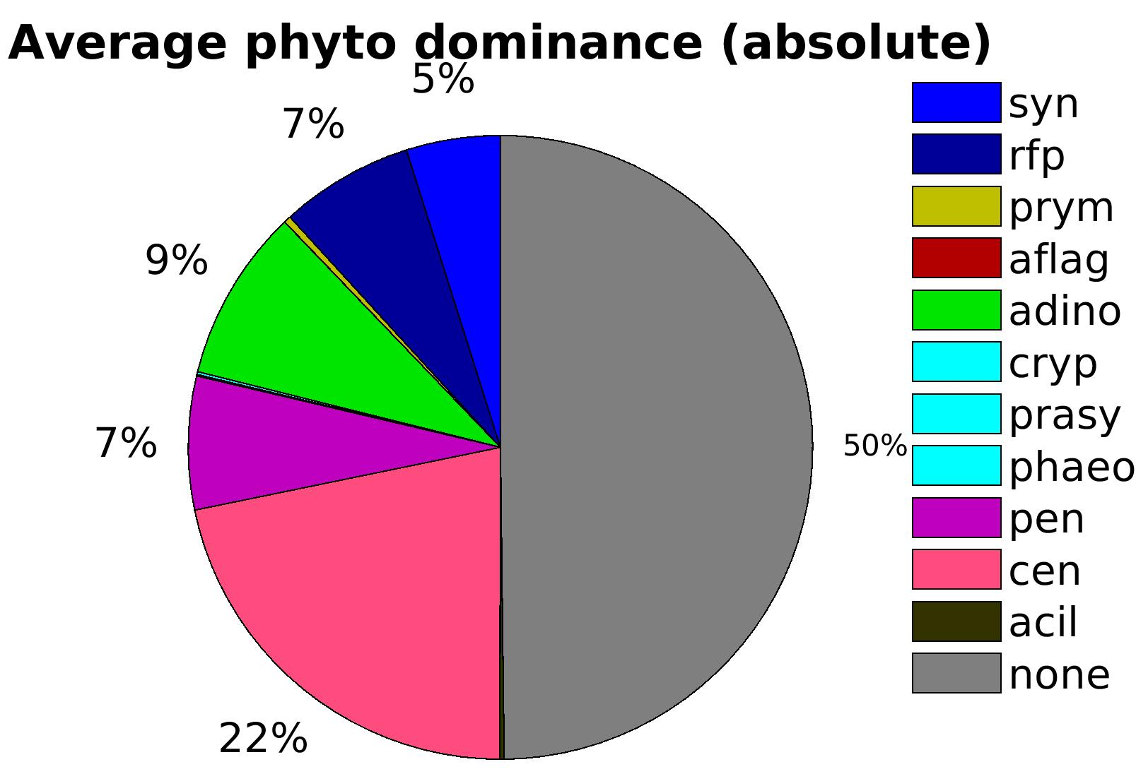
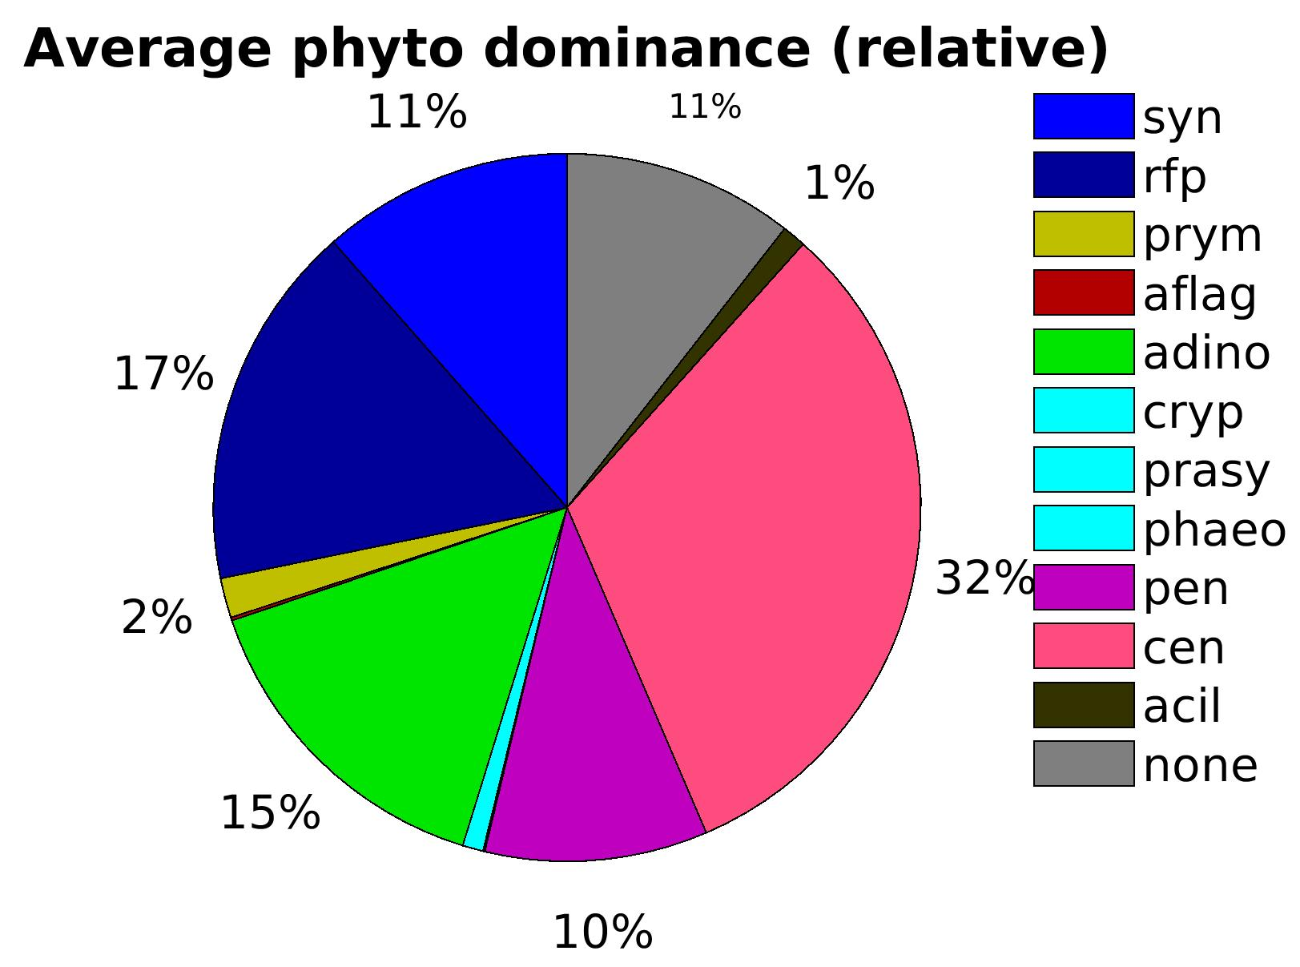
1pre) Phytoplankton community
small
dinoflagellates
centric diatoms
pennate diatoms
- absolute dominance: species >= 50% of the biomass
- relative dominance: species is the most abundant
and represents > 30% of the biomass
Most samples are a mix of species,
not a lot of samples dominated by dinos.
NONE
small
small
dinoflagellates
pennate diatoms
NONE
centric diatoms
centric diatoms
dinoflagellates
pennate diatoms

Slide 4
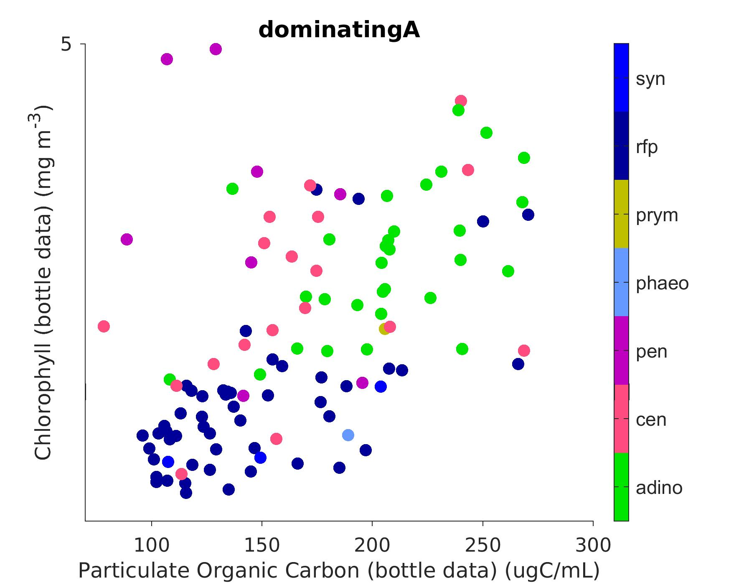
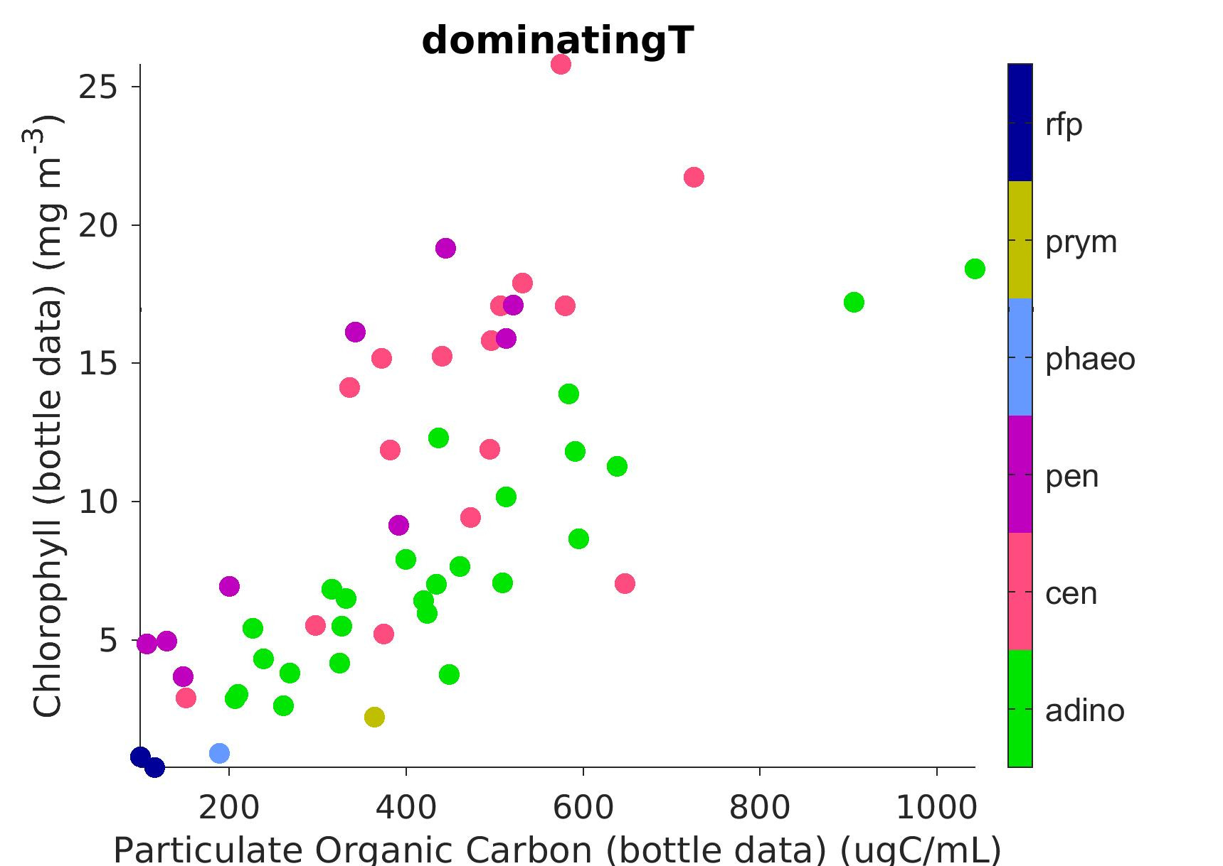
1) Taxonomy = f° (C,Chl)
YES
BUT samples strongly dominated by one taxon are separable in Chl/POC space.
Dominating = above 80%
Dominating = above 50%
Yaxis = Chl
zoom
Xaxis = POC
(only samples dominated by one group)

Slide 5
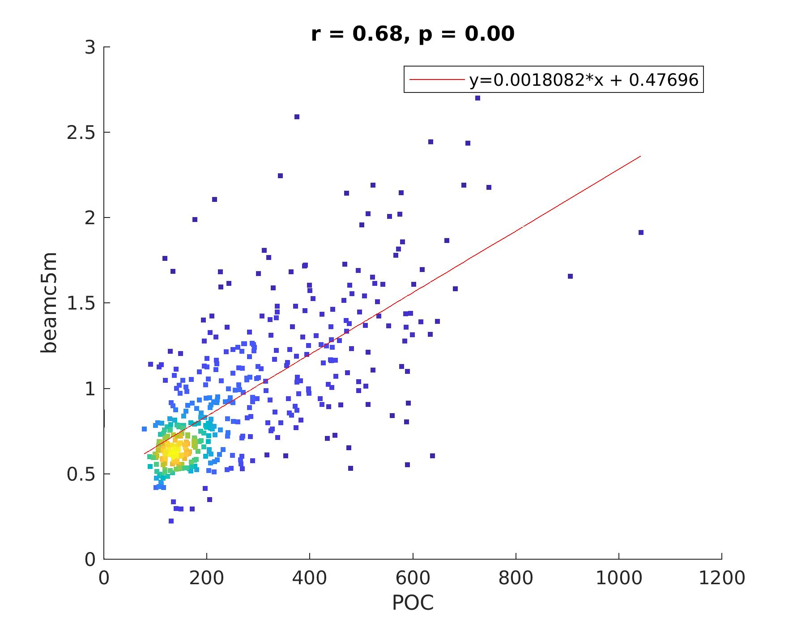
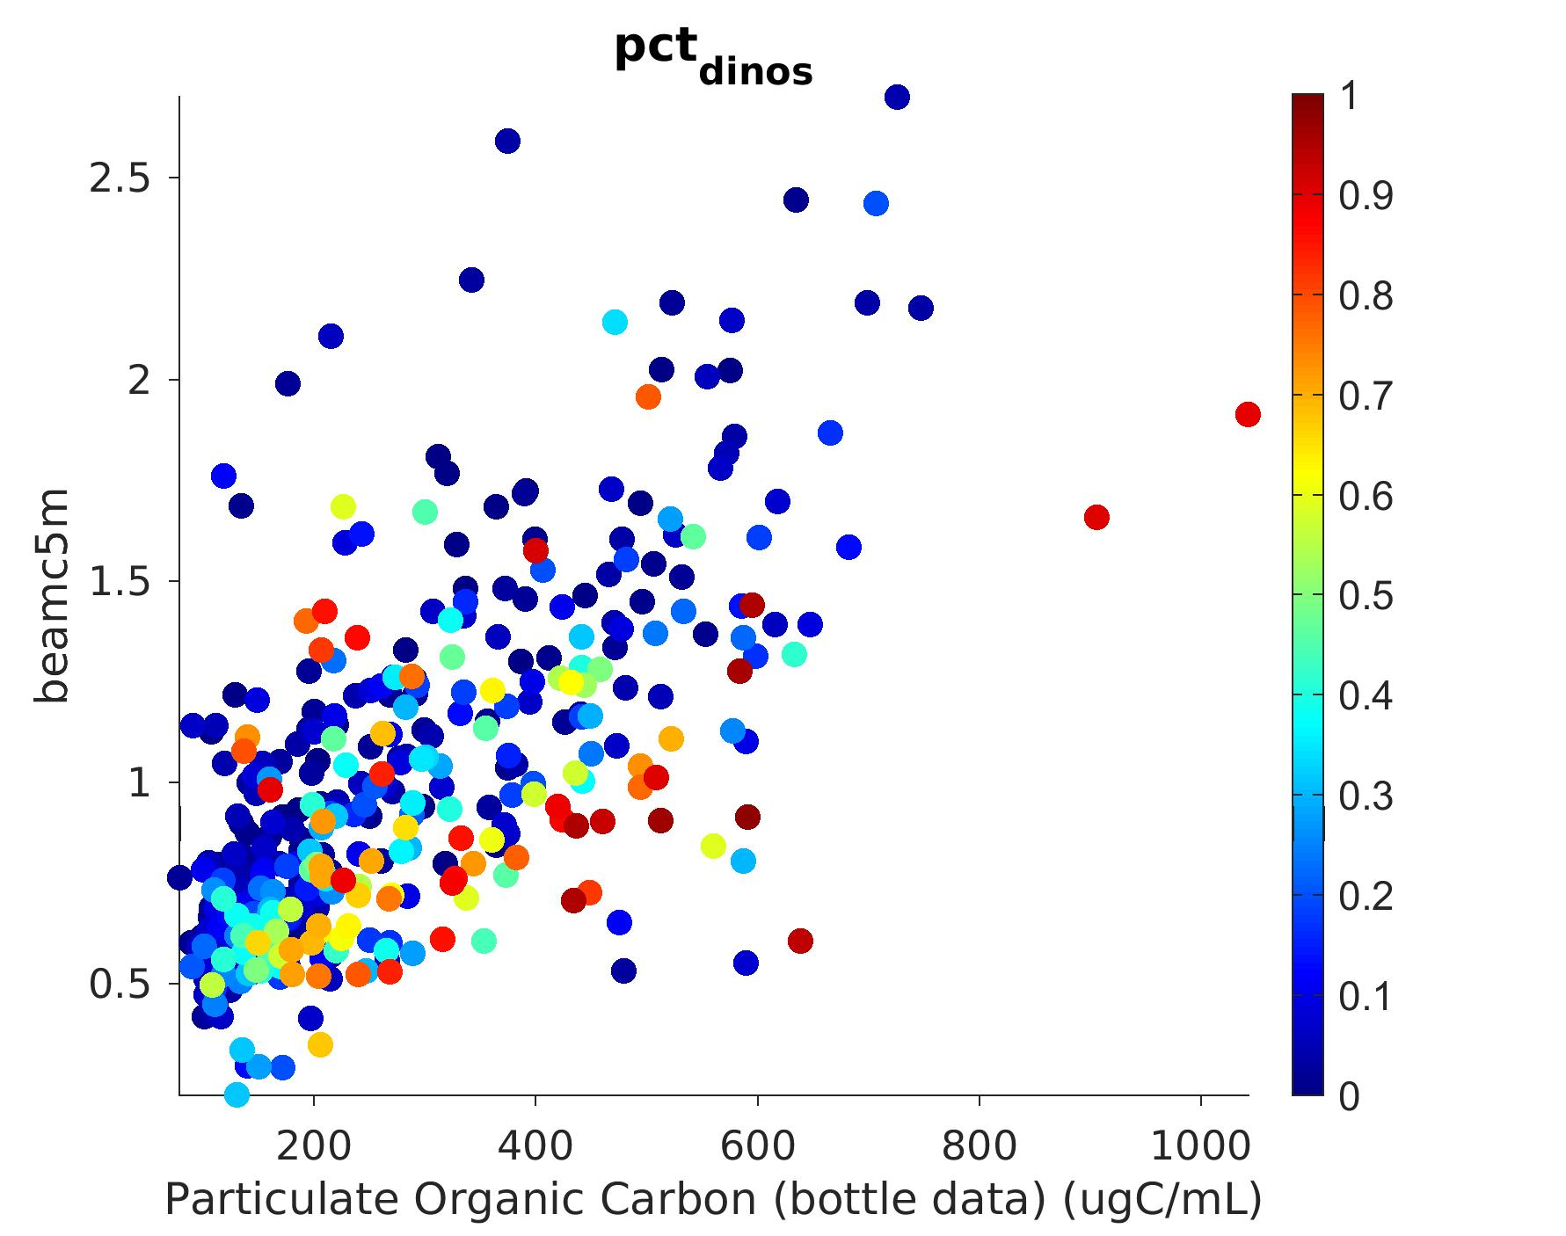
2) Beam-c proxy for POC?
NOT REALLY (particularly w/ dinos)
Correlation POC / beamc @5m
All samples | r = 0.68
pct_dinos > 0.5 | r = 0.50
pct _dinos < 0.5 | r = 0.74
pct_diatoms > 0.5 | r = 0.70
pct_diatoms < 0.5 | r = 0.64
Yaxis = beam-c @5m
→ relationship POC / beamc breaks down for dinos.
(beamc lower than expected for dinos)
Xaxis = POC

Slide 6
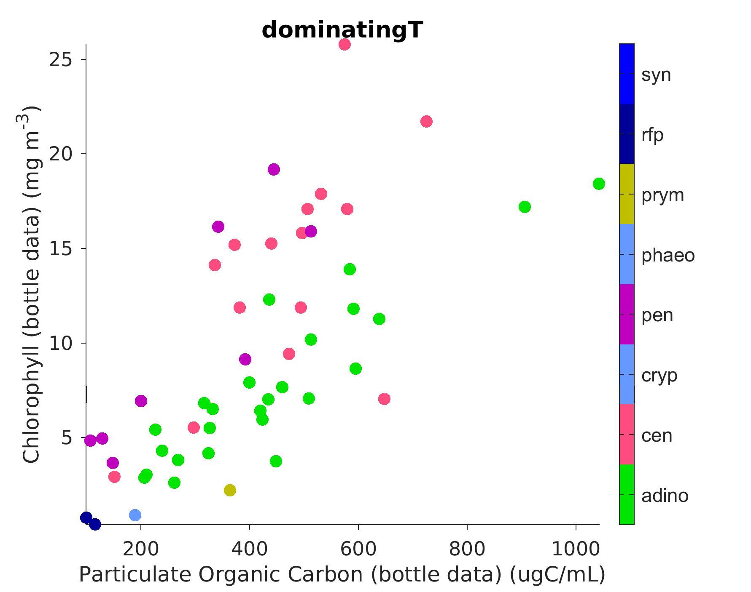
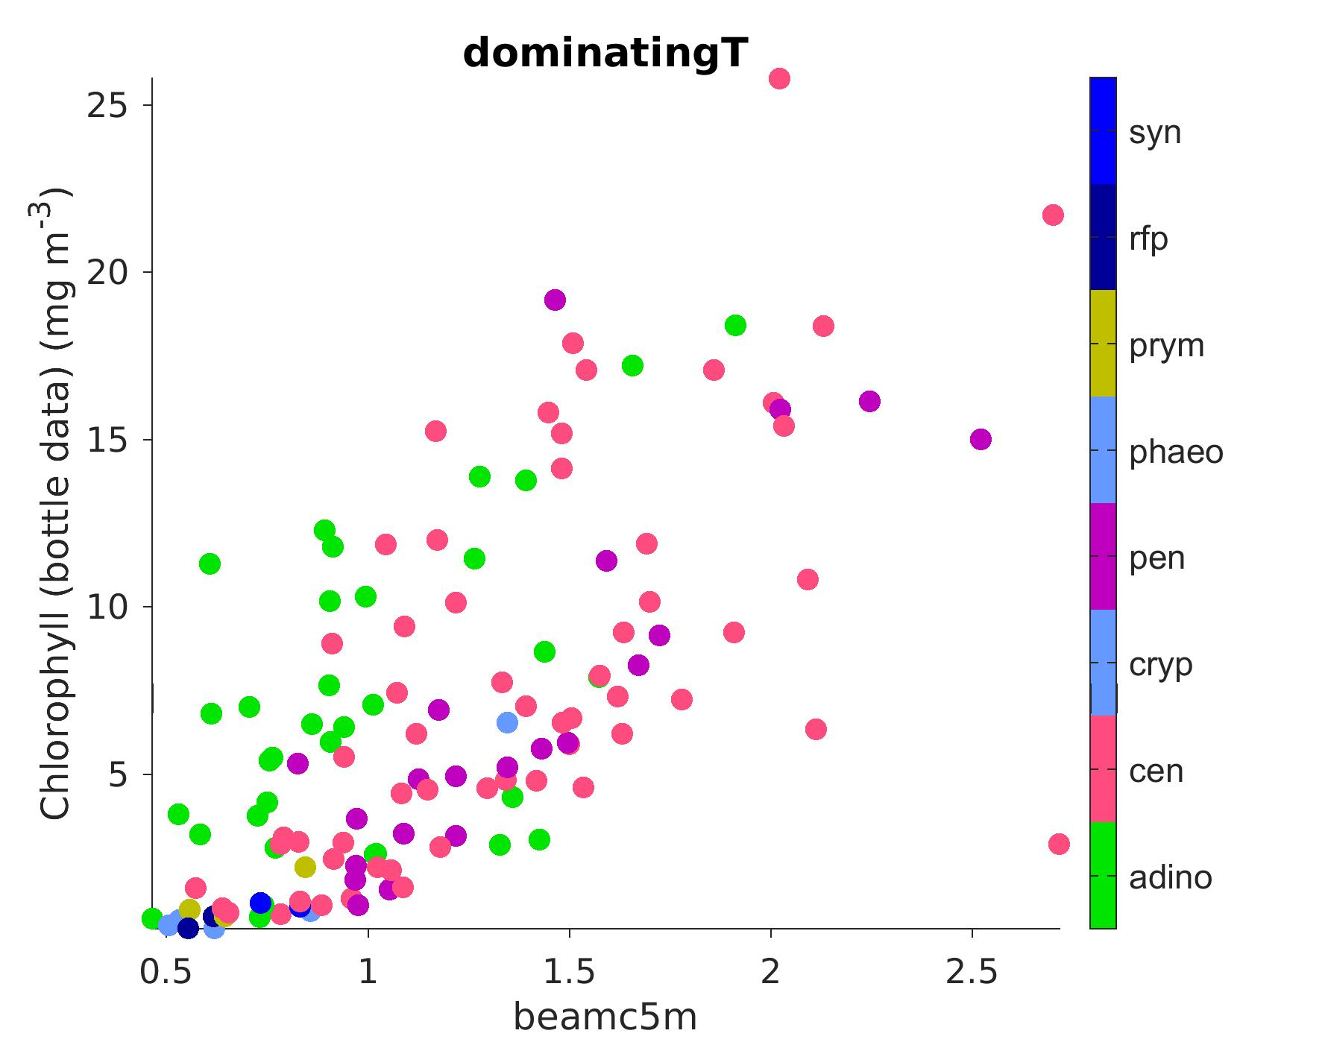
3) Taxonomy = f°(Chl, beamc @5m)
NO (b/c of beam-c/POC dinos issue)
Yaxis = Chl
Xaxis = POC
Xaxis = beamc @5m
beamc:Chl lower for dinos
C:Chl higher for dinos – as expected
(same plot as slide 8)
opposite to expected relationship

Slide 7
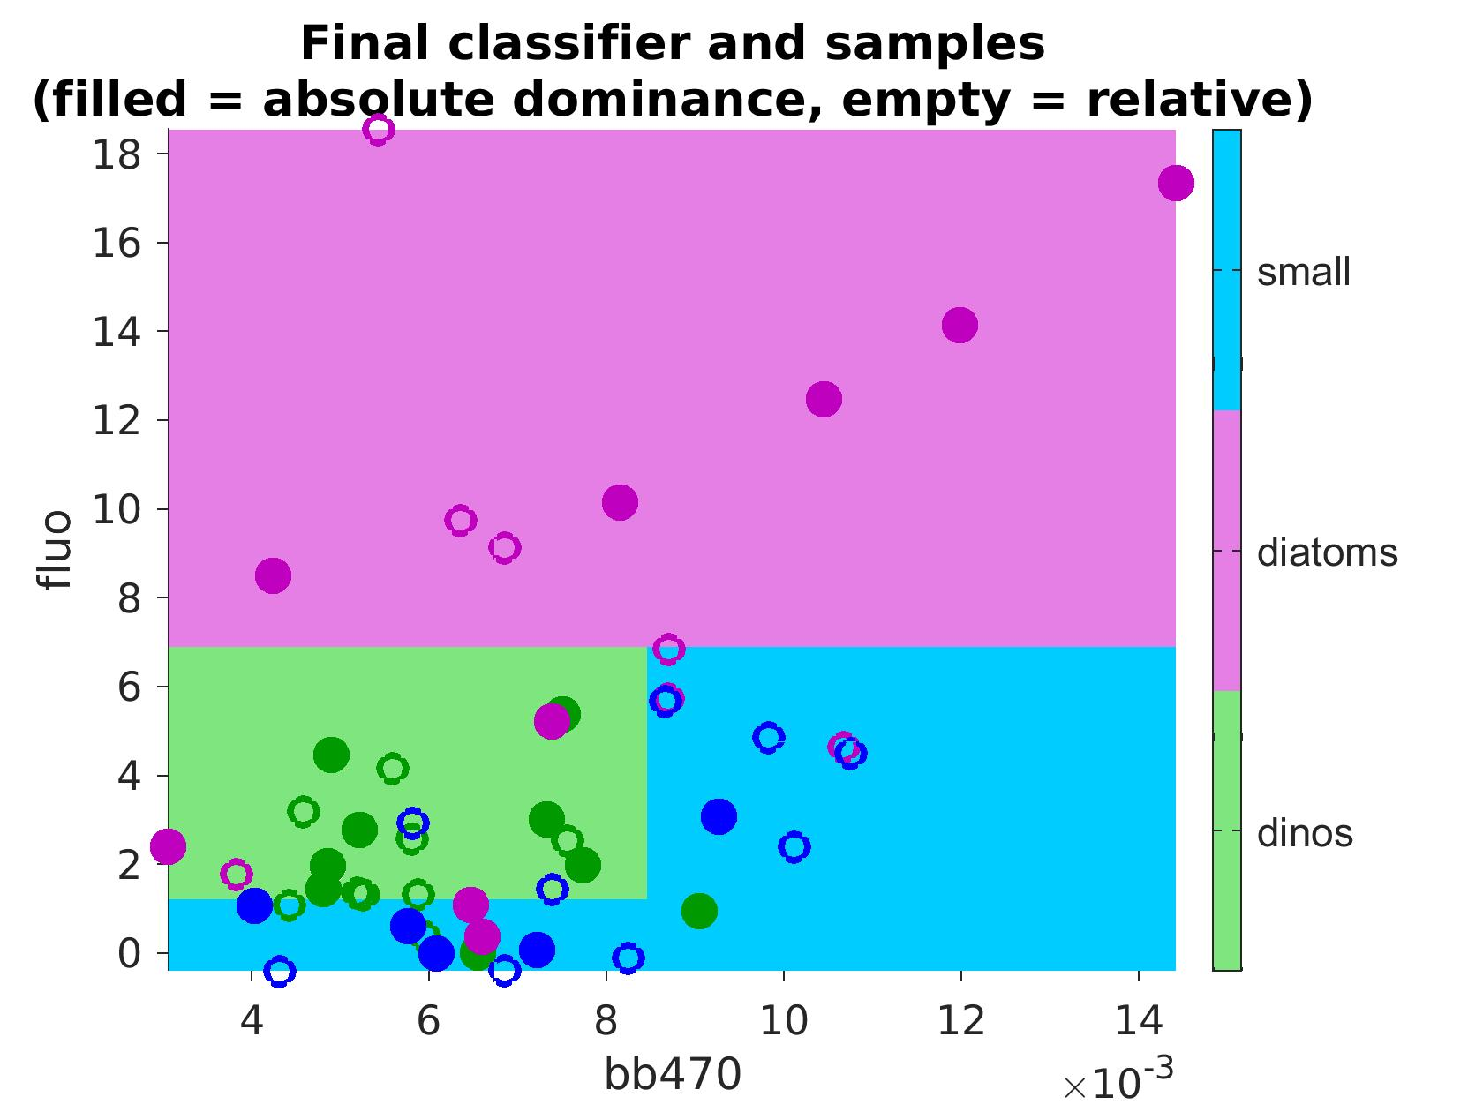
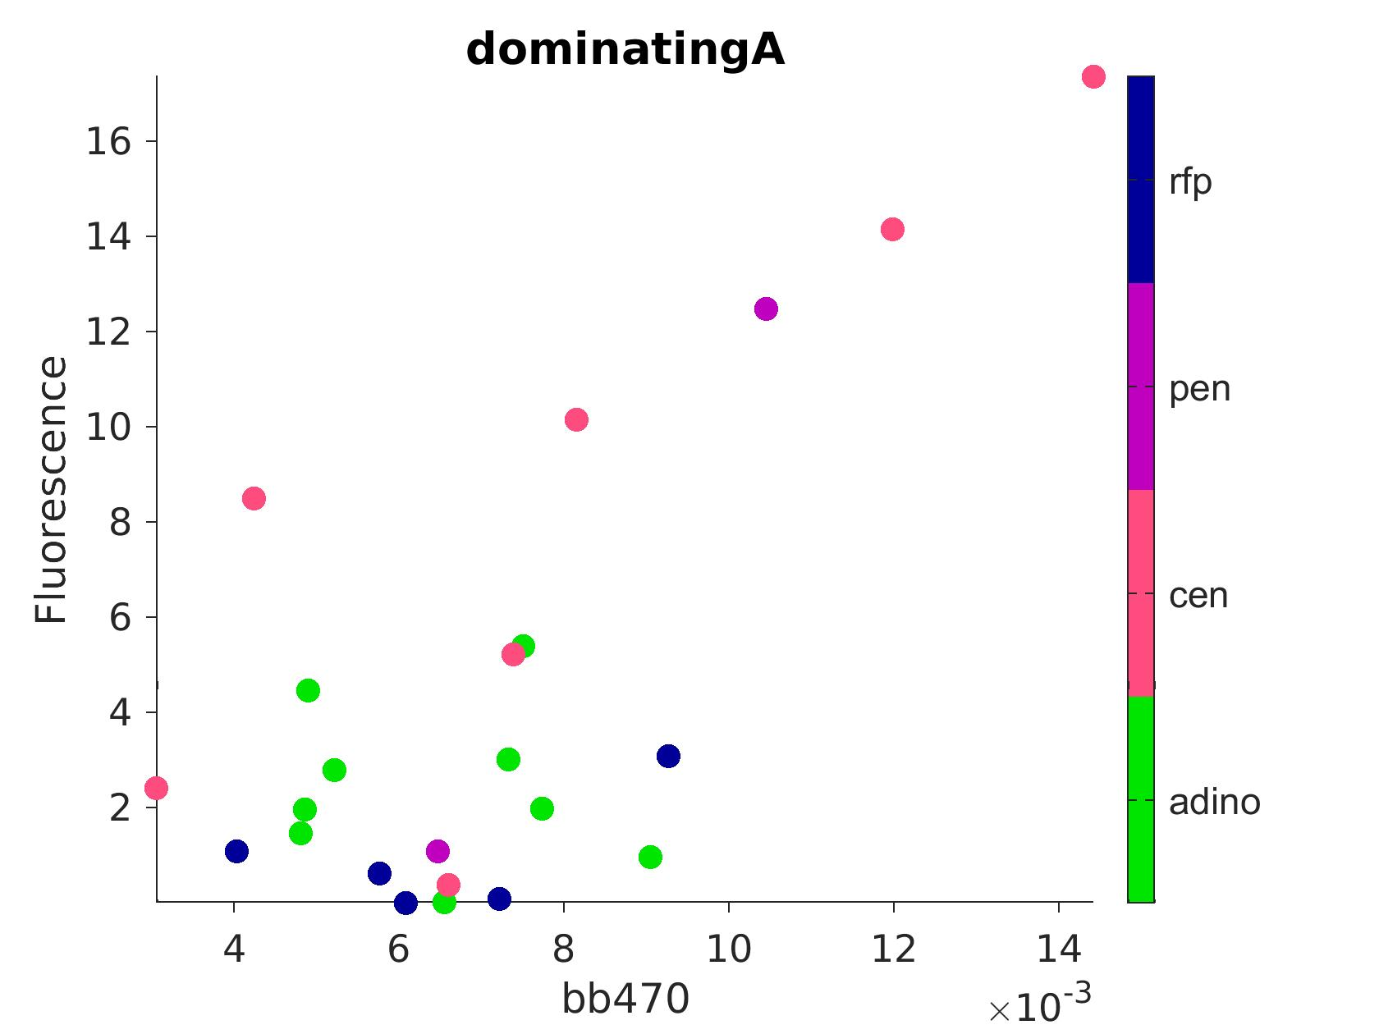
3) Taxonomy = f°(fluo, bbp)
MAYBE
machine learning tree algorithm succeeds in predicting taxonomy (relative dominance)
Surface mooring fluorescence
bb470
Zone that should possibly be attributed to diatoms
Mooring surface backscatter (bb470)
Algorithm trained on absolute dominance (> 50%, filled circles, N=23) and evaluated on relative dominance (open circles, N=26): 55% accuracy on training dataset, 65% on evaluation dataset (only predictors = fluo & bb470).

Slide 8
Machine learning tests
(CTD dataset)
Goal: investigate the presence/absence and robustness of a relationship between phytoplankton taxa and various environmental predictors
Main conclusions:
Taxa classification performance is limited by feature discriminatory power, not by sample size (CTD dataset).
Explored features are limited in their ability to separate communities dominated by Dinoflagellates.
Consistent high-bias model performance across all feature combinations may indicate the presence of noise in the response variable (= taxonomy from BOG samples).
The predictive power of features that do not measure biological properties directly (e.g., time of year, water temp, distance from coast, etc.) suggests that a hierarchical approach that leverages these variables as priors (e.g., in a Bayesian network) may be more appropriate.

Slide 9
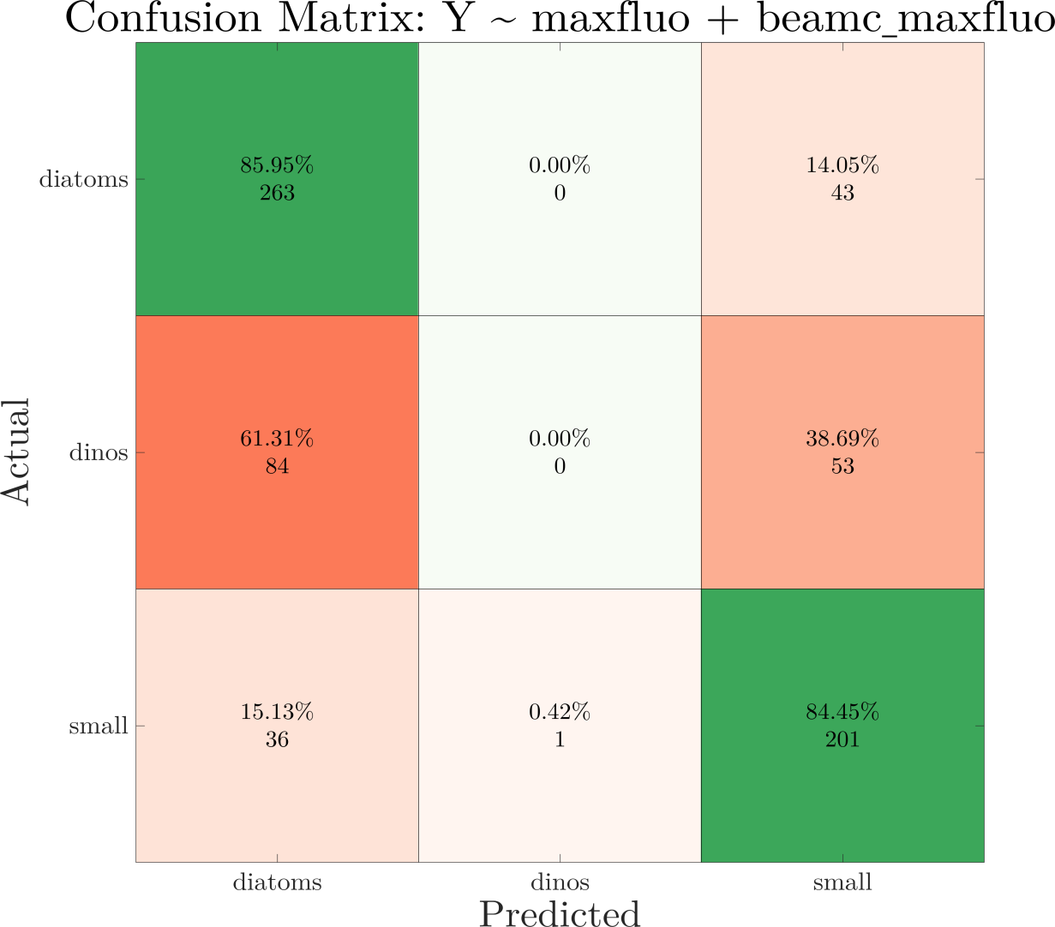
SVM performance:
Model inputs
maxfluo+beamc_maxfluo
Results after hyperparameter optimization:
Confusion matrix obtained from cross-validated model

Slide 10
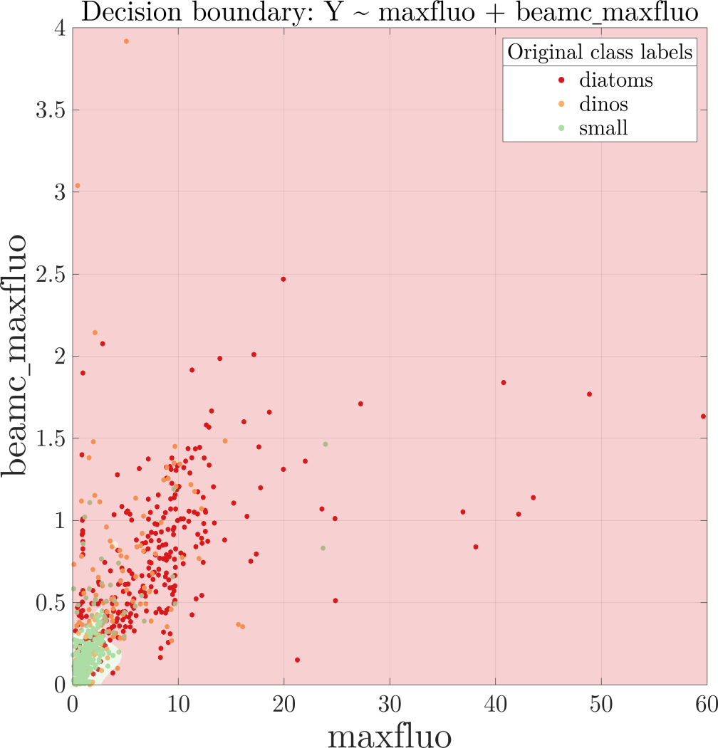
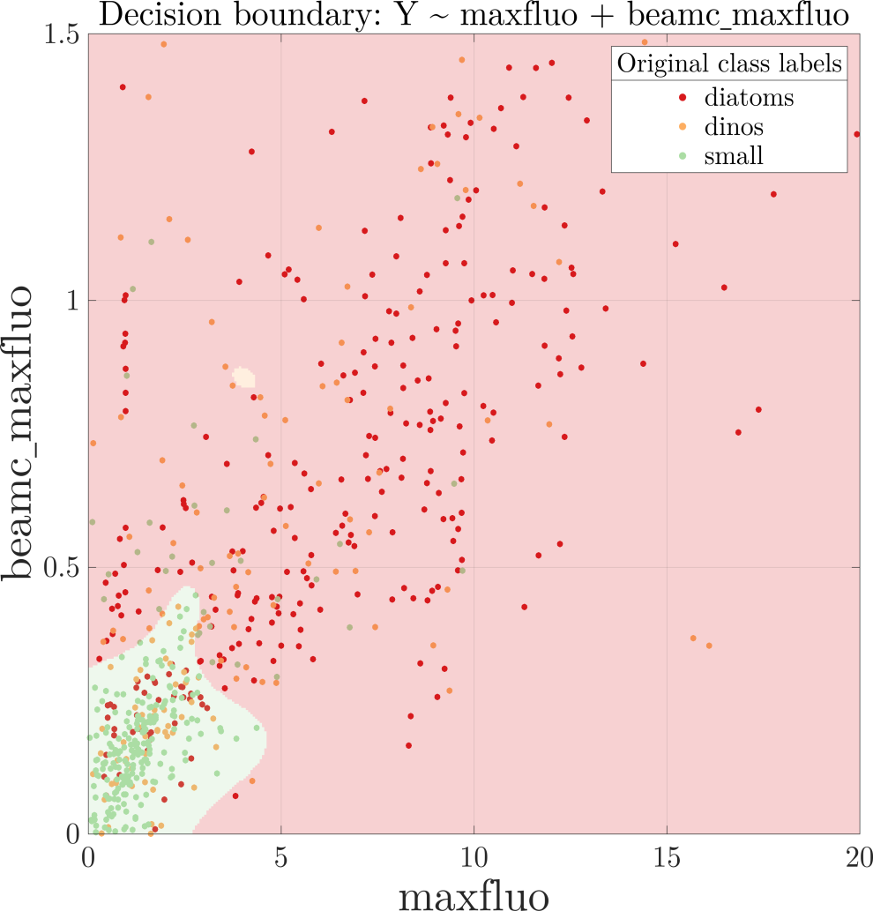
SVM performance:
Features provide reasonable separation between Diatoms and Pico classes, but are unable to separate Dinoflagellate class
The classification regions from the SVM are shown in the background shading, with data points (actual labels) overlaid

Slide 11
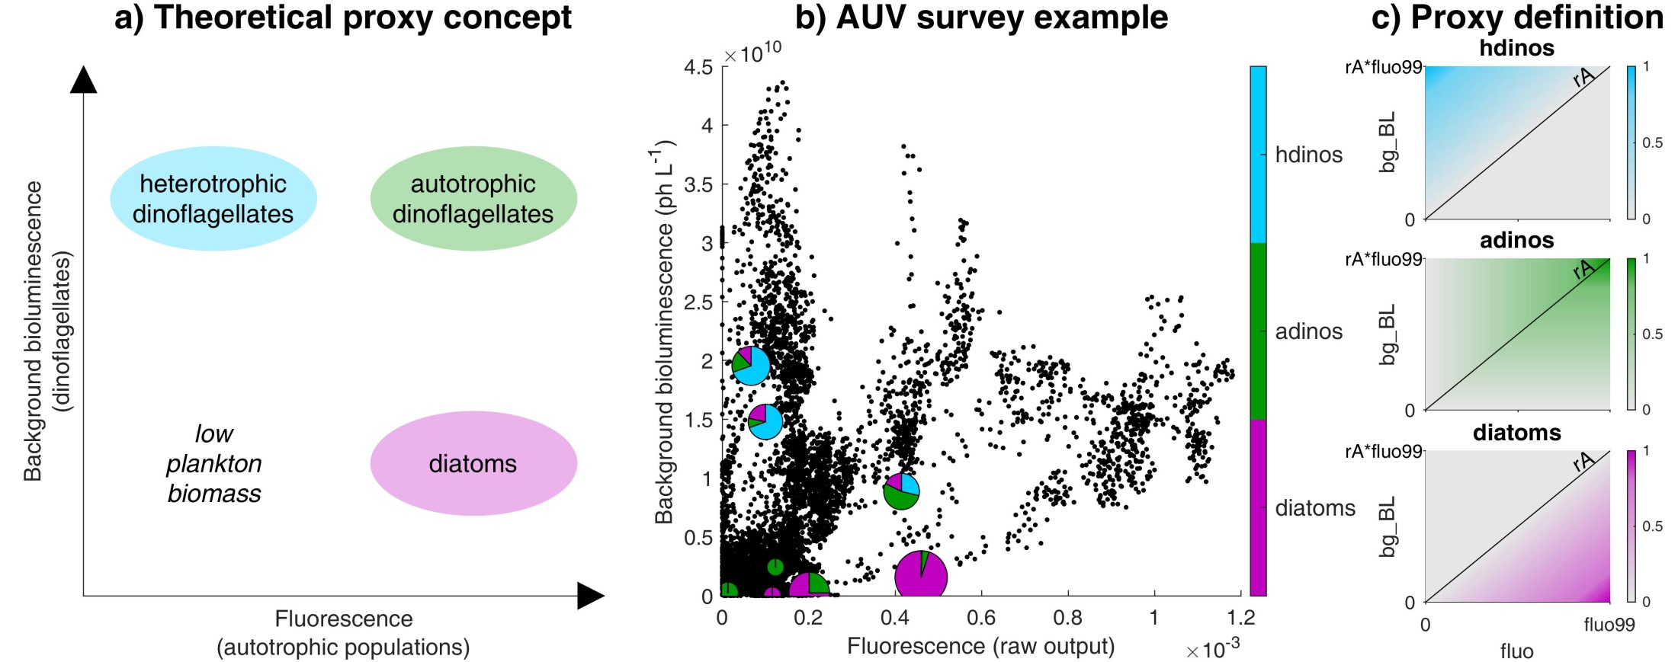
Biolum proxies
Messié et al., submitted to Progress in Oceanography

Slide 12
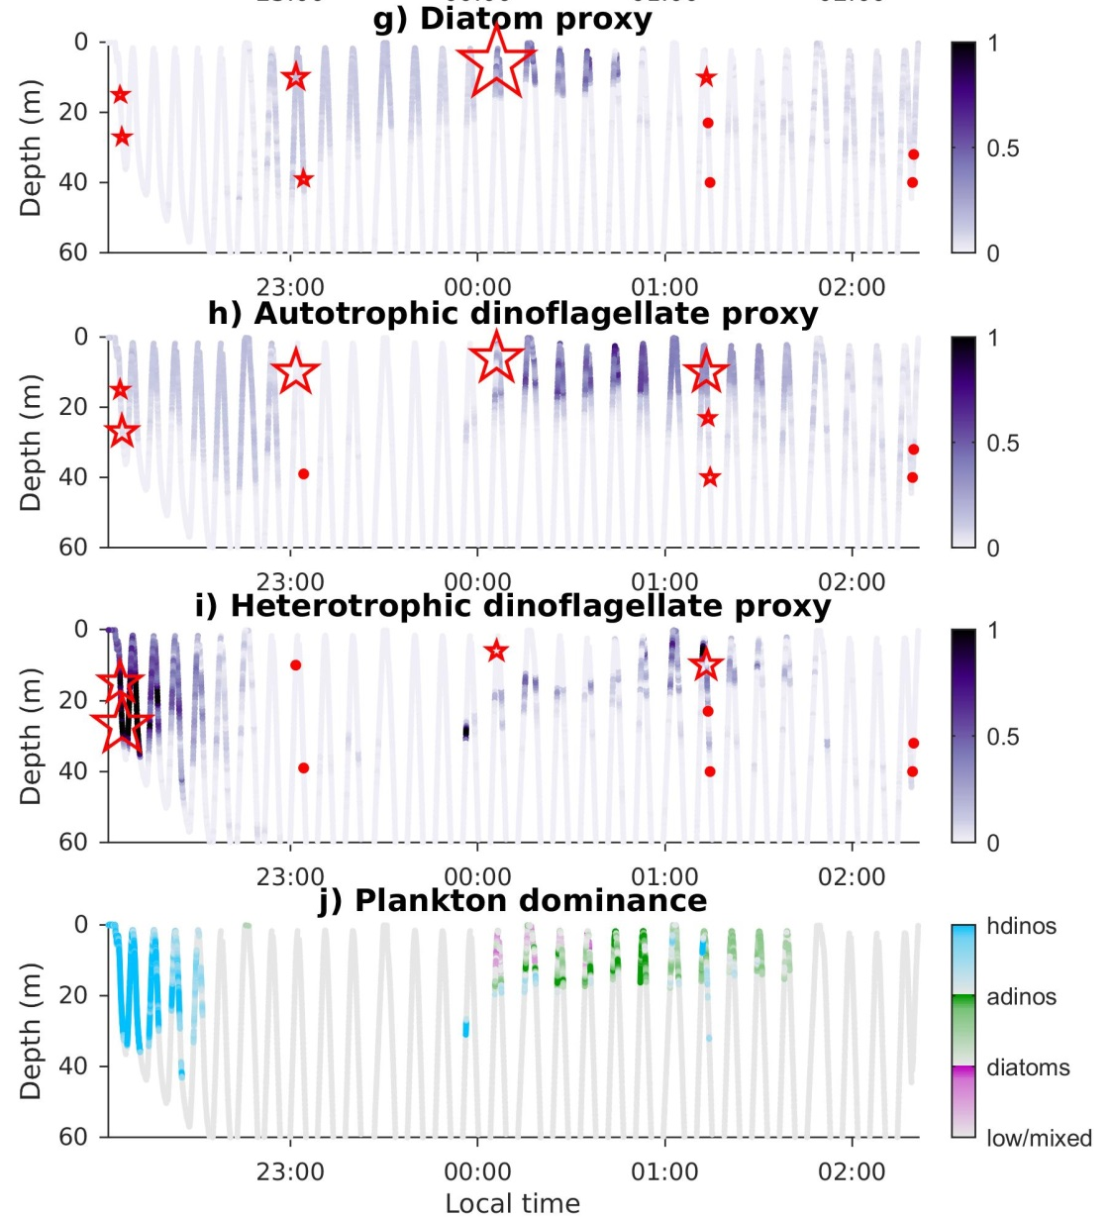
Biolum proxies
Stars/dots = in situ plankton counts
Proxies for diatoms and autotrophic dinoflagellates (nighttime Dorado only)
Messié et al., submitted to Progress in Oceanography

Slide 13
Follow-up project
Main conclusions:
Mixed samples will remain an issue…
… but on other samples there is a relationship between taxa and Chl/POC (in situ)…
… which cannot be captured using the CTD dataset (fails when dinos are present).
Mooring dataset (fluo/bbp) more encouraging but number of samples too small (N=23).
Overarching goals:
Characterize plankton communities from AUV sensors (phytoplankton taxonomy on all AUVs/gliders, plus zooplankton on Dorado)
Investigate spatio-temporal patterns, environmental drivers, phyto/zoo interactions from 15 years of Monterey Bay data
Provide realtime information (onboard processing) for CANON-type experiments (eg follow plankton succession following upwelling) and targeted sampling

Slide 14
Follow-up project
Possible paths (proxies):
focus on the Dorado dataset and attempt to transfer the fluo/biolum proxies to fluo/bbp using supervised learning
focus on the Dorado dataset and look at information carried by additional sensors (LISST-100x, LOPC, LISST-HOLO)
focus on the Dorado diamond dataset that can be matched with gulper analysis (?) and Monterey/Santa Cruz wharf samples
analysis of all available AUV/gliders datasets, using unsupervised learning (look for patterns in data, not necessarily linked to proxies)
Challenges (technical):
bring together huge and disparate datasets efficiently (this analysis and others)
unlimited number of parameters to look at
features vs. point-by-point → look at patches
propagate the information back into the databases
scientific analysis of the results (big data)

Slide 15

