Slide 1
Plankton taxonomic groups from AUV
Monique Messié & Ben Yair Raanan
(+ Francisco Chavez, Mike McCann, Kevin Gomes, Katie Pitz, Yanwu Zhang, John Ryan)
901707

Slide 2
Outline
“taxonomic groups” = diatoms, dinoflagellates, picoplankton
Relevance
    Why develop plankton proxies?
    Goals & significance
    Link to strategic plan / tech roadmap
Background
    Feasibility study results
    Bioluminescence proxies
Project

Slide 3
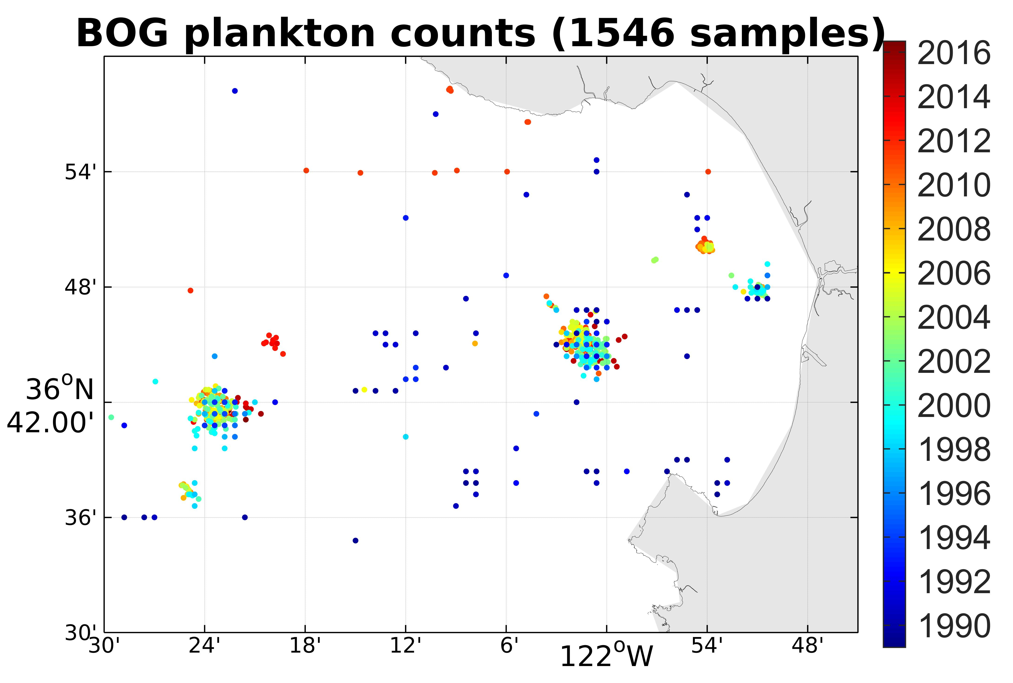
Phytoplankton taxonomy from in situ data
RELEVANCE

Slide 4
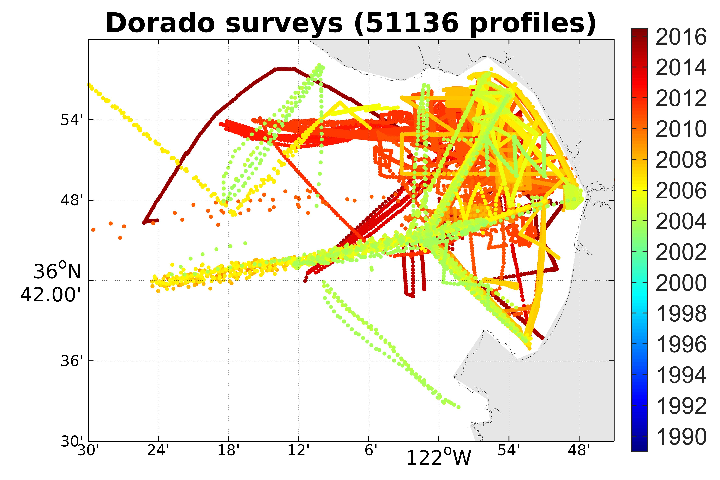
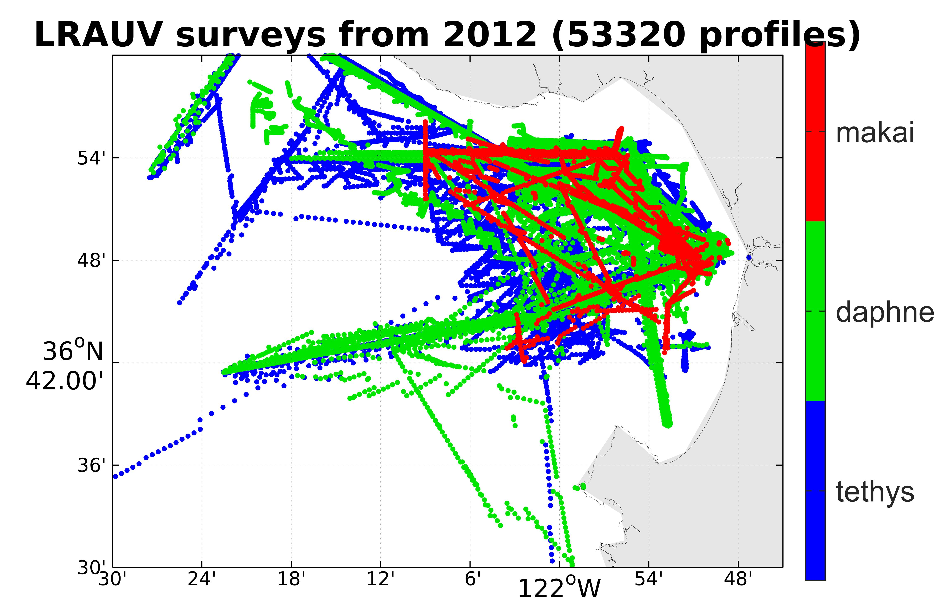
AUV coverage
RELEVANCE
full profiles
almost 2 orders of magnitude more locations
also ships & gliders

Slide 5
Goals & significance
RELEVANCE
Goal: develop proxies for high-level phytoplankton taxonomy (diatoms, dinoflagellates and picoplankton) from biological variables routinely measured by AUVs and gliders (fluorescence and backscatter)
Then decades of ship/AUV/glider and satellite proxies can be processed
  unprecedented views of phytoplankton ecology
  inform more advanced targeted sampling

Slide 6
Relevance to MBARI goals
RELEVANCE
Tightly coupled to MBARI research themes
“ecosystem processes” (impacts of phytoplankton types on higher trophic levels and carbon cycle),
“ocean visualization” (abundance & distribution of phytoplankton)
and “exploration and discovery” (new analytical tools)
In support of tech priorities
“taking the laboratory into the ocean” (developing new tools and techniques for identifying, quantifying, and characterizing species),
and “enabling targeted sampling” (real-time characterization of marine organisms and communities).

Slide 7
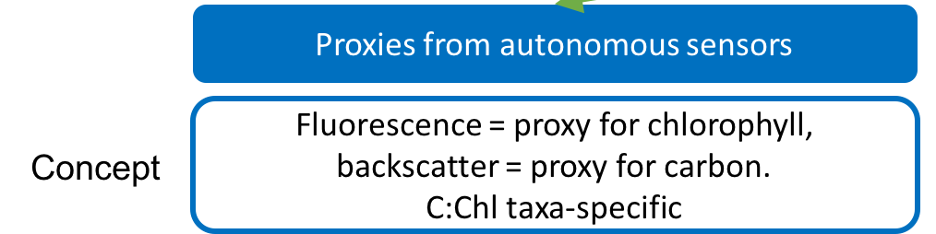
Results from the feasibility study
BACKGROUND
Relationships between phytoplankton taxonomy (BOG samples) and predictors
Questions:
Is C:Chl taxa-specific?
1pre) Are samples taxa-specific?
2) Are fluo / beamc / bbp proxies for Chl / C?
3) Can fluo / beamc or fluo / bbp be used to predict taxonomy?
YES
only ~ 50%
YES for fluo,
NOT REALLY for beamc, NOT SURE for bbp
MAYBE
QC / calibration difficult → small dataset

Slide 8
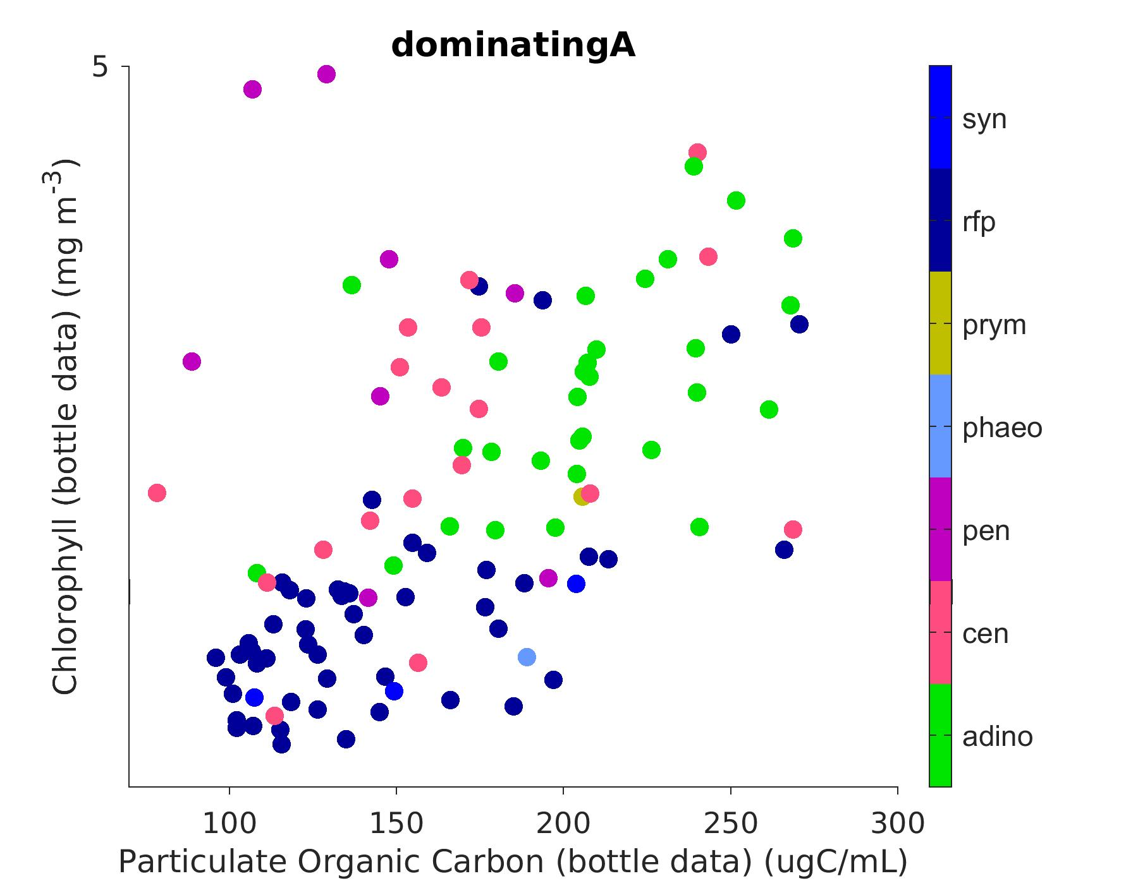
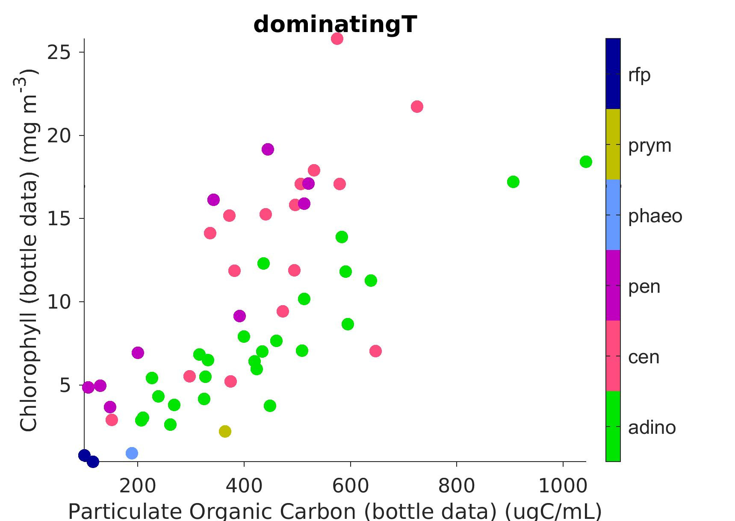
1) Taxonomy = f° (C,Chl)
BACKGROUND
YES
Dominating = above 80%
Dominating = above 50%
Yaxis = Chl
zoom
Xaxis = POC
(only samples dominated by one group)

Slide 9
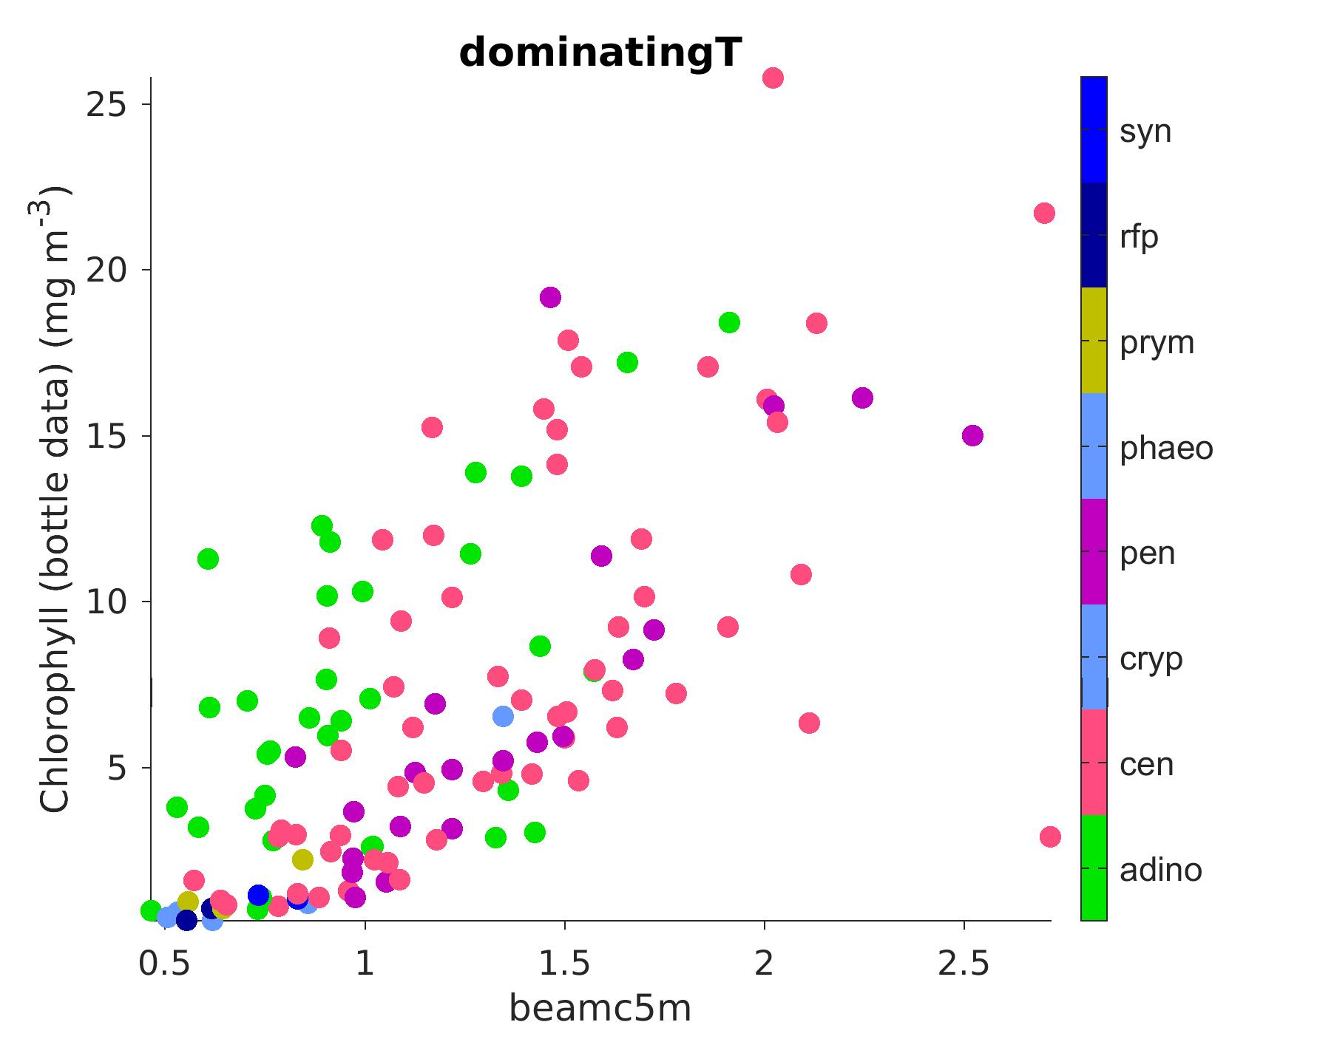
3) Taxonomy = f°(Chl, beamc @5m)
BACKGROUND
NO (b/c of beam-c/POC dinos issue)
Dominating = above 80%
Yaxis = Chl
Xaxis = POC
Xaxis = beamc @5m
C:Chl higher for dinos – as expected
beamc:Chl lower for dinos
opposite to expected relationship

Slide 10
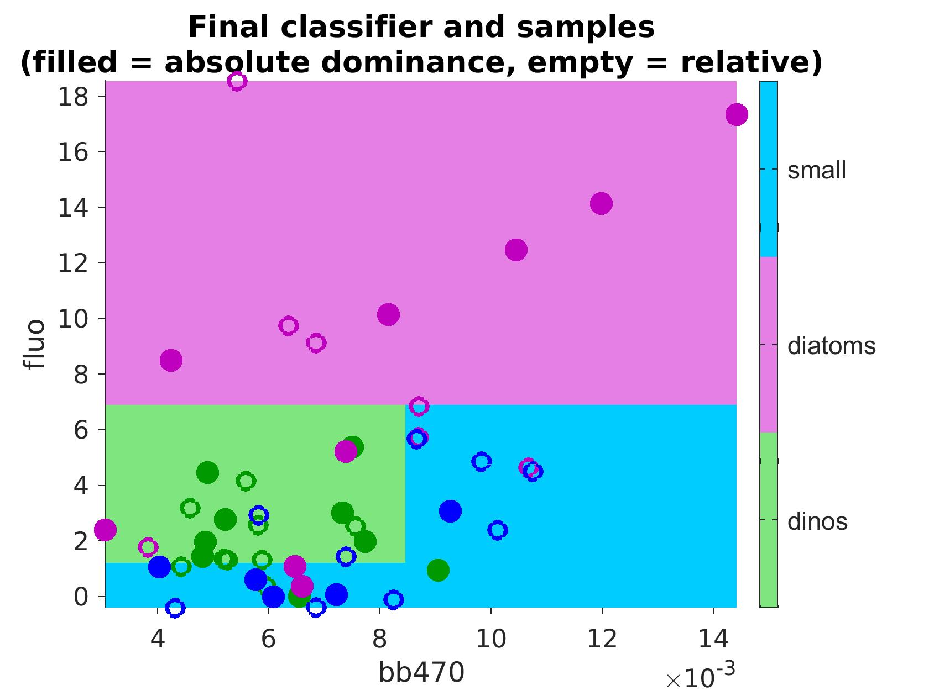
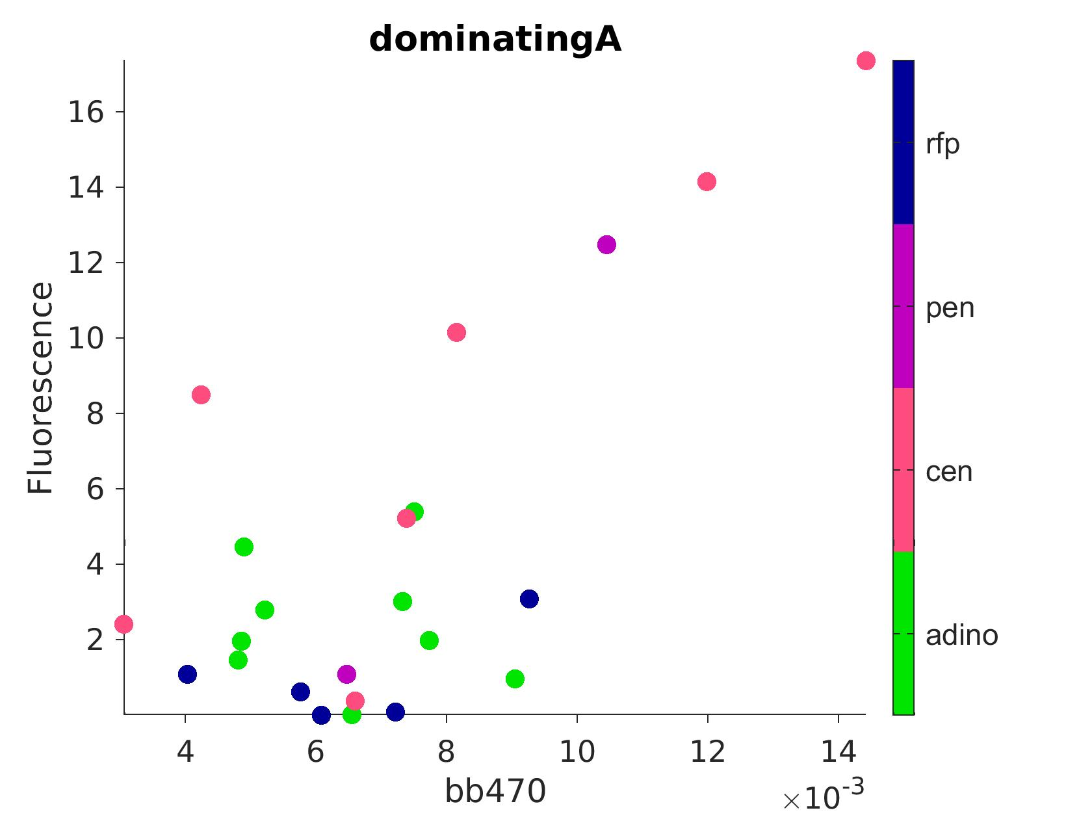
3) Taxonomy = f°(fluo, bbp)
BACKGROUND
MAYBE
absolute dominance (> 50%)
machine learning tree algorithm succeeds in predicting taxonomy (relative dominance)
relative dominance (highest biomass)
Surface mooring fluorescence
bb470
Zone that should possibly be attributed to diatoms
Mooring surface backscatter (bb470)
Algorithm trained on absolute dominance ( ) and evaluated on relative dominance ( )

Slide 11
Machine learning
BACKGROUND

Slide 12
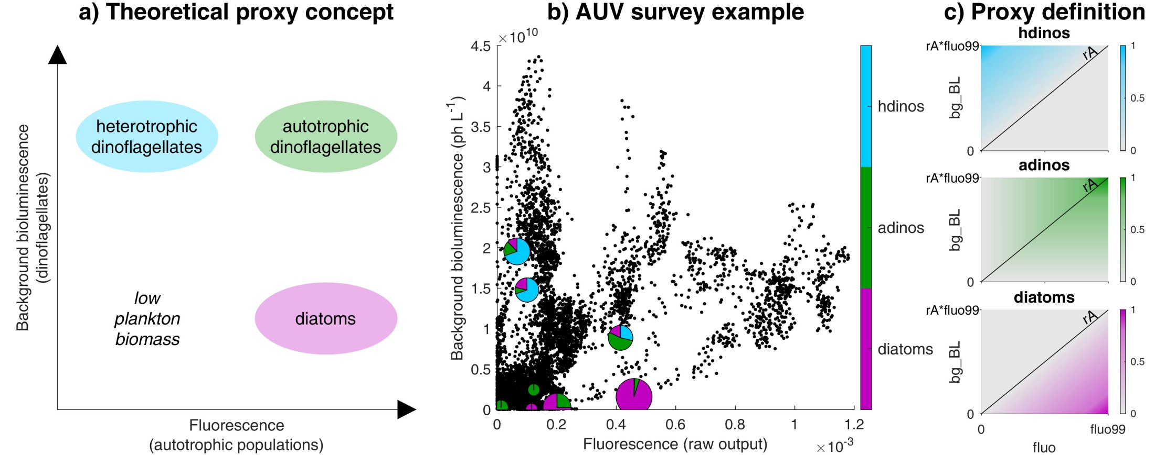
Bioluminescence proxies
BACKGROUND
Messié et al., submitted to Progress in Oceanography

Slide 13
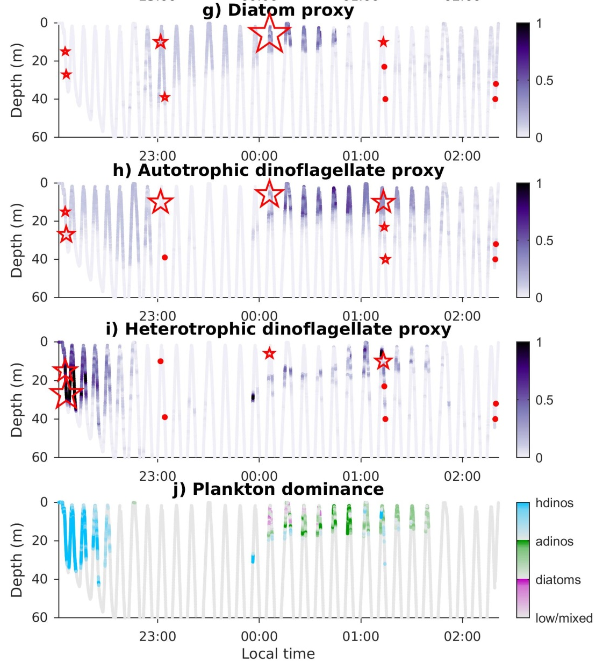
Bioluminescence proxies
BACKGROUND
Stars/dots = in situ plankton counts
Proxies for diatoms and autotrophic dinoflagellates (nighttime Dorado only)
Messié et al., submitted to Progress in Oceanography

Slide 14
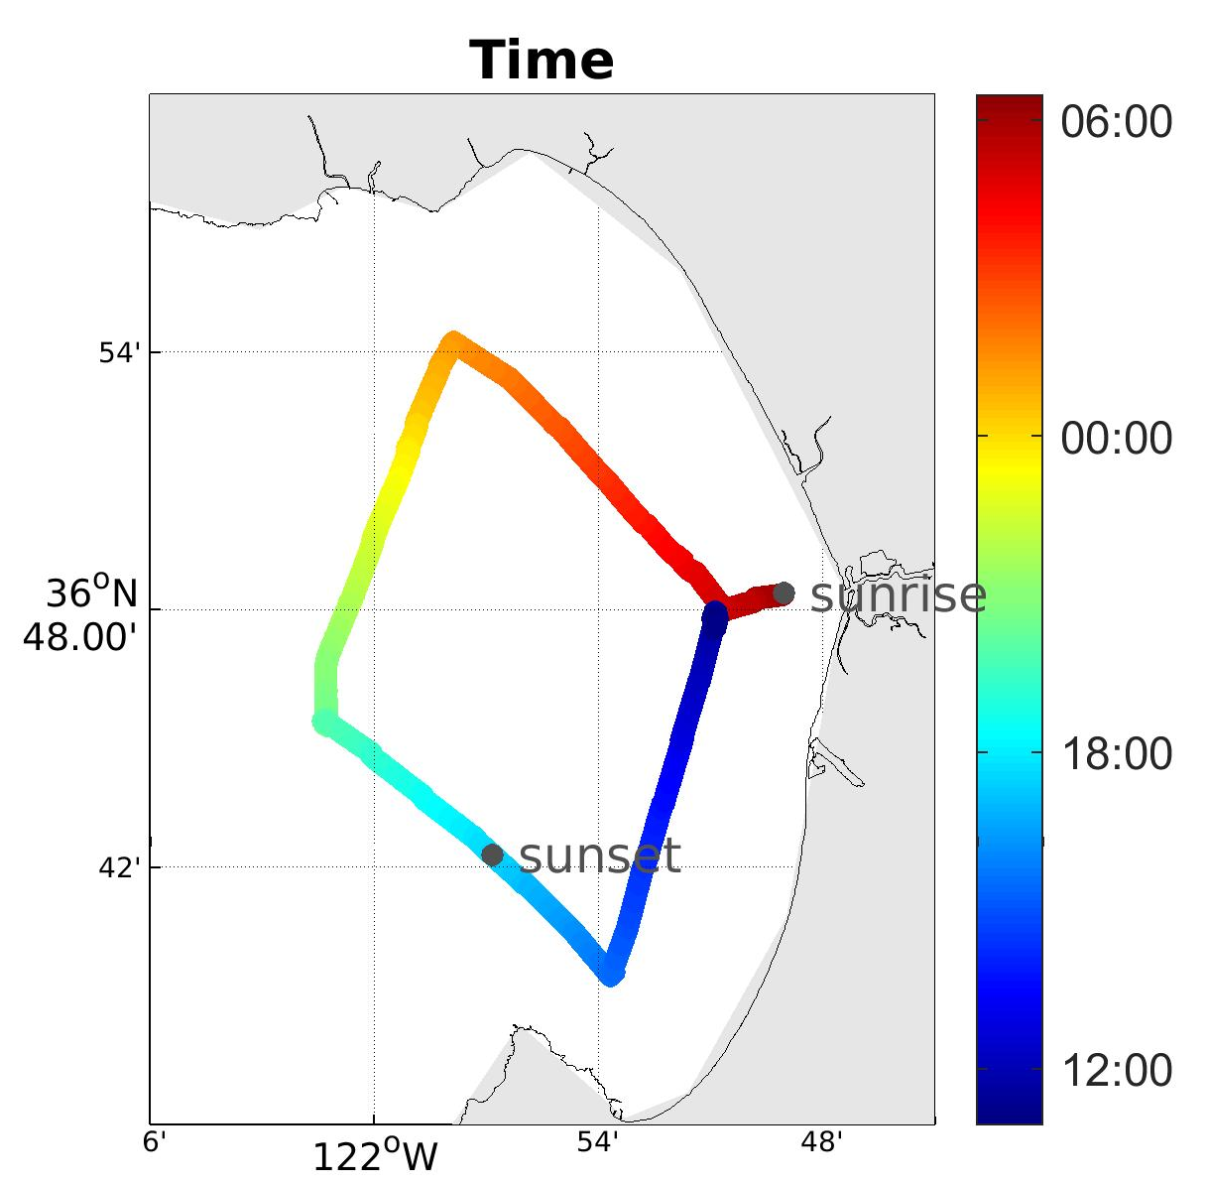
Project overview
PROJECT
At first, focus on the Dorado dataset with 2 paths:
1
Nighttime fluorescence / bioluminescence proxies
supervised machine learning
Fluorescence / backscatter
Dorado diamond dataset:
in situ samples
2
wharf sampling (representative of N & S corners)
eDNA sampling
currently 16 Dorado diamonds

Slide 15
Plans for 2019
PROJECT
First half (w/o Monique)
  Load the entire Dorado dataset into STOQS
  Assess usefulness of LISST-100x dataset
Second half
  Generate the bioluminescence labels & load into STOQS
  Work w/ Katie to generate eDNA labels
  Explore supervised ML on 2 sets of labels
  Start investigating diamonds in depth

