Slide 1
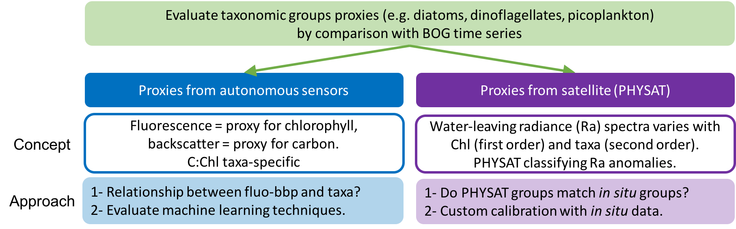
Plankton Proxies:
M1 / CTD dataset
Objective: investigate the presence/absence and robustness of a relationships between phyto taxa and fluo-bbp, based on:
  (a) BOG phyto counts at M1
  (b) concurrent fluo / beam-c datasets from the CTD

Slide 2
Plankton Proxies:
M1 / CTD dataset
Objective: investigate the presence/absence and robustness of a relationships between phyto taxa and fluo-bbp, based on:
(a) BOG phyto counts at M1
(b) concurrent fluo / beam-c datasets from the CTD
Only part of the dataset (counts at C1, M2; fluo / bbp available from the mooring).
Data: surface plankton biomass categorized in 11 taxonomic groups, surface Chl & POC, CTD profiles with fluo, beam-c, temperature, salinity, PAR

Slide 3
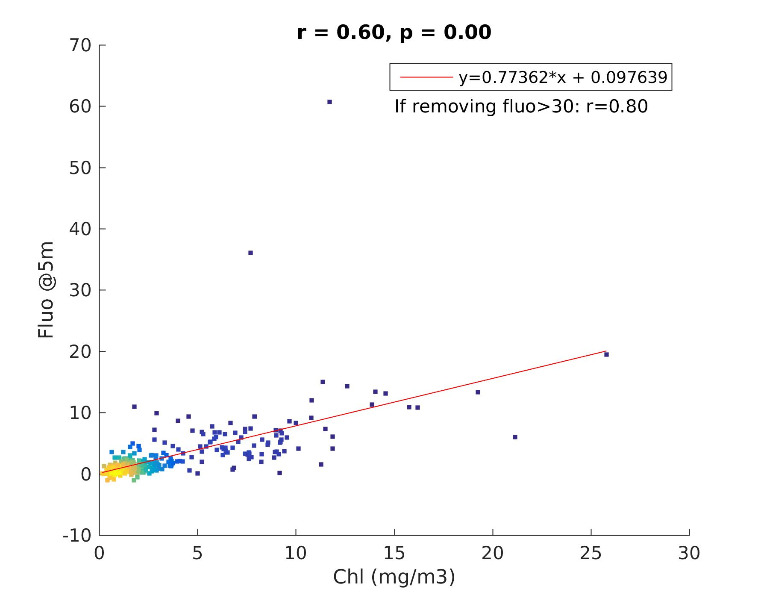
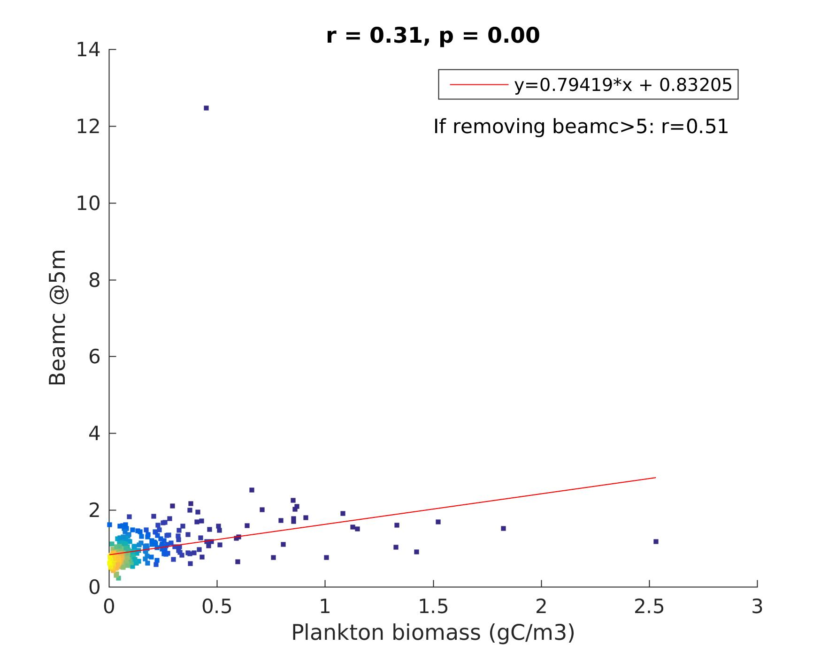
Fluorescence / beam-c
as proxies for Chl / C
r(biomass,Chl) = 0.54
r(fluo,beamc) = 0.83
Autonomous sensors @5 m
color = points density
In situ surface bottle measurements

Slide 4
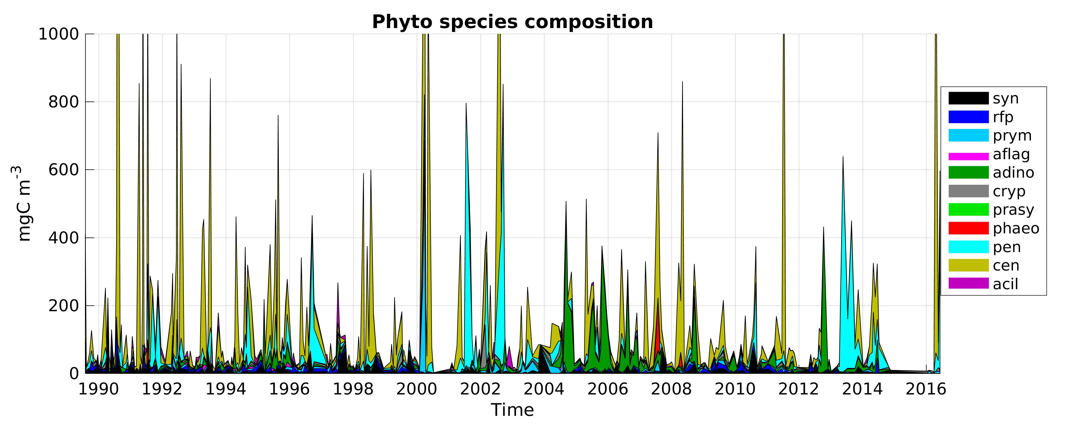
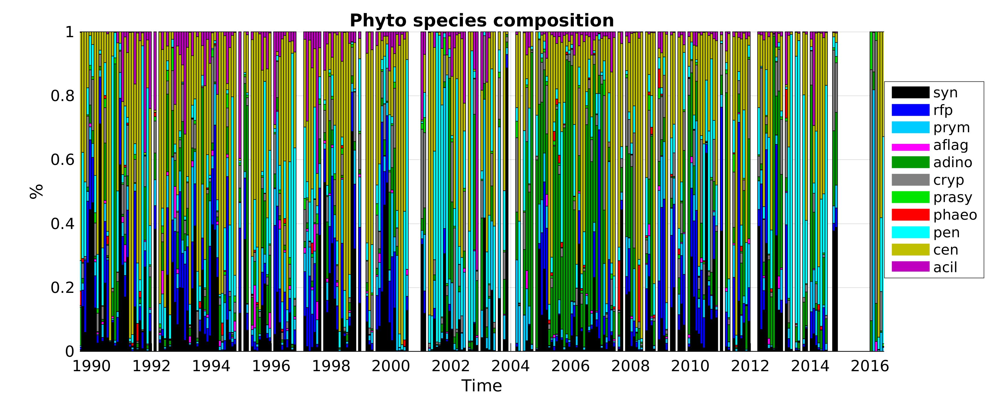
Phytoplankton time series @M1
359 samples with concurrent fluo/beamc data
dinoflagellates
pennate diatoms
centric diatoms
(regrid monthly)

Slide 5
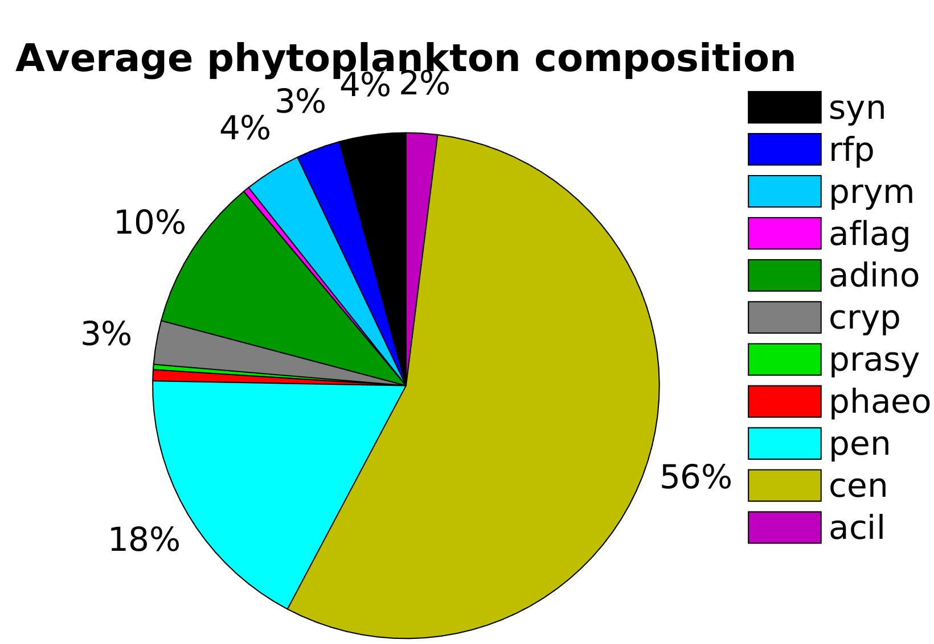
Phytoplankton time series @M1
dinoflagellates
centric diatoms
pennate diatoms
Defining dominance in a sample:
- absolute: species >= 50% of the biomass
- relative: species is the most abundant and represents > 30% of the biomass
“none” = no dominance detected.

Slide 6
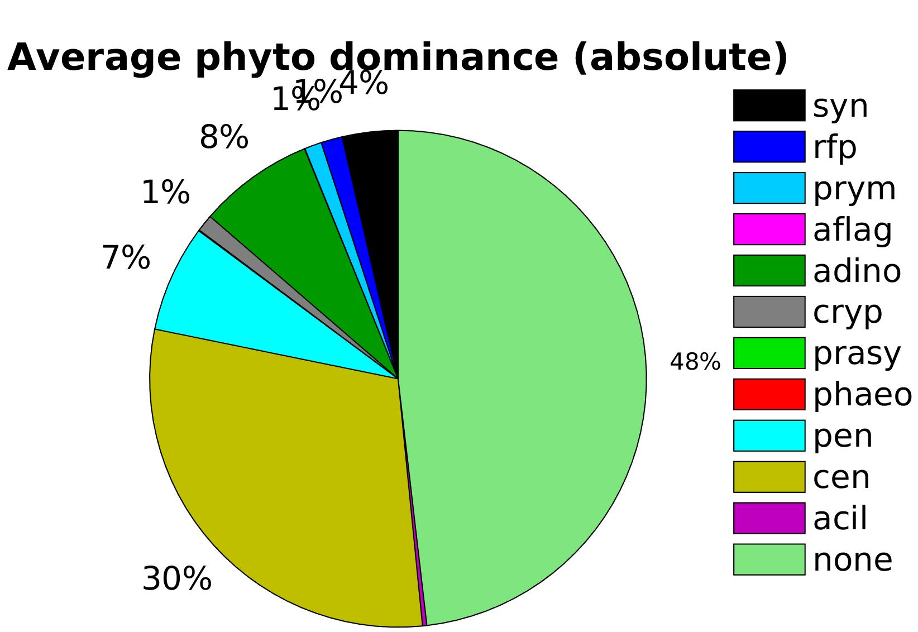
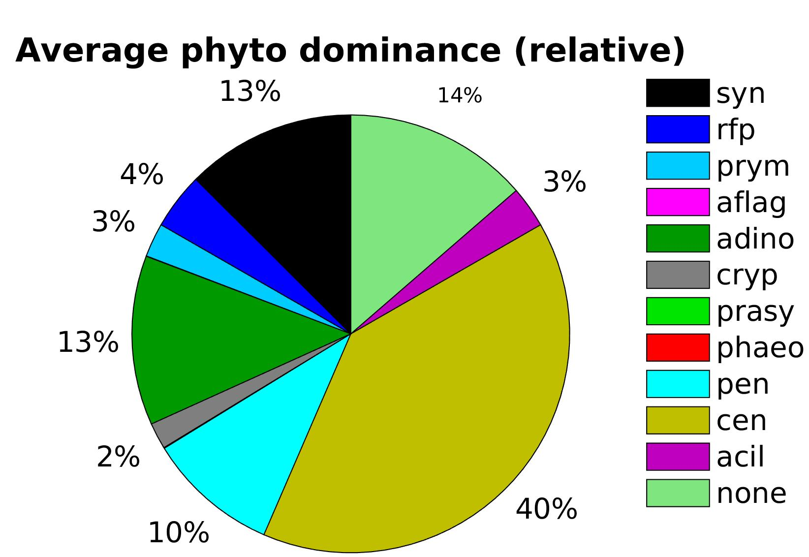
Phytoplankton time series @M1
dinoflagellates
centric diatoms
pennate diatoms
Defining dominance in a sample:
- absolute: species >= 50% of the biomass
- relative: species is the most abundant and represents > 30% of the biomass
“none” = no dominance detected.
dinoflagellates
Synechococcus
NONE
pennate diatoms
NONE
dino
flagellates
centric diatoms
centric diatoms
pennate diatoms

Slide 7
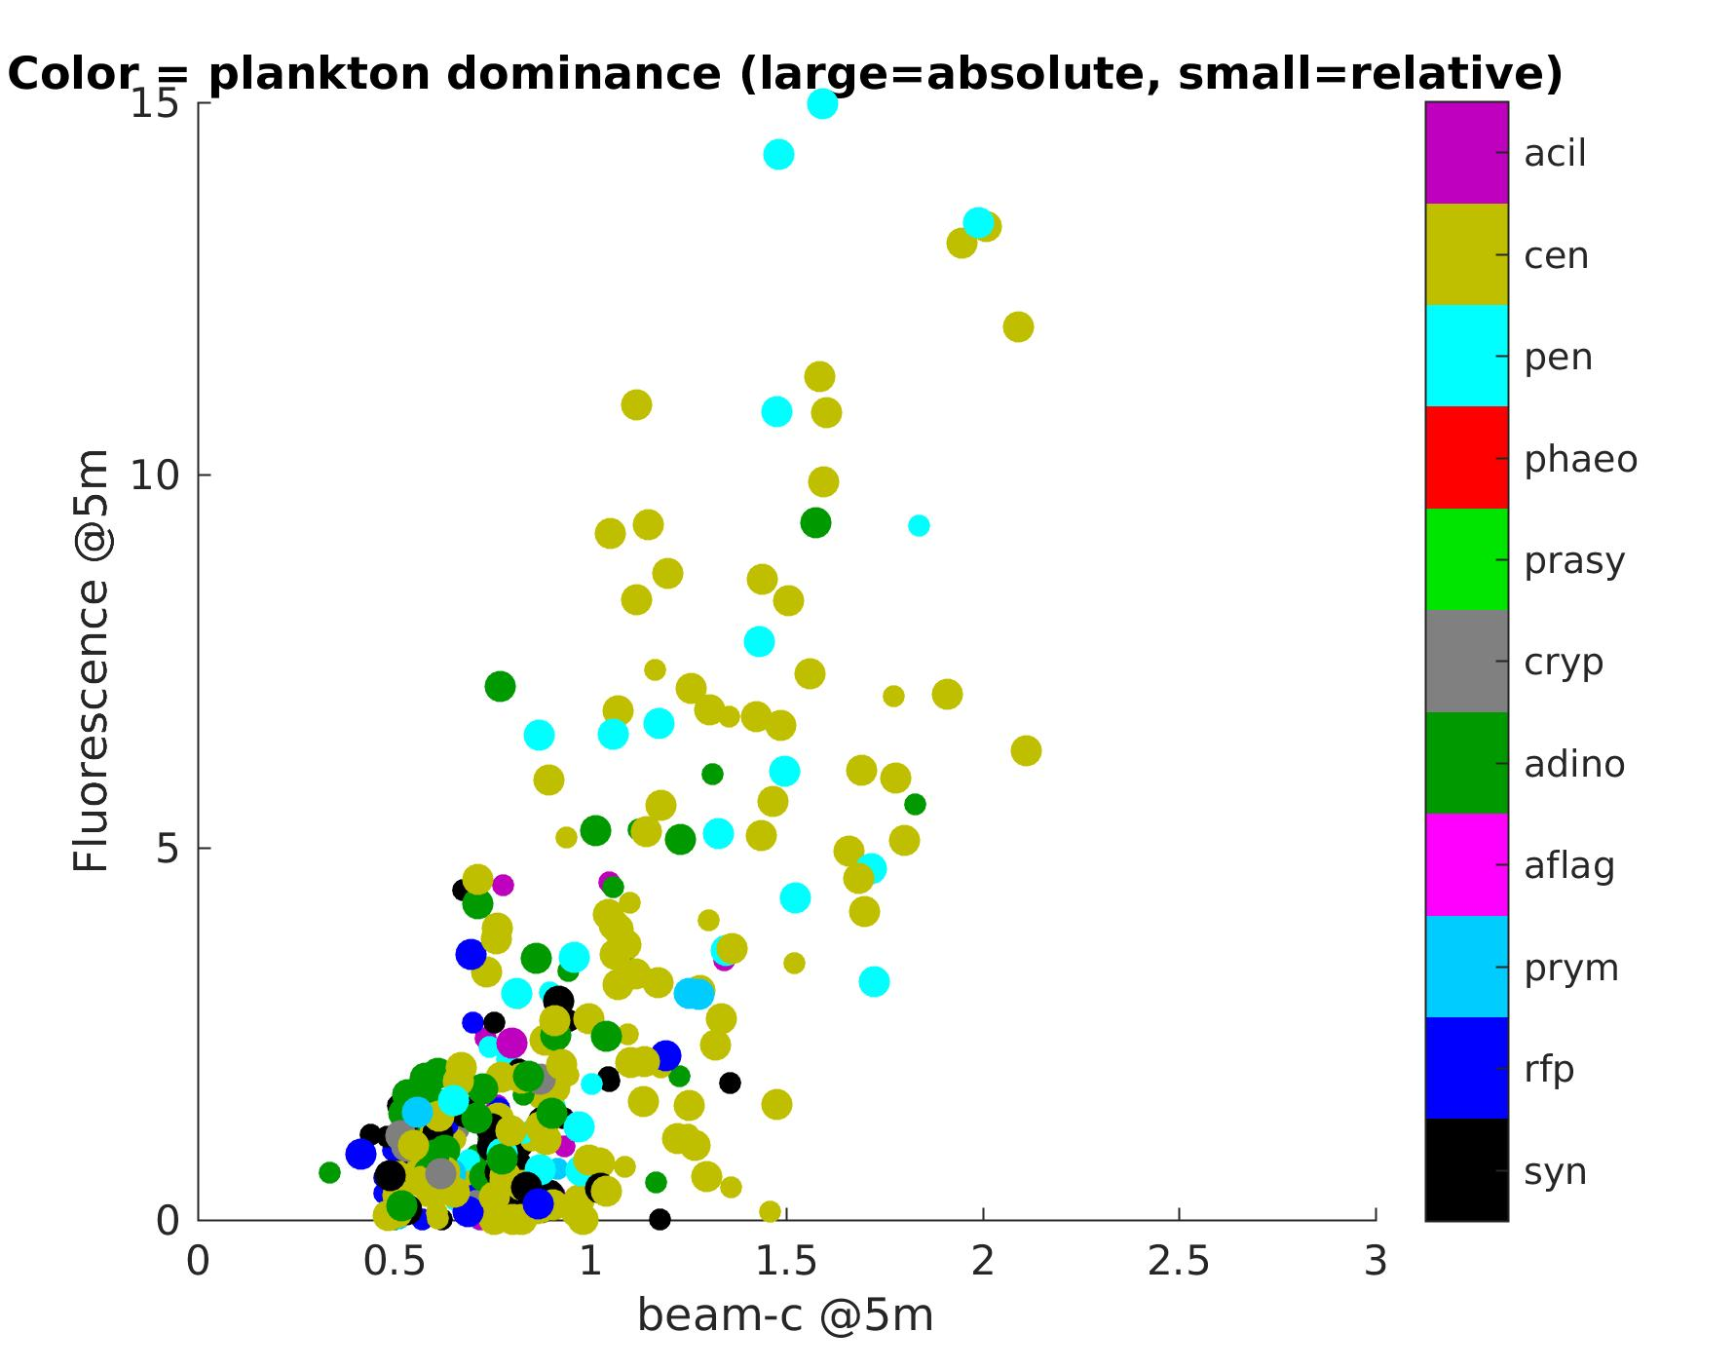
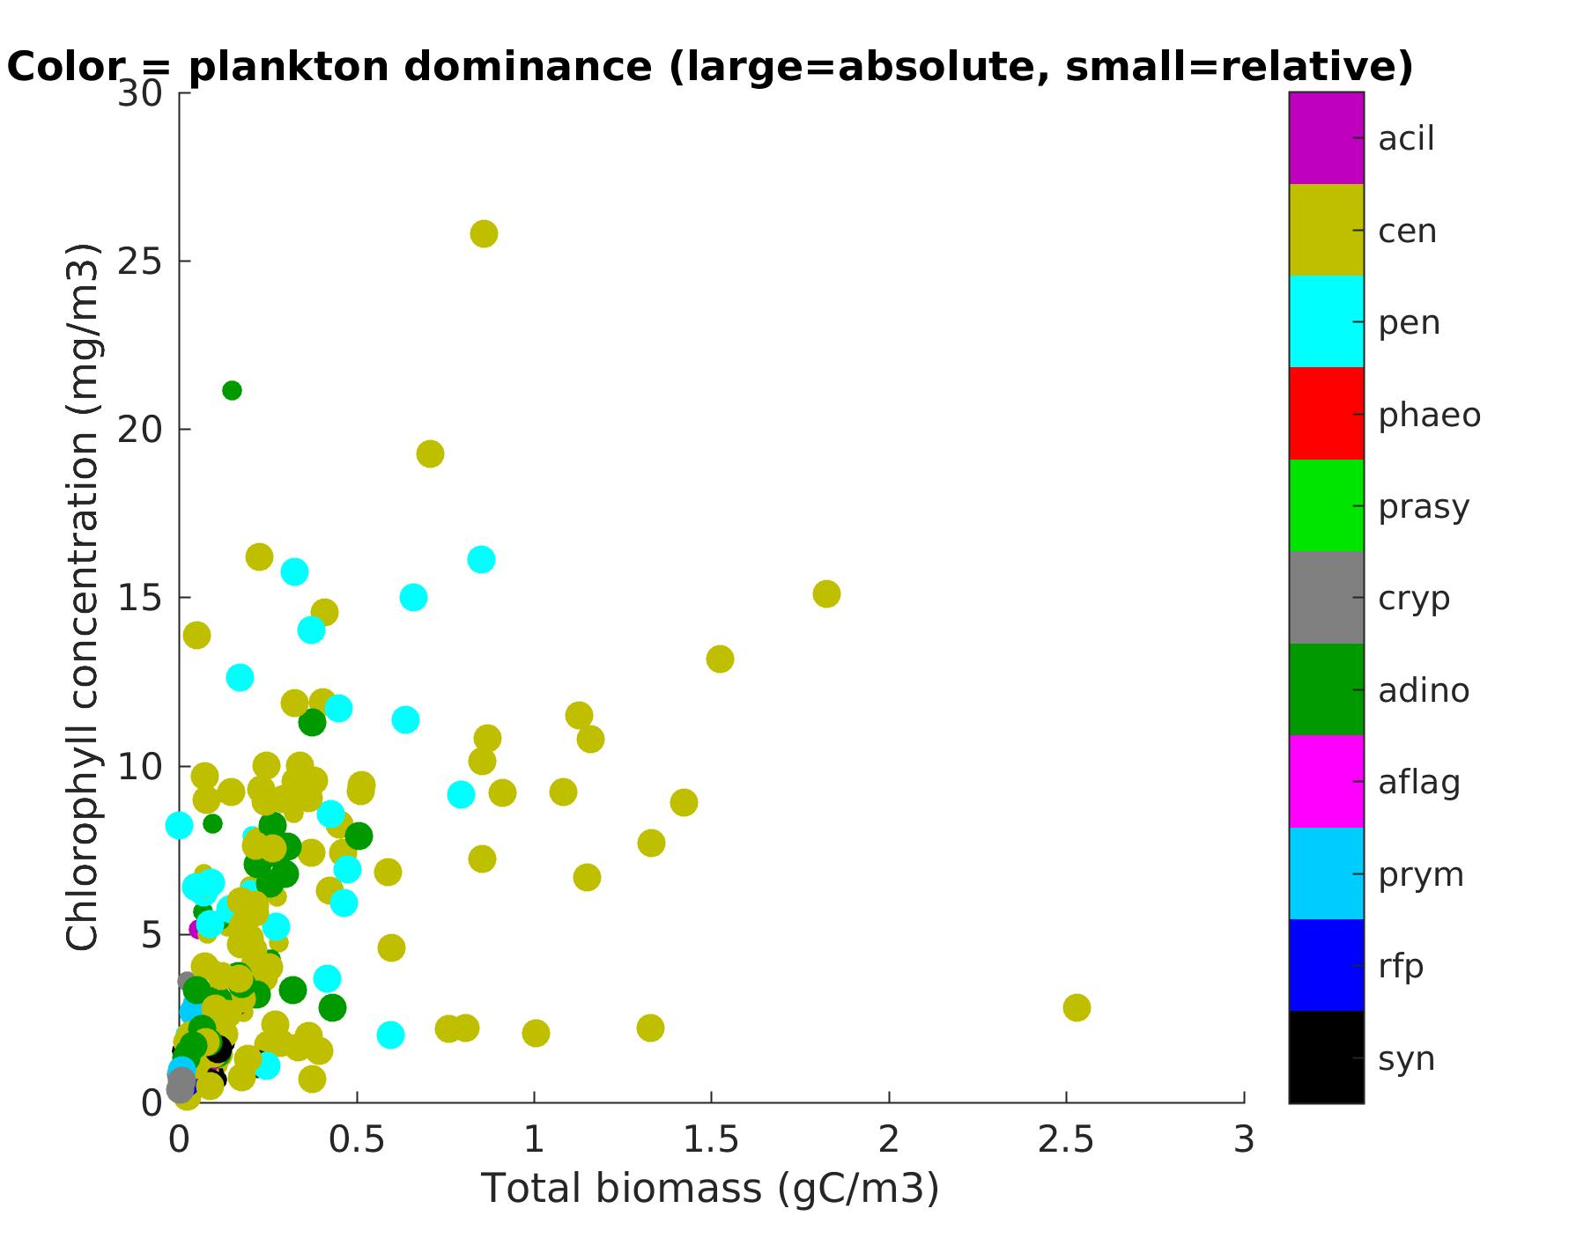
Chl / C as proxy for taxonomy
r(biomass,Chl) = 0.54
r(fluo,beamc) = 0.83
Chlorophyll
Carbon

Slide 8
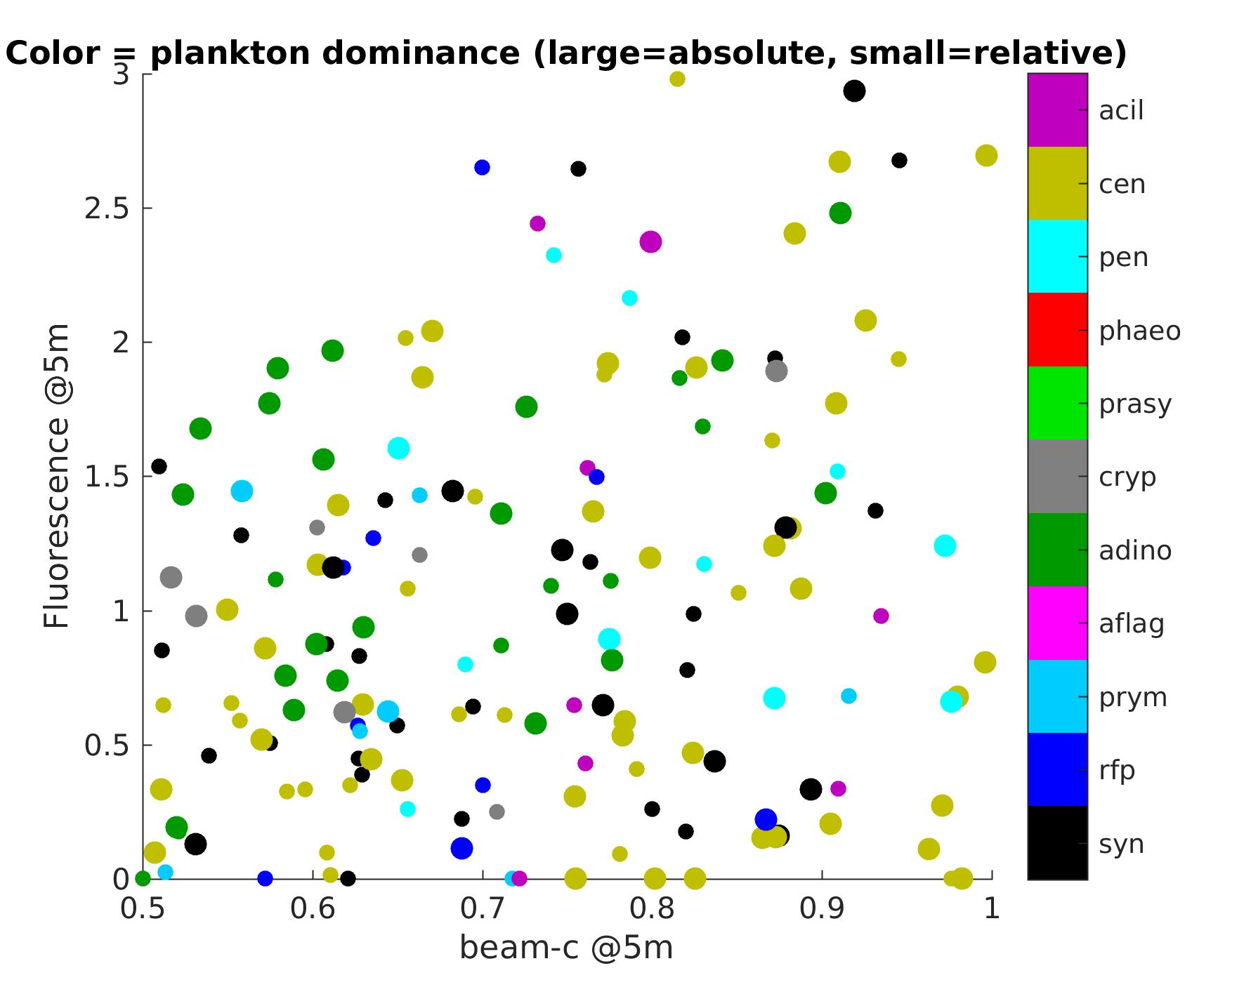
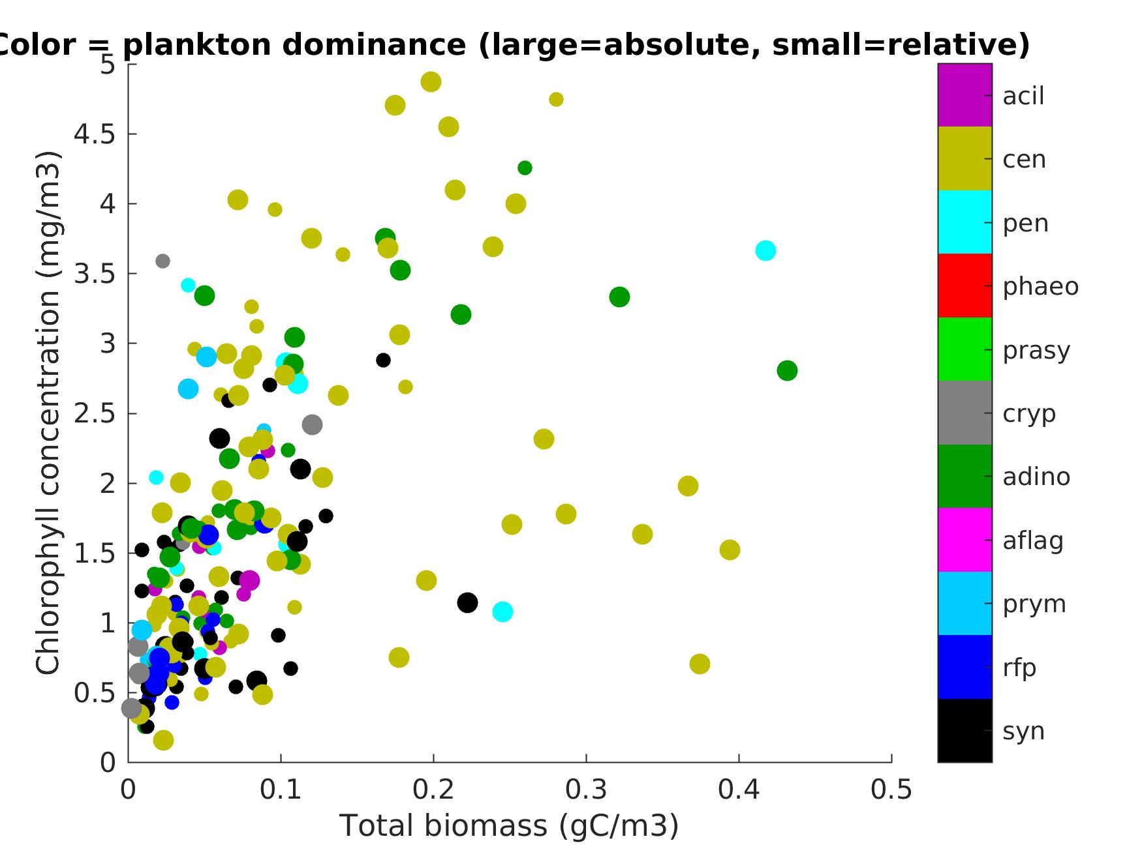
Chl / C as proxy for taxonomy
r(biomass,Chl) = 0.54
r(fluo,beamc) = 0.83
Chlorophyll
Carbon

Slide 9
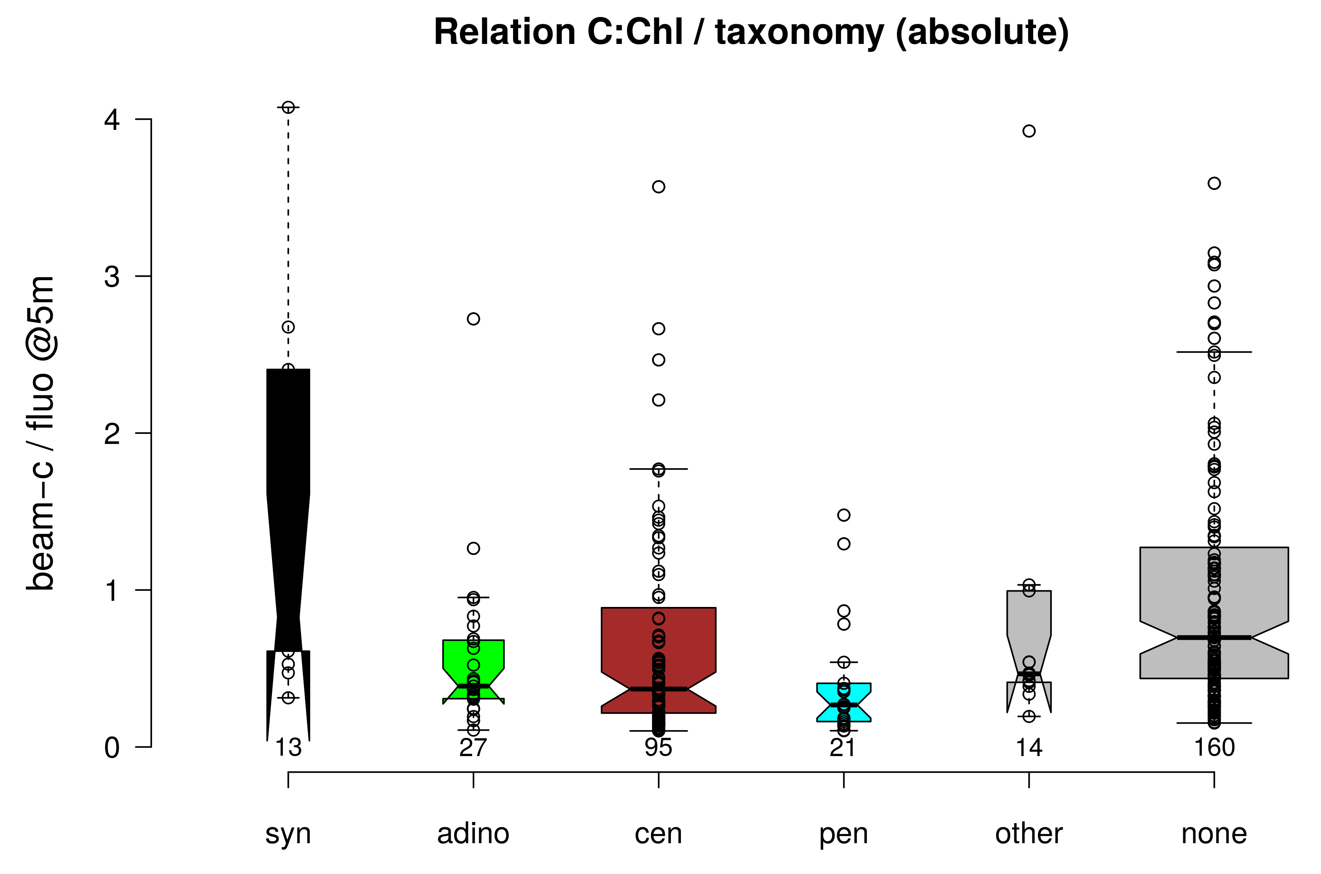
C:Chl as proxy for taxonomy

Slide 10
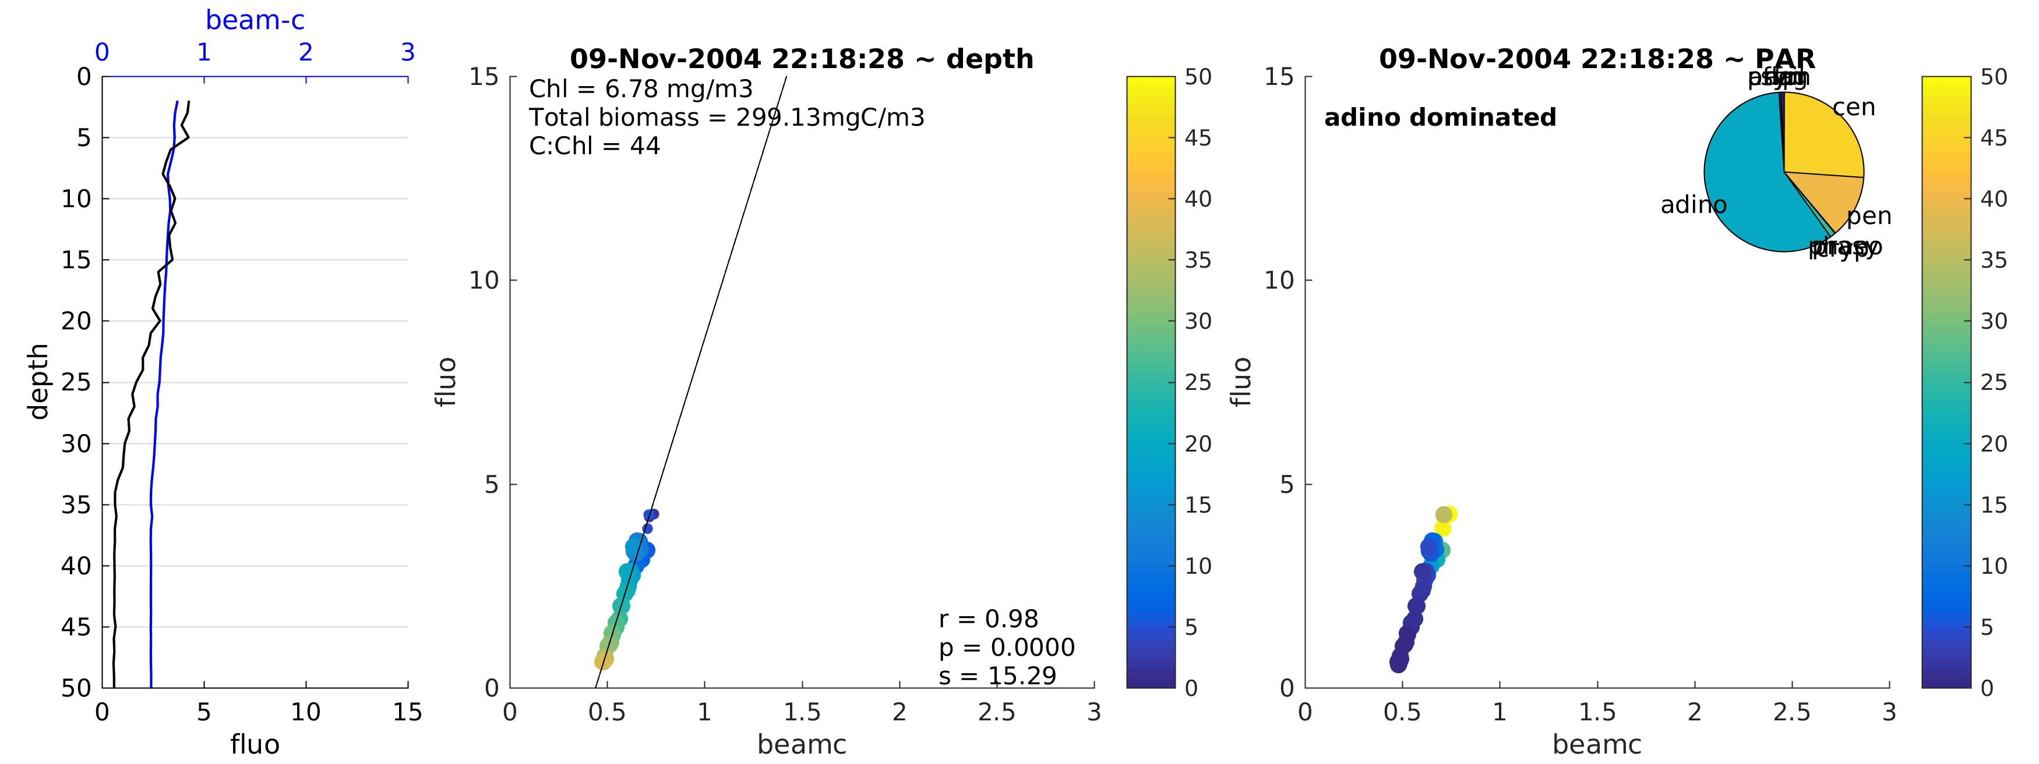
Fluorescence / beam-c profiles: defining S
slope = S

Slide 11
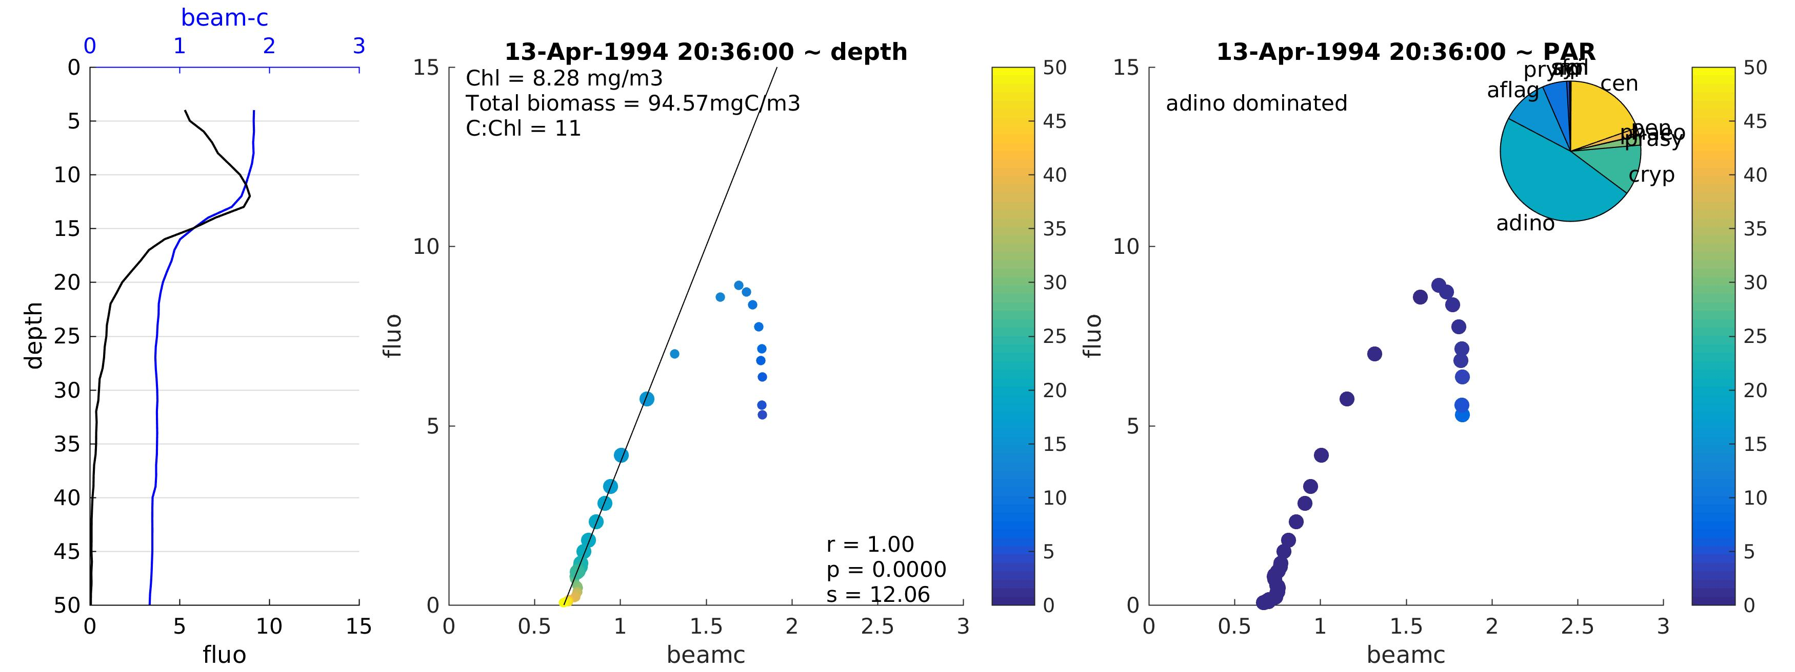
Fluorescence / beam-c profiles: defining S

Slide 12
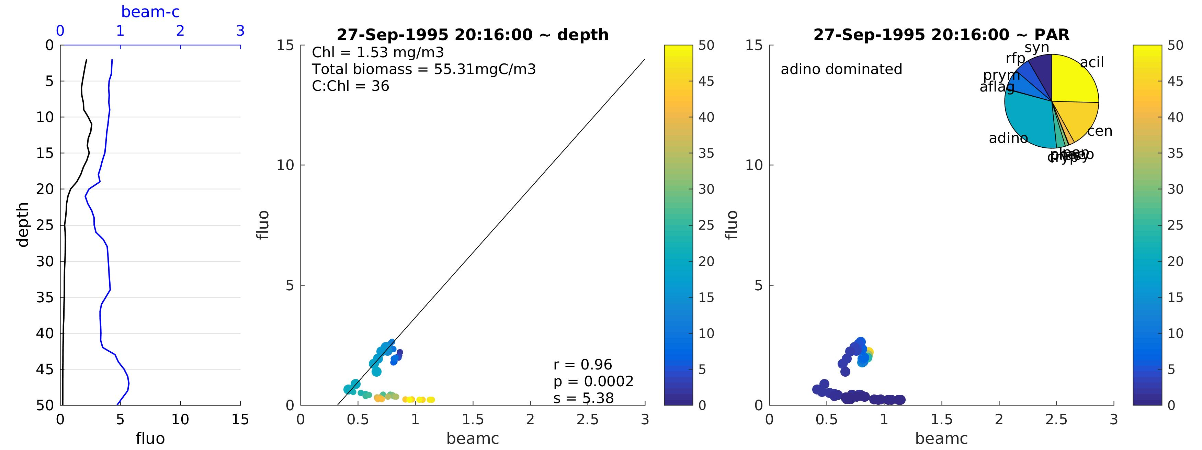
Fluorescence / beam-c profiles: defining S

Slide 13
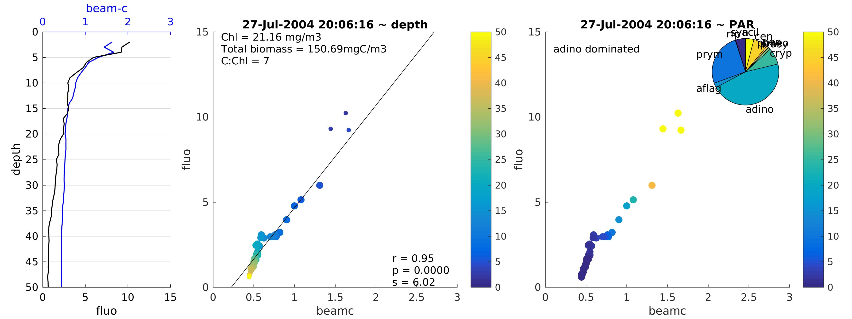
Fluorescence / beam-c profiles: defining S

Slide 14
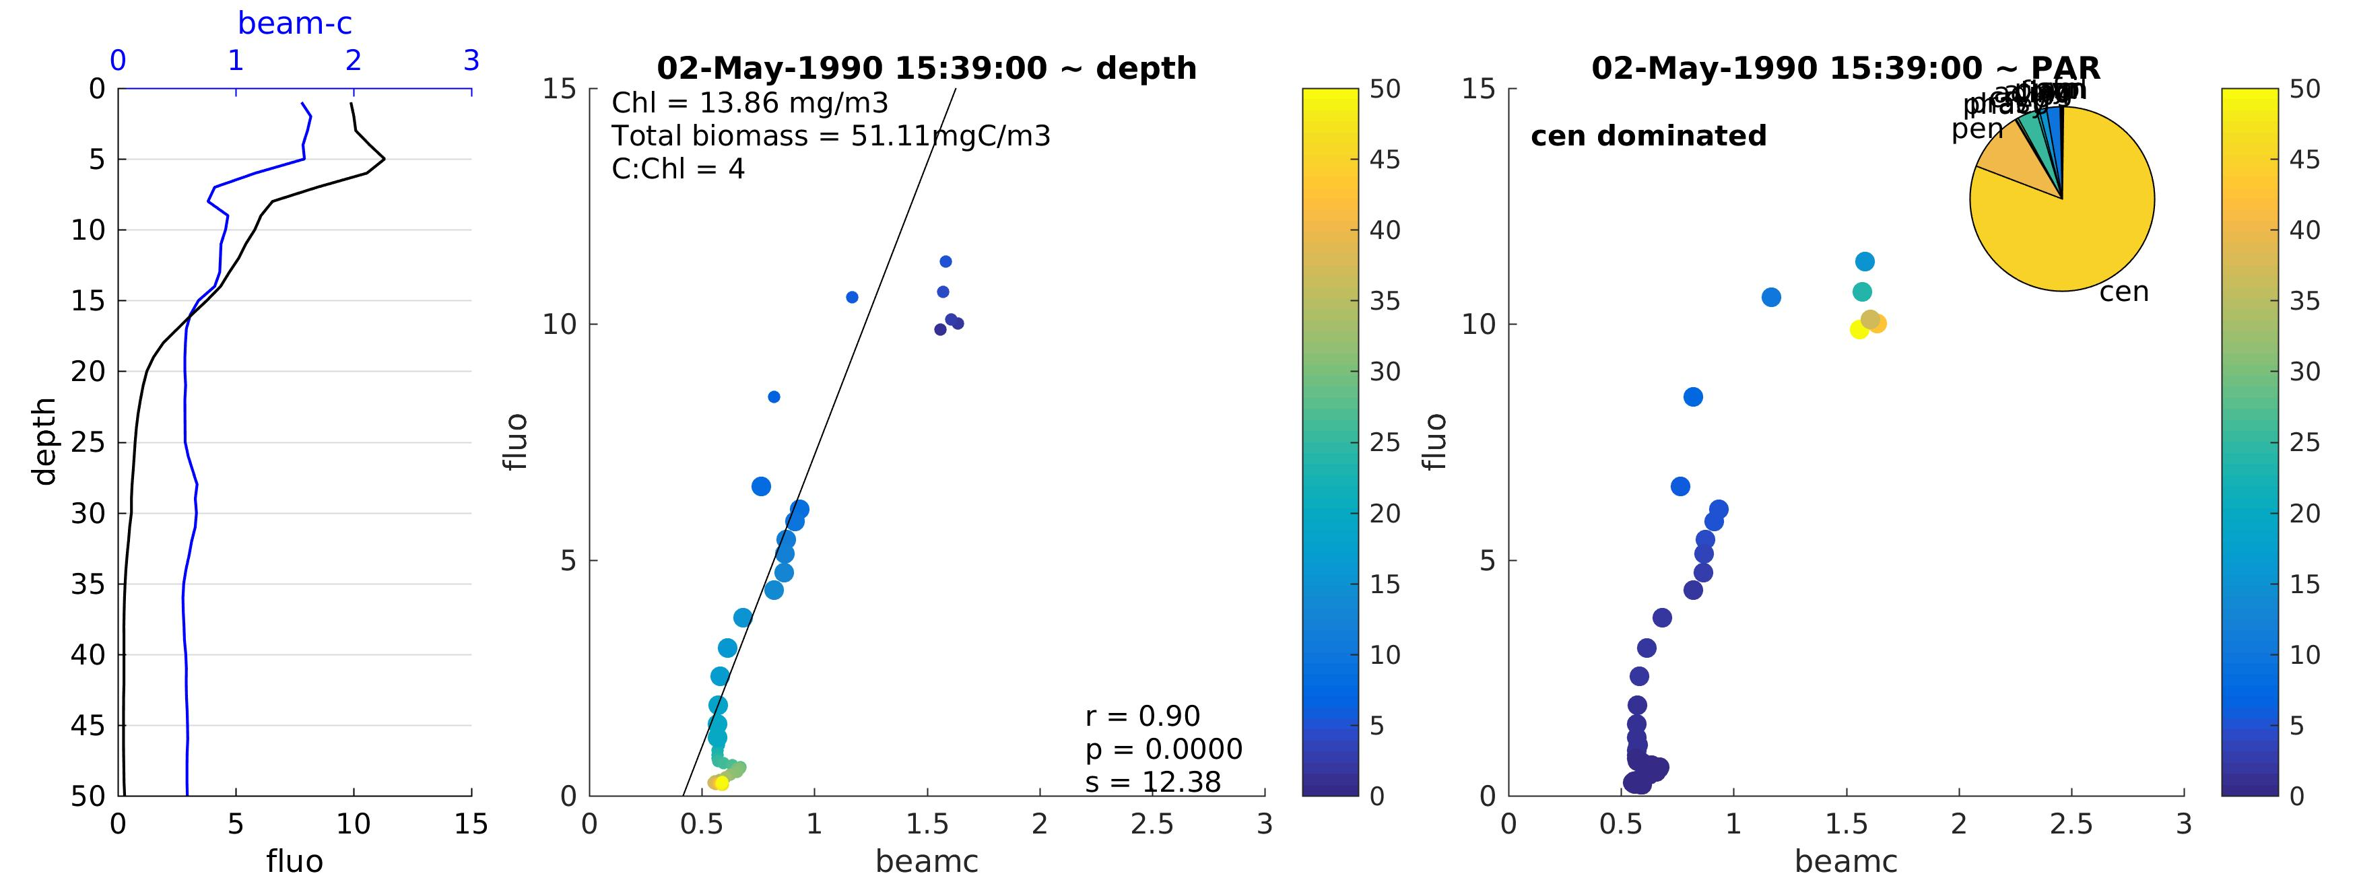
Fluorescence / beam-c profiles: defining S

Slide 15
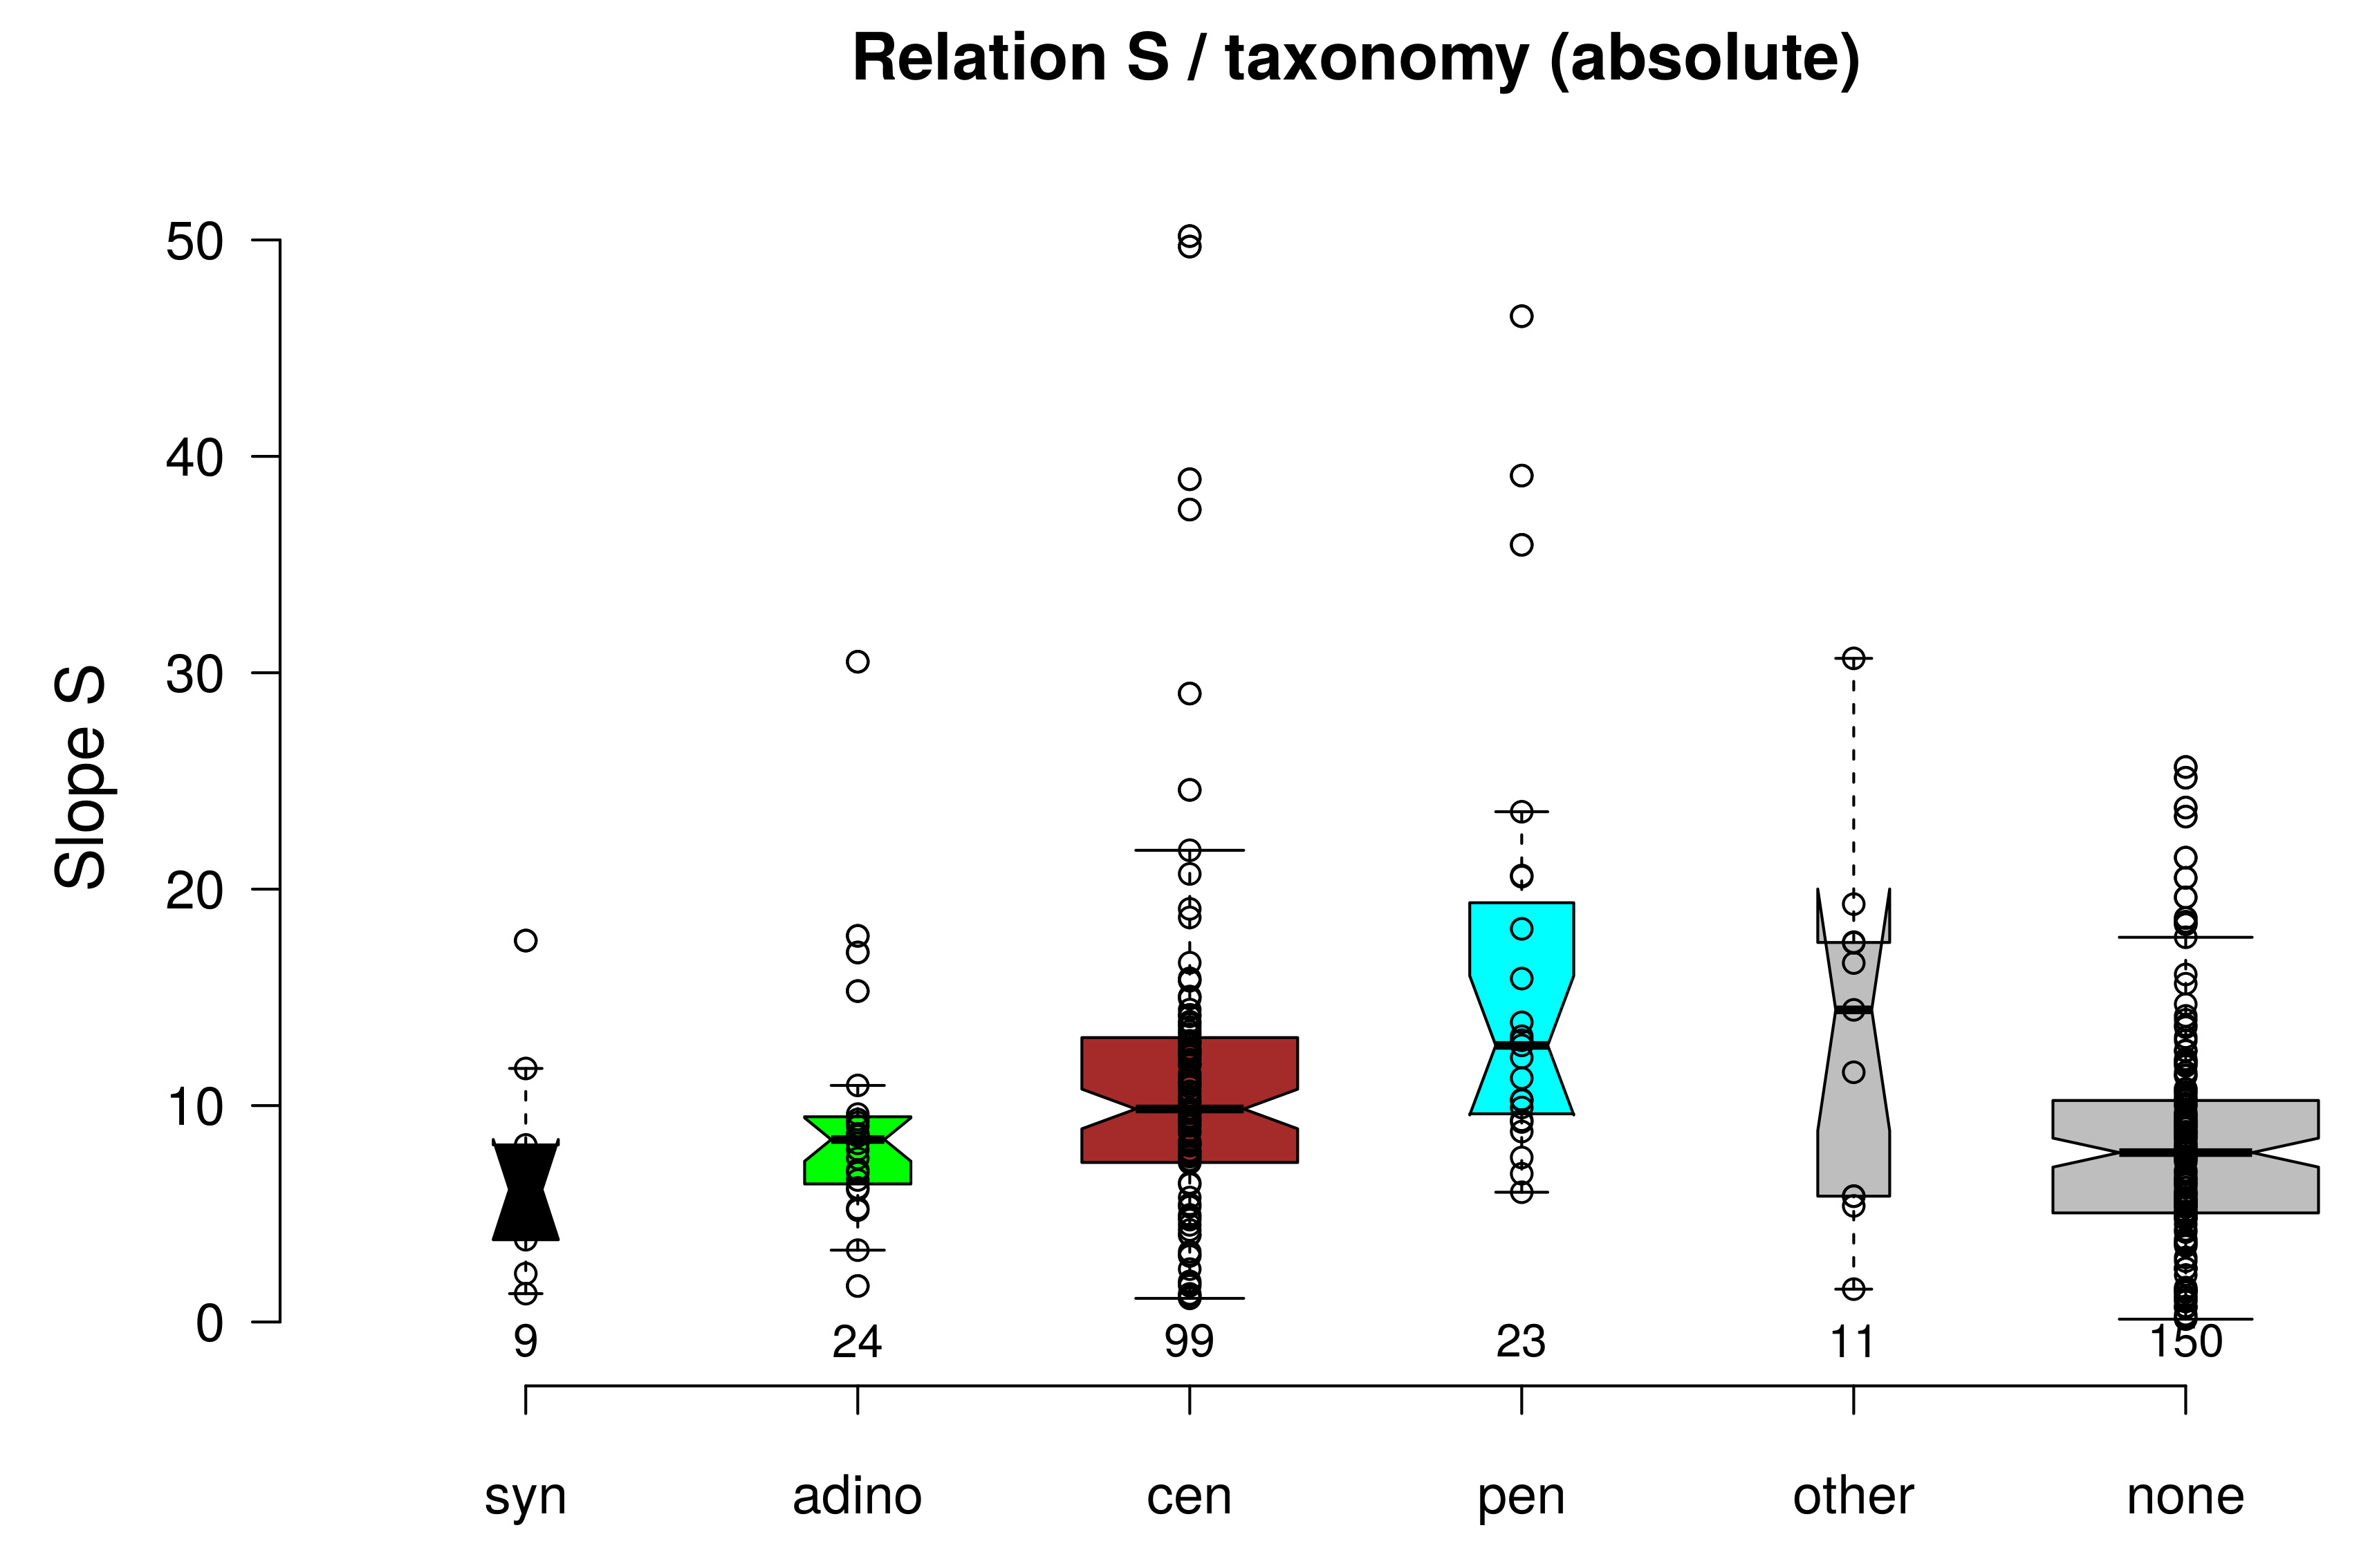
S vs. taxonomy

Slide 16
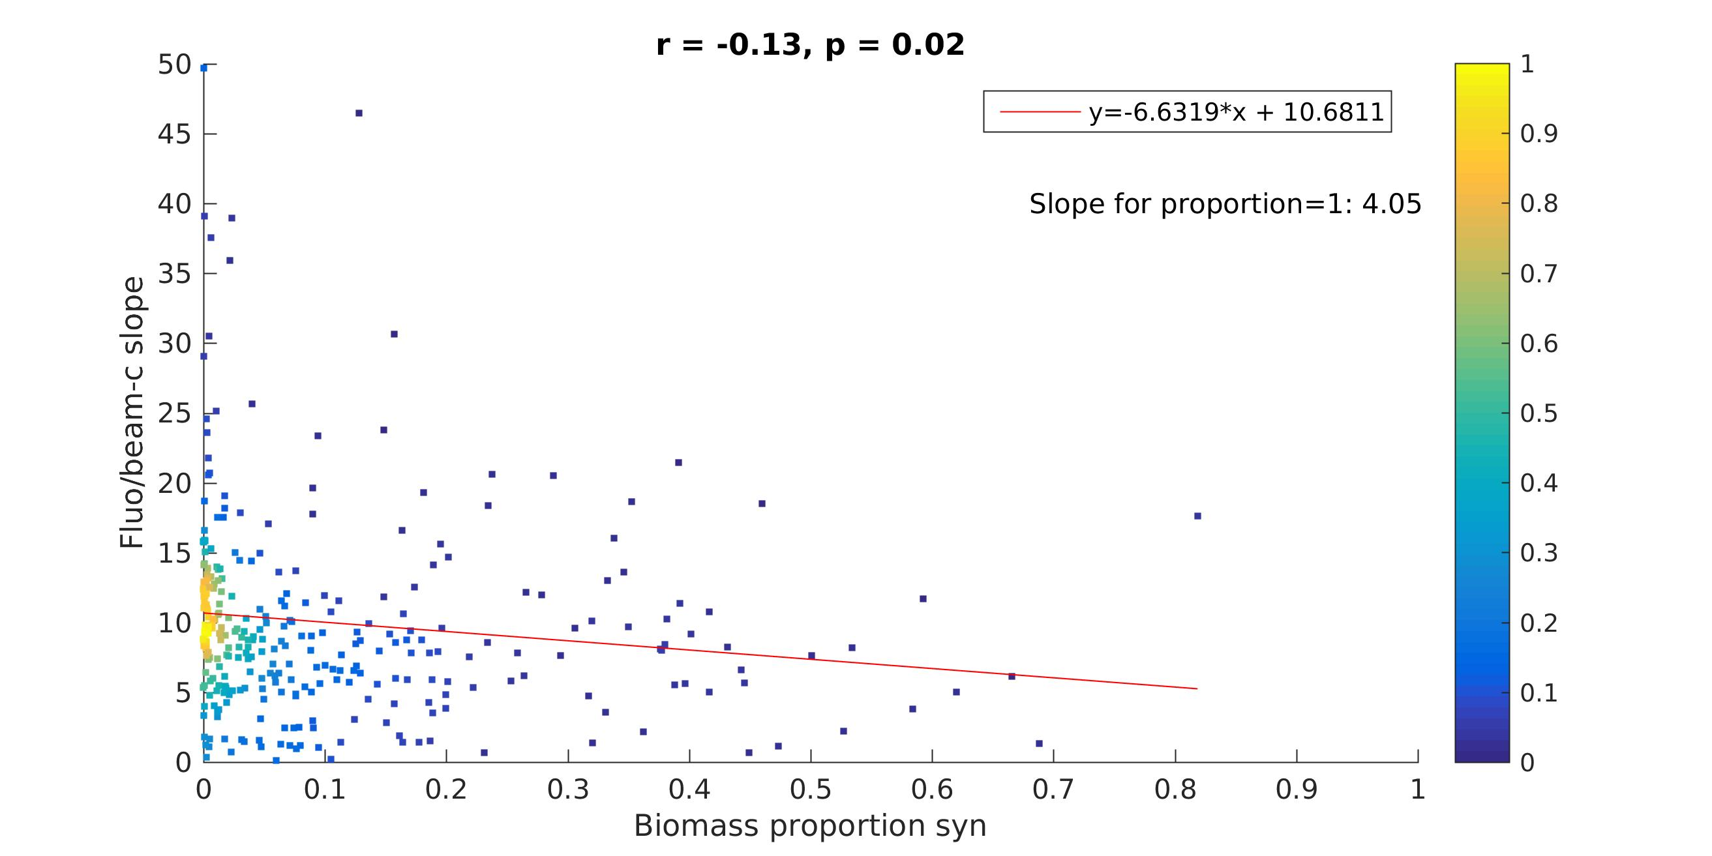
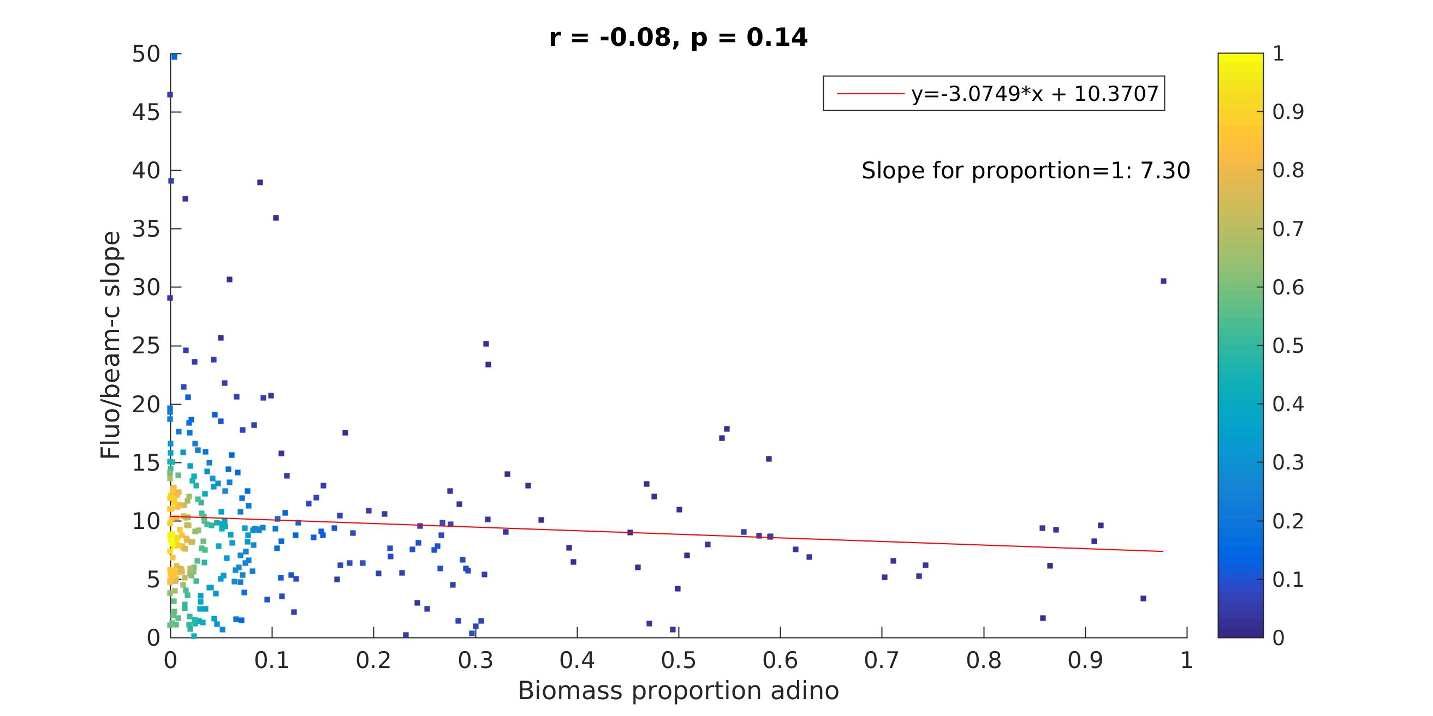
S vs. taxonomy
Synechococcus
Dinoflagellates

Slide 17
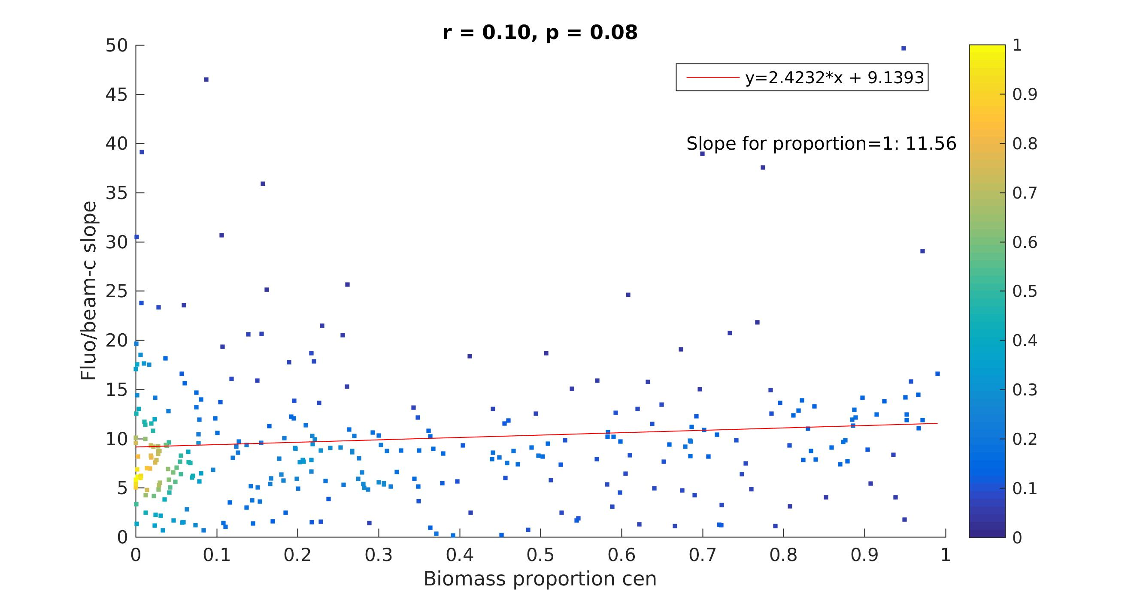
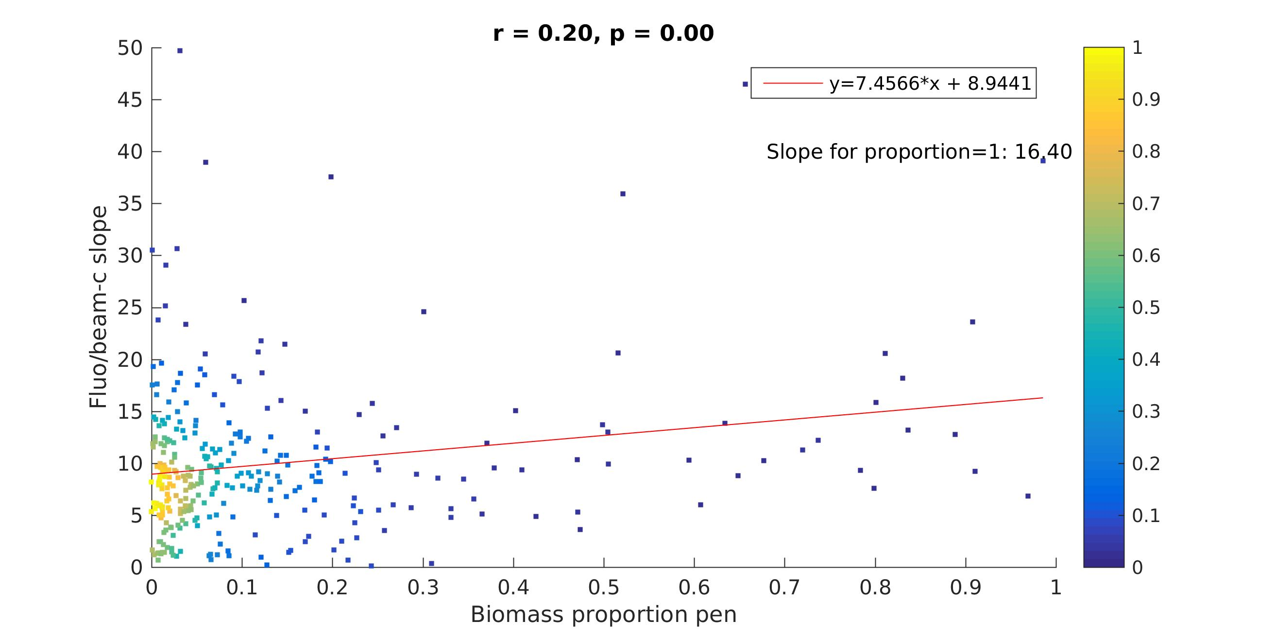
S vs. taxonomy
Centric diatoms
Pennate diatoms

Slide 18
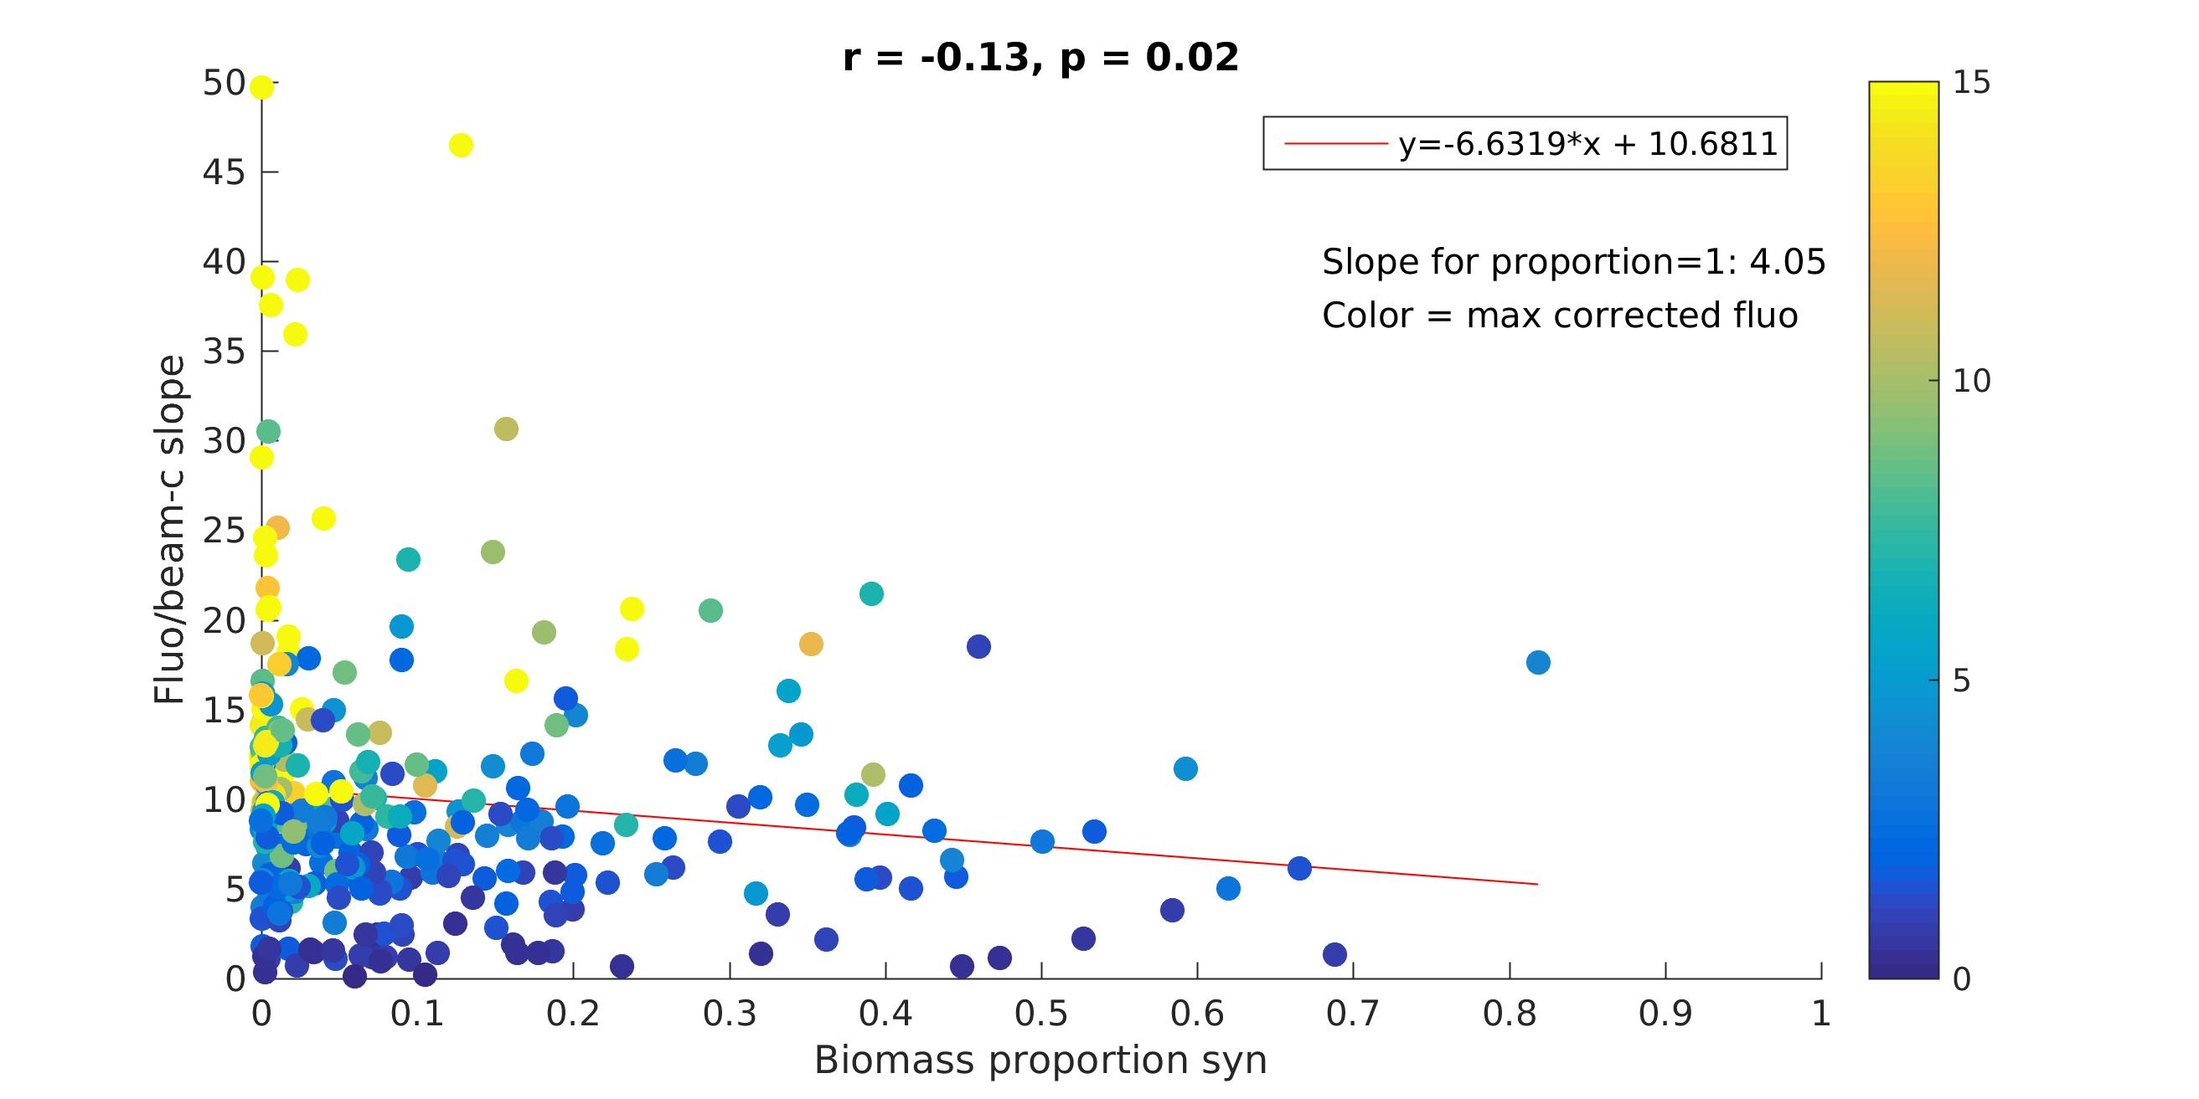
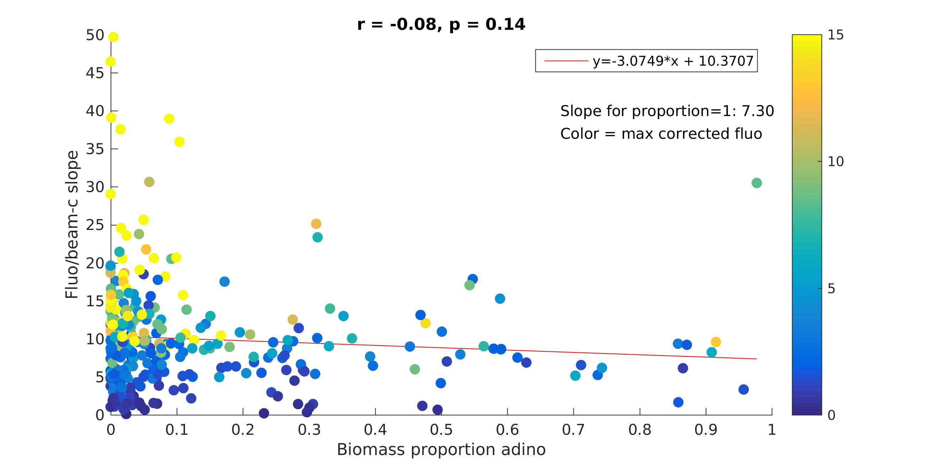
S vs. taxonomy & fluo
Synechococcus
Dinoflagellates

Slide 19
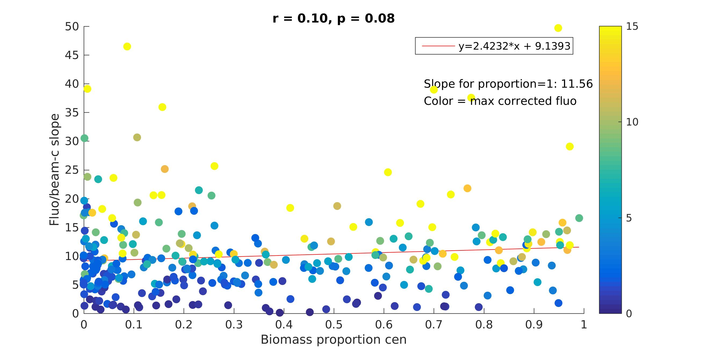
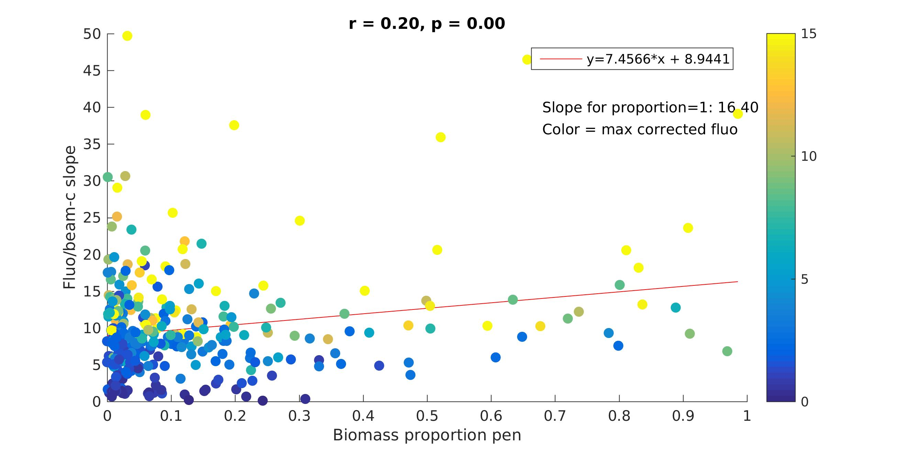
S vs. taxonomy & fluo
Centric diatoms
Pennate diatoms

