Slide 1
Plankton Communities
Classification pipeline

Slide 2
Overview
Transform the problem from regression to a classification problem
Index community "types" using k-means clustering - these clusters will serve as our classes.
Each community is a mixture of: Diatoms, Dinoflagellates, Picoplankton and Other.
Train a classification model to try and separate the communities: Support Vector Machine (SVM).
Perform exhaustive search over our features: chl, par, no3, temp, salt, beamc, fluo, maxfluo, beamc_maxfluo. (poc, values for only 40% of the data). Try all possible combinations (512 models).
Compute performance metrics and “learning curve” for best model.

Slide 3
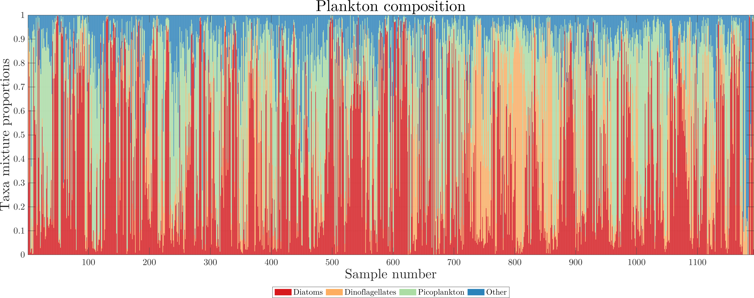
Community "types" using k-means clustering

Slide 4
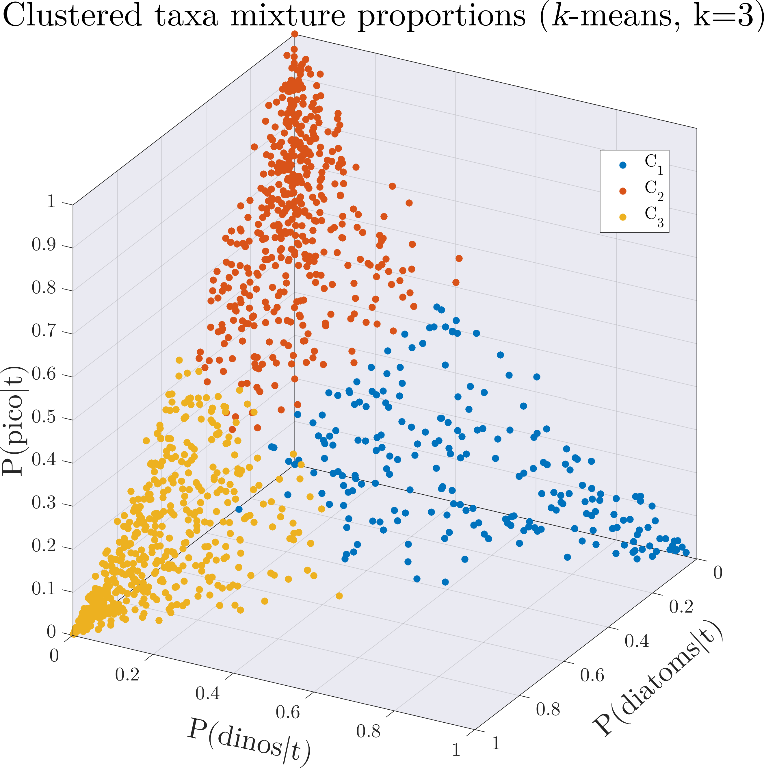
Community "types" using k-means clustering
k-means clustering:
Partition n observations into k clusters.
Each observation belongs to the cluster with the nearest mean (centroid)
k is user specified.
Tried k=1-12.

Slide 5
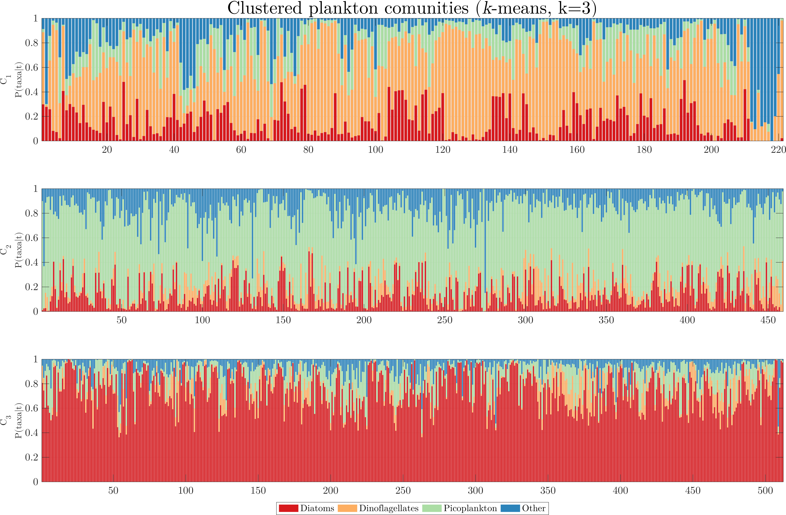
Community "types" using k-means clustering
Dinoflagellate
dominated
Picoplankton
dominated
Diatom
dominated

Slide 6
Classification model: Support Vector Machine (SVM)
SVM:
Binary classifier.
Find widest separating margin between to classes.
Find complex margins using transformation functions.
“One-vs-all” for multi-class case.
Partition data: K-fold cross-validation
By Alisneaky, svg version by User:Zirguezi - Own work, CC BY-SA 4.0, https://commons.wikimedia.org/w/index.php?curid=47868867

Slide 7
SVM model selection
Model inputs | Minimum classification error | Min Error k
Chl + beamc | 34.8 % | 3
Chl + salt + beamc + fluo | 34.9 % | 3
Chl + beamc + fluo | 34.95 % | 3
Chl + beamc + maxfluo | 34.98 % | 3
Chl + beamc + fluo + maxfluo + beamc + maxfluo | 35.05 % | 3
Model inputs | Minimum classification error | Min Error k
Chl + POC | 38.1 % | 3

Slide 8
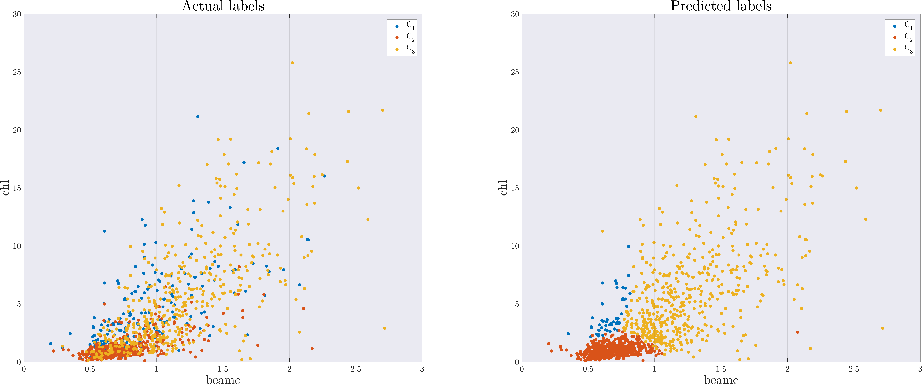
SVM model performance
Model inputs | Minimum classification error
Chl + beamc | 34.8 %

Slide 9
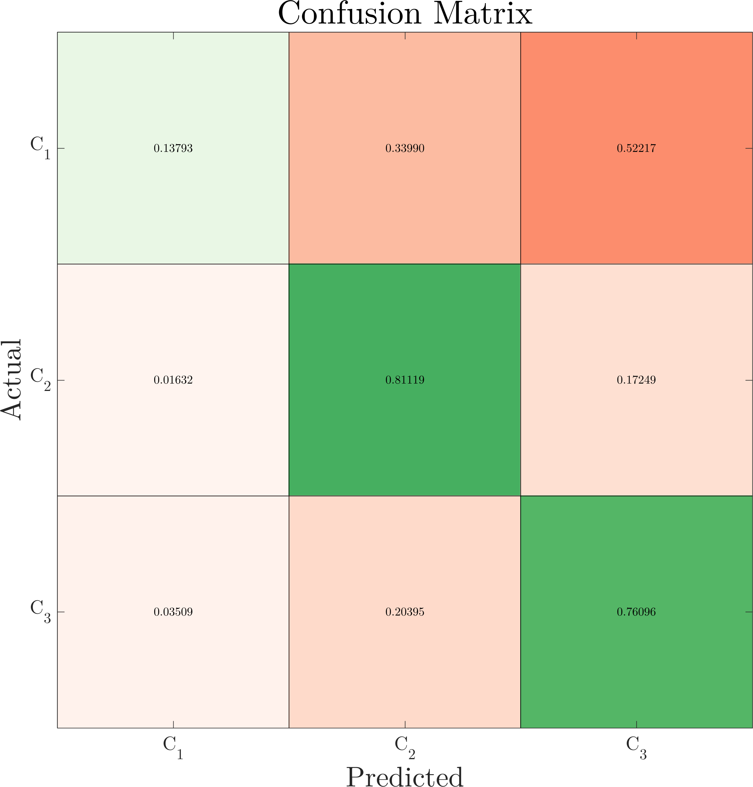
SVM model performance
Model inputs
Chl + beamc
Dinoflagellate
dominated
Picoplankton
dominated
Diatom
dominated

Slide 10
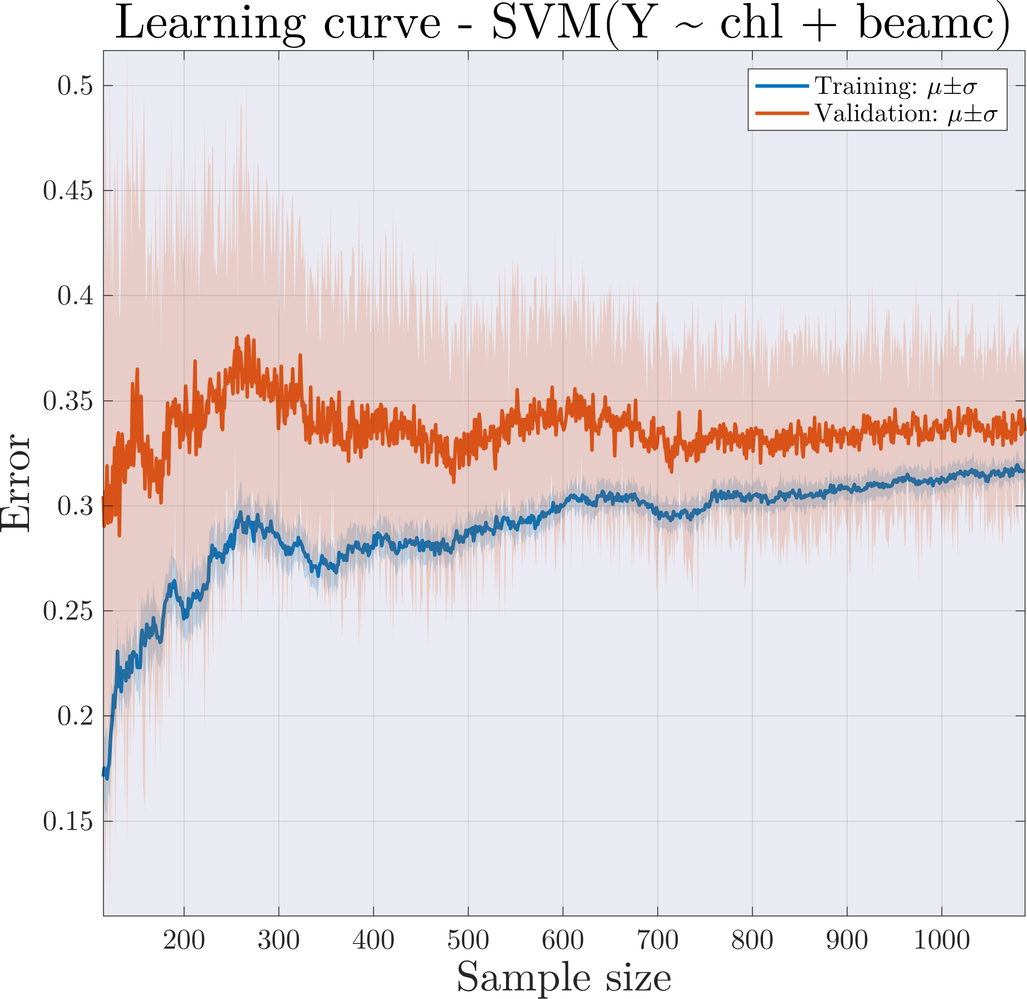
SVM model performance: learning curve
Learning curve:
High bias:
  Training error is unacceptably high.
  Small gap between training and test error.
Suggests:
  Larger training set will not help.
  Changing the features might.
Desired performance

Slide 11
Things to try
Index community "types" using higher granularity (k-means might be a limitation…).
Index community "types" using concentrations instead of mixture proportions.
Feature engineering – add more features.

Slide 12
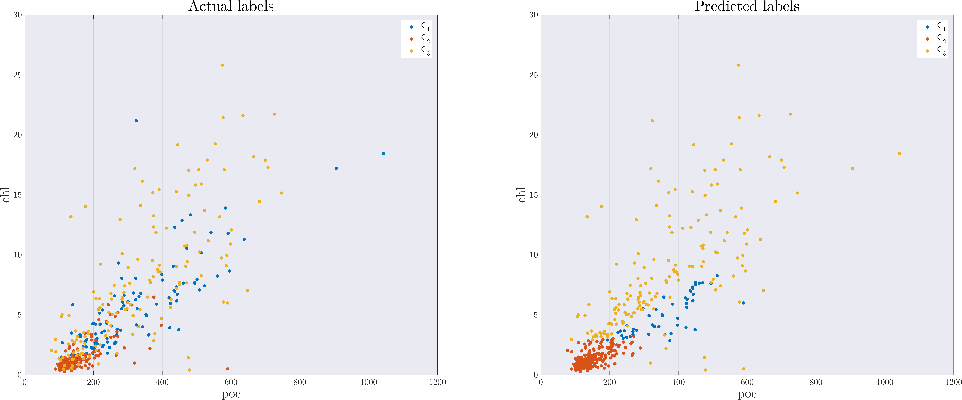
SVM model performance
Model inputs | Minimum classification error
Chl + poc | 34.8 %

Slide 13
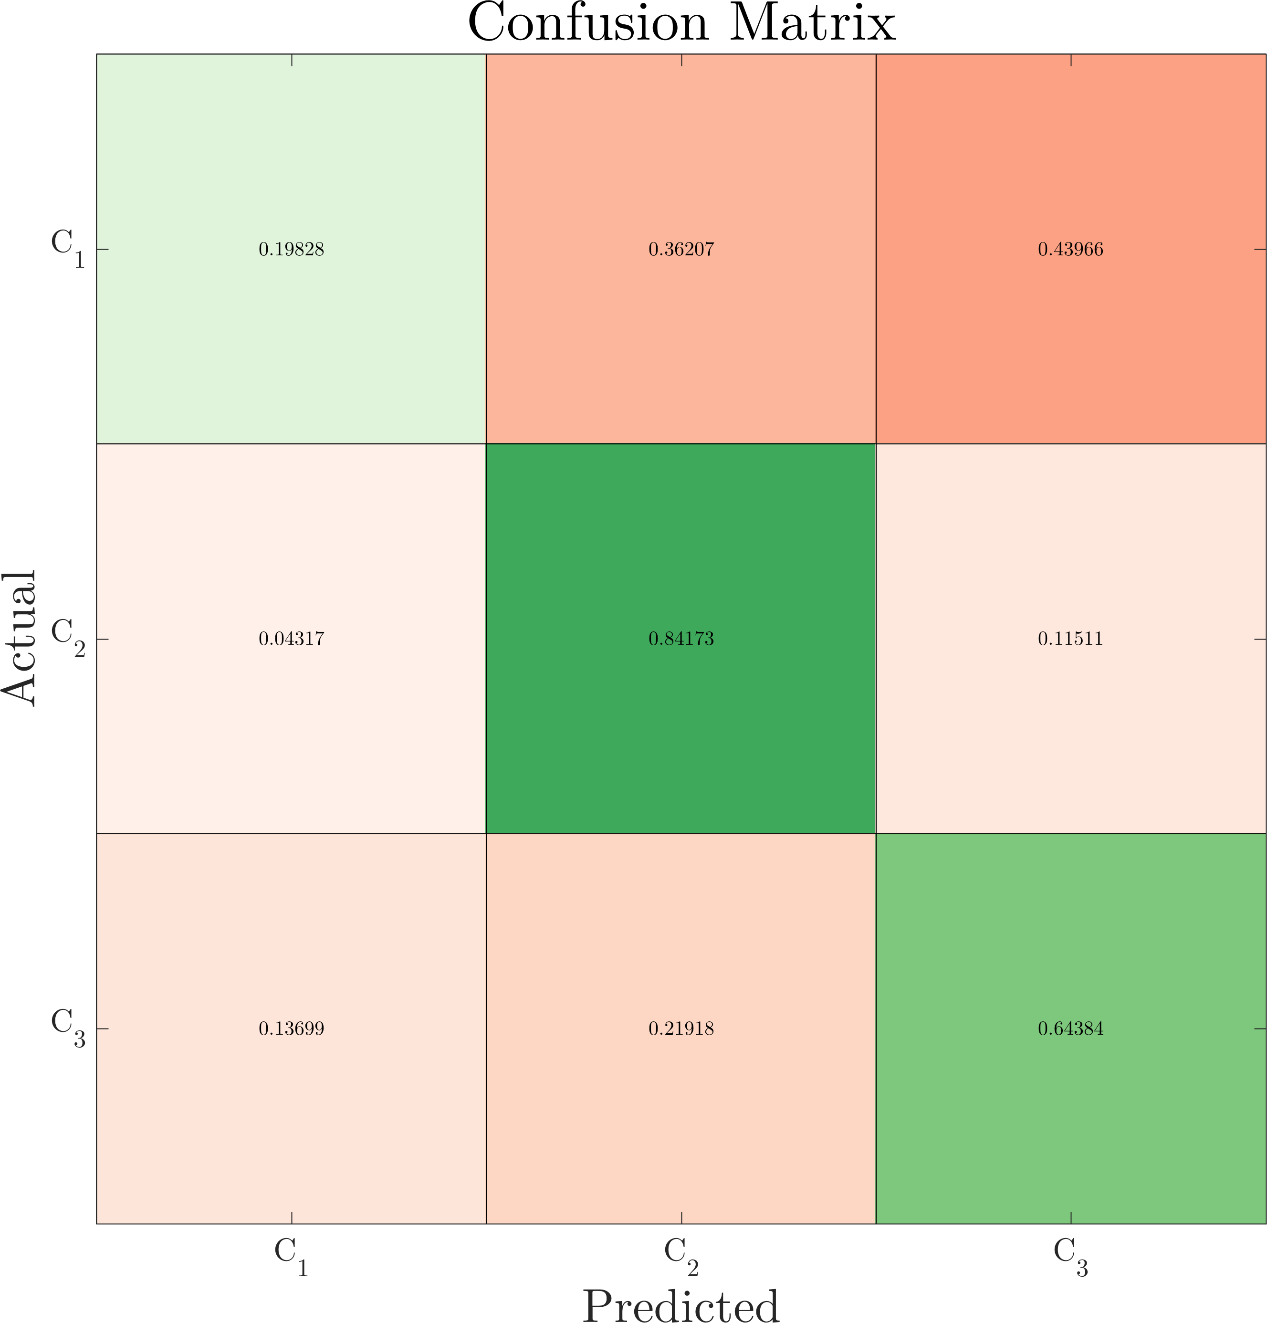
SVM model performance
Model inputs
Chl + POC
Dinoflagellate
dominated
Picoplankton
dominated
Diatom
dominated

Slide 14
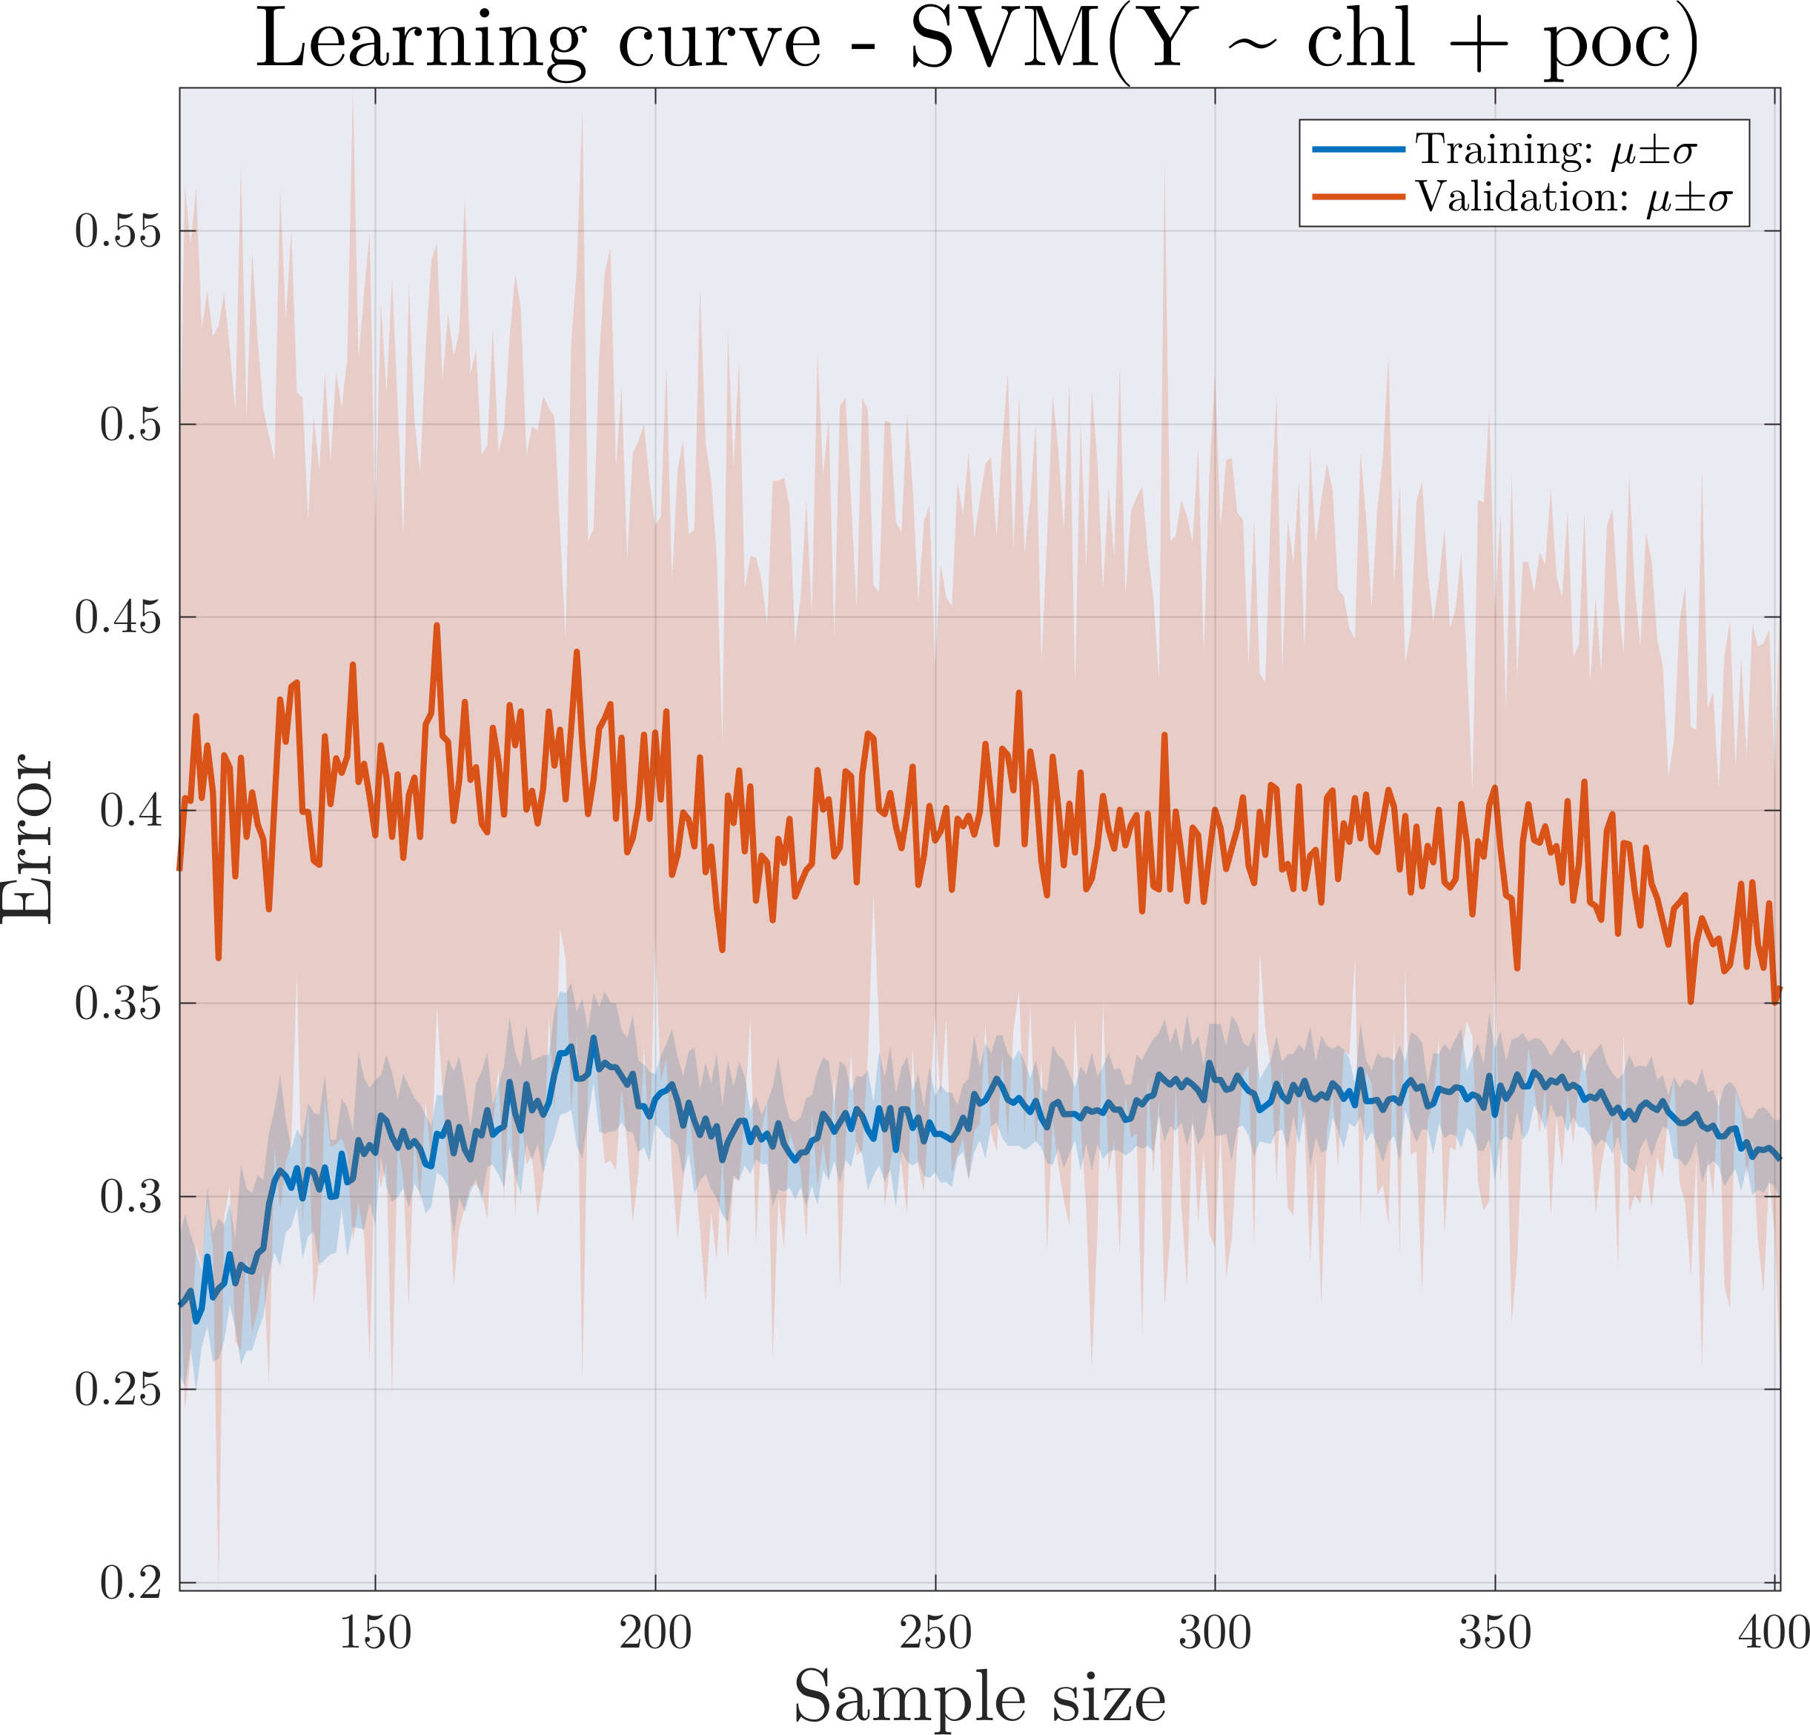
SVM model performance: learning curve
Learning curve:
High bias/Variance:
  Training error is unacceptably high.
  Small gap between training and test error.
Suggests:
  Larger training set might help.
  Changing the features.
Desired performance

Slide 15
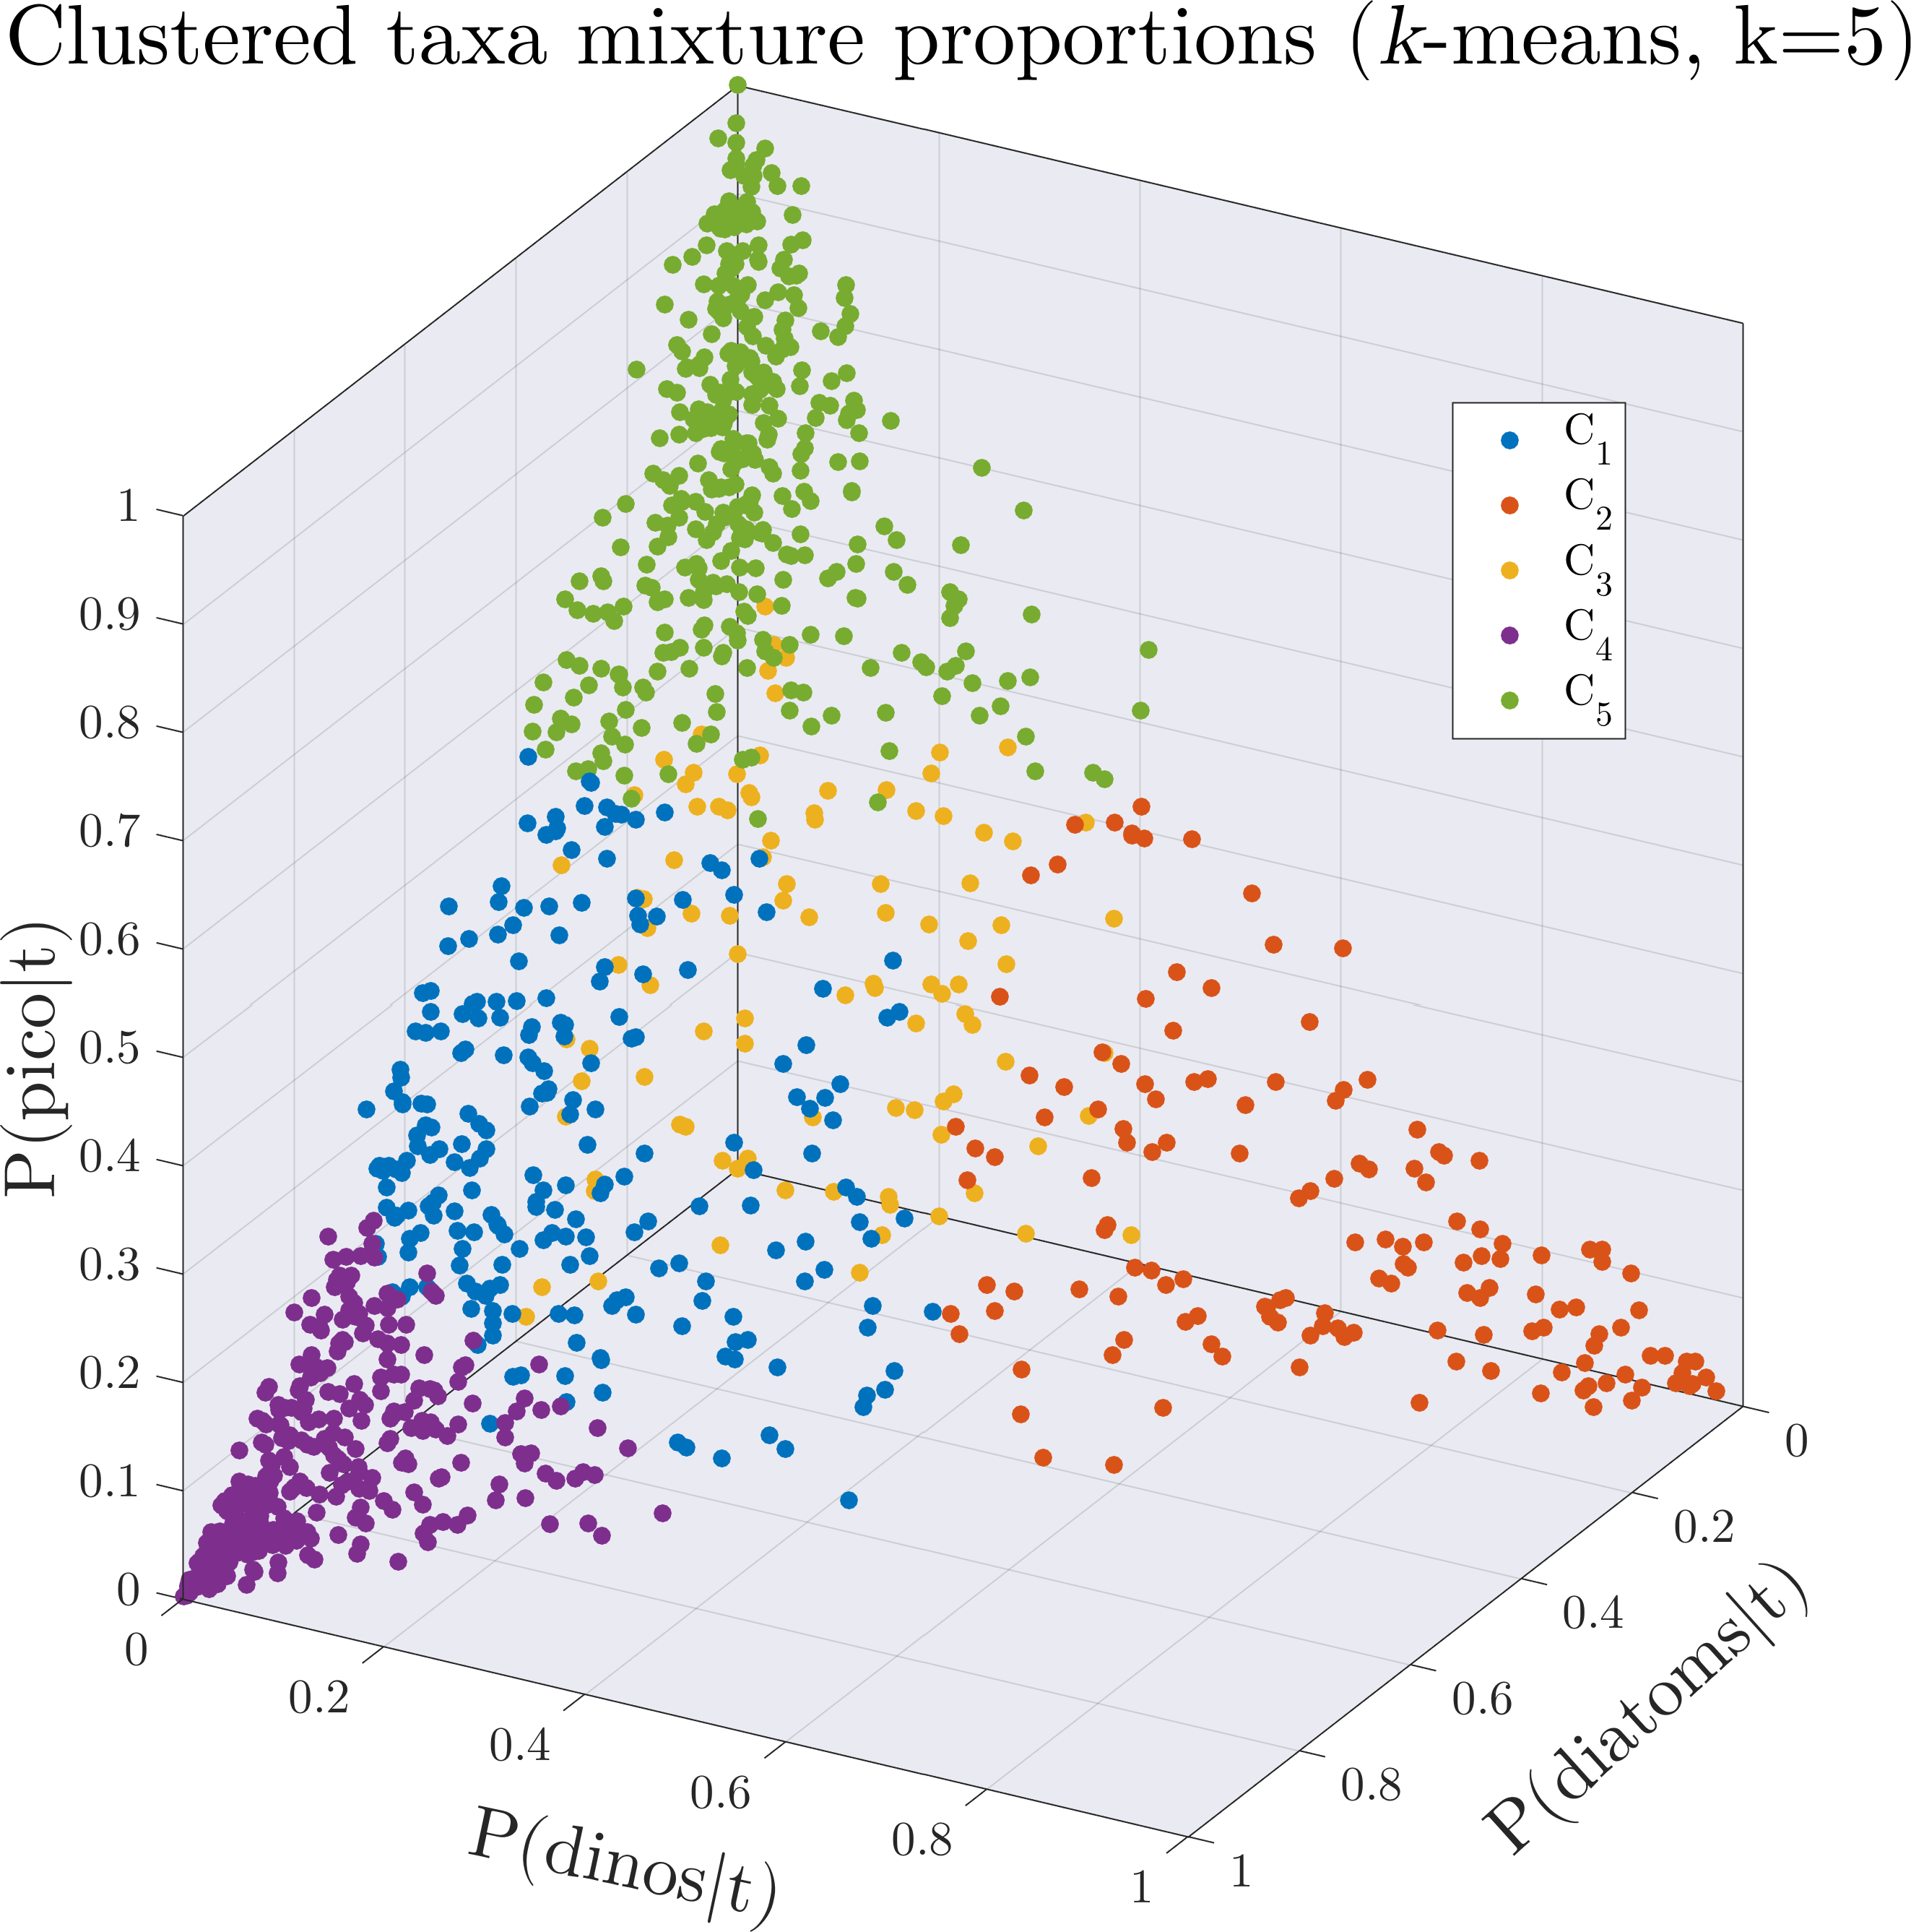
Community "types" using k-means clustering
k-means clustering:
Partition n observations into k clusters.
Each observation belongs to the cluster with the nearest mean (centroid)
k is user specified.
Tried k=1-12.

Slide 16
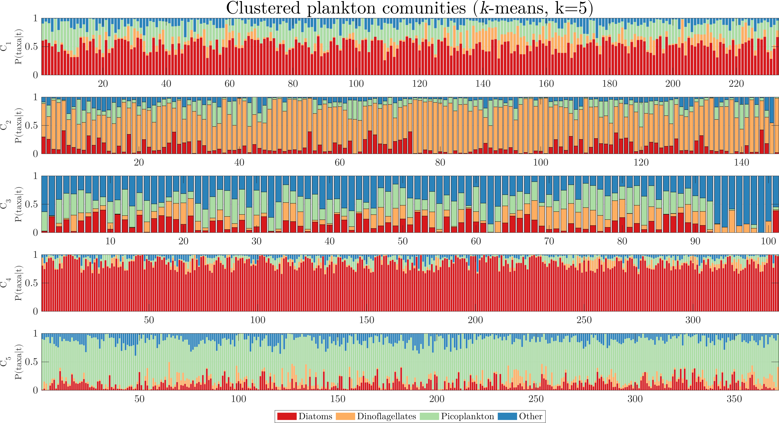
Community "types" using k-means clustering

