Slide 1
Classification of Phytoplankton Communities
Goal: investigate the presence/absence and robustness of a relationship between phytoplankton taxa and various environmental predictors
Main conclusions:
In the CTD dataset, phytoplankton taxa classification performance is limited by feature discriminatory power, not by sample size.
Explored features are limited in their ability to separate communities dominated by Dinoflagellates.
Consistent high-bias model performance across all feature combinations may indicate the presence of noise in the response variable, i.e., the count data from which the community taxa composition is derived.
The predictive power of features that do not measure biological properties directly (e.g., time of year, water temp, distance from coast, etc.) suggests that a hierarchical approach that leverages these variables as priors (e.g., in a Bayesian network) may be more appropriate.

Slide 2
Overview of the approach
Classification of phytoplankton communities
Use k-means clustering on phytoplankton taxa composition data from M1 time-series to index community "types" - these clusters will serve as our classes.
Each community is a mixture of Diatoms, Dinoflagellates, Picoplankton and Other.
Train a classification model to try and separate the communities: Support Vector Machine (SVM).
Perform exhaustive search over our feature set to identify optimal predictors for each class - consider all possible permutations (524,287 models).
Compute performance metrics and “learning curve” for best models.

Slide 3
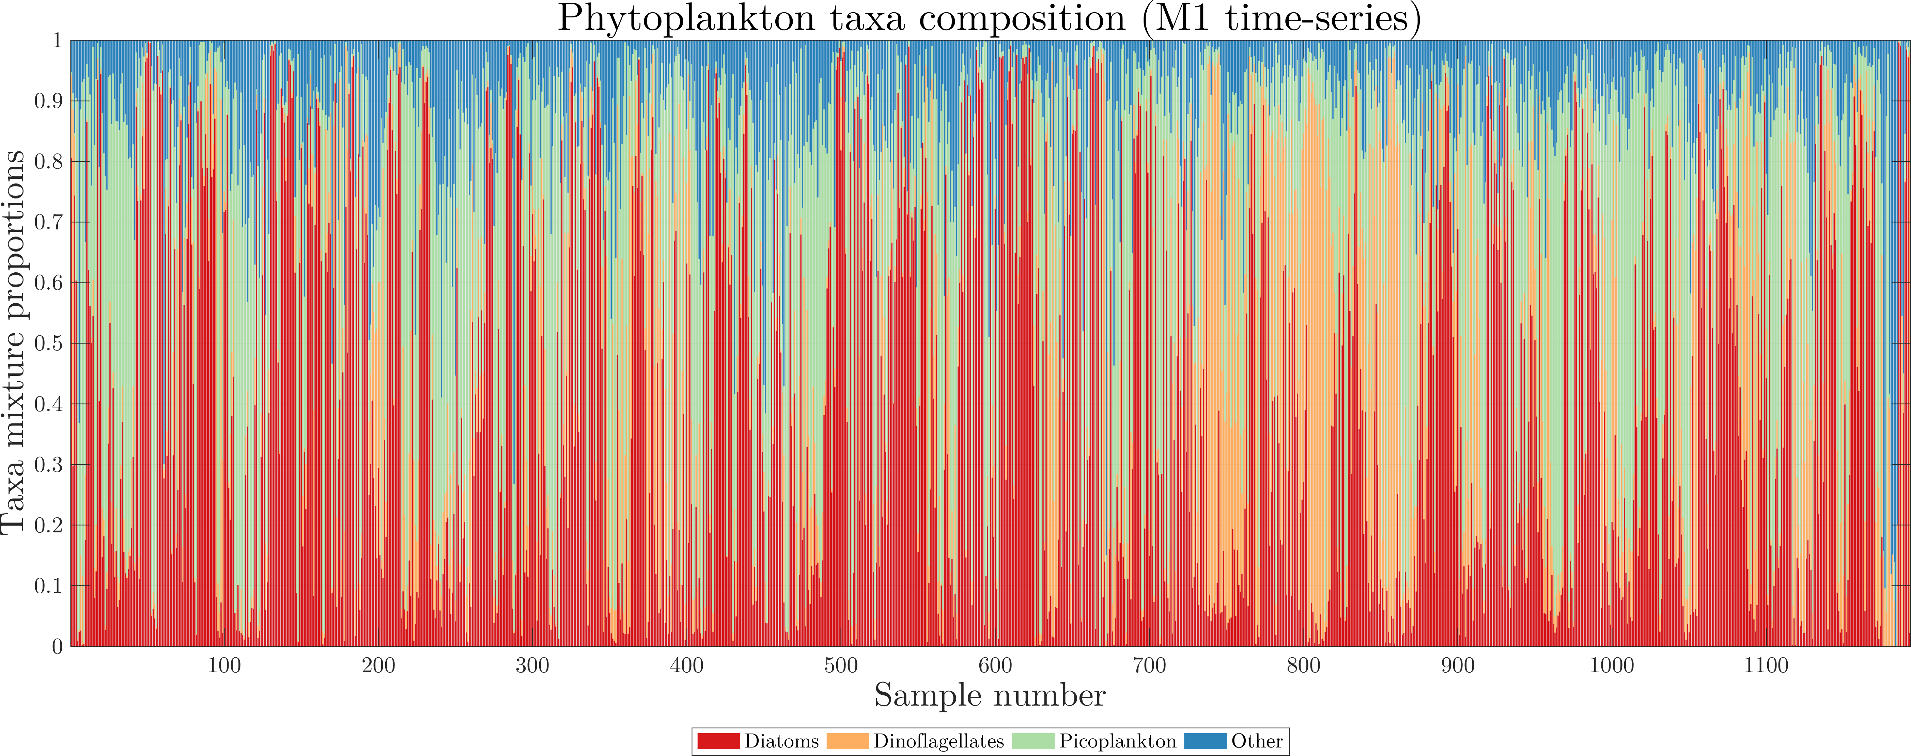
Deriving phytoplankton community types from in-situ count data

Slide 4
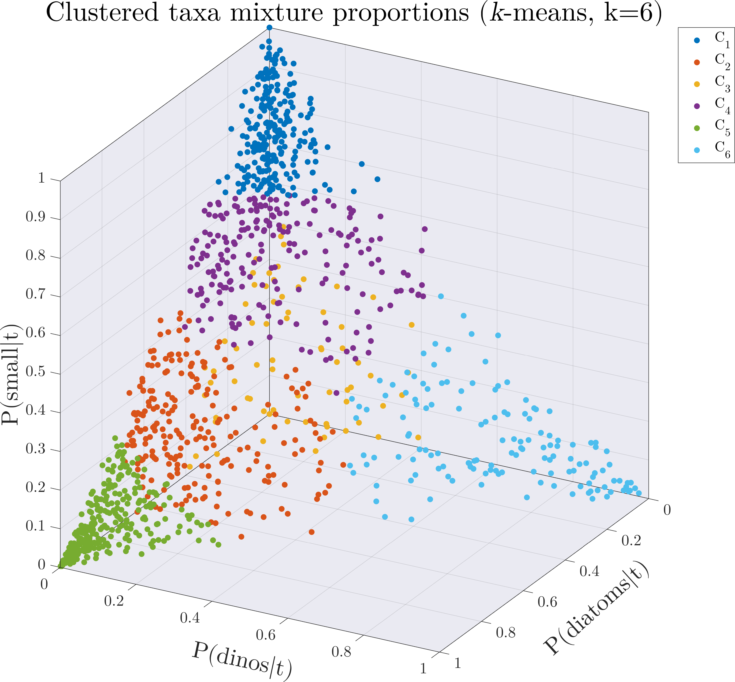
Community "types" using k-means clustering
Picoplankton
dominated
k-means clustering:
Use large number of clusters (e.g., k=6) to extract communities that are dominated by a single taxon
Process only “uni-taxa” communities in classification models
Dinoflagellate dominated community (C₆) incorporates observations that are more mixed to increase the number of samples in the group
Dinoflagellate
dominated
Diatom
dominated

Slide 5
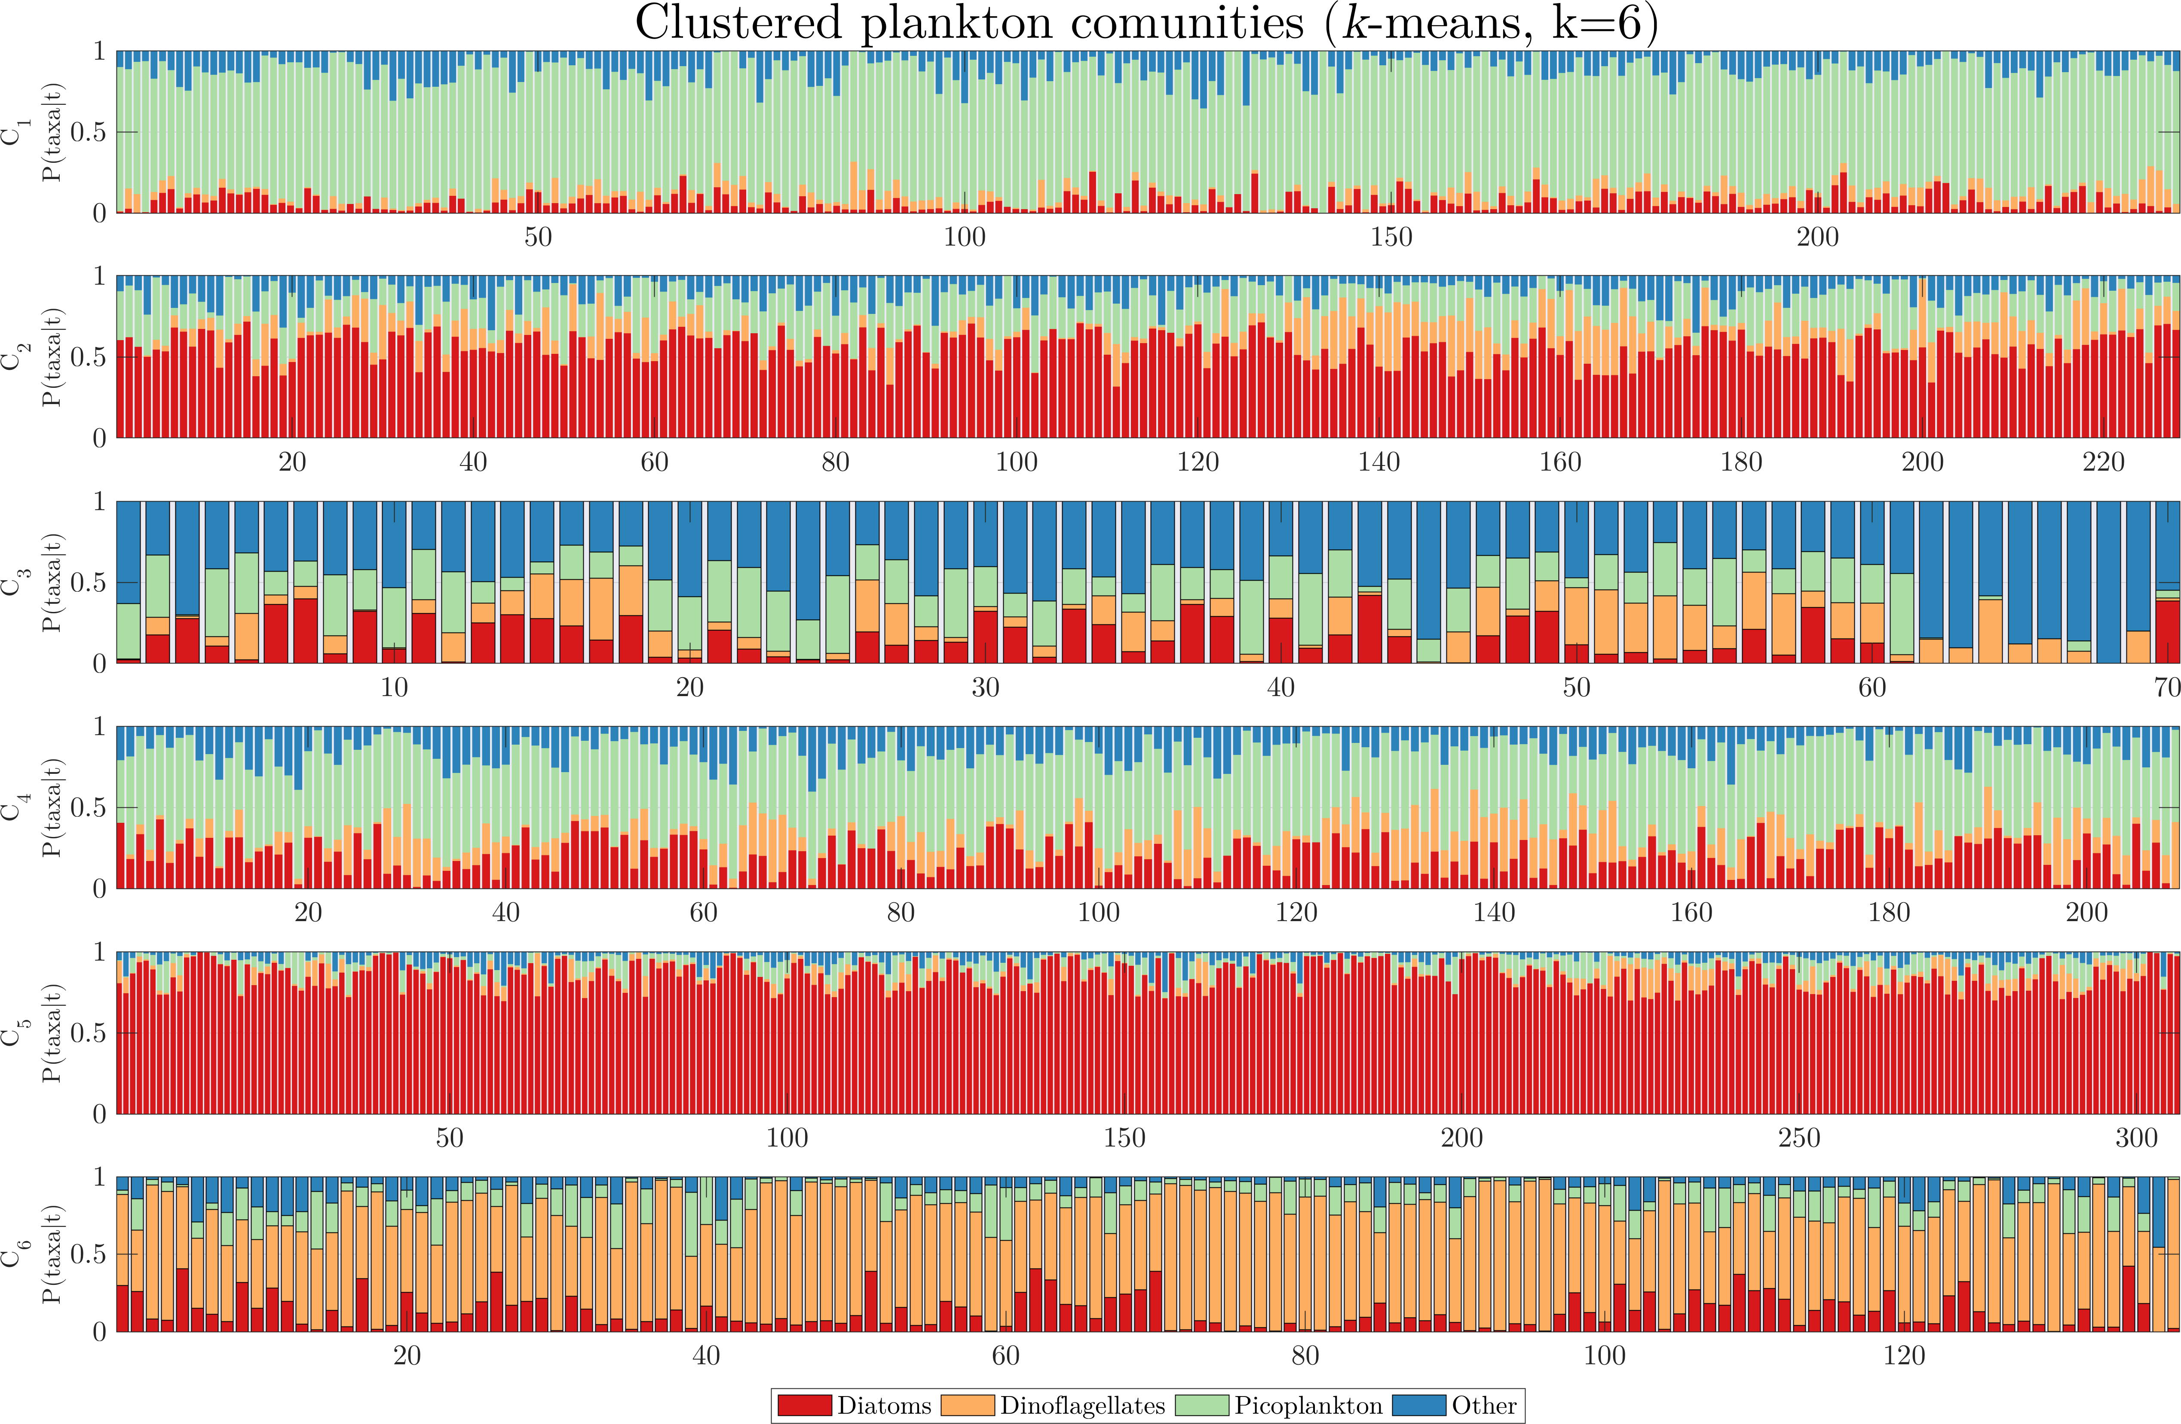
Community "types" using k-means clustering
Picoplankton
dominated
Diatom
dominated
Dinoflagellate
dominated

Slide 6
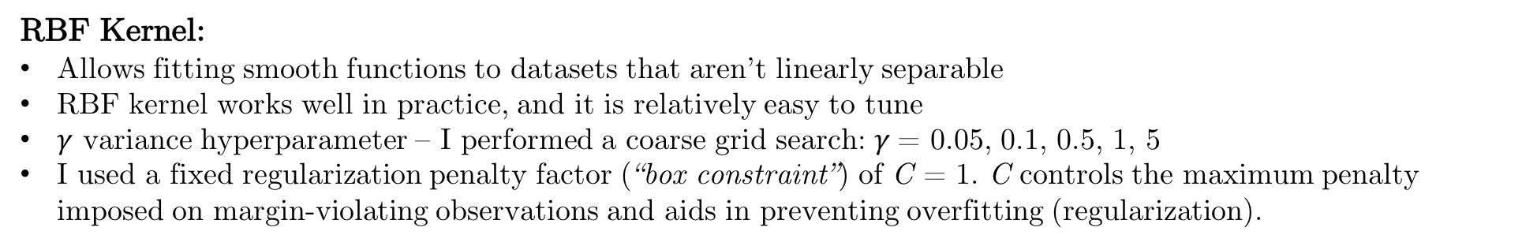
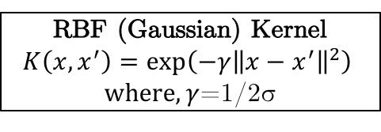
Classification model: Support Vector Machine (SVM)
SVM:
Binary classifier.
Find widest separating margin between two classes.
Find complex margins using transformation functions (kernels)
“One-vs-all” for multi-class case
Partition data: K-fold cross-validation (we used k=5)
RBF Kernel:
Allows fitting smooth functions to datasets that aren’t linearly separable
RBF kernel works well in practice, and it is relatively easy to tune
$γ$ variance hyperparameter – I performed a coarse grid search: $γ$= 0.05, 0.1, 0.5, 1, 5
I used a fixed regularization penalty factor (“box constraint”) of C = 1. C controls the maximum penalty imposed on margin-violating observations and aids in preventing overfitting (regularization).
RBF (Gaussian) Kernel
$$K\left(x,x^{′}\right)=\exp\left(−γ{\left\|x−x^{′}\right\|}^{2}\right)$$
$where, γ$=1/2σ
Figure by Alisneaky, svg version by User:Zirguezi - Own work, CC BY-SA 4.0, https://commons.wikimedia.org/w/index.php?curid=47868867

Slide 7
CTD dataset, kmeans=6
Picoplankton = 242 samples
Diatoms = 306 samples
Dinoflagellates = 138 samples

Slide 8
Predictors
Name | Description
distcoast | Distance from coast
bathy | Bathymetry (water depth)
hour | Hour of day
timeofyear | Year day
chl | Chlorophyll (bottle data)
no3 | Nitrate (bottle data)
allhet | (taxa)
ratiohet | Ratio of heterotrophs to autotrophs biomass
par | Photosynthetically Active Radiation (CTD)
temp | Temperature (CTD)
salt | Salinity (CTD)
strat | Stratification (0-100m average)
strat2 | Stratification (5-100m density difference)
MLD | Mixed layer depth (deltaT = 0.2°C relative to 5m)
beamc | Beam c (CTD)
fluo | Fluorescence (CTD)
slope
maxfluo | Maximum fluorescence
beamc_maxfluo | Beam-c at the maximum fluorescence
Consider all possible feature permutations: 524,287 models
Compute performance metrics for each model (what combination of features best predicts diatoms, pico, dino?)
Sort list by classification performance (MCC)

Slide 9
SVM model selection (kmeans=6)

Slide 10
SVM model selection
Top 10 models sorted by MCC score (averaged over all 3 classes):
Model name |  | MCC | F1-score | ACC | TPR | FPR | Precision | Recall | gamma
1 | timeofyear+chl+allhet+ratiohet+temp+maxfluo | 0.6622 | 0.7613 | 0.8620 | 0.7466 | 0.1137 | 0.8013 | 0.7466 | 1
2 | timeofyear+chl+allhet+temp+maxfluo | 0.6561 | 0.7578 | 0.8601 | 0.7452 | 0.1141 | 0.7918 | 0.7452 | 1
3 | distcoast+timeofyear+chl+allhet+ratiohet+maxfluo | 0.6449 | 0.7481 | 0.8542 | 0.7334 | 0.1205 | 0.7956 | 0.7334 | 1
4 | timeofyear+chl+no3+allhet+temp+maxfluo | 0.6378 | 0.7444 | 0.8513 | 0.7280 | 0.1239 | 0.7902 | 0.7280 | 1
5 | bathy+timeofyear+chl+allhet+maxfluo | 0.6377 | 0.7465 | 0.8523 | 0.7343 | 0.1205 | 0.7786 | 0.7343 | 1
6 | timeofyear+chl+allhet+beamc+maxfluo | 0.6348 | 0.7346 | 0.8513 | 0.7183 | 0.1249 | 0.7980 | 0.7183 | 1
7 | timeofyear+chl+allhet+maxfluo | 0.6347 | 0.7424 | 0.8513 | 0.7298 | 0.1218 | 0.7801 | 0.7298 | 1
8 | bathy+timeofyear+chl+allhet+ratiohet+temp+maxfluo | 0.6344 | 0.7452 | 0.8494 | 0.7312 | 0.1236 | 0.7818 | 0.7312 | 1
9 | distcoast+timeofyear+chl+allhet+beamc+maxfluo | 0.6307 | 0.7352 | 0.8484 | 0.7193 | 0.1260 | 0.7928 | 0.7193 | 1
10 | timeofyear+chl+allhet+ratiohet+maxfluo | 0.6307 | 0.7382 | 0.8494 | 0.7253 | 0.1238 | 0.7815 | 0.7253 | 1
Dominating features are: timeofyear, chl, and allhet

Slide 11
Analysis of best SVM model
(optimized hyperparameters)
Model inputs
timeofyear + chl + allhet + ratiohet + temp + maxfluo

Slide 12
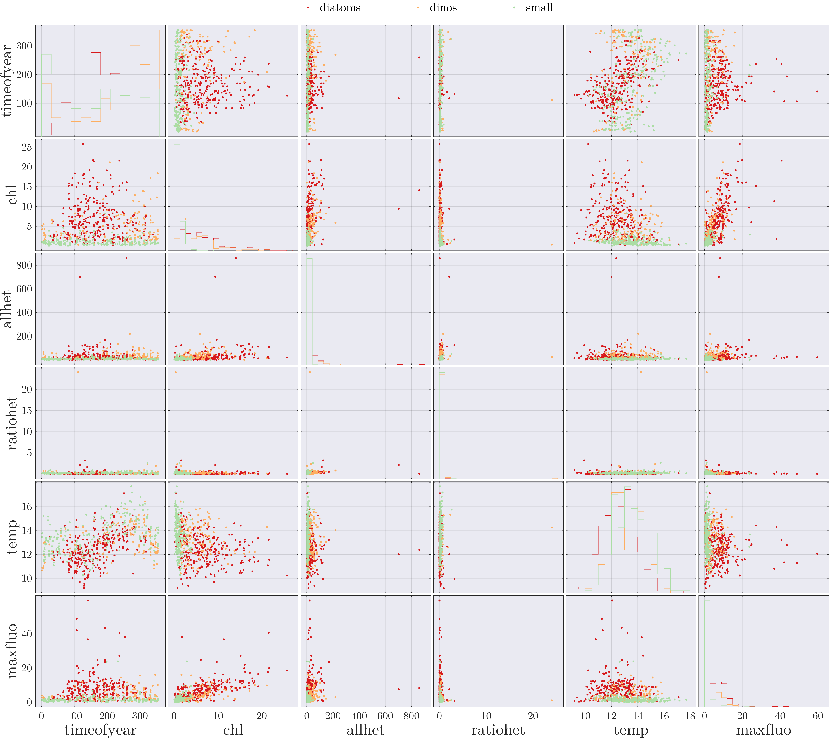
Feature space

Slide 13
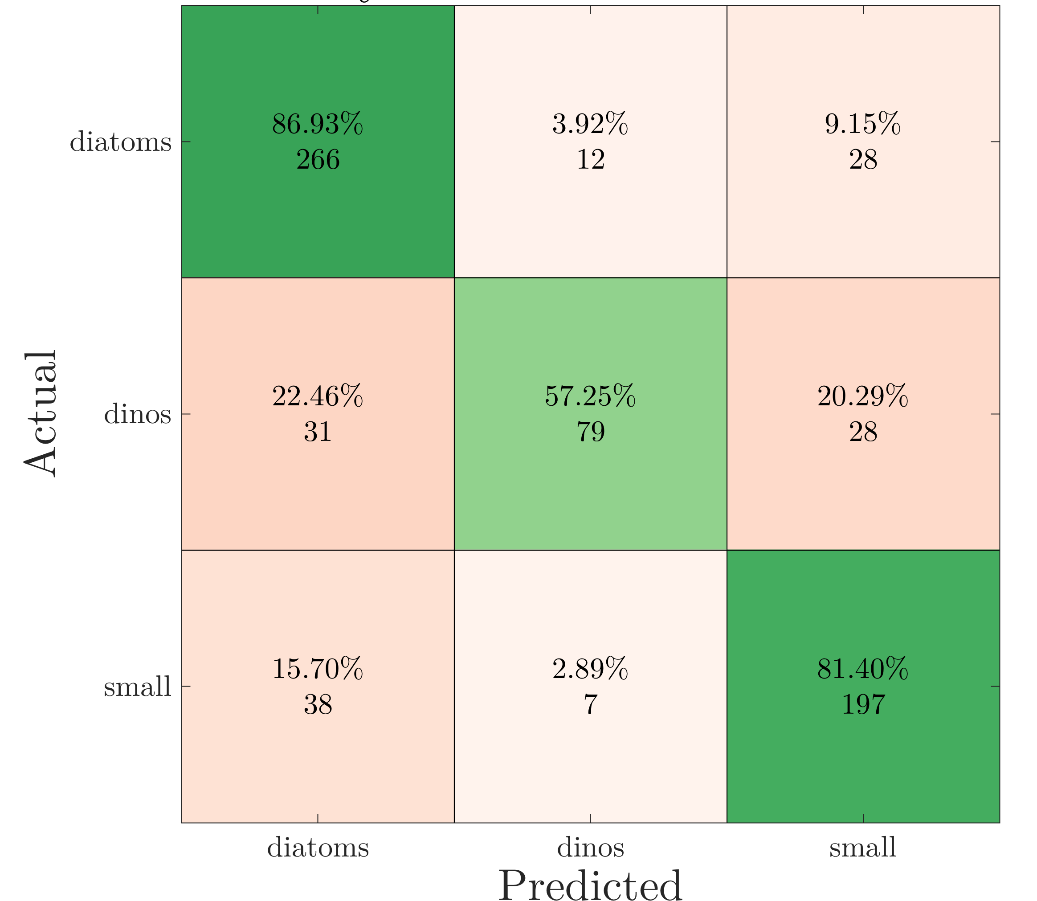
SVM performance
Model inputs
timeofyear + chl + allhet + ratiohet + temp + maxfluo
Results after hyperparameter optimization:
Best observed feasible point:
Coding BoxConstraint KernelScale
onevsone 2.66 1.7602
Overall loss = 0. 19825
Evaluation time = 0.23475 sec

Slide 14
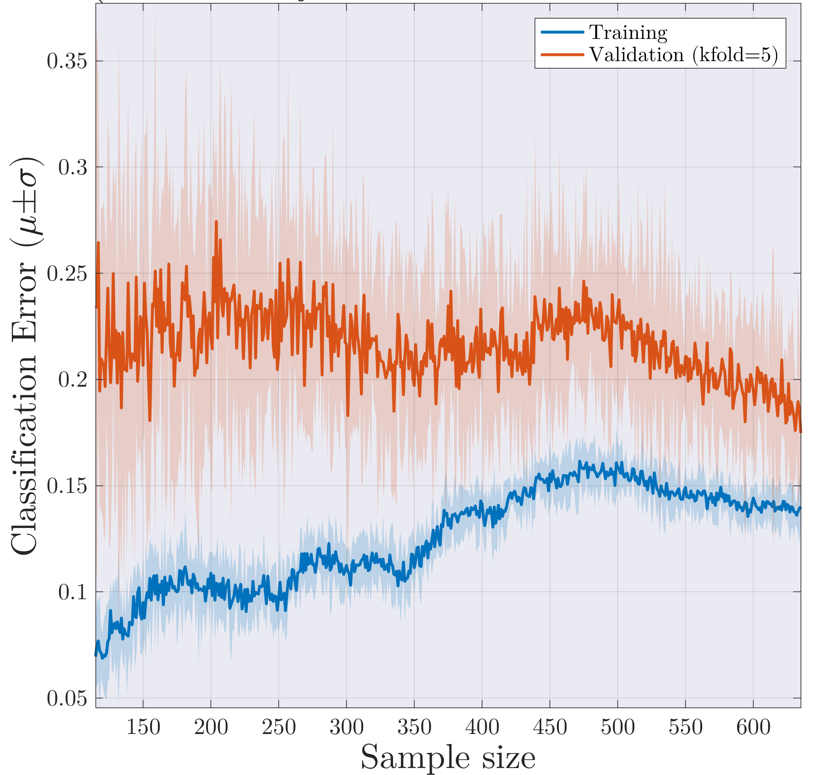
SVM model performance: learning curve
Learning curve:
(avg. classification error vs. sample size)
High bias learning curve:
  Training error is still relatively high (~15%).
  A small gap (<5%) between error in training and validation sets.
These results suggest:
  Limited predictive power using current features, i.e., the classes aren’t well separated in the feature space.
  Increasing the size of the training set will likely have minor impact on classification performance.
  May indicate issue with class labeling, i.e., the response variable (count dataset in our case)
Desired performance

Slide 15
Analysis of 2D SVM model
(optimized hyperparameters)
Model inputs
maxfluo+beamc_maxfluo

Slide 16
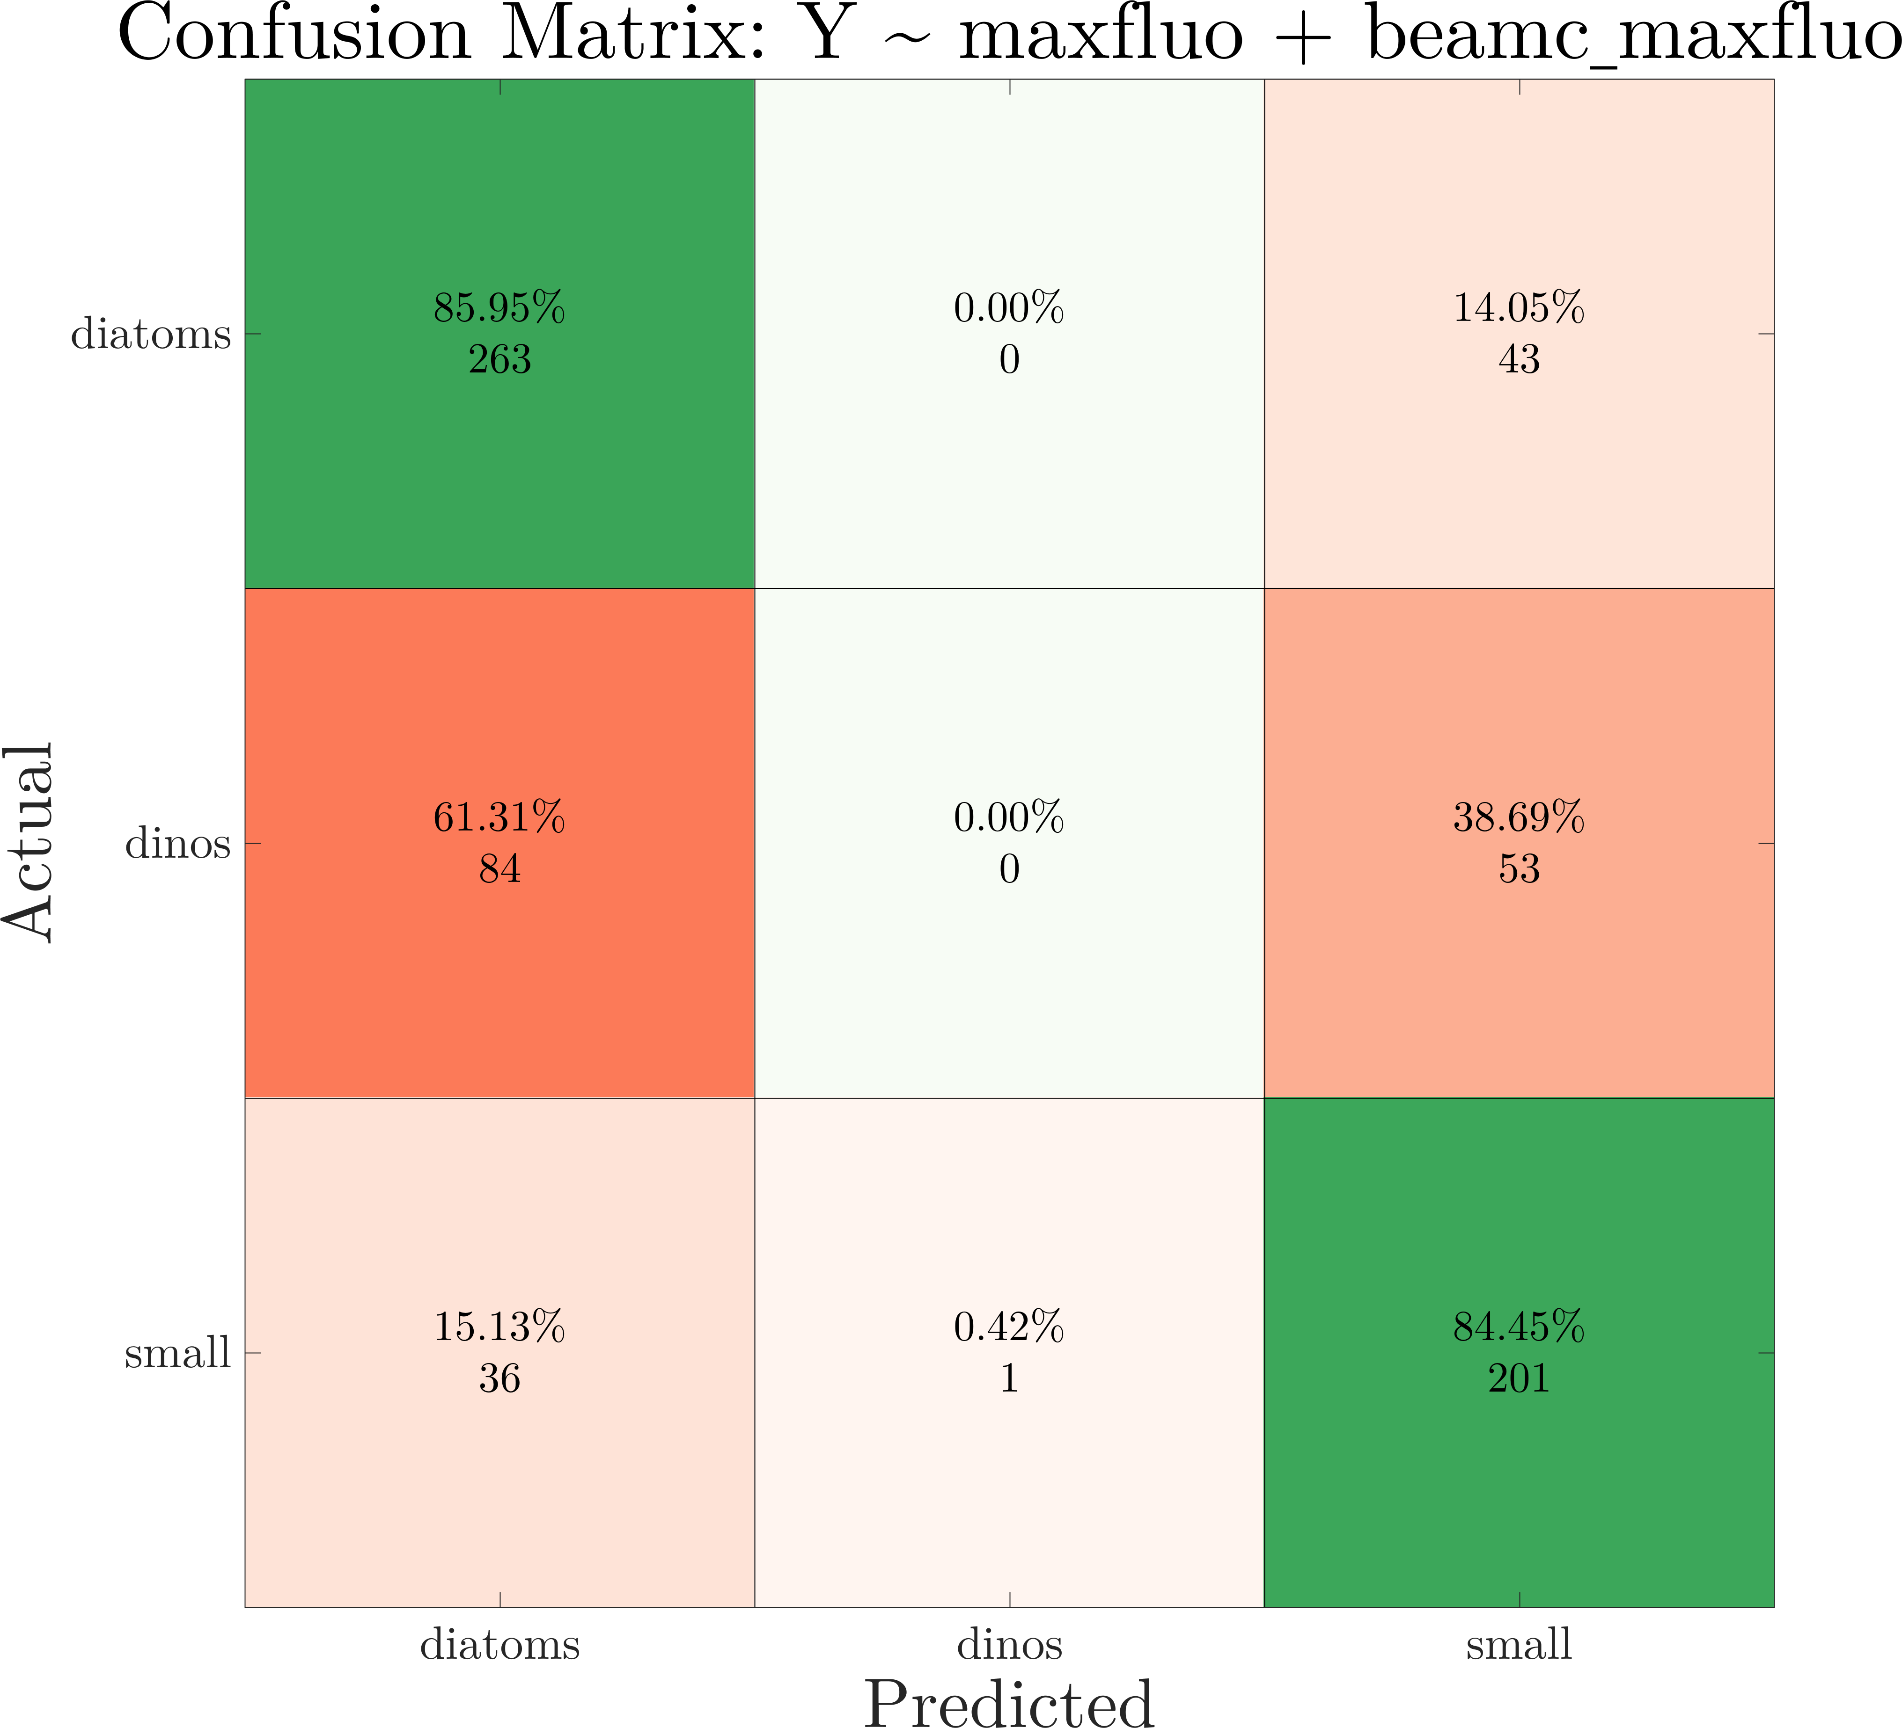
SVM performance
Model inputs
maxfluo+beamc_maxfluo
Results after hyperparameter optimization:
Best observed feasible point:
Coding BoxConstraint KernelScale
onevsone 3.0918 0.46196
Observed loss value = 0.31865
Function evaluation time = 0.31224
Confusion matrix obtained from cross-validated model:

Slide 17
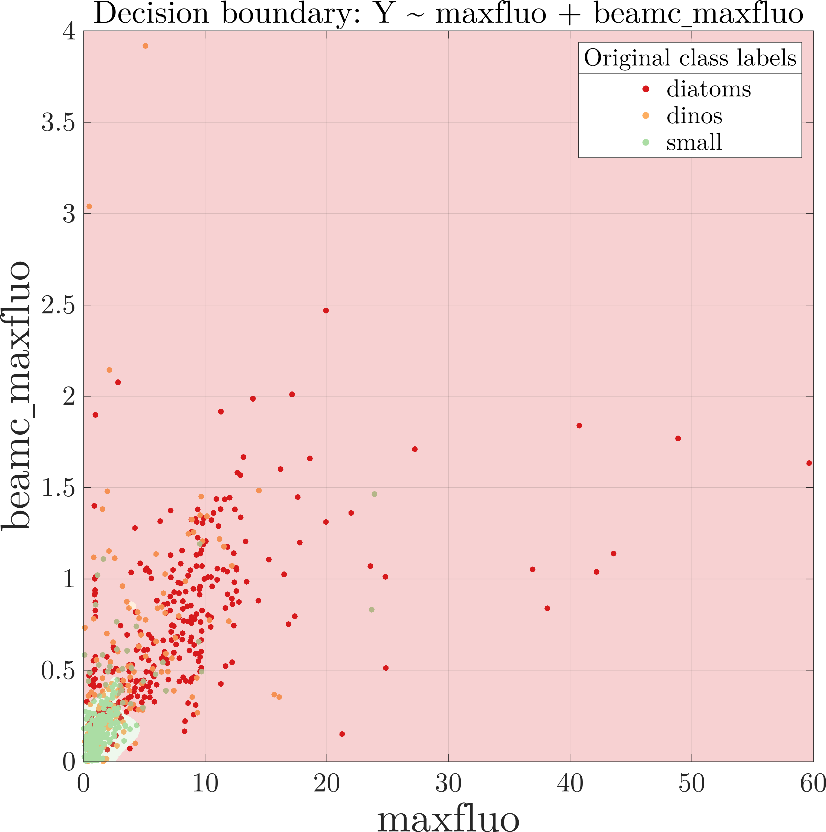
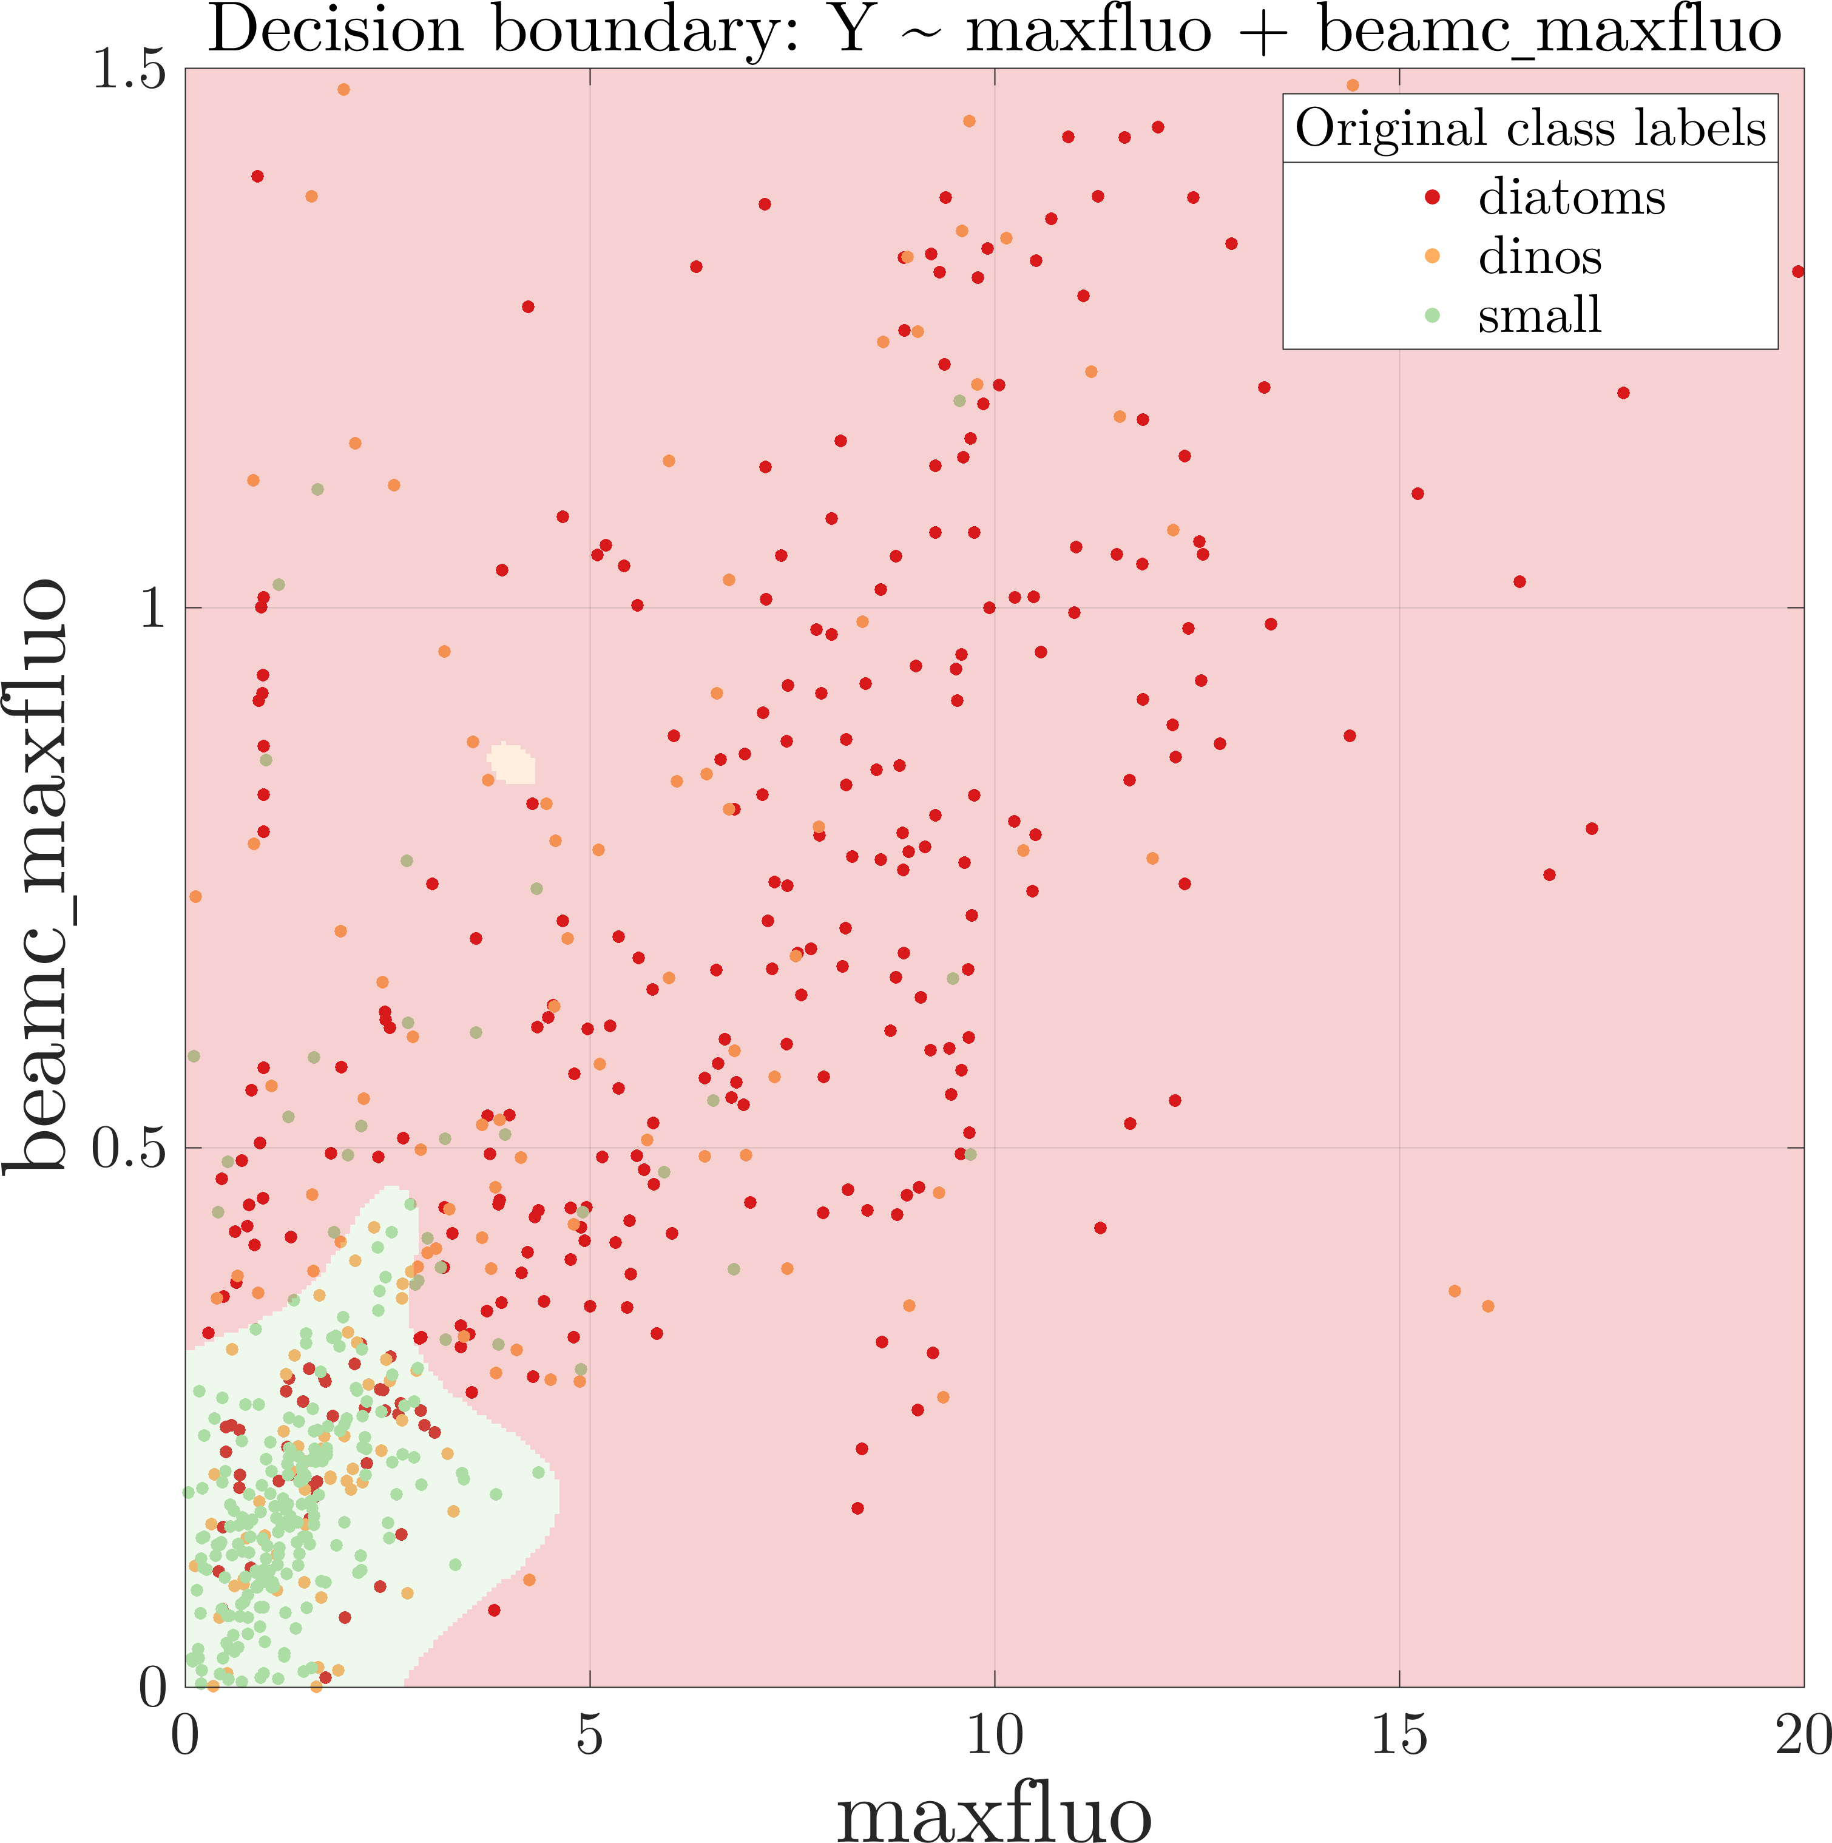
SVM performance:
Features provide reasonable separation between Diatoms and Pico classes, but are unable to separate Dinoflagellate class
The classification regions from the SVM are shown in the background shading, with data points (actual labels) overlaid

Slide 18
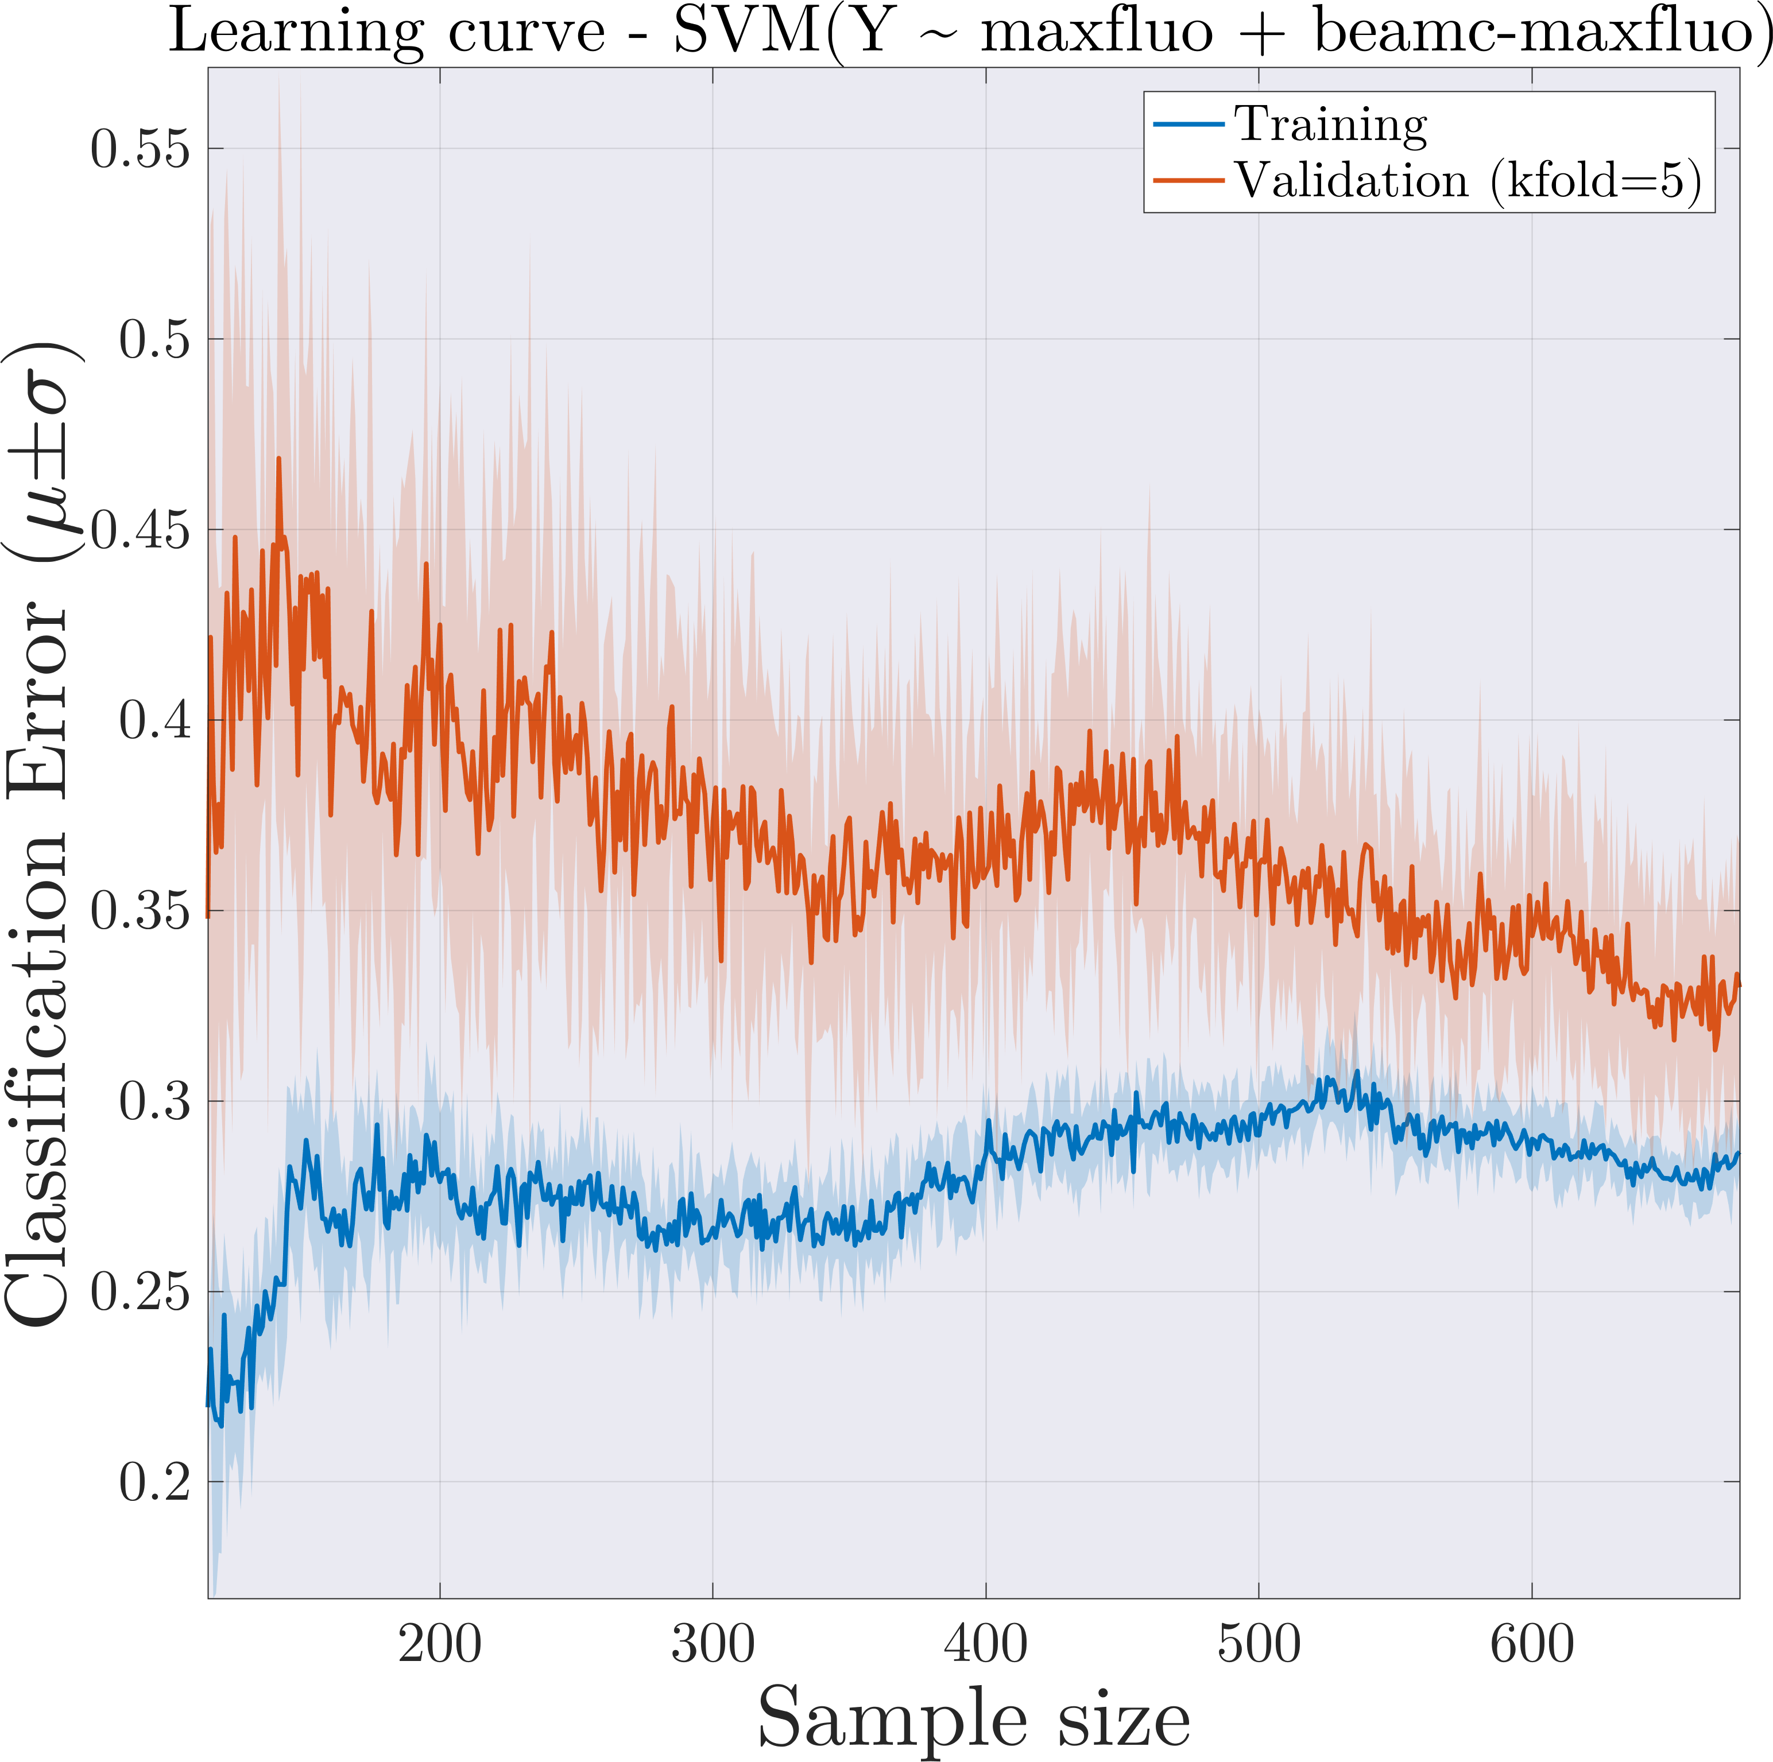
SVM model performance: learning curve
Learning curve:
High bias learning curve:
  Training error is high (>20%).
  Small gap between training and test error.
These results suggest:
  Increasing the size of the training set will likely have minor impact on classification performance.
  The classes are poorly separated in the current feature space.
Desired performance

