Slide 1
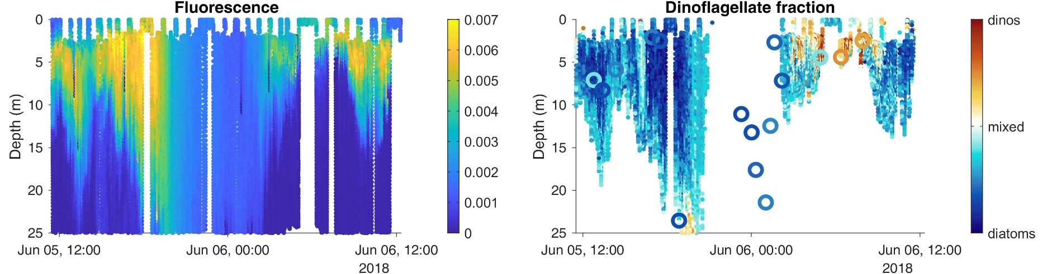
ML-derived plankton taxonomy proxies from AUV data
Predictors = temperature, fluorescence, backscatter routinely measured by AUVs
Labels = nighttime bioluminescence-derived dinoflagellate vs diatoms (dinoflagellates are bioluminescent, diatoms are not)
Output = ML-derived dinoflagellate vs diatom fraction
Example survey in June 2018
Left: one predictor
Right: ML-derived proxy (high fluorescence regions) and eDNA validation (circles)

Slide 2
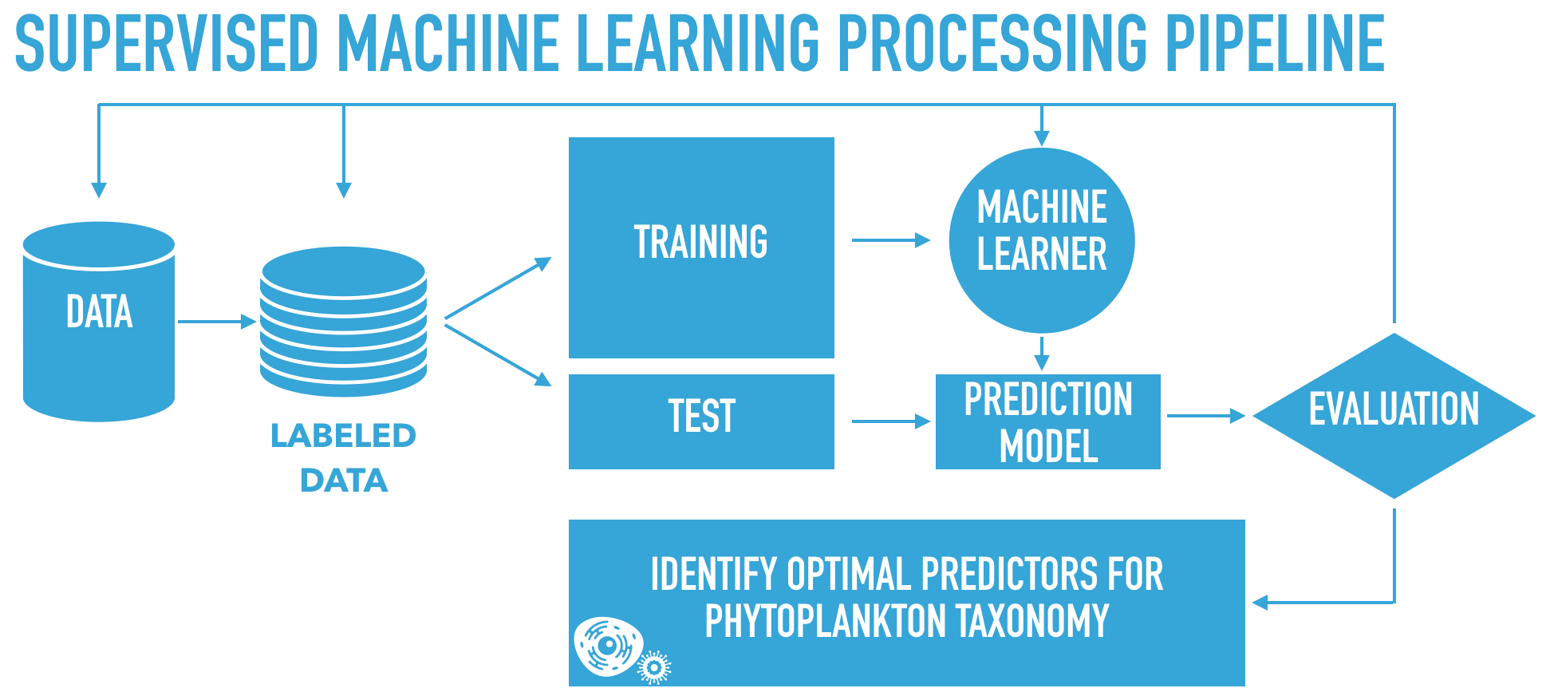
ML pipeline
Automated workflow to investigate the presence/absence and robustness of a relationship between phytoplankton taxa and various environmental predictors
2

Slide 3
Opportunities and challenges
Science outcome:
  Proxies extend the spatio-temporal coverage of plankton taxonomic information by orders of magnitude, enabling new understanding of patterns and drivers
Challenges:
  Proxies are trained on another proxy instead of “true” taxonomic data from microscopy or environmental DNA (small dataset)
  Comparison against data is good but complicated by comparing apples to oranges (information based on bioluminescence vs eDNA vs microscopy)
  Need a better understanding of how data from different origins/methods can be compared to each other.

