Slide 1

R.O.V.V.R.
Live Streaming Virtual Reality from ROV Doc Ricketts
2018 Abstract Presentation

Slide 2
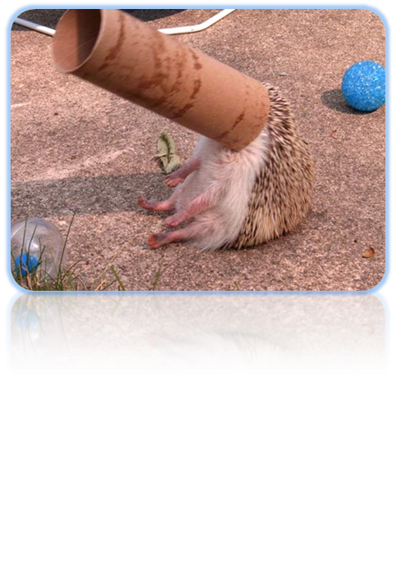
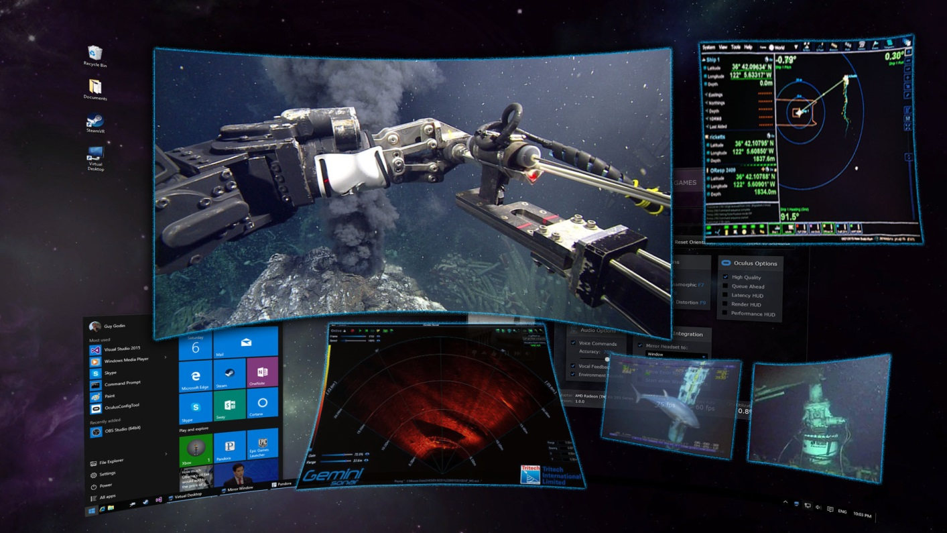
ROVVR
Virtual reality is quickly evolving, becoming a new mechanism for a high level of engagement of users in science, sociology, and entertainment. The heightened sense of presence, when offered to a technical mind, could enable better scientific understanding of complex data that are difficult to grasp in standard two-dimensional presentations.
Virtual reality can place an individual in the deep ocean in a way only previously felt through manned submersibles. With augmented reality components, which layer metadata over live images, we can combine the best aspects of manned and unmanned systems
 | 4.04%

Slide 3
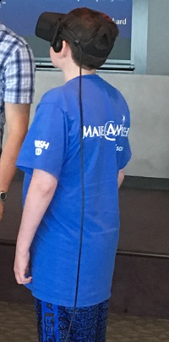
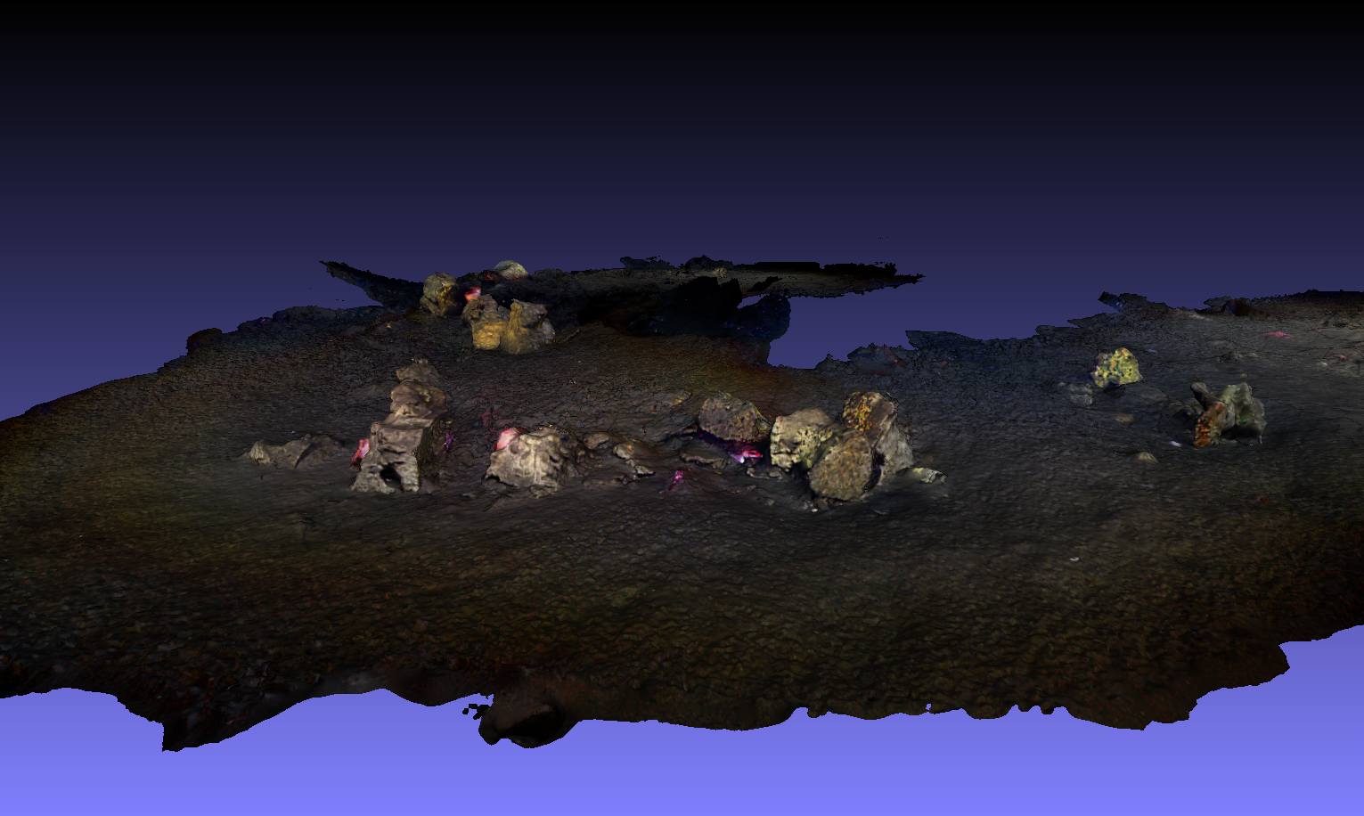
ROVVR – 2017
The ROVVR project is currently 5-months into a 1-year scoping study, aimed at assessing the state of the art in virtual reality, potential applications, and challenges to bringing this technology into the deep ocean.
Accomplishments to date:
Investigate current state of technology, and trends.
  Vive, Oculus, Google
  Unity, WebGL
Make industry connections.
  xRex Studios
  Suometry
Investigate and demonstrate potential use cases.
  Virtual exploration of 3D Larvacean filter model
  Photogrammetry of whale fall site
  Outreach: Make-a-wish
  Interface with real time data streams/video.
Photogrammetric 3D scale model of Francisco whale fall.

Slide 4
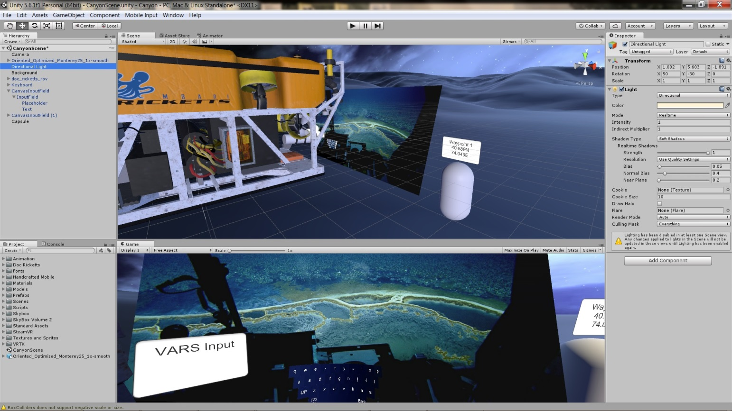
Proposal
In 2018, we propose to begin development of a system that will enable collection of stereoscopic high-definition video, processing it into 3D video suitable for display in a VR headset. This video will be panoramic and real-time. With access to vehicle data, existing topography maps, and historical biological and physical data, the video will be augmented to allow scientists to make more informed decisions regarding sample collection and other observations.

Slide 5

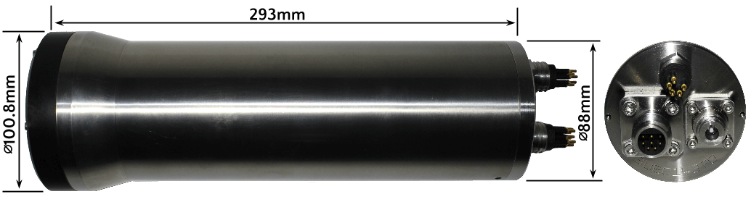


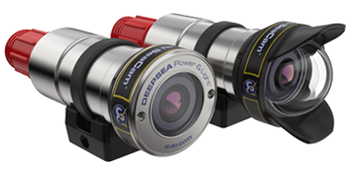
Proposed Design
By leveraging off-the-shelf components for subsea imagers and purchasing stitching software, the effort required to evaluate the benefit of these tools can be evaluated with little risk and low labor requirements.

Slide 6
Proposed Design - Block Diagram
VR Headset
PC
Suometry Software
DSPL/SubC Cameras
Yellobrik
D.R. Science Can
Decklink/Aja Capture Cards
CWDM Video DeMux
Topside Fiber Break Out
CWDM
Video Mux
Shogun
Control Room
ROV Doc Ricketts
This development will dovetail with planned upgrades to the ROV Doc Ricketts, which provide bandwidth and position accuracy better than ever before.

Slide 7

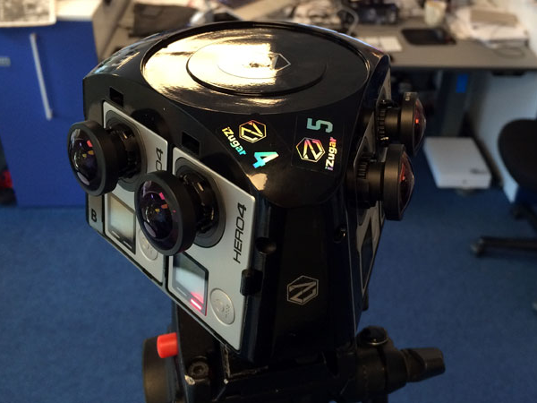
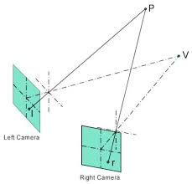
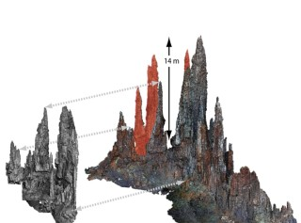
The Effect
Post-processing of calibrated stereo video will have transformative scientific payoff, allowing for determination of size and placement of organisms relative to each other in three-dimensional space. This information would allow us to ask questions about predator-prey relationships, ecology, and behavior that are not currently tractable. Virtual reality exports of the video through outreach channels and social media will be a product of the system as well.

Slide 8
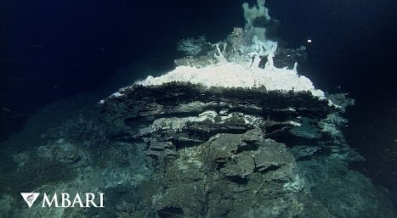
Conclusion
Development of a virtual reality application for ROV dive analysis is the strong embodiment of the Strategic Plan’s theme of Ocean Visualization, as the proposed tools will enable for data synthesis between video and any 3-dimensional datasets. The ability to transport the user into a large survey area surrounded by video, spatial data, and topography, and the ability to visualize change is an excellent example of Innovation Through Integration, a key aspect of the Technology Roadmap.
Project Team
Steve Haddock – Science Lead
Eric Martin – Lead Eng.
Mike McCann – Co-Lead Eng.
Benjamin Erwin – Project Mgr.
Thanks for your consideration.
-ROVVR Team

