Slide 1
Prelim FEA Analysis
ROVVR Camera

Slide 2
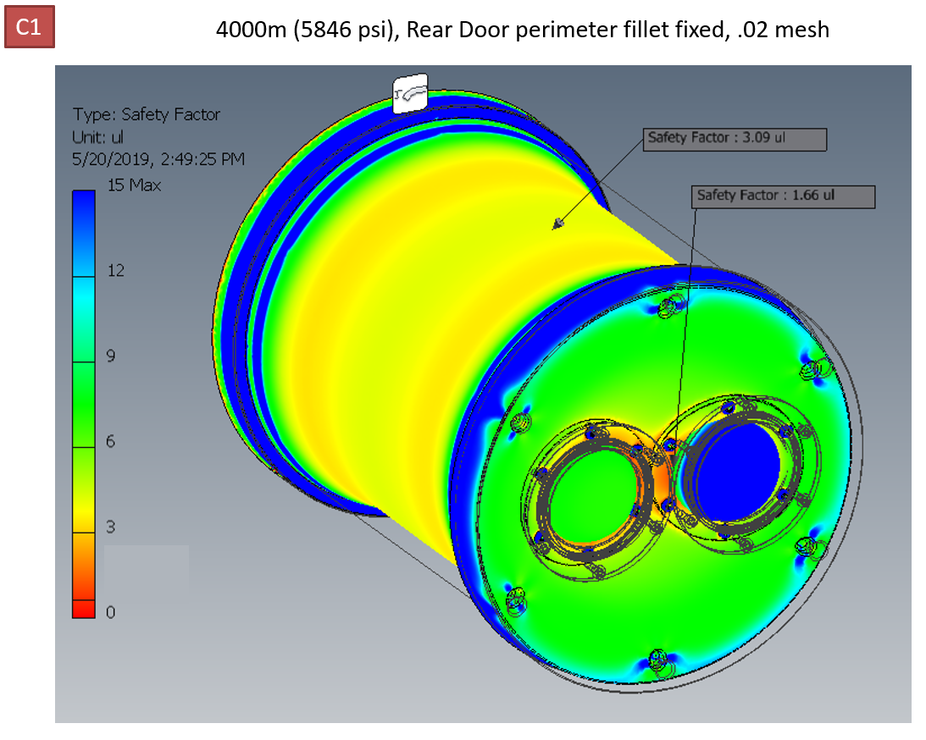

Slide 3
Door design for these tests is 1.95" thick (Grade 5 Ti)

Slide 4
Test is run with pressure at 4000m seawater

Slide 5
Displacement of the dome seat (x2) is approximately 0.005" from outside to inside. This is our biggest concern - that the metal seat that the domes are sitting on will not be flat enough under pressure and will result in uneven stress on the glass

Slide 6
Final Notes
When originally ran our tests with a door that was 1.70" thick and the seat displacement had a difference of 0.015" to 0.020". That made us uncomfortable so we bumped the door thickness by another .25".
If there was only one dome, the seat would be displaced evenly around the perimeter of the dome and the depth rating would be much higher. With two domes, there is a bridge of material between them that is our weak spot (still meets safety factor at depth, but might cause domes to break).
We plan to use a mechanical seal on the domes using a bore seal oring around outside perimeter. The glass face (equator plane) will be sitting directly on a machined Titanium surface. We have done this successfully on several other housings that have been in service for 5 years in Hawaii going to depths of 6000m. The other sealing method is to use a two part epoxy that remains somewhat compliant after curing. This has worked well for shallower applications but is much harder to service (replace domes) and doesn't solve the problem of the uneven seat at depth.
<end update>

