Slide 1
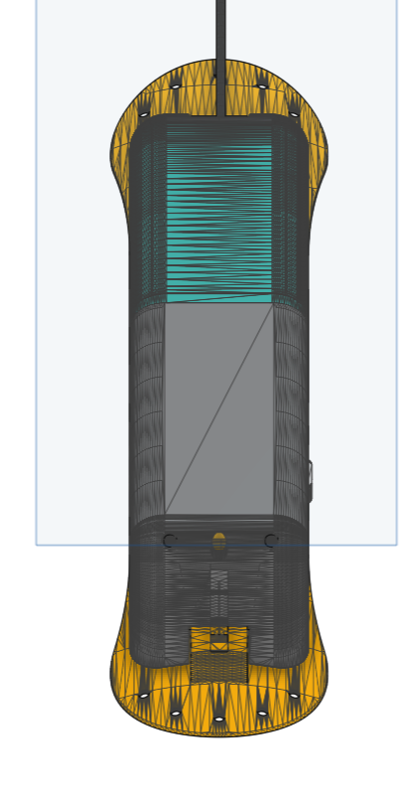
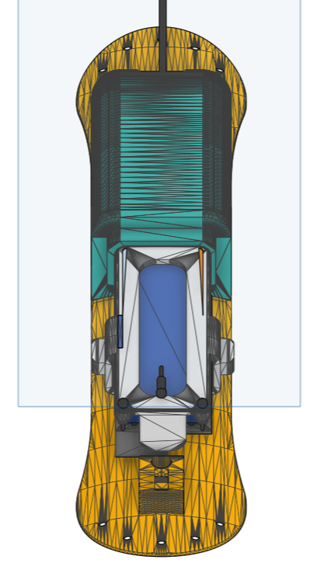
Remove the 3-D printing housing

Slide 2
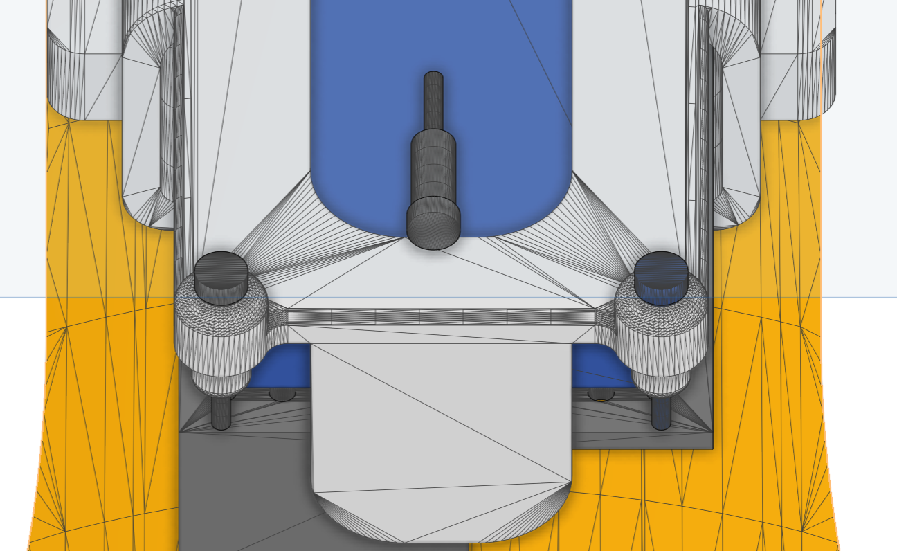

Slide 3
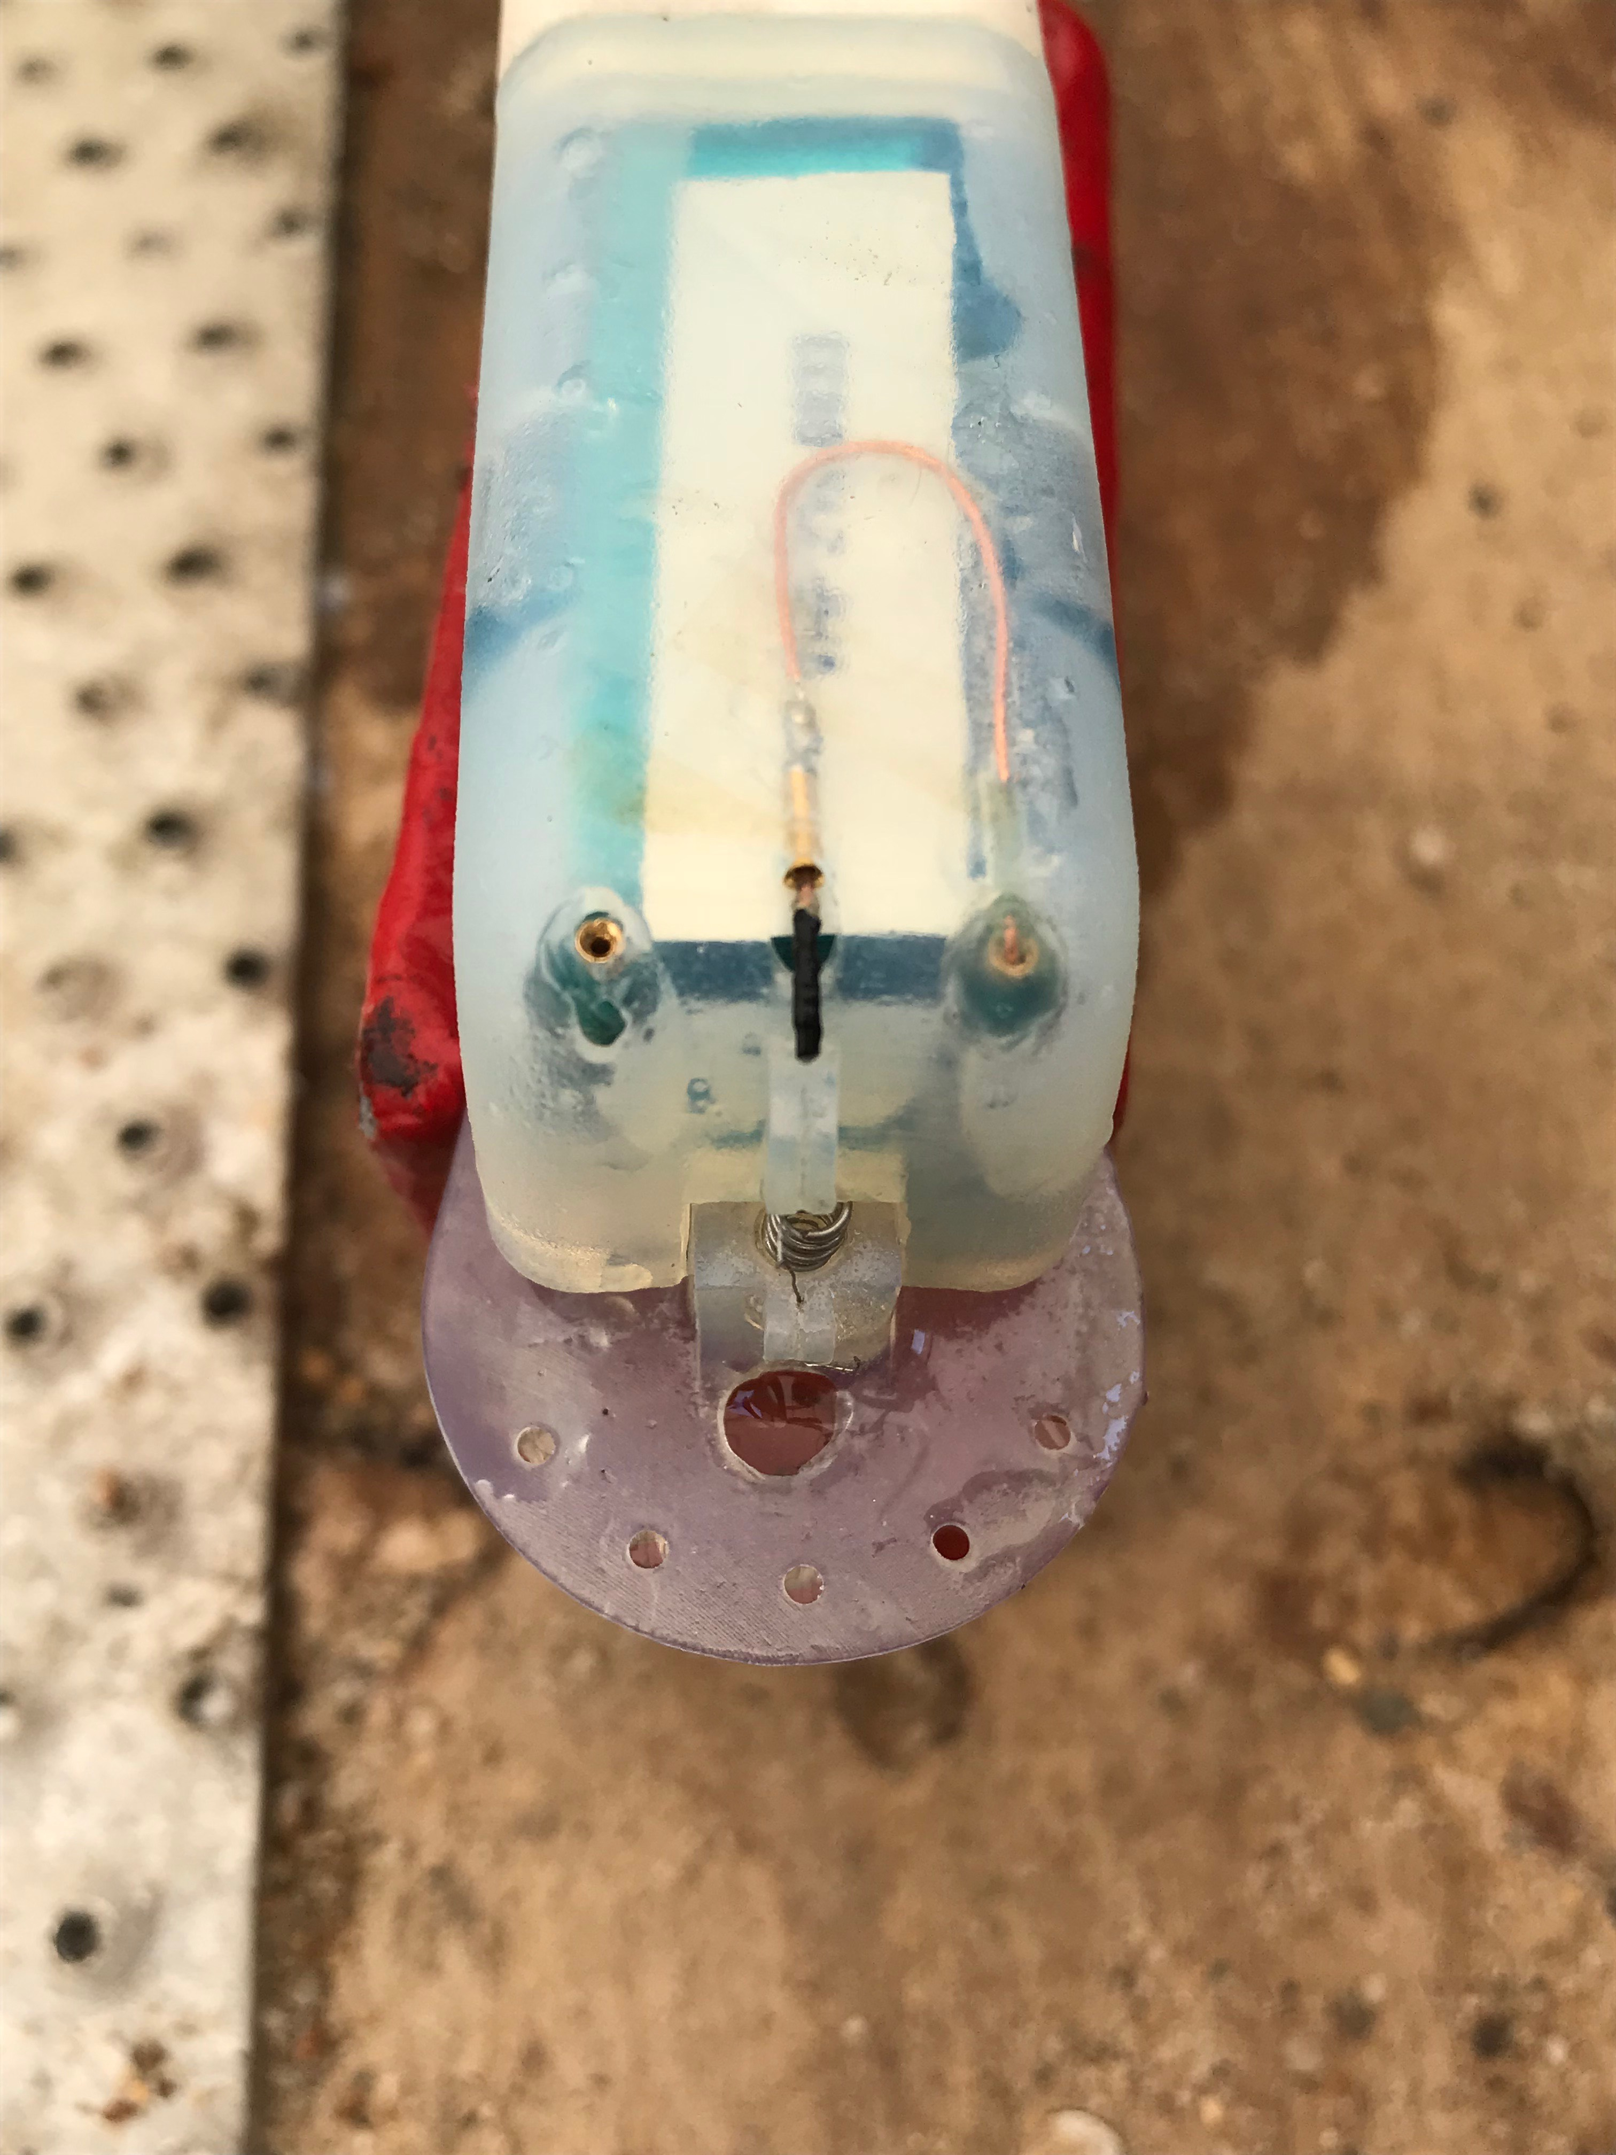
The pin that induces a current on the burn wire. The copper wire (blue arrow) creates an extension to allow “release” to be inserted into center receptacle.

Slide 4
Release Components
24 Gauge Copper Wire
Heat-Shrink Tubing
30 or 32 Gauge Nichrome Wire
Coil the nichrome around copper wire and then seal with tubing. I think it helps to put a small amount of silicone to each tube end.

Slide 5
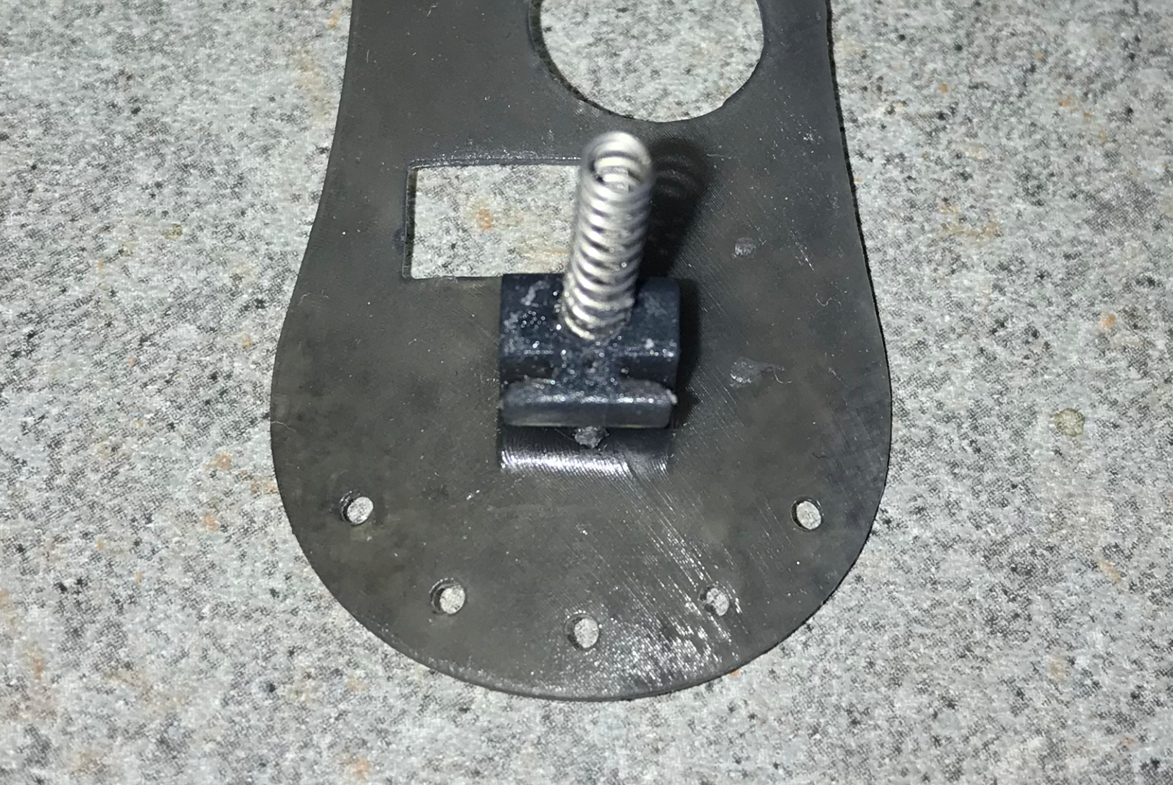

Slide 6
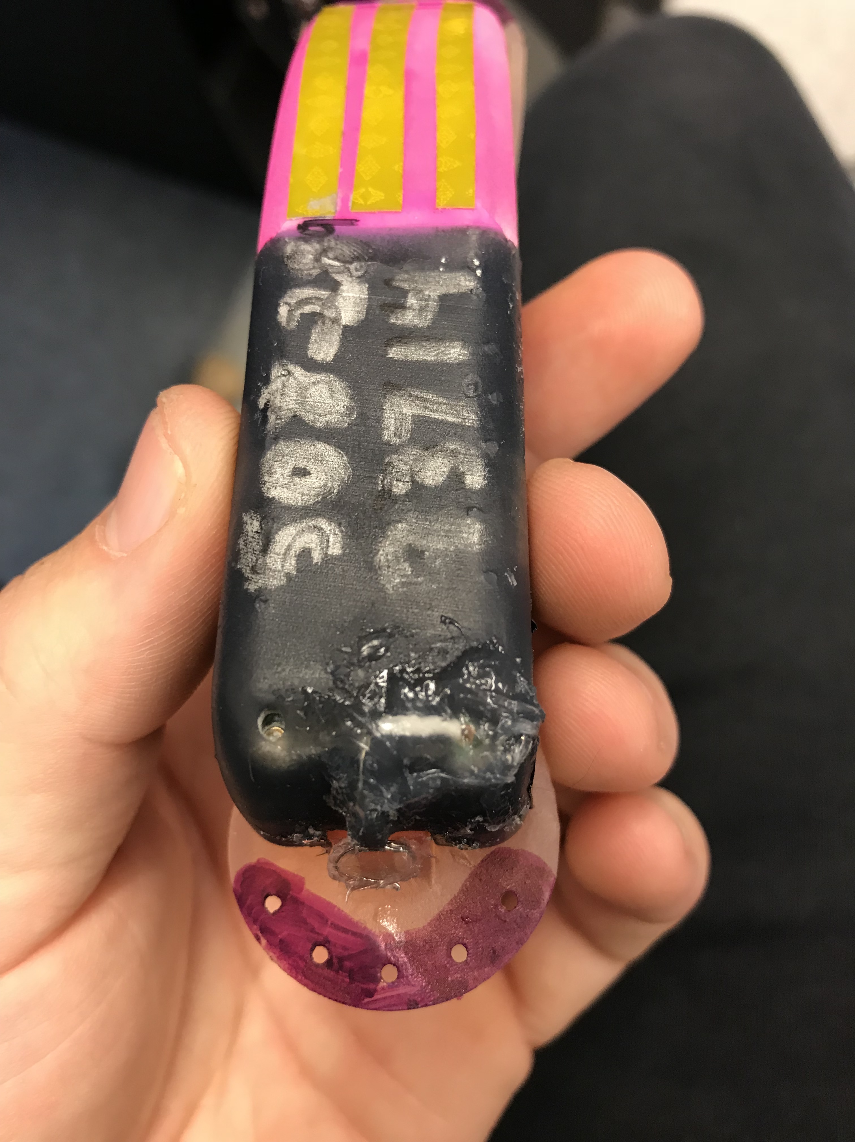
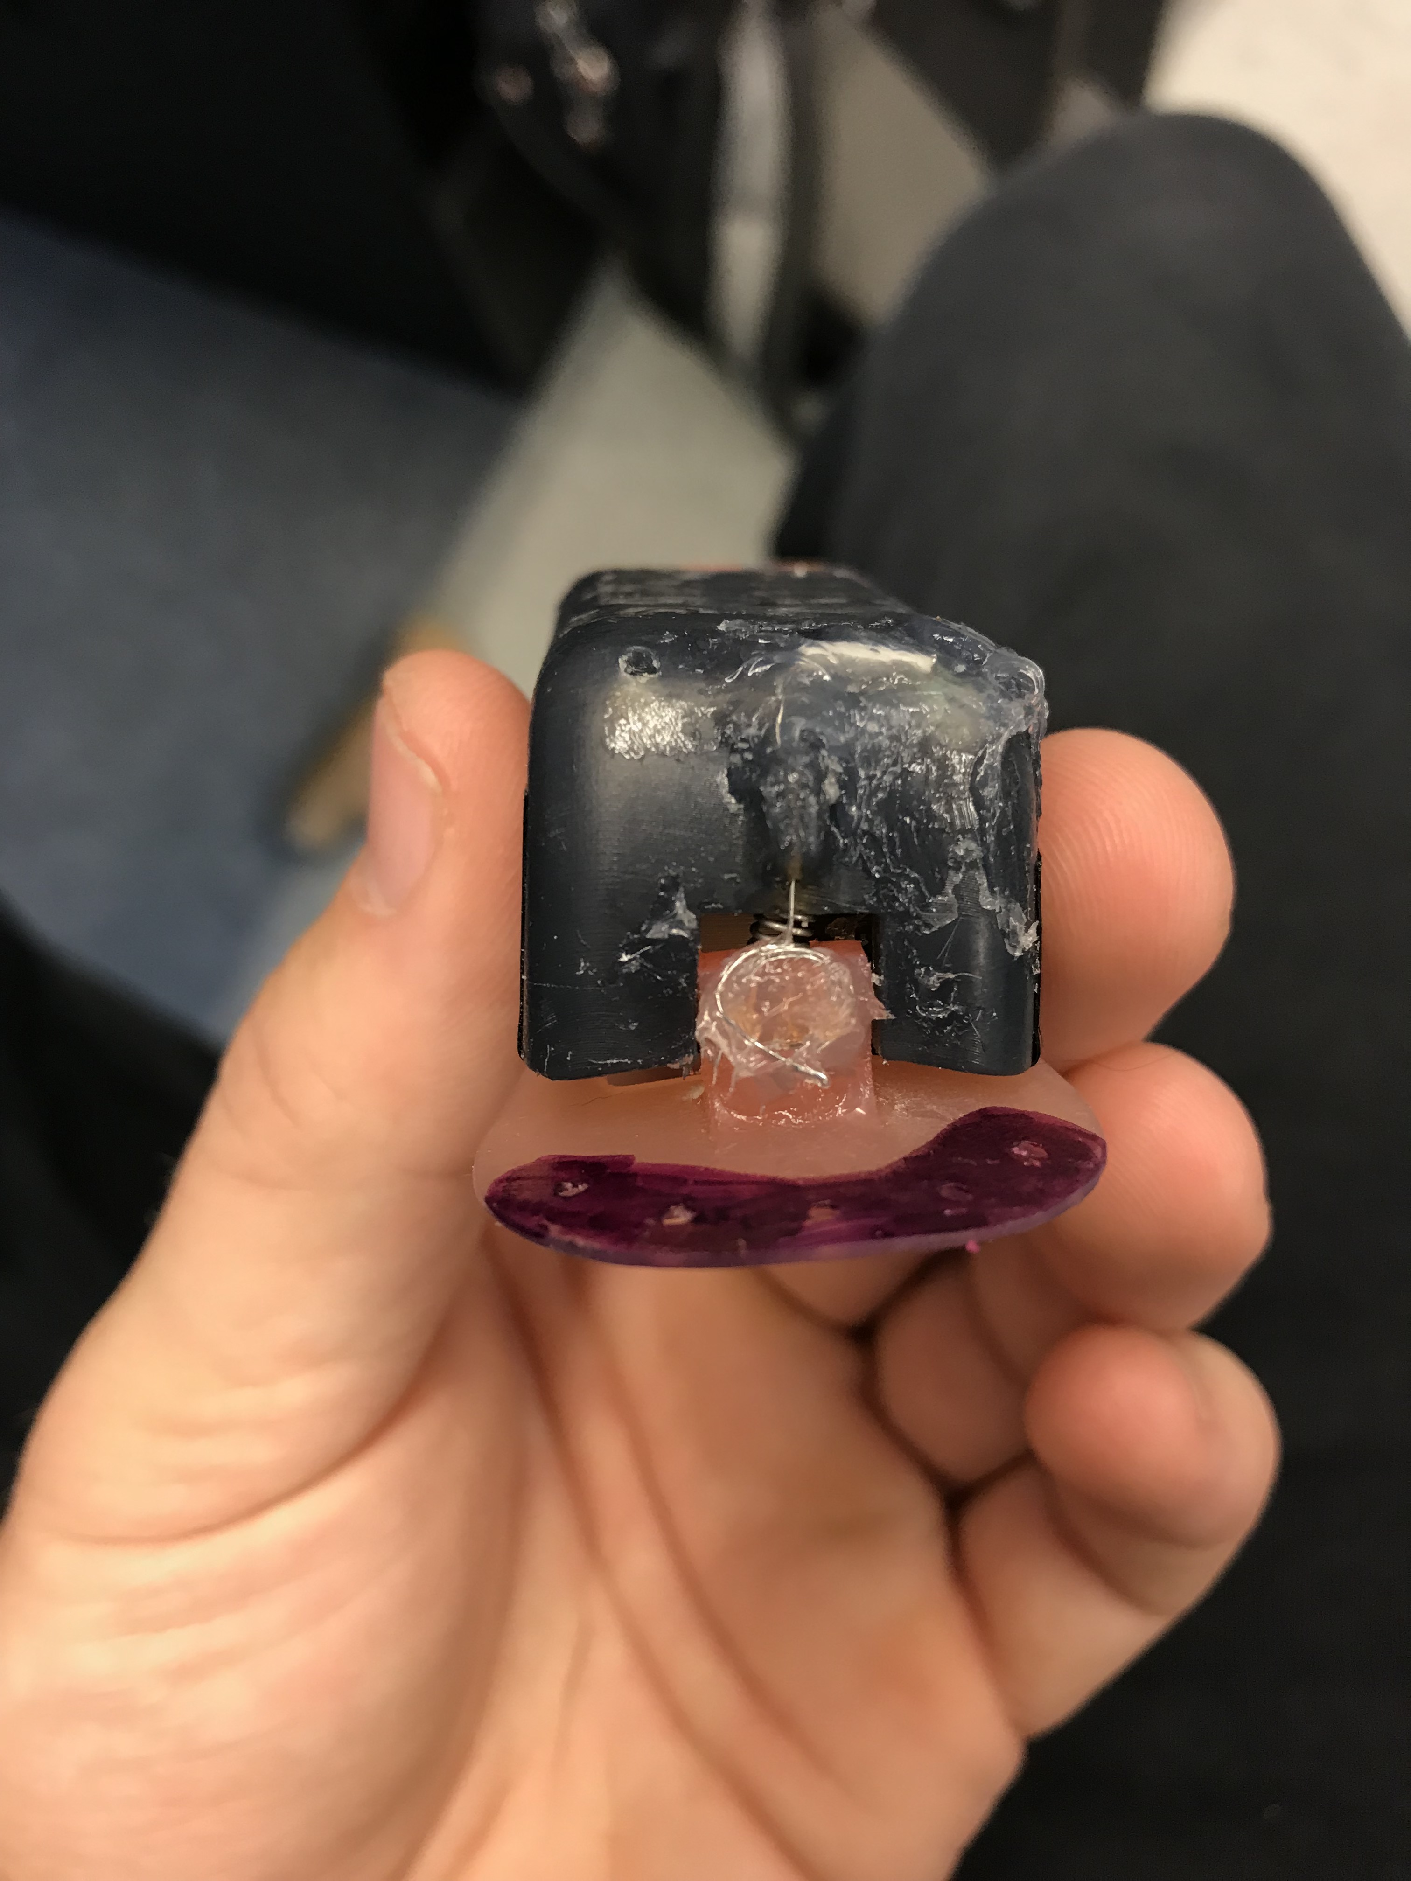
Full release setup. It is important to cover release-to-pin connection with silicone, or else it will corrode rapidly. Nichrome wire is slipped into base and tied securely as to compress the spring as much as possible.
Note: this is a different setup as slide 3. We now put our release into right pin and insert nichrome wire through hole in housing and base.

Slide 7
Final Notes
Our tag creates a current of ~3.9 volts on the burn wire. 34 gauge nichrome wire burns in 5 minutes, while 30 gauge burns in 20 minutes.
The length of spring is more important than spring stiffness. We use a ¾ inch spring.
I can send you part #s for any of the materials listed in this slide except for the pins.

