Slide 1
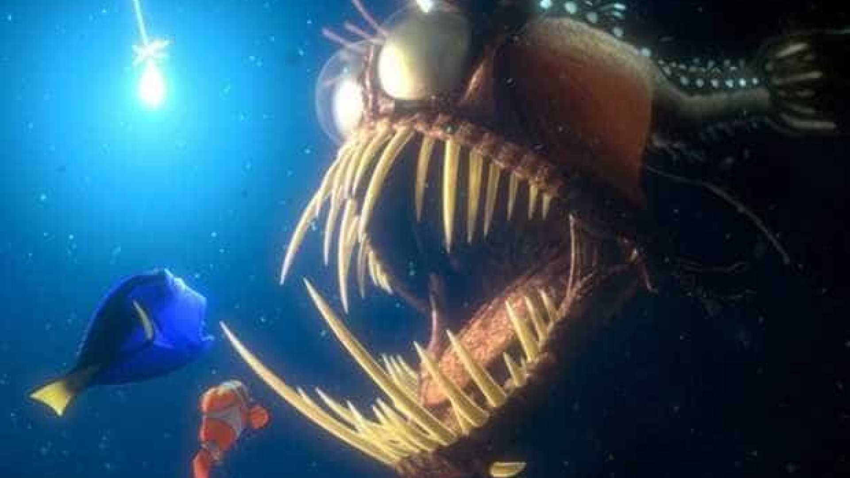
901200 – Multi-Spectral StealthCam

Slide 2
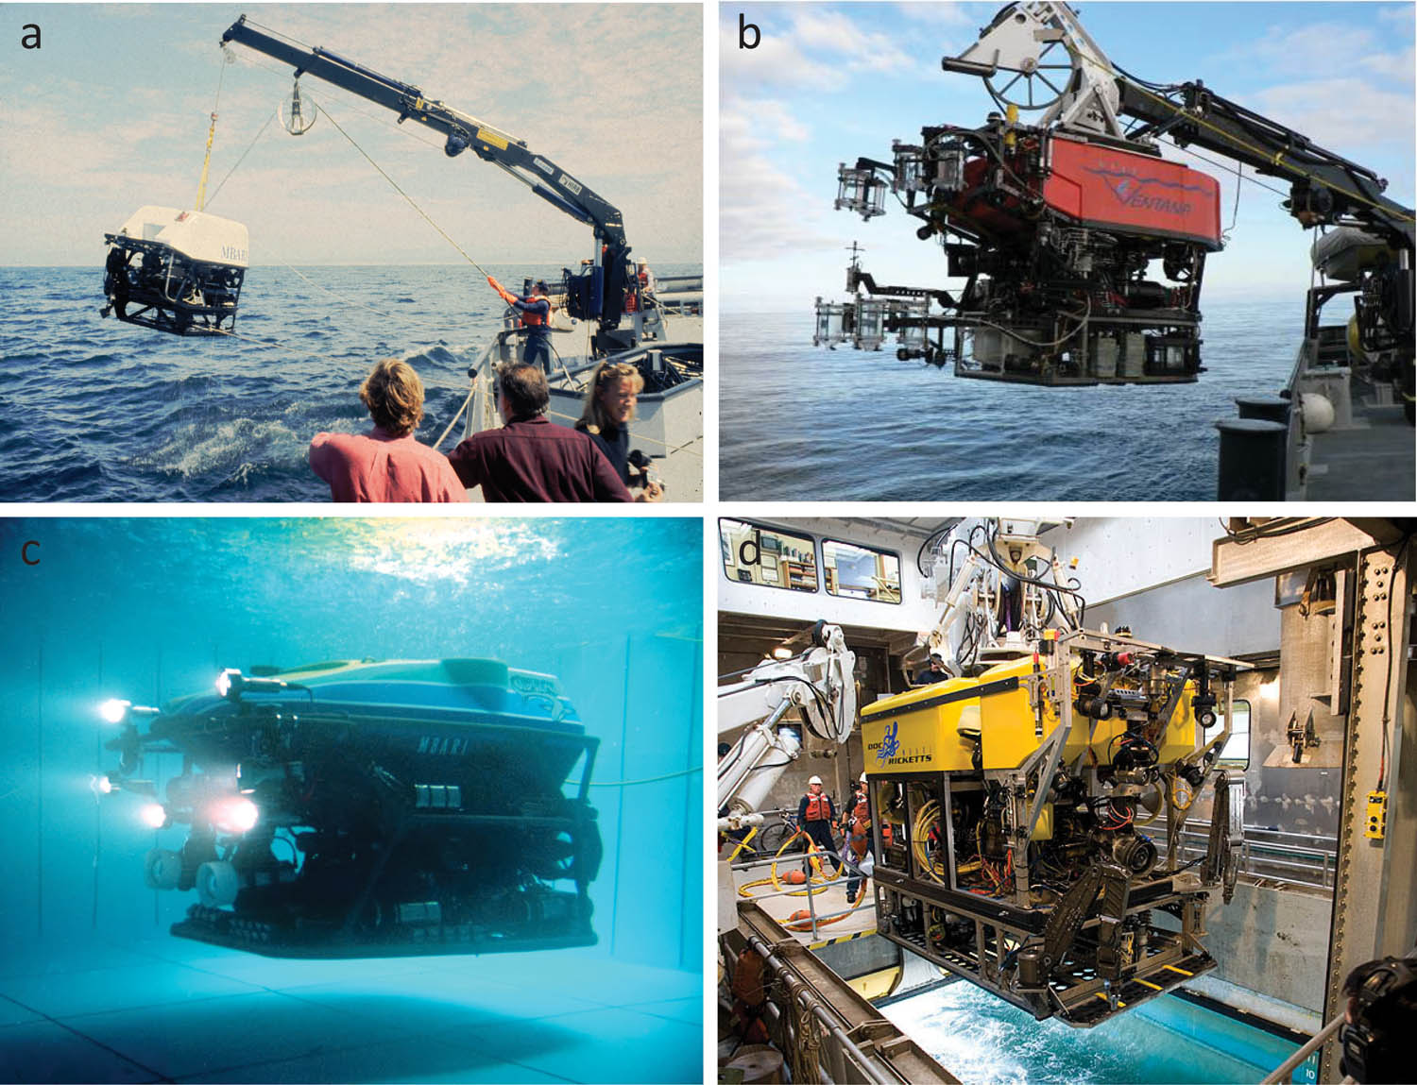
StealthCam: What is the fundamental problem we are addressing?
Animals in ocean use and respond to light
Artificial light often needed to observe animals
Artificial light can disrupt normal animal behavior
Light wavelength and intensity can attract, repel, or have no effect on animals

Slide 3
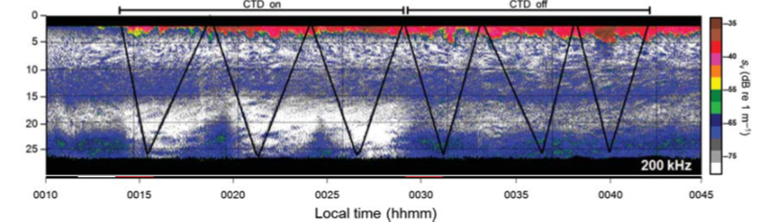
StealthCam: Why is this work important?
Effect of open-path fluorometer (blue light) on copepods in Monterey Bay
  Left 3 samples: CTD On
  Right 3 samples: CTD Off (15 fold decrease in abundance)
Erroneous results could be reported based solely on the choice of wavelength
The goal of the project is to understand effects of light wavelengths and intensity on animals to:
  facilitate design of less invasive imaging systems
  understand effects of current video systems on animal behavior and interpretations of existing datasets

Slide 4
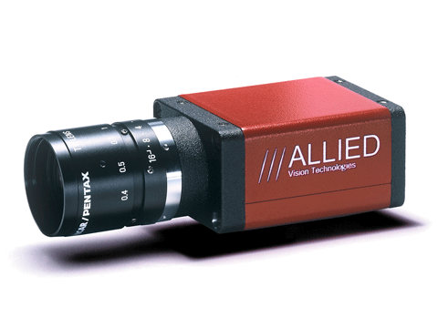
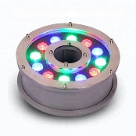
StealthCam: What is our approach?
Research Vessel
`
Design and build a modular camera and light system
  - Tethered (with power, comms, and live video to ship)
  - Wavelength (380-850 nm) and intensity of light user controlled from ship
  - Depth rated to 300 meters
  - Deployable from R/V Paragon or other small vessel
  - Deployable by a 1 or 2 person team
Echosounder
(Downward Looking)
Tether
Experimentally examine animal behavior in situ
  - Deploy StealthCam with user controlled light array
  - Observe animal behavior with downward-facing, ship-mounted echosounder
Stereo Cameras
Multi-Spectral LED

