Slide 1
Multi-Spectral DropCam
Abstract Presentation
Monday May 21, 2018
Chad Kecy

Slide 2
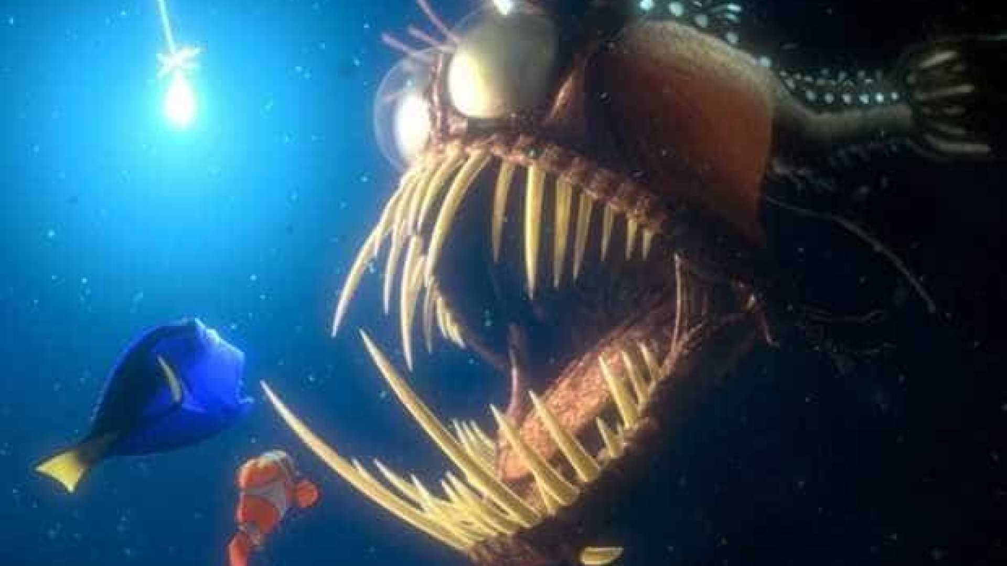
Fundamental Problem
Animals in ocean use and respond to light
Artificial light often needed to observe animals
Artificial light can disrupt normal animal behavior
Light wavelength and intensity can attract, repel, or have no effect on animals

Slide 3
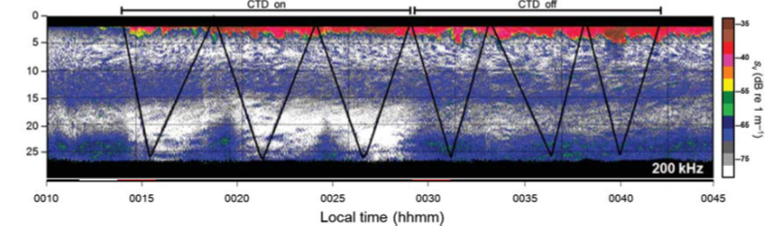
Fundamental Problem
Effect of open-path fluorometer (blue light) on copepods in Monterey Bay
  Left 3 samples: CTD On
  Right 3 samples: CTD Off (15 fold decrease in abundance)
Notes:
Blue light = 420 nm in this case

Slide 4
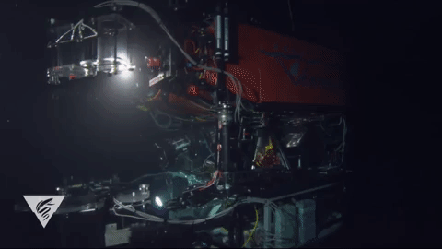
Project Goal
To understand effects of light wavelengths and intensity on animals to:
  facilitate design of less invasive imaging systems
  understand effects of current video systems on animal behavior and interpretations of existing datasets

Slide 5
Project Description
Design and build modular camera and light system
  Tethered (with power, comms, live video)
  Depth rated to 300 meters
  Deployable from R/V Paragon or other small vessel
  Wavelength (380-850 nm) and intensity of light user controlled
Experimentally examine animal behavior in situ
  Deploy DropCam with user controlled light array
  Observe animal behavior using downward-facing, ship-mounted echosounder
3rd year of BOS or standalone project?

Slide 6
System Concept
Boat
`
Tether
Echosounder
(Downward Looking)
Camera
Module
Max Depth
300m
Rigid
Support
LED
Module
Notes:
E

Slide 7
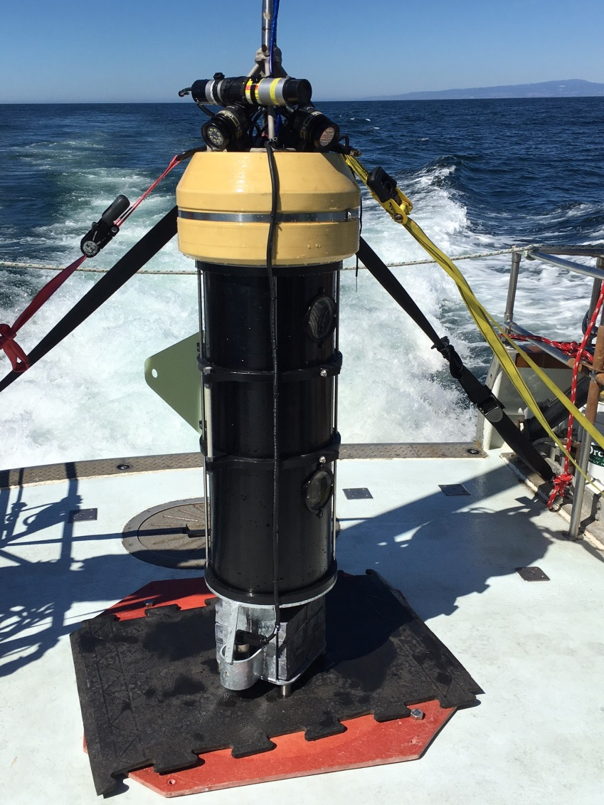
Technology: Camera Module
Electronics based on prototype Benthic Observation System (BOS)
  Single camera version of BOS
    Much smaller than prototype
  AC power
  Cable modems for comms
  PLC for control
  Minimal engineering effort

Slide 8
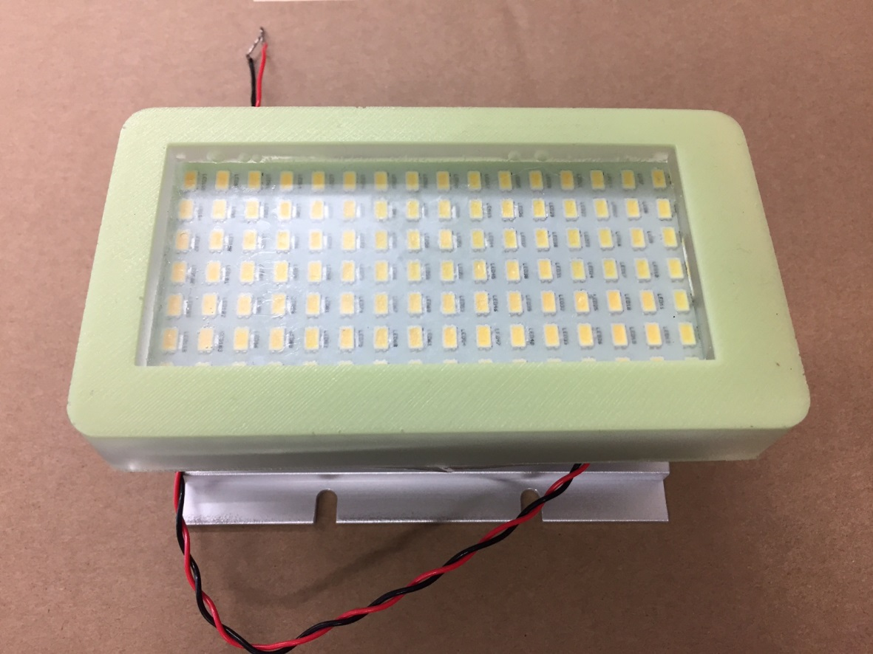
Technology: LED Module
LED Module based on existing white LED design
  Adjustable wavelength and intensity
  Serial control from camera module
  DC Power
  Potted Housing
Notes:
Add Thom Maughan description illustrating that a lot of LED module design will stem from what he’s already done

Slide 9
Project Team
Kakani Katija, PI
Kelly Benoit-Bird, Lead Scientist
Chad Kecy, PM, Lead Engineer (EE)
Thom Maughan, SE
Franҫois Cazenave, ME
Jared Figurski, R/V Paragon Operator

Slide 10
Timeline
2019 DropCam Efforts | Q1 | Q2 | Q3 | Q4
Develop camera module | x
Develop LED module | x
Build camera module |  | x
Build LED module |  | x
Integrate modules and interface on Paragon |  |  | x
Field testing |  |  |  | x

Slide 11
Data / Video
Primary product is high-definition video
Compatible with existing MBARI/VARS formats
Amount of video generated will be modest due to short duration deployments and experimental rather than time series focus
Notes:
Last sentence? Learning animal behavior based on wavelength and intensity is science.

Slide 12
Impact
Evaluate organismal behavior in response to range of light wavelengths and intensity
Inform design of current and future ocean imaging systems
  LRAUV Imager
  EyeRIS
  DropCam science use cases
  ROV science
  i2MAP
  BOSS
  Autonomous Midwater Platform
Notes:
Add ROV

Slide 13
Questions?

Slide 14
Spare Slides

Slide 15
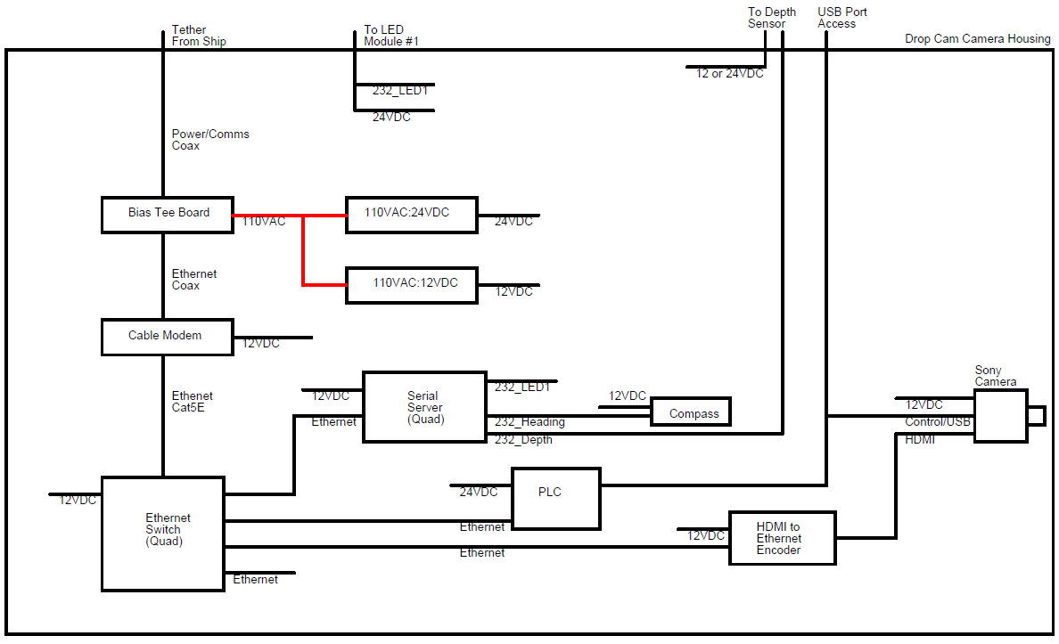
Camera Block Diagram

