Slide 1
4K Camera Test Data

Slide 3
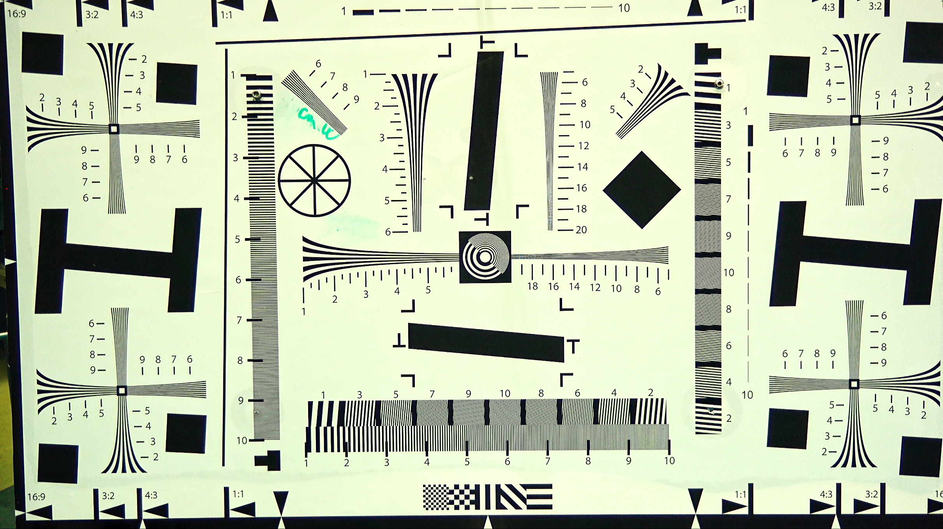
Resolution Test Method
Corner resolution
Line pairs/PH
Chromatic aberration
Center resolution
Geometric distortion

Slide 4
DSPL_20180814T120017_ProRes_2.tiff

Slide 5
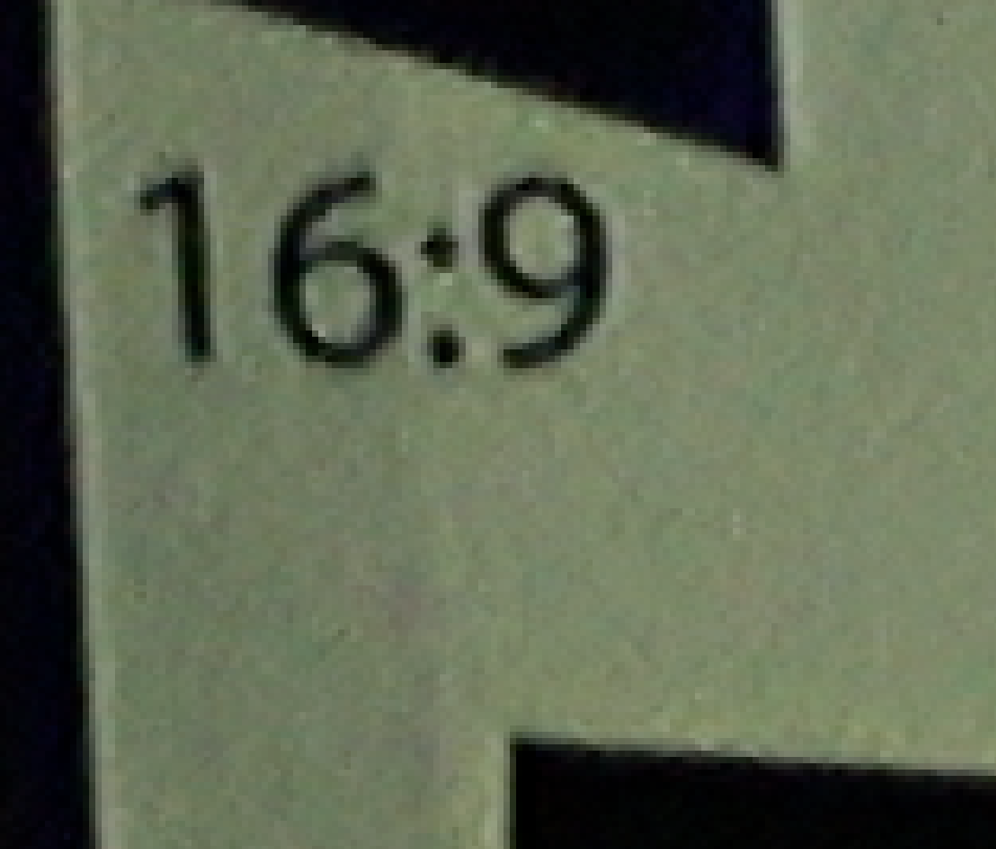
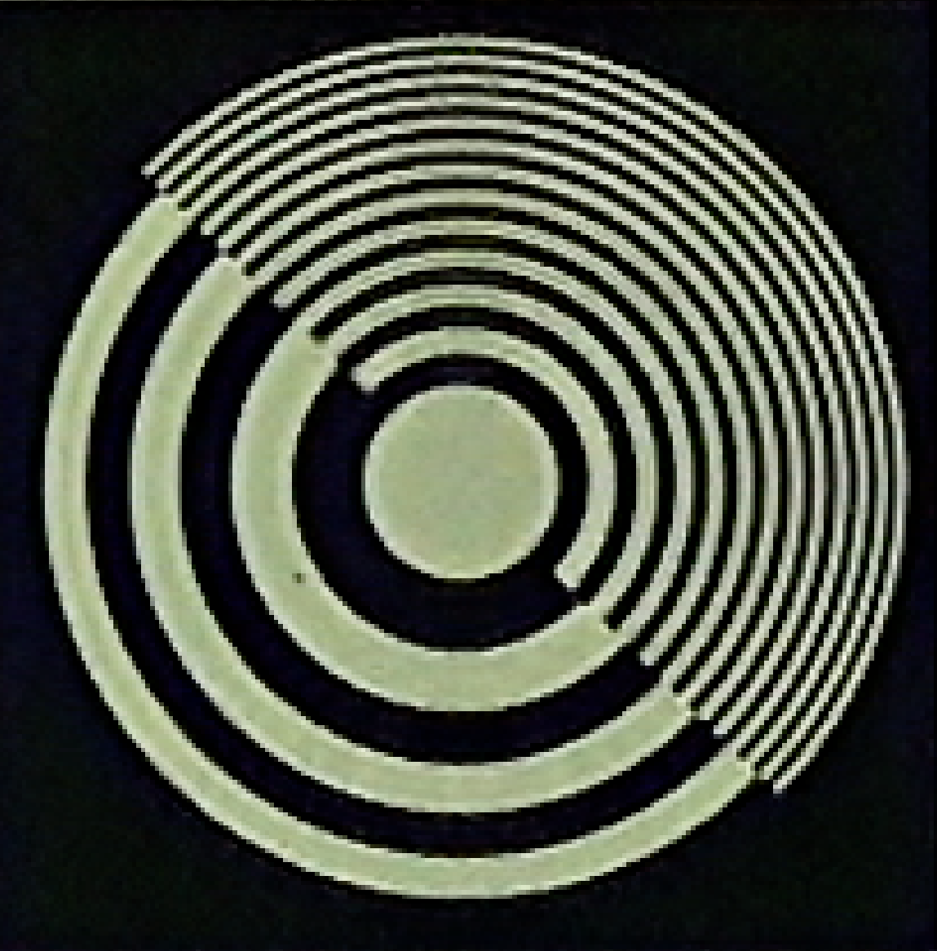
DSPL_20180814T120017_ProRes_2.tiff

Slide 6
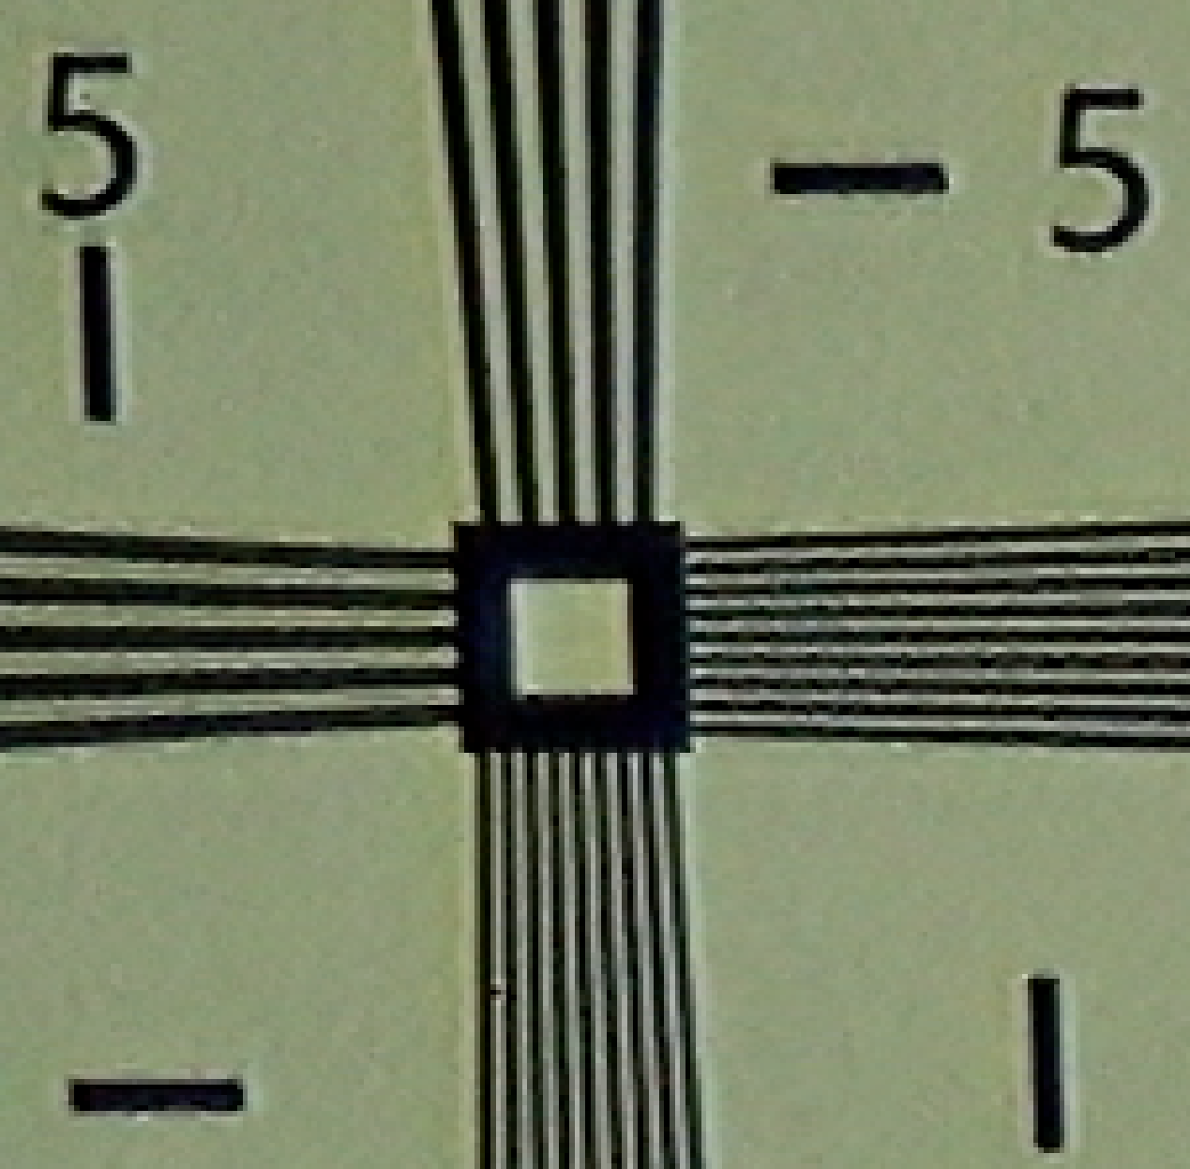
DSPL_20180814T120017_ProRes_2.tiff

Slide 7
SulisZ70_20180724T124059_ProRes_2.tiff

Slide 8
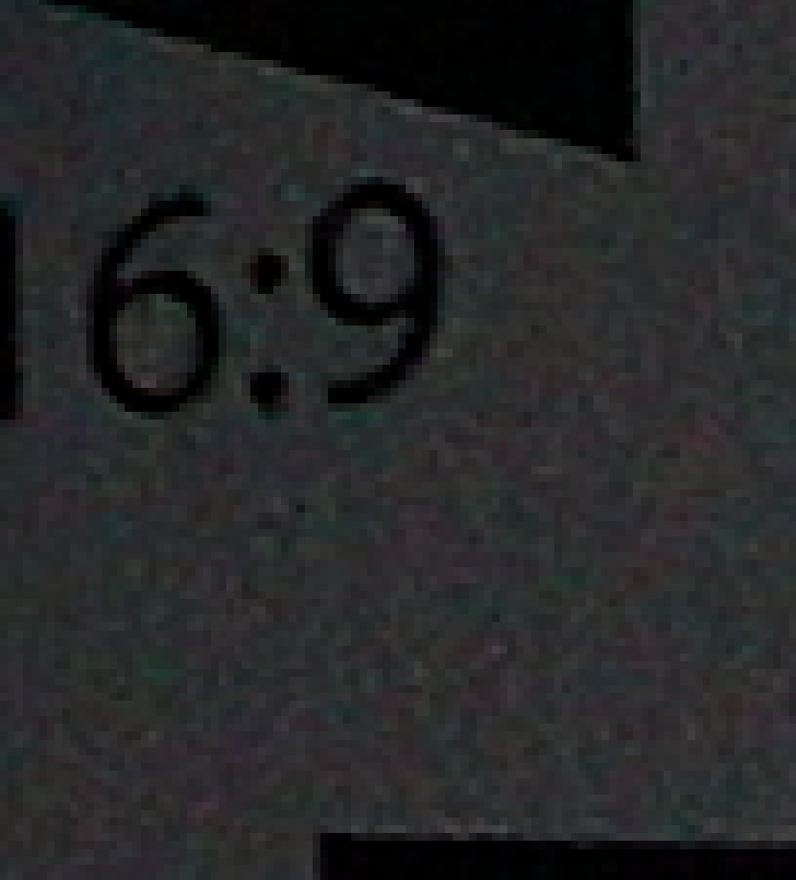

SulisZ70_20180724T124059_ProRes_2.tiff

Slide 9
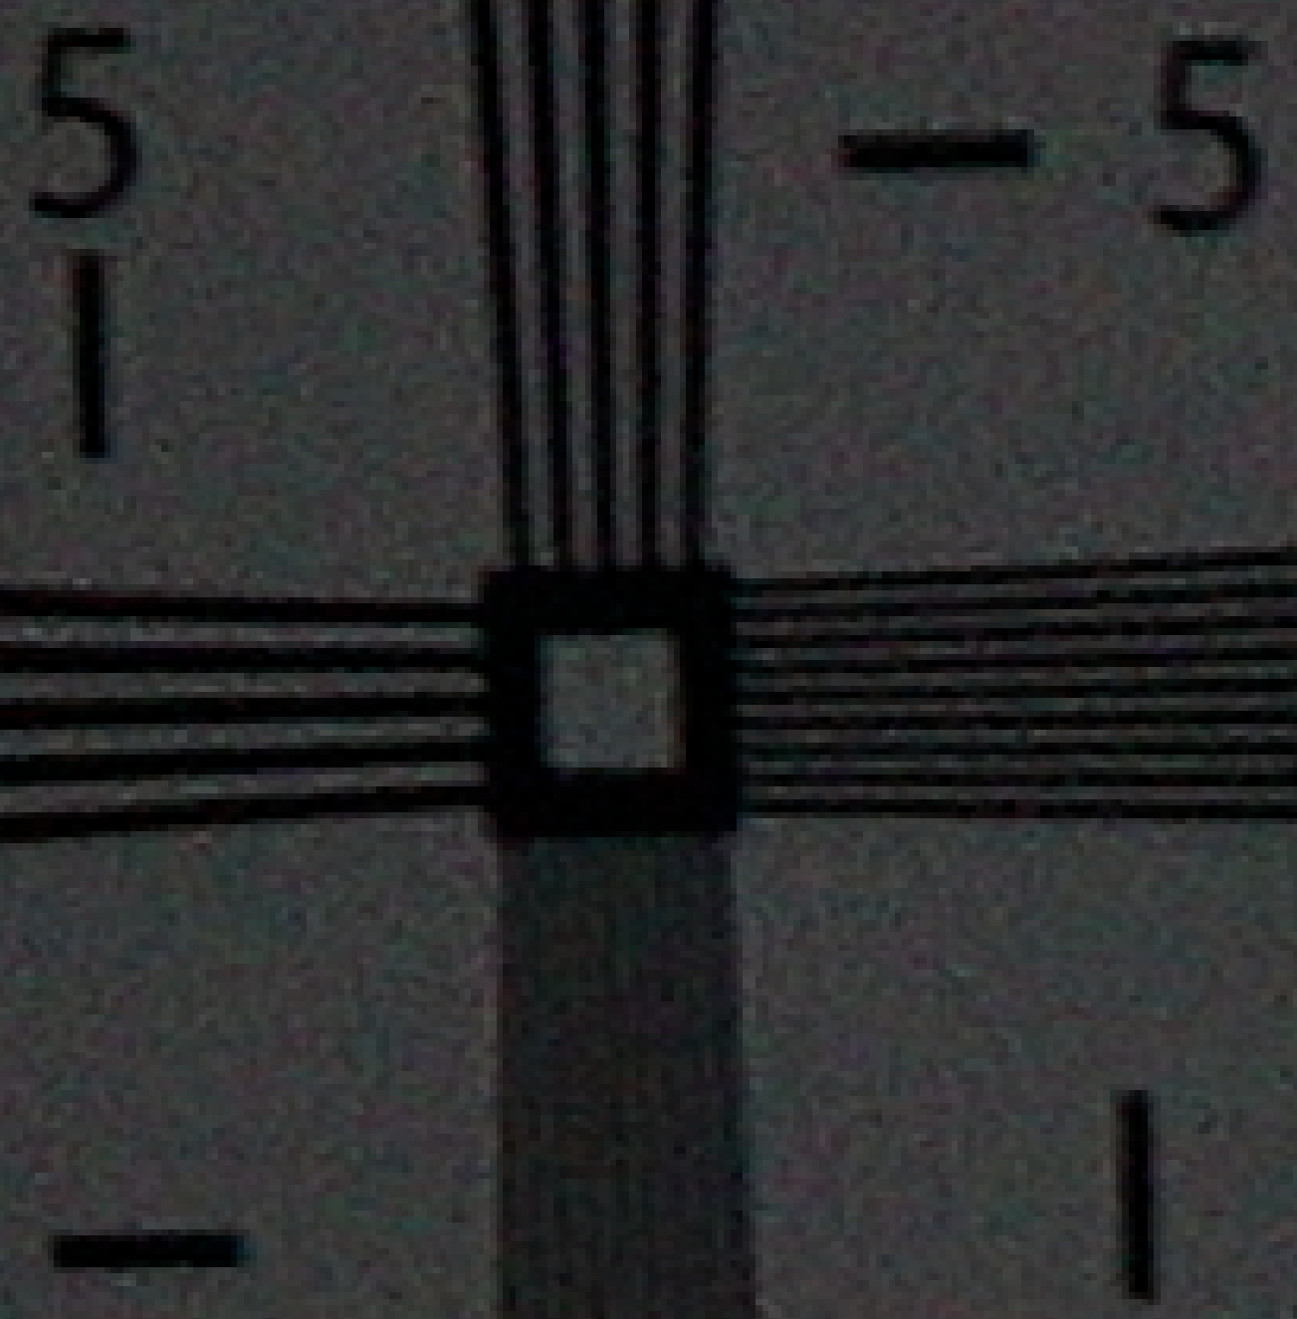
SulisZ70_20180724T124059_ProRes_2.tiff

Slide 10
Insite_Pacific_MiniZeus_4k_20180829T115312Z_prores_2.tiff

Slide 11

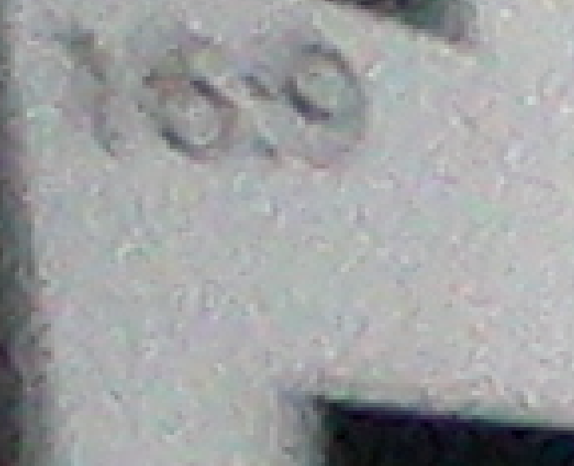
Insite_Pacific_MiniZeus_4k_20180829T115312Z_prores_2.tiff

Slide 12
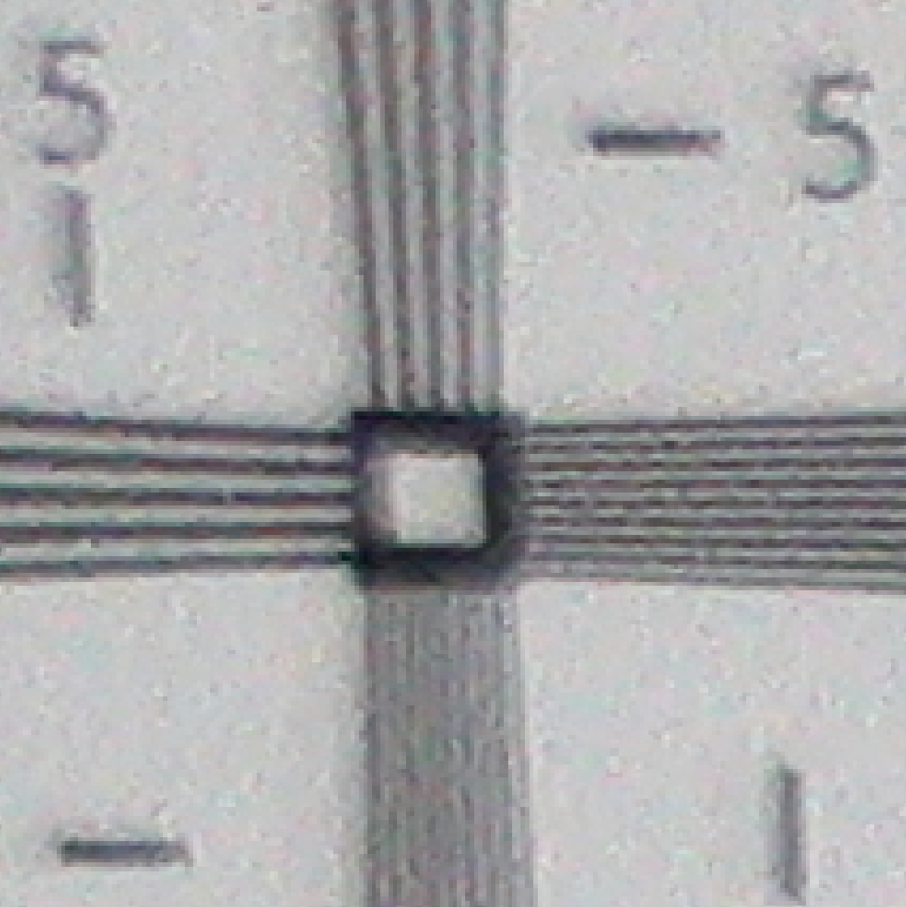
Insite_Pacific_MiniZeus_4k_20180829T115312Z_prores_2.tiff

Slide 13
SubC_20180621T141643_ProRes_2.tiff

Slide 14
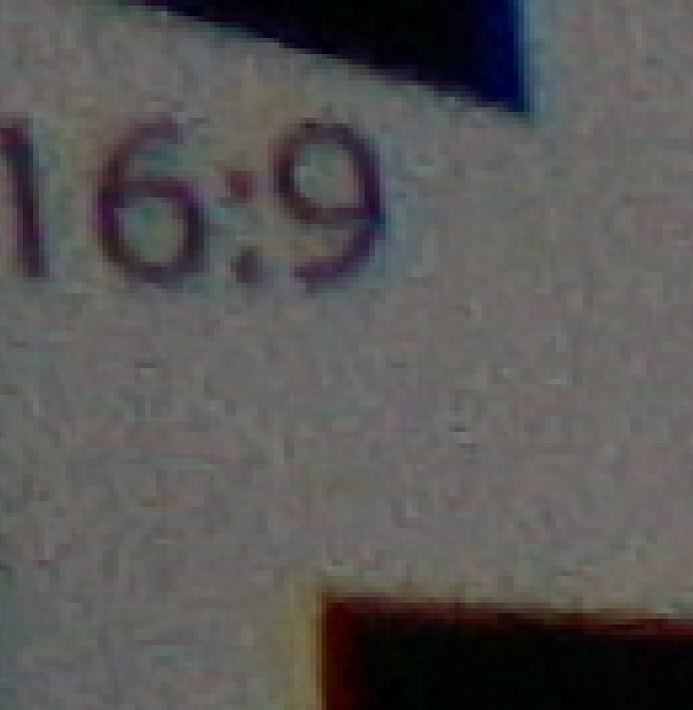
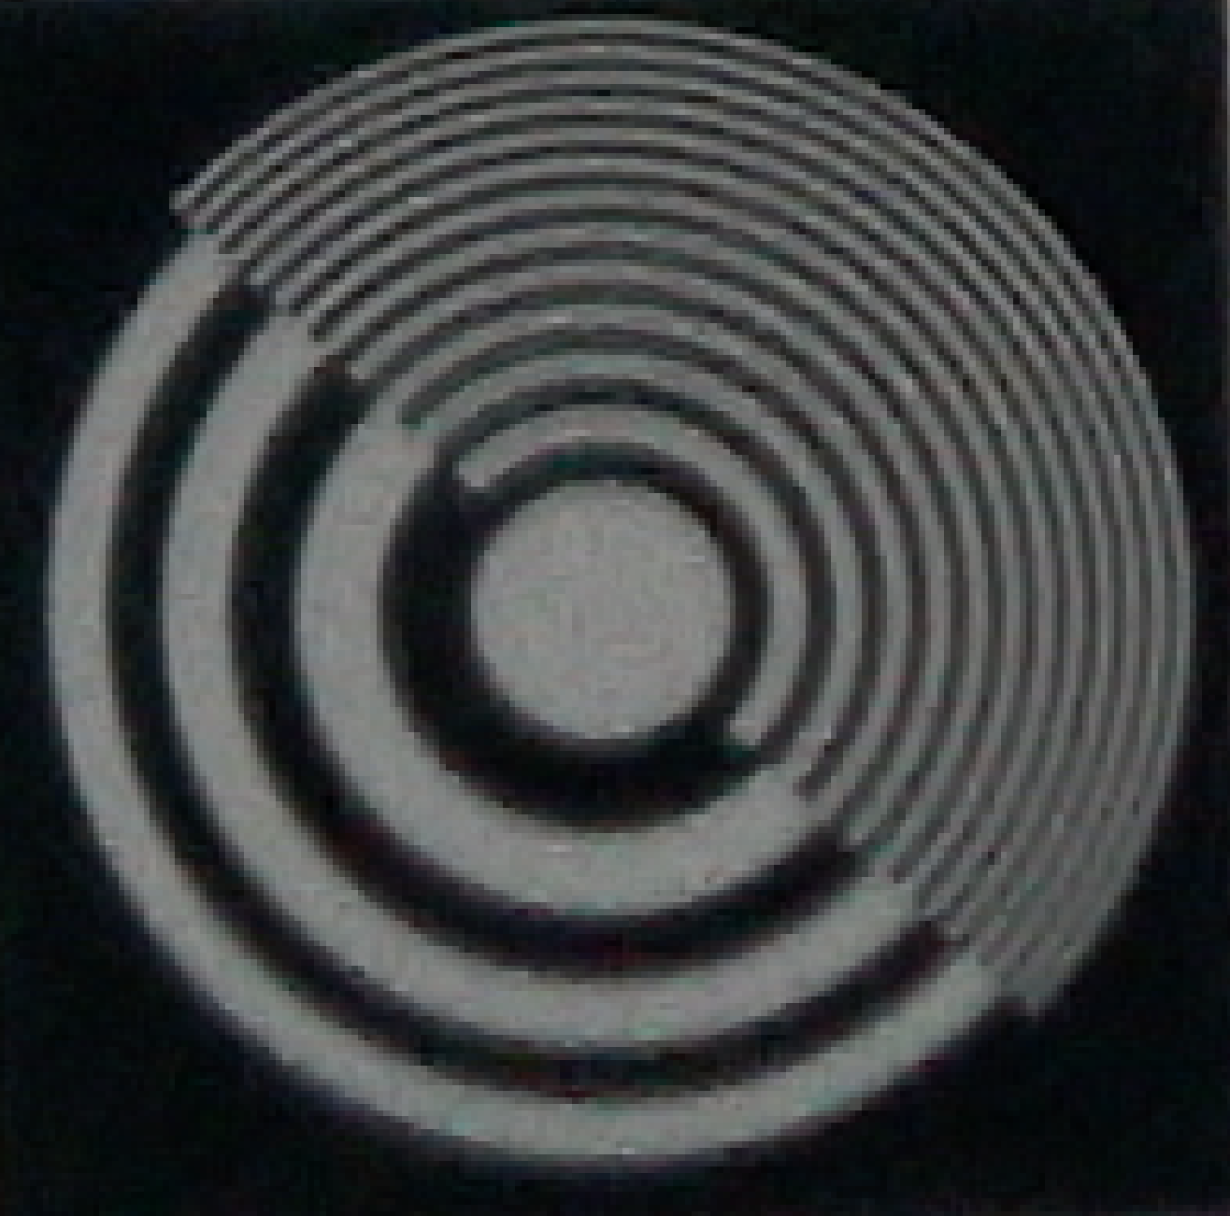
SubC_20180621T141643_ProRes_2.tiff

Slide 15
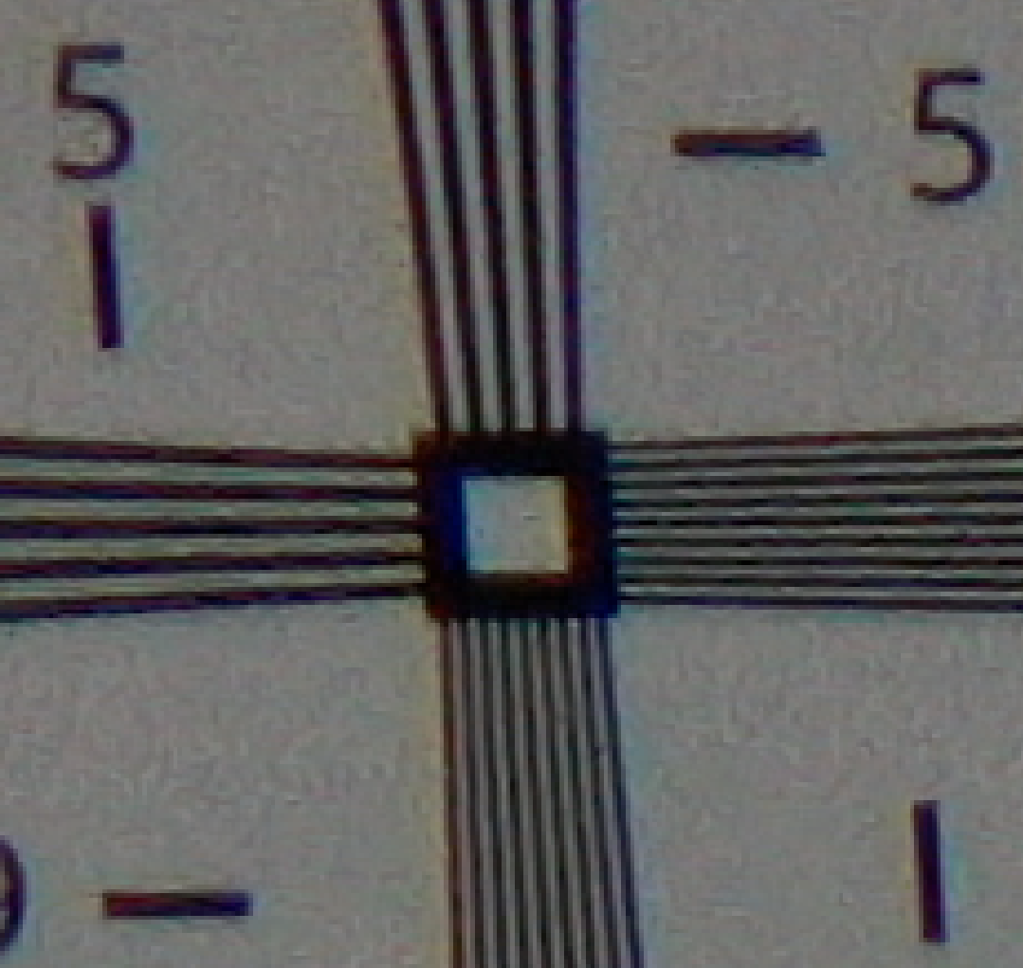
SubC_20180621T141643_ProRes_2.tiff

Slide 16
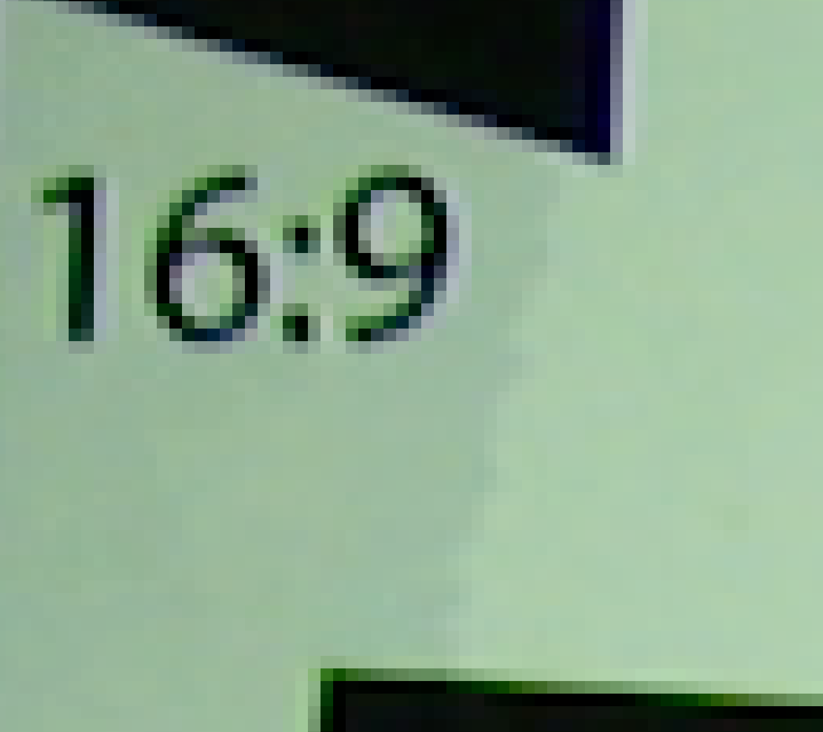
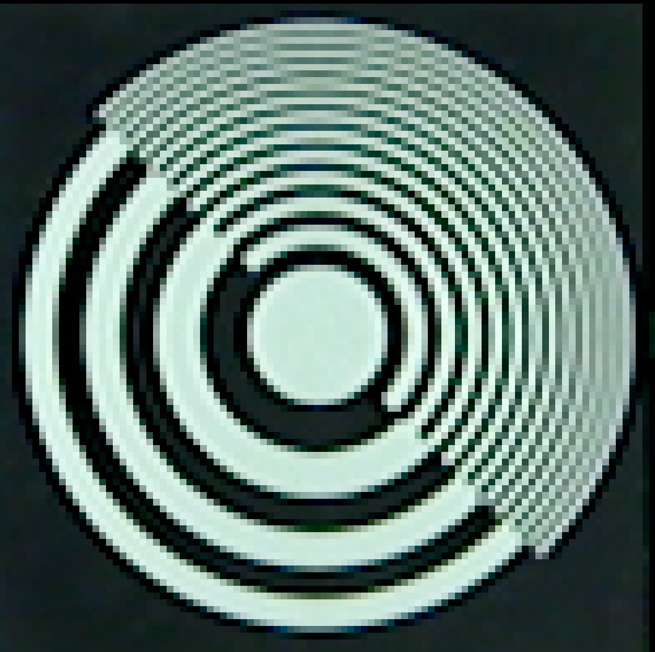
i2MAP camera in 2K 2015-06-15_Test_Dives_29.tiff

Slide 17
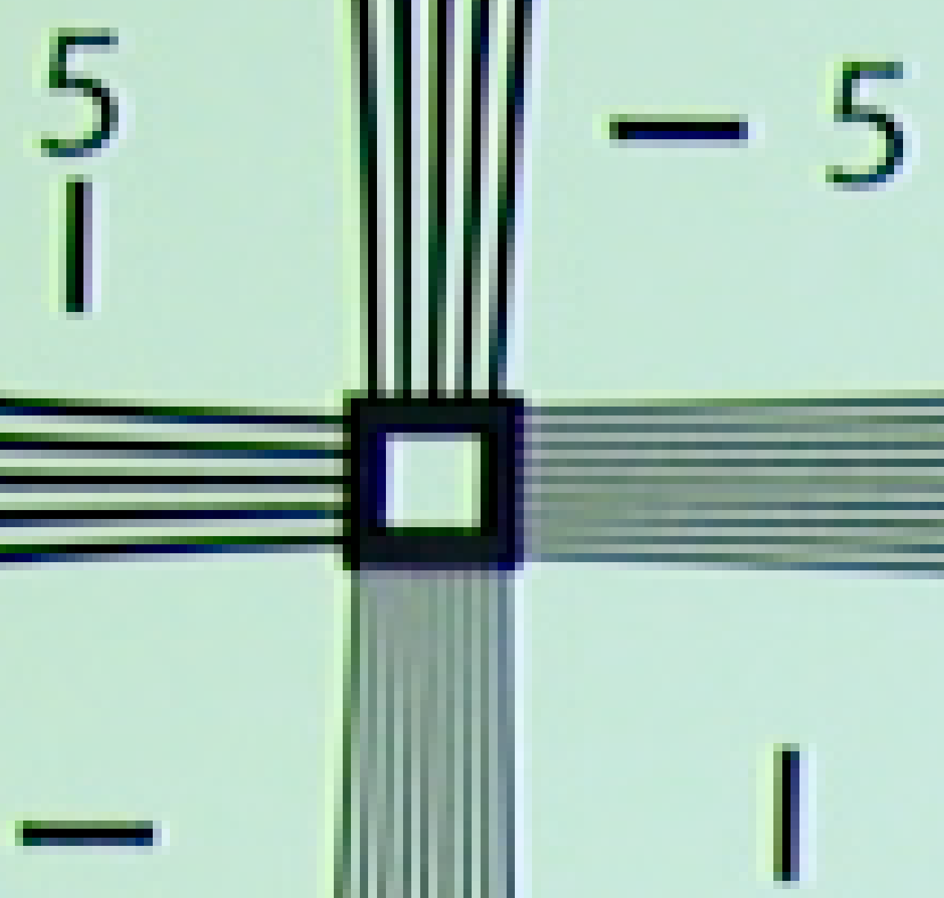
i2MAP Camera in 2K 2015-06-15_Test_Dives_29.tiff

Slide 18
i2MAP Camera in 4K i2MAP_20190514T120549ZTestTank4K_F562.tiff

Slide 19
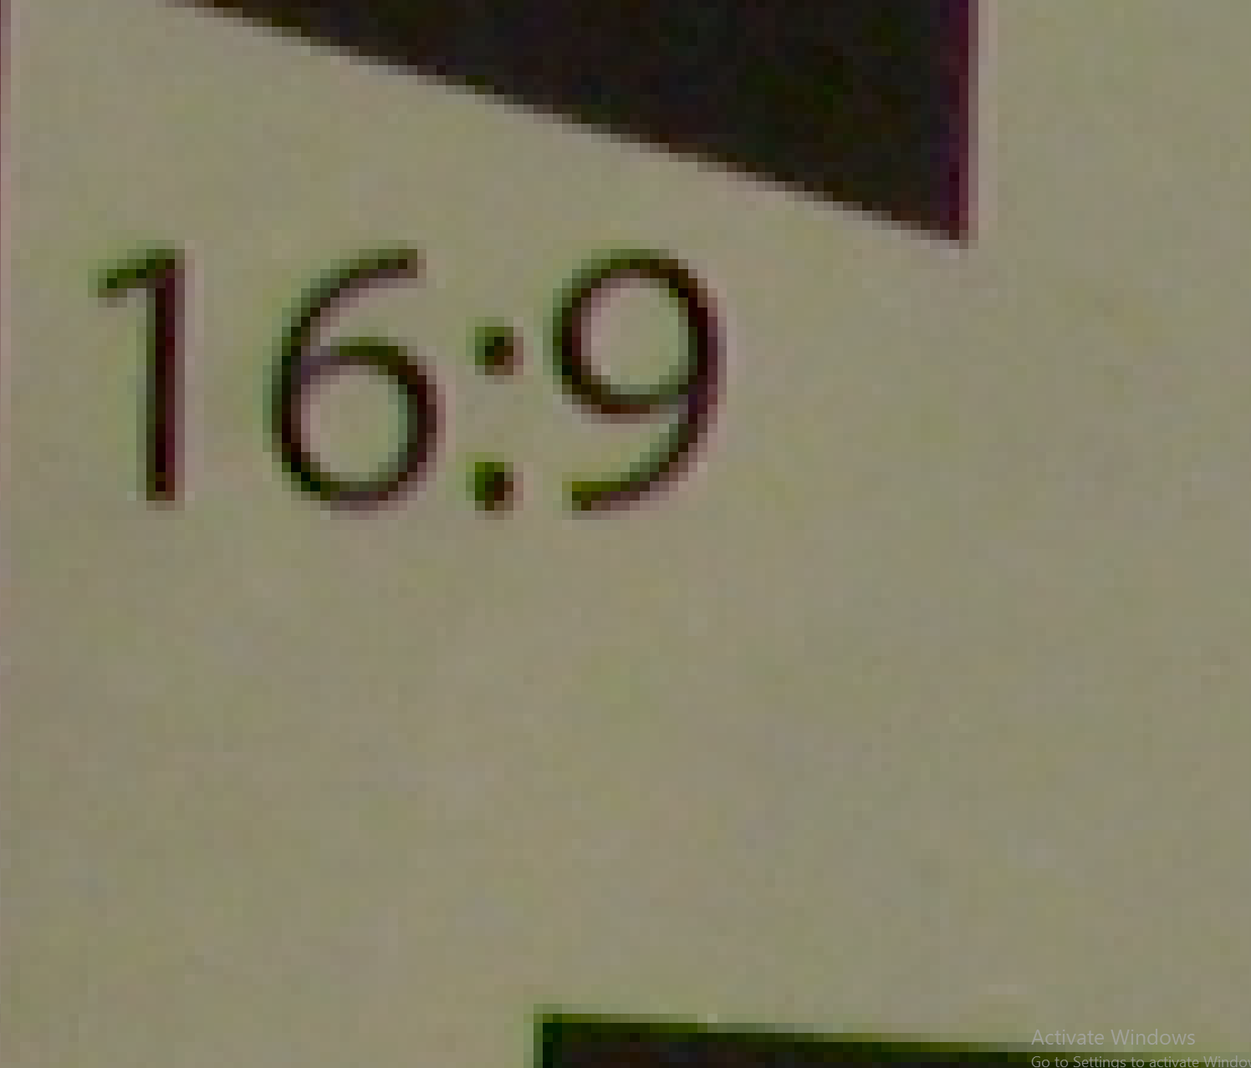
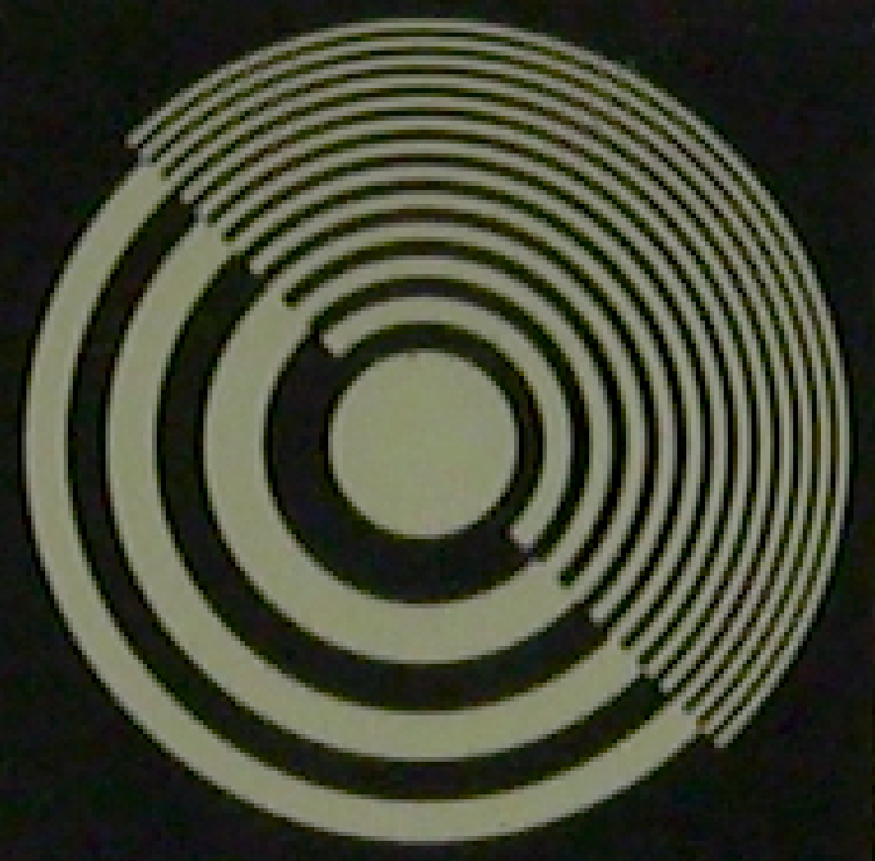
i2MAP Camera in 4K i2MAP_20190514T120549ZTestTank4K_F562.tiff

Slide 20
i2MAP Camera in 4K i2MAP_20190514T120824ZTestTank4K_F31.tiff

Slide 21
