Slide 1
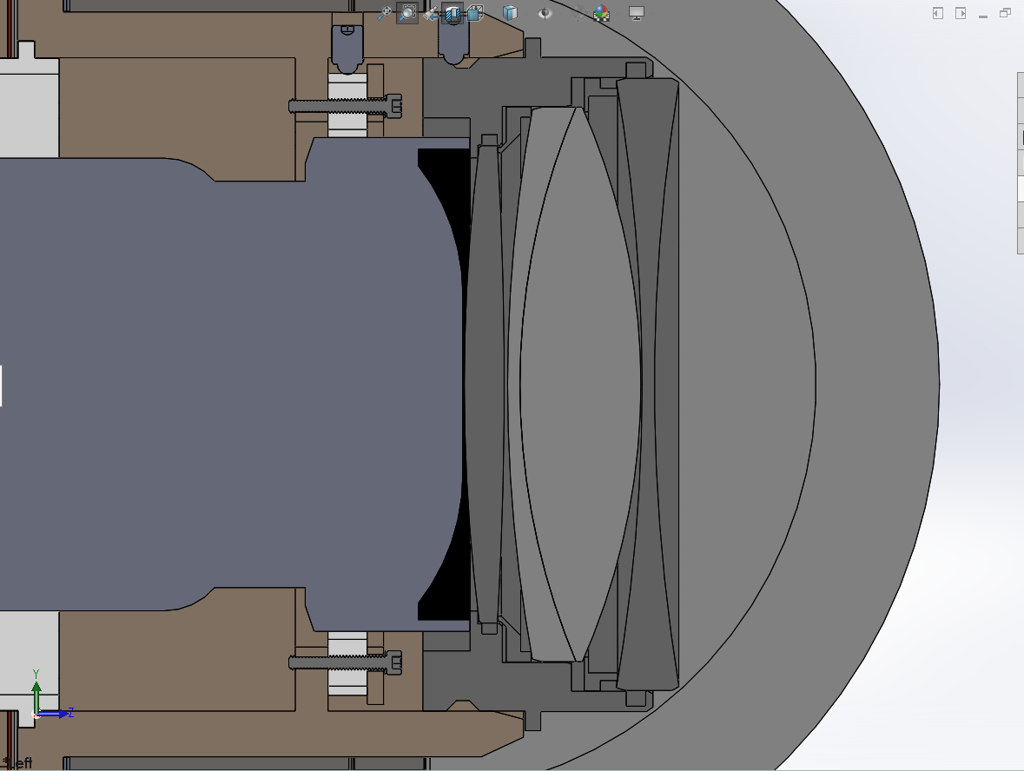
0.05MM FLARE GUARD CLEARANCE WITH 0.3MM AIR GAP
CANON LENS FRONT ELEMENT
ADAPTER CELL LENS FIRST ELEMENT
0.3MM – 0.1 + 0.3mm AIR GAP

