Slide 1
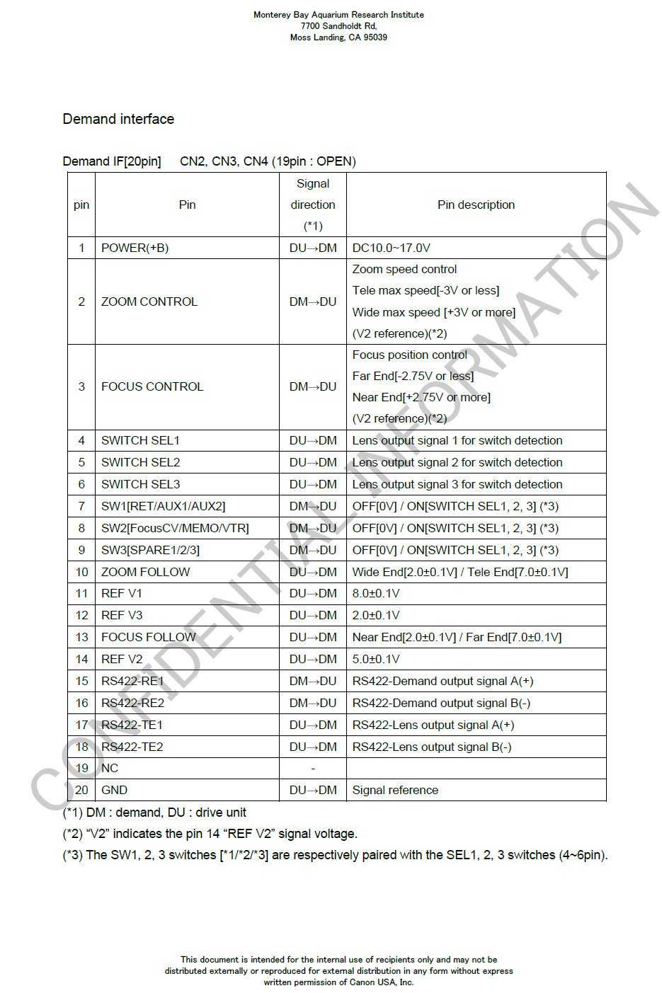
Canon Lens Demand Interface

