Slide 1
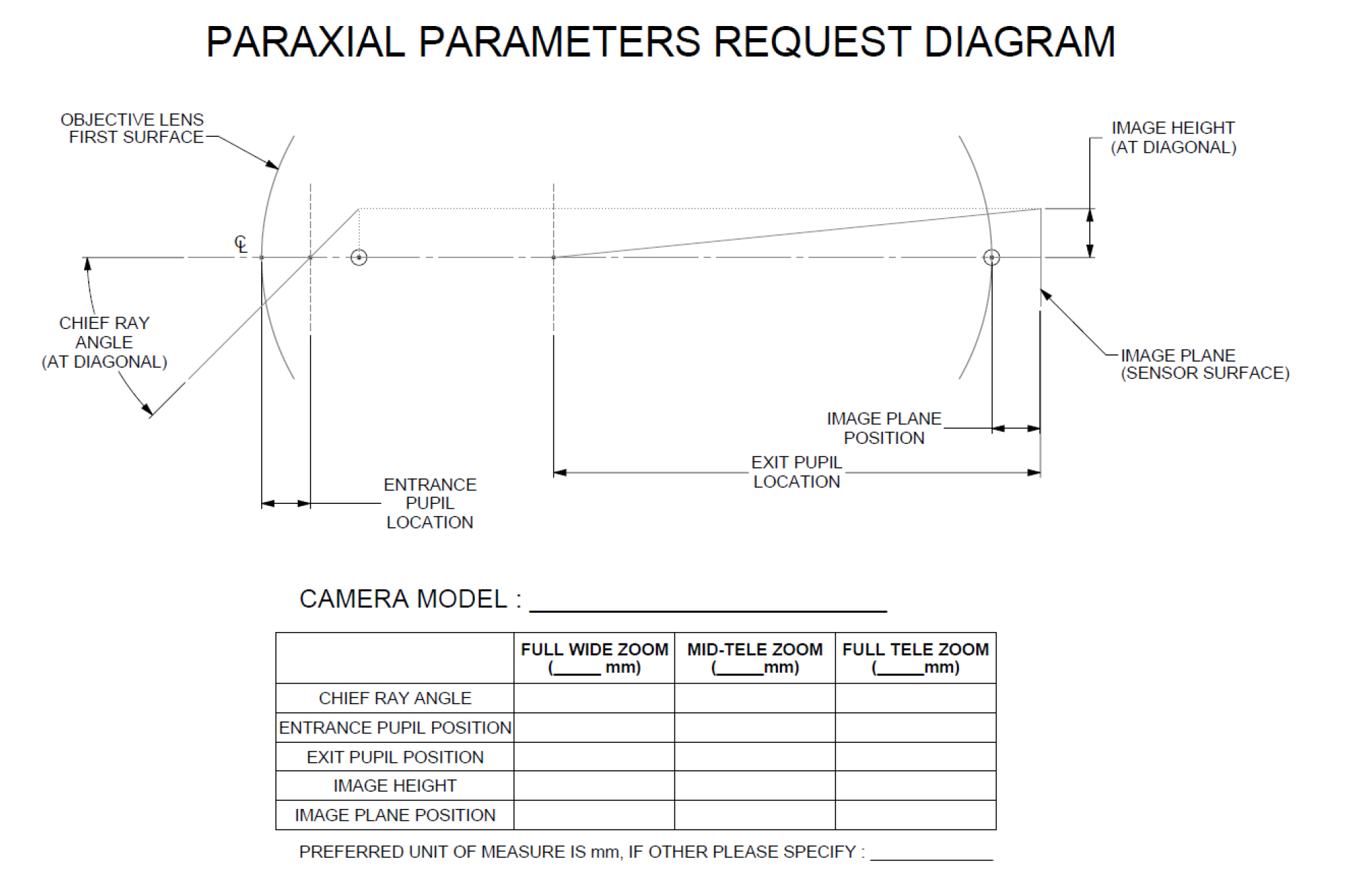
Canon CJ12ex4.3B 4K/UHD Lens
4.3
40
65
Need data at MOD

Slide 2
Canon CJ15ex4.3B 4K/UHD Lens
4.3
40
65
Need data at MOD

