Slide 1
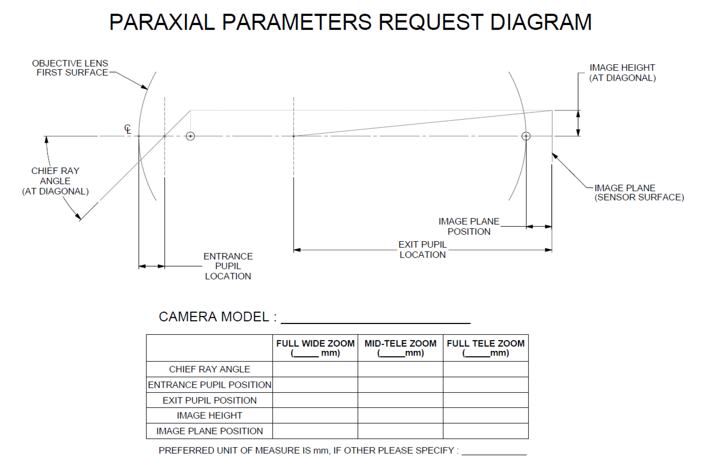
Fujinon UA14x4.5BERD 4K UHD Lens

