Slide 1
3840 X 2160 Imager Array
Middle Zone
100% of Picture Height
Outer Zone
150% of Picture Height

Slide 2
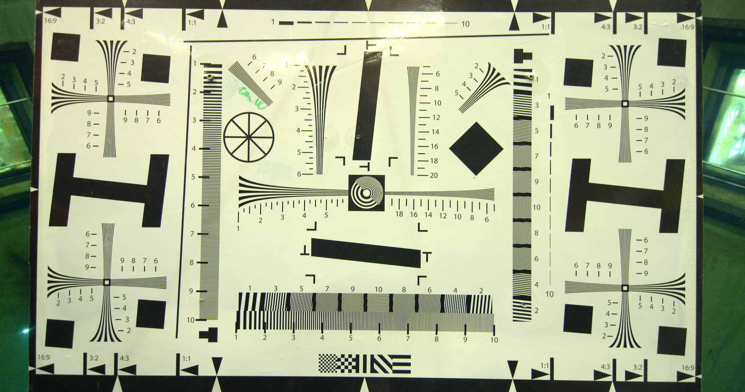
Center zone resolution and contrast
Corner resolution, contrast and lateral color
Outer zone resolution and contrast
Geometric distortion

Slide 3
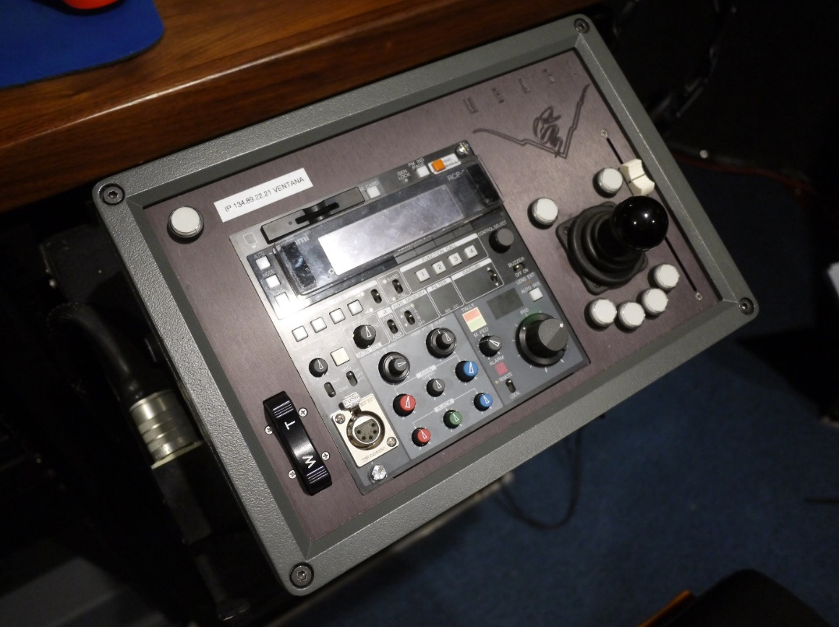
Focus Position Slider
Pan & Tilt Control
Zoom Rate Control Rocker Switch
Manufacturers Camera Control Panel

