Slide 1
Workshop on 4K ROV Camera Requirements

Slide 2
Proposed Attendees (14 in Harbor view)
Alana
Ben Irwin
Dave French
Steve Haddock
Bruce Robison
Lonny Lundsten
Nancy Jacobson
Ventana rep.
Brian Schilling?
Kakani Katija
Alana Sherman
Kelly Benoit-Bird?

Slide 3
Goals of the Workshop
Evaluate the importance of ROV image products to MBARI
  For scientific observation.
  For public outreach and education.
Establish requirements for the next generation of ROV cameras
  For evaluating commercial products
  For informing “build vs buy” decision process
  For justifying transition cost and effort to management

Slide 4
Major High Level User Requirements
Image quality
  Resolution
  Contrast ratio
  Color reproduction
Camera controls
  Zoom, focus and iris
  Black and white balance, shutter speed , etc.
Camera size and weight
Camera cost
Camera maintenance requirements and ease of repair

Slide 5
Image quality

Slide 6
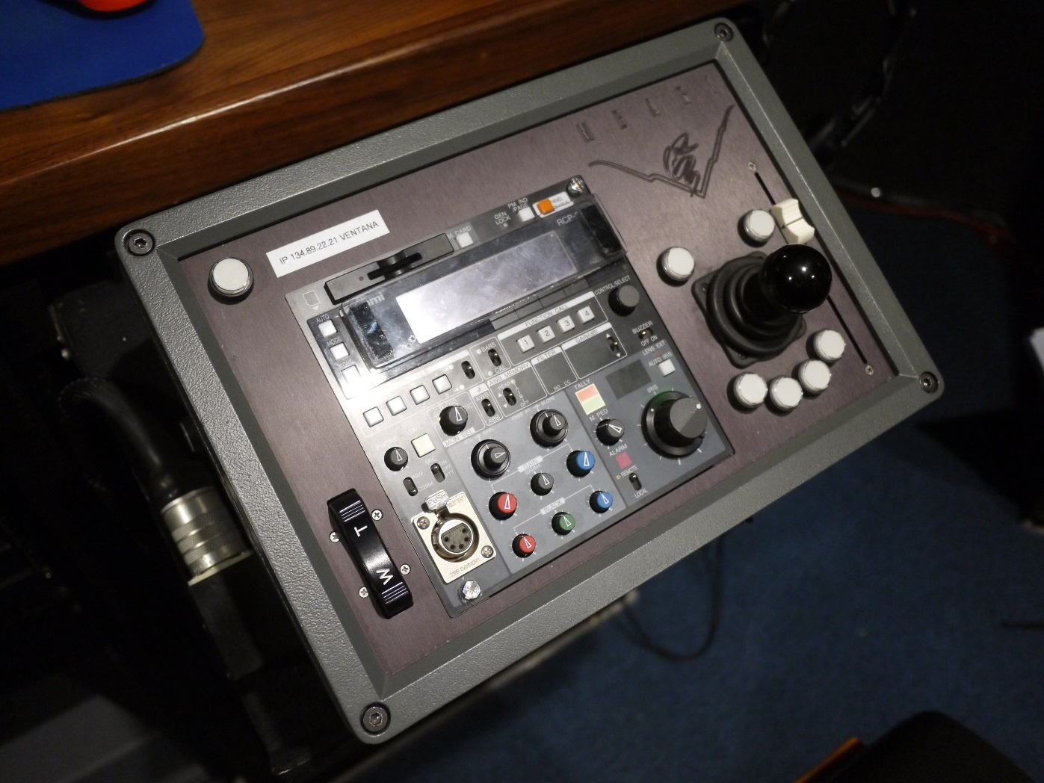
Camera controls
Focus Position Slider
Pan & Tilt Control
Zoom Rate Control Rocker Switch
Ikegami RCP

Slide 7
Camera control examples
Example of fine zoom control – variable rate servo
Example of poor zoom control – fixed rate servo
Example of fine focus control – position control servo with fast response and ramping.
Example of poor focus control – fixed rate servo with lag
Autofocus?

Slide 8
How important is fine focus and zoom?

Slide 9
Camera size and weight
HDTV camera on Ventana
Current Insite camera on Ricketts

Slide 10
Camera cost

Slide 11
Camera maintenance requirements and ease of repair

Slide 12
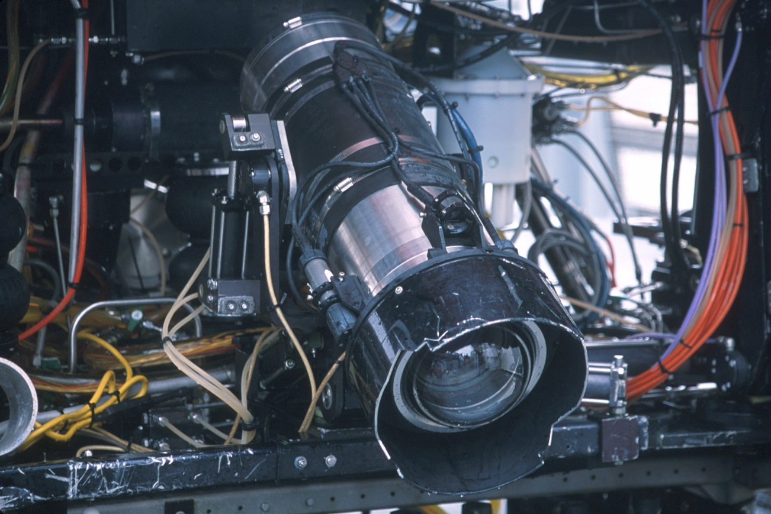
Trade-offs
Image quality vs dome (camera) size

Slide 13
Timing
Start now?
Delay?

