Slide 1
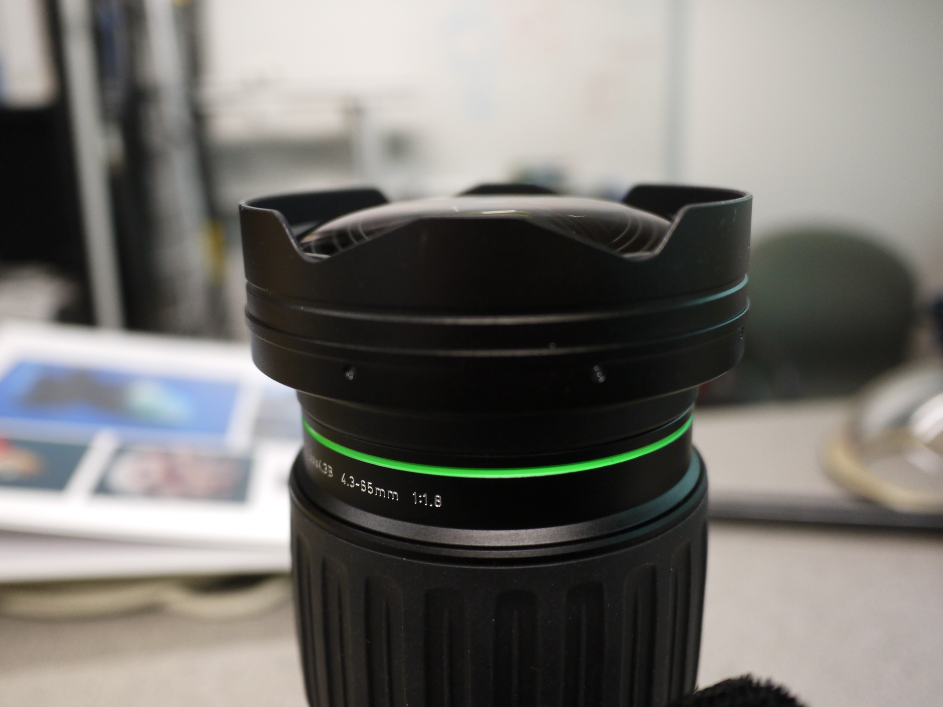
Can this part of the lens be removed without causing structural problems?
Small socket screws

