Slide 1
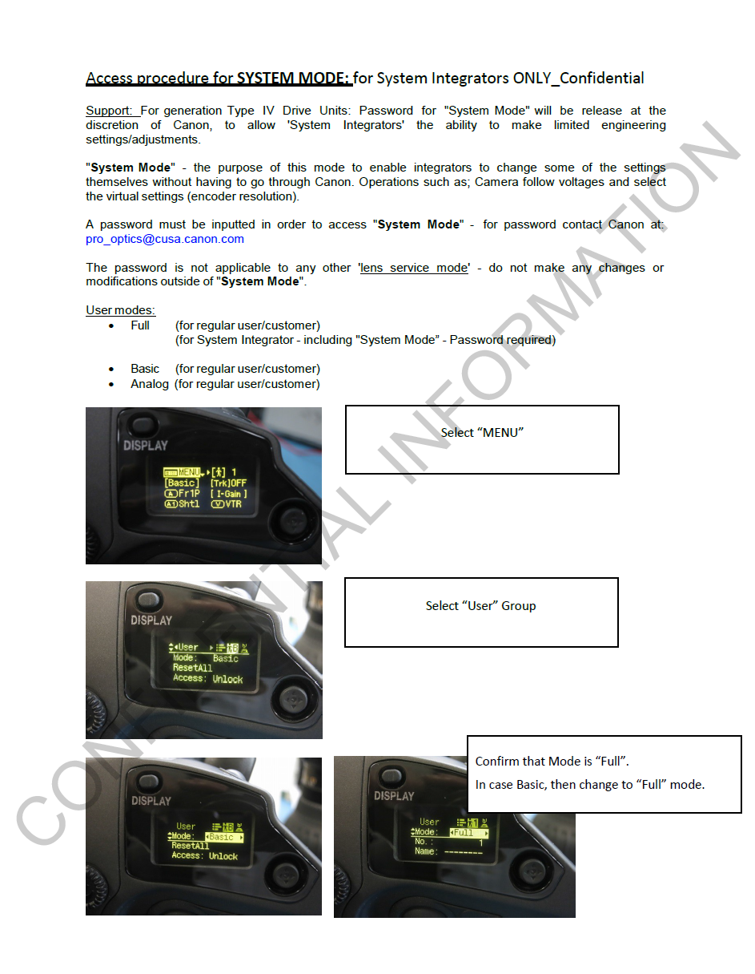

Slide 2
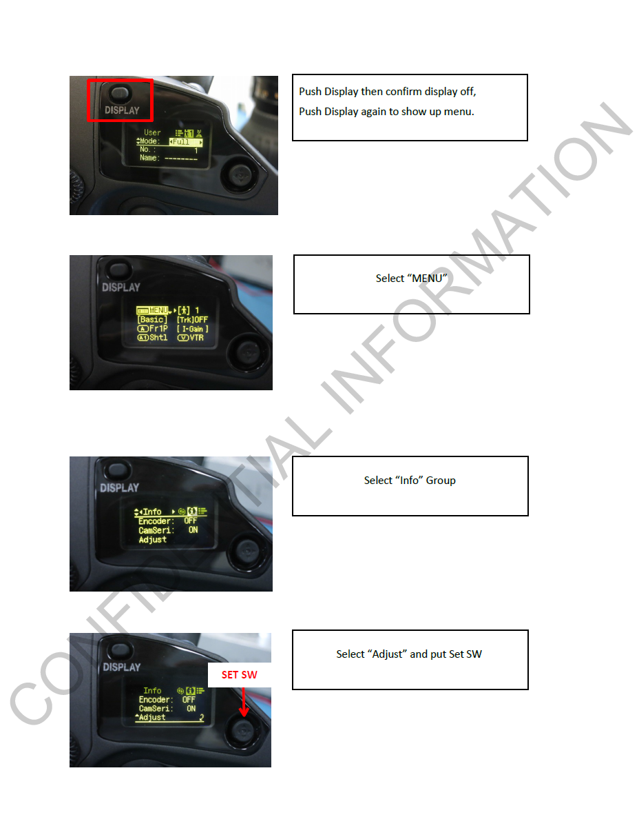

Slide 3
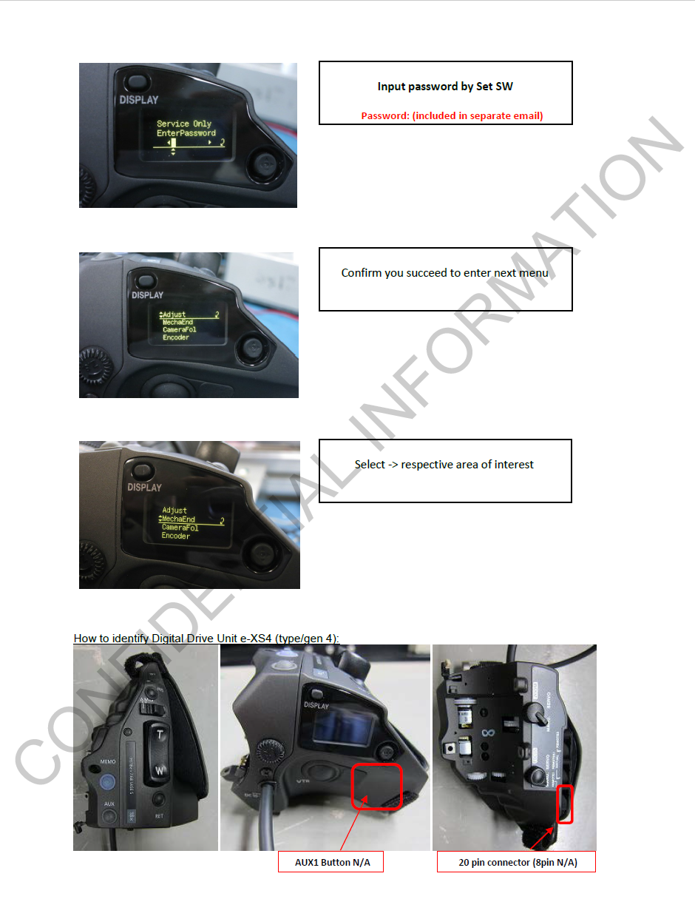
Password = 2310KUTJ
Case sensitive!
perform “MechaEnd” function after you attach servo unit again

Slide 4
