Slide 1
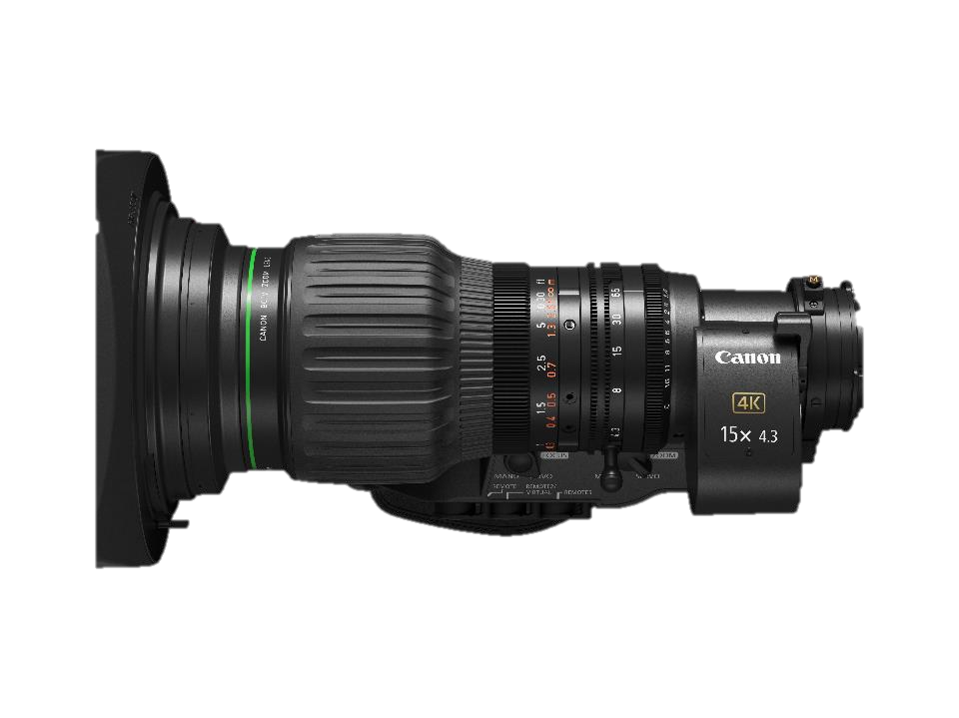
Optical Center of CJ15ex
Optical Center of CJ15ex is NOT mechanical center of front lens.
I suggest following way to find optical center.
Camera
Additional lens from MBARI

Slide 2

1. Shoot chart with using camera and additional lens which we have to align with our lens.
Camera
Chart

Slide 3
2. Set the lens “Zoom tele end” and move the chart center to the center of display
Center of Display
Camera

Slide 4
3. Set the lens “Zoom wide end”, you will see chart center shift from display center
Center of Display
Shift
Camera

Slide 5
4. Shift the additional lens, or lens+ camera, to match center of display and center of chart
Center of Display
Camera

Slide 6
5. Set the lens “Zoom tele end”.
Repeat same adjustment.
You will see smaller center shift this time.
Repeat this adjustment until chart stay at the center when you move zoom from tele to wide.
Camera

