Slide 1
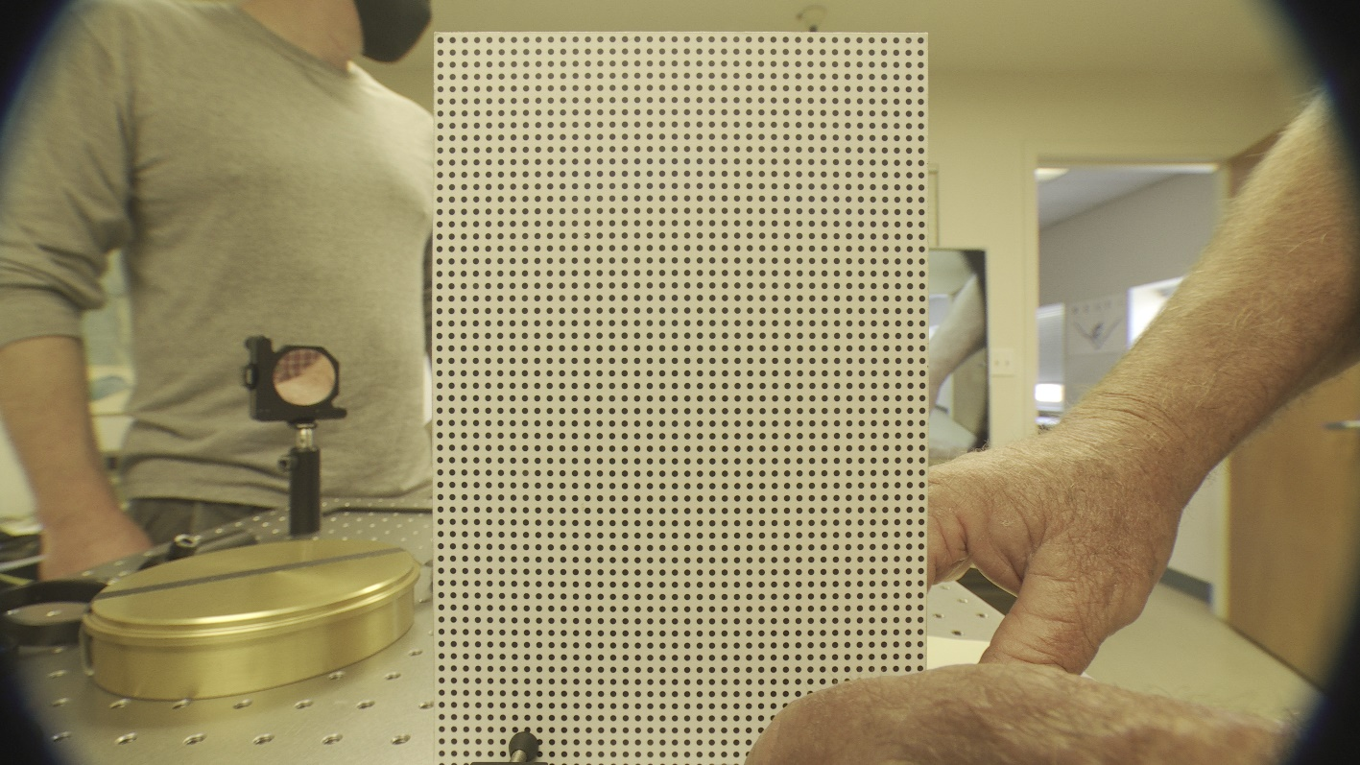
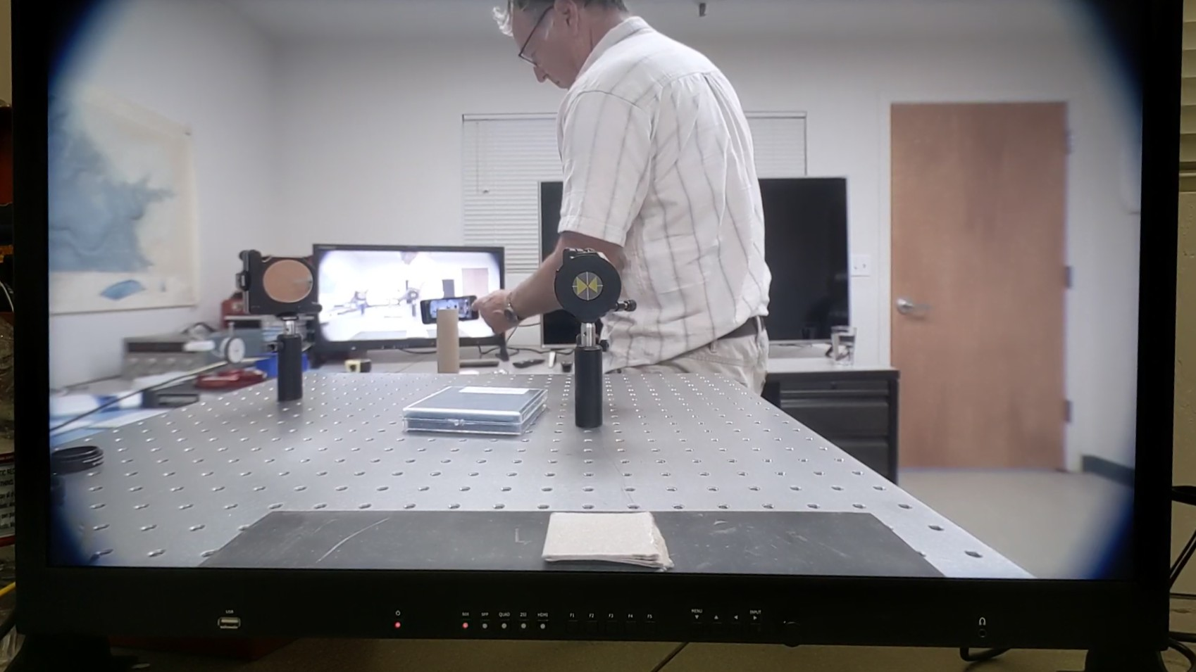
Wide Angle (FL 4.8mm) Images
4K CAMERA FIRST OPTICAL TEST RESULTS. Optical Adapter in Air. 6/25/2021
Pre-axial alignment. Canon to adapter 1st element spacing ~ 0.6mm. Focus set to target distance. Camera was white balanced pre-install of adapter. Note slight yellow cast.
Post-axial alignment. Canon to adapter 1st element spacing also reset to 0.31mm. Focus set to target distance. Note that the centering butterfly mark is on the monitor, not the target. Camera was white balanced with corrector in place.

Slide 2
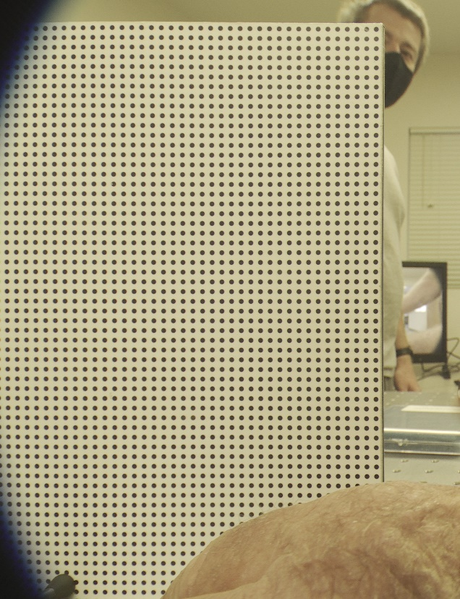

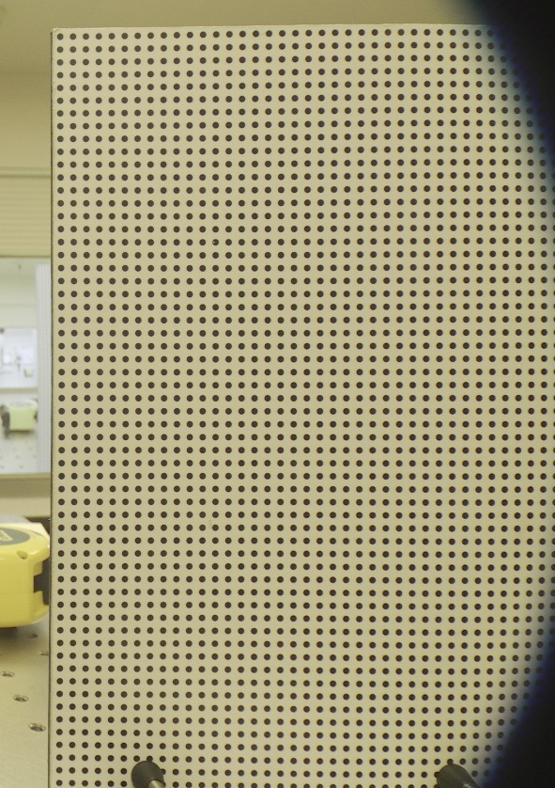
Pre-axial alignment Images at ~ 150mm (actual MOD is closer to 130mm)
Left
Center
Right

Slide 3
Methods
Laser beam is aligned to the corrector center using spot reflections at ~ 1m.
Bullseye target is moved to ~ 0.5m in front of corrector and aligned on laser beam. Laser is turned off.
Center mark is placed on exact center of the video monitor as measured from screen dimensions (need to improve this method of determining imager center?).
Camera optical block/Canon lens is calibrated to bring the center of the bullseye target image (Adapter optical center) on the monitor center mark (Imager center):
  With lens in wide, adjust optical block closer to center.
  Zoom in on target and adjust Canon lens front closer to center.
  Repeat process until target remains centered all through zoom range.

Slide 4
Items of note
Vignetting
  Did not seem to change noticeably when changing Canon lens to adapter spacing from 0.6 to 0.3mm. Could try move lens spacing to 0.26mm (mechanical limit is 0.24mm) – but vignetting does not seem to be noticeably effected by spacing.
  Triple checked Canon to adapter 1st lens element spacing to be exactly 0.31mm.
  Moving lens to ~ 5-6 mm focal length is needed to remove vignetting.
Centering
  Was impossible to center when starting with front in wide and then zooming and doing the rear (tilt). Adjustments diverged.
  Starting with rear in wide (rear is most sensitive) and then front in full zoom would converge.
  When system appeared aligned in tilt and centering, the optical block/Canon mechanical centering is about ~1.5-2mm higher then the optical center. Can the Canon lens optical center really be this far from the mechanical center???
    Maybe my target is off – need to wait for Paul to get back Tuesday, he is expert on the laser centering.
  When the Canon lens was centered it zooms through the entire range holding exact center and without wobble (see PostAlignZoomSequence video).
  When all is centered, if you rotate the adapter there is a slight image rotation about the center - see PostAlignAdapterRotate video. Should I use the center of this rotation as the true optical center for the bullseye target?
MOD
  Appears to be about 130mm.
  Shot target at 130mm and ~150mm.
  Images looked pretty good. See MOD_~130mm video.
General
  Once the system is aligned the optical alignment holds when the optical adapter is removed and replaced – especially if placed in the same rotation position (see 2E above).
  During alignment you have to be careful not to lock down the front or rear adjustment while moving the other end – must be free to rotate slightly.
  The adjustment screw-ball to cup system for locking the lens fore-aft position works, but you must make sure that the ball is well fixed in the cup when setting the Canon lens to Adapter spacing shims. After axial alignment and tightening everything down you can remove the adapter and double check the spacing to confirm. May take a few iterations to get the spacing exactly right. The method of measuring the spacing is rock solid and allows shimming to +- 0.05mm and measurement to 0.01mm easily.

Slide 5
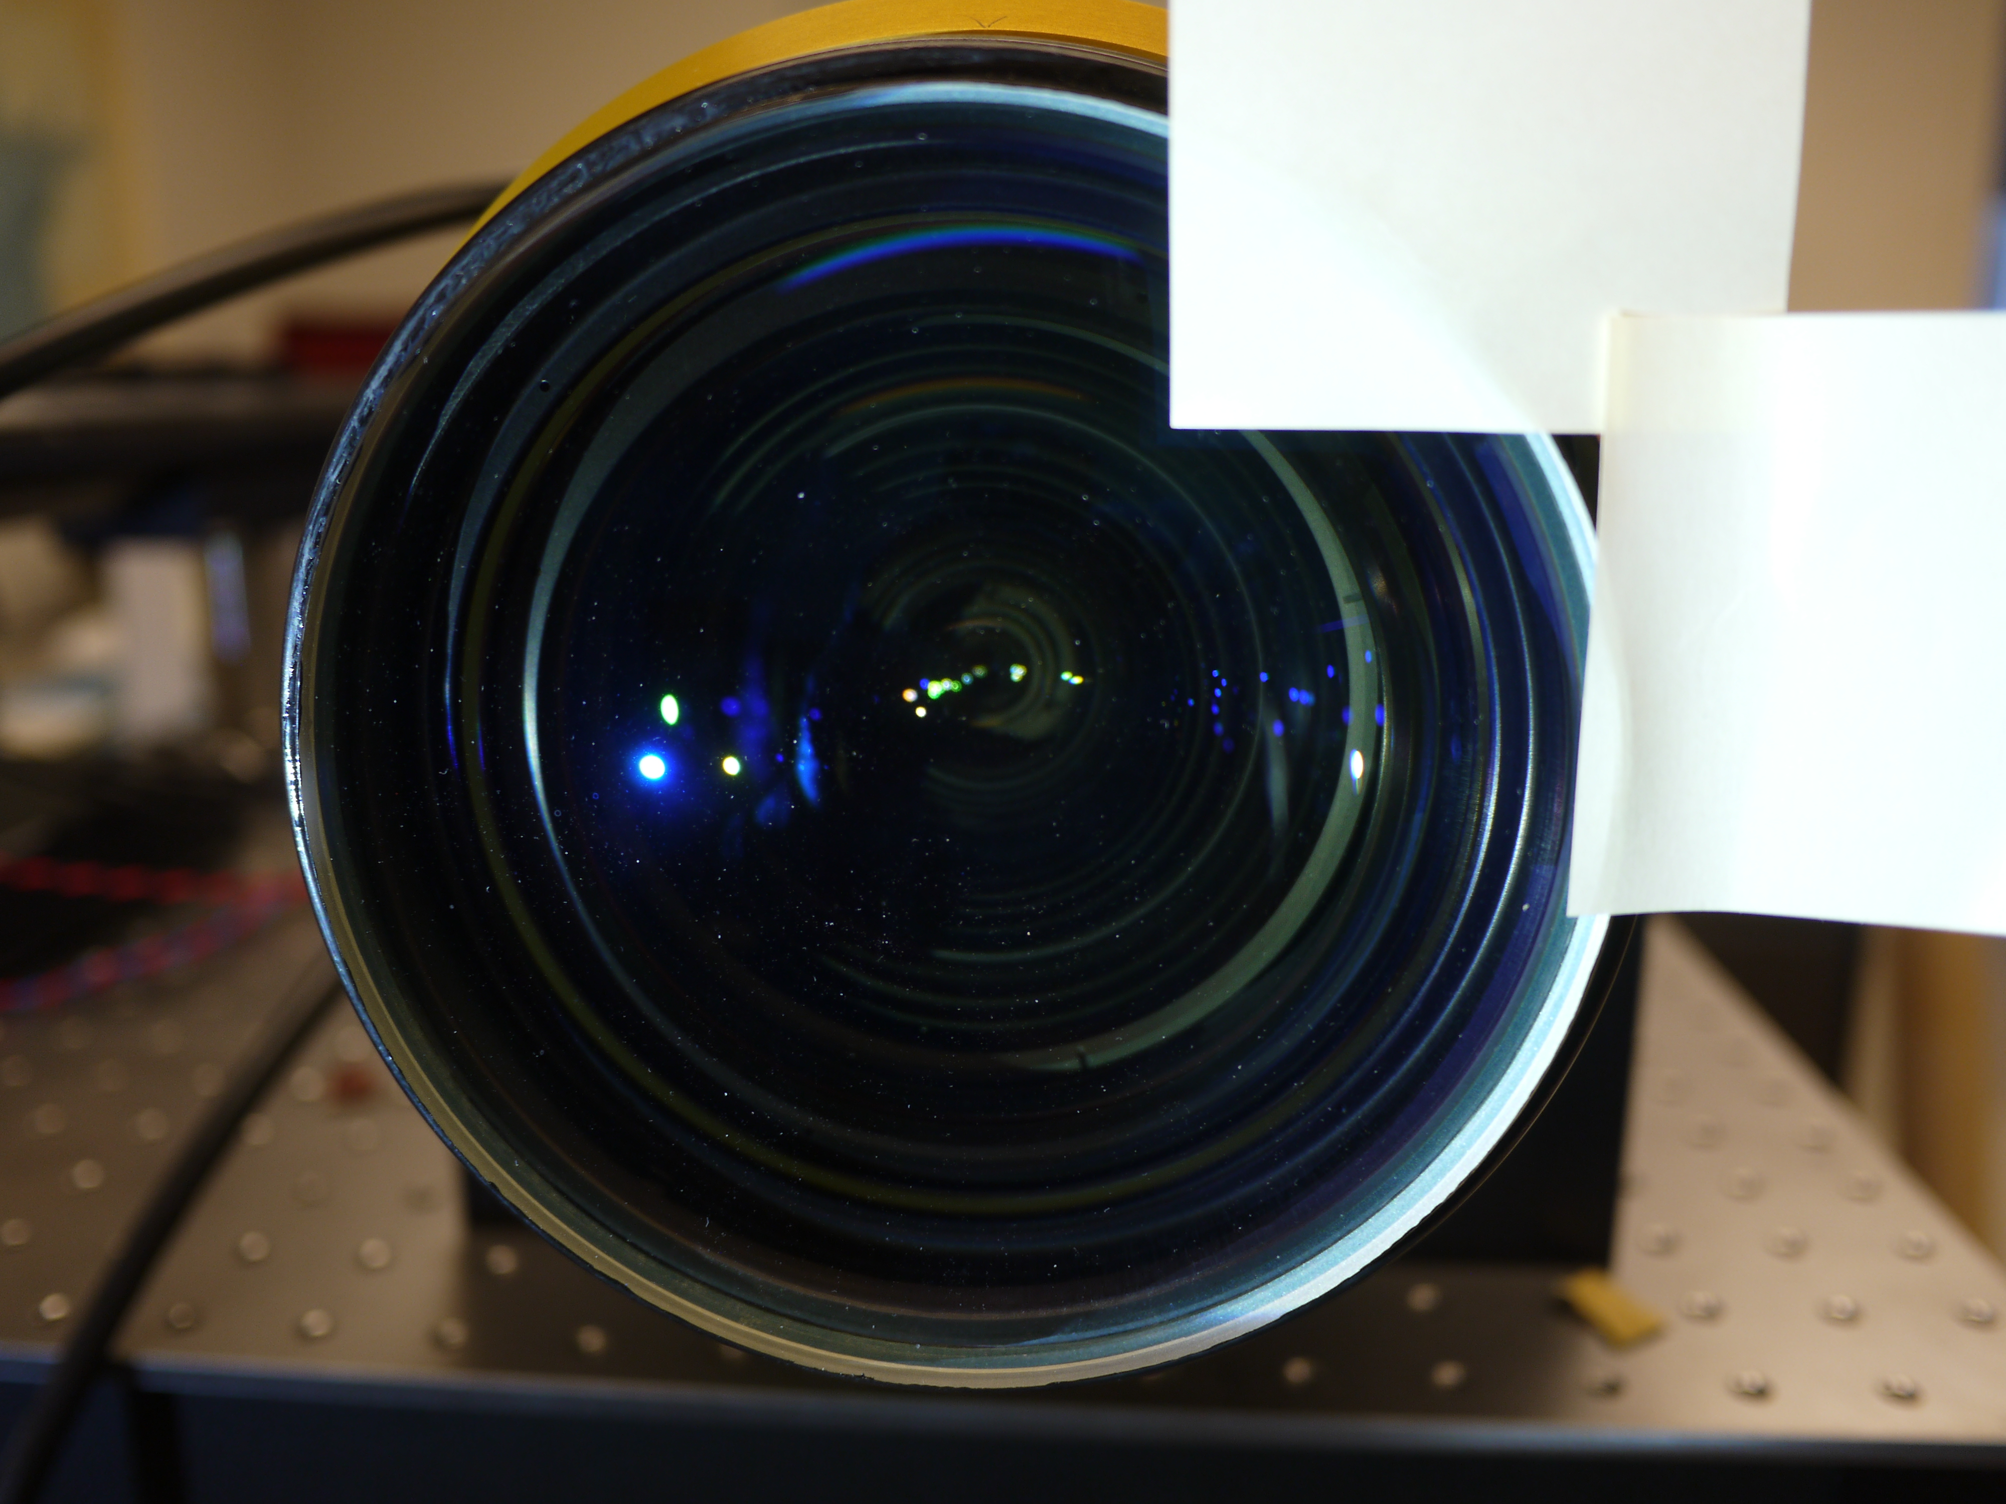
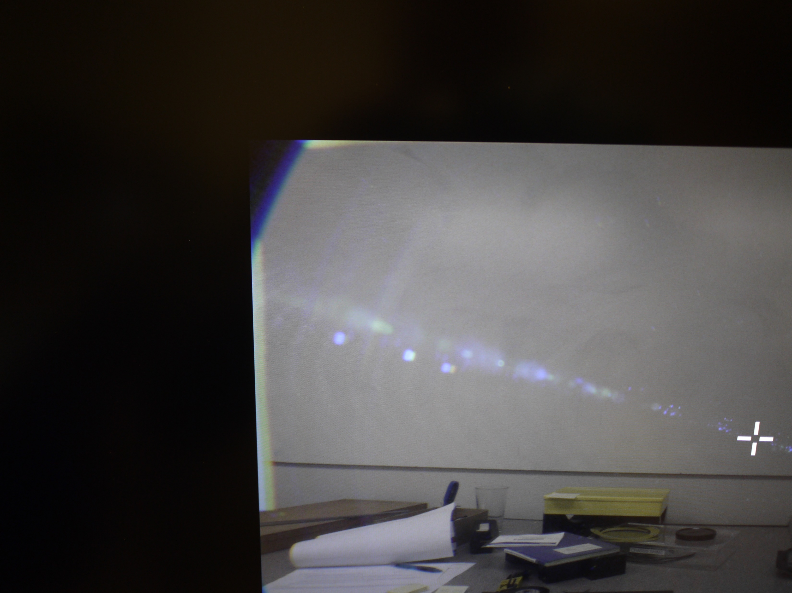
Part 2 6/28/2021:
F-stopped down to image vignetting. Post-it’s placed just at the very edge of the visible frame. Monitor underscanned to get full image. Zoom – full wide.
Bright edge is the exact edge of the first lens element.
Post-it’s just showing up in the edge of the image.

Slide 6
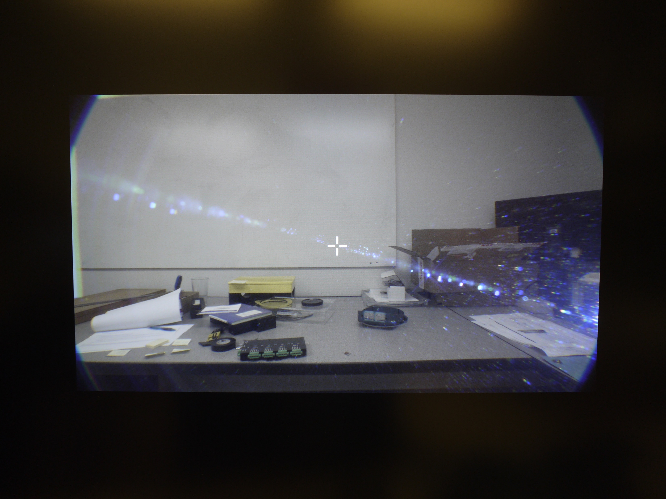
Full Frame of post-it test. Note to image the post-it’s with the iris stopped way down I have a bright light hitting the lens at a sharp angle.

Slide 7
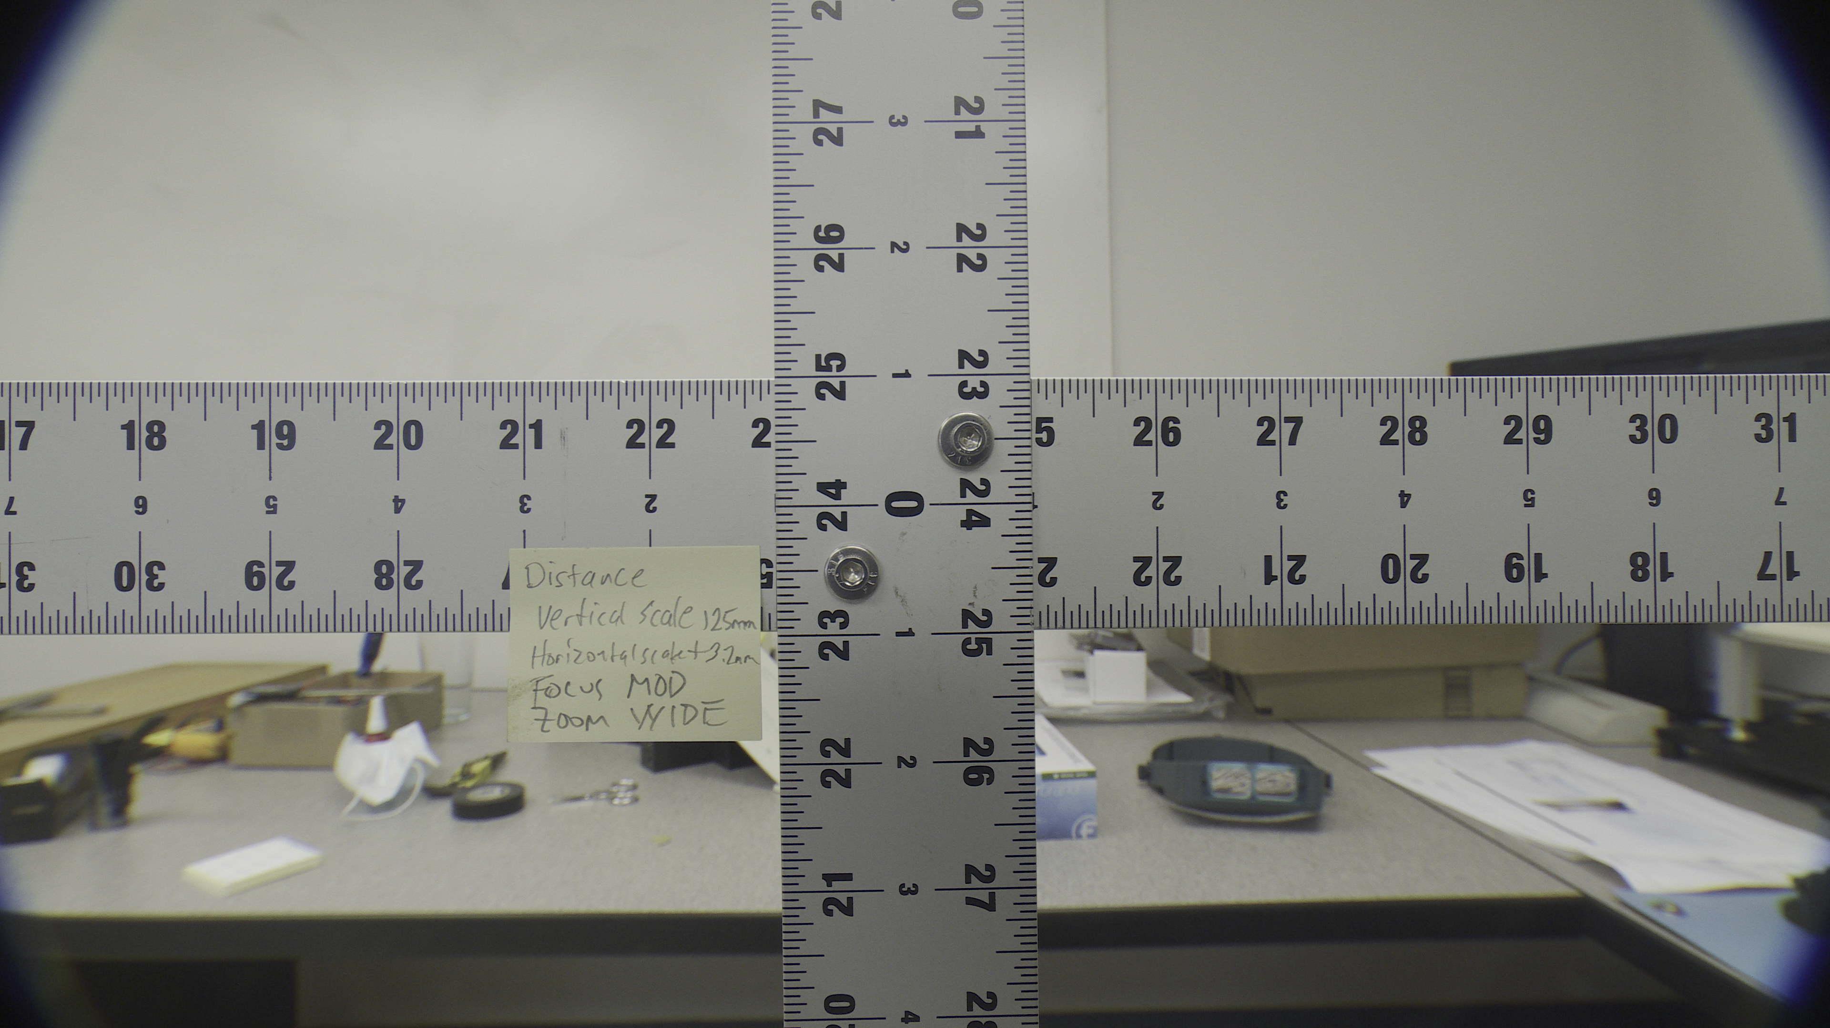
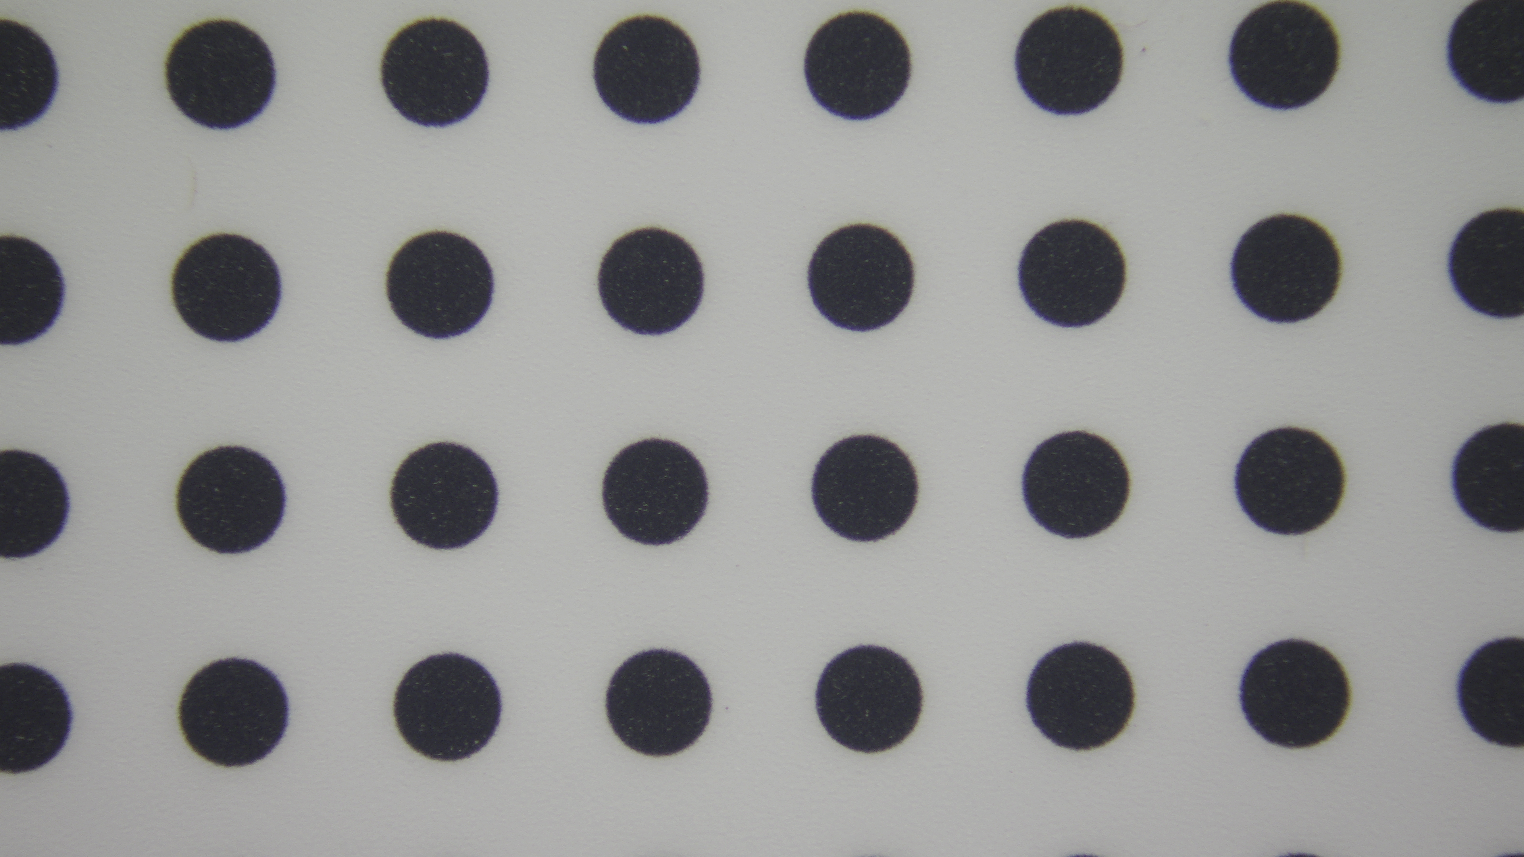
Part 3 6/29/2021:
Measured object sizes. Note that distance measurement to target is +/- 1-2mm.
201.9 mm
16.2 mm
359.0 mm
28.9 mm
Distance from vertex:
Vertical scale 125mm
Horizontal scale is + 3.2mm back
Zoom full wide (4.3mm)
Focus MOD
Distance from vertex:
Vertical scale 148.6mm
Zoom full tele
Focus MOD

Slide 8
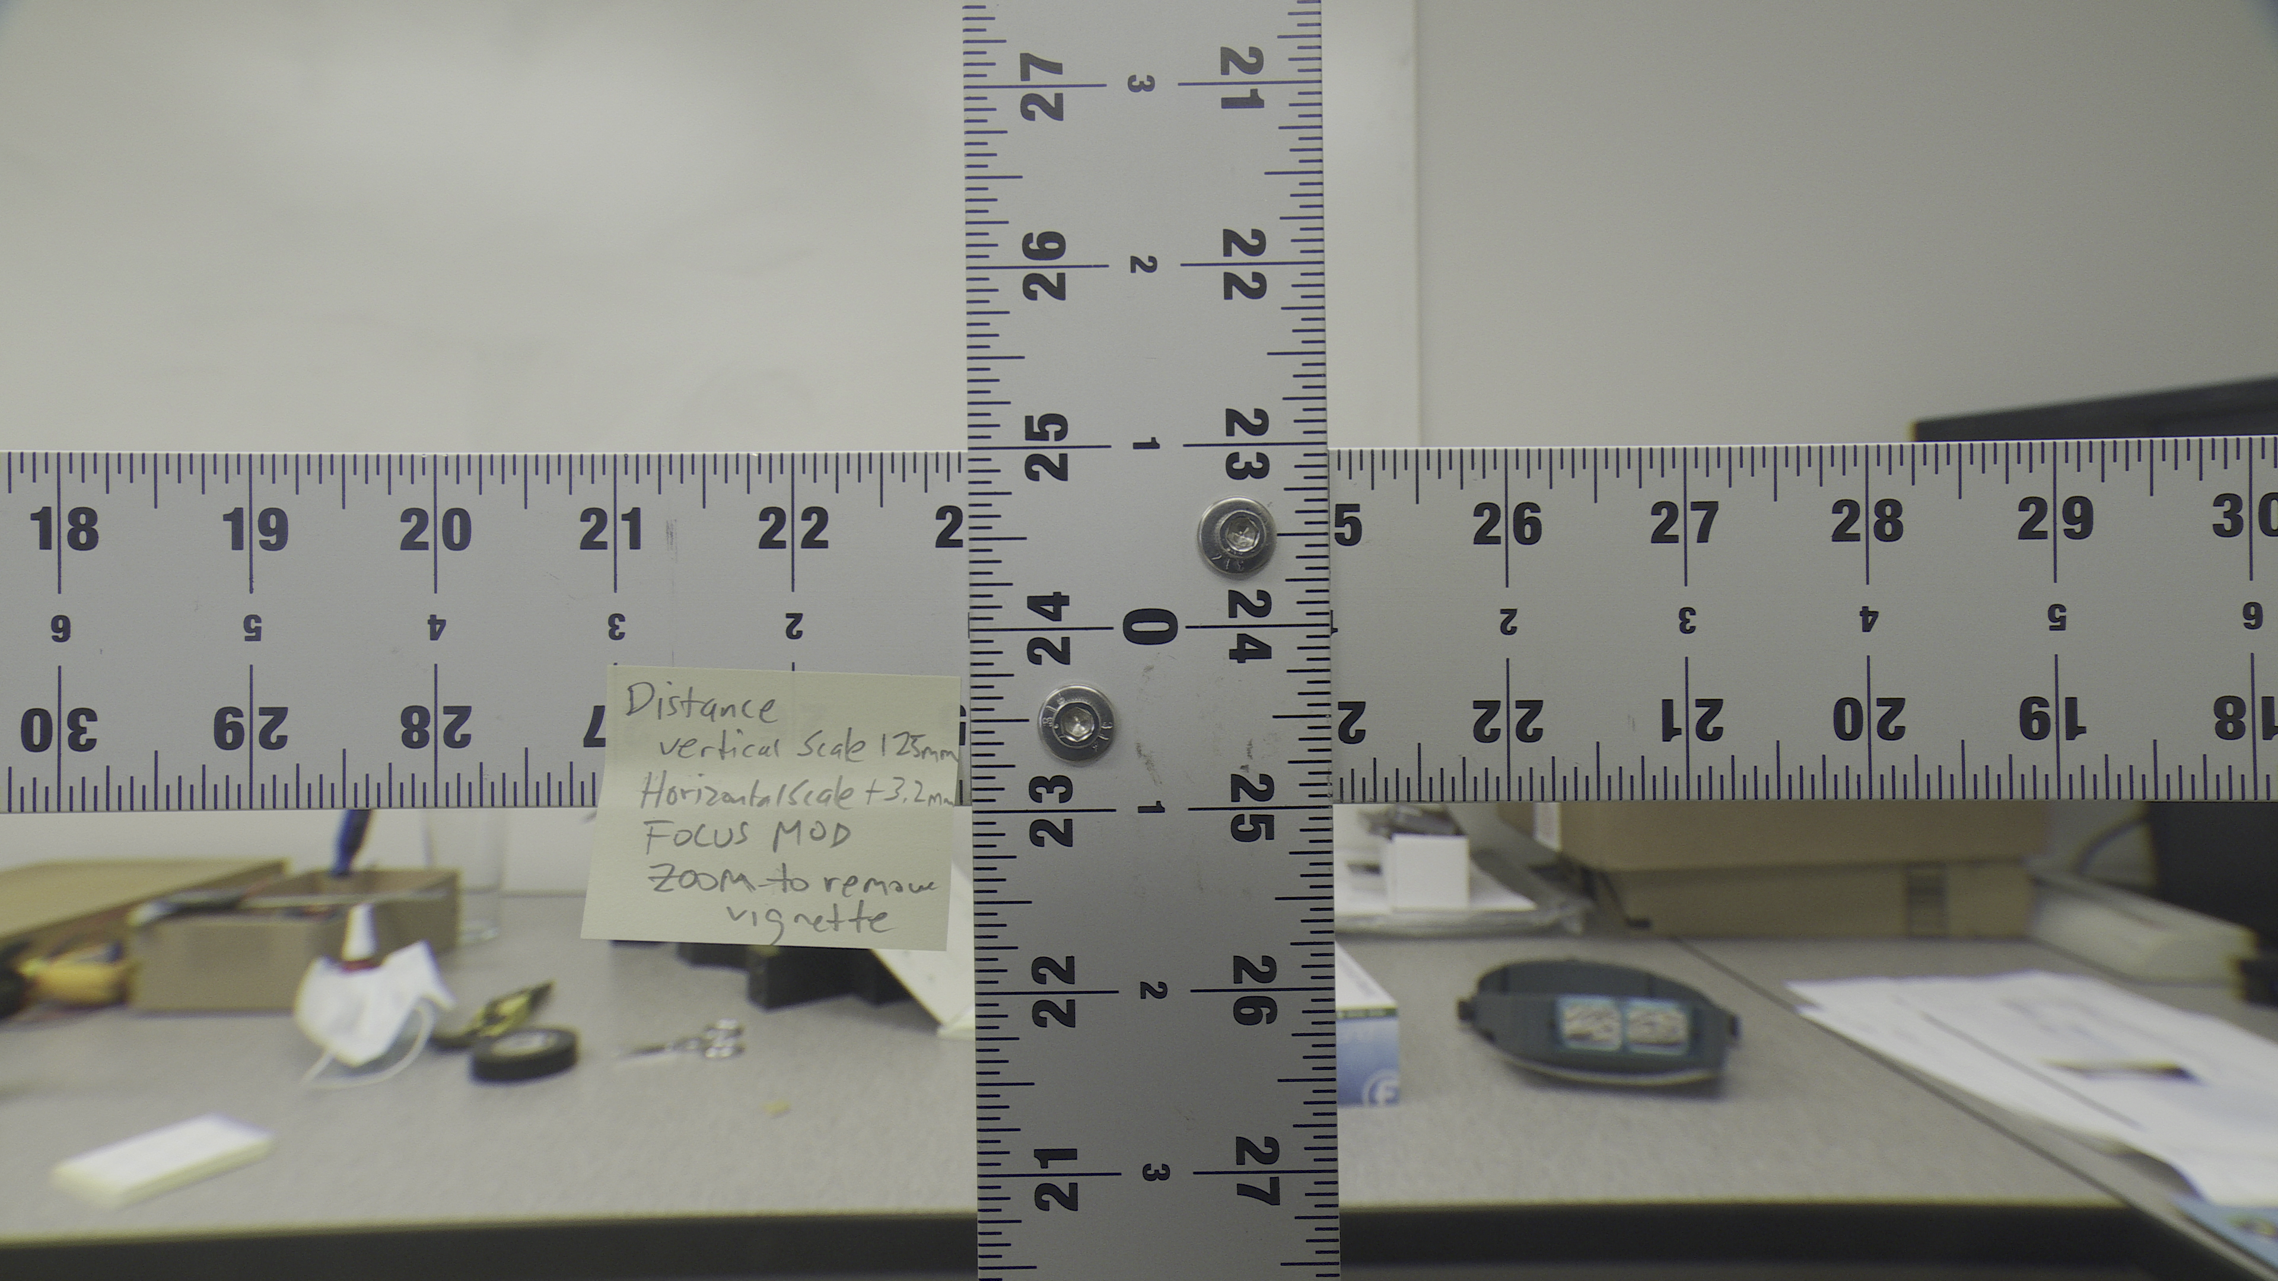
179.3 mm
318.7 mm
Distance from vertex:
Vertical scale 125mm
Horizontal scale is + 3.2mm back
Zoomed to remove vignette at all focus settings.

Slide 9
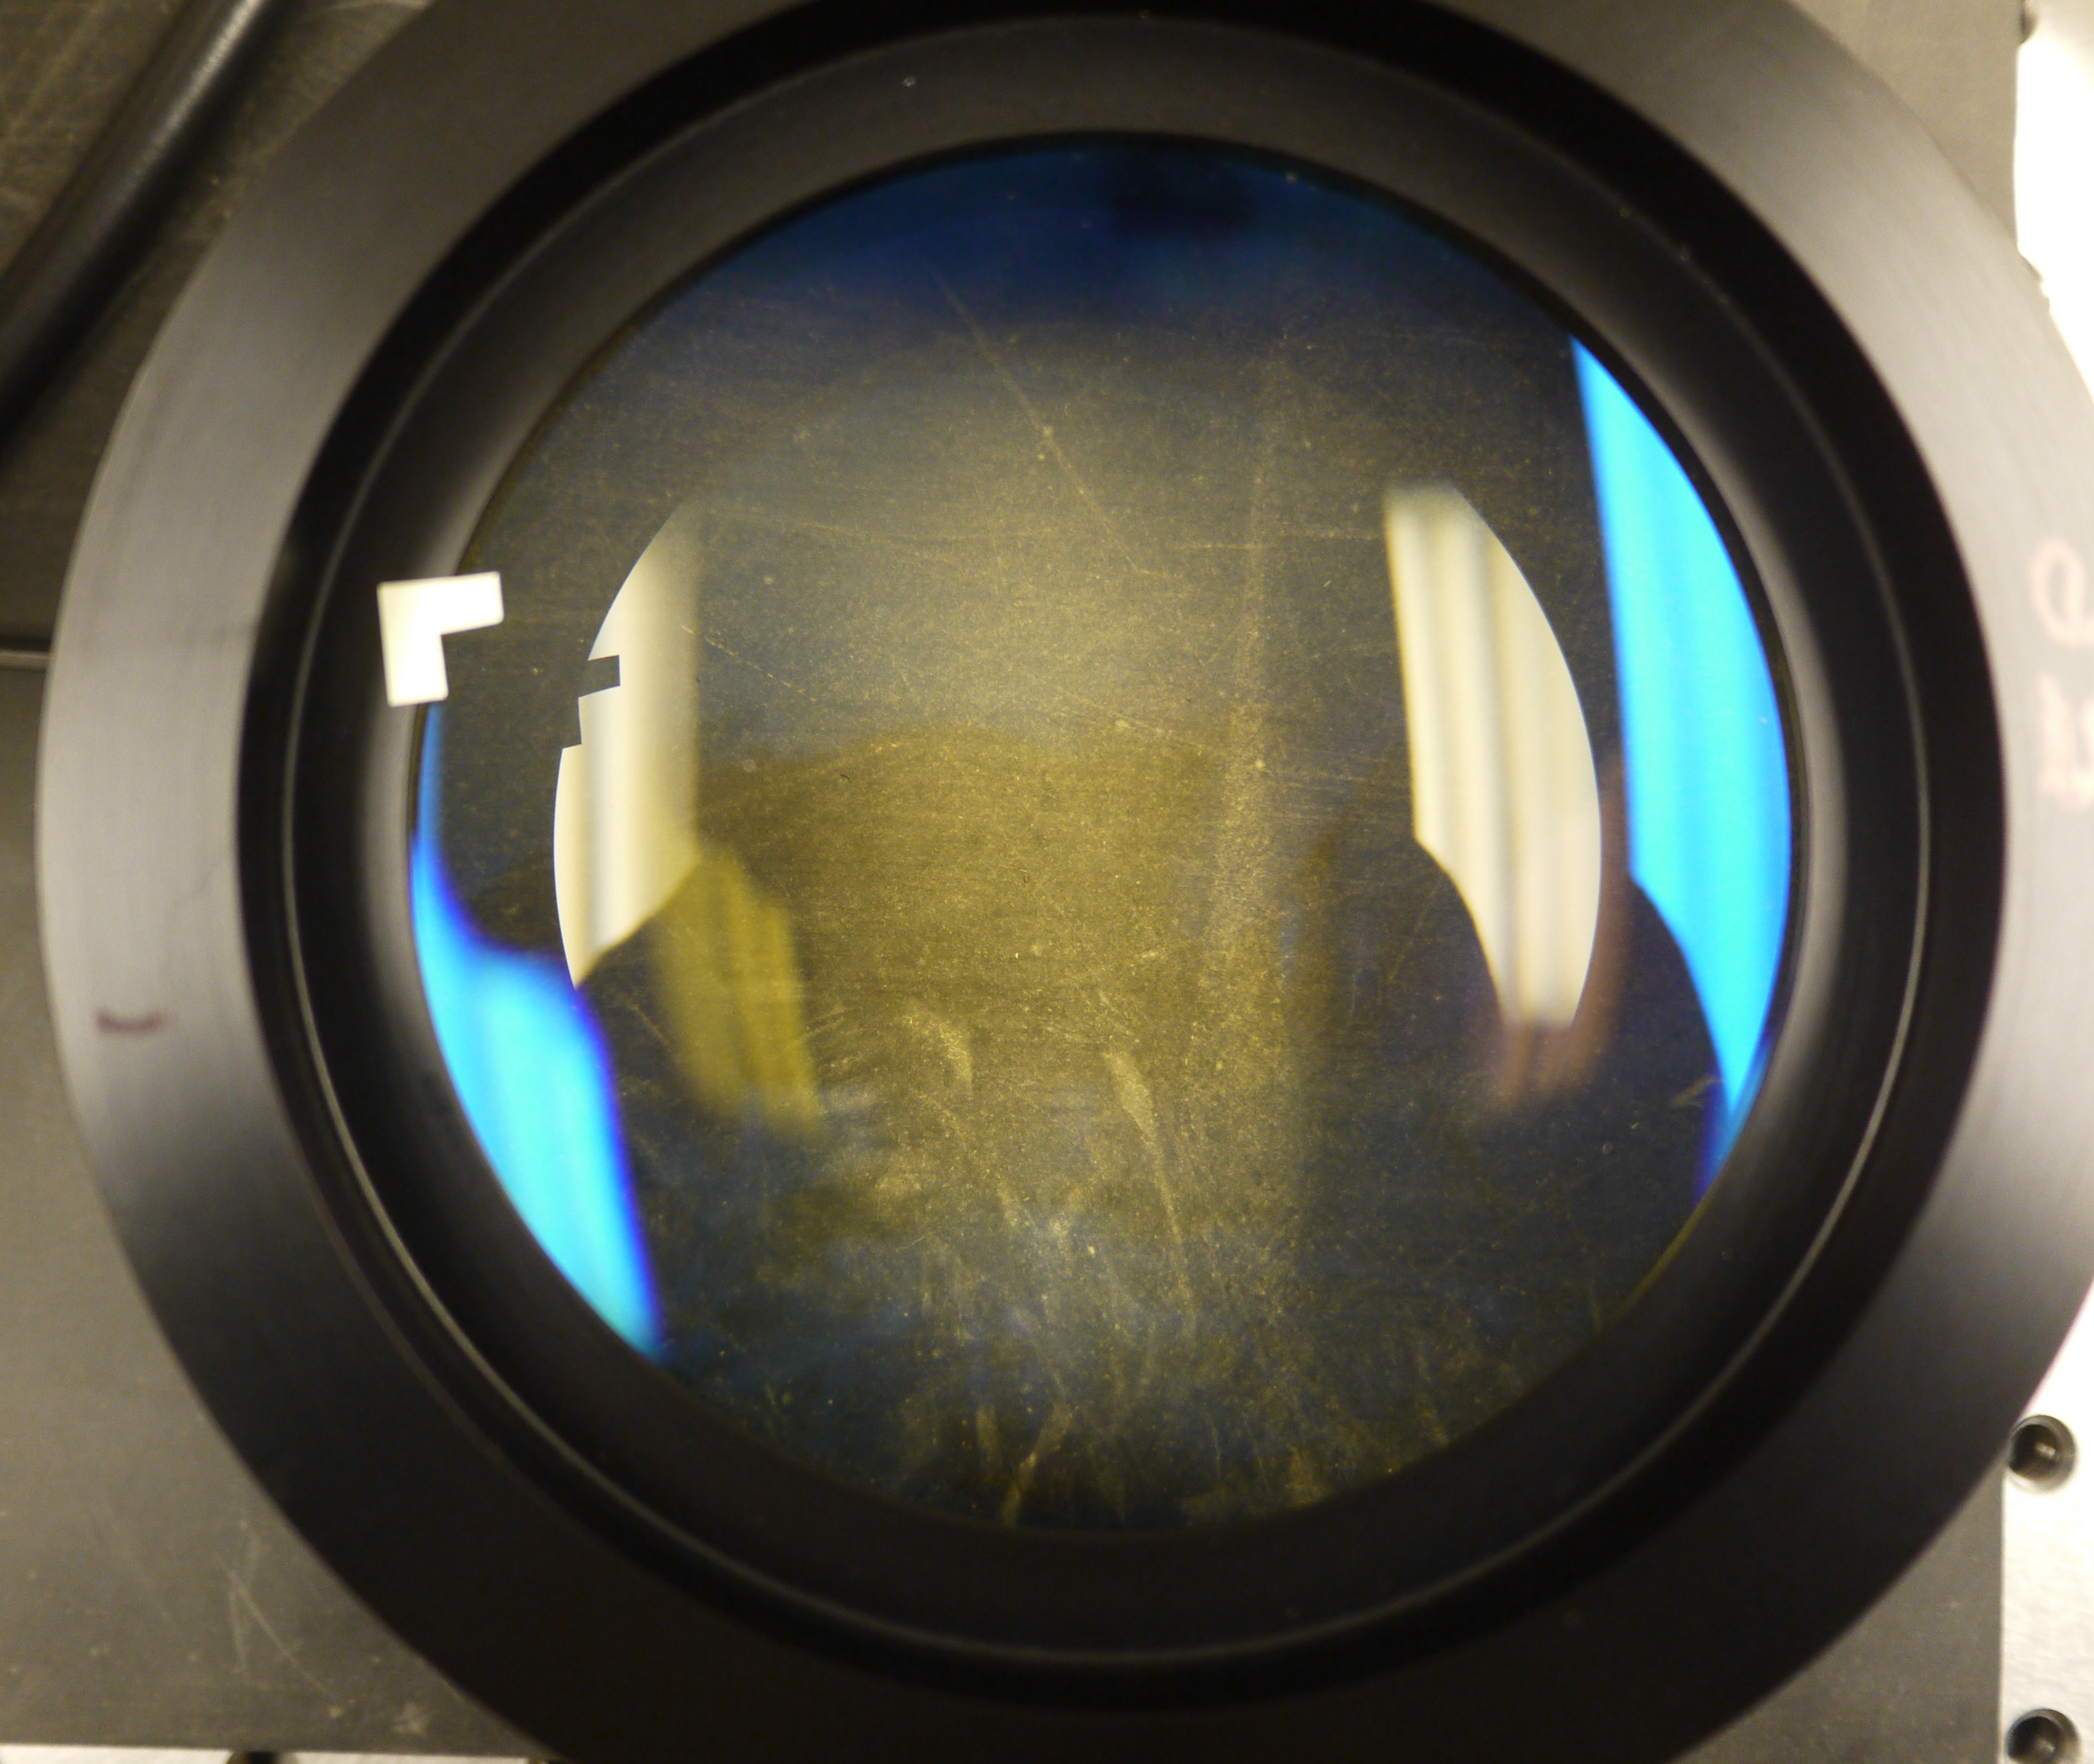
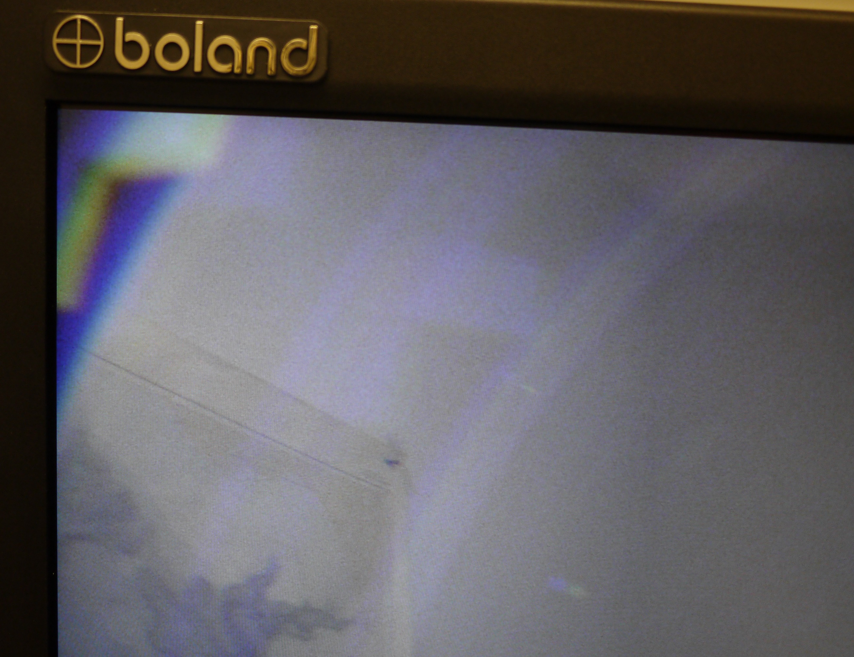
Post-it with corner placed ~ 0.5 mm into glass area of rear lens
Edge of lens support flange blocks illumination of post-it?
Vignetting of other lens elements past rear lens

Slide 10
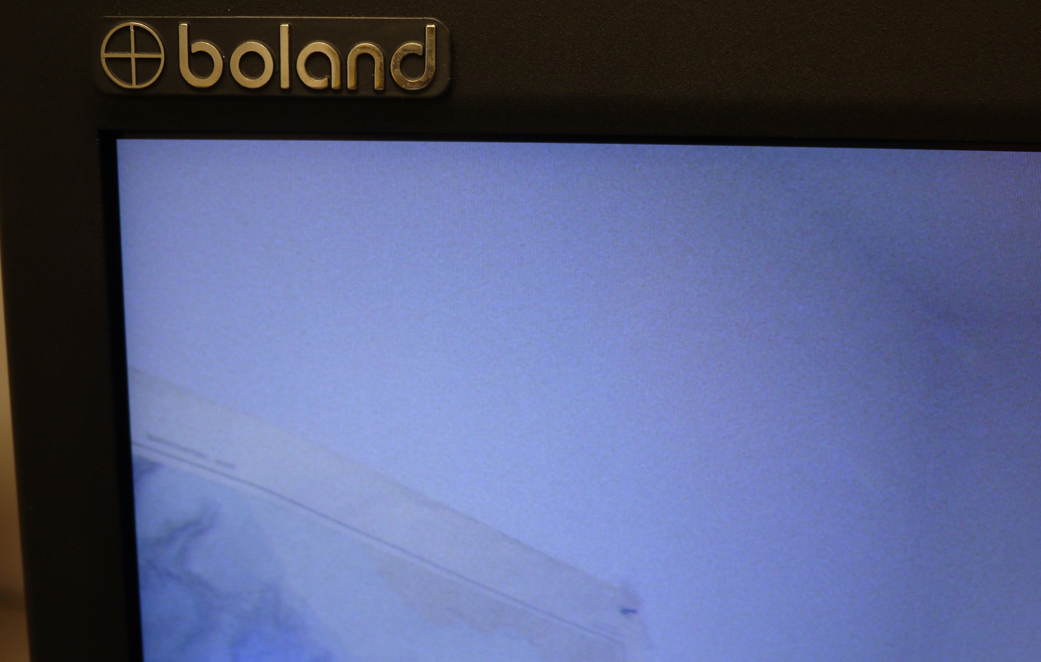
Reality check – Canon lens without adapter (full wide)

