Slide 1
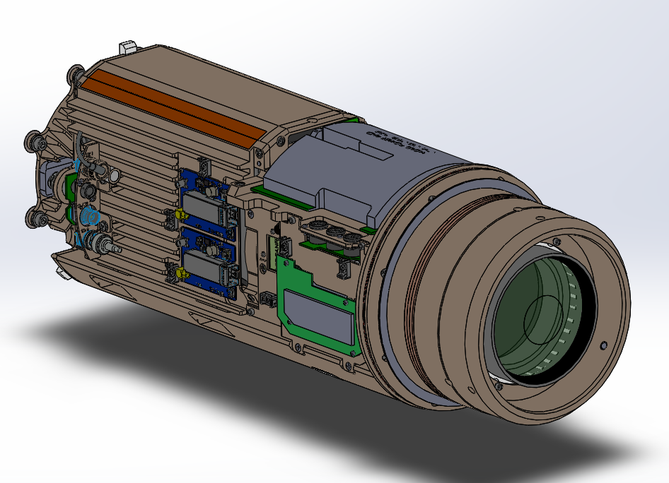
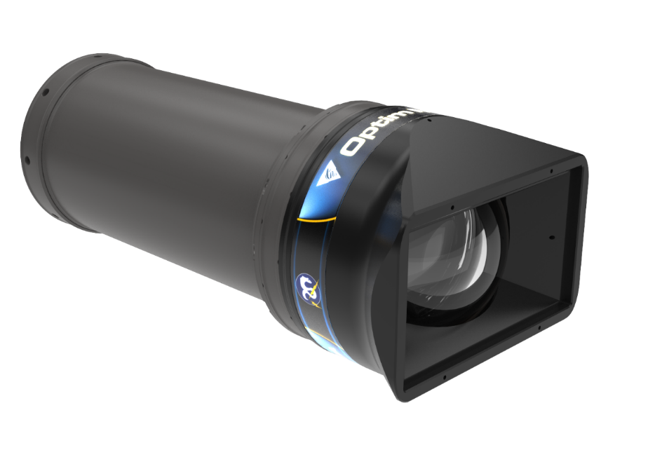
OPTIM MxD Camera System Camera Chassis Shim Spacing and Optical Centering Alignment
Note: See “notes” view for additional discussion and information on the slides

Slide 2
Before Beginning Shim Setting Procedure
Have the optical block and front of Canon lens adjustment screws set for mechanically centering the two parts.
Perform the back focus adjustment on the Canon lens! See camera user manual for procedure. Don’t forget this step!

Slide 3
Optical Alignment Requirements (from 89L REV 3 CORRECTOR TOLERANCES - FINAL - AUG 5, 2020)
Corrector cell to dome
Canon lens to corrector cell

Slide 4
Camera Alignment Components - Cartoon
Camera Chassis radial alignment cone
Axial stop
Camera Chassis
Rear support clamp fastener and springs to force chassis to forward axial stop
Dome Port
Optical Adapter Lens Assembly
Titanium housing
dome support ring
Optical Block and Lens Assembly

Slide 5
Canon Lens and Optical Block Reference Points
Lens X-Y Adjustment
Optical block X-Y adjustment
Optical block
Optical center
Chassis and lens mechanical center
Lens face of front element
Lens flange
Note: Canon lens mechanical center of front element is NOT necessarily co-axial with optical center of lens ☹ (..Canon communication)
Also assume lens and optical block are aligned by B4 lens mount – we have no control over this.

Slide 6
Adapter Optical Cell Reference Points
Calibration plan requires that the optical center of the adapter cell is aligned with the mechanical reference points on the adapter assembly. Adapter cell assembly uses laser interferometry alignment to verify that individual lens centering and tilt specifications are met. (see PDR slide #32)
mechanical optical center & tilt reference
fourth glass element
Optical and mechanical center are aligned
first glass element
mechanical axial distance reference

Slide 7
Camera Chassis Reference Points - Cartoon
chassis alignment cone
Rear chassis plate to housing ID adjustment tabs
Housing bulkhead bolt circle
mechanical center radial reference surface
Axial spacing reference surface
Mechanical center
Adapter cell radial and Z alignment surfaces.
Bore
Face
Lens flange (optical block mount)
Shims for adapter cell front lens to dome port spacing adjustment
Rear camera chassis center support fastener
Axial spacing of Canon lens to adapter cell shim adjustment

Slide 8
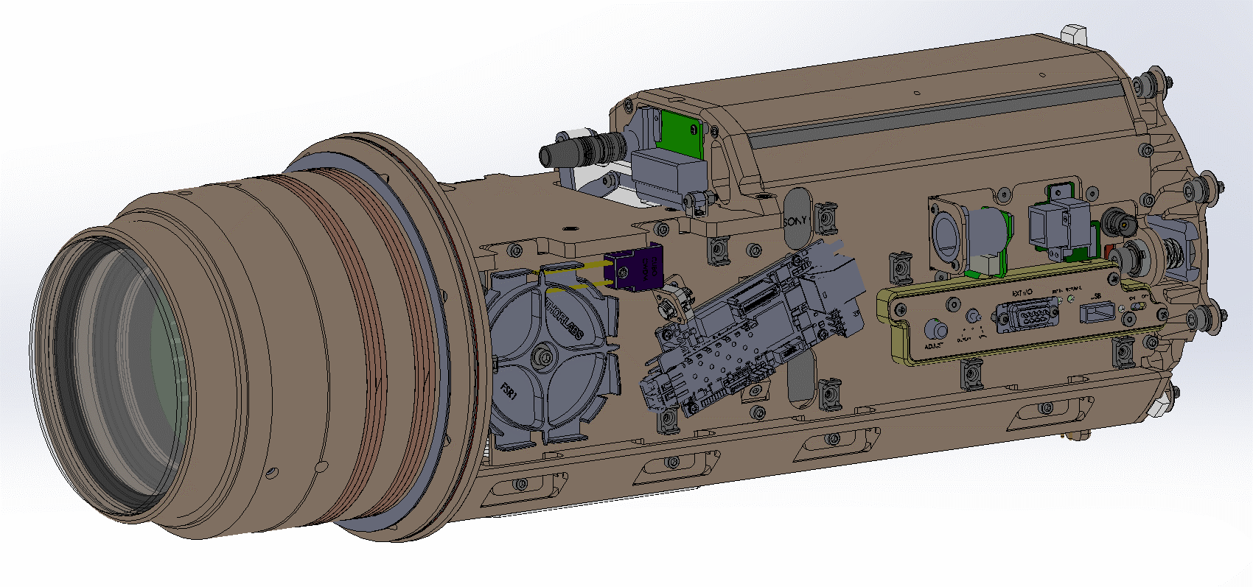
Chassis Spacing Alignment Components
Chassis to housing radial alignment PEEK rings
Not shown, chassis length adjustment spacer
Adapter cell to dome port spacing shims
Canon lens to adapter cell spacing shims
Chassis radial alignment tab (x3)
Chassis alignment cone
Springs apply 57 lbs. of force against housing
Optical Adapter Lens Assembly
Optical block X-Y adjustment screws (x3 screws radially spaced)
Adapter lens retaining screws (3x)
Canon lens X-Y adjustment screws (3x)

Slide 9
Housing Reference Points
Housing bulkhead bolt circle
mechanical center reference
mechanical axial distance reference
Optical and mechanical center
Housing ID clamps during initial assembly
Q1: Dome axial position change at pressure? Apparently -0.007 inches [0.18mm]
Note: Dome must be carefully aligned with the support ring reference bore. Split tolerance with adapter alignment?

Slide 10
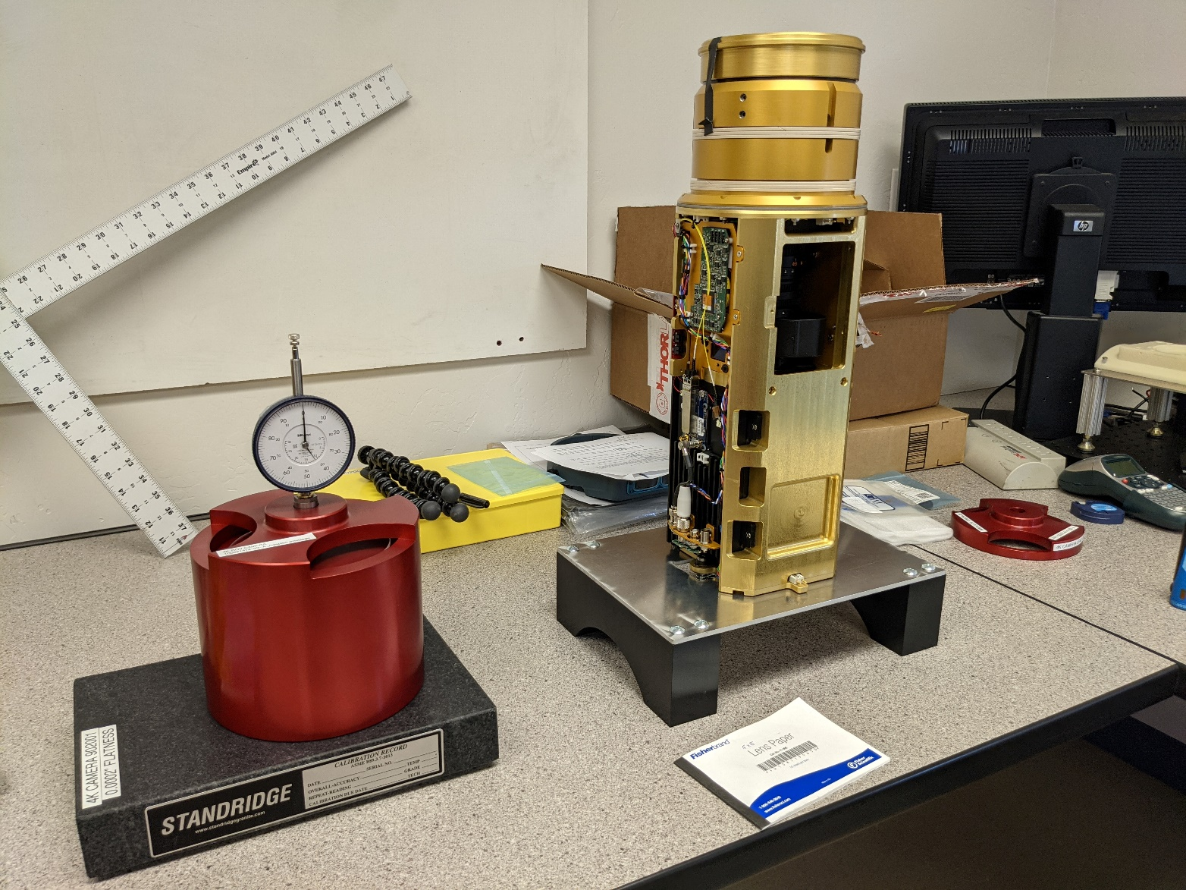
Shim Adjustment Jigs & Tools
100221414-92-A_CameraLensGage
100221414-94-A_AdapterGageBlock (inside)
100221414-93-A_AdapterLensGage
Chassis cradle doubles as chassis vertical support

Slide 11
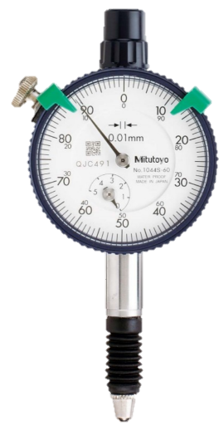
Step 1: Set Canon lens to optical adapter spacing by adjusting shims between the chassis adapter cone and the chassis.
Step 1A:
Measure distance to vertex of optical adapter cell using alignment cone as a jig. Use lens paper on lens surface.
Step 1B:
Measure distance from alignment cone to granite block. as a jig. Also use same thickness lens paper on granite block.
Large plunge micrometer (borrow from shop)
A
Chassis alignment cone (prior to installing on camera chassis)
B
Adapter cell
Granite Block
Granite Block
Step 1C:
Difference (B-A) is adapter spacing (11.83mm nominal). Enter MEASURED distance in the EXCEL worksheet in ChassisShimsCalibrationProcedure.xlsx

Slide 12
Illustration of Method of Verifying Adapter Cell Dimension Using Plunge Micrometer and Chassis Alignment Cone
B
A

Slide 13
Step 2: Set Axial Distance of Canon Lens with Gage and Shims
Install the chassis alignment cone using the nominal shim stack plus any offsets measured on the optical adapter.
  Installation (and re-installation after shim adjustment) is easiest when camera is set vertically with the front facing down.
Note that insulating Kapton shim must be installed on chassis side of shim stack to maintain electrical isolation of chassis from the alignment cone.
The shim stack compresses with clamp force and it takes several laborious iterations of clamping and measuring to get the final shim stack height correctly set.
The is a tool in ChassisShimsCalibrationProcedure.xlsx for estimating the shim mix to make a target stack height.
This step is the hard part and the rest is much easier – at least until the optical alignment!

Slide 14
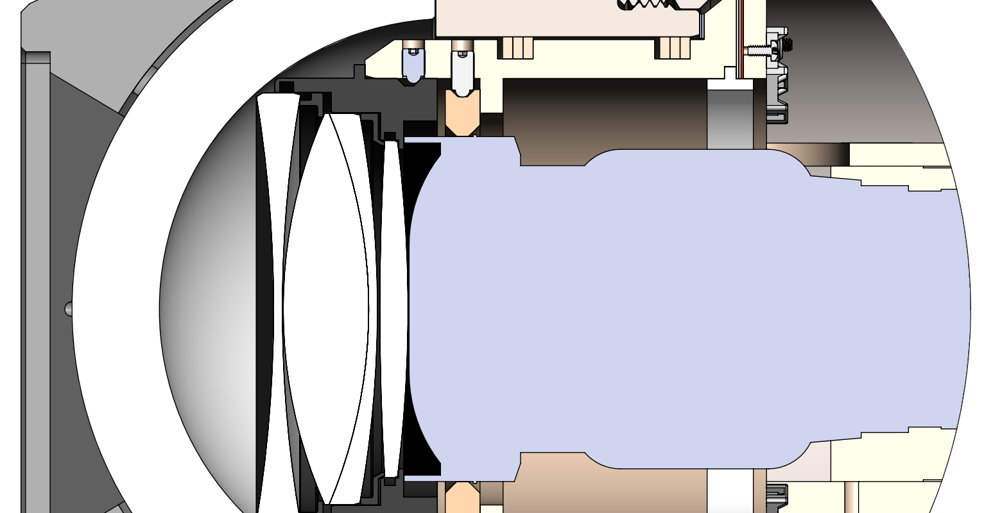
Adapter Lens cell to Canon Front Lens Tolerance
0.05MM FLARE GUARD CLEARANCE WITH 0.3MM AIR GAP
CANON LENS FRONT ELEMENT
ADAPTER CELL LENS 4th ELEMENT
Specification: 0.3MM – 0.1 + 0.3mm AIR GAP

Slide 15
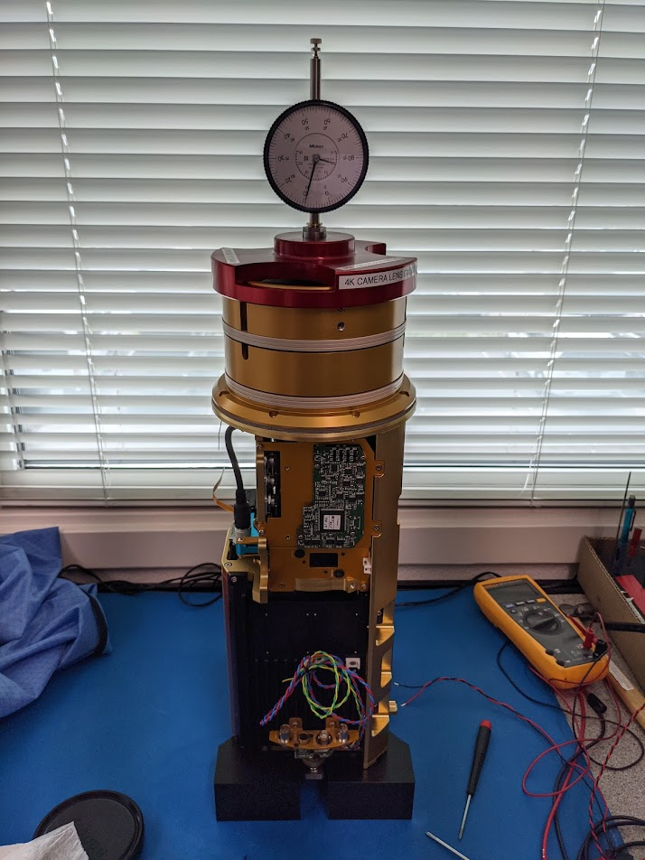
Step 2A: Set Axial Distance of Canon Lens with Gage and Shims
Step 2B:
Zero gage jig mounted dial indicator on granite block (with lens paper)
Step 2C: Dial gage will read offset from nominal spacing distance. Use lens paper for lens protection!
Exact spacing specification
Step 2D: Adjust axial spacing shims in 0.05 mm increments for 0.3mm Canon lens setback
Granite Block
Canon lens to adapter cell calibration fixture
Step 2E: Note final value in worksheet ChassisShimsCalibrationProcedure.xlsx and make a copy for records.

Slide 16
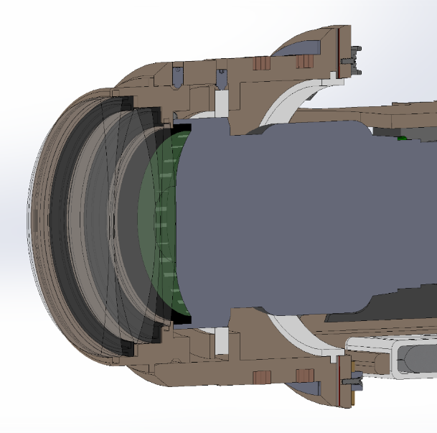
Step 3: Install optical adapter cell on chassis alignment cone
Canon lens centering screws (x3)
chassis alignment cone
Adapter Cell retaining screws (x3)
reference surface
optical adapter cell

Slide 17
Optical System Alignment – Laser method
This alignment procedure assumes that the optical elements within adapter cell have been separately verified to be assembled within optical alignment tolerances that define a system optical axis which is concentric with outside diameter of its aluminum shell. It is further assumed that the shell outside diameter, chassis alignment cone internal and PEEK alignment ring diameters, dome mounting internal diameters and dome centration are all within design tolerance.
Alignment Laser and target setup.
  Pointing laser beamed through a 1mm aperture in a diffuse target set 233.4 mm from vertex of front Canon lens element.
  Attenuation filter* that can be placed between the laser and the target.
  A Jig or clamp to securely hold the camera chassis assembly in position.
Step 1: Centering of laser beam on Adapter Cell optical axis.
  Make sure that the Canon lens aperture is COMPLETELY CLOSED or imager damage may occur!
  Point laser and diffuse target at the adapter cell and observe the reflected image from the elements of the adapter cell on the diffuse target.
  Adjust the position of the laser & target until these reflections are exactly centered on the laser 1mm aperture. Tip: this maybe easier if you temporarily place a mask behind the optical adapter cell to block reflections from the Canon lens.
  The laser beam is now aligned on the optical axis of the Adapter Cell.
Step 2: Align the Canon lens/Optical block assembly to the Adapter Cell optical axis.
  Place the attenuator in front of the laser beam and open the Canon lens aperture so that a visible laser spot appears on the video image.
  Set the Canon lens zoom to full wide at f 8 and adjust focus to obtain a clear image of the Laser spot aperture.
  Adjust front of Canon lens laterally (X-Y) with front adjustment screws to center the laser spot in the video image.
  Change Cannon lens setting to full zoom and note image shift of the laser spot from the center of the field.
  Adjust the tilt of the Canon lens/Optical block assembly with the rear screws to re-center the laser spot in the image field.
  Repeat steps 3-5 until the laser dot remains stationary and located at center of image while lens is adjusted from full wide and full zoom settings.
Step 3: Verify Dome Alignment on optical axis.
  After final chassis and housing assembly repeat step 1 above to center on reflections from dome and adapter cell optics. All reflections should line up with the laser beam aperture within 1.mm. (how far can they be off?)
  Repeat step 2 above and verify that when changing the Canon lens setting from full wide to full zoom the laser spot remains near the center of the image field within ± 19 microns.
Note on adjusting radial alignment screws. While adjusting the front and back of the optical system, keep the screws barely firm to allow the system to tilt as the opposite end is adjusted. It takes a fine feel to have the screws engaged in the adjustment but not so tight as to cause binding or warping. After all adjustments are complete, apply Loctite to screws one by one and tighten firmly and evenly. Re-check optical alignment when done.
* Attenuator filter must allow a safe power level be projected toward the imager when the Canon lens aperture is open.
Notes:
At full zoom, dome decenter of 0.30 mm yields object deviation from center = 19 microns.
At full zoom, dome tilt of 0.15 degrees yields object deviation from center of image = 18 microns.
At full wide, dome decenter of 0.30 mm or dome tilt of 0.15 degrees produces ~ 1 micron of object deviation from center of image.

Slide 18
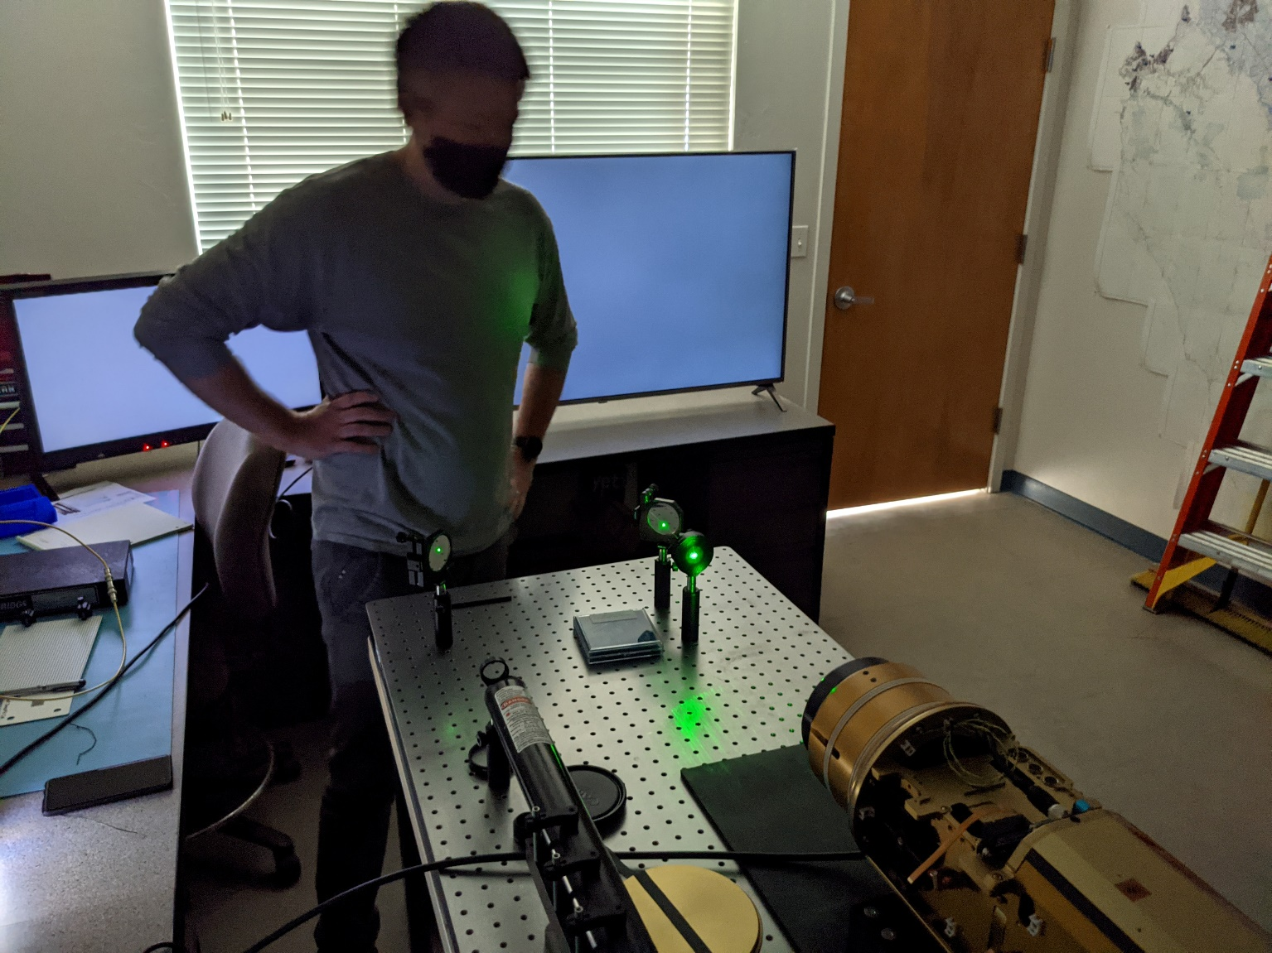
Laser Alignment Setup
Mirror
Mirror
Target
Attenuator

Slide 19
Step 4: Center alignment laser on Optical Adapter cell by centering reflections from glass surfaces on target.*
* With Canon lens aperture closed!
Attenuator
1mm aperture in white target
Centering made easier by temporarily adding a mask behind the optical adapter cell to eliminate reflections from the Canon lens
1mW Laser
(633nm HeNe)
~232 mm
Front lens element vertex of Canon lens

Slide 20
Step 5: Center alignment laser on video image using front lens X-Y adjustment.*
* With attenuator in place!
Attenuator
1mm aperture in white target
1mW Laser
(633nm HeNe)
3 fine pitch radial adjustment screws
With Canon lens in full wide position, adjust lens to exactly center laser spot on image (set center cross target on monitor menu)

Slide 21
Step 6: Tilt alignment laser on video image using rear lens X-Y adjustment.*
1mm aperture in white target
* With attenuator in place!
Attenuator
1mW Laser
(633nm HeNe)
3 fine pitch radial adjustment screws
With Canon lens changing from full wide to full zoom position, adjust rear of lens to minimize lateral movement of the laser spot on image
Continue to adjust lens X-Y position and tilt settings until image is centered in lens wide position and center target remains exactly in position during lens zooming.

Slide 22
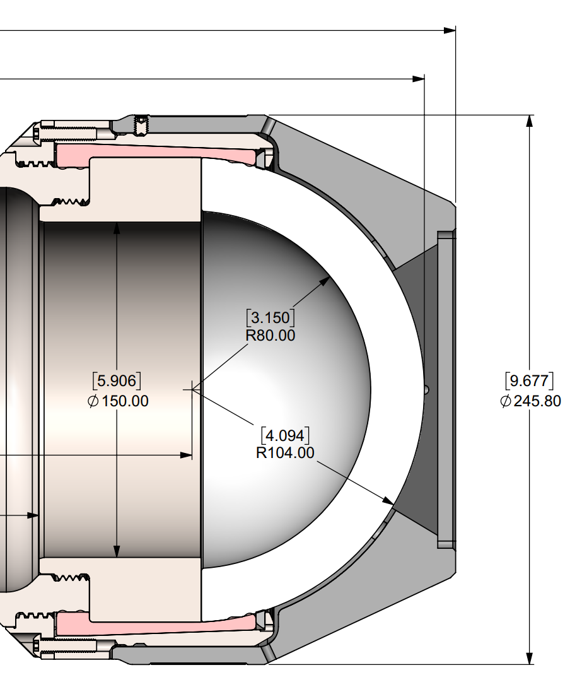
Step 7: Confirm Housing Reference Surface to Dome Distance
DeepSea will measure and provide dimension from chassis reference surface to apex of dome concave surface in final housing checkout documentation.
Enter provided value in the ChassisShimsCalibrationProcedure.xlsx
Nominal dimension: 148.44mm

Slide 23
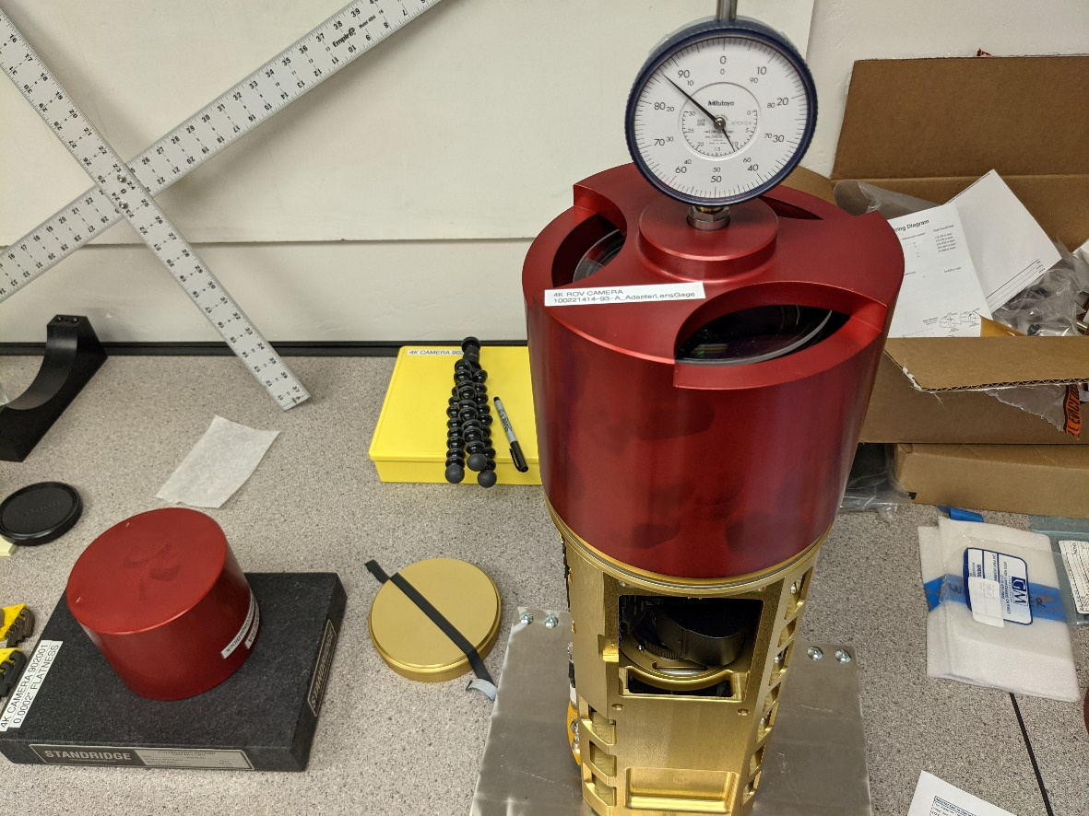
Step 8: Measure Exact Adapter Cell to Dome Port Spacing
Note use of glass disk on 1st optical adapter element. This disk is also used on top of adapter gage block when zeroing dial indicator
Measuring offset of adapter cell to dome port spacing from nominal (see ChassisShimsCalibrationProcedure.xlsx)
100221414-94-A_AdapterGageBlock

Slide 24
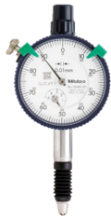
Step 9: Install shims to set adapter cell to dome port spacing
40 lbs. force
Dome to adapter cell calibration plug
Adjust axial dome to adapter spacing shims in 0.05 mm increments for nominal specification + specified bias (see slide # 59 and ChassisShimsCalibrationProcedure.xlsx for bias)

Slide 25
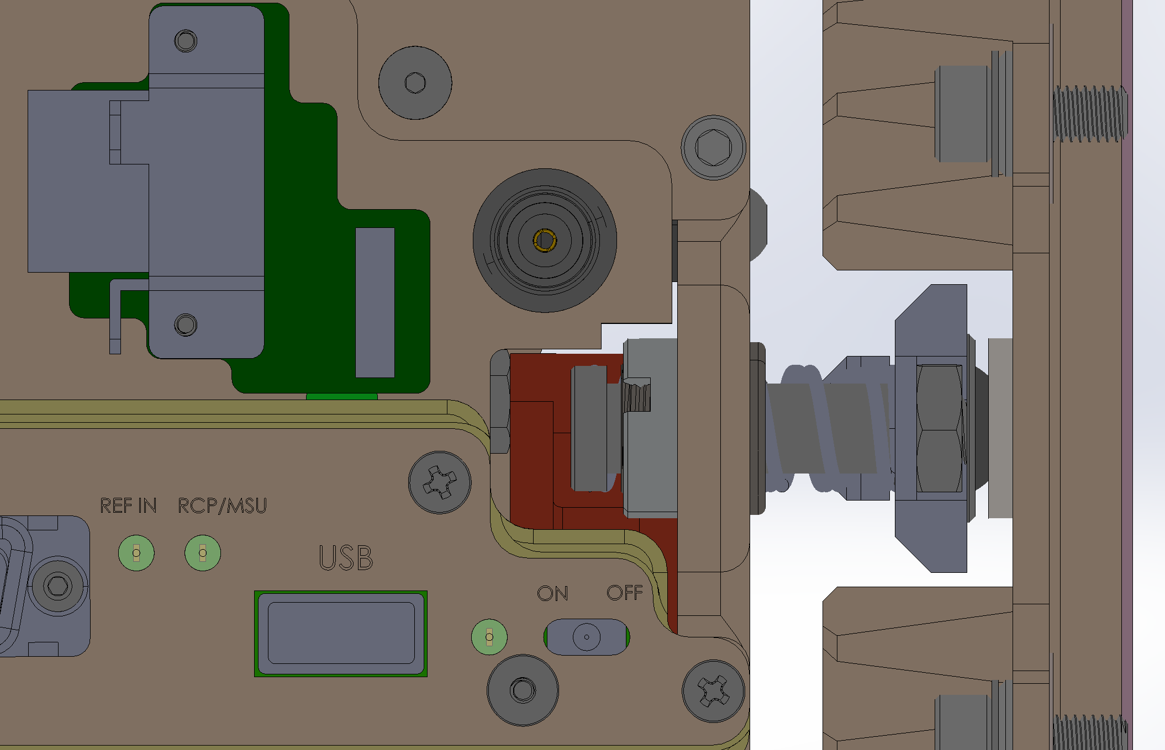
Step 10: Set Rear Clamp Spacing Washer Thickness Based on Total Shim Stack Height.
0.150” Spring Compression limit*
Heatsink/bulkhead fixed to housing end cap
0.050” Spring Extension limit
Select appropriate spacing washer depending on final adapter to Canon spacing and adapter to dome port shim stack up. 0.130 to 0.250” spacers allows static adjustment for adjusting for different shim configurations.
See ChassisShimsCalibrationProcedure.xlsx
Chassis fore/aft active compliance
*set by maximum recommended spring compression
Shoulder screw/guide determines maximum spring extension (shown in nominal or room temperature assembly position)
Compression springs
MRC Dec. 1, 2020

Slide 26
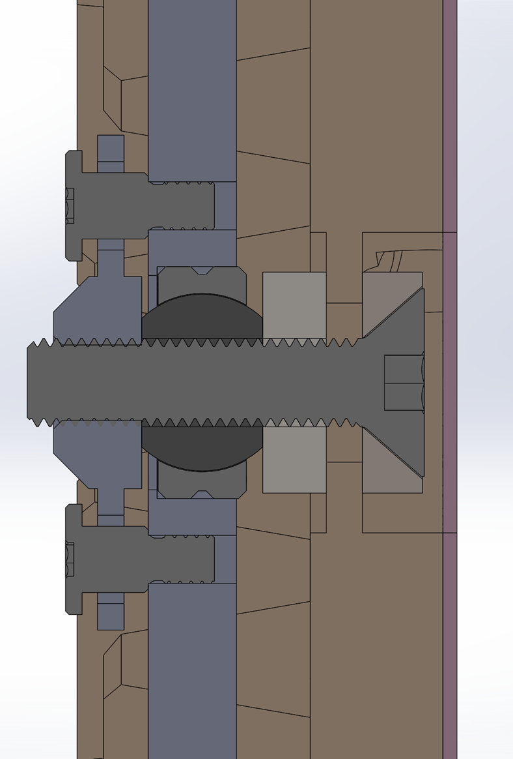
Step 10: Set Rear Clamp Spacing Washer Thickness Based on Total Shim Stack Height.
Select appropriate spacing washer depending on final adapter to Canon spacing and adapter to dome port shim stack up. 0.130 to 0.250” spacers allows static adjustment for adjusting for different shim configurations.
See ChassisShimsCalibrationProcedure.xlsx
Compression springs
MRC Dec. 1, 2020

Slide 27
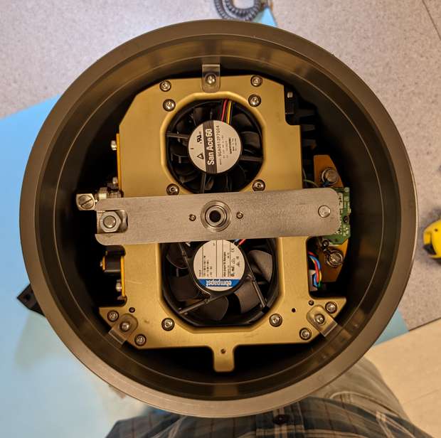
Step 11: Install and Mechanically Center Camera Chassis in Housing and Tighten Radial Alignment Tabs..
Adjust and tighten radial alignment tabs
Radial alignment tabs hold the camera chassis in centering alignment during the initial closure of the housing endcap.

Slide 28
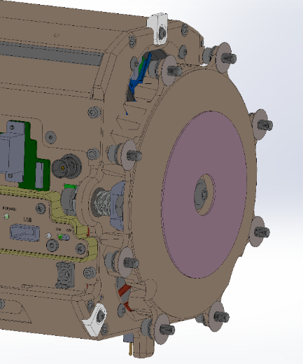
Step 12: Install Camera Housing Endcap and Tighten Center Support Fastener.
Access to allow tightening the chassis center support fastener is through the endcap center vent port
After chassis center support fastener is tightened, chassis alignment is firmly locked and chassis and housing bulkhead can be removed and re-installed without requiring re-alignment, but mark and keep the same radial alignment of the chassis to the housing.

Slide 29
Step 13: Optical Verification Testing of Complete Assembly.
Re-locate the optical axis by repeating step #3 with the fully assembled housing. Retro-reflections from dome and adapter optics centered within < 1mm at aperture.
Attenuator
1mm aperture in white target
1mW Laser
(633nm HeNe)

Slide 30
Step 14: Verify Complete Assembly Decenter and Tilt Alignment
Attenuator
1mm aperture in white target
1mW Laser
(633nm HeNe)
Laser spot should be in the center of the video image
Maximum spot movement through zoom range should be ≤ ± 19 microns
Notes:
At full zoom, dome decenter of 0.30 mm yields object deviation from center = 19 microns.
At full zoom, dome tilt of 0.15 degrees yields object deviation from center of image = 18 microns.
At full wide, dome decenter of 0.30 mm or dome tilt of 0.15 degrees produces ~ 1 micron of object deviation from center of image.

Slide 31
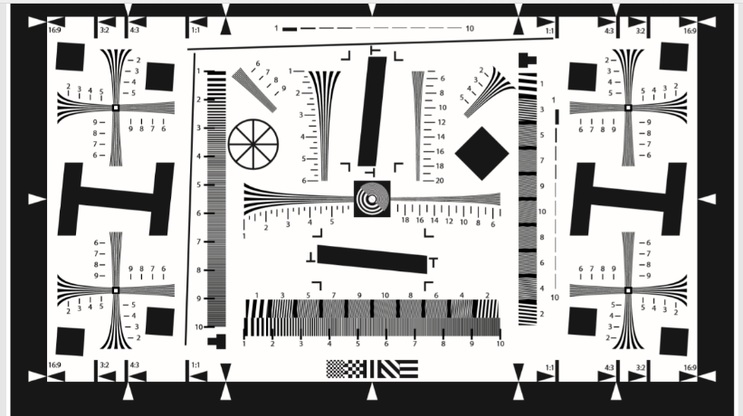
Step 15: In-Water Optical Verification Test of Complete Assembly.
Qualitatively compare in-water test target with in-air reference image for consistent resolution and lateral color, especially at image edges.

Slide 32
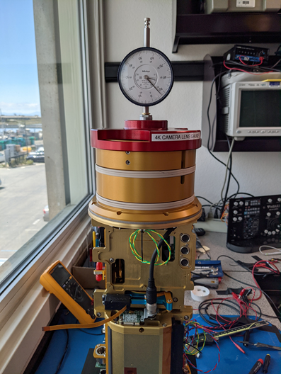
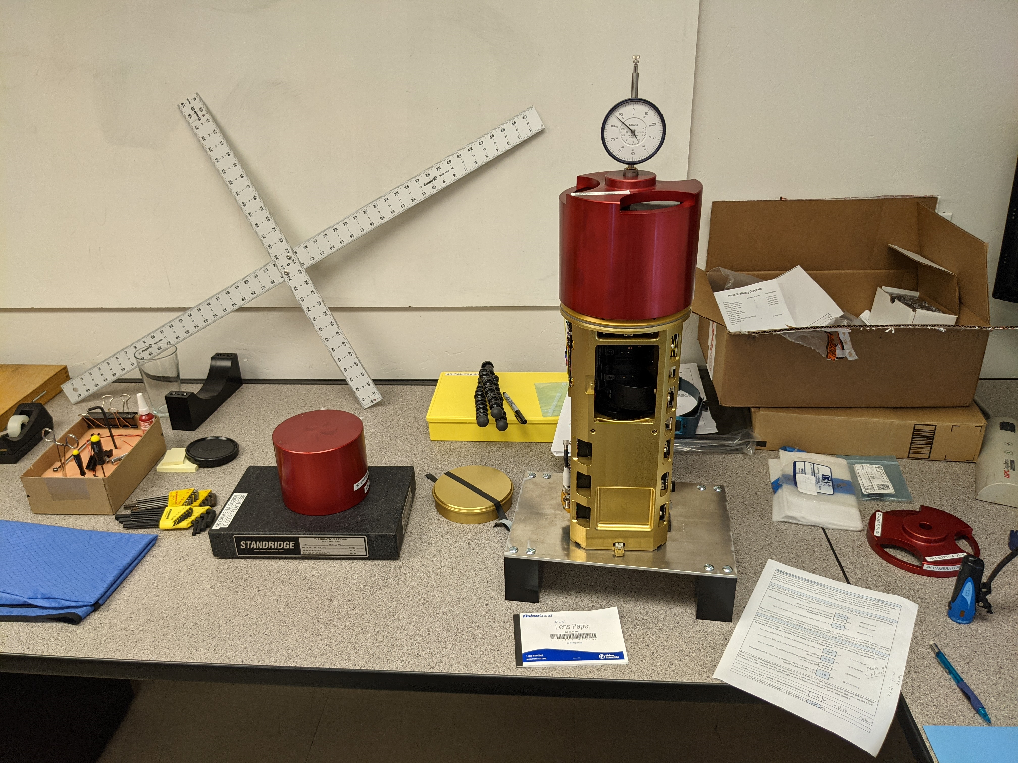

Slide 33
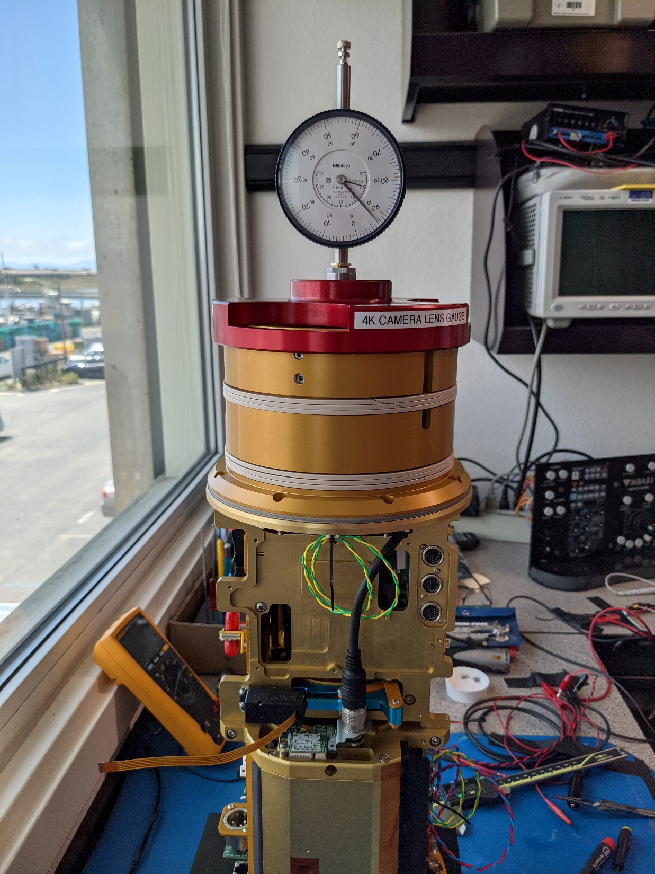

Slide 34



Slide 35
