Slide 1
Camera PCB Layout Guide

Slide 2
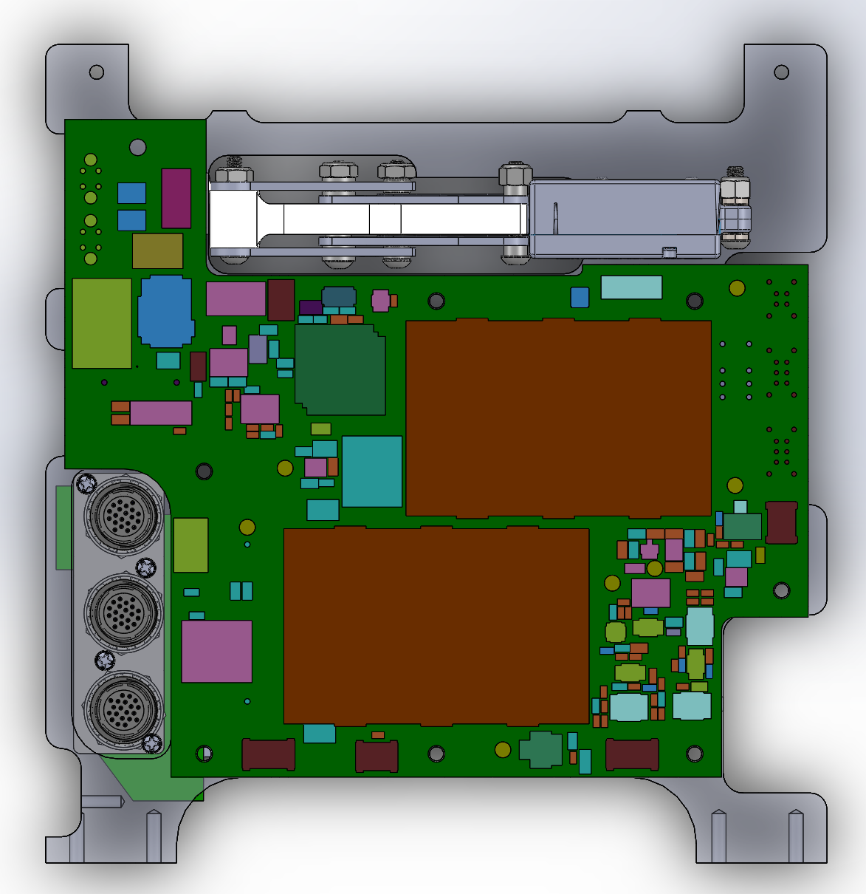
PCB TOPSIDE

Slide 3
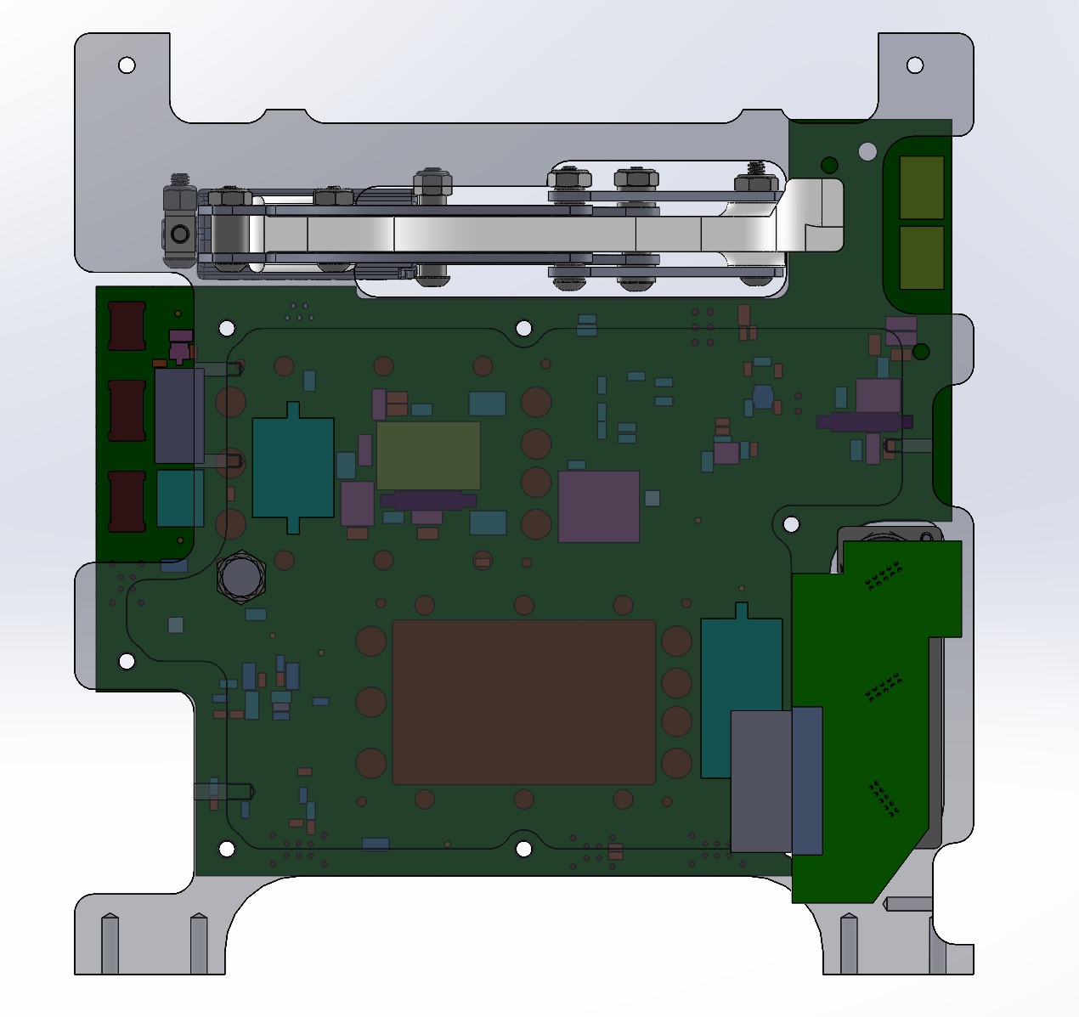
PCP BOTTOMSIDE

Slide 4
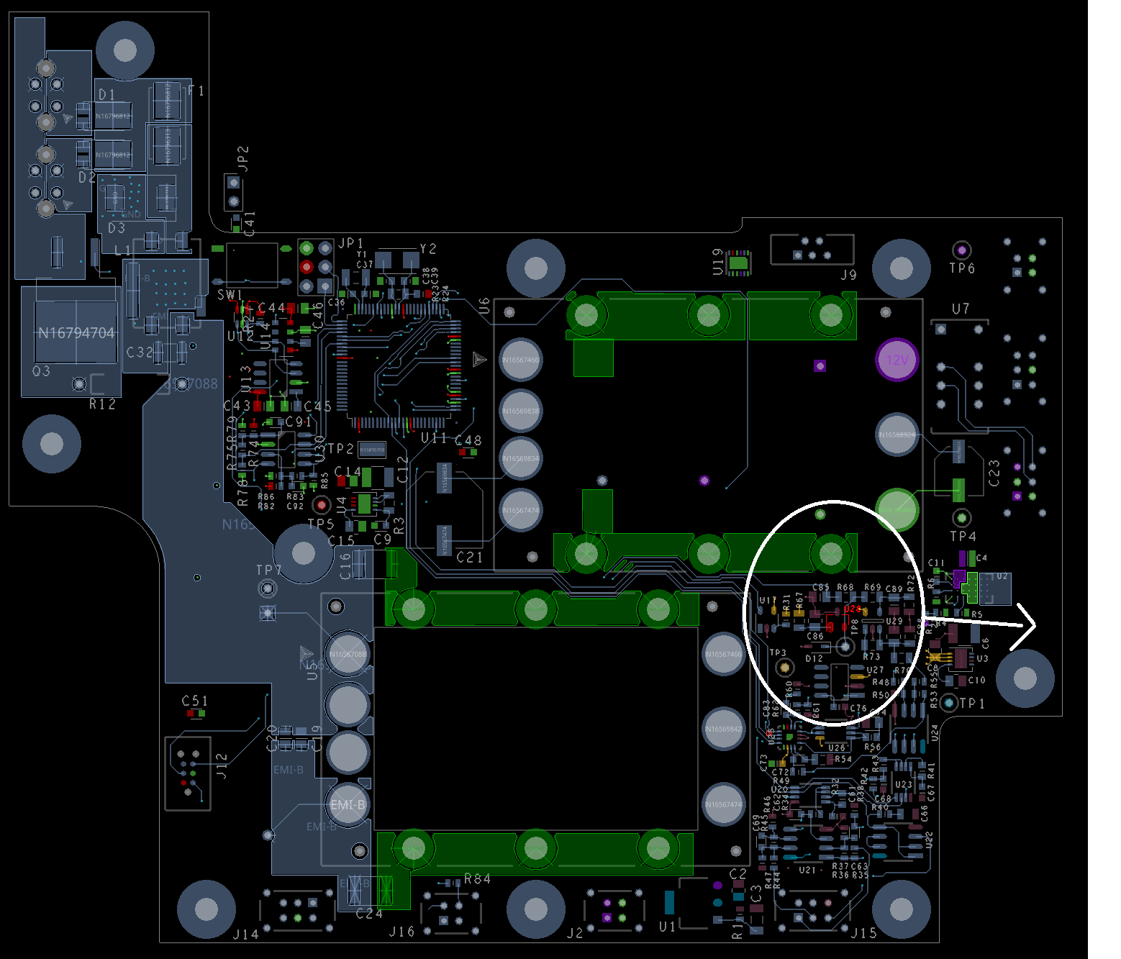
TIE THE VICOR FRAME GND TO THIS MOUNT HOLE/PADSTACK?
THERMAL RELIEFS
MOVE U28 TO HERE AND PROVIDE THERMAL RELIEFS BETWEEN PCB AND SUPPORT HOLE. STILL NEED MECHANICAL SUPPORT. WANT TEMP MEASURED TO BE CLOSE TO CHASSIS/SUPPORT TEMP. AND NOT PCB TEMP.
MOVE J12 A LITTLE INBOARD (0.10”?)
TIE THE VICOR FRAME GND TO THIS MOUNT HOLE/PADSTACK?

Slide 5
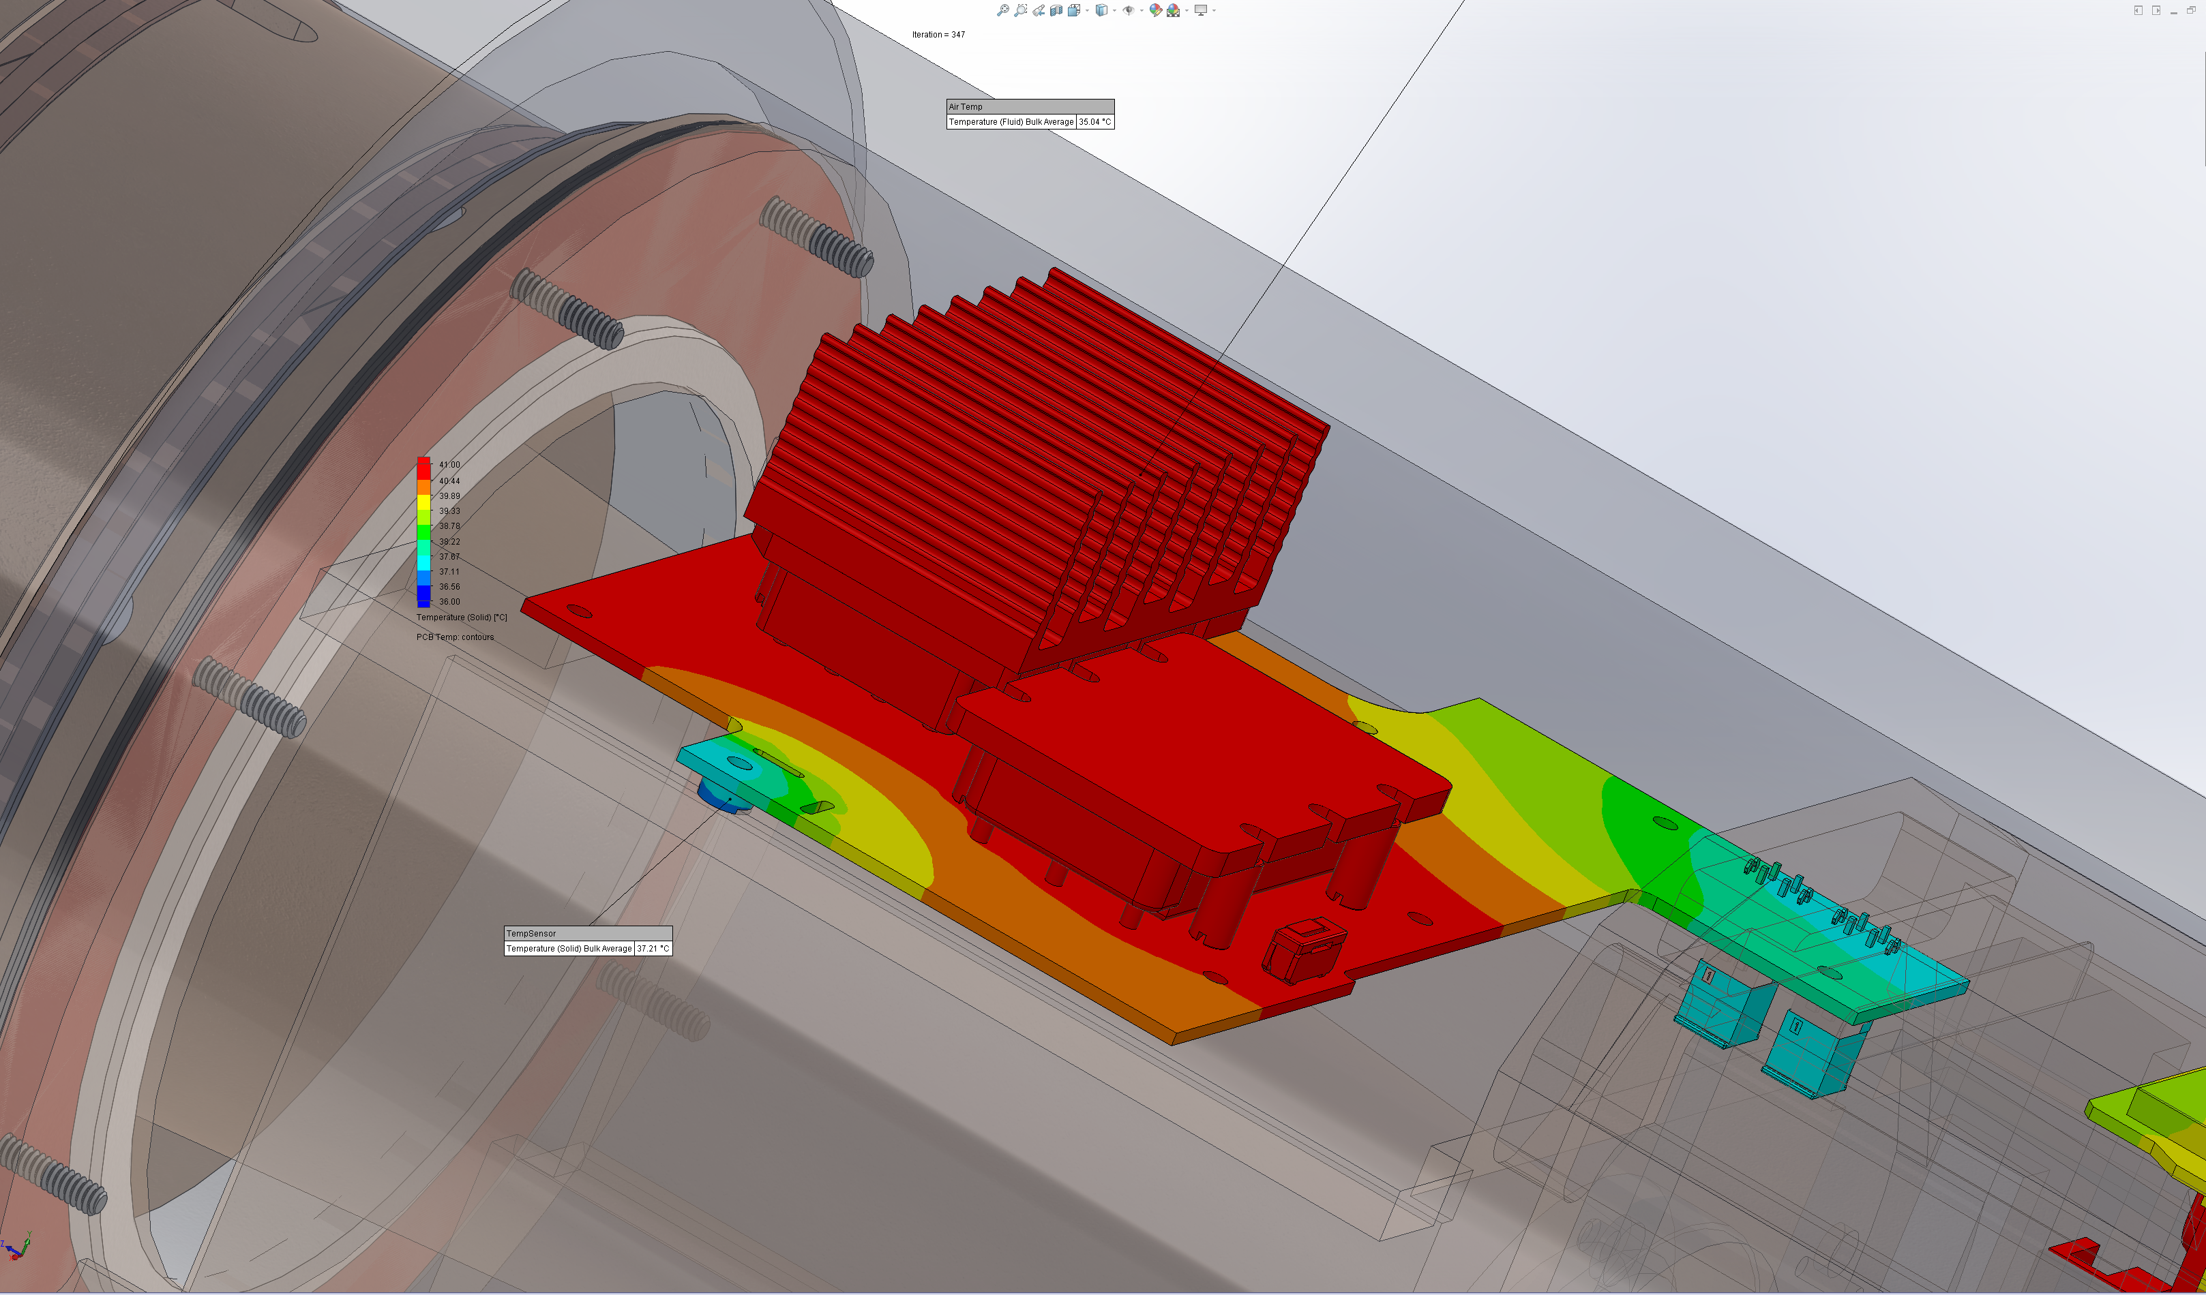
Simulation shows temp sensor ~4 deg. cooler with post and thermal reliefs in PCB

