Slide 1
MBARI 4K Camera Assembly Guide
Mark Chaffey
June 2021

Slide 2
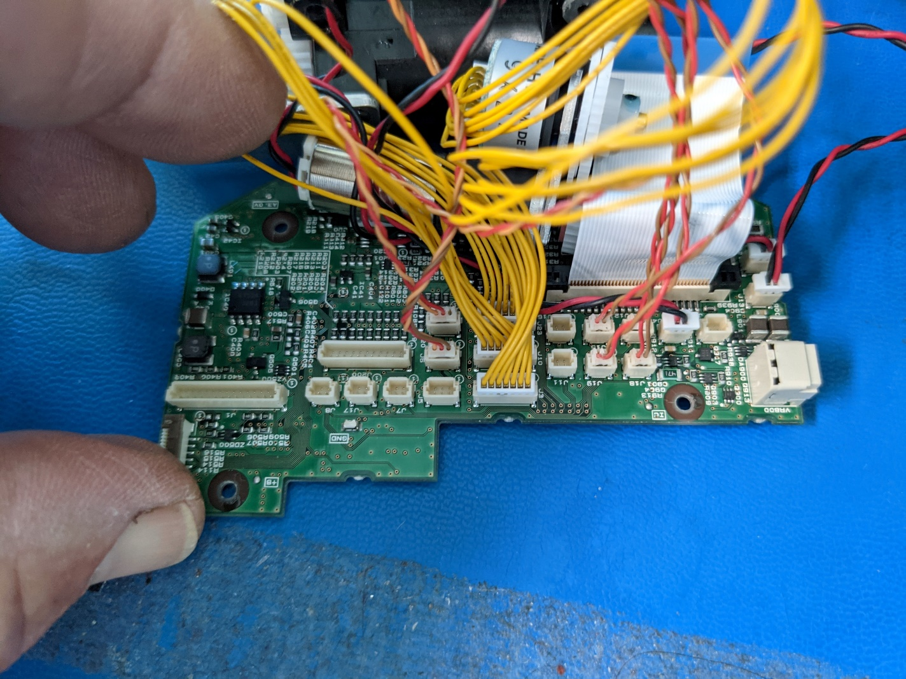

Slide 3
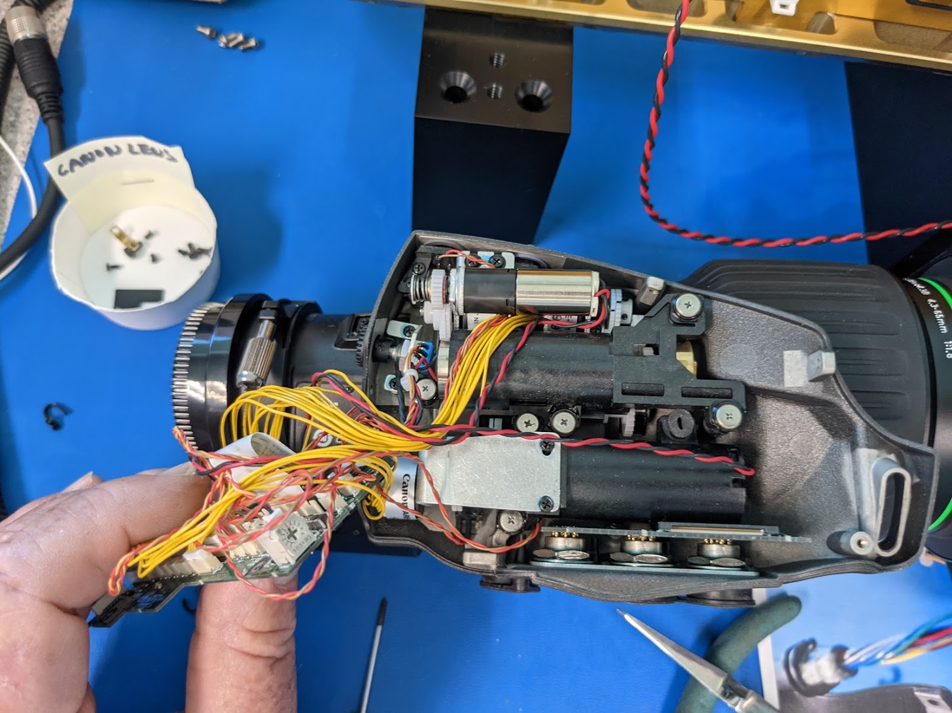
Missing shoulder screw?

Slide 4
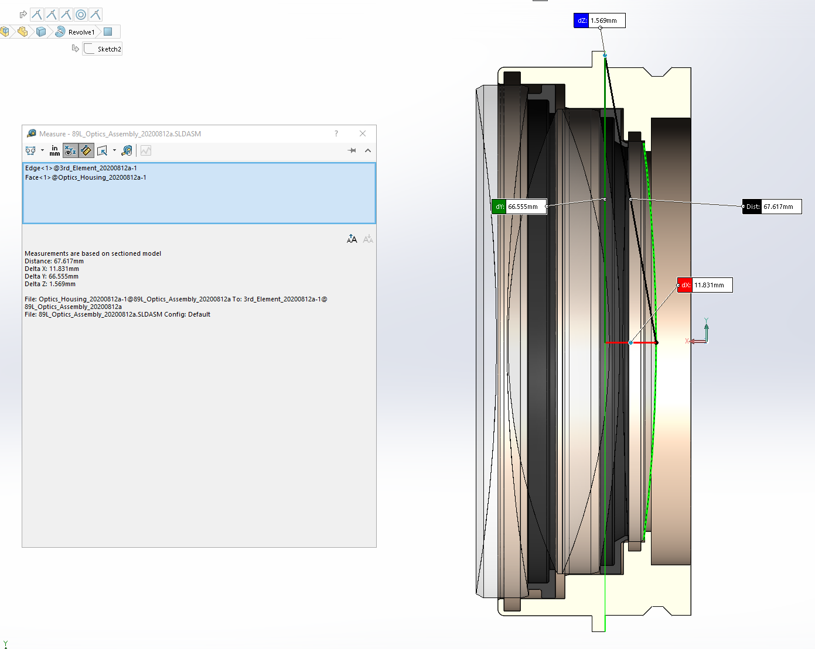

Slide 5
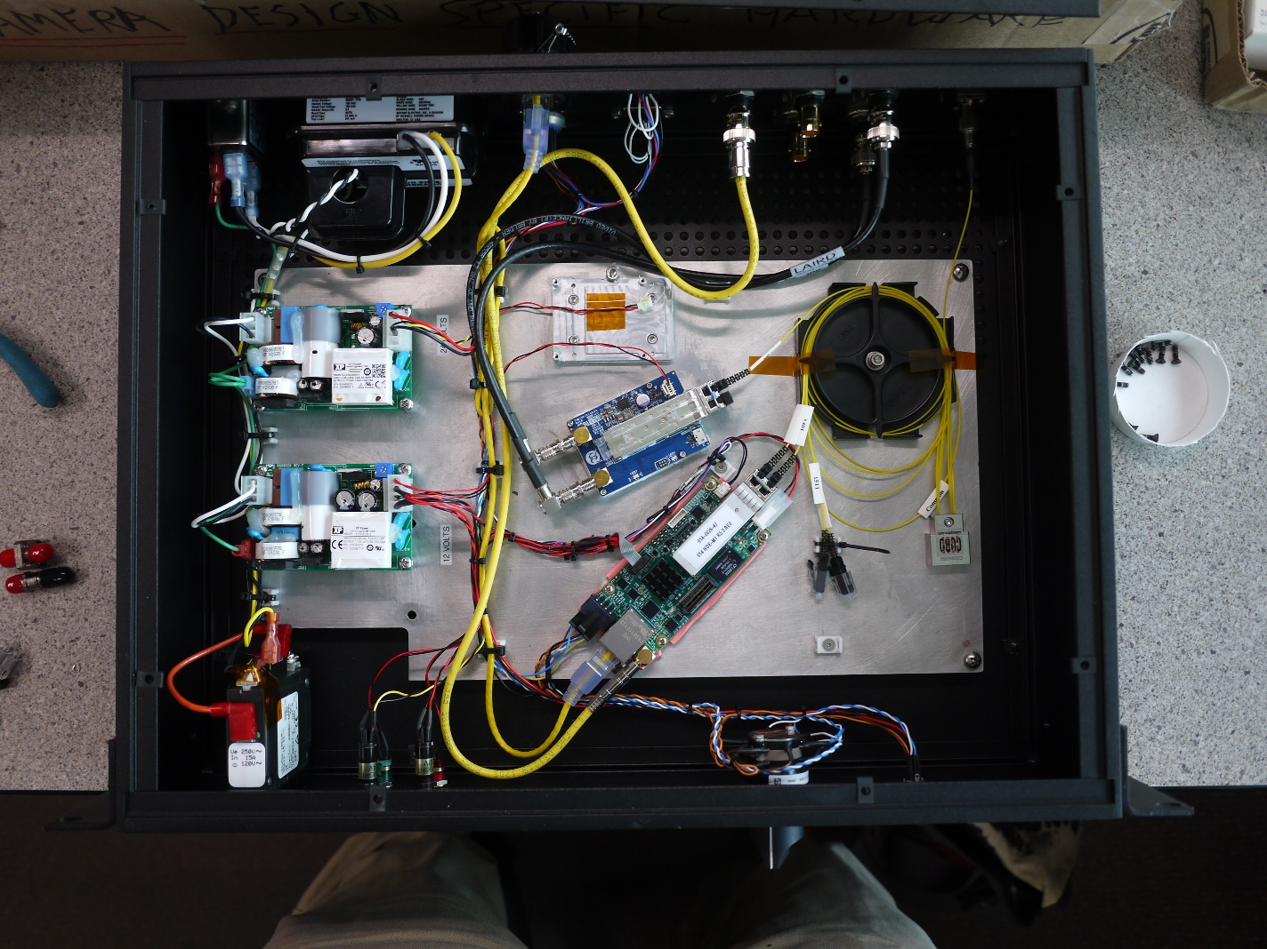
Rack box wiring and optics

Slide 6
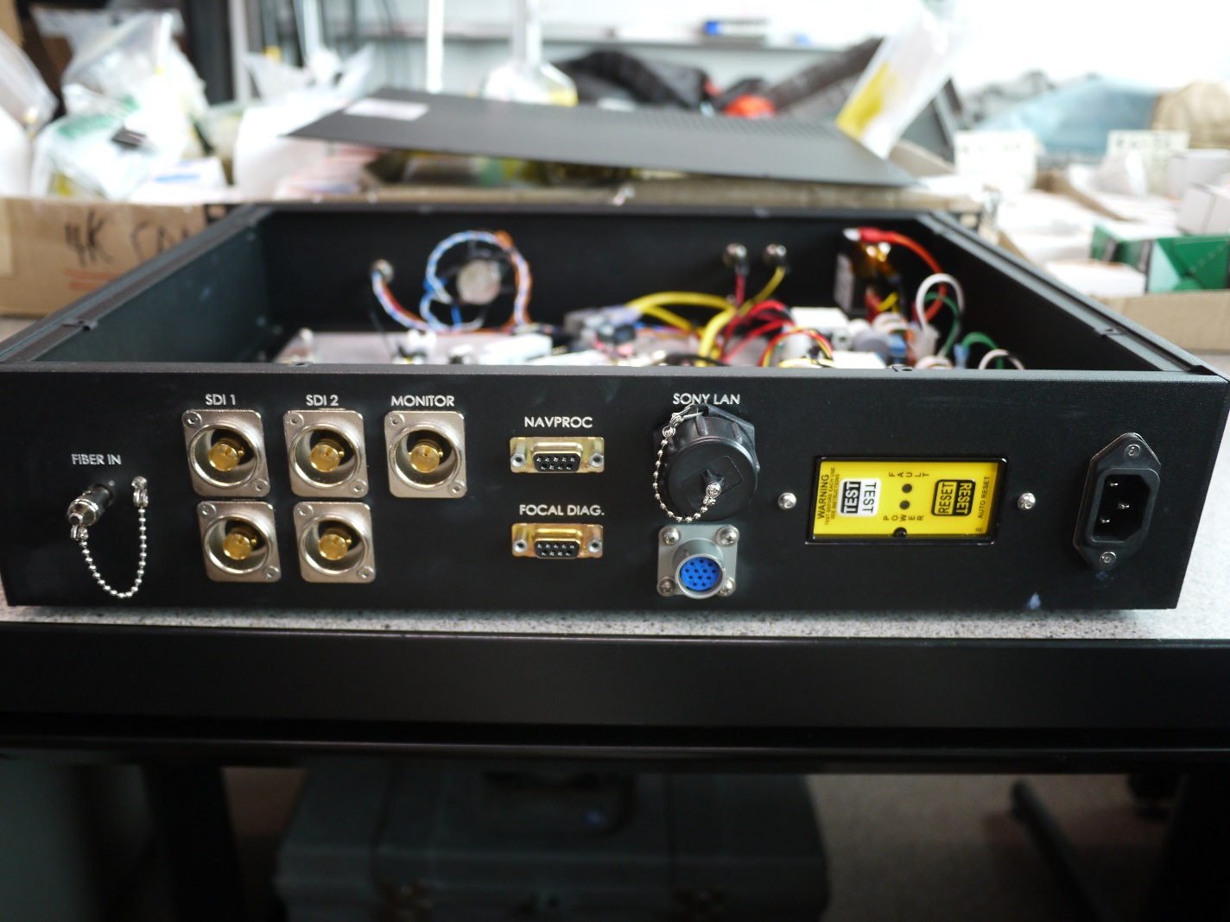
Rack box rear panel

Slide 7
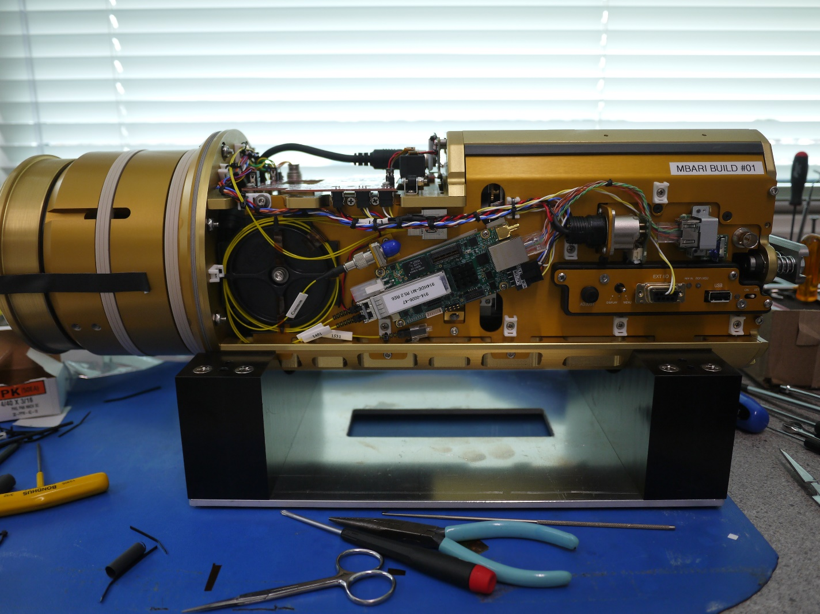
Left side wiring and optics

Slide 8
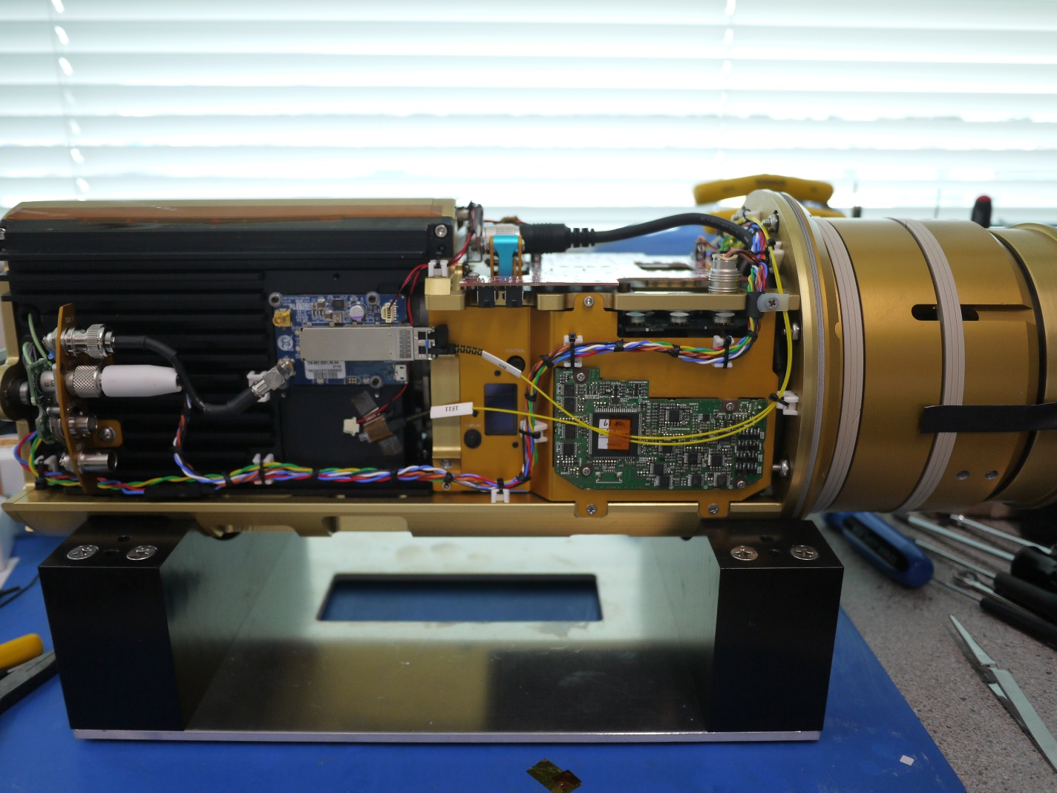
Right side wiring and optics

Slide 9
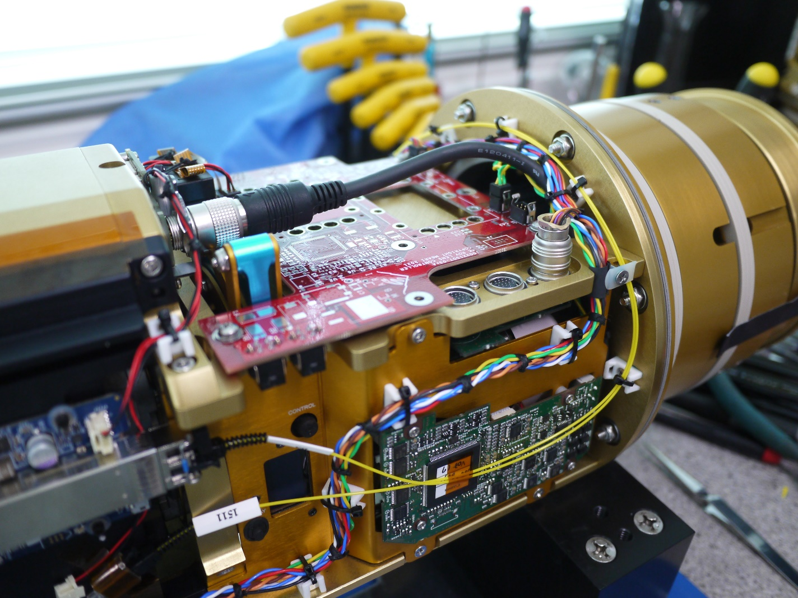
Right side detail

Slide 10
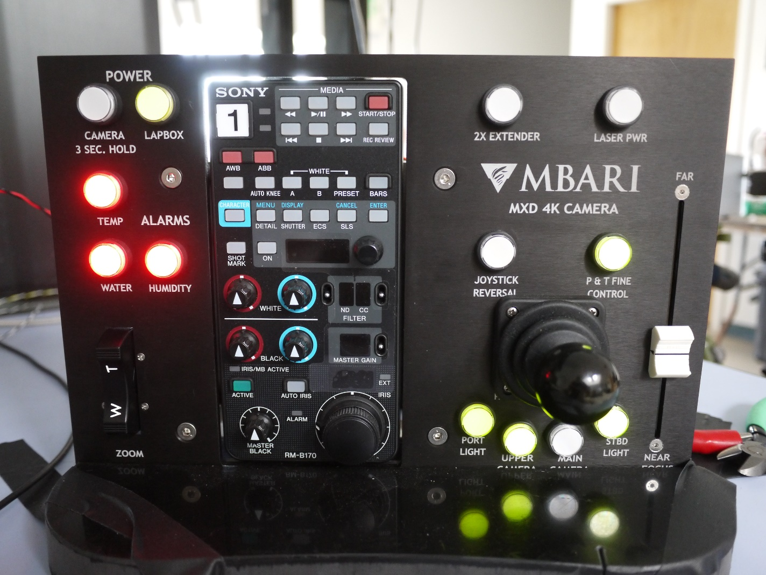
Prototype panel

Slide 11
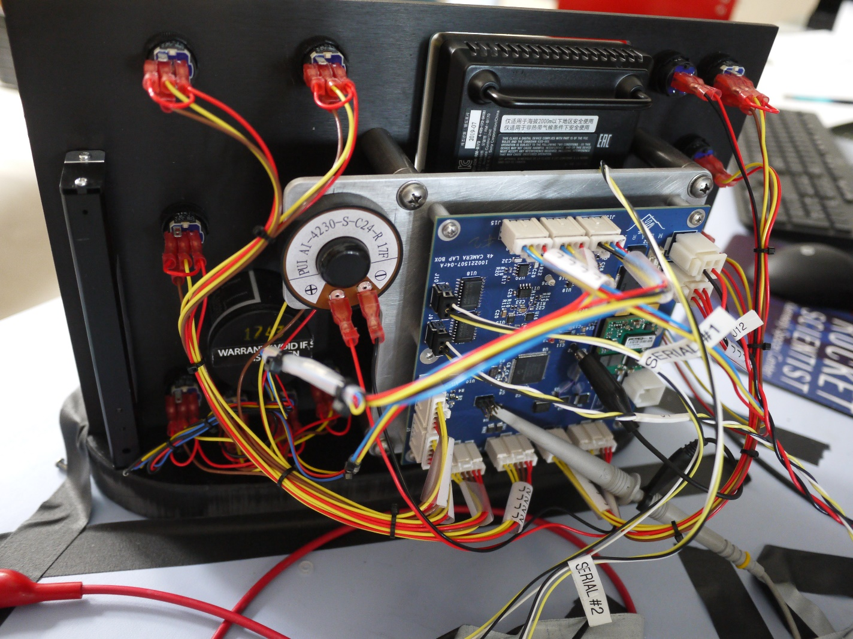

Slide 12
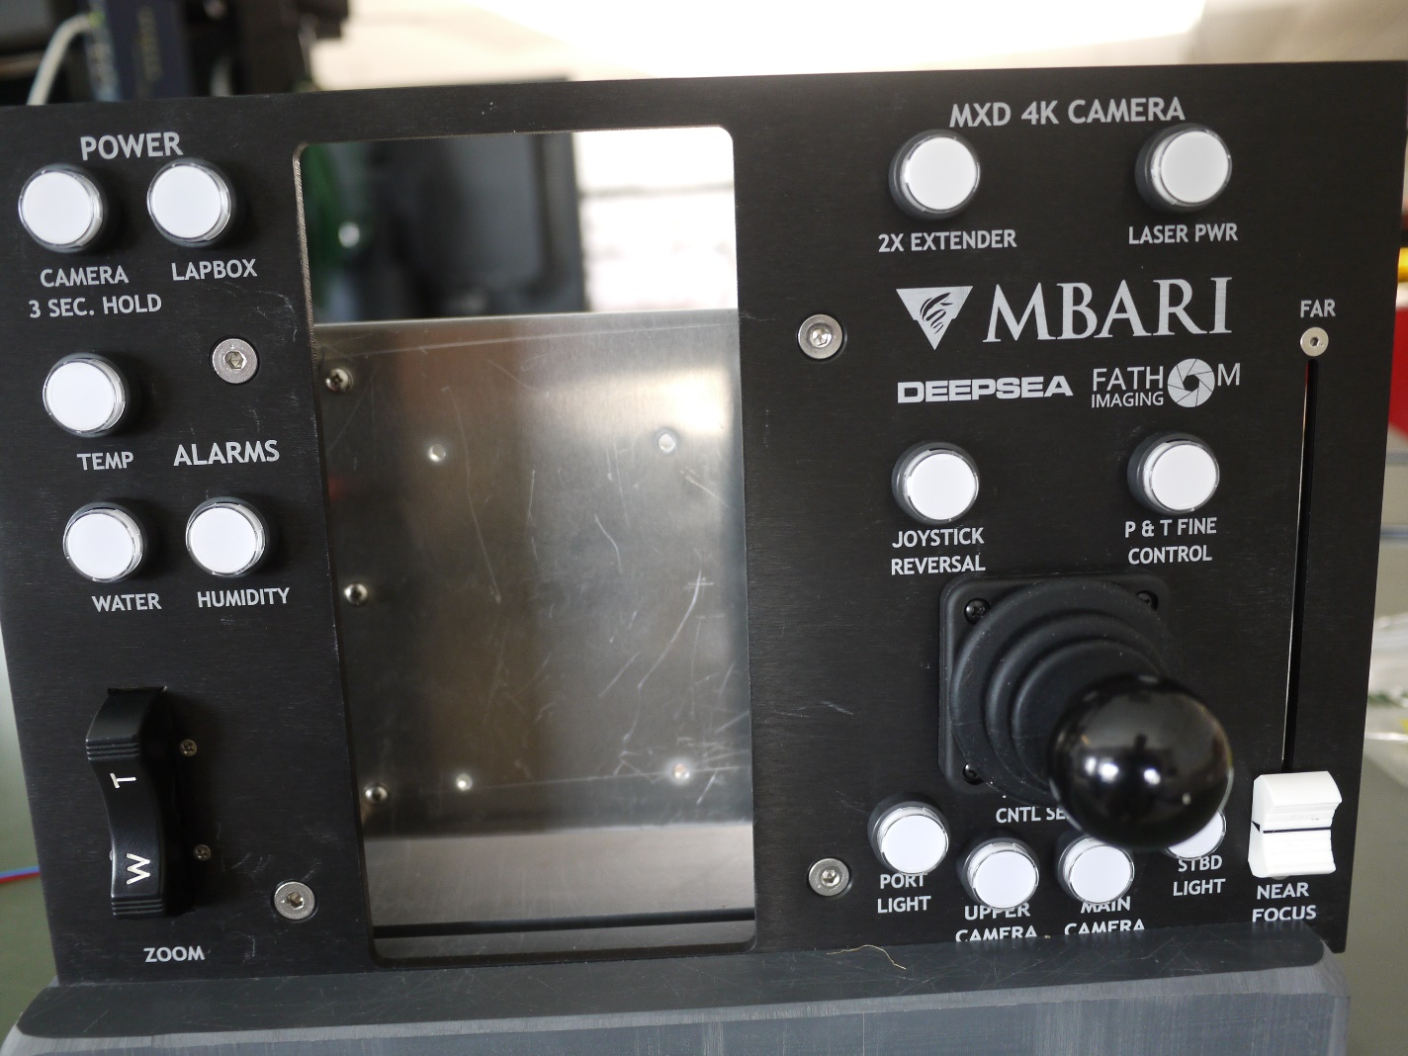
Final panel

Slide 13
