Slide 1
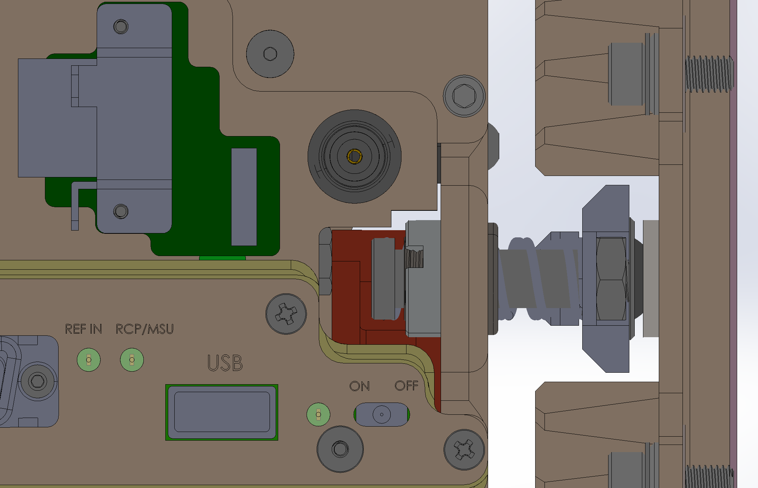
Chassis Fore-Aft Compliance Design Values
Heatsink/bulkhead fixed to housing end cap
0.150” Spring Compression limit*
The worst case for spring compression is a short cold housing (0°C) and long hot chassis (45°C) combined with the manufacturing tolerance stack and the maximum hydrostatic pressure. The manufacturing tolerance stack includes of the housing and chassis parts. is calculated as a +/- three sigma distribution in 8 parts, each with a ±0.005 inch tolerance specification. The worst case maximum summed spring compression is 0.0795 inches and the design travel is 0.150 inches providing an 89% design margin. The major contributor is hydrostatic compression of the housing.
The highly unlikely worst case for spring extension is a long hot housing (40°C) and a cold short chassis (0°C) combined with the manufacturing tolerance stack. Hydrostatic pressure is not a worse case condition because it reduces spring extension. The worst case maximum calculated spring extension is 0.0248 inches and the design travel is 0.050 inches providing a 101% design margin.
The spring force is generated with 2 separate pairs of slightly different springs pushing the camera chassis against the front housing reference surface. The combined force generated is 57 lbs. in the nominal position, 77 lbs. force at full design compression of 0.150 inches and 50 lbs. force at full extension of 0.050 inches.
Static spacer allows adjusting for + 0.100 and – any chassis/Canon lens length.
The resonant frequency of the chassis – spring combination is 0.31 Hz or a ~3 second period, well below typical ROV vibration frequencies.
Note that the screw head in the illustration is not an interference with the heat sink. The full available travel is over 0.150” of compression.
0.050” Spring Extension limit
Chassis fore/aft active compliance
*set by maximum recommended spring compression
Shoulder screw/guide determines maximum spring extension (shown in nominal or room temperature assembly position)
0.100” spacer allows static adjustment for Canon lens / housing length (+0.100, - any length)
Compression springs
MRC Dec. 1, 2020

Slide 2
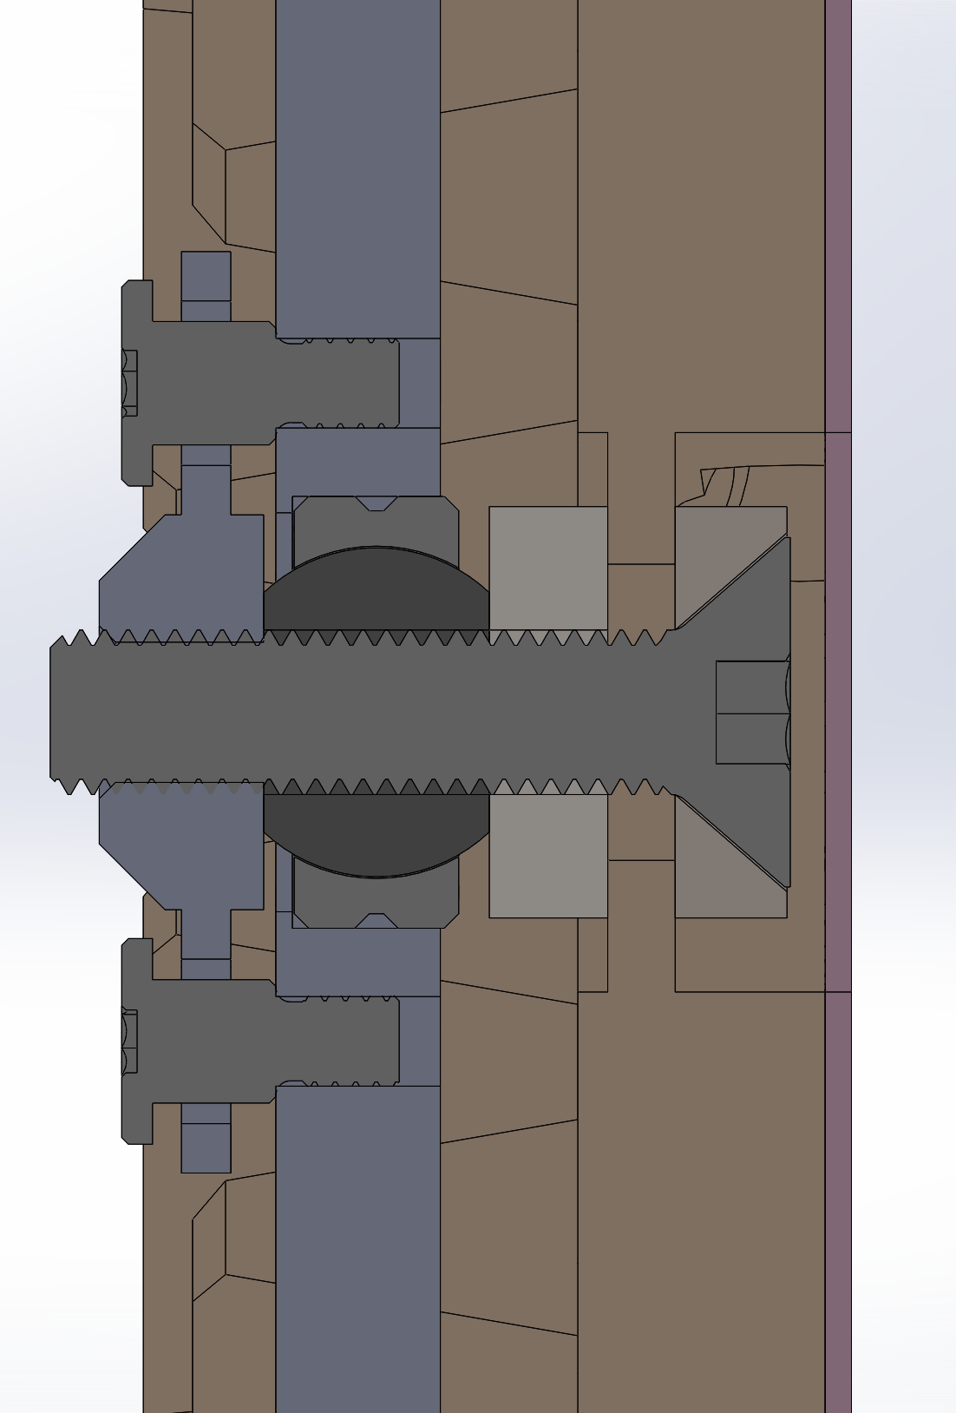
Chassis Rear Clamp Design Values
Bulkhead mount (35KPSI 6061-T6 Al)
Spherical bearing contact (65 KPSI steel)
Clamp nut (60 KPSI steel)
Friction force 1248 lbs.
Clamp washers (120 KPSI steel)
Rear Clamp Cross-Section

Slide 3
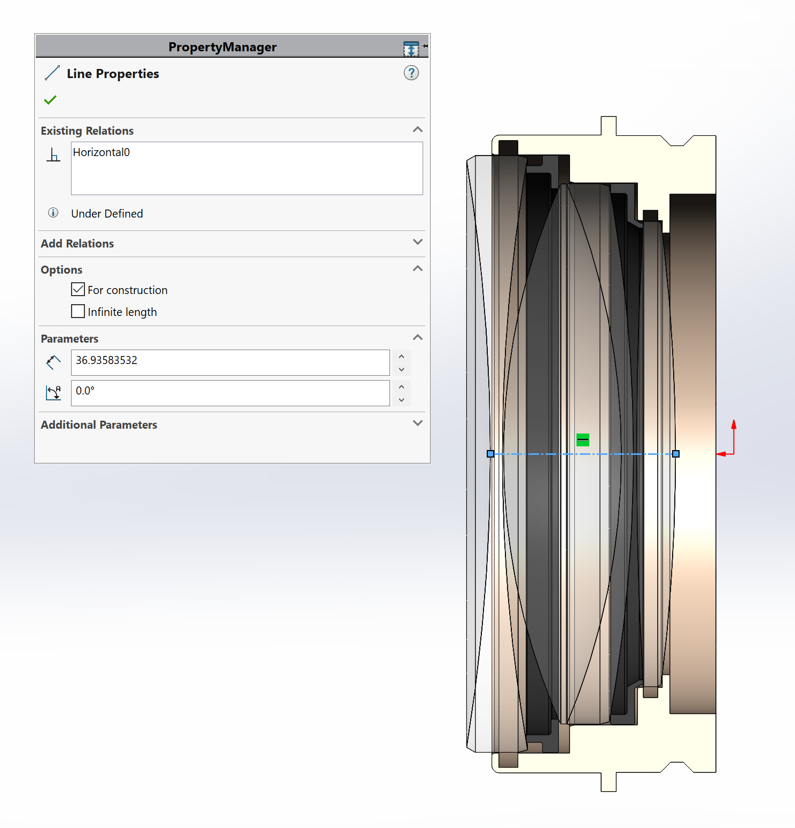
36.94mm. Am I measuring the correct place for the stack height?
Solid Model = 89L_Optics_Assembly_20200812a

