Slide 1
Thermal Analysis Design Data

Slide 2
Simulation Conditions
Internal analysis
Water temp: 25° C
Hc = 79.60 W/m2/°C (0.25 cm/sec. longitudinal flow)
Heat load 67.6W (design expectation 62W)

Slide 3
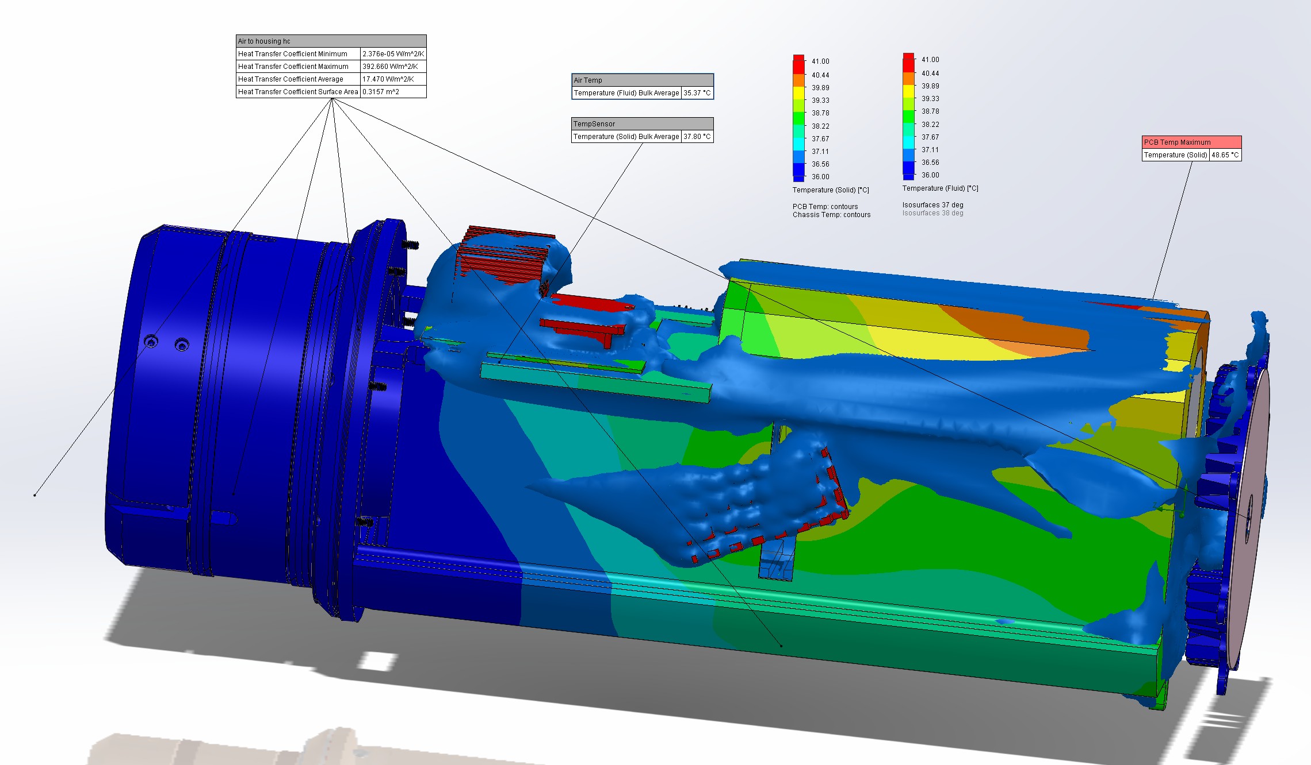
Illustration shows steady state isosurface of 37° C air temperature. Sensor temperature is 0.8 ° C higher. ∆ T sensor reading to water is 12.8° C. ∆ T air avg. to water is 10.37° C. Note that rear of housing is warmer and there is some air re-circulation so temperature sensor is set for 46 ° C cutoff – lower than the avg. max. air temp. but closer to the max air into Sony temp. (45 ° C )

Slide 4
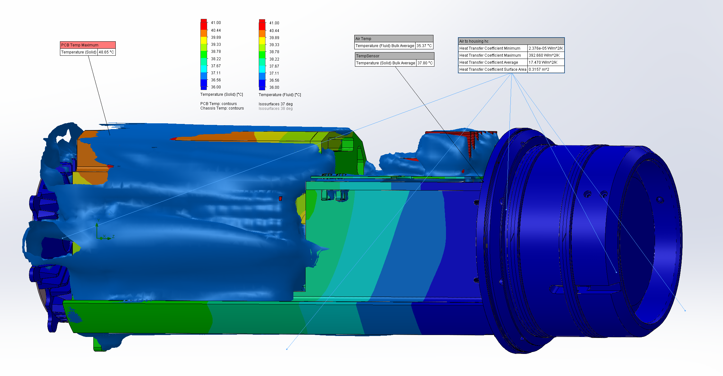
Same conditions opposite side of the housing showing 37° C air being pulled into vents in front of DSP&L media converters.

