Slide 1
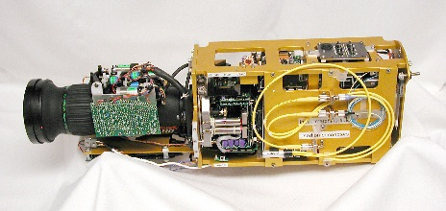
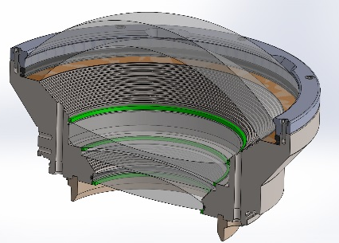
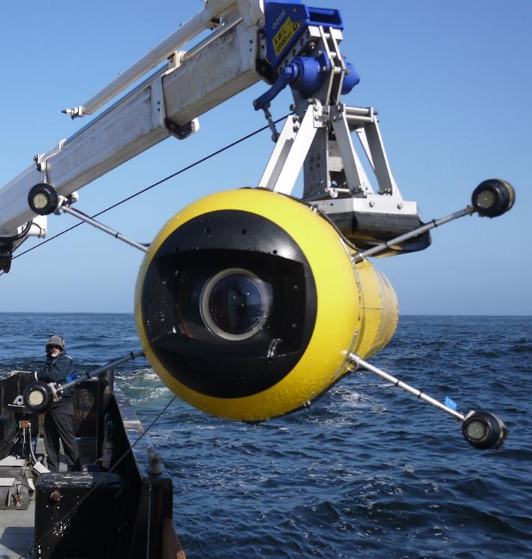
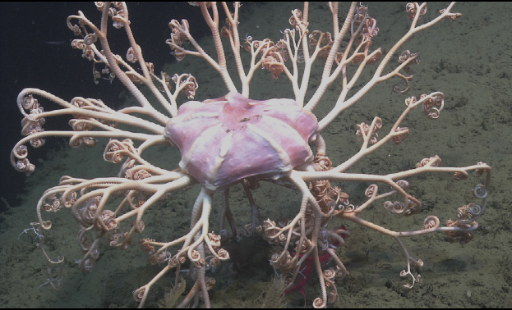
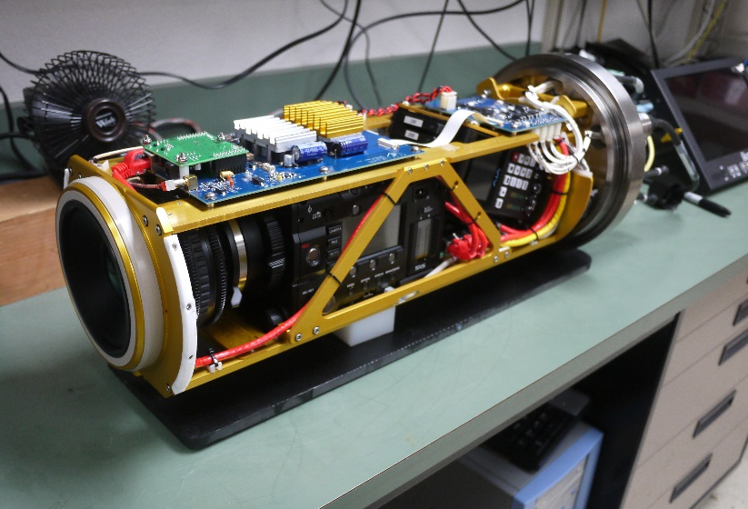
MBARI Video Camera Work
MBARI’s first ROV camera project – a DXC3000 in 1987!
First full HDTV ROV camera system.
First high quality large format AUV camera system.

Slide 2
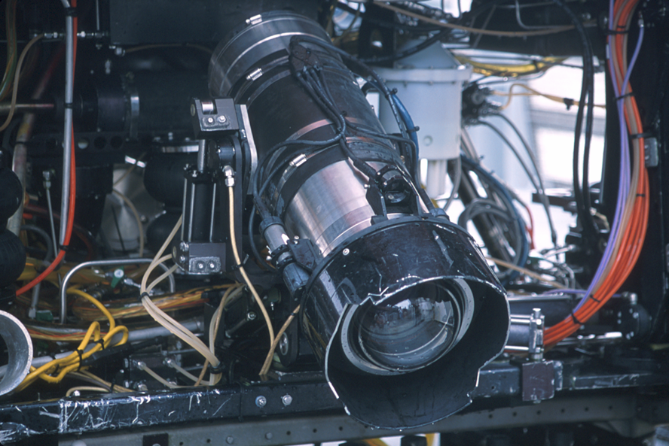

4000 Meter ROV Camera
Sony HDC-750 camera and Fujinon HA10X5.2 wide angle zoom lens. MBARI camera and lens servo controls. Optical design by Milt Laikin, housing by Insite.

Slide 3
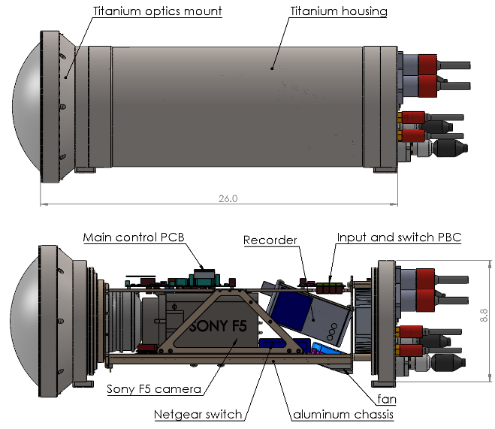

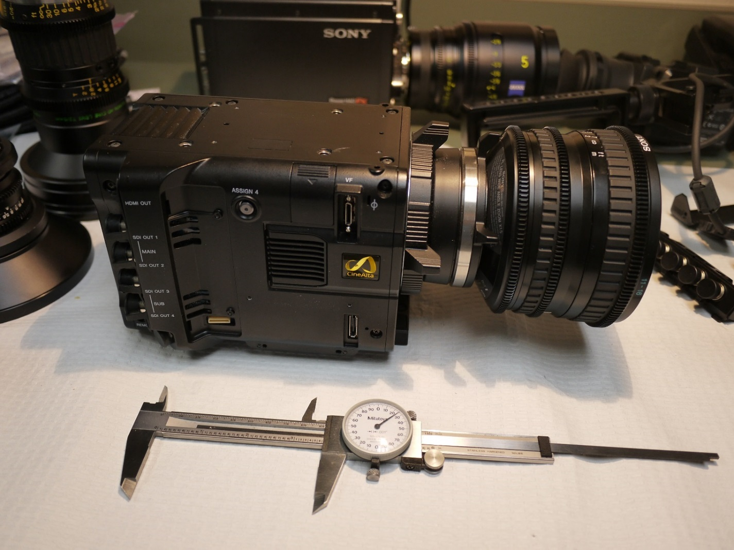
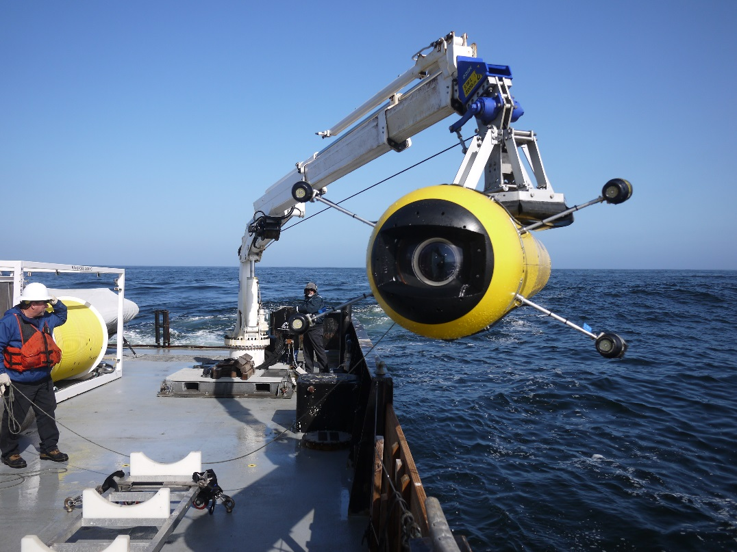
MBARI i2MAP 4K Autonomous Vehicle Camera
Sony PMW-F5 and AJA Ki Pri Quad recorder super 35 Bayer array and Sony SCL-P11X15 wide angle lens. Camera assembly and housing by MBARI. Optical design by Paul Remijan.

Slide 4
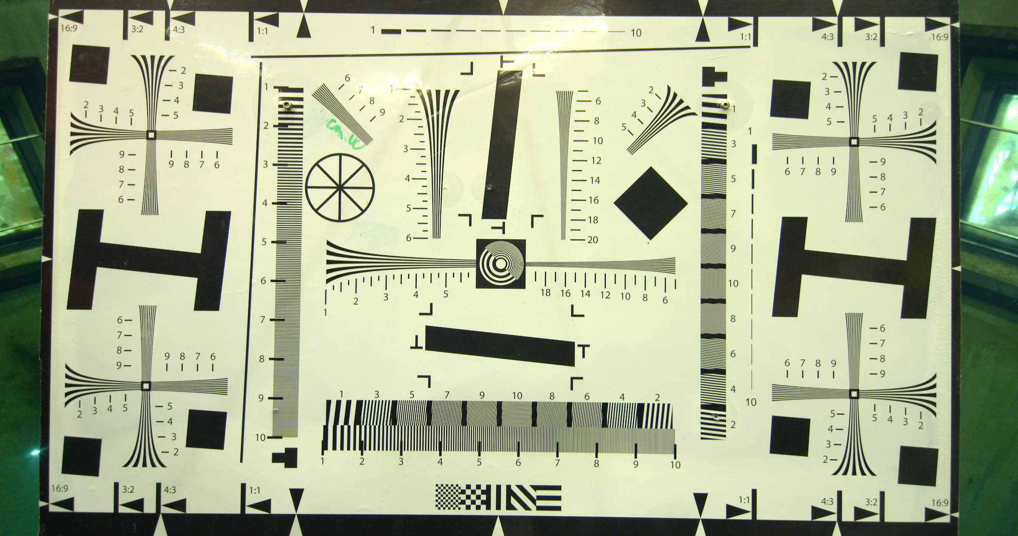
MBARI i2MAP 4K Autonomous Vehicle Camera ~1 meter
Corner resolution
Center resolution

Slide 5
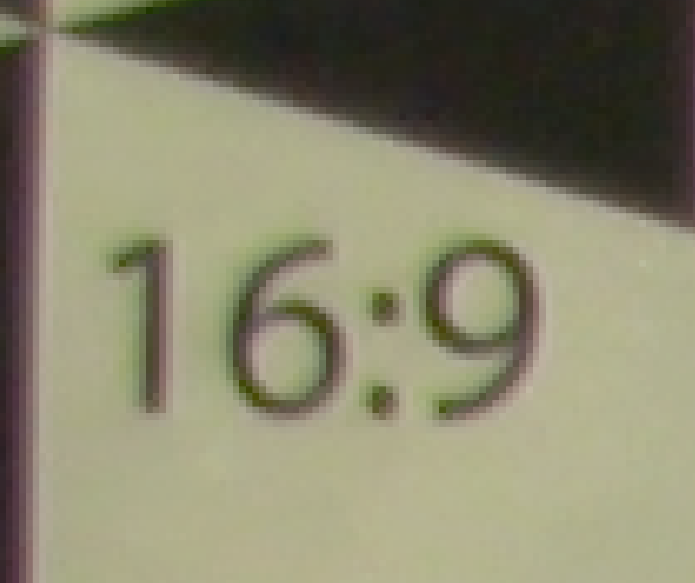
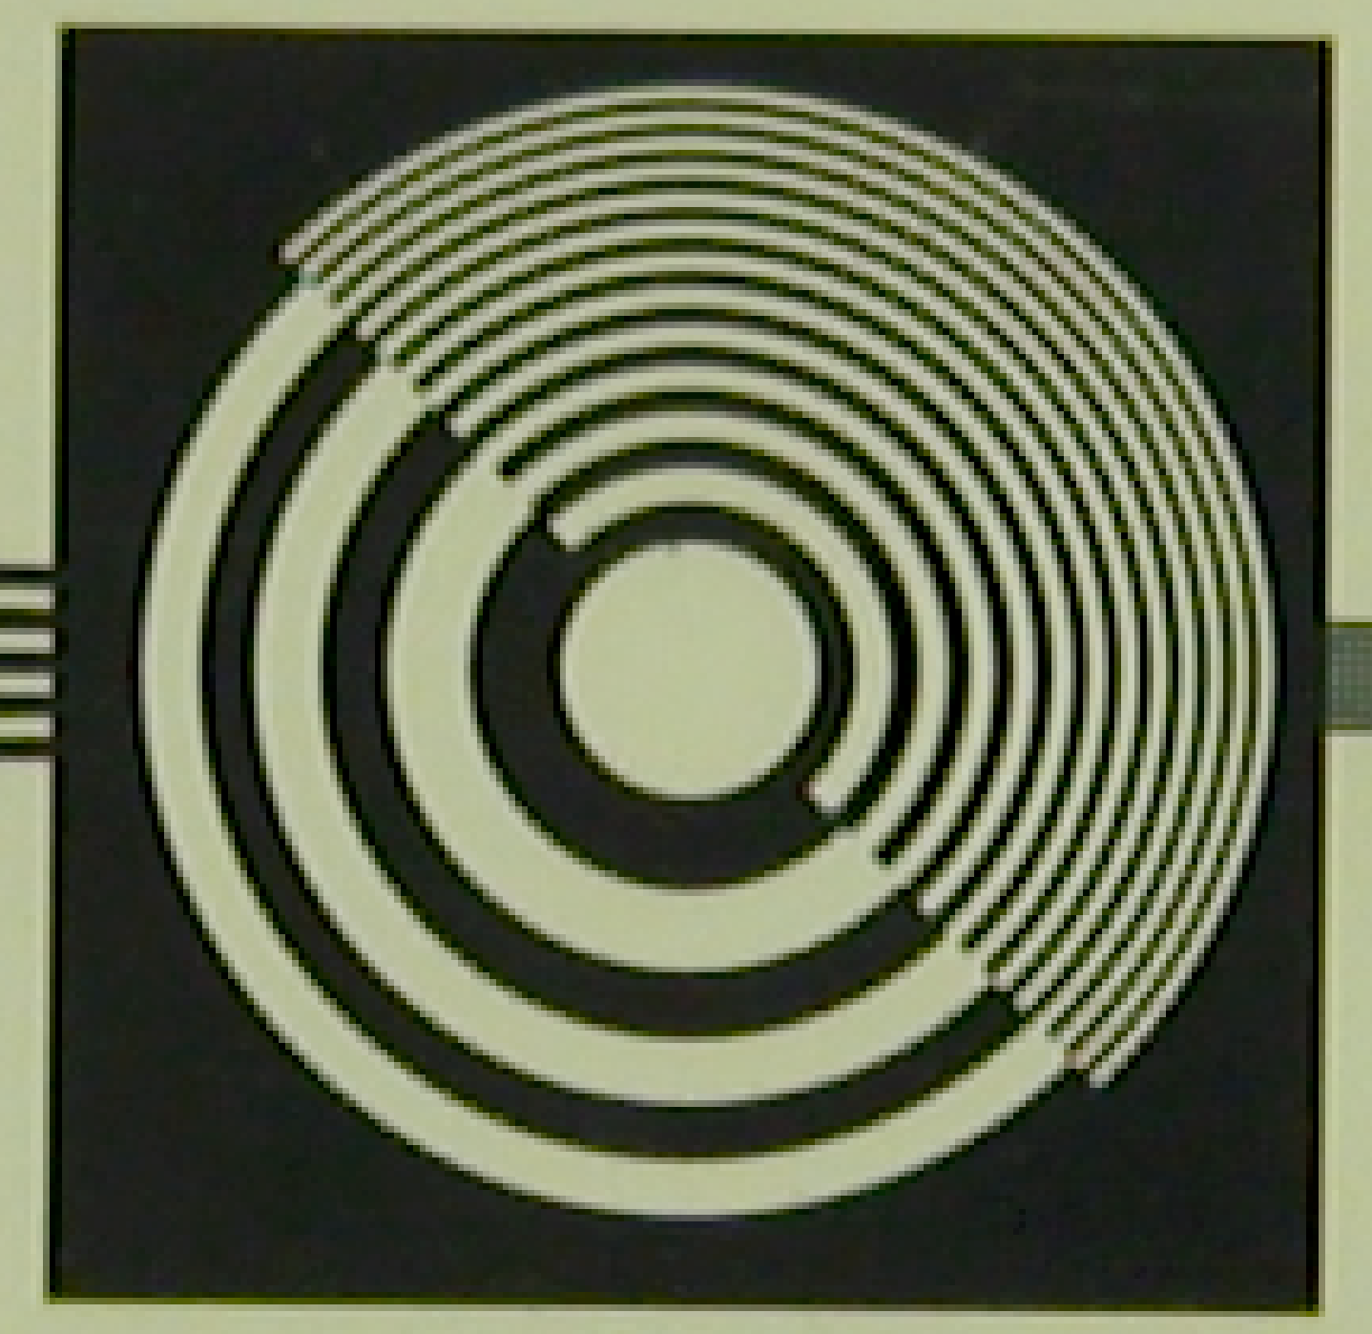
MBARI i2MAP 4K Autonomous Vehicle Camera
(in filtered sea water)

Slide 6
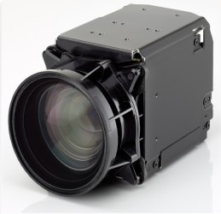



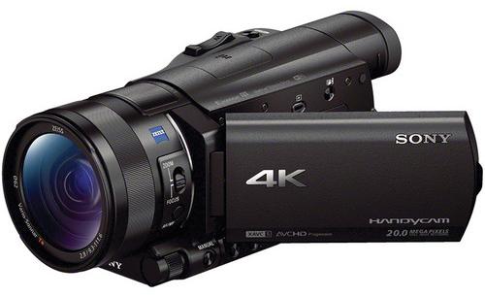


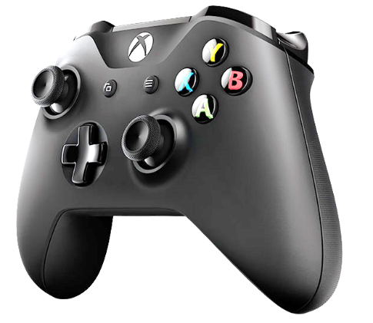
Tests of Commercially Available ROV 4K Cameras (corner resolution)
Building Blocks
DSP&L
Sony FCB-ER8550
SubC
Sulis
Sony FDR-AX100
MBARI i2MAP 4K
Insite
All commercial cameras tested had very poor lens controls…….

Slide 7
Major High Level 4K Camera Requirements
Image quality
  Resolution
  Contrast ratio
  Color reproduction
Camera controls
  Zoom, focus and iris
  Black and white balance, shutter speed , etc.
Camera size and weight
Camera cost
Camera ease of maintenance
Full Requirements Doc: \\Atlas\ProjectLibrary\901900_MBARI_Advanced_Imaging_Infrastructure\EngineeringDesignDocuments\4KCameraRequirements

Slide 8
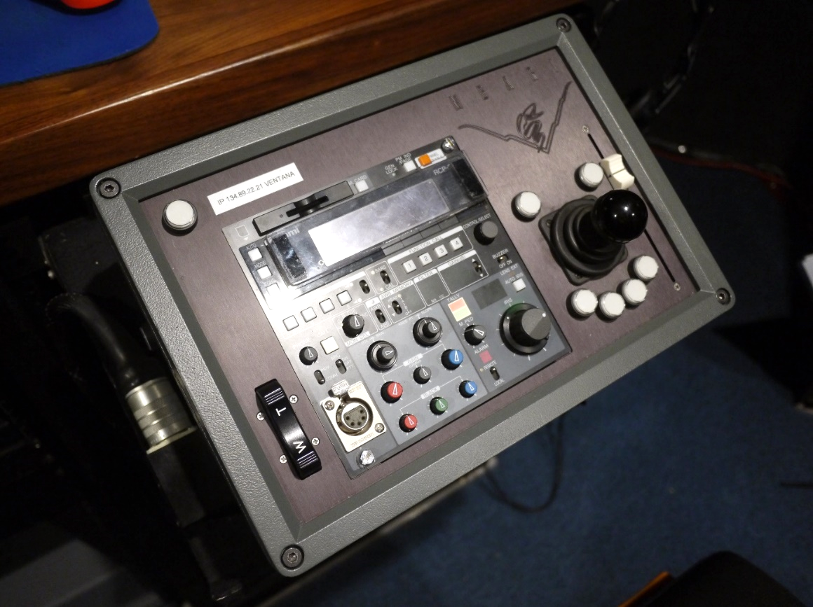
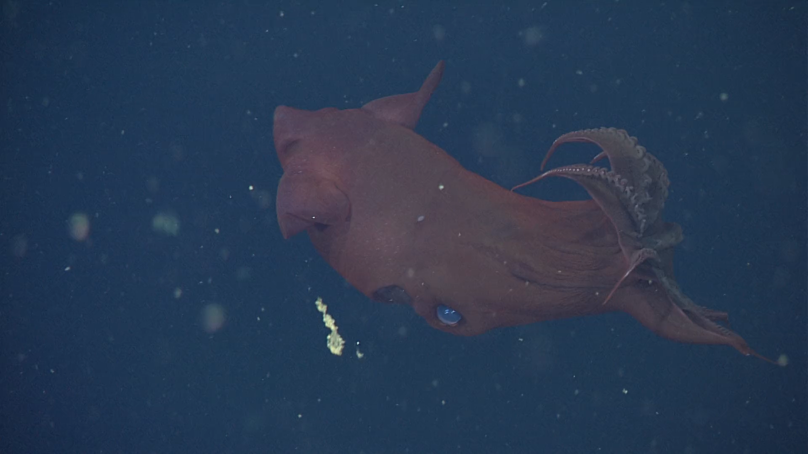
MBARI requirements for our main ROV cameras
MBARI requires professional quality zoom and focus controls!
Focus Position Slider
Pan & Tilt Control
Focus example
Zoom Rate Control Rocker Switch
https://www.youtube.com/watch?v=X8oWnbcLI40
Ikegami RCP
(2,794,882 views)

Slide 9
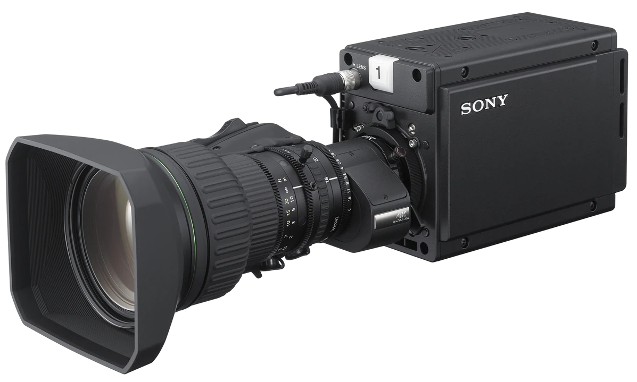
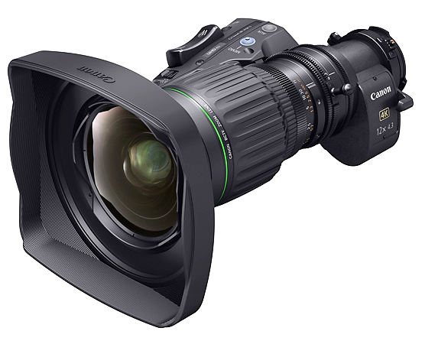
Best Candidate Camera Module
Sony HDC P50
  2/3” 3-Chip CMOS imager
  4096x2160 progressive scanning @ 60 frames/sec.
4K Resolution Lenses – very important!
  Fujinon UA13x4.5 BERA 4K UHD Wide lens with 13x Zoom
  Canon CJ12ex4.3B 4K UHD wide-angle lens with 12x Zoom

