Slide 1
4K ROV Camera Development Project
November 19, 2019 – Mark Chaffey

Slide 2
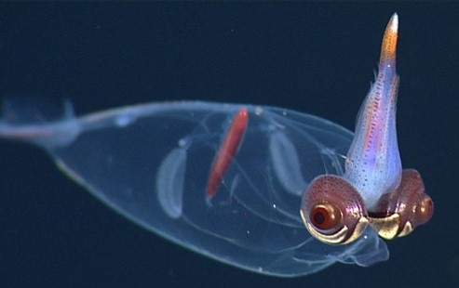
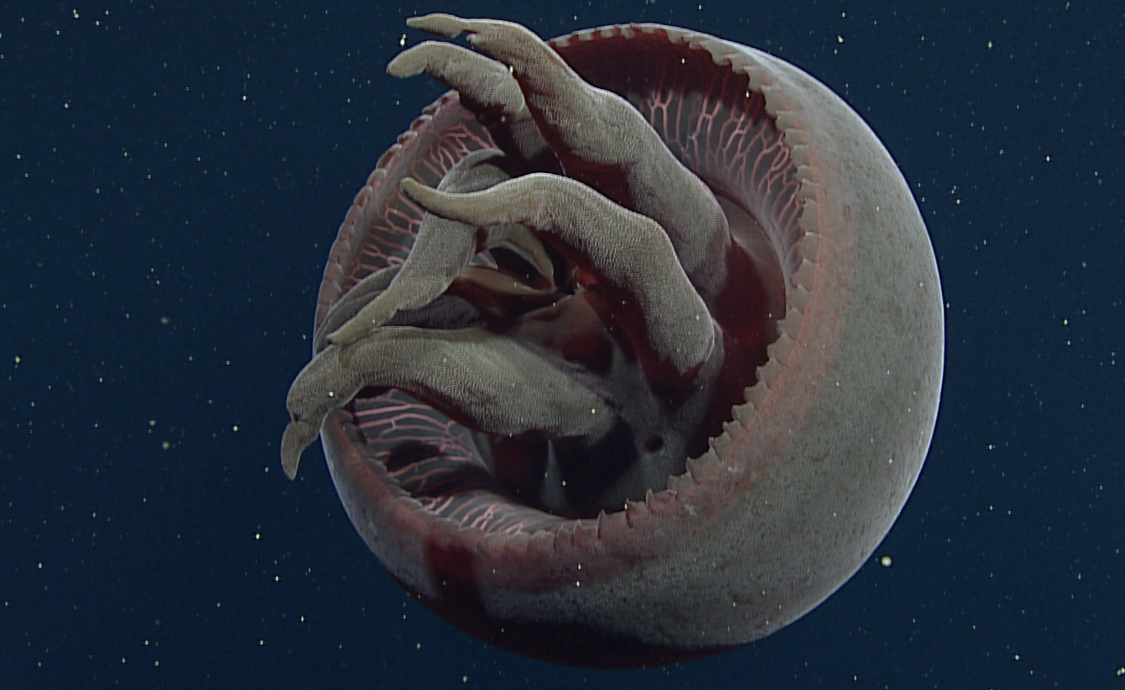
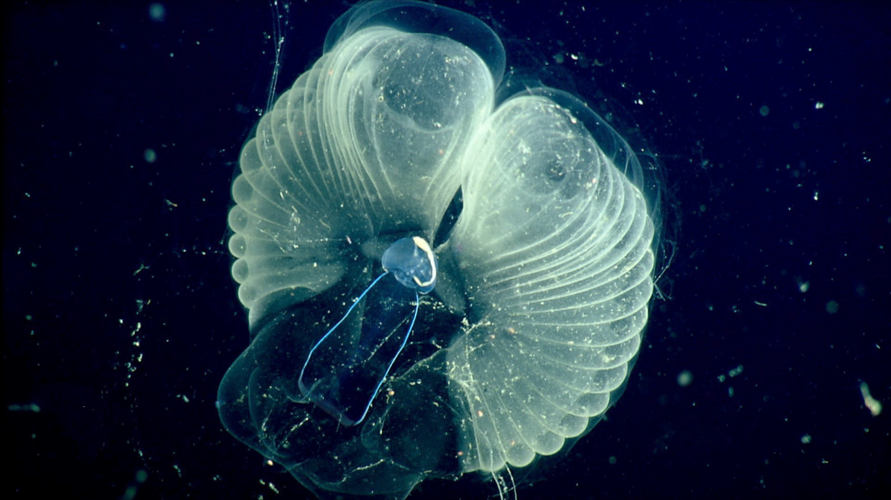
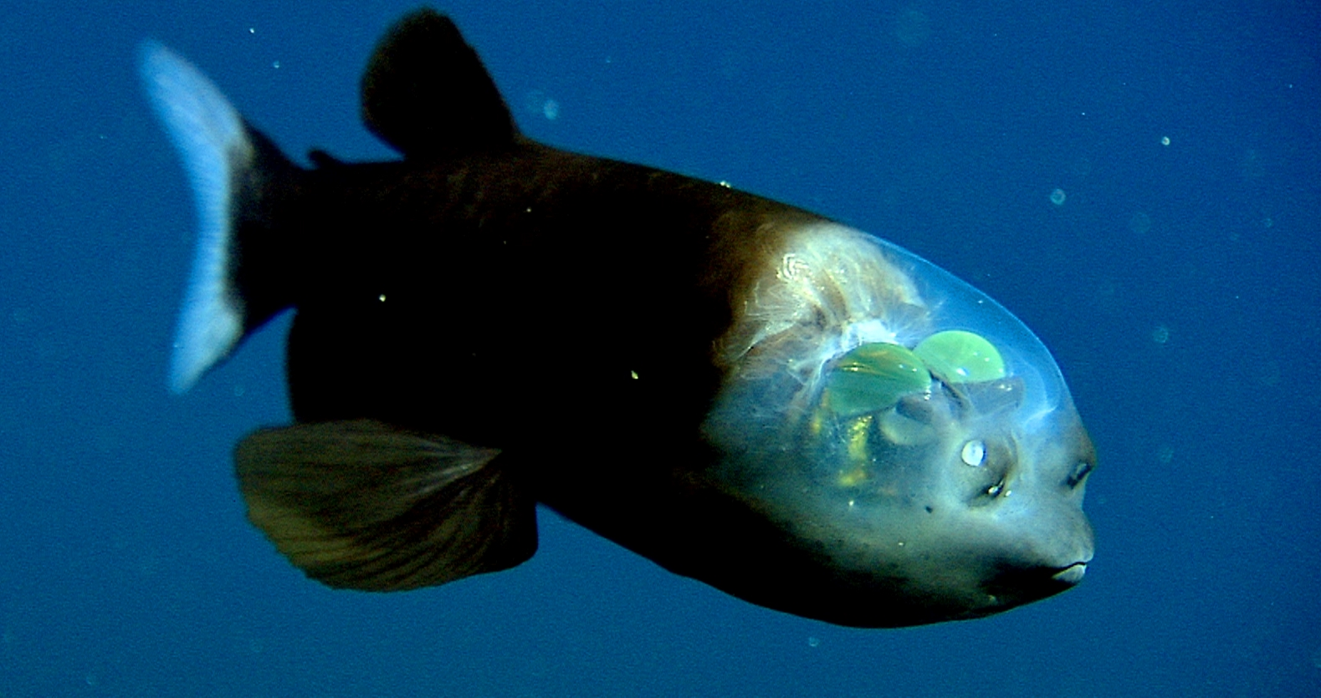
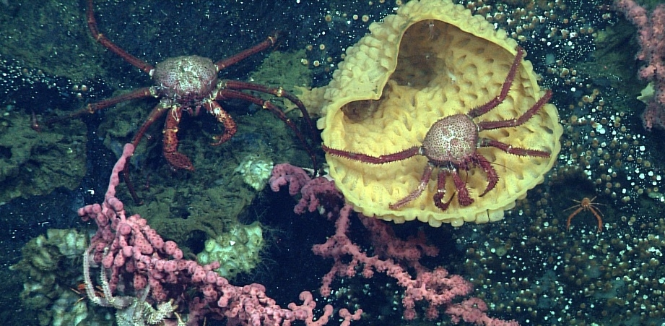
MBARI Strives for the Highest Quality ROV Video to Support our Research Mission

Slide 3
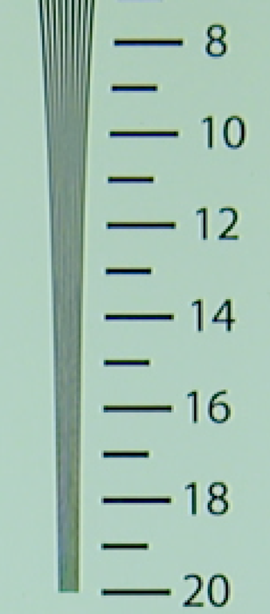
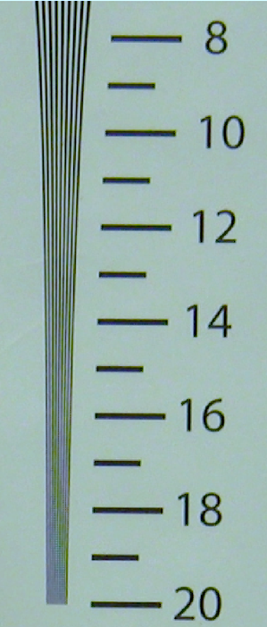
Advantages of 4K Video
Actual i2MAP Test Tank Recordings Horizontal Resolution in Hundreds of Line Pairs/Picture Width
Imaged in 2K
Imaged in 4K
Four times the pixel resolution of current HD.
  Better resolution increases scientific insight.
  Provides high quality images for public outreach and education.
  Allows cropping of images for publication with minimal visual degradation.
Images are scanned progressively.
  Eliminates interlace artifacts.
Future proof your image library.
  Major producers of educational and documentary material are requiring 4K formats.
High quality 4K camera modules are now available.
  2/3” 3-chip for excellent depth of field and sensitivity.
  Compact modules suitable for deep housings.

Slide 4
Existing Commercial Products Do Not Meet Our Requirements
MBARI in-water tested “4K” cameras from the these commercial ROV camera companies:
  Sulis Subsea
  Deep Sea Power & Light
  Insite Pacific
  SubC Imaging Inc.
Each failed to meet our image quality and/or lens control precision requirements.

Slide 5
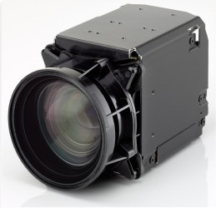
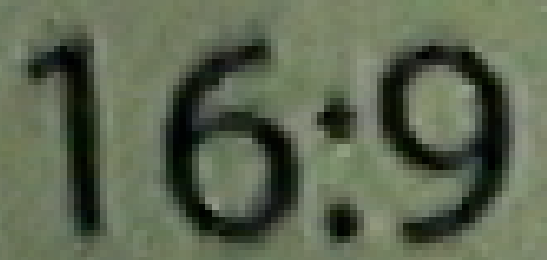


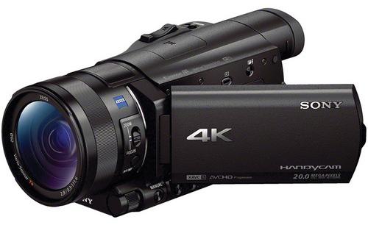
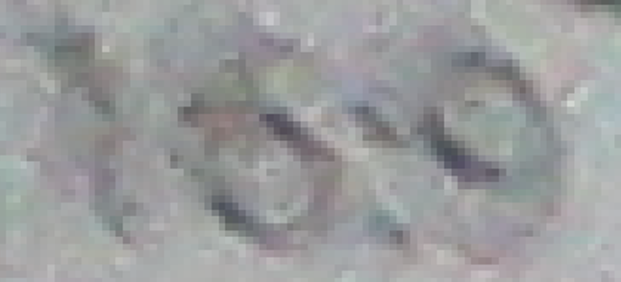

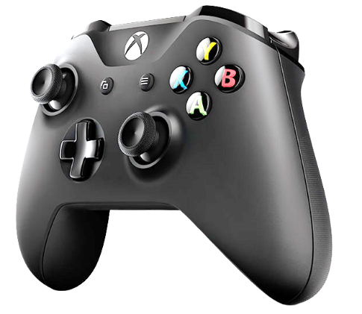
Tests of Commercially Available ROV 4K Cameras (corner resolution)
Building Blocks
DSP&L
Sony FCB-ER8550
SubC
Sulis
Sony FDR-AX100
MBARI i2MAP 4K
(for comparison)
Insite
All commercial cameras tested had very poor lens controls…….

Slide 6
Major Camera Requirements Summary
Image quality
  Resolution – 4K (4096 x 2160) or UHD (3840 x 2160) progressive scanning format capable of 59.94 or 60 frames per second.
  Contrast ratio – MTF at least 50% at 100 line-pairs per millimeter.
  Color reproduction - ITU-R BT.2020 color gamut.
Camera controls
  Zoom, focus and iris – professional quality “feel” with fully servoed rate and position.
  Black and white balance, shutter speed , etc.
  Temperature, humidity and water alarms.
Camera size and weight – comparable to Insite Zues Plus HDTV camera.
Full requirements document is available upon request.

Slide 7
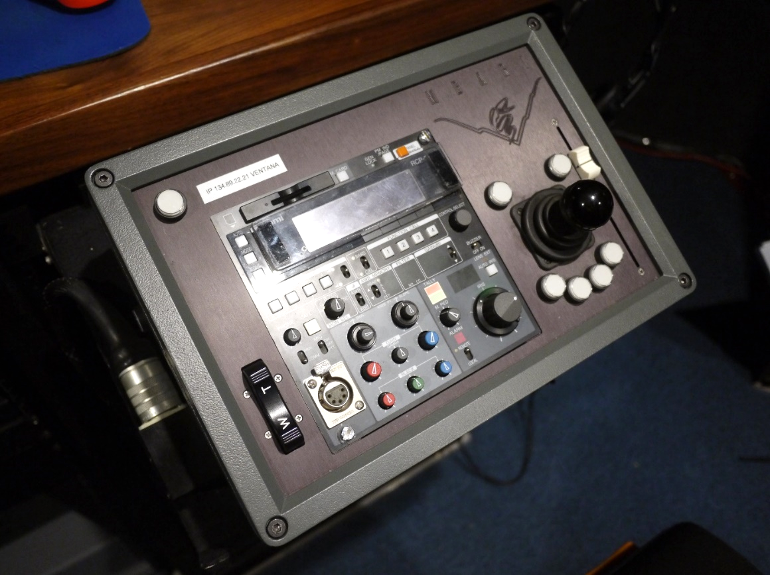
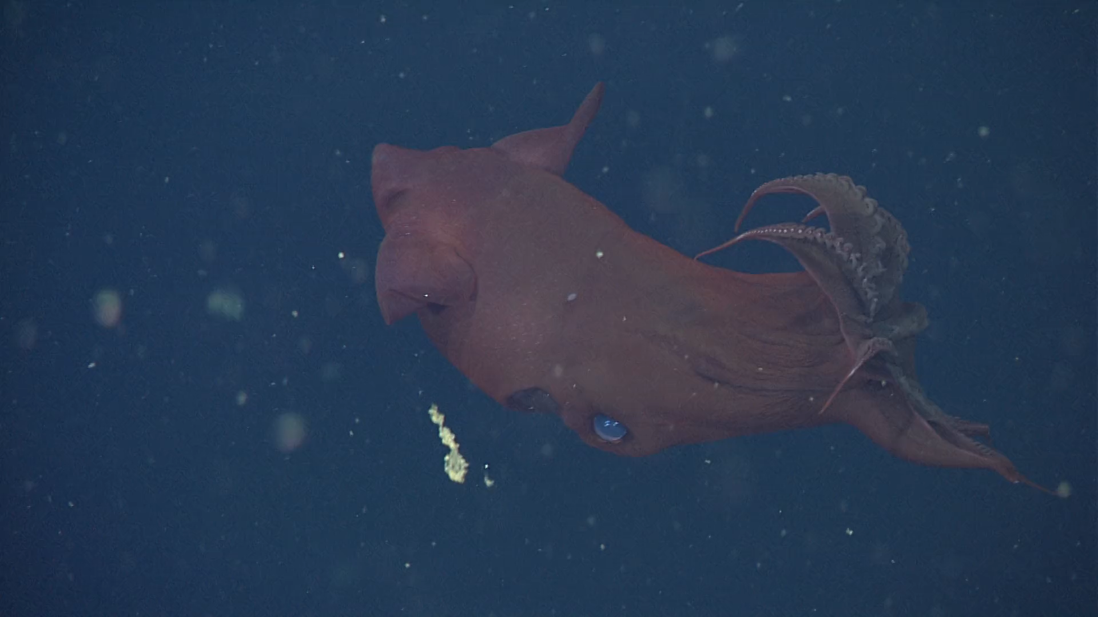
Topside Control Box Requirements
MBARI requires and builds professional quality zoom and focus controls!
Focus Position Slider
Pan & Tilt Control
Focus example
Zoom Rate Control Rocker Switch
https://www.youtube.com/watch?v=X8oWnbcLI40
Sony RCP
(2,794,882 views)

Slide 8
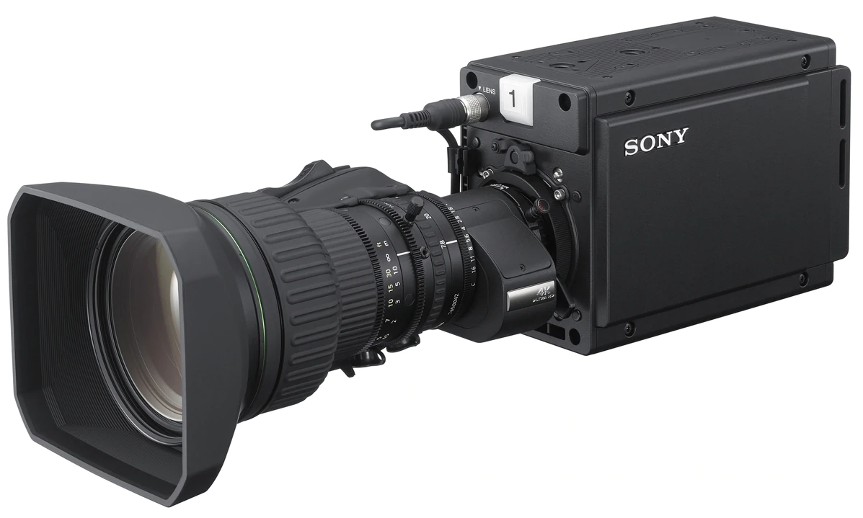
MBARI is Developing a State-of-the-Art 4K ROV Camera
Based around the Sony HDC-P50 Module and Canon CJ15ex4.3B 4K UHD Super Wide lens with 15x Zoom.
  2/3” 3-Chip CMOS imager
  4096x2160 progressive scanning @ 60 frames/sec.
  Global shutter
  ITU-R BT.2020 color gamut
  High Dynamic Range (HDR) capable
  Smooth precision rate zoom and position focus servos.
  Professional topside control box.
  Single fiber telemetry for quad 3G-SDI video and all auxiliary channels.
  14-36Volt power supply input.
  Internal monitoring for temperature, humidity, pressure and water alarm.
  Housing size approximately equivalent to Insite Pacific Zeus Plus camera.

Slide 9
Development Plan
MBARI is modifying the HDC P-50 to fit inside a 180mm I.D. Housing.
  Custom chassis
  Telemetry, electronics and lens control systems.
  Topside control box.
Plan is to have commercial vendor design and fabricate the optical dome port, optical adapter assembly and housing.
  Highly respected and experienced deep ocean vendor.
  Optical engineering is by the leading expert in the field.

Slide 10
4K 4000 meter Camera Systems Costs
MBARI has partnered with Deep Sea Power & Light (DSP&L) to co-develop the camera system.
DSP&L will provide camera systems to third parties and also ongoing support over the product lifetime.
Sharing the NRE by ordering a system through DSP&L during the development phase lowers the cost for all participants.

Slide 11
Development Schedule
The following dates reflect the current schedule. They are advisory and may change, but the plan is to adhere to this schedule if possible.
First release RFP for optics and housing to potential vendors. September 20, 2019. (done)
Deadline for initial vendor response. October 10, 2019. (done)
Final vendor selection. October 31, 2019. (done)
MBARI releases final housing internal diameter and internal length. March 24, 2020.
Critical design review (CDR) of complete design including vendor optical and housing design and MBARI camera system. Final review of all interfaces, connector ports, lens alignment fixtures, chassis to housing interface, etc. April 20, 2020.
Release to fabrication following the resolution of any issues raised in the CDR. ASAP following CDR.
Final assembly of all camera system components (MBARI and vendor) August 12, 2020.
At-sea testing completed. September 4, 2020.

Slide 12
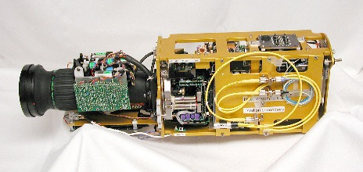
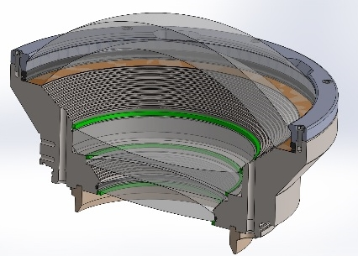
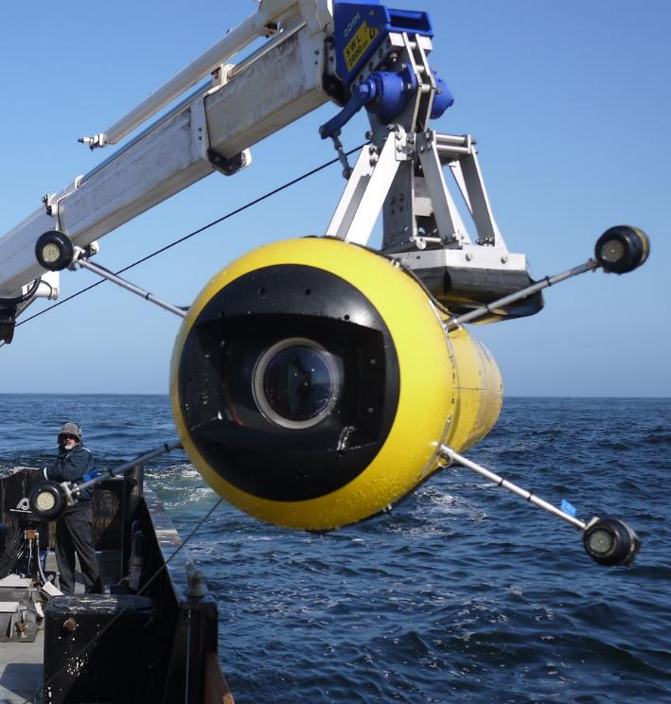
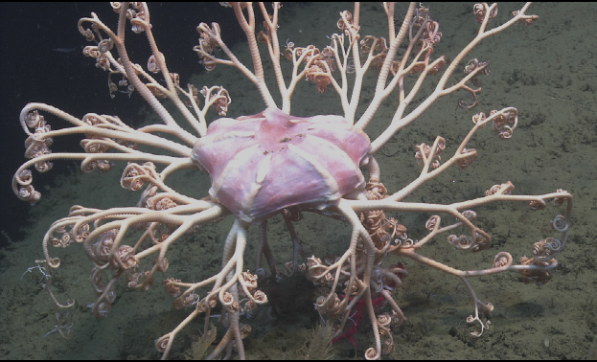
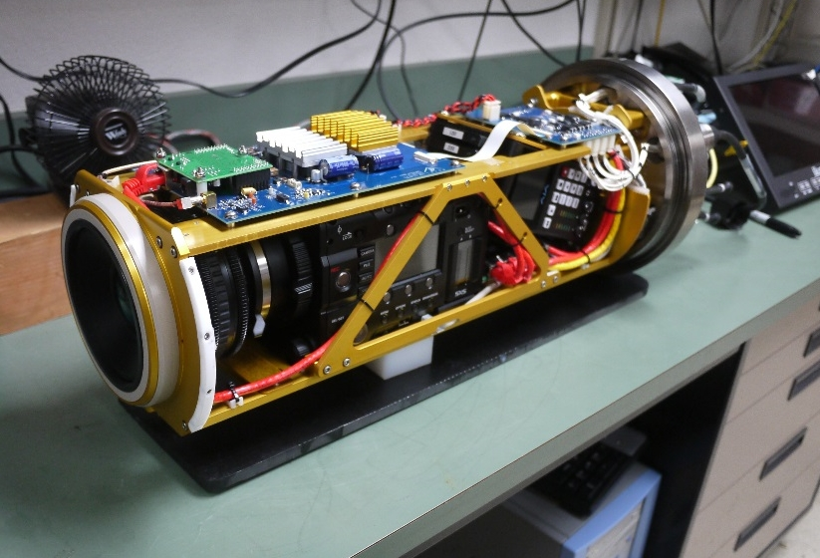
Previous MBARI Video Camera Work
MBARI’s first ROV camera project – a DXC3000 in 1987!
First full 1920x1080 HDTV ROV camera system.
First high quality large format AUV camera system.

Slide 13
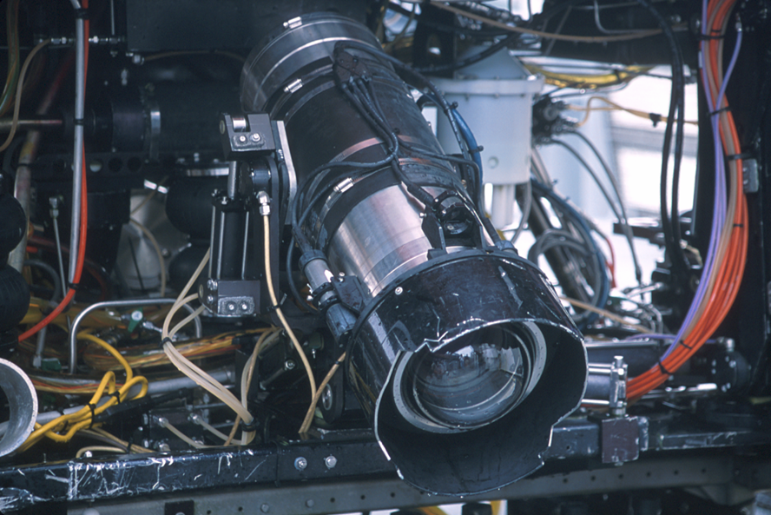
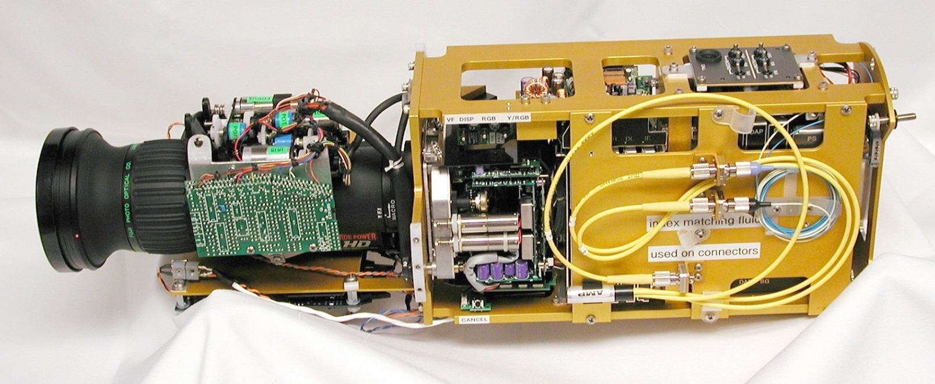
4000 Meter ROV Camera
Sony HDC-750 camera and Fujinon HA10X5.2 wide angle zoom lens. MBARI camera and lens servo controls. Optical design by Milt Laikin, custom housing by Insite Pacific.

Slide 14
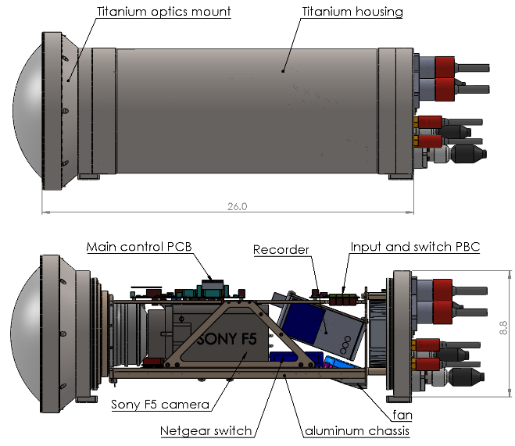
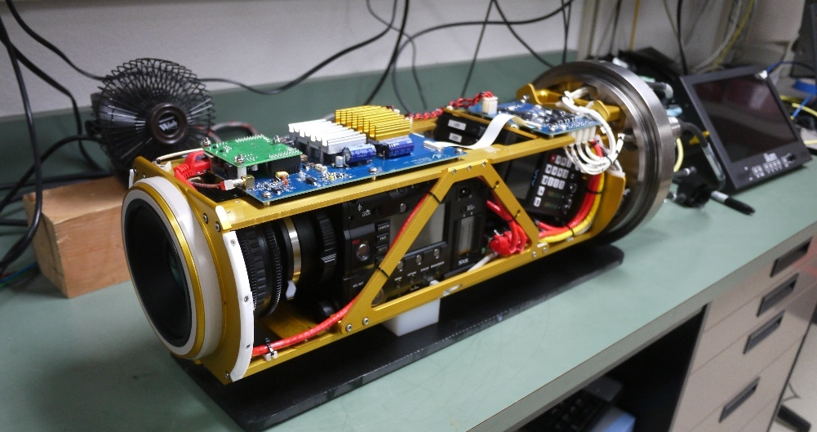
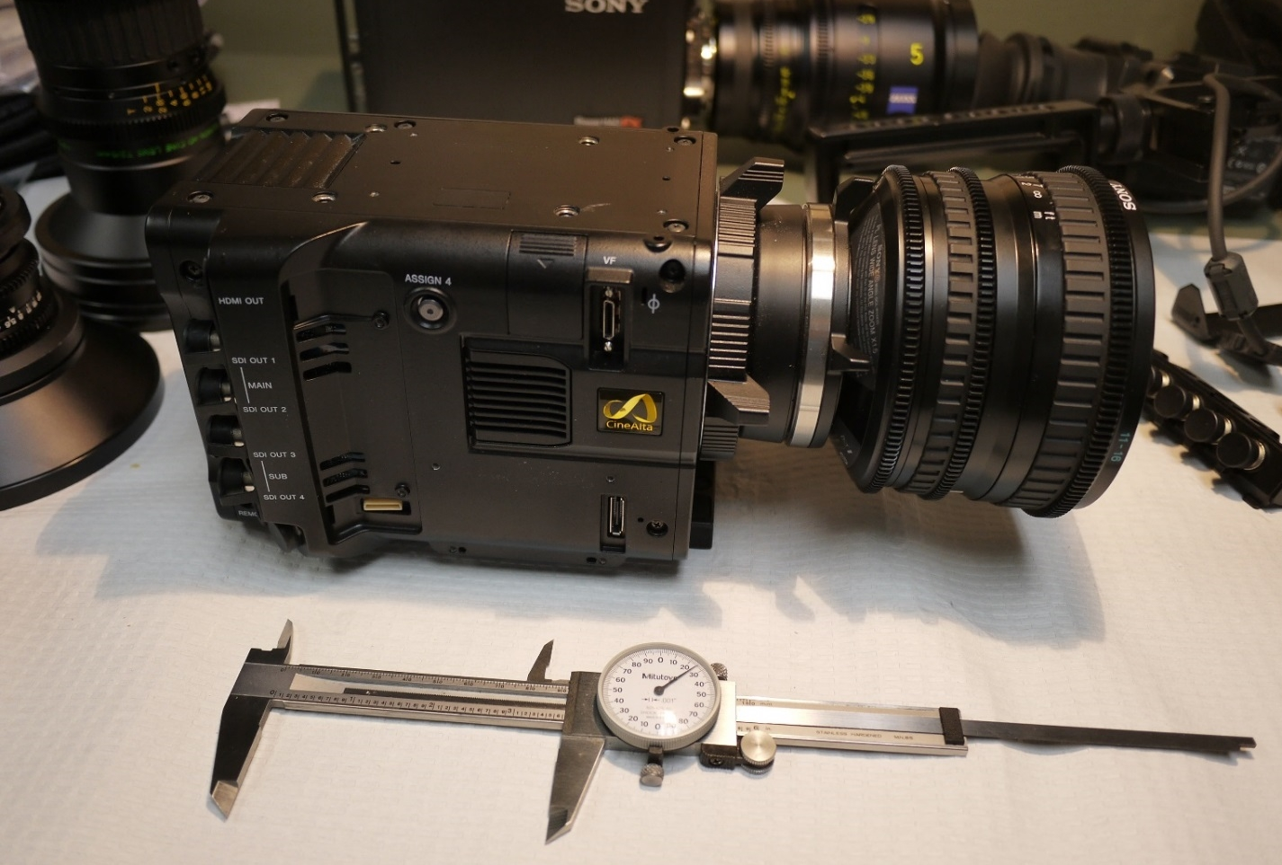
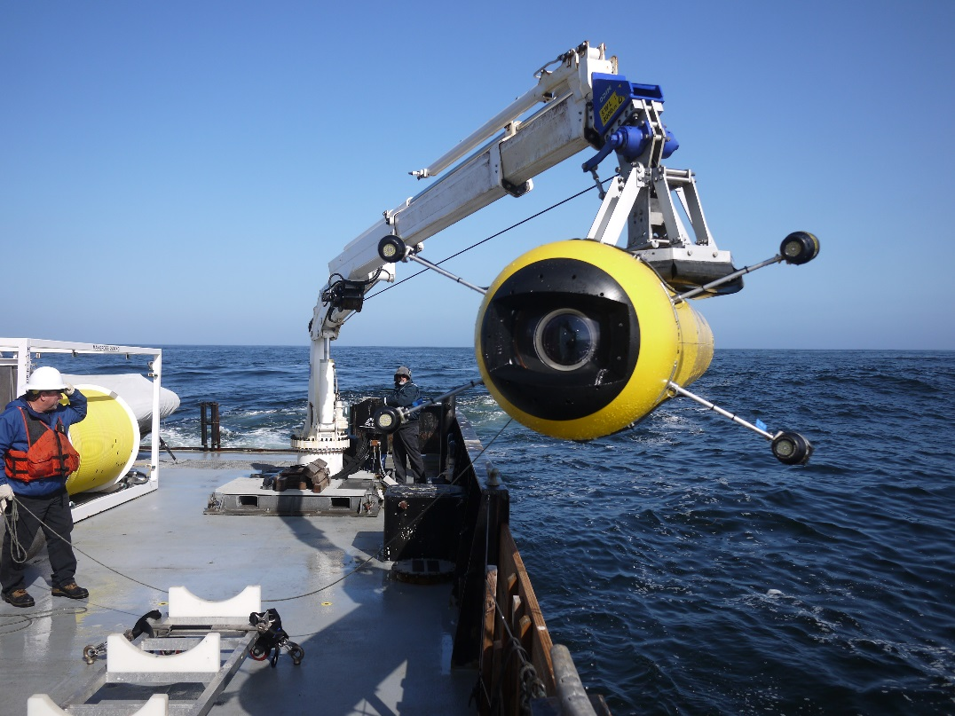
MBARI i2MAP 4K Autonomous Vehicle Camera & 2 TB Recorder
Sony PMW-F5 and AJA Ki Pro Quad recorder super 35 Bayer array and Sony SCL-P11X15 wide angle lens. Camera assembly and 1500 meter housing by MBARI. Optical path design by Paul Remijan PhD.

Slide 15
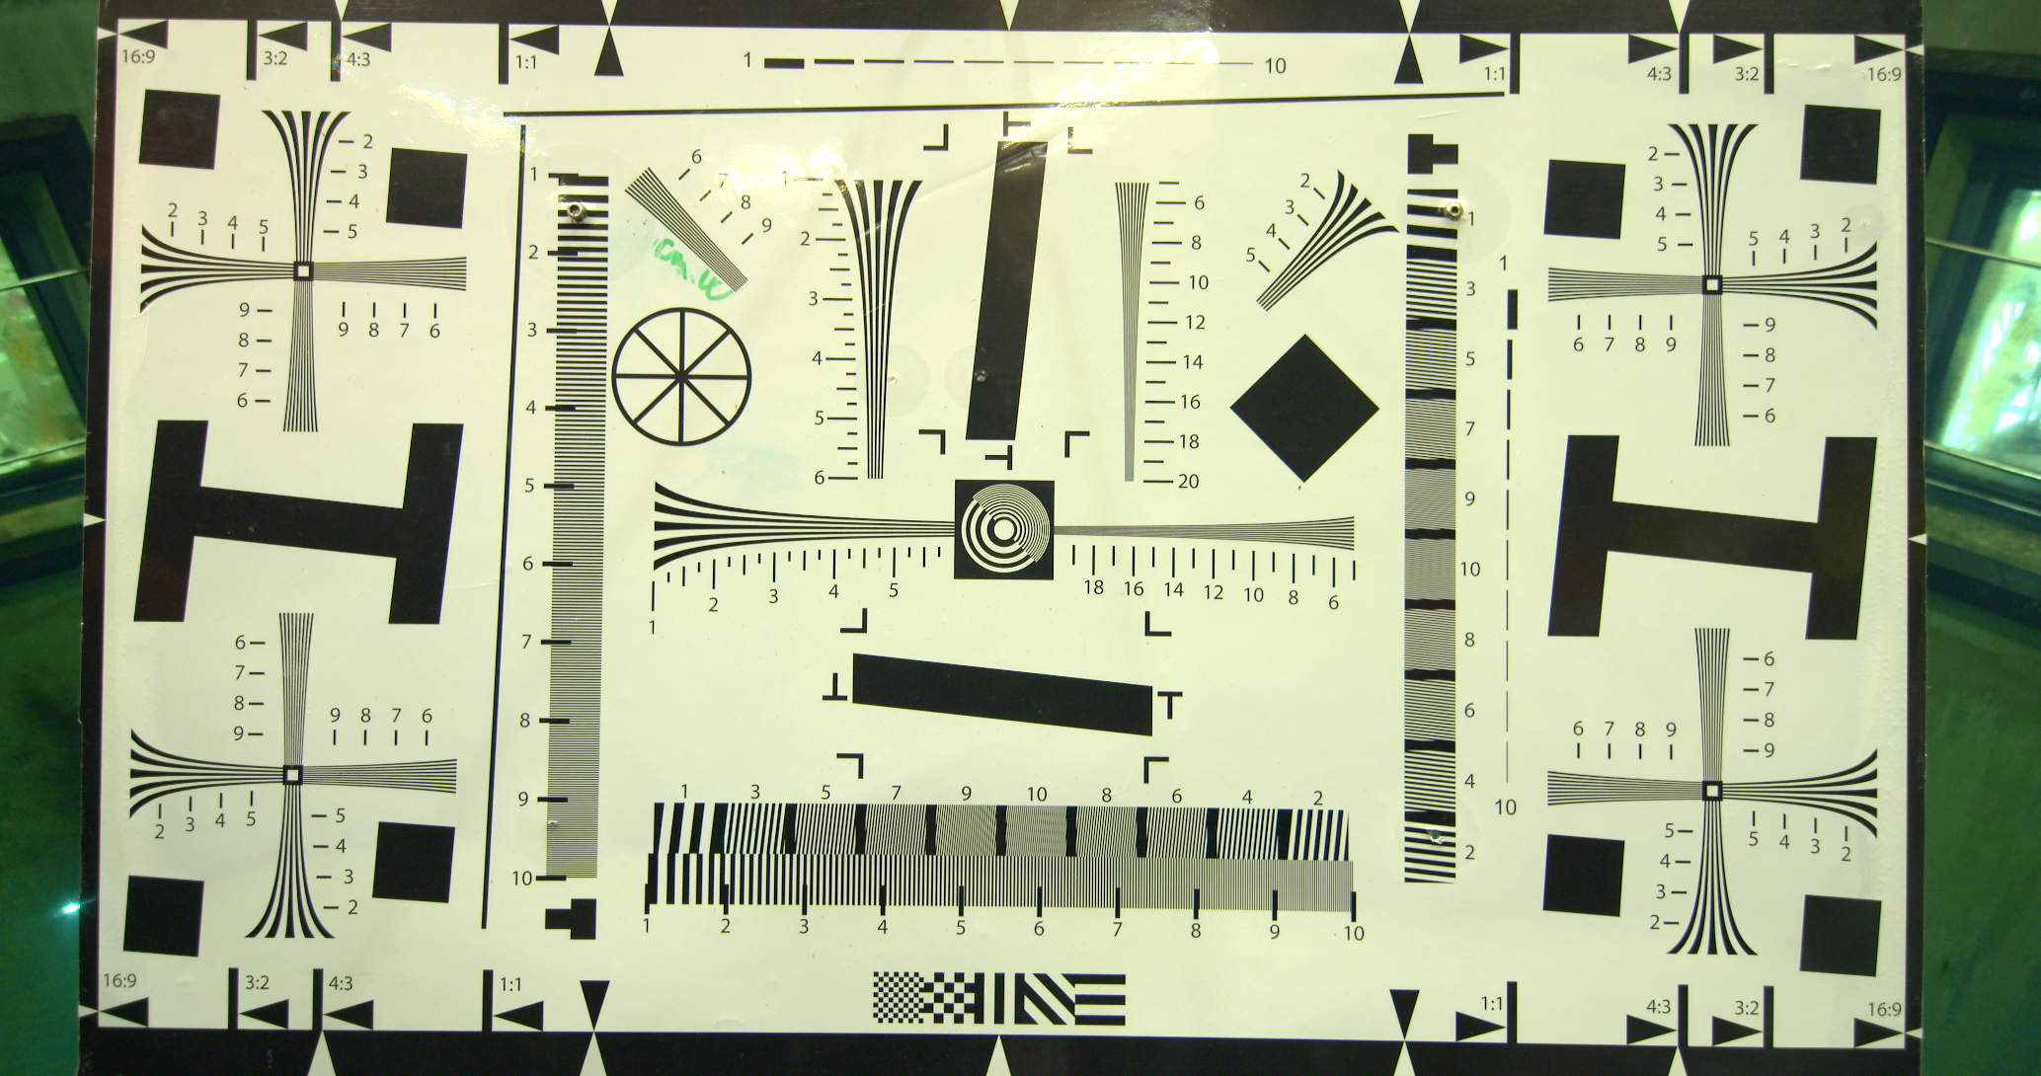
MBARI i2MAP 4K Autonomous Vehicle Camera ~1.5 meters
Corner resolution
Center resolution

Slide 16
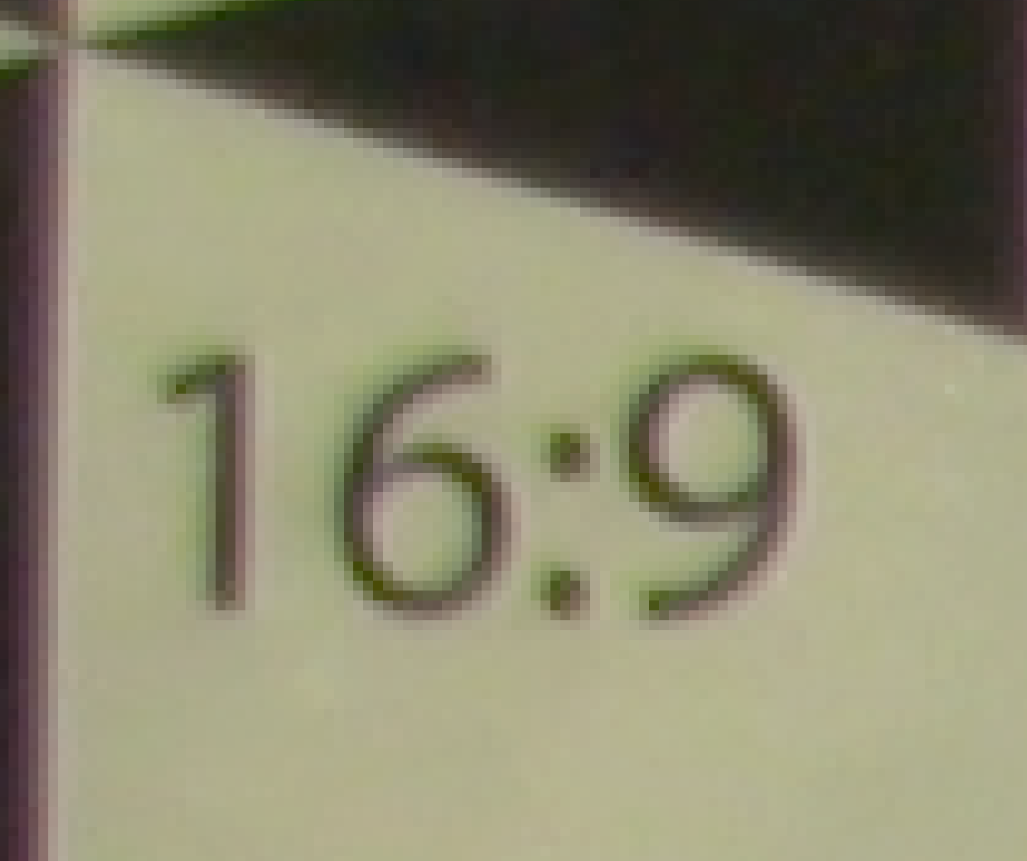
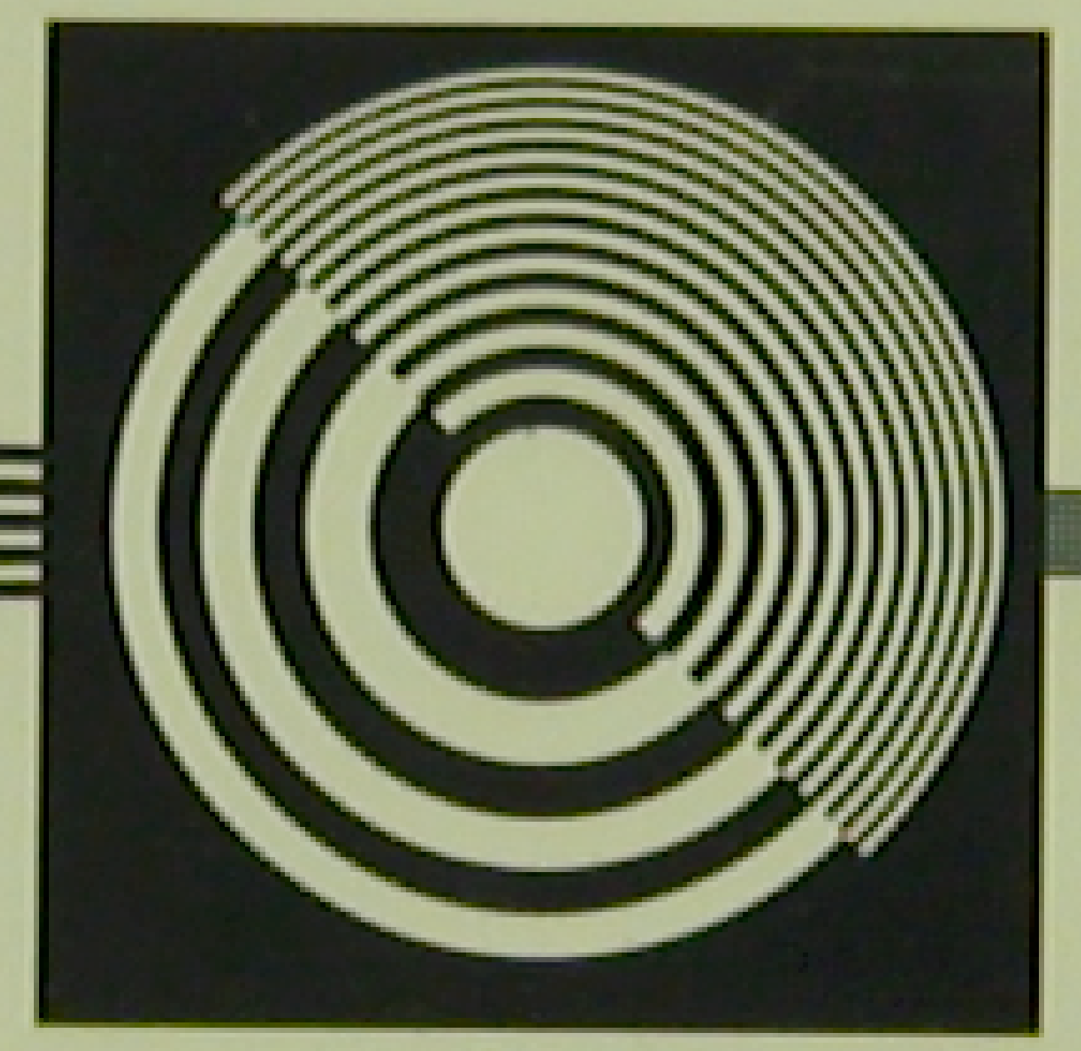
MBARI i2MAP 4K Autonomous Vehicle Camera – pixel limited resolution at 1.5 meters (in filtered sea water)
Low noise
Minimal lateral color
High MTF across the entire image
Picture Extreme Diagonal Corner
Picture Center

Slide 17
End

Slide 18
The History of Video Formats and Cameras at MBARI
COMING NEXT
4K!
CAMERAS
Sony DXC 3000 & Panasonic SDTV
1988
Sony HDC-750 HDTV
Zues Plus Ikegami HDL40-HDL57 HDTV
Sony HDC-P50 UHDTV
1988
1998
Betacam SP
Analog
RECORDERS
2018 ProRes HQ Files 1920x1080 60i
1995
2010
Digital Betacam 720x480 60i
1999
2020 +
Panasonic D5 1920x1080 60i
20 years + !!
2020
ProRes HQ Files 4096x2160 60p
4K Video!
Museum of Obsolete Media & Formats
Notes:
Museum of obsolete media!

