Slide 1
Agenda: 4K ROV Camera Architecture Brainstorming
July 2, 2019

Slide 2
Invited Attendees?
Dave French
Andy Hamilton
Paul McGill
Brent Roman
Mike Risi
Rich Henthorn

Slide 3
Goals of the Session
Background on lens controllers
  Performance requirements.
  Architectural constraints.
Brainstorm on lens controller architectures
  Four different architectural possibilities.
    #1 - Build from scratch.
    #2 - Use Fujinon controller for Iris.
    #3 - Use analog inputs to Fujinon Controller.
    #4 - Use digital inputs to Fujinon Controller.
  What option is the easiest to implement?
  How much software development required?

Slide 4
Requirements
Camera controls
  Zoom : RATE control with smooth start and stop into low speed movement , but fast ramp to high speed. Feedback is either tachometer or encoder, depending on drive motor selection.
  Focus : POSITION control with smooth ramps to commanded position. Feedback is either position pot or encoder depending on drive motor selection.
  Iris: POSITION control with smooth ramps to commanded position. Feedback is either position pot or encoder depending on drive motor selection. Command signal comes though camera/lens interface.
    Option: Use Fujinon lens drive for Iris.
  Black and white balance, shutter speed , etc. Handled through camera system remote control panel (RCP).

Slide 5
Issues to resolve in system design
Can Ethernet be real-time enough for control response without lag or intermittent sluggishness?
  Option would be to switch to EIA232/422, but would then have to write communications application?
Which embedded processor/development environment would be the best choice for the motor drive application?
Fujinon remote digital interface does not appear to have a rate control mode for zoom – position only. Would this be any good?
Not clear of Fujinon analog zoom input is rate or position – looks like position. Better option to spoof the hand control rocker input? It is definitely a rate control.

Slide 6
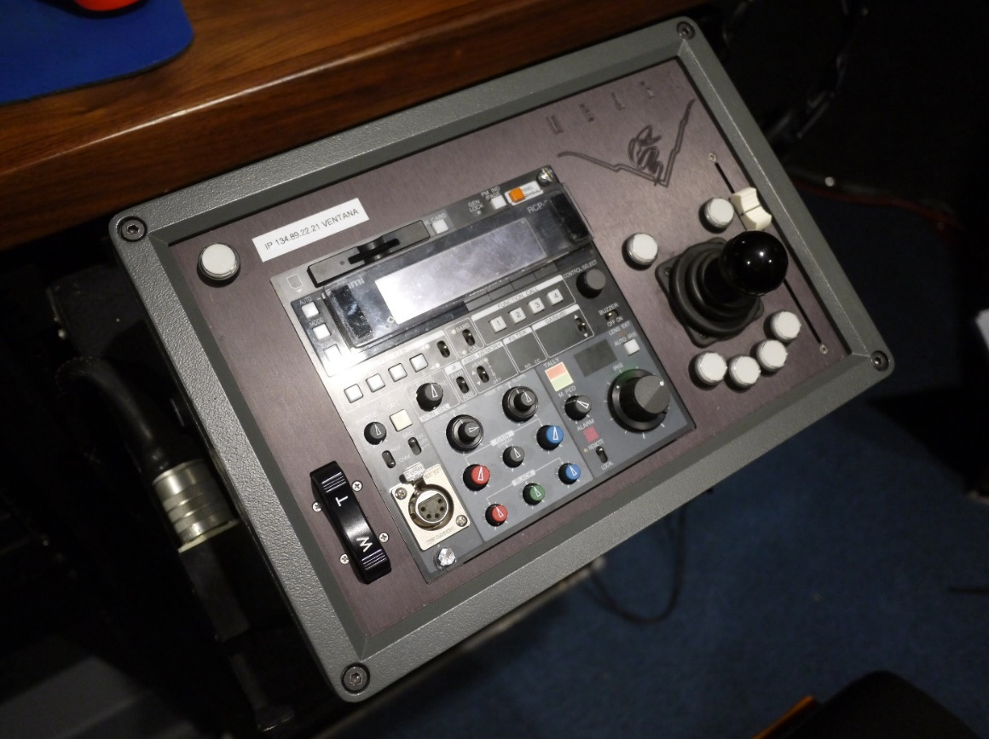
MBARI requirements for our main ROV cameras
MBARI requires professional quality zoom and focus controls!
Focus Position Slider
Pan & Tilt Control
Commercial follow focus example
https://vimeo.com/43330022
Zoom Rate Control Rocker Switch
Ikegami RCP
Focus example
https://www.youtube.com/watch?v=X8oWnbcLI40
(2,794,882 views)

Slide 7
Top to Bottom Architecture 1

Slide 8
Top to Bottom Architecture 2

Slide 11
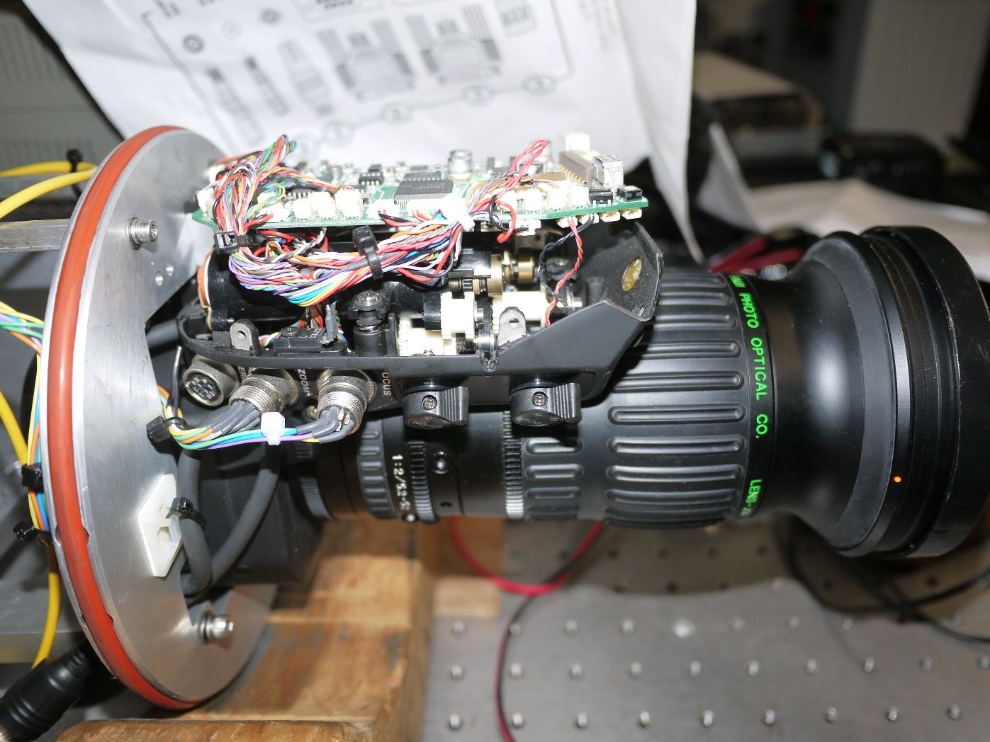

Slide 15
Current Lapbox Design

Slide 16
Fujinon Lens Control Interfaces

Slide 17
Fujinon Lens to Camera Interface

Slide 18
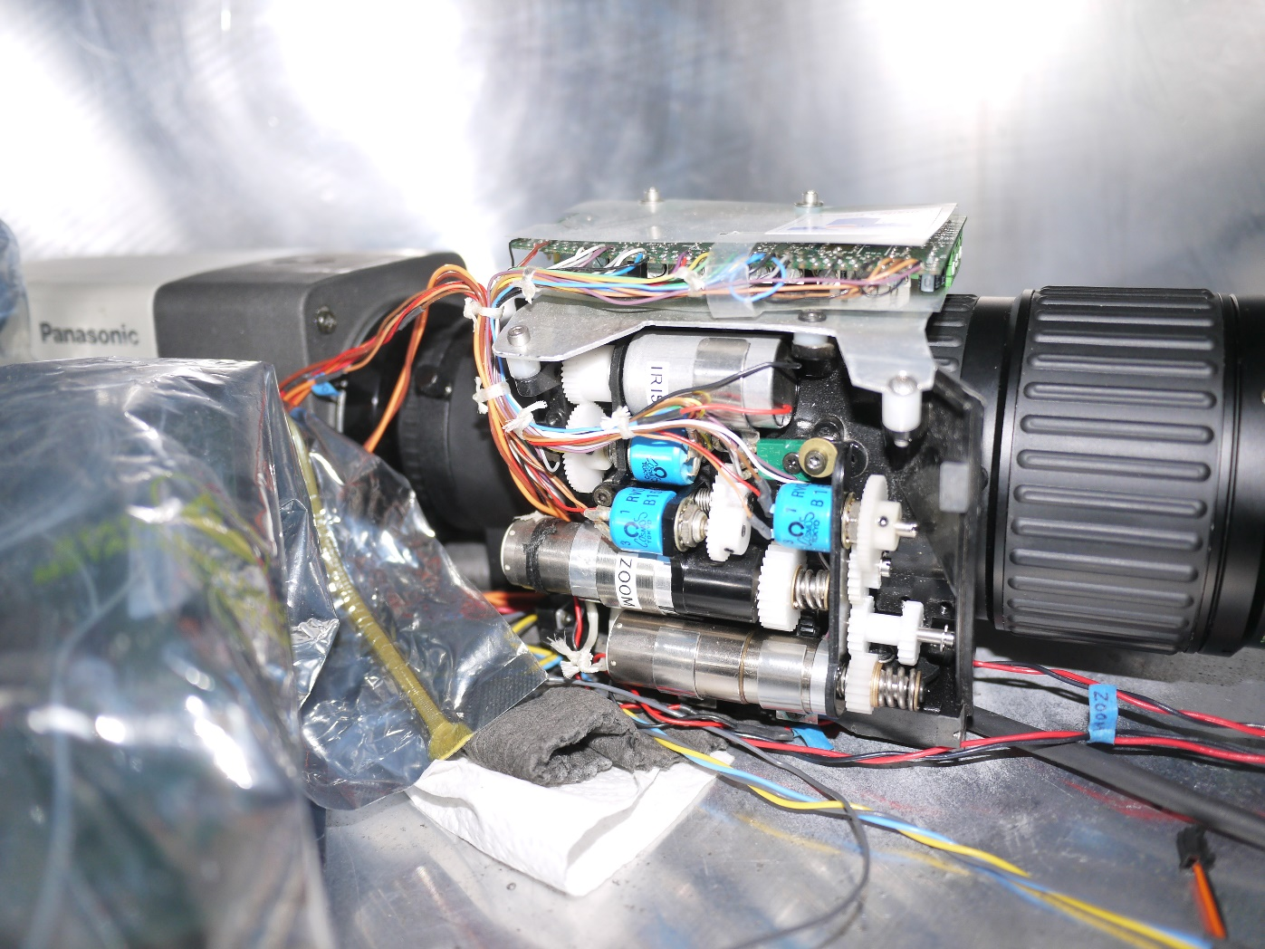
Older HD lens

Slide 19
Micro coax cables

Slide 20
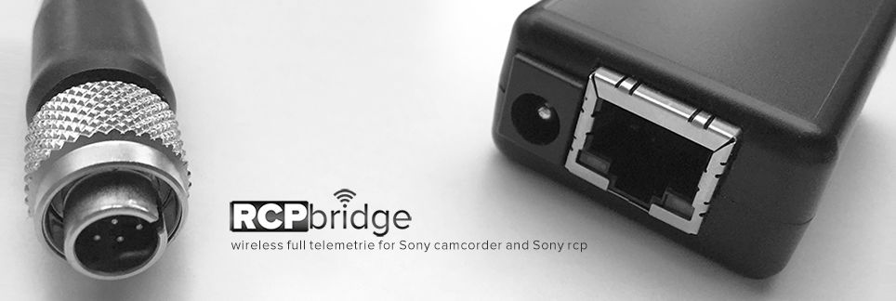
Possible technology
Ethernet to fiber converters
  https://fibertronics.com/2-port-switch-101001000-rj45-to-2-sfp-ports
  https://fibertronics.com/101001000base-t-to-sfp-ethernet-media
  https://www.blackbox.com/en-us/store/Detail.aspx/Pure-Networking-Copper-to-Fiber-Media-Converter---10-100BASE-TX-to-100BASE-FX-SFP/LHC210A
  https://www.perle.com/products/10-100-poe-media-converters.shtml#applicationdiagrams
Sony RCP serial to Ethernet converters

Slide 21
Lens Drive Motors & Encoders
Drive motors
  Maxon
  www.faulhaber.com
Torque limit clutches
  https://dynatect.com/product/clutches/mechanical-slip-clutches/series-16/
  https://shop.sdp-si.com/catalog/?brand=sdp&cid=p680
Encoders
  https://ecatalog.dynapar.com/ecatalog/incremental-encoders/en/E9?_ga=2.158800634.171294003.1560294496-1192861477.1560294496

Slide 23
Sony HDC-P50 Camera
Geometric center
15.5mm offset
Optical center

Slide 25
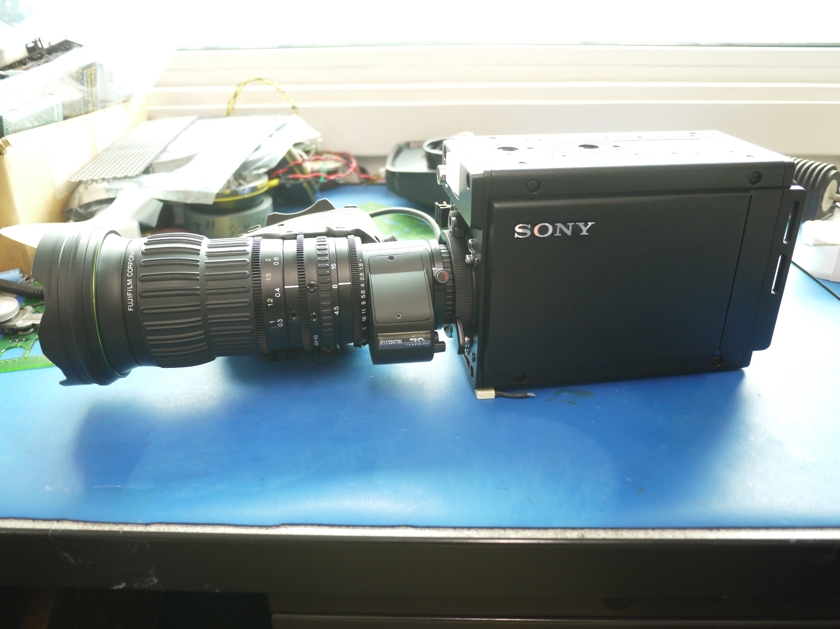

Slide 26
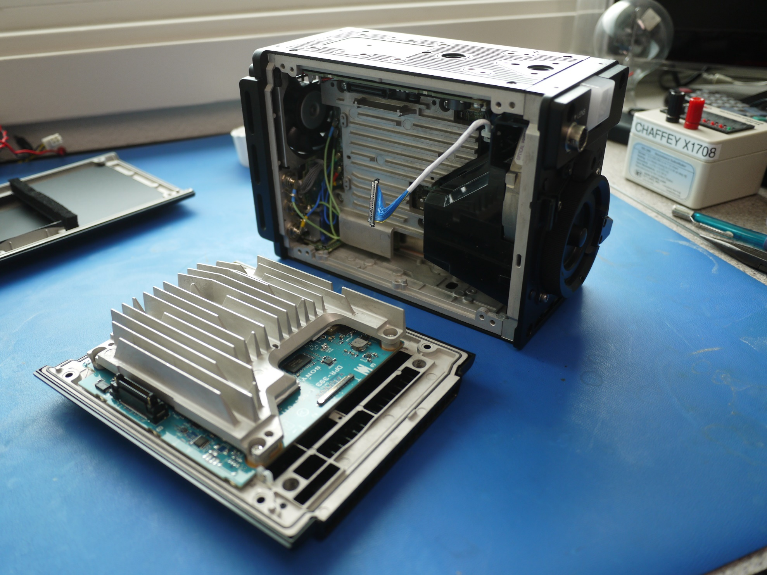

Slide 27
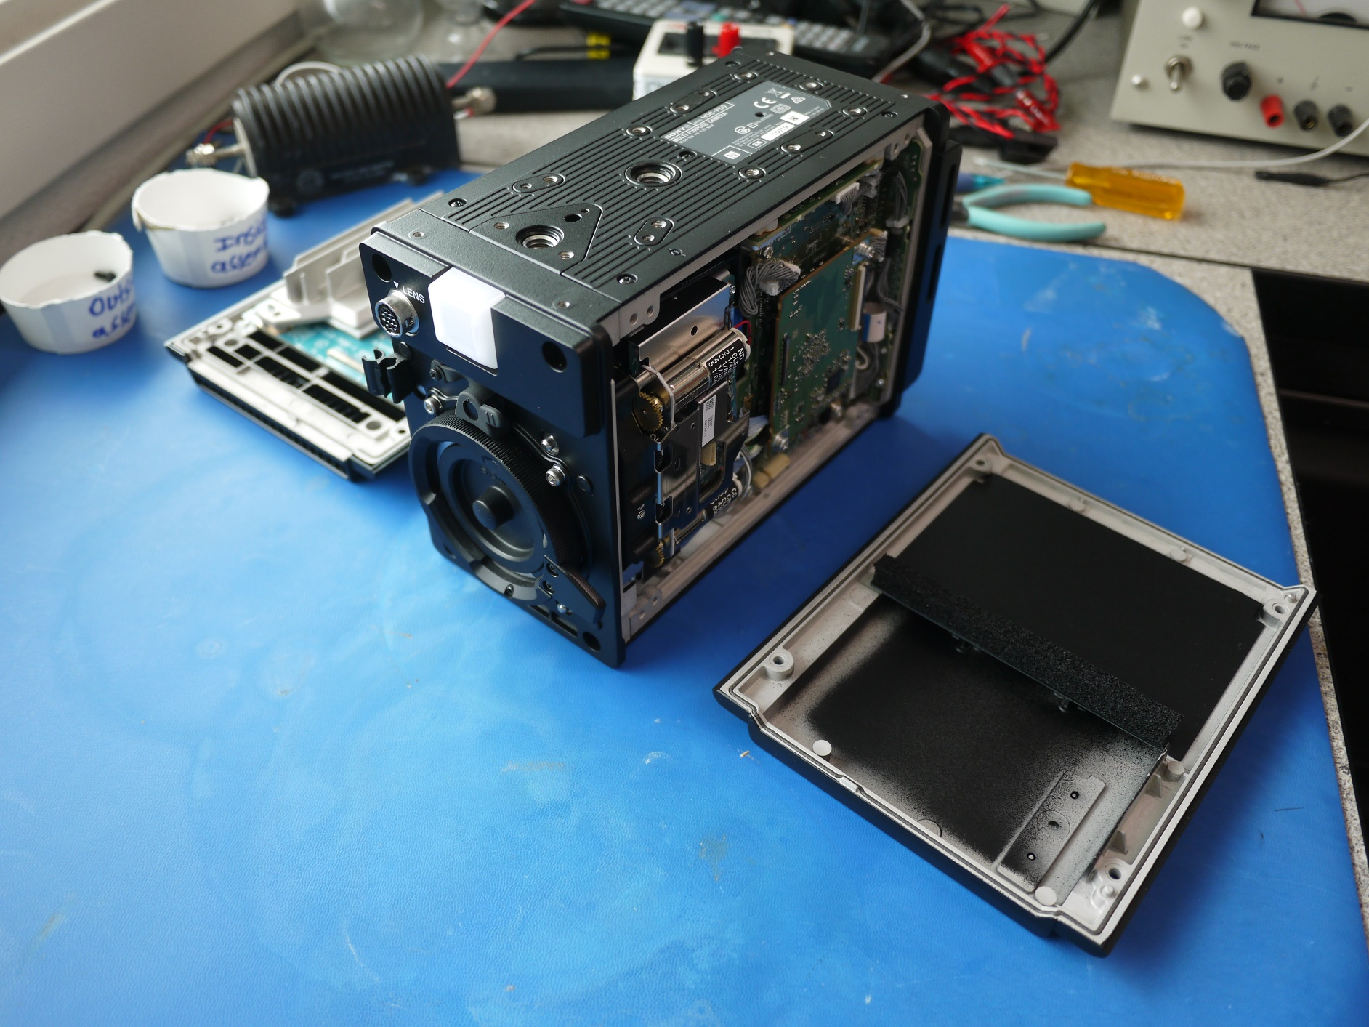

Slide 28
