Slide 1
MBARI 4K ROV Camera Project Concept Review
November 13, 2019
It is vital that this project produce a camera system that produces the highest quality image but also is fully operational on a day-to-day basis, compatible with both ROV's and supportable over it's operational life.
It is important at this early stage that necessary features to allow this can be incorporated into the requirements from the beginning.

Slide 2
Attendees
Operations
  Ben Irwin
  Dave French
  DJ Osborne
  Mike Burczynski
  Craig Dawe
  Bryan Shaefer
Science
  Jim Barry
  Steve Haddock
  Kim Reisenbichler
Video Lab
  Lonny Lundsten
Engineering
  Andy Hamilton
  Francois Cazenave
  Paul Roberts
  Todd Walsh
conflict
conflict
conflict
project team

Slide 3
Post-review notes (by Paul Roberts) have been added to notes section of slides!
Major action items from review notes:
MC: Mark Chaffey
DJ: DJ Osborne
CD: Craig Dawe
JB: Jim Barry
BE: Ben Erwin
FC: Francois Cazenave
MB: Mike Burczyski
KR: Kim Reisenbichler
LL: Lonny Lundsten
SH: Steve Haddock
BS: Bryan Shaefer
Set camera operating temp range max. to GOC surface temp.
Work with Ricketts to set maximum size envelope allowed.
When a better total power requirement is known work with Ventana and Ricketts on electrical connector and voltage specification. Seacon MINK 10#20 is preferred.
Dual focus rate controls on lapbox.
Lens position feedback required.
Flare shroud must accommodate different laser arrangements. (easily swapped?).

Slide 4
902001 ROV 4k Camera Project Summary
Both DMO and the Video lab recommended MBARI start working toward incorporating 4k or UHD video into our vehicles.
We tank tested cameras from Sulis, SubC, DSP&L and Insite Pacific.
  Sulis and DSP&L had pretty good optics but very poor zoom and focus controls.
  SubC and Insite Pacific had poor optics and very poor zoom and focus controls.
We were unable to identify a commercial product significantly better than the existing Zeus Plus HD cameras.
A 2020 project was proposed and approved to build a high quality 4K camera system.
  Some project funds have been moved to 2019 buy-ahead.
  Prior to committing funds – and development direction – review is needed.

Slide 5
Goals of the Meeting
Update on the current status of the ROV 4k camera project.
  Overall plan of action.
  Schedule.
Review the camera system requirements – ESPECIALLY the operational requirements.
  Size and weight limitations.
  Connector specifications
  Fiber compatibility.
  Vehicle interchangeability.
  “Maintainability”
Review the current system design.
  Camera and lens selection.
  Size and weight estimates.
  Telemetry system.
  Optical dome port and housing.
  Topside control box.
  File recording and transfer.
Notes:
SH: operation requirements only for this meeting?
MC: Requirements doc have the full requirements
DJ: No other nibbles except for DSPL?
MC: DSPL is contracted so we are paying them
BE: What rights will DSPL have?
MC: They will provide housing and optics and may sell cameras using the design to others
KR: Wouldn’t folks be better off buying later?
MC: Maybe, but don’t tell them :)
JB: Details haven’t been worked out in MBARI recovering NRE but we would recoup from the cost if other groups buy these cameras as well.
SH: have the sensor and optics been decided
MC: Basically yes, they have.

Slide 6
Project Plan of Action
MBARI will build and integrate the camera system.
  Modify standard camera to fit in the smallest housing feasible.
  Design and build all other internals and telemetry.
Deep Sea Power & Light will design and the build housing.
  Optical dome port.
  Relay optical system and mounts.
  Titanium housing.
Actively seeking additional users to share in NRE costs (OET, SIO, etc.)

Slide 7
Development Schedule
The following dates reflect the current schedule. They are may change, but the plan is to adhere to this schedule if possible.
First release RFP for optics and housing to potential vendors. September 20, 2019. (done)
Deadline for initial vendor response. October 10, 2019. (done)
Final vendor selection. October 31, 2019. (done)
MBARI releases final housing internal diameter and internal length. January 24, 2020.
Critical design review (CDR) of complete design including vendor optical and housing design and MBARI camera system. Final review of all interfaces, connector ports, lens alignment fixtures, chassis to housing interface, etc. February 20, 2020.
Release to fabrication following the resolution of any issues raised in the CDR. ASAP following CDR.
Final assembly of all camera system components (MBARI and vendor) August 12, 2020.
At-sea testing completed. September 4, 2020.

Slide 8
Camera System Requirements
Full camera systems requirements are here: \\Atlas\ProjectLibrary\902001_4K_ROVCameraDevelopment\EngineeringDesignDocuments\4KCameraRequirements\4KCameraMBARIRequirements.pdf
Important operational requirements – lens control…
Lens position logging still a requirement?
Notes:
CD: The focus of the old Sony was super camera control, since then haven’t experienced anything as good. Huge effort and it was great.
MC: That level of control is a requirement.
MC, SH, CD, KR: need to have focal setting of the lens relayed back to the system to be recorded and used later (scale est, etc)
SH: Even the current controller can be improved. Hard to focus on the photophore of fish. Didn’t have fin enough control.
JB: Would be nice to have control of the fineness of focus (coarse or fine).
MC: Rate control for the zoom is very important.
JB: Could have a coarse and fine slider
DJ: These control are even more import for 4k resolution.

Slide 9
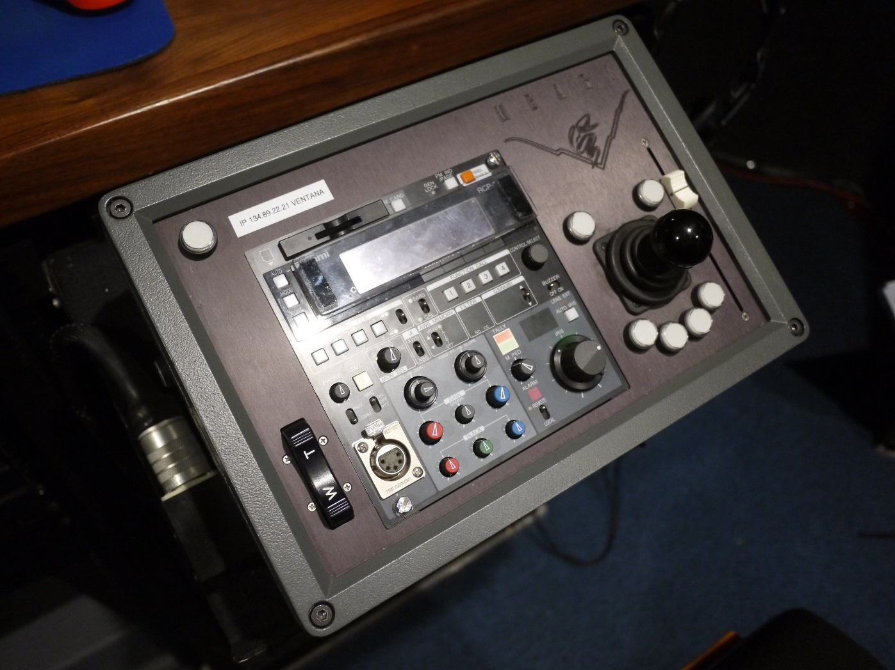
Camera controls
Focus Position Slider
Pan & Tilt Control
Zoom Rate Control Rocker Switch
Ikegami RCP
Focus example
https://www.youtube.com/watch?v=X8oWnbcLI40
(2,794,882 views)
Notes:
MC: What about the box overall
SH: Lot of wasted space
BE (and many): unused controls
DJ, BS BE, MC: iris control is required BS others can be remoted
MC: sony controller is too big to fit in box, but the subset can fit,
SH: iris, white balance and gain are required
MC: Would be nice not to have to hack it

Slide 10
Camera System Requirements continued…
Important operational requirements – Status monitoring.
Add allowable seawater operating temperature range for camera system? What should it be? See below also.
Notes:
MC: thermal shutdown
DJ: you’d still have comms to the camera?
MC: yes
SH: does higher temperature cause red shift?
MC: I’m not sure, they work hard to maintain image quality over temperature range
DJ: I thought it was 50 W
MC: maybe up to 80
DJ: we may need a different connector
MC: not really anyway around the power draw
(Many): temperature shutoff is a great idea!

Slide 11
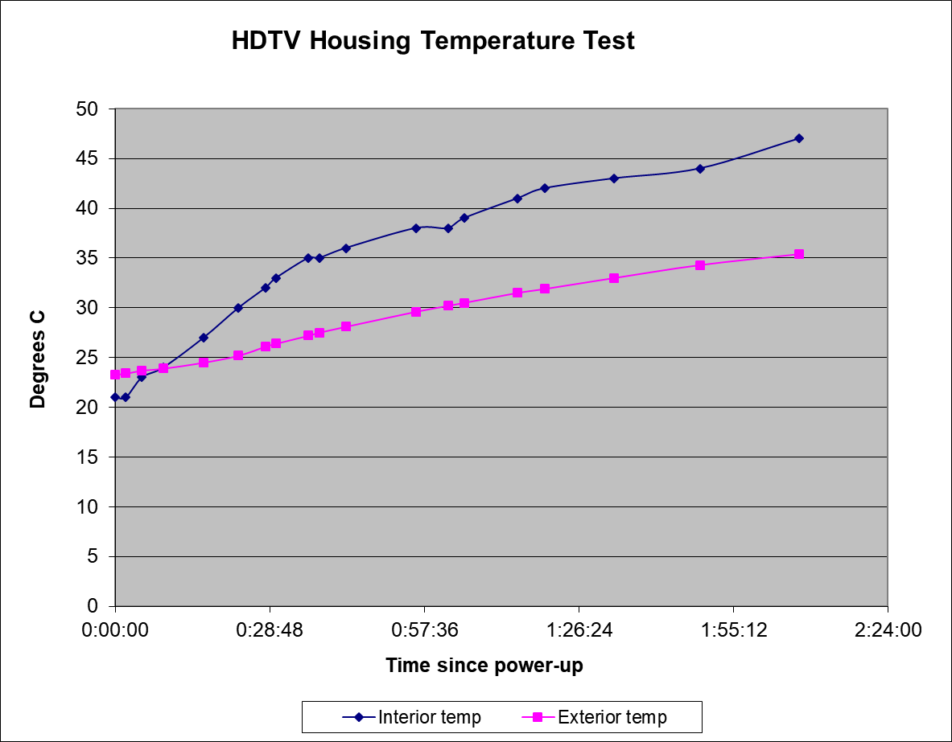
Titanium Housing in Air Example
72 Watts in air temperature test
Auto shutdown requirement protects against:
  If cooling fan fails.
  If camera is accidently left on in air.
Overheating above 40 degrees C will permanently damage electronics.
1 hour cutoff

Slide 12
Camera System Requirements continued…
Important operational requirements – Telemetry system
Notes:
Question: Are we all OK with a single-mode “dark” fiber?
BE: on Ricketts will always have dedicated fiber
DJ: this is also true on Ventana
MC: like to keep it at single fiber and power
(Many): best compatibility from single fiber
JB: likely want to have multiple cameras soon after deployment

Slide 13
Camera System Requirements continued…
Important operational requirements - Housing
Notes:
CD: What is the port lifetime based on?
MC: Depends on the method used to test the port
SH: 99.5% is over the 5-years or per dive?
MC: over the 5-years
CD: cost of domes is around $6000 so not too expensive

Slide 14
Camera System Requirements continued…
Important operational requirements - Housing
It has been pointed out that this does not specify a maximum external size. There is a more detailed discussion on size in the system design below. Having DSP&L design the housing makes this specification more important and we need to set a maximum operational size specification.
Notes:
MC: DSPL needs an envelope for size
BE: we already have some size issues.
Additional notes on size (mark). Heard comments that diameter was not as much as issue as length. Craig D. commented that he did not think that the old HD camera was necessarily too large for Ventana, replacement was more of a reliability move. Also mentioned that problems may have been due to vibr-coring and shaking the camera.
Bryan S. thought that size was defiantly an issue on the Ricketts, especially length. They have about an inch clearance front and back. When panning and tilting.

Slide 15
Camera System Requirements continued…
Important operational requirements - Housing
Add seawater temp range for camera operation? 27 C might be hard to do….
Change to Seacon MINK10 (2#14, 8#20) FCR? Can this connector on the ROV provide 70-80 Watts (3.4A @ 24V)? Best voltage range for ROV?
Notes:
MC: need to add camera temp operation requirement
JB, many: gulf of california should set the upper limit
Connectors:
MC: compatibility
DJ: don’t have to use the MINK19
DJ: MINK10-L might be a good option gigabit path
BE: have several paths for MINK10-L
BE: but our MINK10-L ar AC 110
DJ: Same as our ports
MC: Let’s continue to work on connector options
DJ: One option is to use a mink10 and double up the pins
MC: what about Seacon?
(Many): all manufacturers have supply issues these days
MC: Should have RA connectors for both fiber and power
(Many): agree
DJ: Buy in on seacon fiber connector?
(Many): Yes

Slide 16
Camera System Requirements continued…
Important operational requirements – Additional
Include provision for laser mounting on the same plane as the camera in the dome support and hood design. (DJ).
Power supply
  18 to 36 VDC at 70-80 Watts.
  What is the best voltage range for the ROV’s?
Any requirements needed for seamless Ricketts to Ventana compatibility.
Specific requirements for maintenance and support?
Other missing requirements?
Notes:
MC: What about voltage?
(Many): most likely 24V is okay
MC: most likely 16-36 switcher in the housing.
MC: I’ll add the laser mount provision in the flare guard
DJ: Want to move the lasers to the hemisphere
BS: Ours are off the side
MC: any shroud design needs to take into account mounting the lasers on the side
(Many): multiple lasers
MC: Multiple shrouds for different lasers

Slide 17
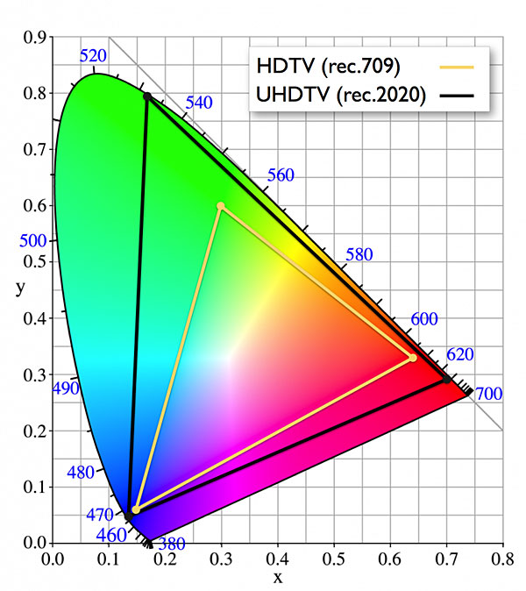
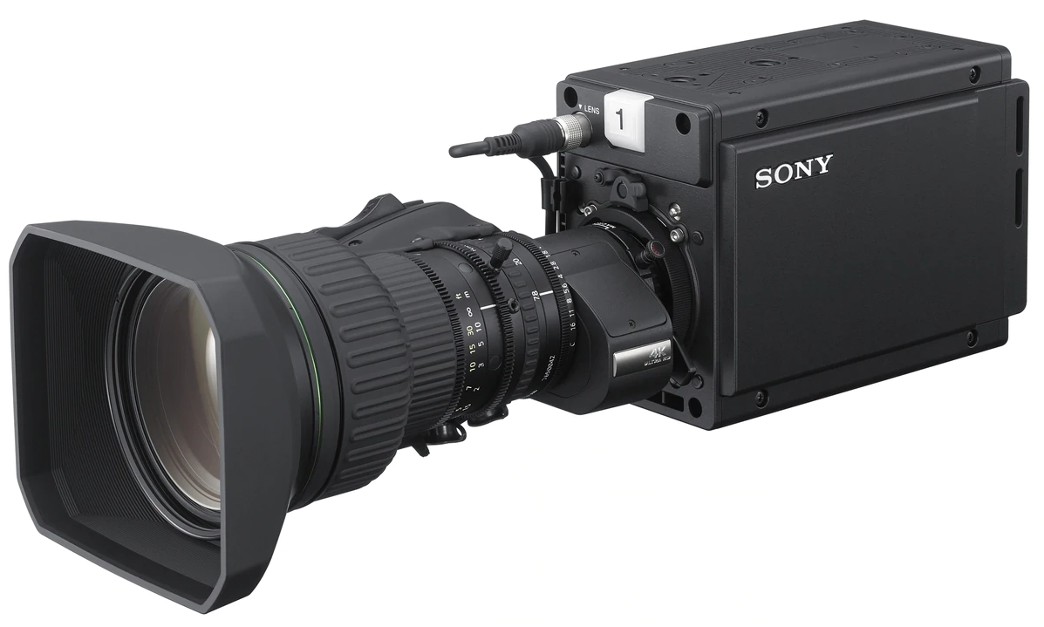
Best Candidate Camera Module
Sony HDC-P50
  2/3” 3-Chip CMOS imager
  4096x2018 progressive scanning @ 60 frames/sec.
  Box camera version of HDC-3000/5000 top of the line portable cameras
  Global shutter
  ITU-R BT.2020 color gamut
  High Dynamic Range (HDR) capable
Lenses
  Fujinon UA13x4.5 BERA 4K UHD Wide ENG style lens with 13x Zoom
  Canon CJ12ex4.3B 4K UHD wide-angle lens with 12x Zoom
BT.2020 color space
Vs
BT.709 color space
Notes:
CIE Chromaticity Diagram (1931). The three dimensional color space CIE XYZ is the basis for all color management systems. This color space contains all perceivable colors - the human gamut – based on experiments with actual human vision. Many of them cannot be shown on monitors or printed.
The two dimensional CIE chromaticity diagram xyY (above) shows a special projection of the three dimensional CIE color space XYZ.
Camera Sensor
MC: Want to use the latest HDC-P50 Ony camera, heli, wire cams, sports
BE: There’s a big advantage for the framerate and resolution at 60 FPS 4k
SH: What about low light sensitivity?
MC: About the same as the ikegami, f11, 2000 lux
JB: gain control?
MC: looks really good at gain +6
BE: Should we look at montior color space support
MC: yes
SH: color bit depth?
MC: I think it’s 10 bits, which is greater than the human eye
MC: HDR is perhaps a big improvement
(Many) need to discuss HDR options for monitors
SH: Does HDR impact frame rate
MC: no, it’s a different gamma setting, no frame to frame processing
Lens
MC: Lens?
JB: hate to give up zoom
SH: like to have close focus
MC: Jim you want more zoom?
JB: we want to get in as close as we can for distant targets but also don’t want to compromise other features
MC: we’ll look at zoom options
MC: Lenses are super wide, can we stop them down
DJ: more is better but the same works
Long discussion about how wide to go
MC: TBD on this question

Slide 18
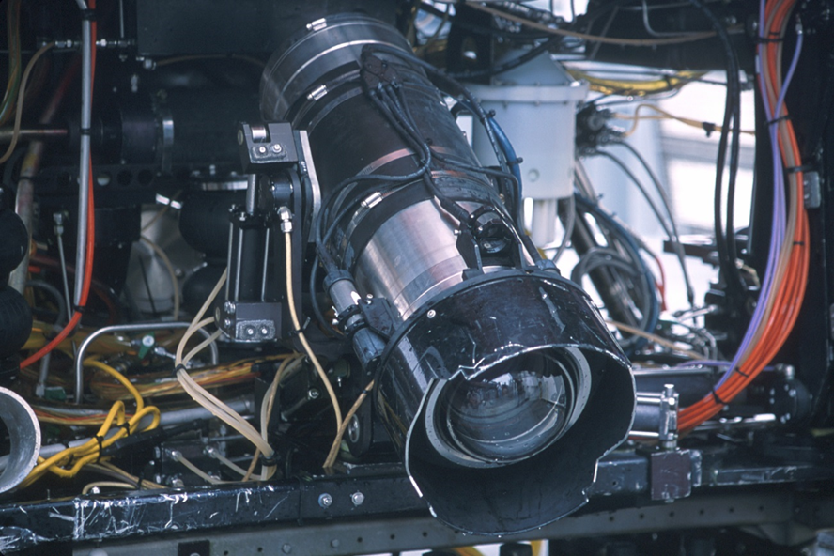
Size and Weight Estimates
Original HD camera was too large for best integration.
Zeus Plus size/weight successful on both vehicles.
4K camera needs a 6” ID dome for not compromising the optical design, the same dome size as original HD camera.
Careful design of the 4K dome retainer and glare shield should result in a overall size similar to Zeus Plus.
Need to specify in detail maximum dimensions for camera package to provide guidance for DSP&L design effort.
Target camera size
Notes:
DJ: will the shroud be inside or outside of the current round shroud
MC: it won’t be any larger in any dimension.
MC: I’m happy with the camera.
DJ: cost?
MC:$70k, but we can get them for ~$30k
MC: Go on record that the current housing is too big. The Zeus seems to be a workable size
MC: The goal is to get it in the Zeus size
(Many): Cool!
SH: PT has some vibration now and needs to be fixed.
BE: We’re looking into to the ROS PT options to reduce vibration
MB: How many cameras will we have?
MC: three, so we will have a spare
BE: Length is the bigger limit
SH: What is the length of camera+lens?
BE, BS: going to square shroud will buy us inches
MC: Shorter is better, but I think it will fit in Zeus housing

Slide 19
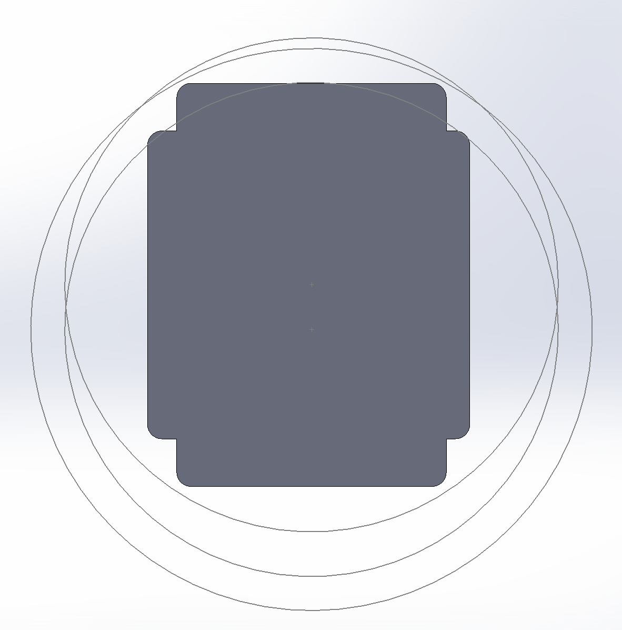
The Challenge of a Small Housing with the P-50 Camera
No camera modifications
  Housing internal diameter 7.72 inches (same as original HD camera).
Do not move optical block
  Requires more space in upper chassis
  Housing internal diameter 6.75 inches (same as Zeus Plus).
Move optical block up 15.5mm
  Probably not possible. But 5-10mm may be OK.
  Still will require upper chassis modification.
  Housing internal diameter 6.75 inches (same as Zeus Plus).
Final design will compromise by moving the optical block up slightly and modifying the upper chassis frame also. Maximum target internal diameter is 7 inches.
Geometric center
Optical center
Notes:
DJ: What does service look like
MC: Board swap red/green light for status, user service is straightforward
DJ: Can we vibercore with it?
MC: sounds like a bad idea
JB: is there a way to add bumpers to isolate the camera from vibration,
BE: depends on wavelength of vibration
SH: is there any smaller camera with the same specs?
MC: not that I know of
CD: can the camera fit unmodified in the larger housing?
MC: could you tolerate a larger housing?
(many): some agreement
CD: can Ricketts handle it?
BS: maybe, but can do it without a shorter housing.
DJ: thinking of a product, the smaller housing is a benefit
MC: also nice to have a drop in replacement
CD: drop-in with a larger housing might be more appealing.
JB: Action item: what are the size and weight limits for the ricketts
(Many): Advantages to smaller size and some disassembly

Slide 20
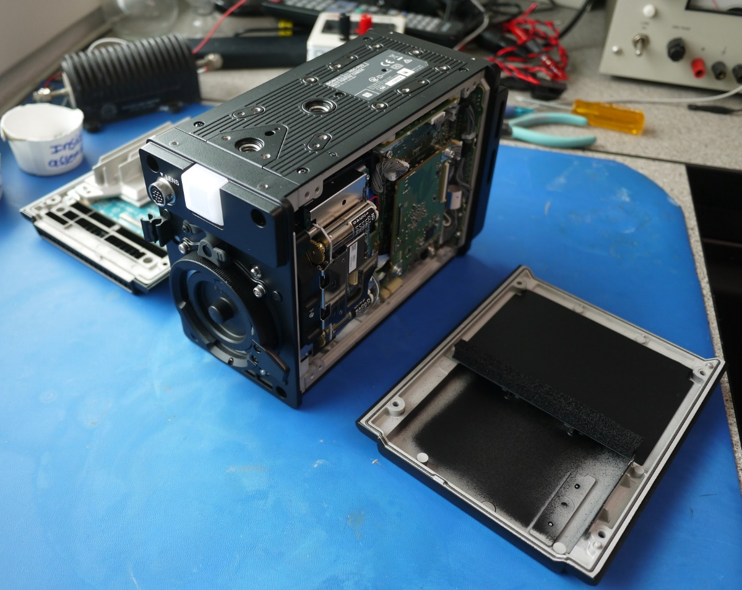
Chassis Modifications
Anticipate custom front, rear and top chassis frame elements.
Maintaining designed airflow is critical.
Advantages of modification.
  Smaller, lighter housing.
Dis-advantages of modification.
  Will Sony provide repair service?
  May have to re-assemble in original frame for factory service (1-2 hours of careful effort).

Slide 21
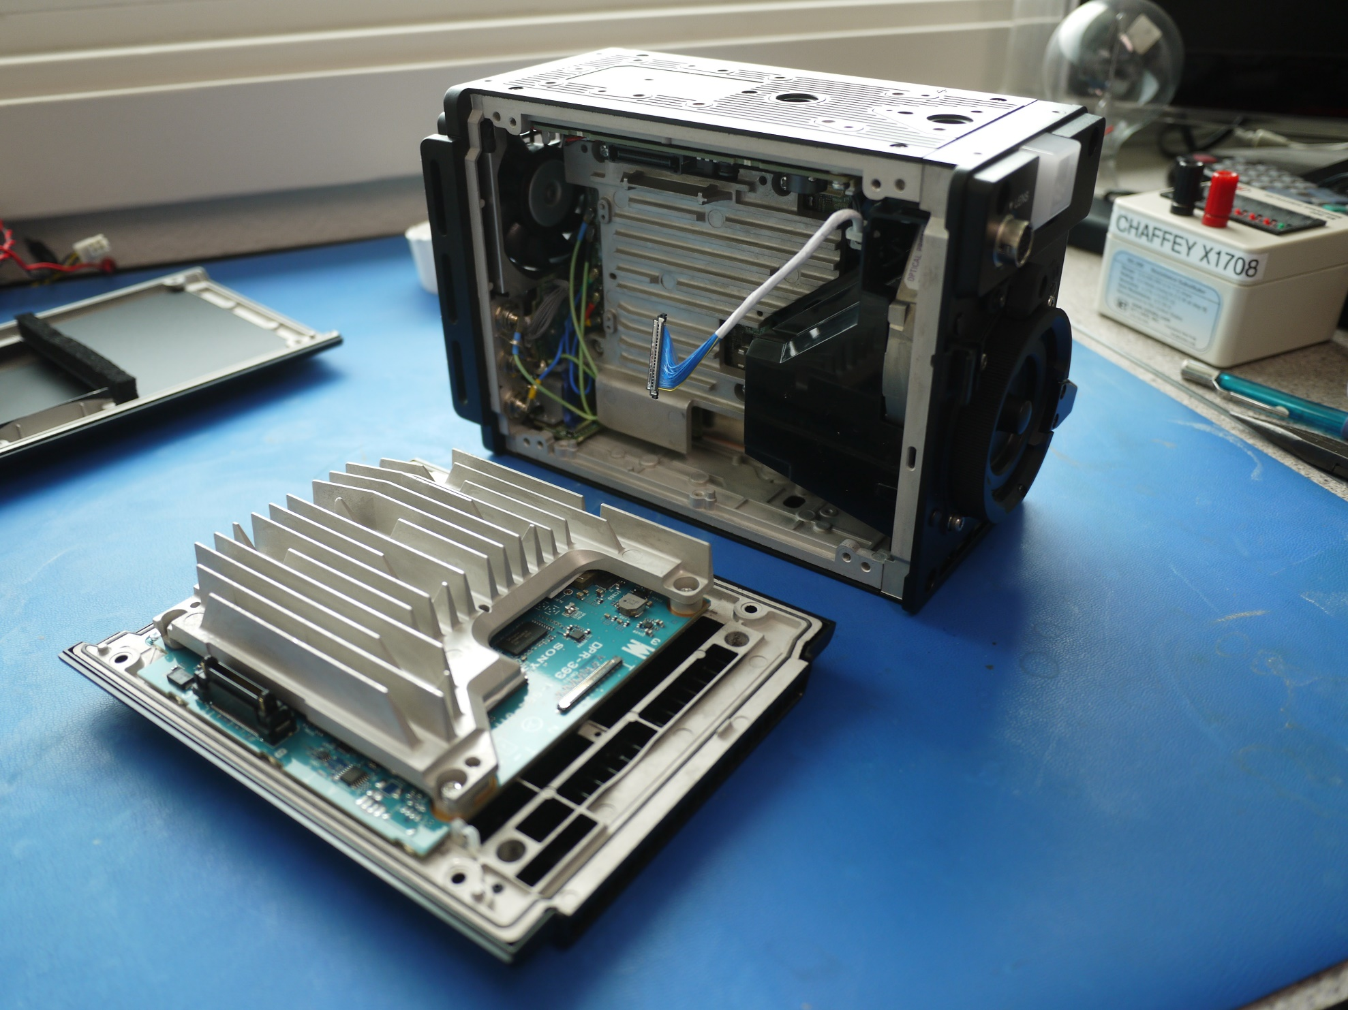

Slide 22
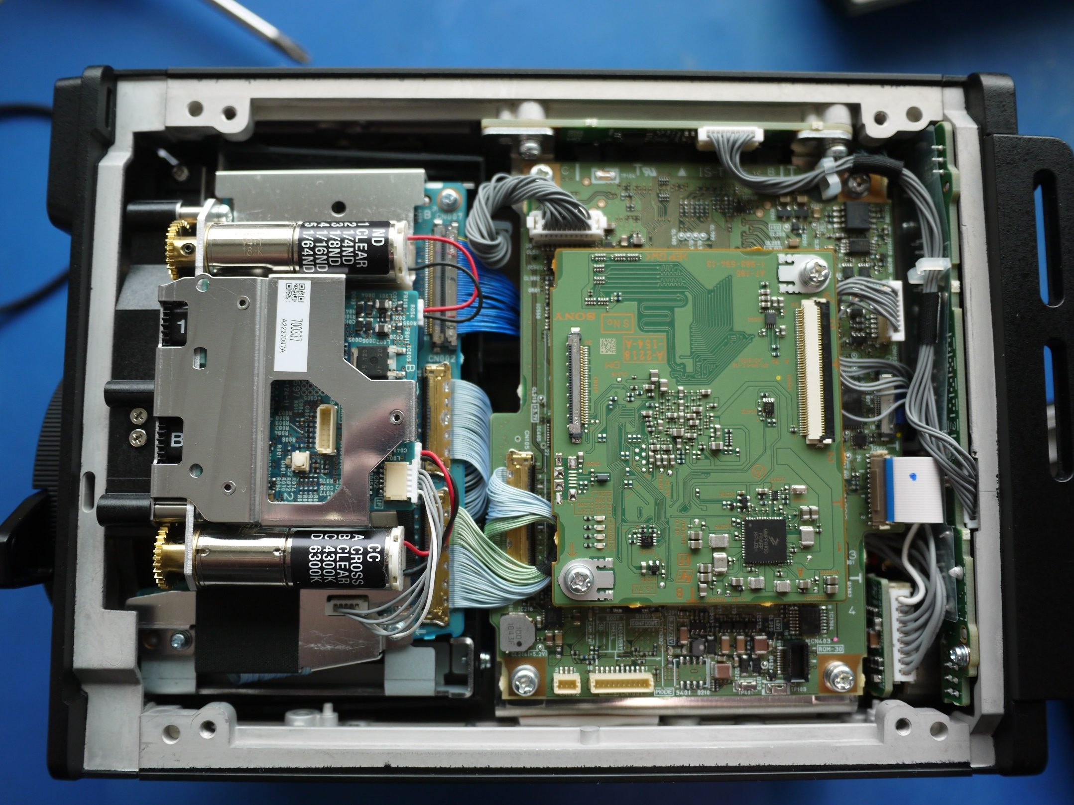

Slide 23
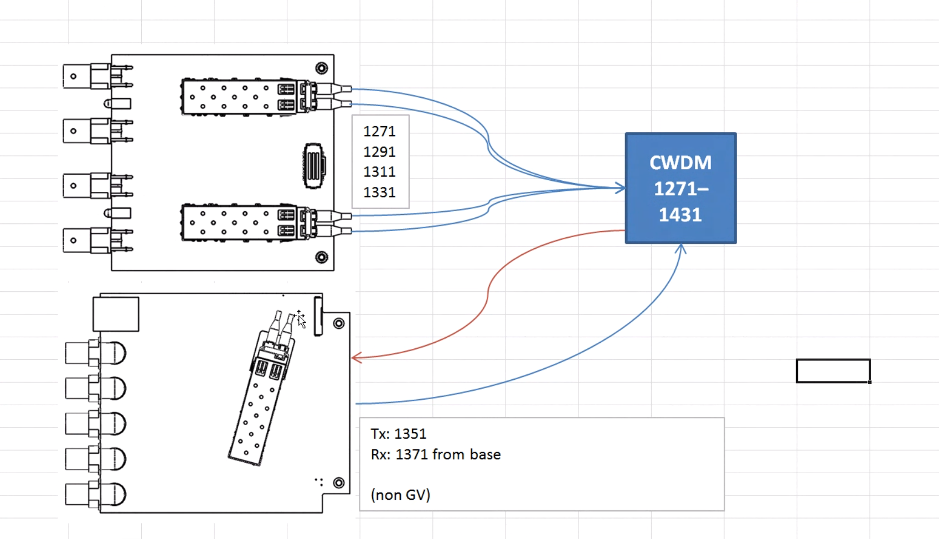

Slide 24
Argument for Modifying Frame
Optical block
Camera electronics are all digital and on four main PCB’s.
  Less tuning than previous cameras.
Existing cables are long enough.
  High speed coax cables extremely hard to modify.
Board level diagnostics and service manual support in-house service if necessary.
  Vector scope and standard tools are all that is required.
Careful design – especially maintaining temperature control – should result in a very reliable system.
Micro coax cables

Slide 25
Telemetry System - Top to Bottom Architecture with Off-the-Shelf Grass Valley / Telecaster Telemetry
Grass Valley T-POV-3244-TDL-CA-12V
Notes:
Telemetry
Telecaster option
MC: simplest, least risky option for 4k
SH: zoom, focus, iris would talk to telecaster?
MC: yes
BS: is camera control over ethernet?
MC: it would be over serial, and that should be better for lag
MC: Andy has a micro in mind for this

Slide 26
Optical Dome Port and Housing
  Deep Sea Power & Light is designing and building the housing assembly.
    Optical dome port.
    Relay optical system and mounts.
    Titanium housing.
    Will retain the optical engineer MBARI used for i2MAP (Remijan).
    Providing a One year warranty on design and materials, following with time and materials repair and replacement.
  Why use outside vendor?
    Vendor can provide on-going maintenance and repair support for the optics.
      Requires clean-room environment.
      Parts stock.
      More important with multiple operational units, i.e. at least two cameras.
    Reduces MBARI technical risk.
      Accelerates schedule.
      Vendor has direct experience.
    Use of vendor increases chances of additional users signing on to share NRE.
  MBARI is performing the final camera systems integration and testing.
Notes:
Vendor
(many) Good idea to use outside vendor and DSPL is a good option

Slide 27
Camera controls
To add stand-alone capability, add alarm lights for:
Over-temperature
Humidity alarm (>20%?)
Water alarm
Focus Position Slider
Pan & Tilt Control
Zoom Rate Control Rocker Switch
Notes:
Topside Box
MC: plug compatible with existing box
SH: but without ikegami?
MC: yes
SH: should have an open slate for new focus controls
MC: Yes, but vehicle comms should be compatible with existing one.

Slide 28
Topside Control Box
Zeus Plus & Ikegami hardware

Slide 29
Current Lapbox Design Detail
Replace with Sony RMB-170
Replace with MBARI Micro PCB

Slide 30
Lens Drive Servos and Housekeeping
MBARI in-housing PCB provides the following functions.
  Analog lens drive signals for zoom and focus.
  Power conversion and monitoring.
    Over-temperature camera shutdown.
  Local environmental monitoring.
    Temperature.
    Humidity.
    Pressure.
    Water alarms.

Slide 31
Lens Drive System
Notes:
Lens Drive
SH: can you still get the lens settings read out with analog control?
MC: likely yes, control with analog and read out on 232
MC: 232 control does not look very good
MC: proposed action is to use the analog control input and 232 to read position
KR: so the lens has their own feedback and control?
MC: yes, that’s how they get the super fine control
SH: what about bringing up the controls all the way up to topside?
MC: if you lied their controls then that might be feasible
JB: it would be nice to see how good the fujinon controls are
JB, SH: like having dual sliders
SH: what other controls are there?
MC: Camera controls are on the smaller sony box

Slide 32
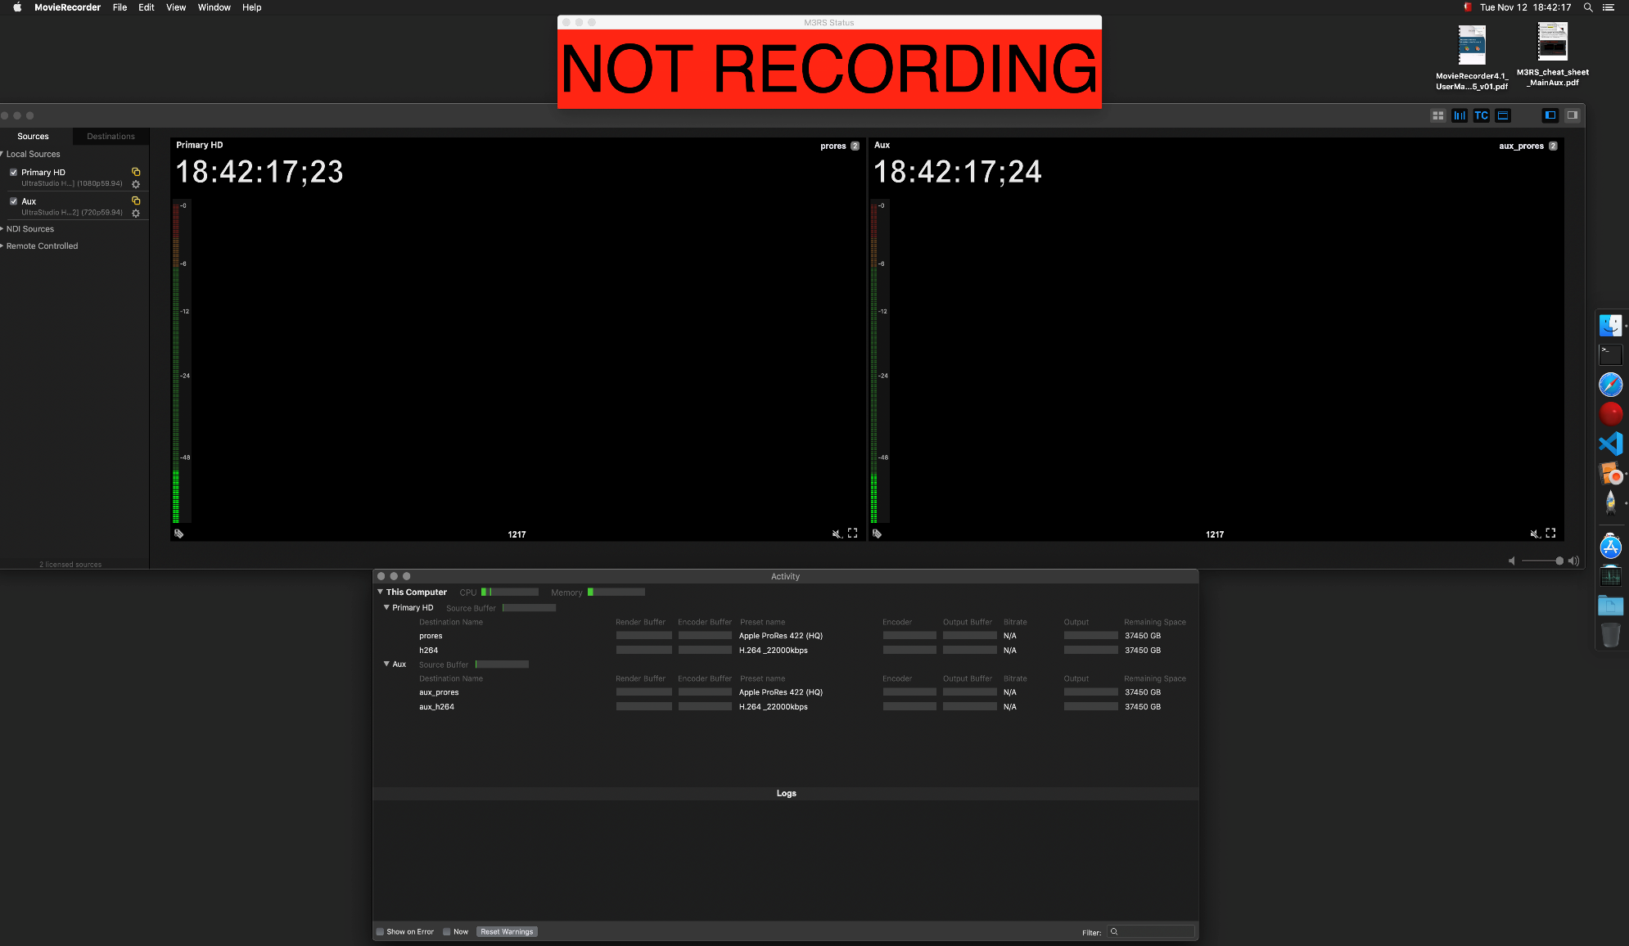
File capture and transfer -- M3RS
Shipboard, lab, mobile versions (e.g. miniROV)
    Records current camera stream and future cameras (up to 4K)
    Records multiple streams, 2 now, up to 16
    Recorded to HDD RAID now, LTO-8 in near future
M3RS (replaces video tapes)
Notes:
Recording
LL: planning to use M3RS can support up to 16 4k feeds
BE: worry about rack and loose thunderbolt cables
LL: the new rack mount will have BNC
BS: the only issues have been user error
DJ: Mark is there money with topside upgrades?
MC: no
BE: Monitors would be good
SH: what about overlay?
BE, BS: we are working on that
SH: can you fly with 4k overlay
BS: Yes, but there is work to do for upgrades next year
DJ: sounds like there is time to adapt to 4k
MC: glad to hear the file capture is going well

Slide 33
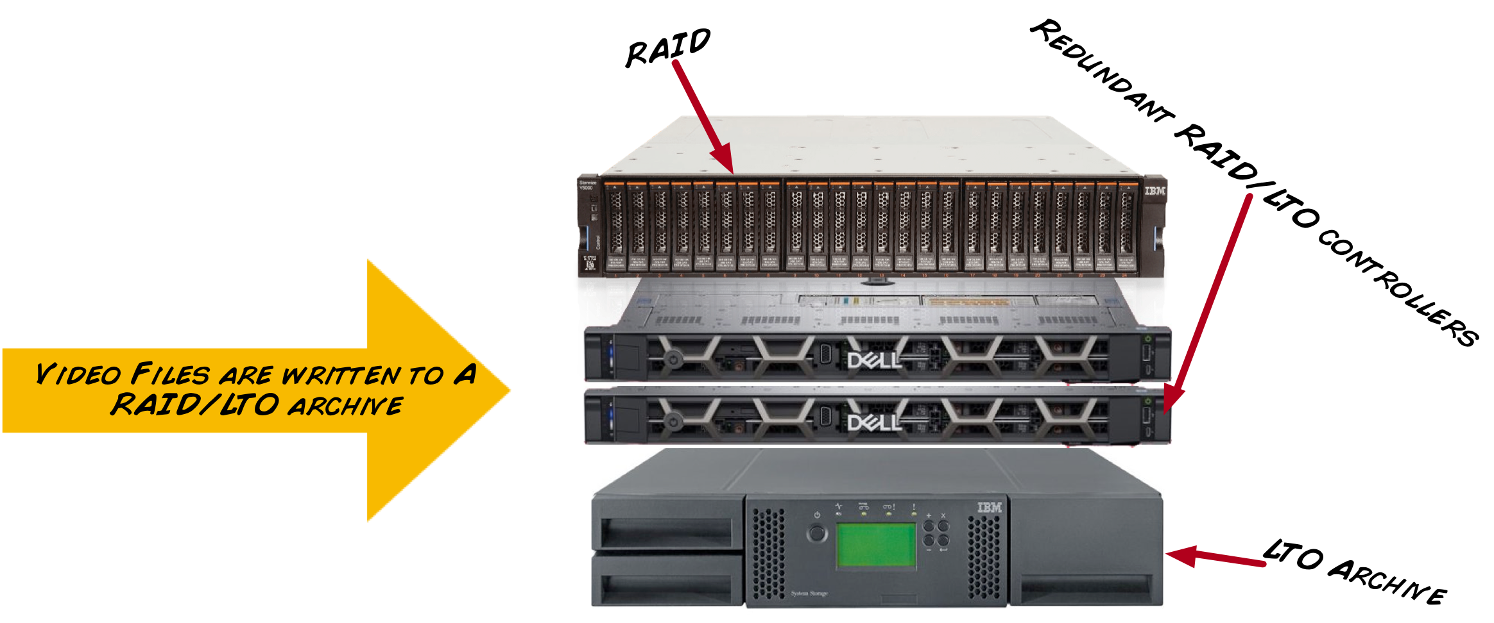

Each video has correct creation-time metadata
2018-09-22T10:25:01Z
2018-09-22T10:40:01Z
2018-09-22T10:55:01Z
2018-09-22T11:05:01Z
2018-09-22T11:20:01Z
ProRes HQ
~ 25GB
H264/MP4
~ 2.5GB
Video is recorded in 15 minute chunks

Slide 34
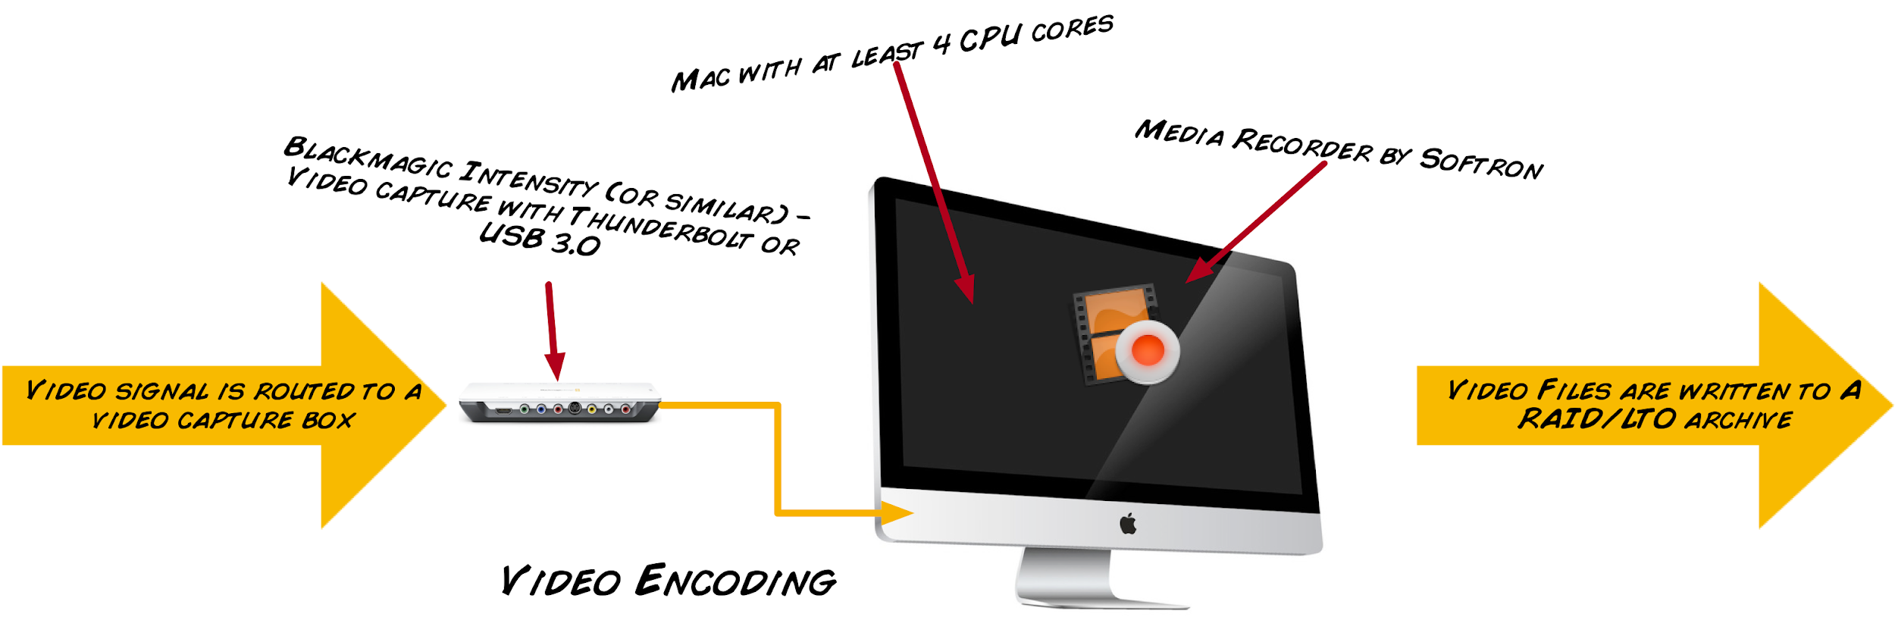
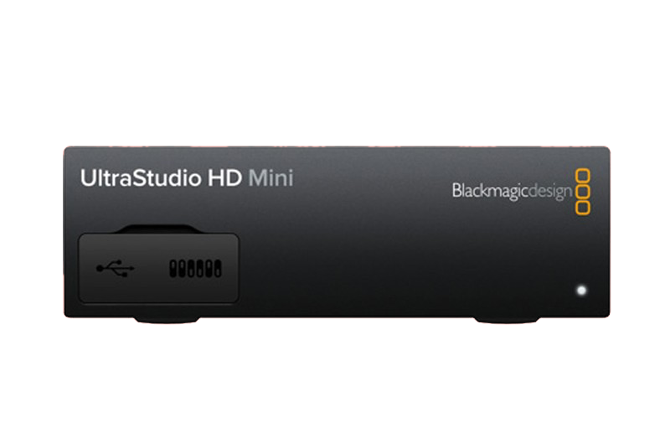
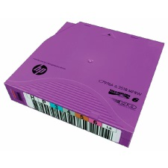
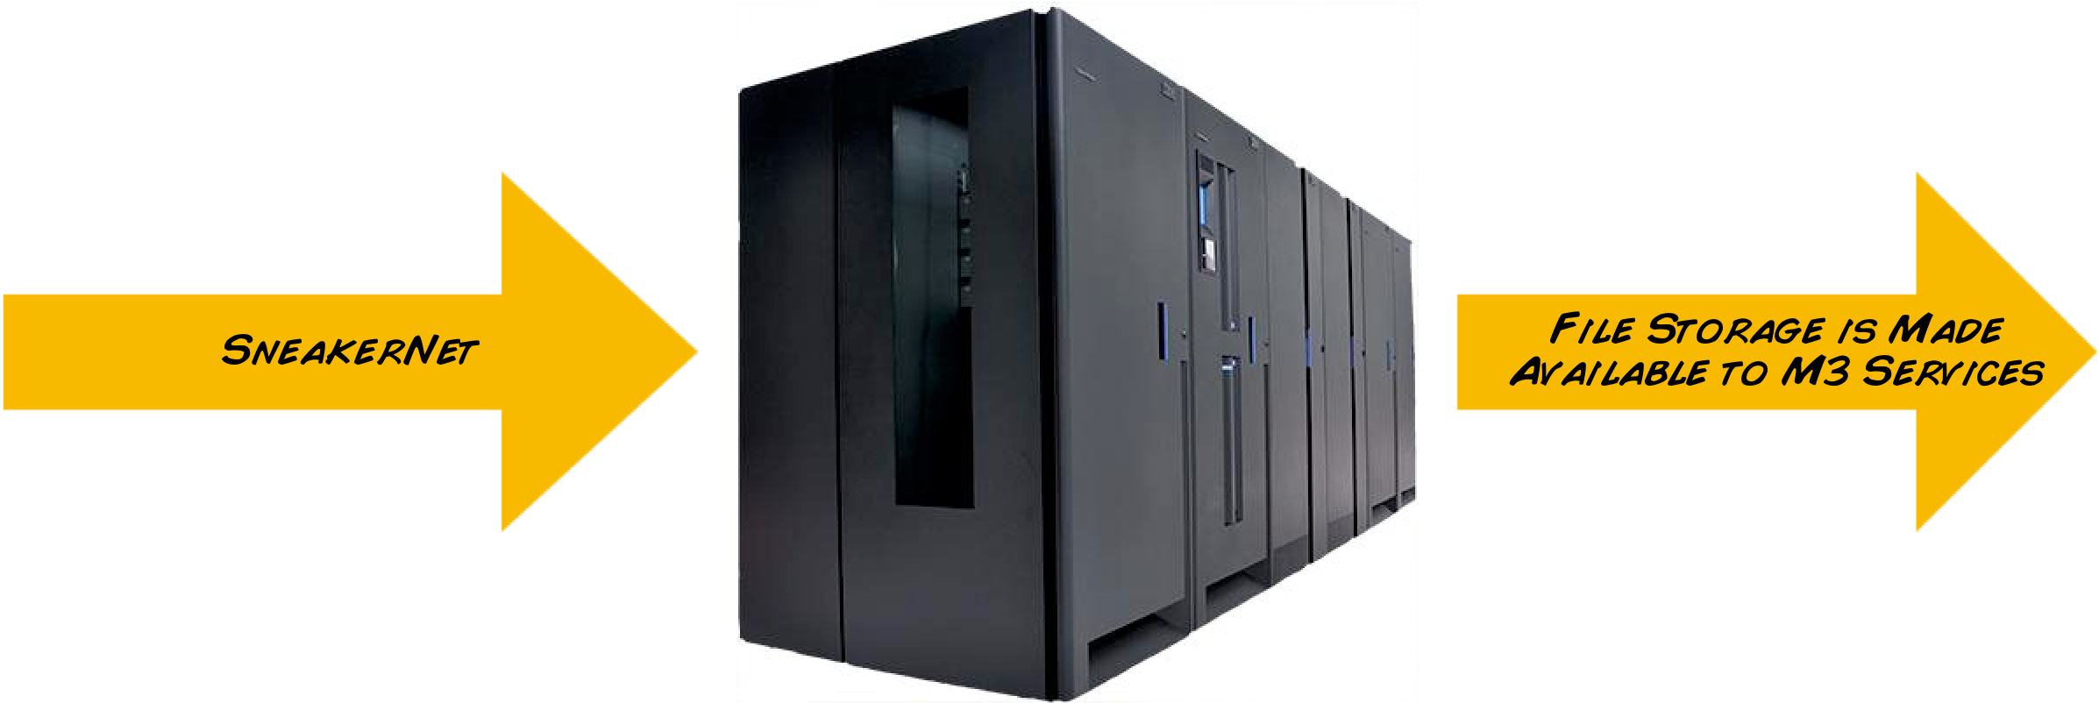

Slide 35
Technical challenges including long term data storage
4K video at 60 frames per second (4096 x 2160 60p) is a very large jump in the amount of data.
  Master level Apple ProRes Codec 422 HQ is about 848 Gigabytes per hour.
  Mezzanine level H.264 or H.265 Codec is around 10:1 or 85 Gigabytes/hr.
The MBARI Titan network share system has the capacity to support 4K video acquisition on MBARI’s main vehicles for at least 10 years.
Over a period of time the video data would grow to be by far the largest data share at MBARI.
Are there responsible ways to reduce the 4K total video data volume while preserving the value of video data thereby lowering the resource and capital cost?

Slide 36
Next Steps
Update requirements.
  Add new and refine existing requirements.
  Generate interface control document with DSP&L.
Order camera and lens.
Begin chassis design.
Finalize telemetry and electrical system design.
Order telemetry system components.
Notes:
Summary
MC: need to formalize the connector issue and size of housing
MC: plan is to capture everything in 4k, 4k backup will always be kept, PI may decide to only keep some 4k.
MC: 840 GB / hour / vehicle, Todd has converted our system to be able to handle it easily.
MC: data will be hand carried over from ship, storage problem is solved at mbari
JB: about EOY spending, don’t buy unless you know it’s the one.

Slide 37
END

Slide 38
Top to Bottom Alternative Architecture

Slide 39
Cost Models for Handling 4K Video Data from the MBARI ROV’s
To examine possible strategies for reducing the cumulative data storage requirements for 4K video four different technical approaches and their respective cost models were examined:
Model A – Keep all 4K video data at the Master (and Mezzanine) level.
Model B – During annotation flag 15 minute clips for keeping in 4K, otherwise transcode to LT level.
  Requires extra labor and computing time ($).
  LT Clips can still be edited.
  All off-site backups are still 4K and could still be retrieved if necessary.

Slide 40
Four Different Cost Models for Handling 4K Video Data from the MBARI ROV’s, continued..
Model C – While recording on the ships, select recording (Codec) format.
  Master = Apple ProRes HQ (848 GB per hour) + Mezzanine.
  LT level = Apple ProRes LT (394 GB per hour) + Mezzanine.
  Once selection is made backups and on-line video will only be in the selected mode.
Model D - During annotation flag 15 minute clips for keeping in 4K, otherwise discard 4K and only retain Mezzanine level.
  Cost model assumes LTO tape can be re-used.
  Mezzanine level difficult to edit/copy (inter-frame encoding optimized for streaming).
  All off-site backups are still 4K and could still be retrieved if necessary.

Slide 41
Cost Model A – Keep all 4K Video at Master Level
Video Clip Quality:
Master
Mezzanine
Offsite Backup Tape Archive
848 GB + /hour
All Master and Mezzanine Level 4K Video Files
Master and Mezzanine Level File Capture & write LTO tape (MBARI M3 System)
On site Titan Disk and Tape store
4K Camera
848 GB + /hour
All Master and Mezzanine Level 4K Video Files
X 2 ROV’s !
Shipboard
On-shore

Slide 42
Cost Model D – Annotation Selects 4K Video at Master Level, All Else Mezzanine (H.265?) Only
Video Clip Quality:
Master
Mezzanine
Offsite Backup Tape Archive
848 GB + /hour
All Master and Mezzanine Level 4K Video Files
Master and Mezzanine Level File Capture & write LTO tape (MBARI M3 System)
Temp File Store
Onsite Titan Disk and Tape store
4K Camera
X 2 ROV’s !
Some Master Else Mezzanine Level 4K Video Files
Shipboard
On-shore

Slide 43
Annual Costs Model A: All Data + 4K ROV Cameras (4028 60p) + Converting Archive to Files
Expansion Space:
Annual Fixed Cost on and off-line = $0.70 per Terabyte Capacity ($16k per year + tape)
Current Space:
Annual Fixed Cost on and off-line = $12.08 per Terabyte Capacity ($188k per year + tape)

Slide 44
Model D Video Only Storage Volumes with 20% 4K Annotation Selects + Mezzanine
Expansion Space:
Annual Fixed Cost on and off-line = $0.70 per Terabyte Capacity ($16k per year + tape)
Current Space:
Annual Fixed Cost on and off-line = $12.08 per Terabyte Capacity ($188k per year + tape)

Slide 45
Model D - Video Only Storage Costs with 20% 4K Selects 80% Mezzanine vs. Model A – Keep All 4K Video
Pre-2018 D5 Tape Annual Cost
Pre-2018 D5 Tape Annual Cost
Scalable

Slide 46
2030 Storage Costs Model A, keep all 4K vs Model D, 4K selects

Slide 47
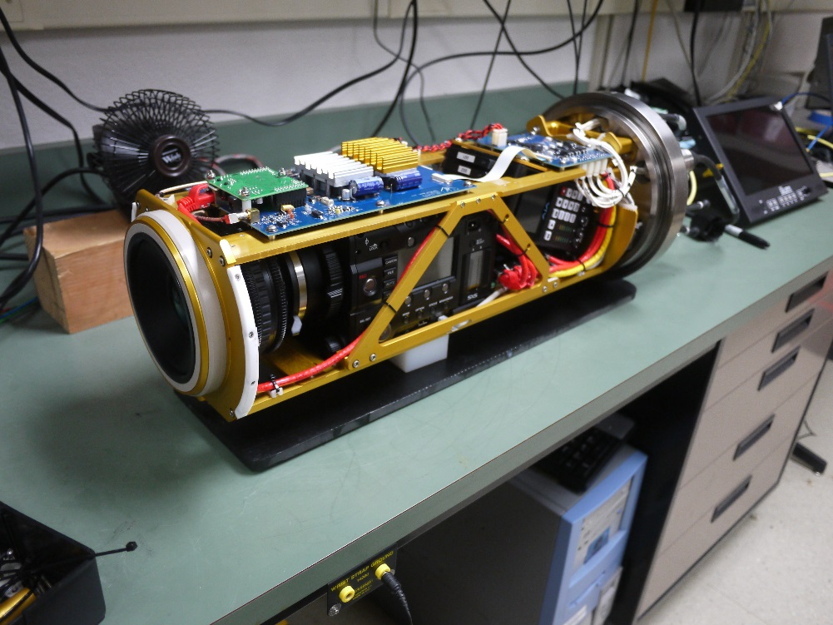
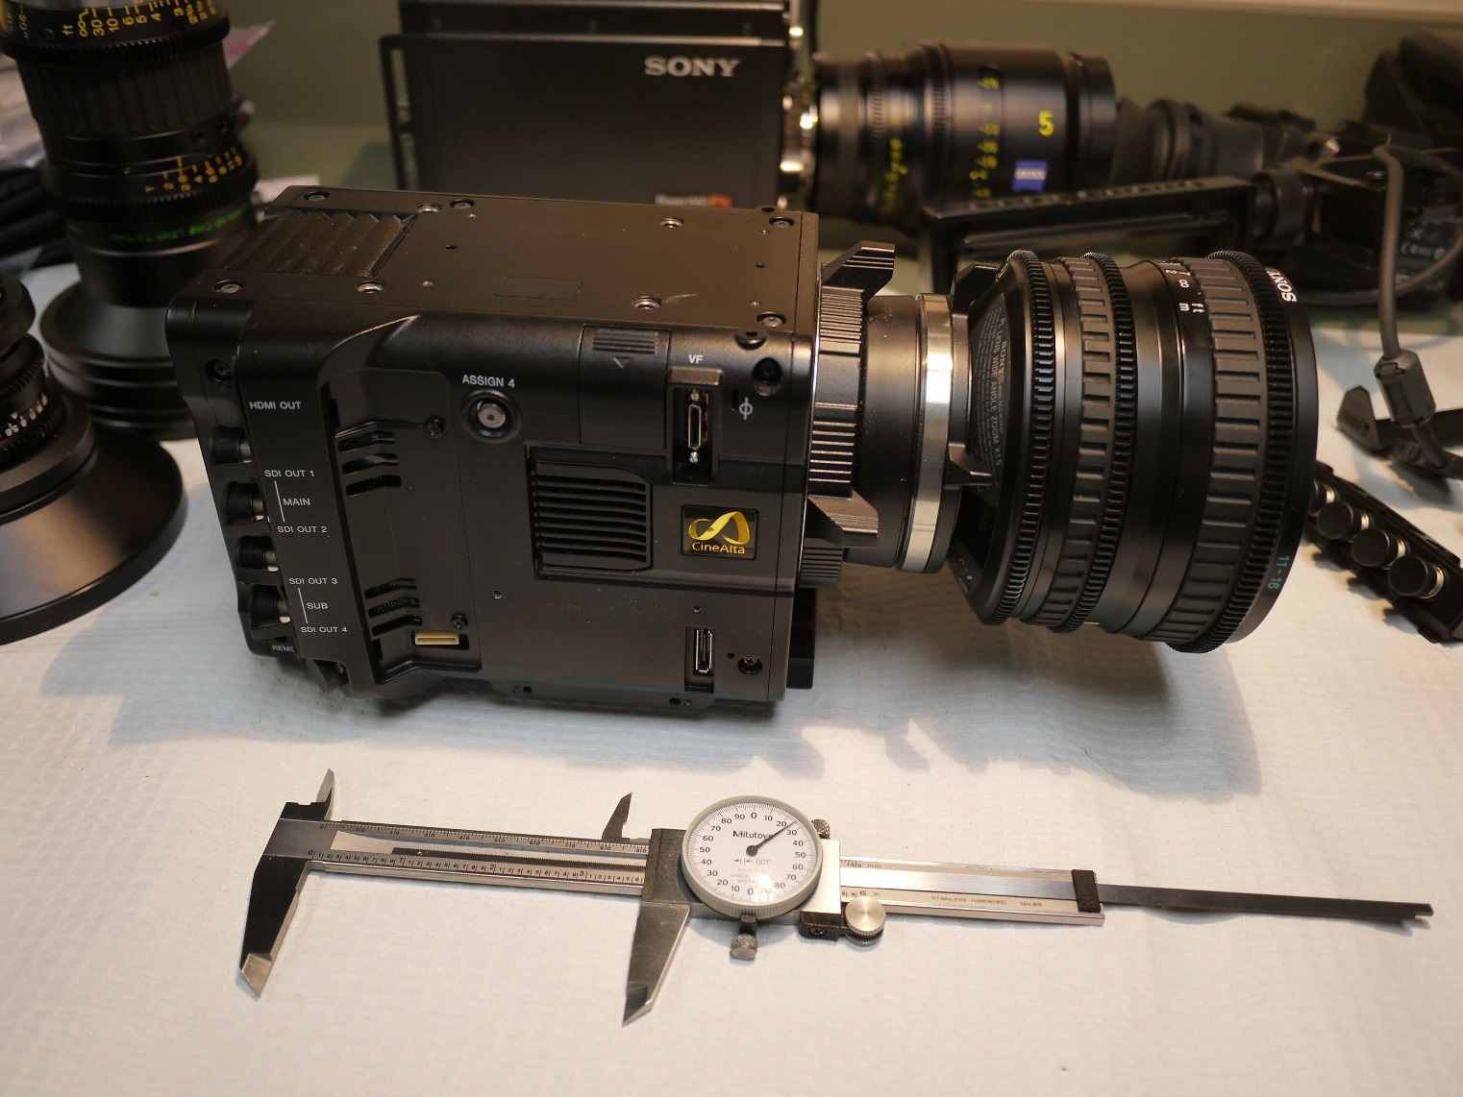
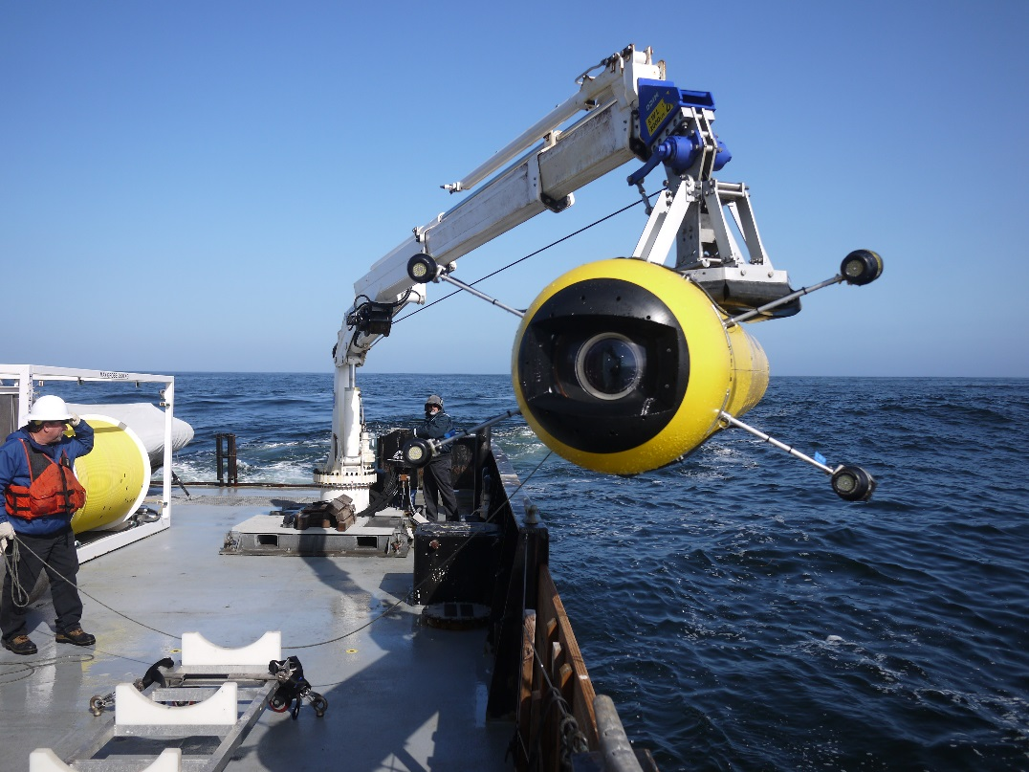
Other camera projects

