Slide 1
MBARI 4K Camera Electrical Design

Slide 2
Electrical Analog System Simulations
For each case perform:
  DC transient at 50 Hz on appropriate input.
  Frequency sweep to 20 KHz.
  Pulse response at 200Hz.
Circuits in camera:
  I2C digital to analog converter (DAC8550) Zoom and Focus drive outputs.
    Zoom = +/- 3V centered around 5V reference.
    Focus = +/- 2.75V centered around 5V reference.
  SPI bus ADS8350 analog to digital converter Zoom and Focus lens position inputs.
    Zoom position follow wide +2V, tele +7V.
    Focus position follow wide +2V, tele +7V.
Circuits in lapbox:
  SPI bus ADS8350 analog to digital converter Zoom and Focus control (adjustable potentiometer) position inputs.
    Zoom position pot wide +0V, tele +12V.
    Focus position follow wide +0V, tele +12V.
  DSPIC Processor built in 12 bit ADC.
    Pan & Tilt joystick X axis, 0-5V
    Pan & Tilt joystick Y axis, 0-5V

Slide 3
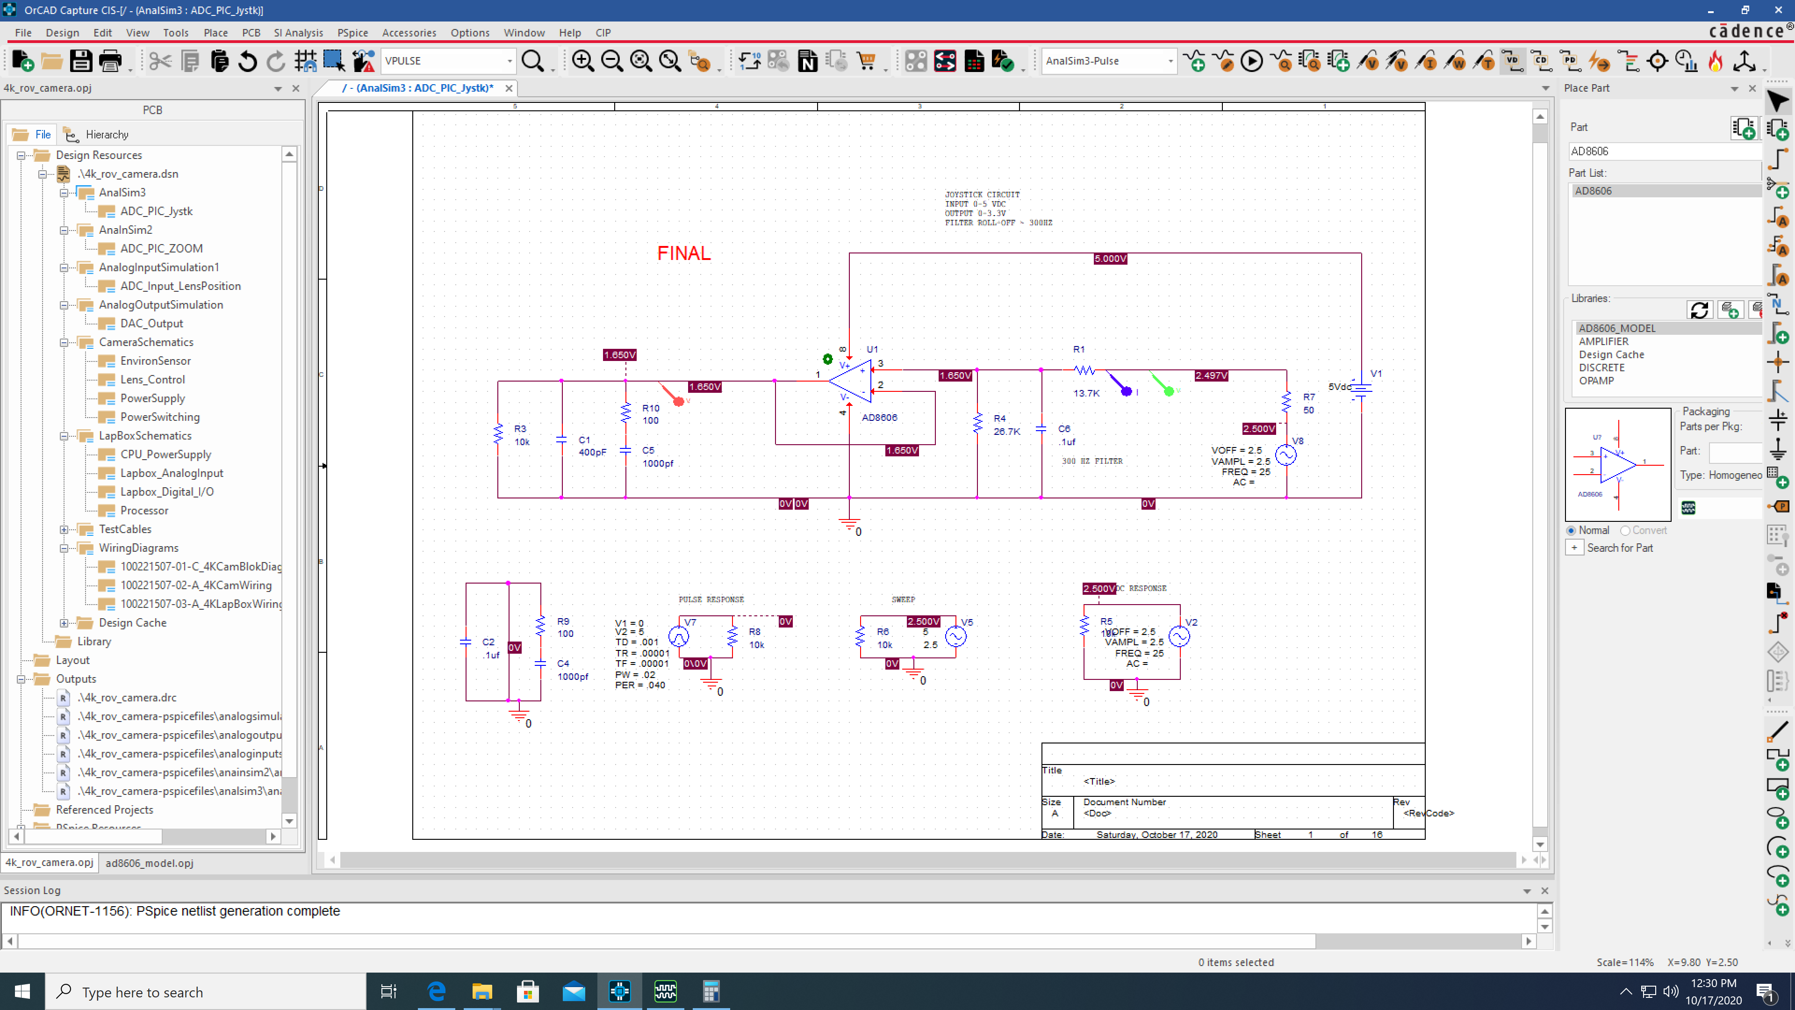
DSPIC Processor 12 bit ADC. Pan & Tilt joystick X axis, 0-5V

Slide 4
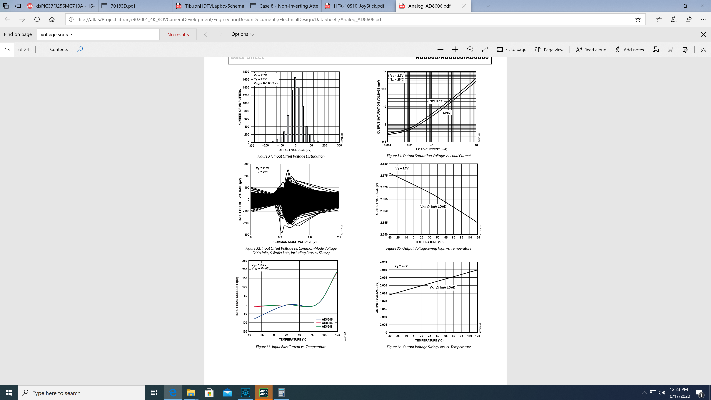

Slide 5
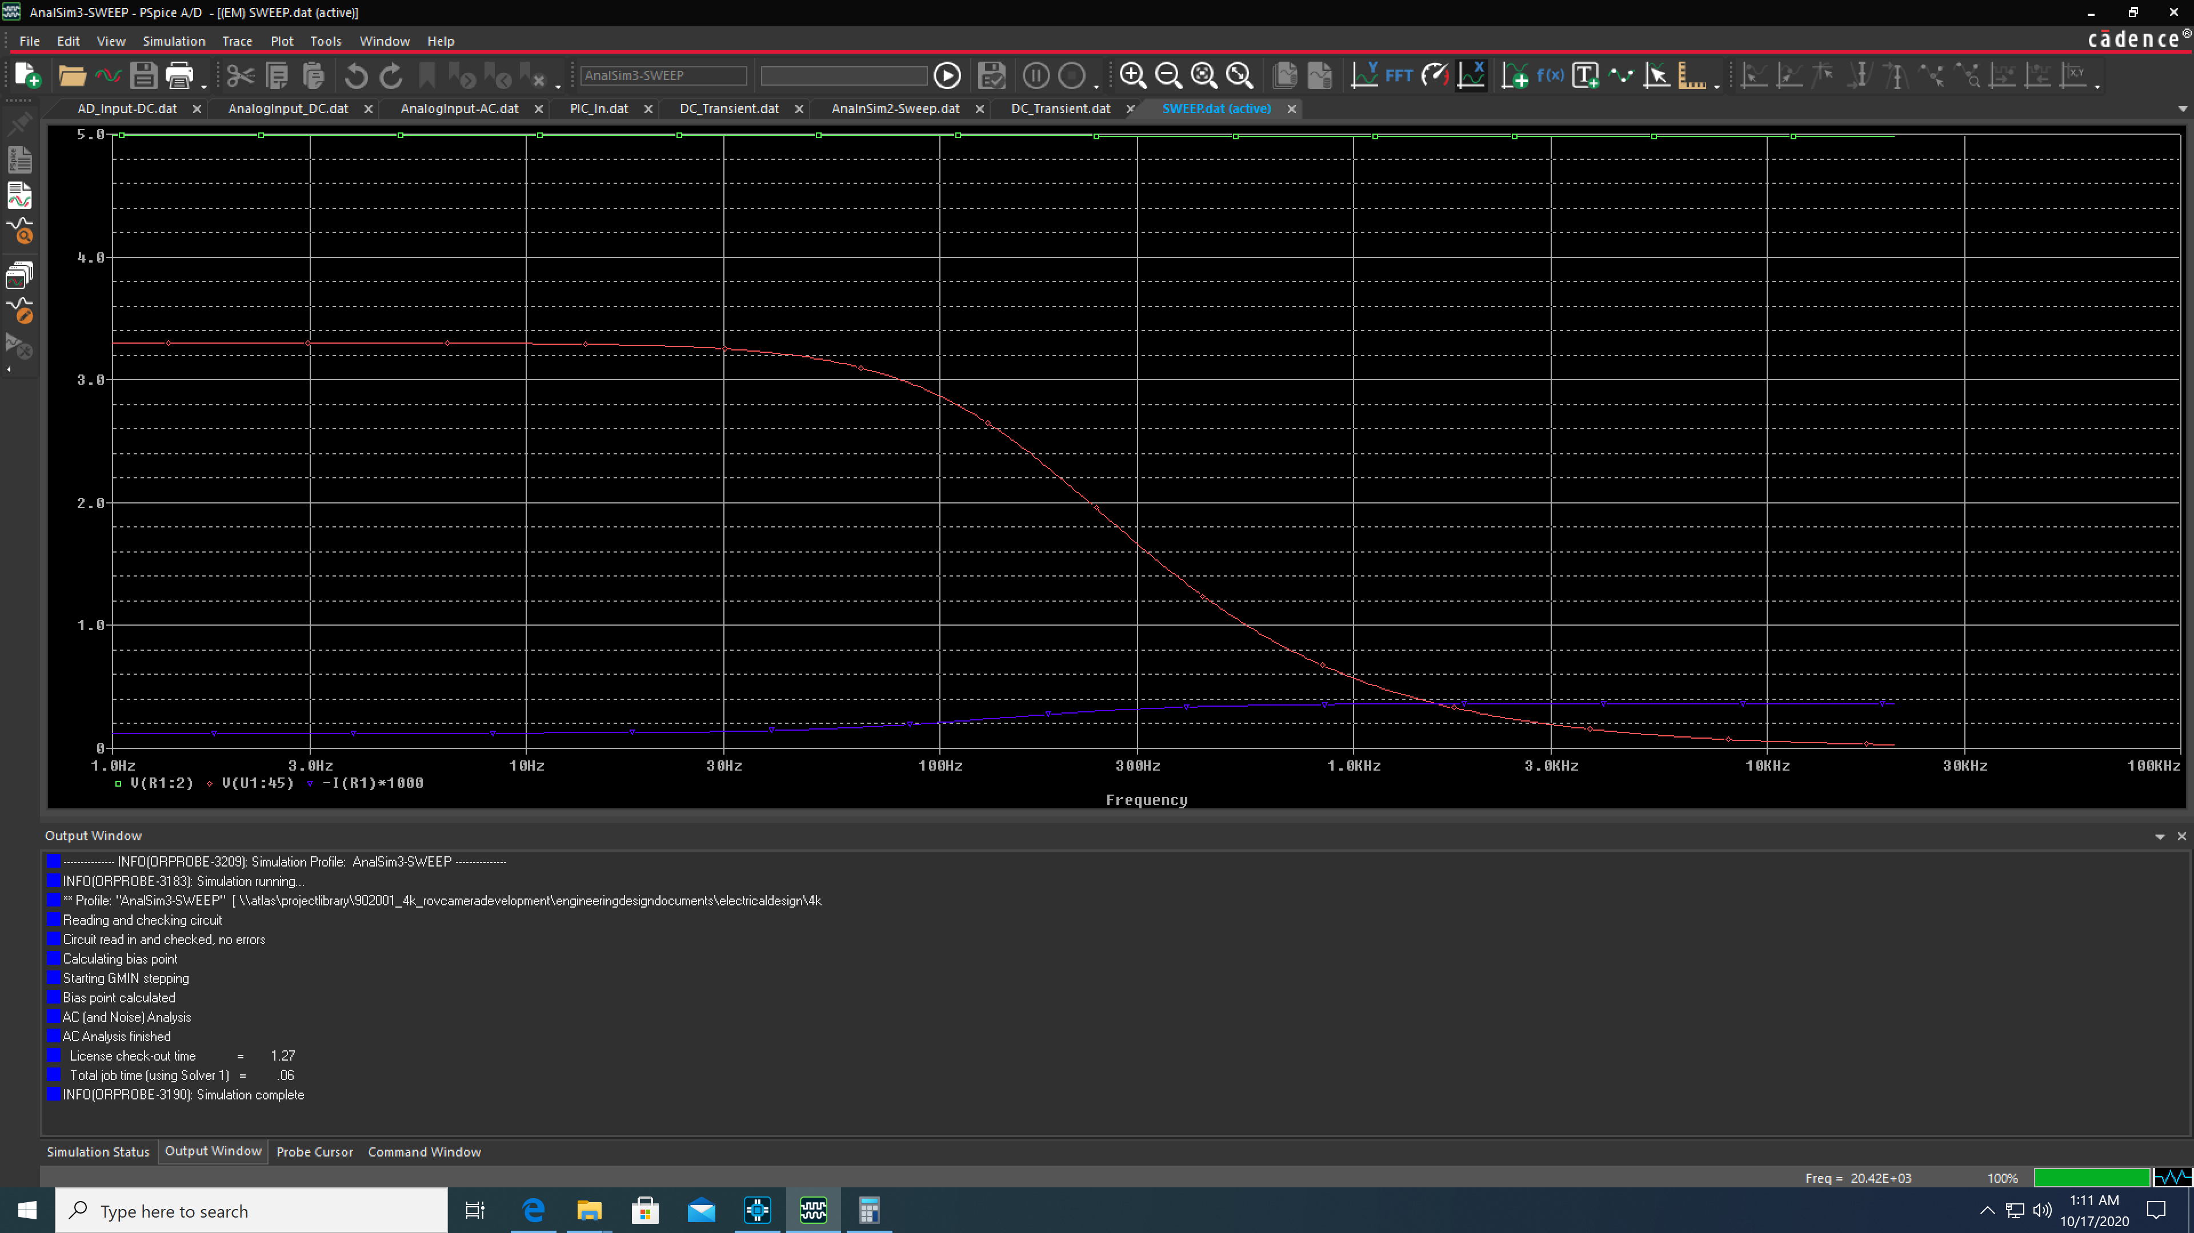
DSPIC Processor built in 12 bit ADC. Pan & Tilt joystick X axis, 0-5V
Sweep

Slide 6
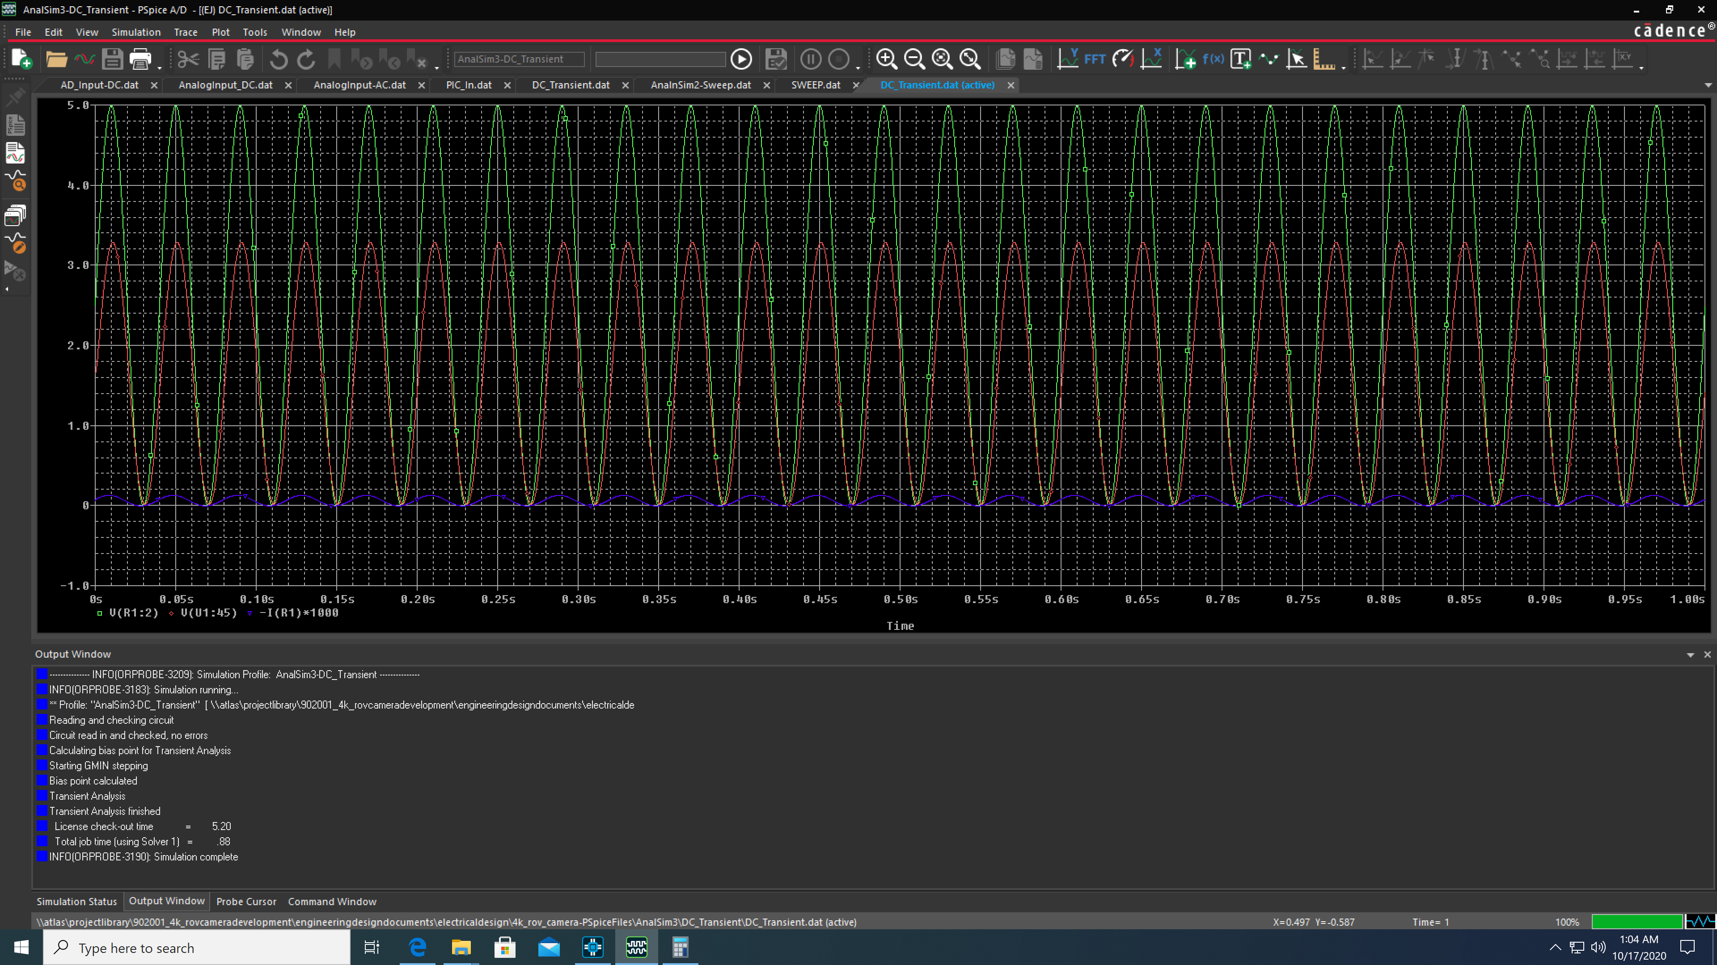
DC Transient Response

Slide 7
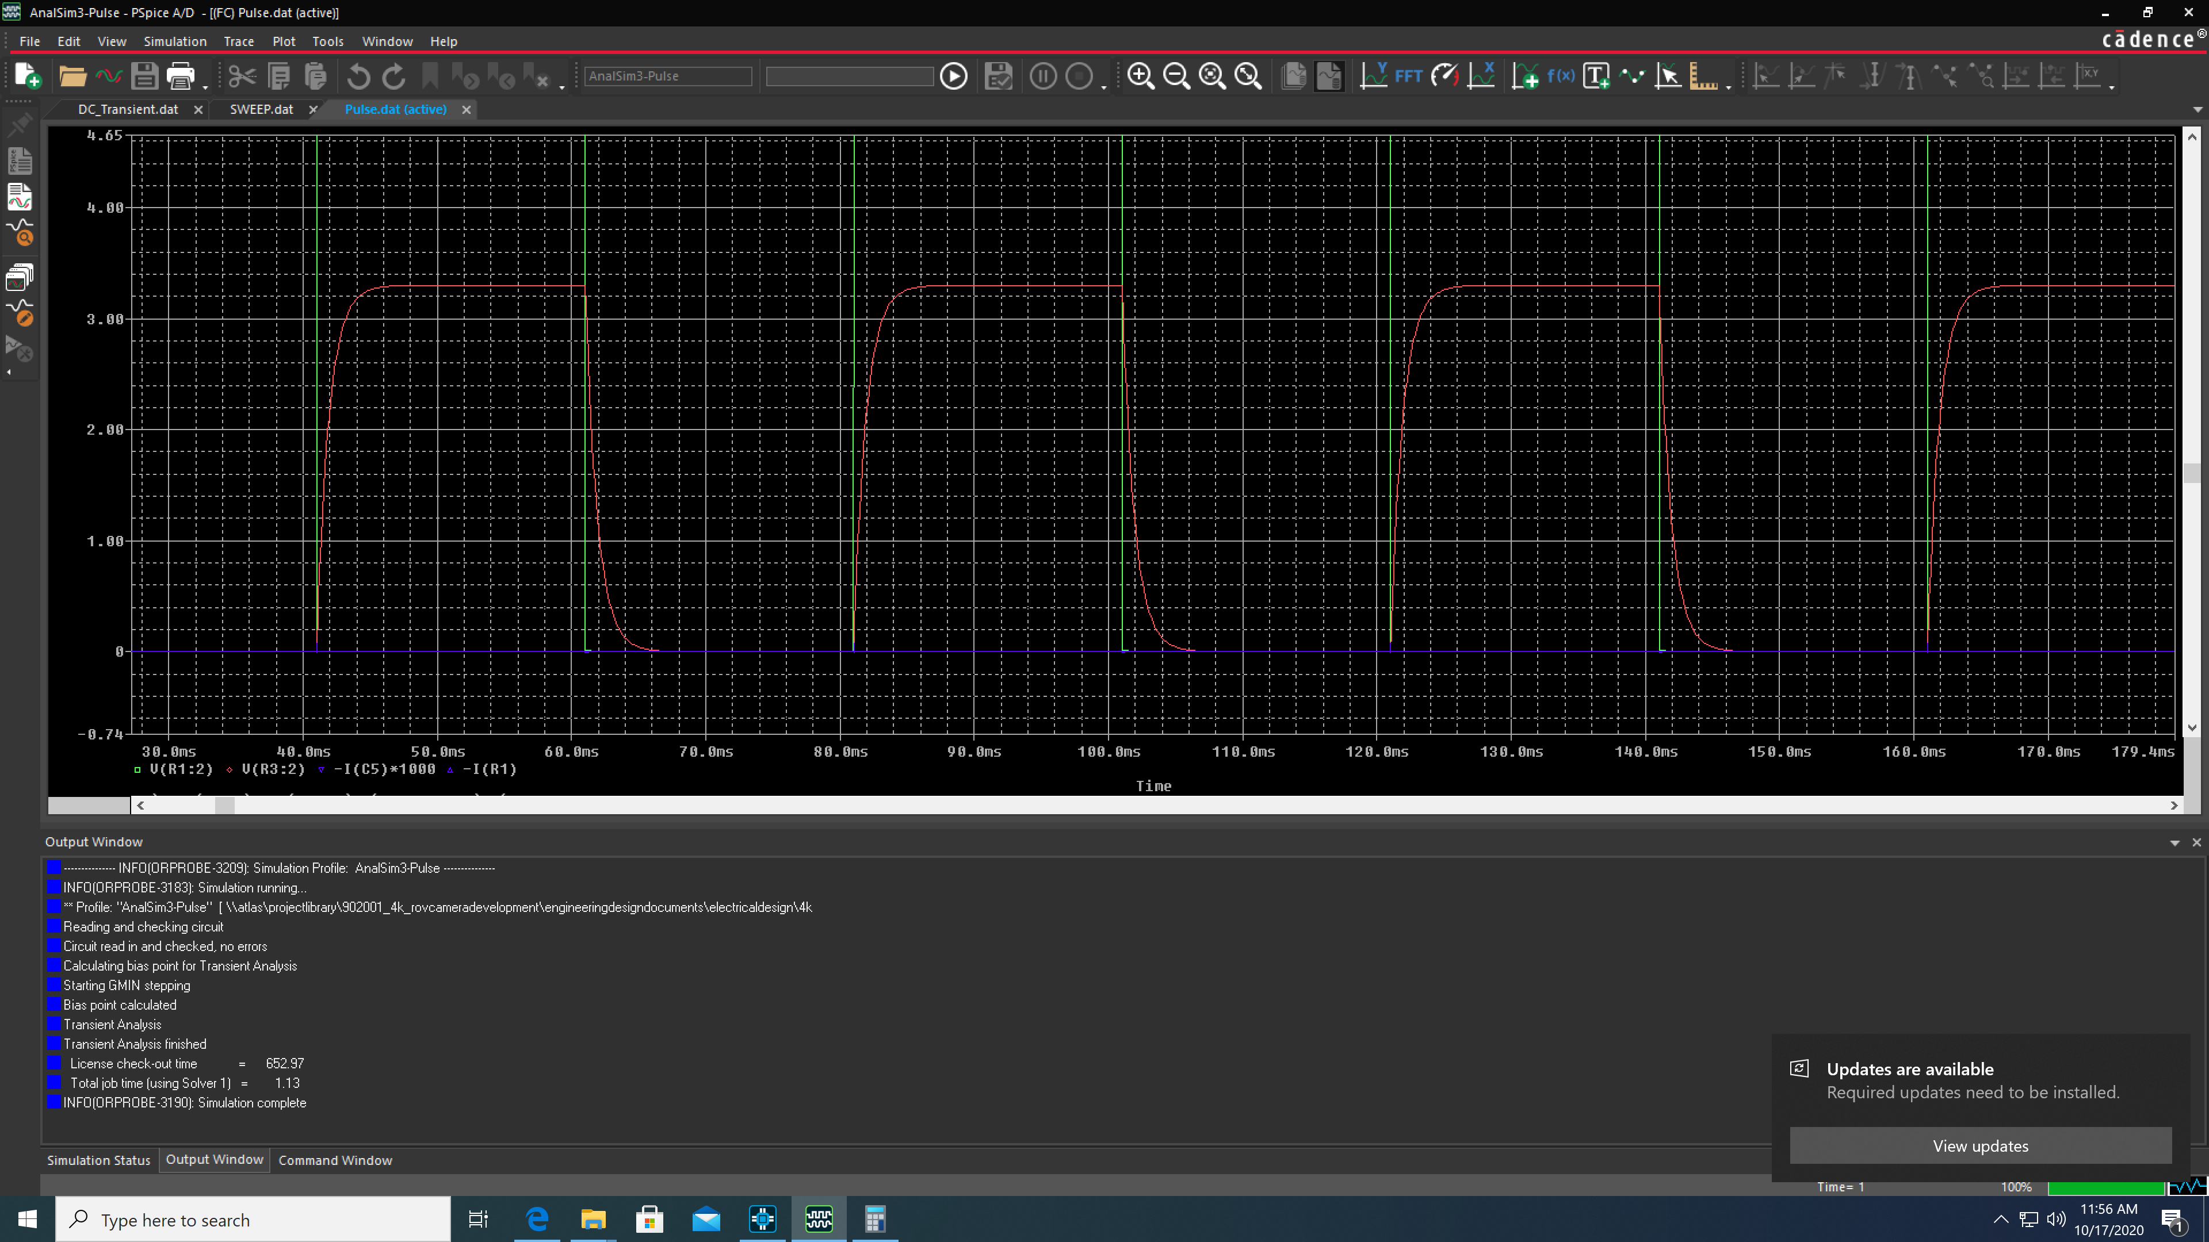
DC Pulse response

Slide 8
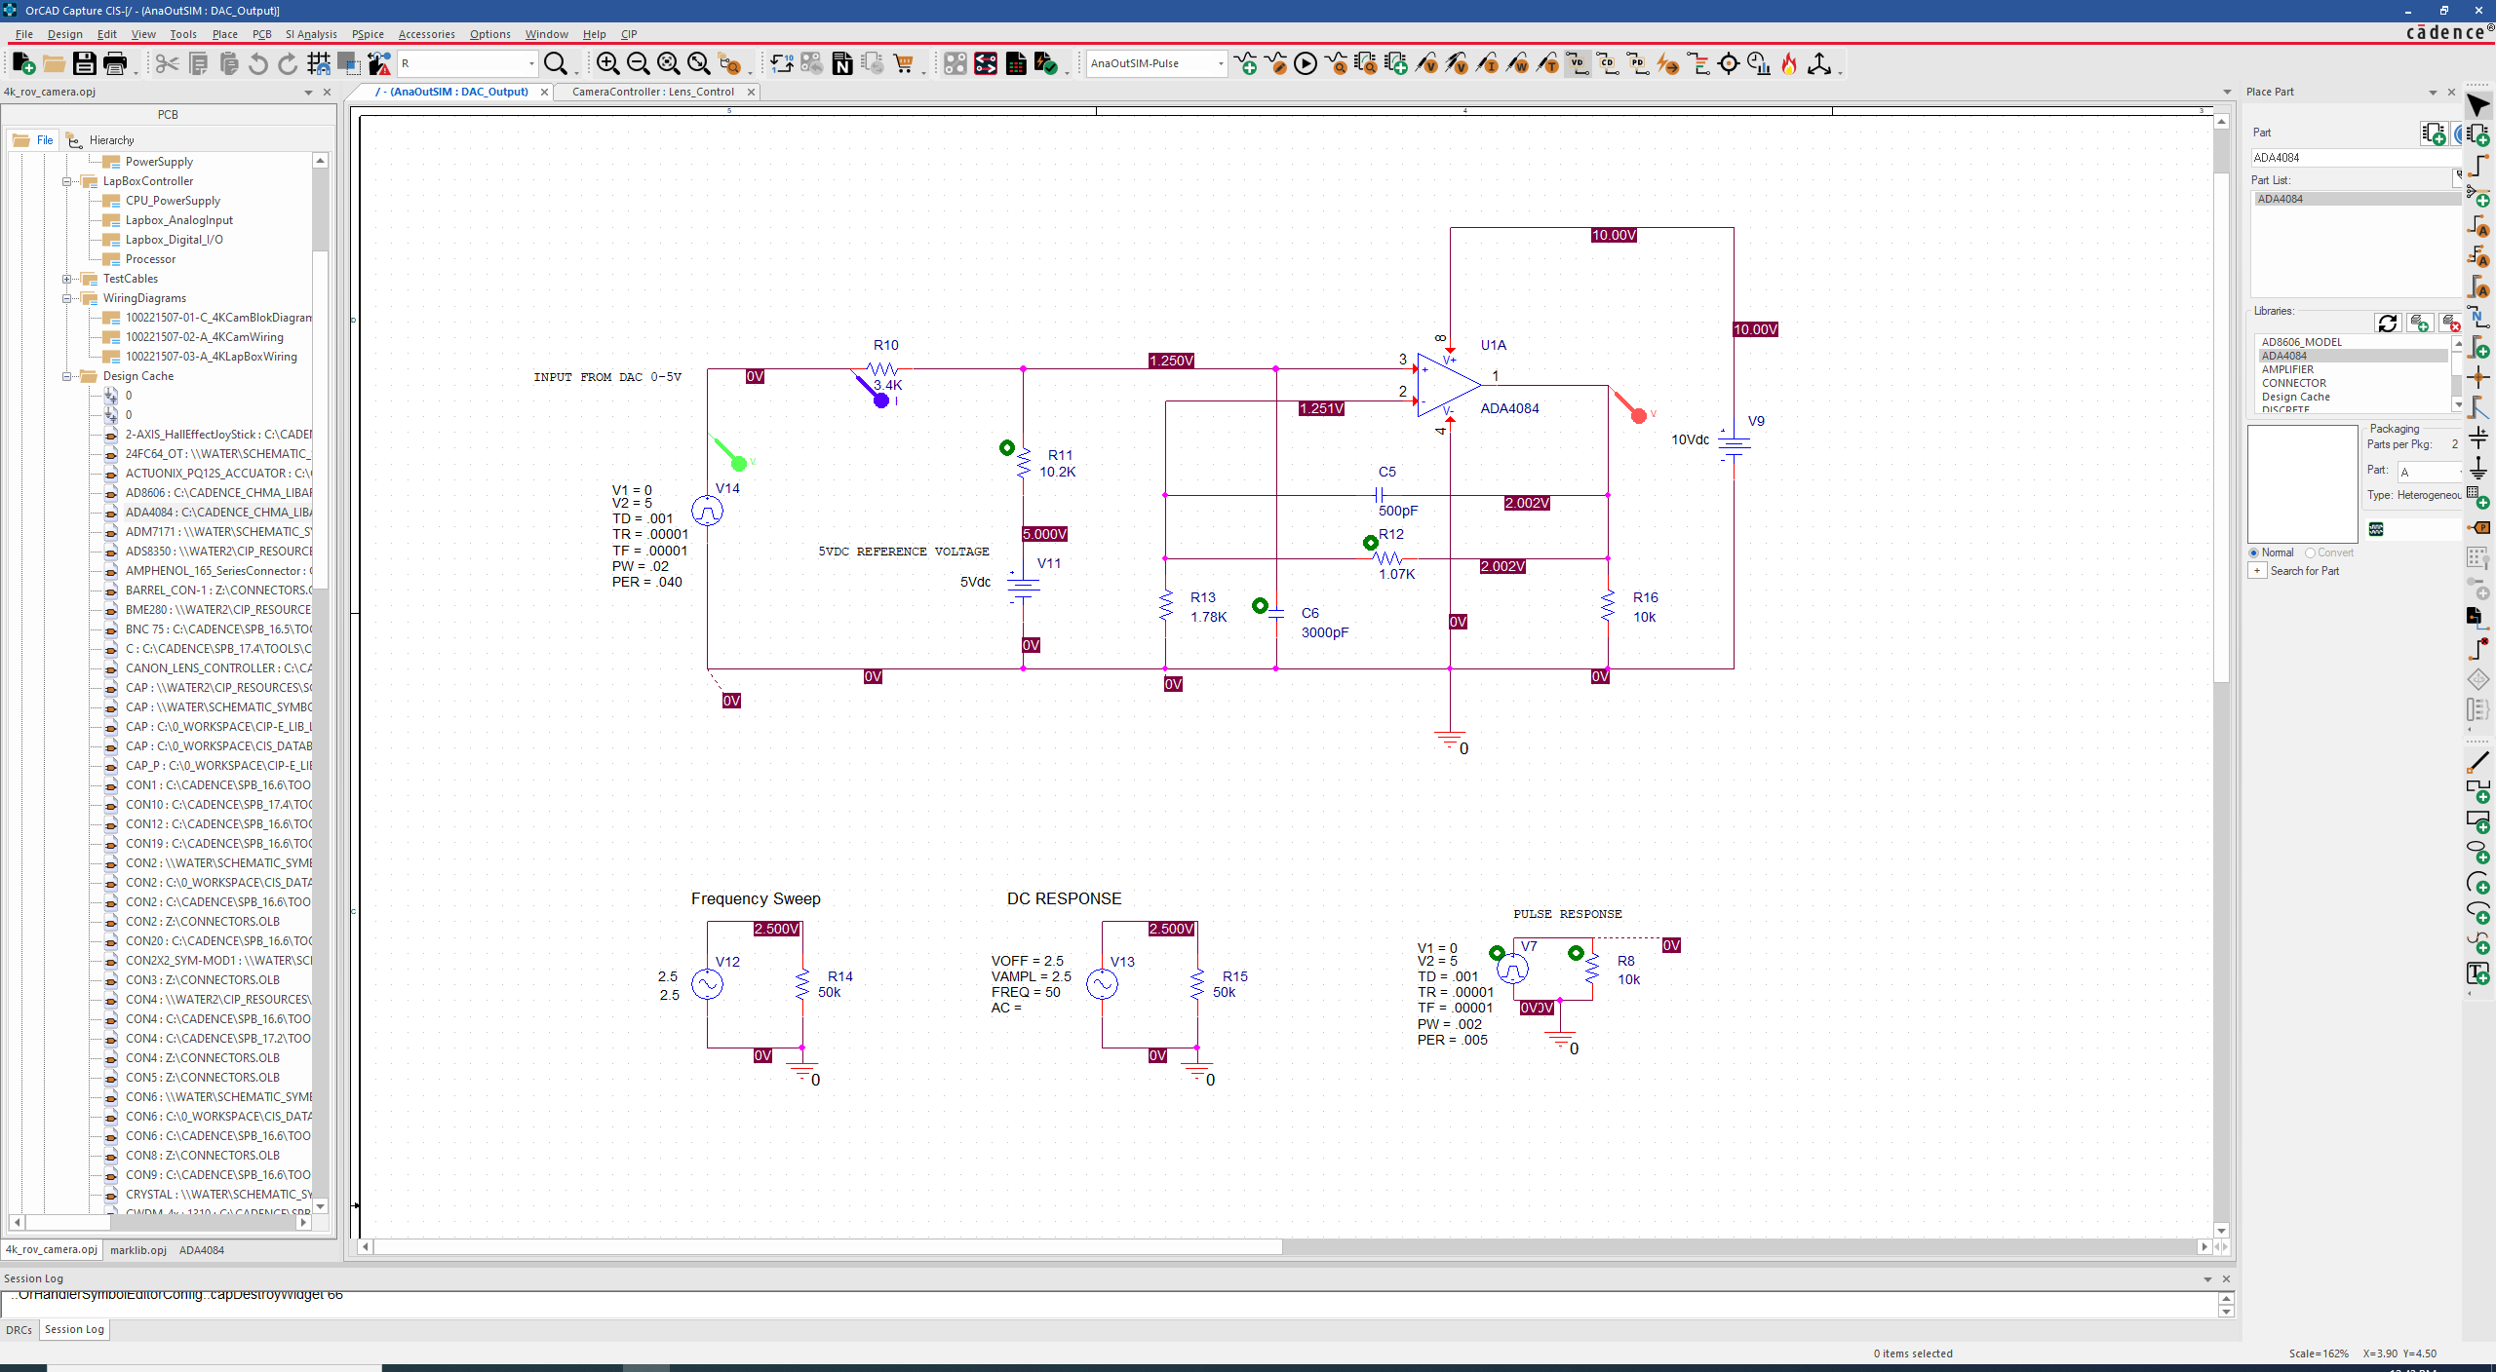
Camera controller lens interface – DAC lens commands out
Reference Circuit - +/- 3V Out

Slide 9
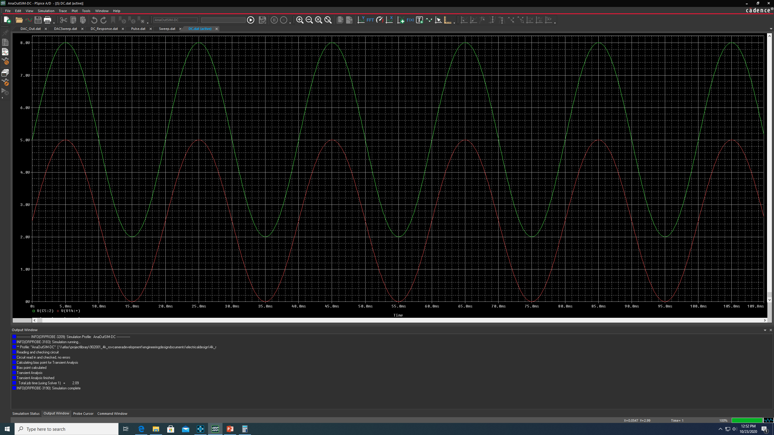
Camera controller lens interface – DAC lens commands out
DC Transient Response

Slide 10
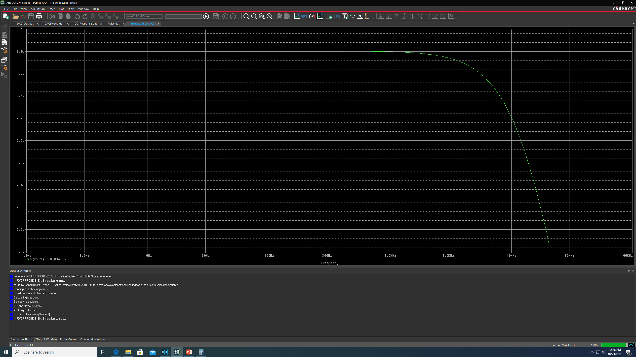
Camera controller lens interface – DAC lens commands out
AC Sweep Response

Slide 11
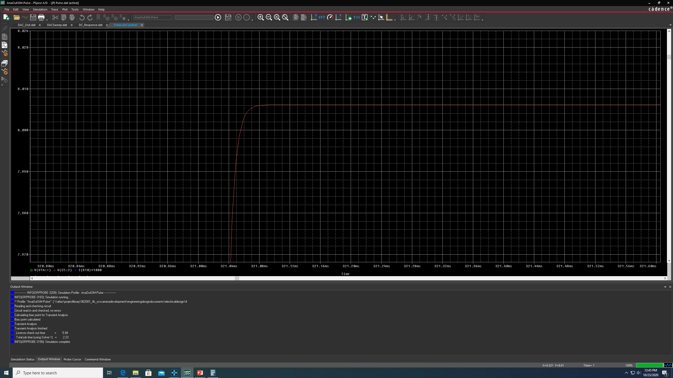
Camera controller lens interface – DAC lens commands out
200 Hz Pulse Response

Slide 12
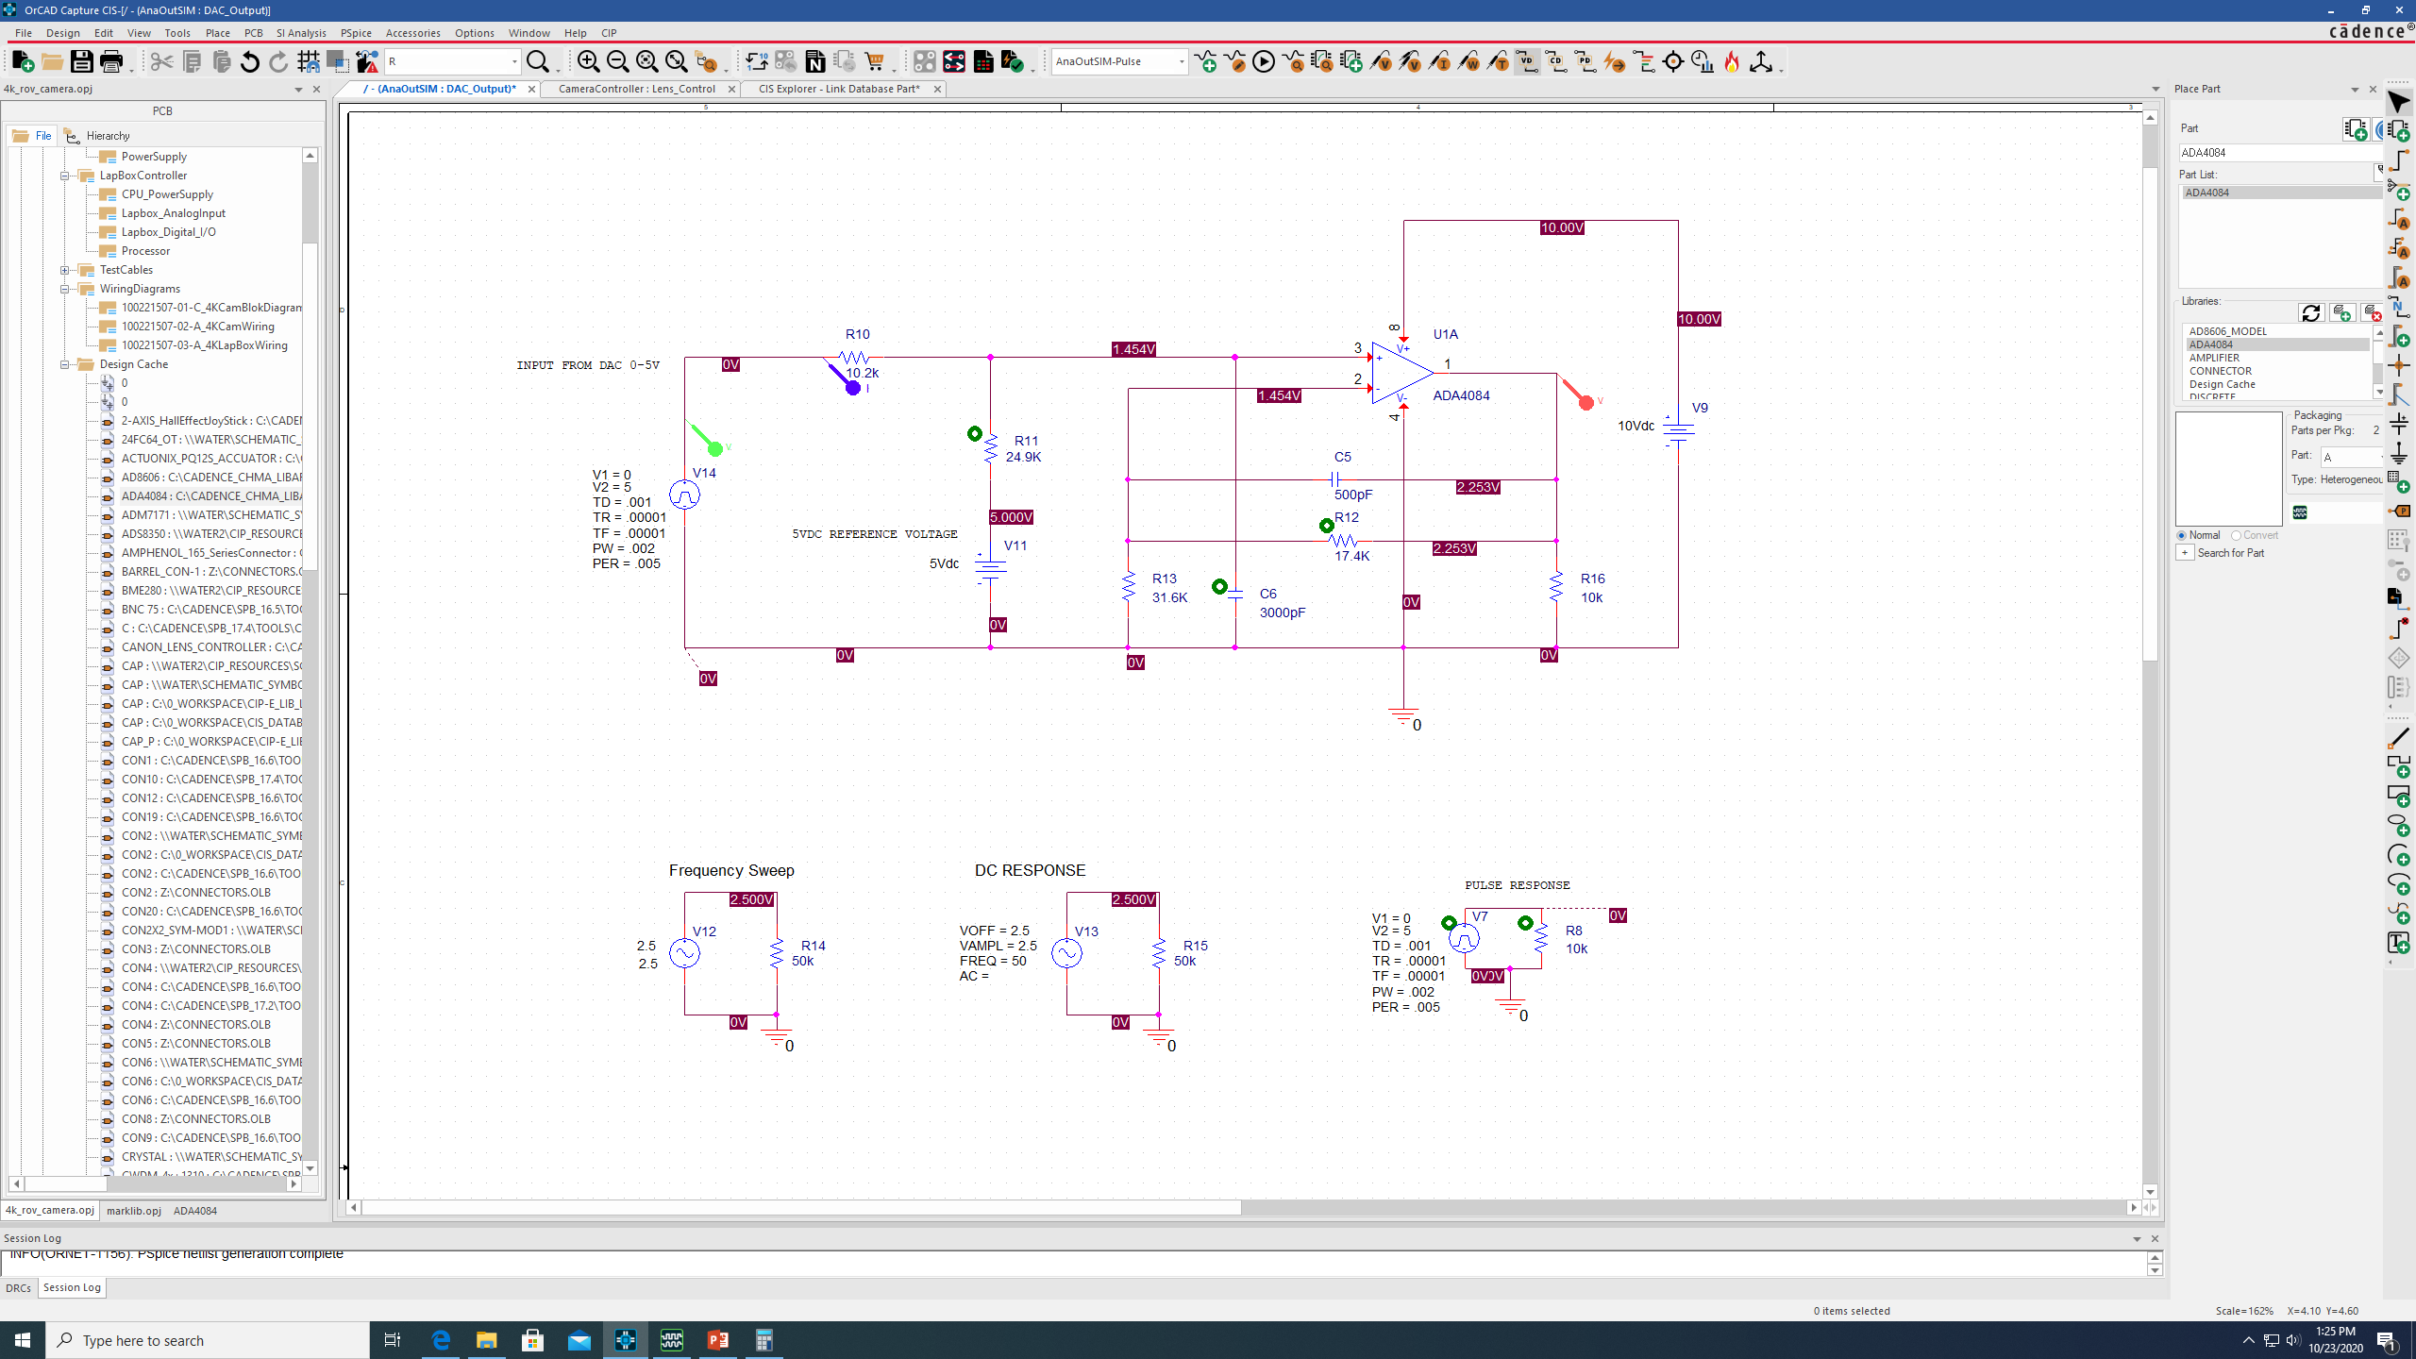
Camera controller lens interface – DAC lens commands out
Reference Circuit +/- 2.75V Out

Slide 13
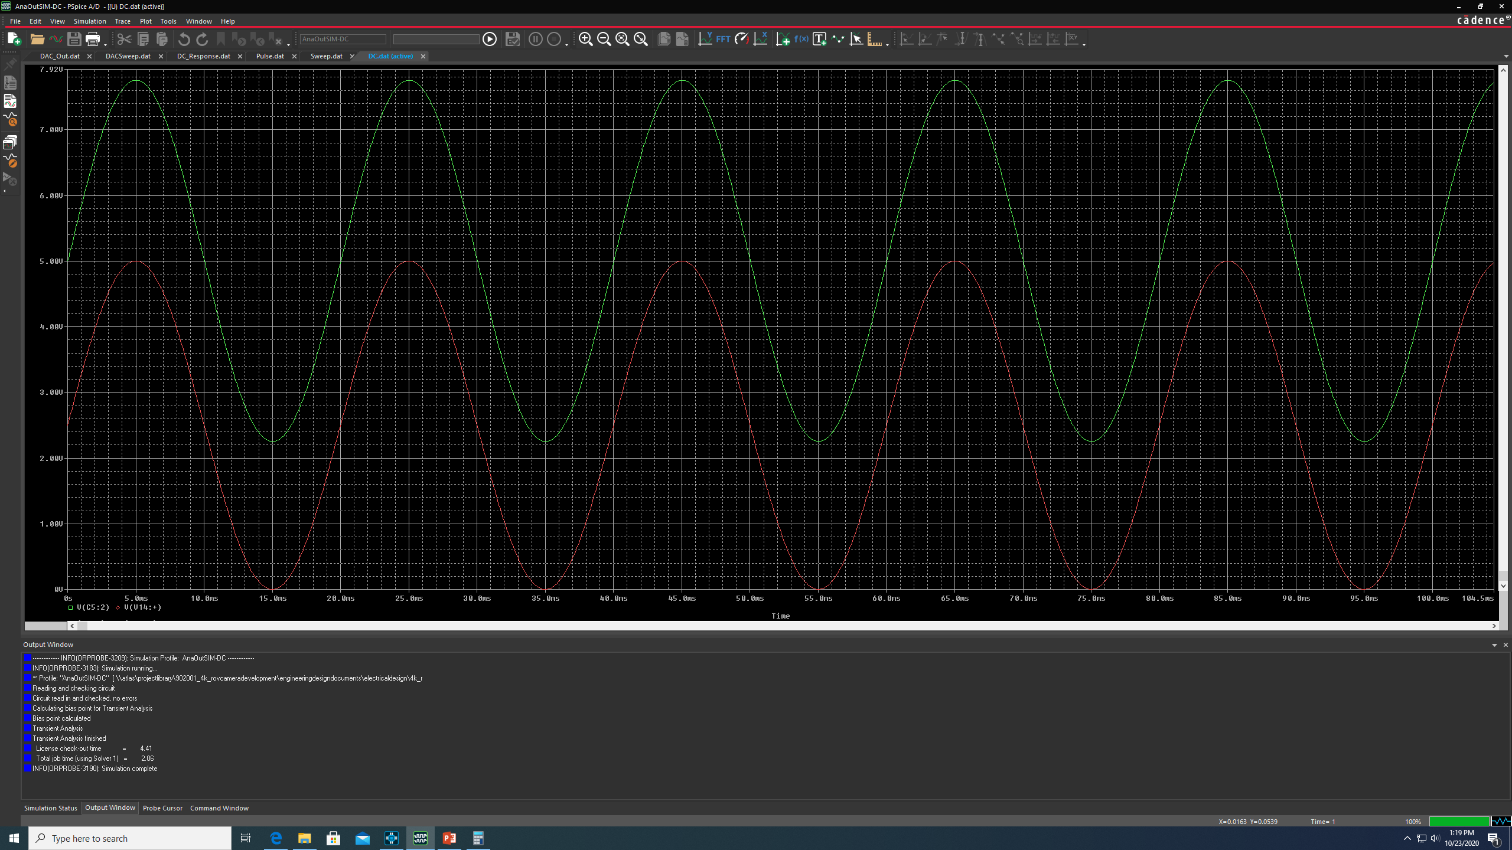
Camera controller lens interface – DAC lens commands out
DC Transient Response

Slide 14
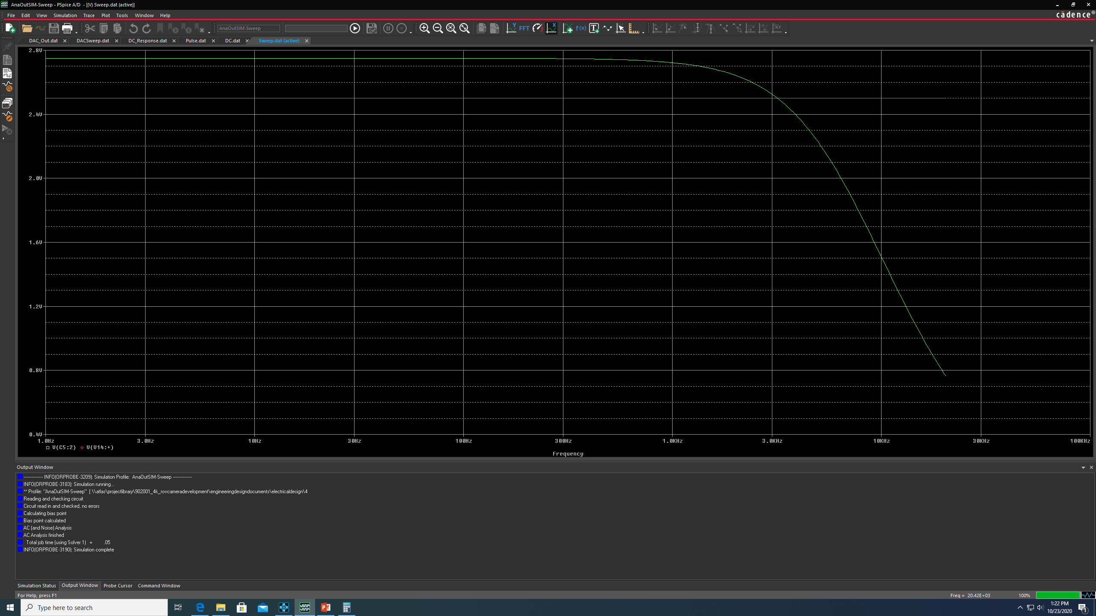
Camera controller lens interface – DAC lens commands out
AC Sweep Response

Slide 15
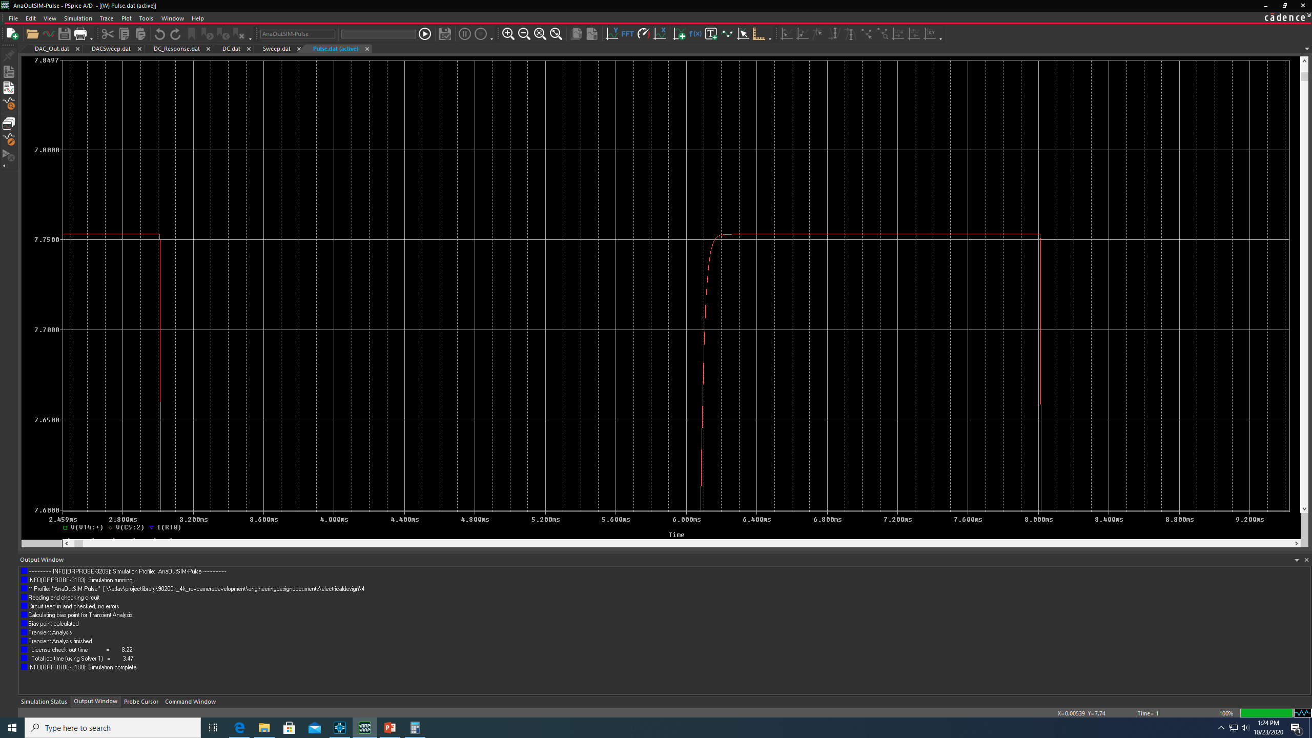
Camera controller lens interface – DAC lens commands out
200 Hz Pulse Response

Slide 16
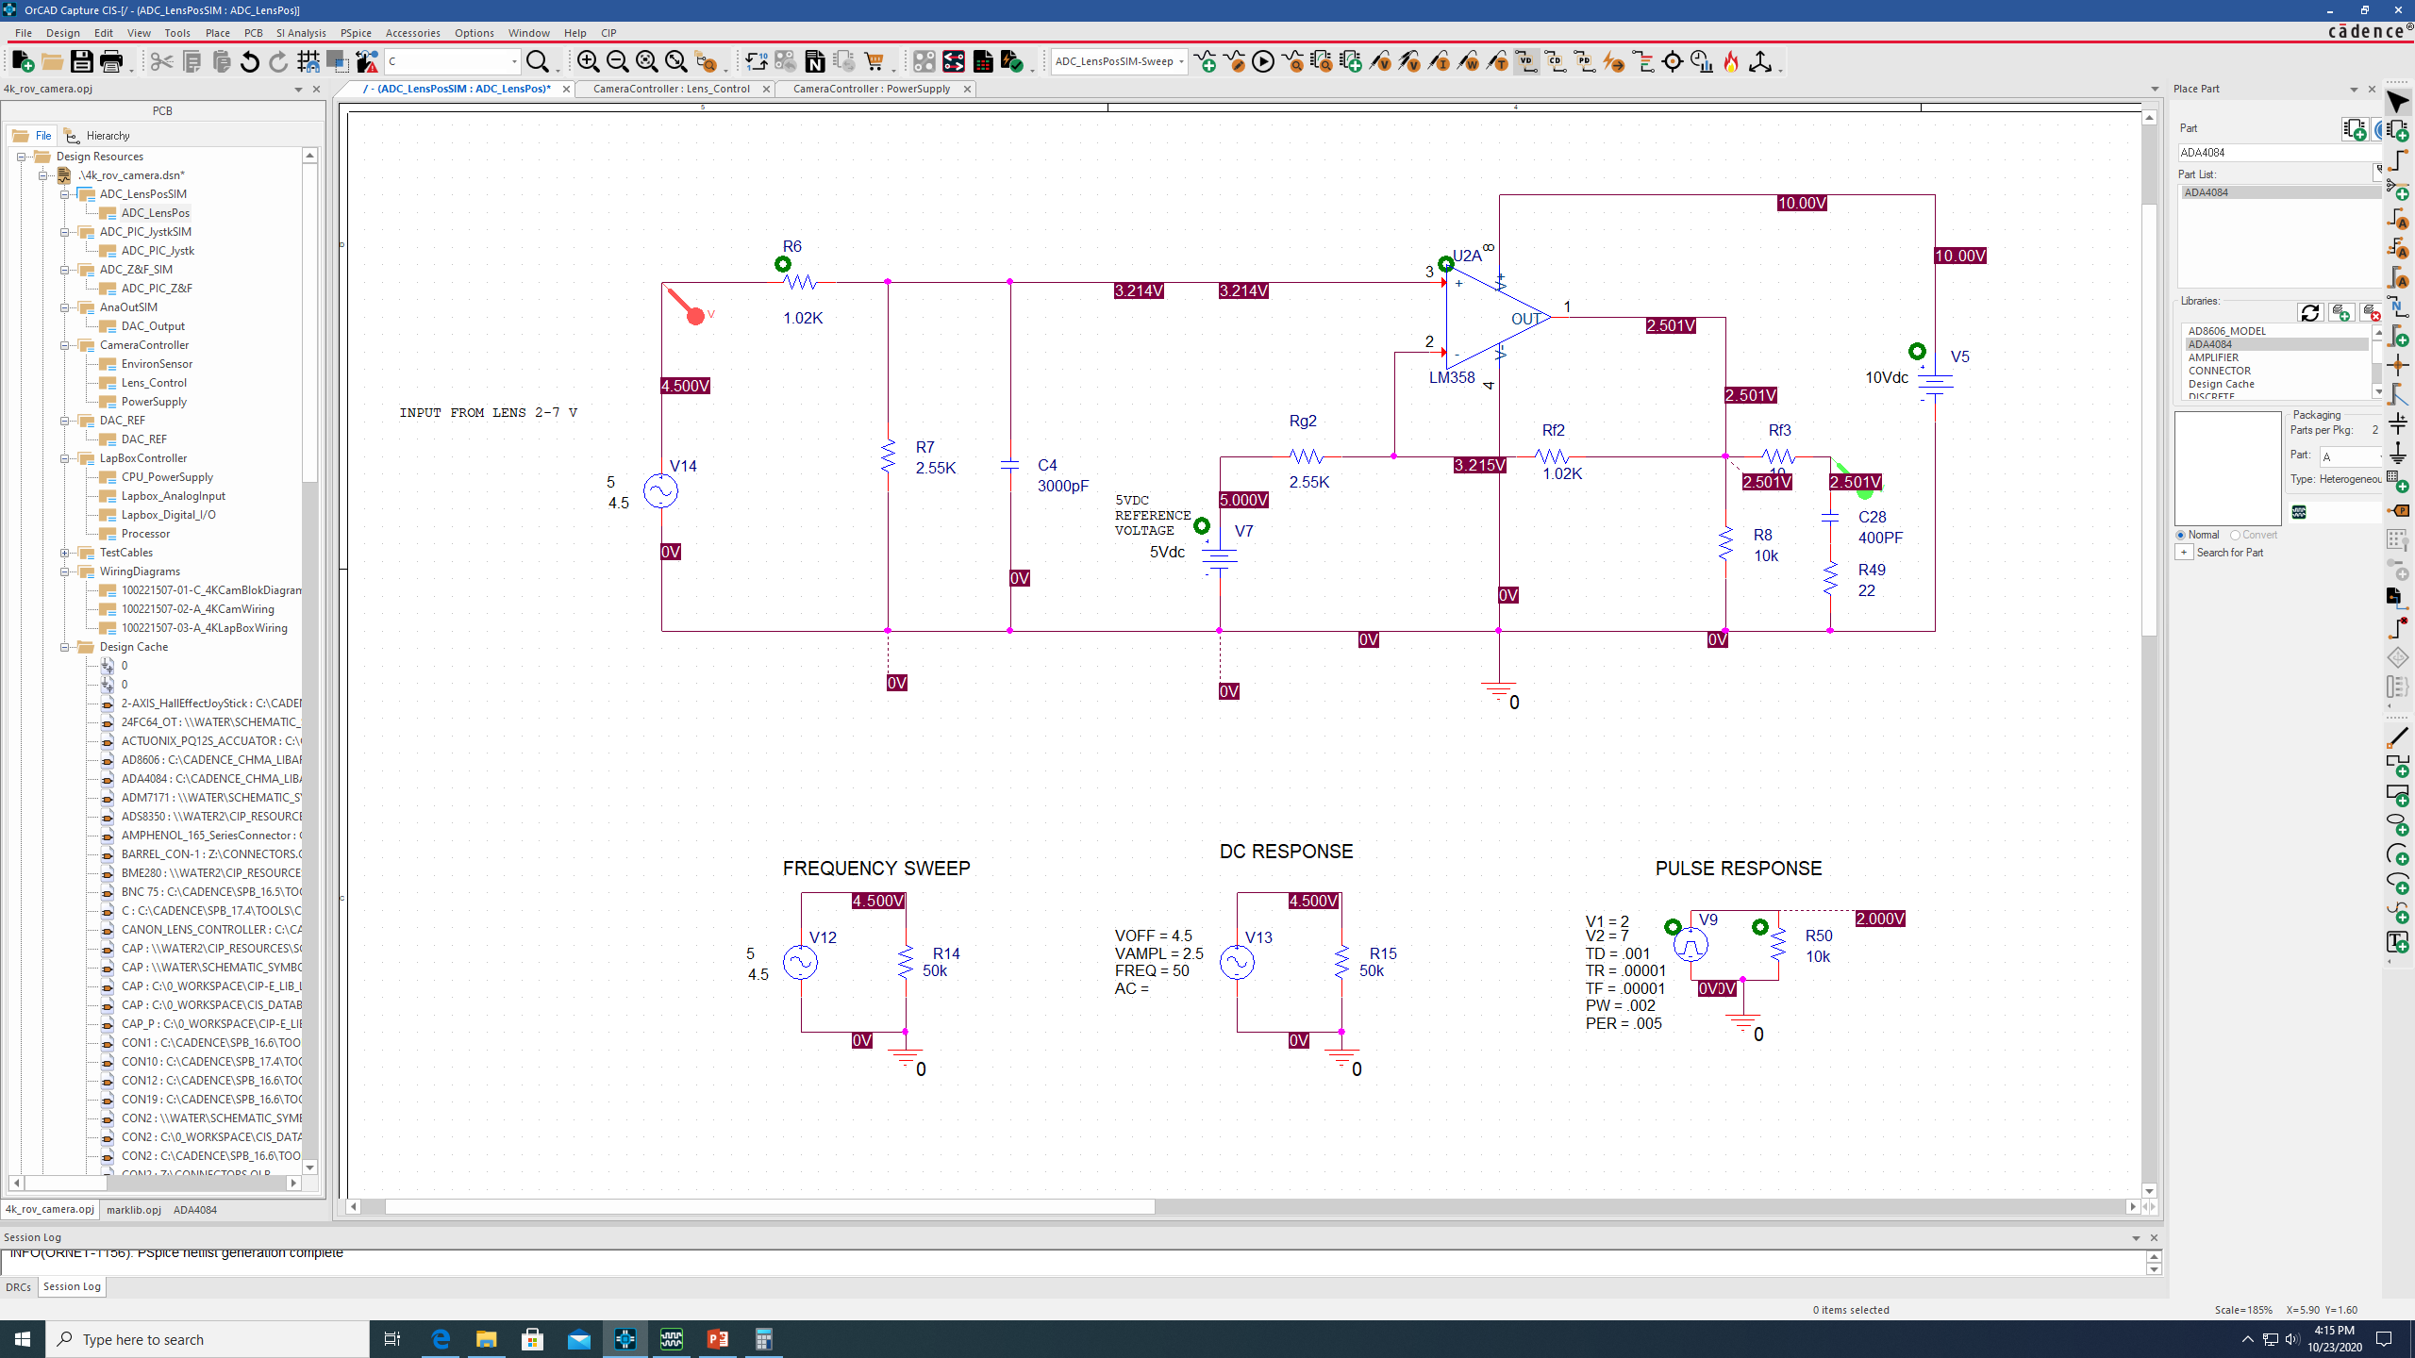
Camera controller lens interface – lens position in to ADC
2-7 VDC

Slide 17
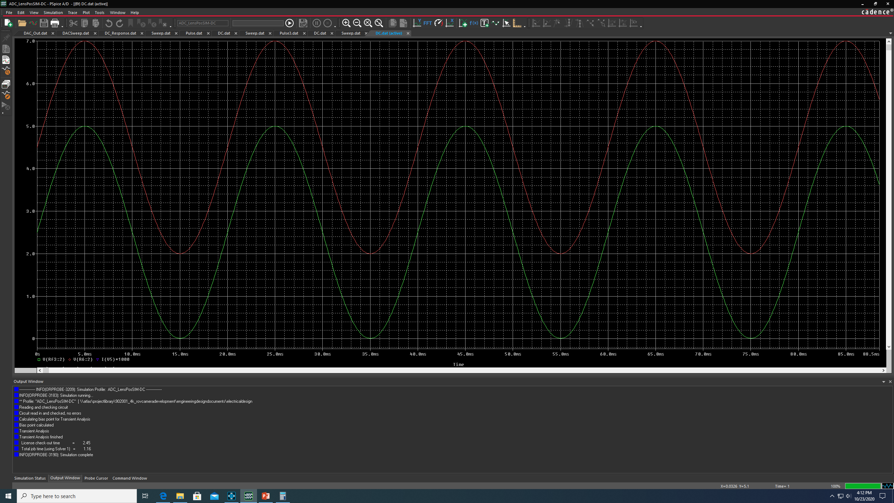
Camera controller lens interface – lens position in to ADC
2-7 VDC DC Transient Response

Slide 18
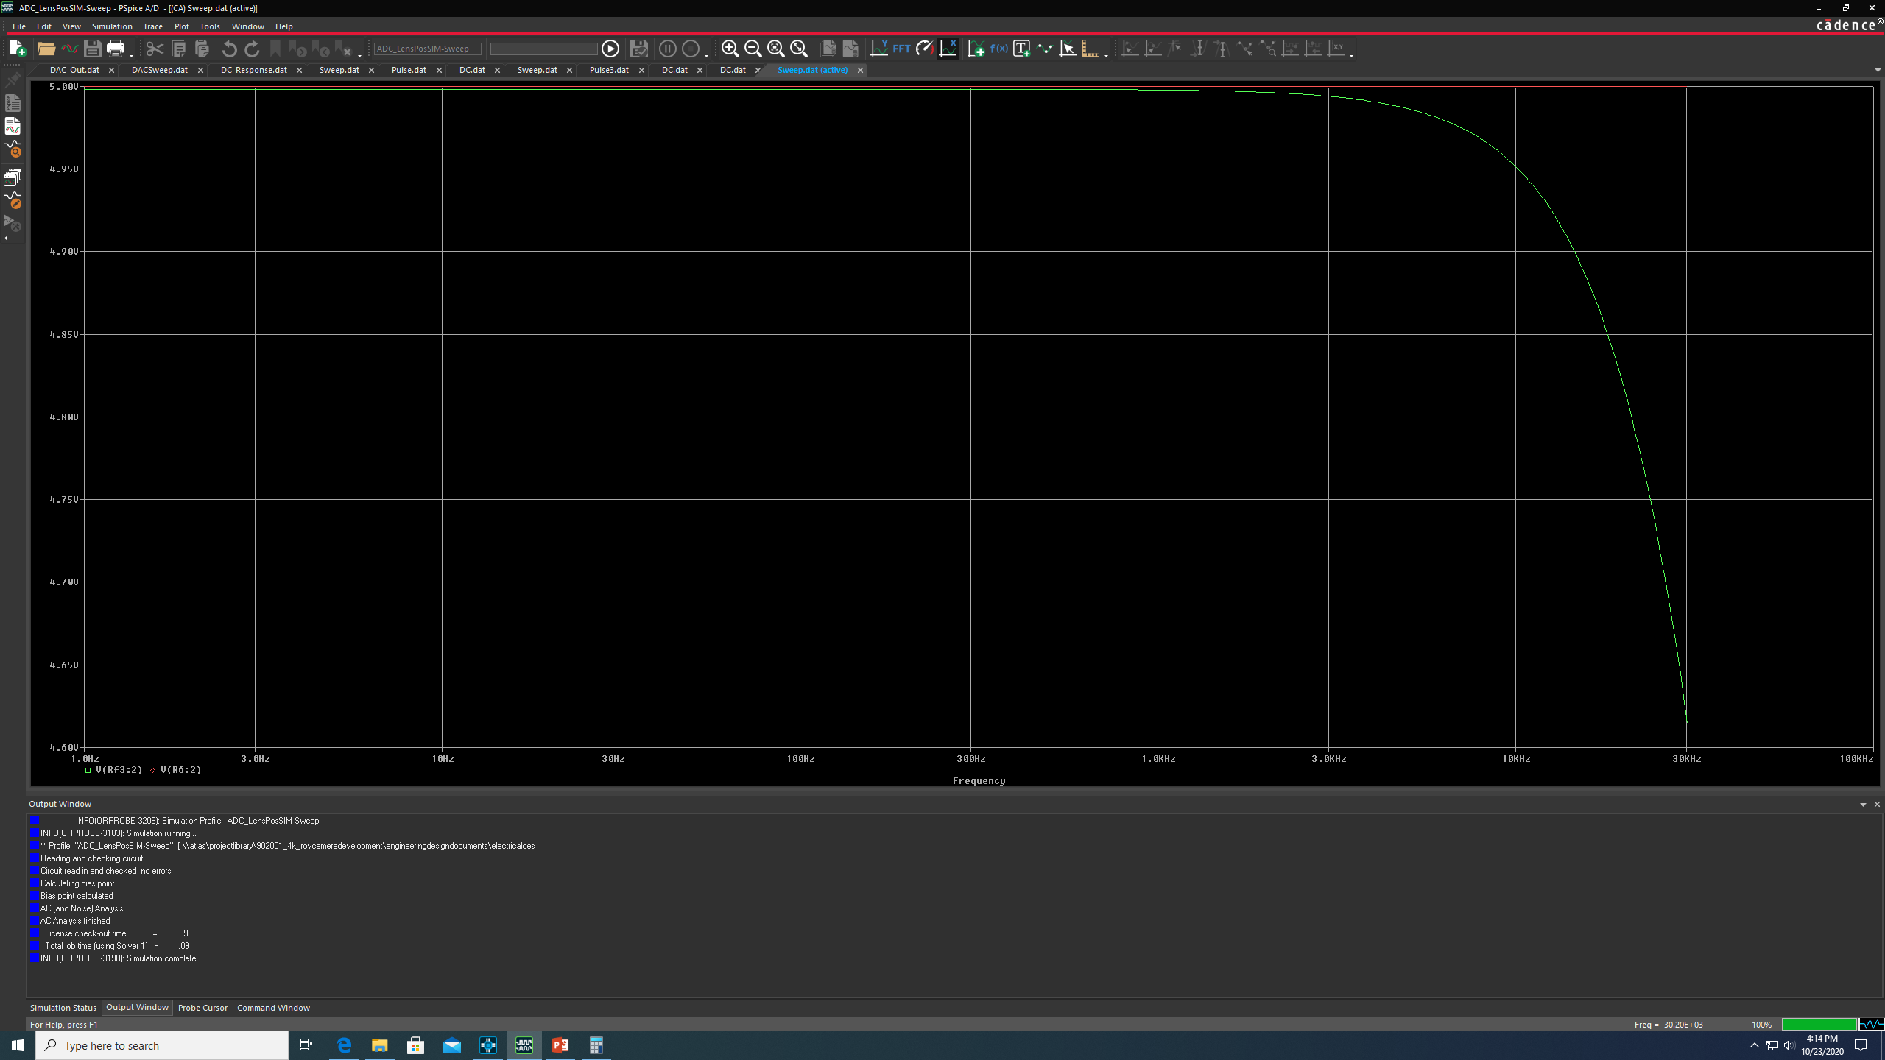
Camera controller lens interface – lens position in to ADC
2-7 VDC AC Sweep Response

Slide 19
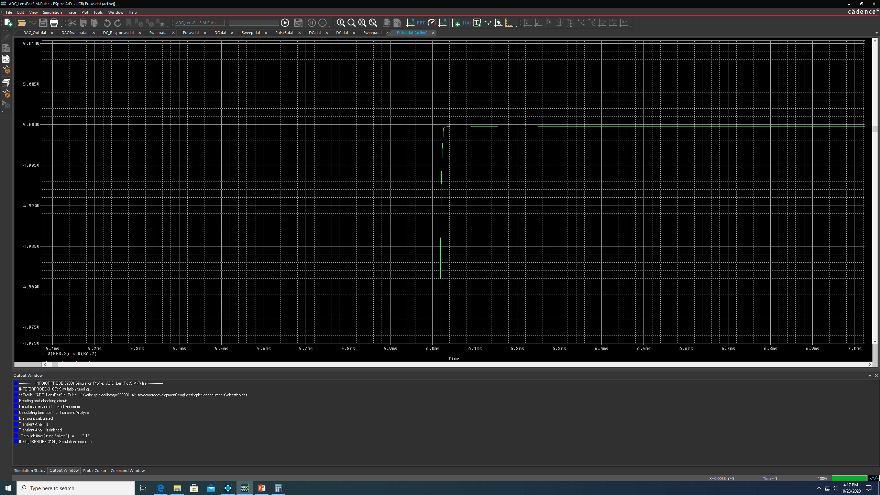
Camera controller lens interface – lens position in to ADC
2-7 VDC 200 Hz Pulse Response

