Slide 1
How We Got Here – the History of Video Formats at MBARI
4K?
1988
1998
2018 Prores HQ Files 1920x1080 60i
Betacam SP
Analog
1995
2010
Digital Betacam 720x480 60i
1999
2020 +
Panasonic D5 1920x1080 60i
20 years + !!
2020?
Prores HQ Files 4096x2160 60p
4K Video!
Museum of Obsolete Media
Notes:
Museum of obsolete media!

Slide 2
Looking Ahead - Video Storage Cost Comparison
Stay with HD vs 20% 4K Selects
1080 60p video
4028 60p video
Pre-2018 D5 Tape Annual Cost
Pre-2018 D5 Tape Annual Cost

Slide 3
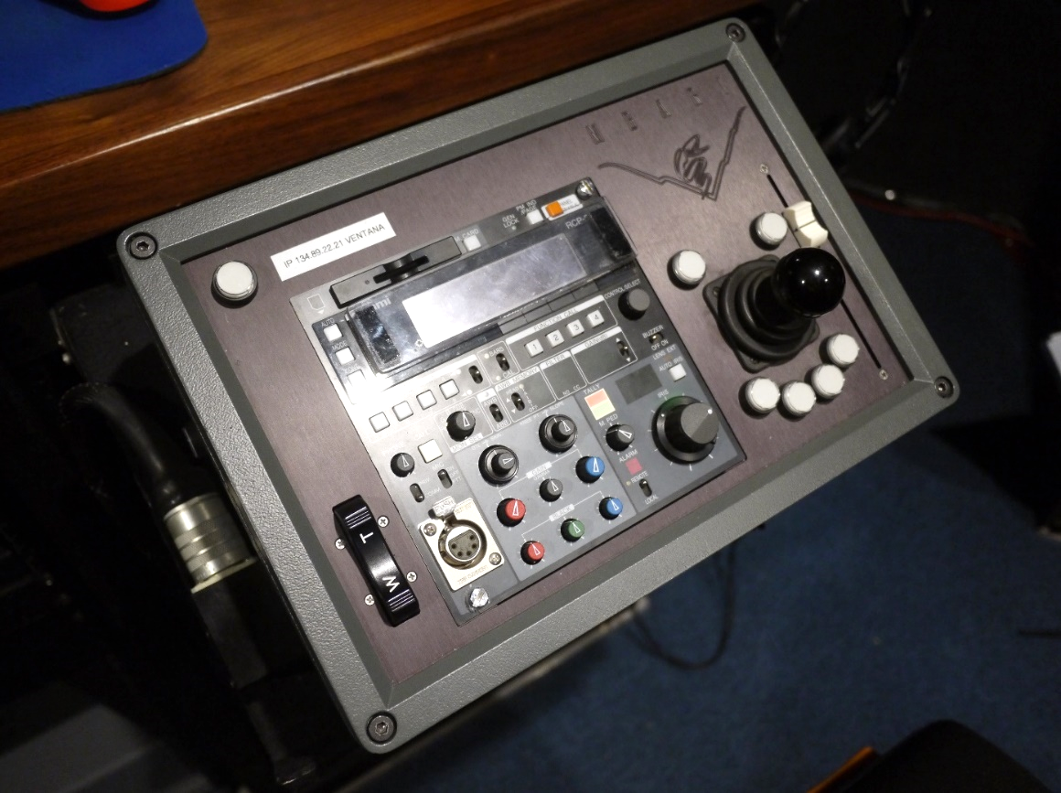
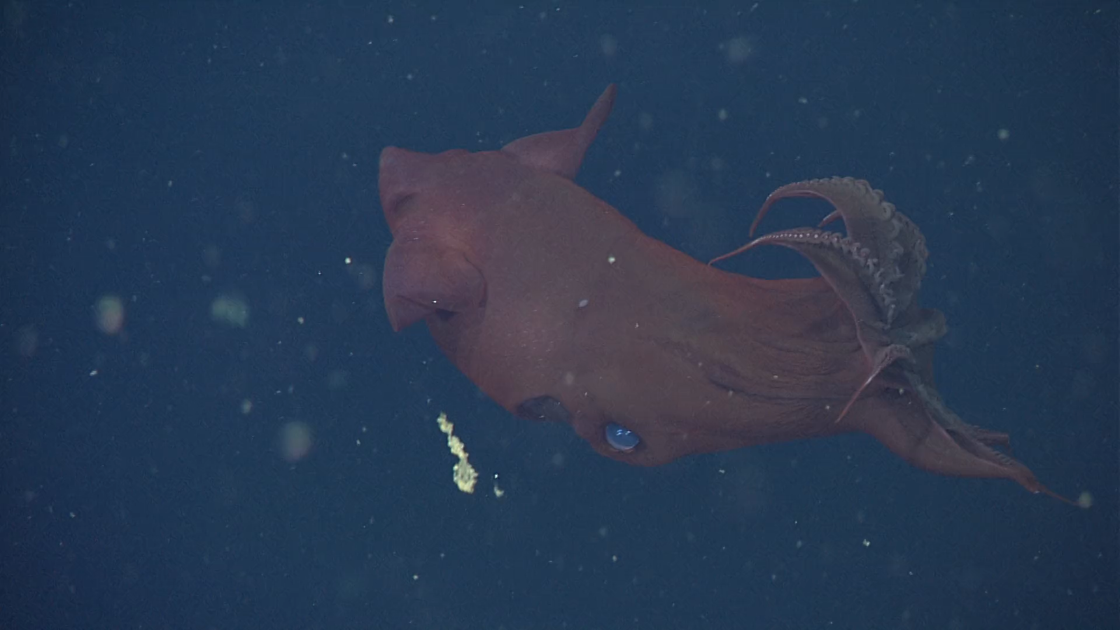
MBARI requirements for our main ROV cameras
MBARI requires professional quality zoom and focus controls!
Focus Position Slider
Pan & Tilt Control
Focus example
Zoom Rate Control Rocker Switch
https://www.youtube.com/watch?v=X8oWnbcLI40
Ikegami RCP
(2,794,882 views)

Slide 4
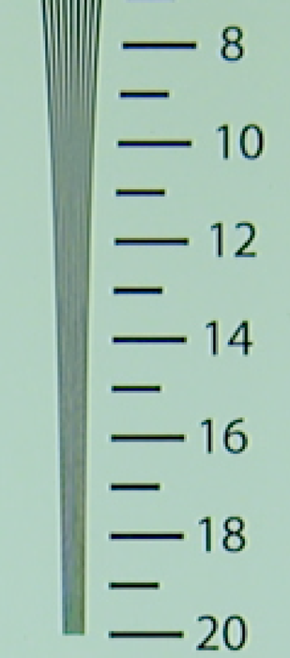
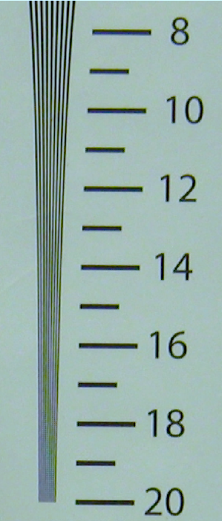
Advantages of 4K Video
i2MAP Test Tank Recordings Horizontal Resolution in Hundreds of Line Pairs/Picture Width
Imaged in 2K
Imaged in 4K
Four times the pixel resolution of current HD.
  Better resolution increases scientific insight.
  Provides high quality images for public outreach and education.
  Allows cropping of images for publication without too much visual degradation.
Images are scanned progressively.
  Eliminates interlace artifacts.
High quality camera modules are now available.
  2/3” 3-chip for excellent depth of field and sensitivity.
  Compact modules suitable for deep housings.

Slide 5
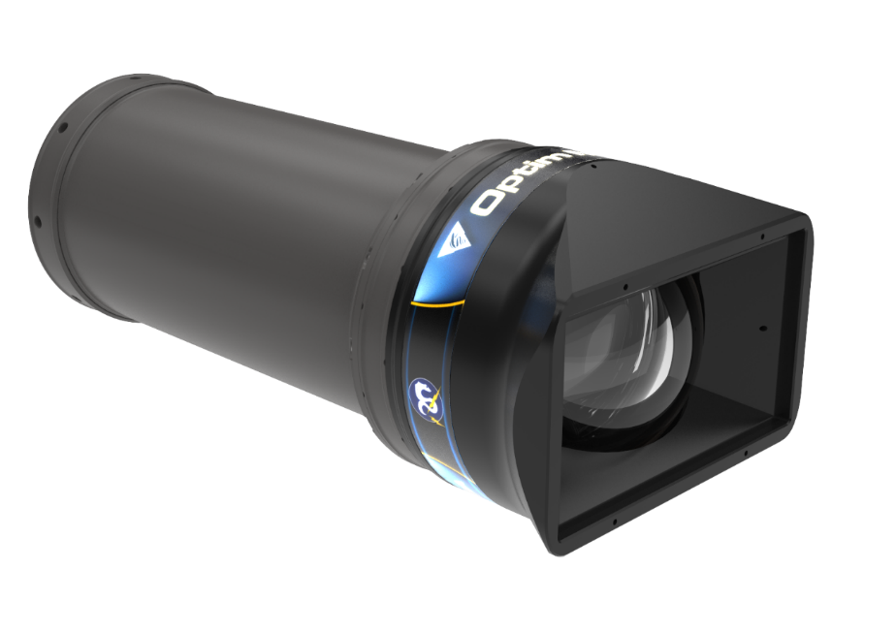
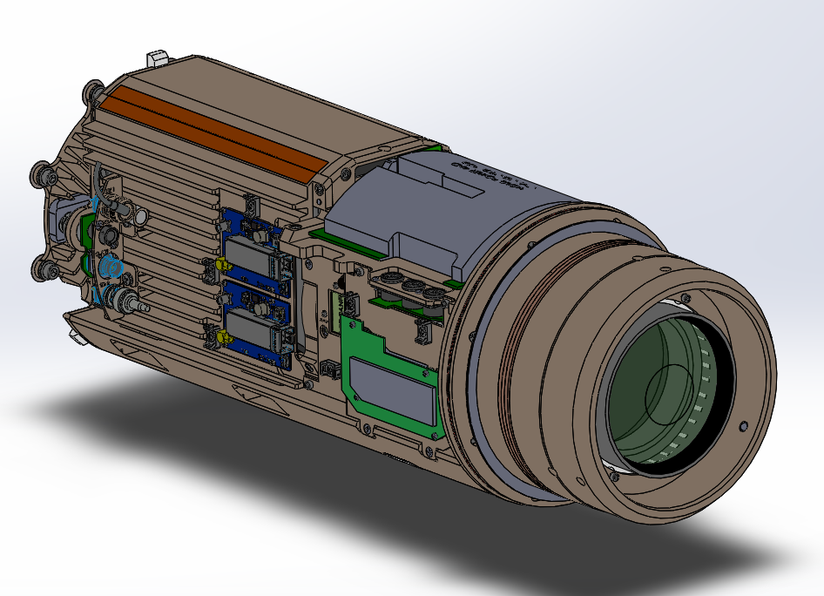
OPTIM MxD Camera System

Slide 6
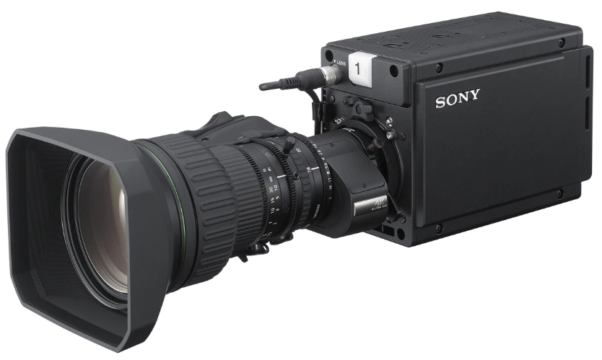
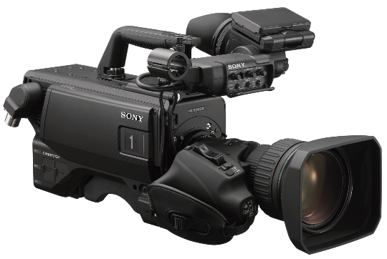
System Designed Around the Sony HDC-P50 Camera
Sony HDC-P50 Module and Canon CJ15ex4.3B 4K UHD Super Wide lens with 15x optical zoom.
  2/3” 3-Chip global shutter CMOS imager*.
  3840x2160 progressive scanning @ 60 frames/sec.
  ITU-R BT.2020 color gamut.
  High Dynamic Range (HDR) capable.
  Professional topside control box supports precision rate zoom and position focus servos.
  Single fiber telemetry for dual 12G-SDI video (24G!!) and all auxiliary channels supports most features including high frame rates.
  18-36Volt DC power supply input (18-30V with integrated sizing lasers).
  Internal monitoring for temperature, humidity, pressure and water alarm.
  Housing size approximately equivalent to Insite Pacific Zeus Plus camera.
The HDC-P50 is derived from the Sony HDC-3500 and 4500 series field cameras.
  * The 2/3” 4k imager is key, allowing a large depth of field, super wide angle and large zoom in a compact lens.
Notes:
In ROV videography a wide field of view AND large zoom factor are both important for both for piloting and scientific image capturing. An additional quality that is very important is a wide depth of field – having as much depth of the image appearing to be in focus as possible – due to the difficulties of maintaining precision focus with both a moving vehicle and often moving targets.
This is the opposite of the usual goals of cinematography where a narrow depth of field is often used to direct viewers to the focused dramatic object and the background is purposely de-focused. Digital cinematography uses 35mm and ever larger imagers and the PL lens mount.
So while large format high resolution digital imagers are taking the cinematography world by storm, ROV videography is best served by cameras developed for another mass application, live sports coverage and action field shooting such as live news coverage. Here the premium is on a wide depth of field, both wide angle and powerful zoom capabilities and a light portable package. These properties require a relatively smaller imager size with the most popular being the 2/3” format and B4 lens mount.
The Sony HDC P-50 is a breakthrough camera in that uses a new imager that has 4K resolution in the 2/3” sensor format. This sensor size allows a very wide angle lens that also provides 15X zoom in a compact package. The camera will output progressively scanned video in the UHD 3840x2160 format at 60 frames a second, which is state-of-the-art.

Slide 7
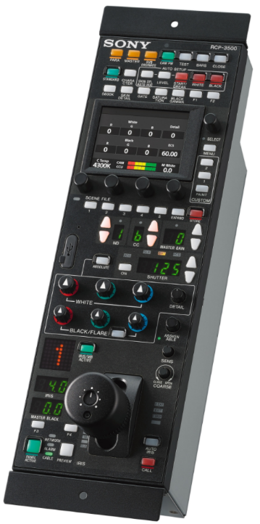
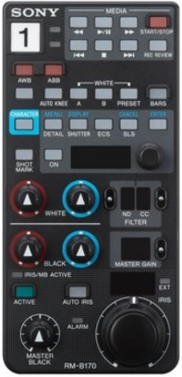
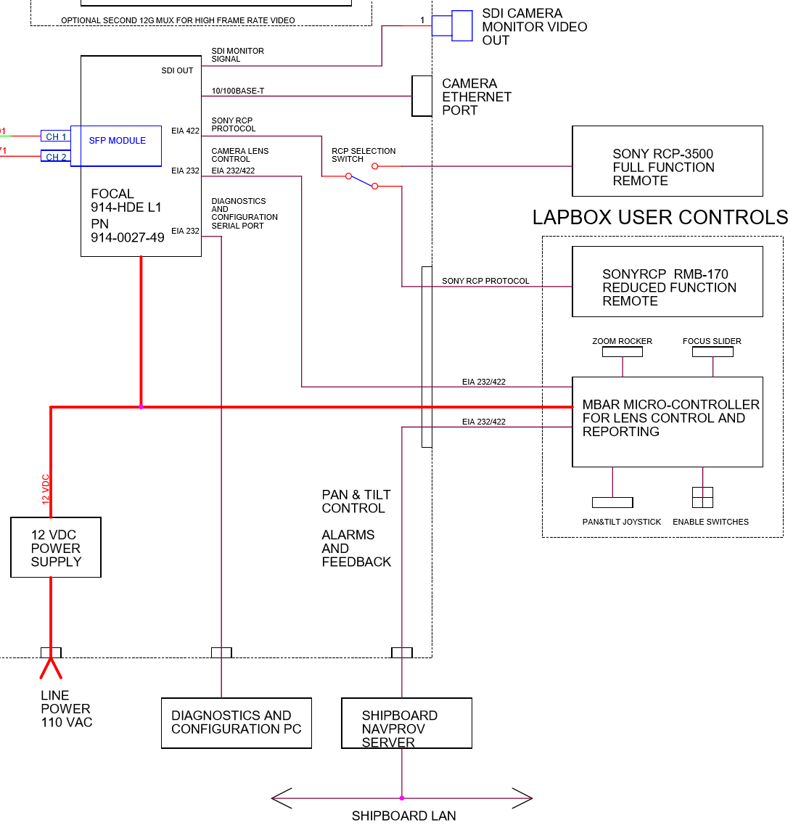
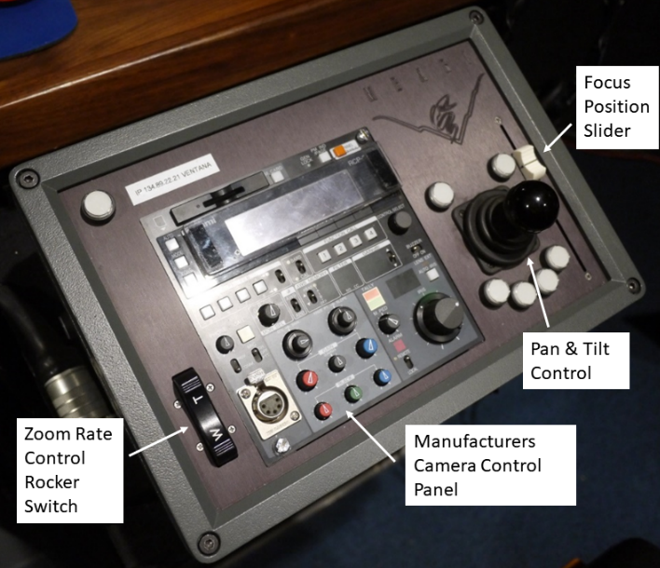
Camera interface, serial control, Ethernet interface, video outputs
RM-B170 Reduced function camera control for laptop
RCP-3500 Full function camera control, providing remote access to all features

Slide 8
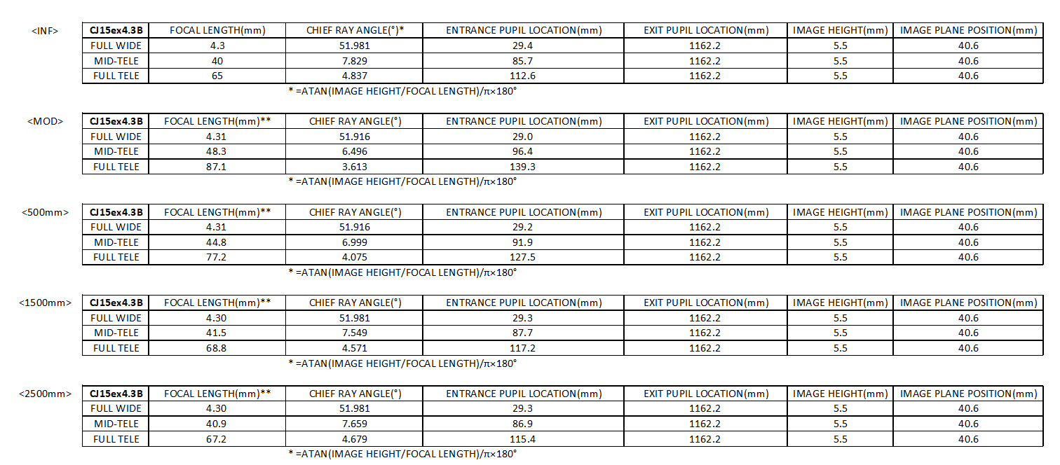
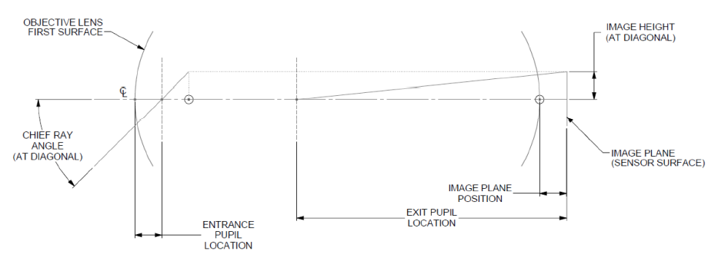
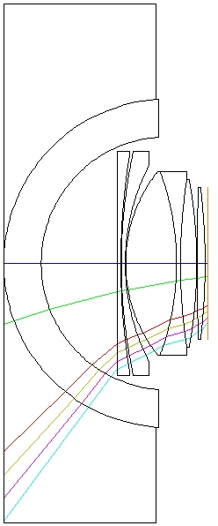
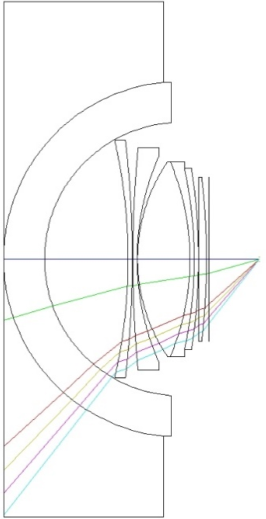
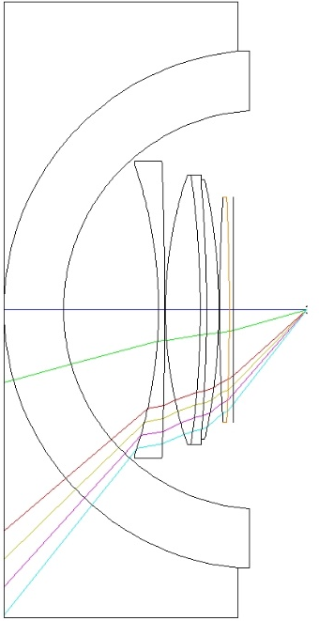
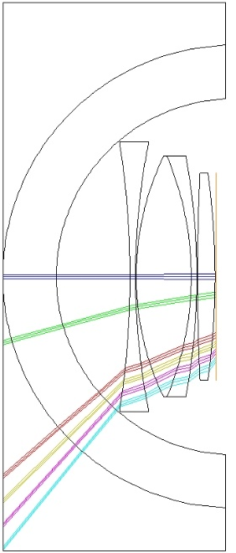
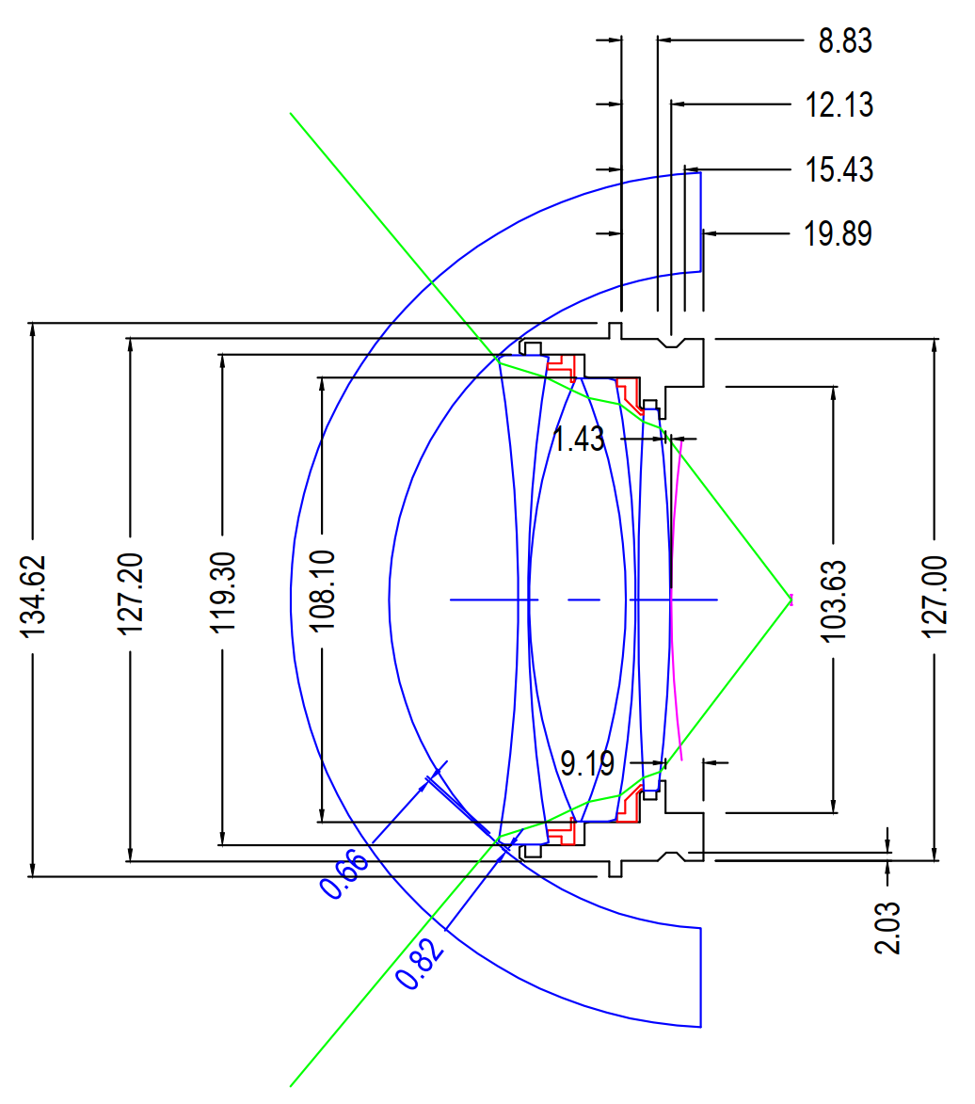
Optical Design Process
Source paraxial ray data from Canon at multiple object distances and focal lengths.
Based on a preliminary model, run generative iterations and evaluate against a merit function using optical modeling software (Zemax)
Iterations balance manufacturability, performance, tolerance sensitivity, and design priorities (e.g. internal reflections, thermal performance, etc.).
Initial design concepts demonstrated that the inner dome radius needed to increase from ~76mm to 80mm in order to reasonably achieve primary optics design objectives.
Proposed final design subjected to further analysis, Monte-Carlo simulation, tolerance sensitivity analysis, manufacturability risk evaluation

Slide 9
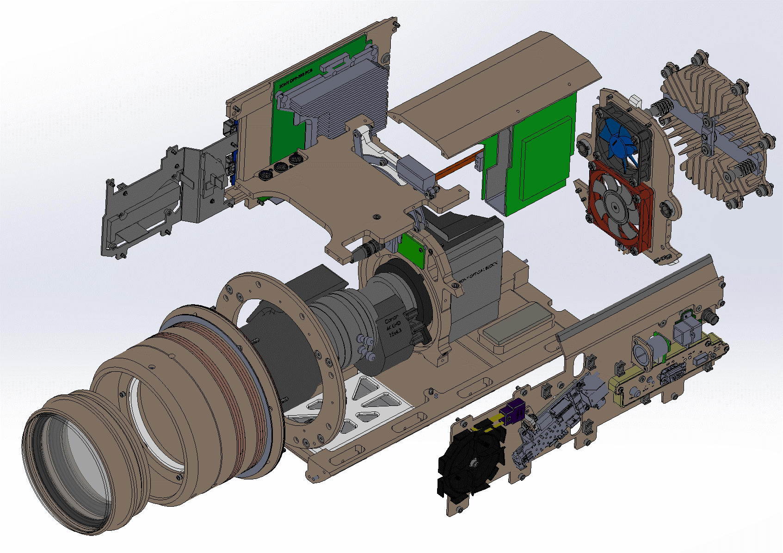
Camera Chassis Major Components
Right Panel and DPR-393 PCB
Camera Top Plate and System PCBs
Bulkhead Mount and Alignment Springs
Lens Servo Panel
Chassis Top Plate
Alignment Cone
Rear Plate
Optical Adapter Cell
Left Panel
Base Plate
Desiccant Holder

Slide 10
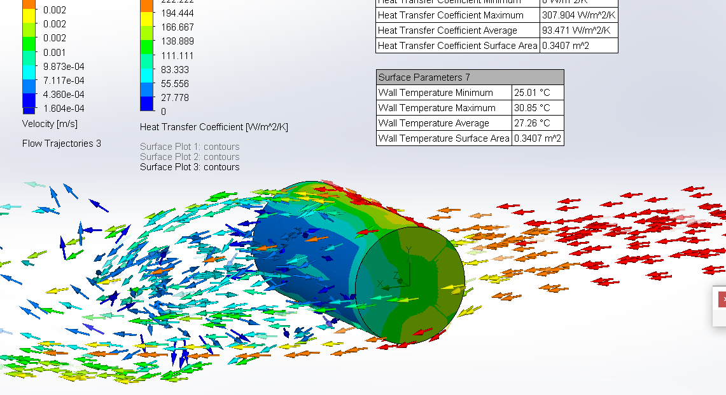
Results from 0.0025 meter/sec water flow
Forcing conditions:
Heat flow = 61.6 Watts

Slide 11
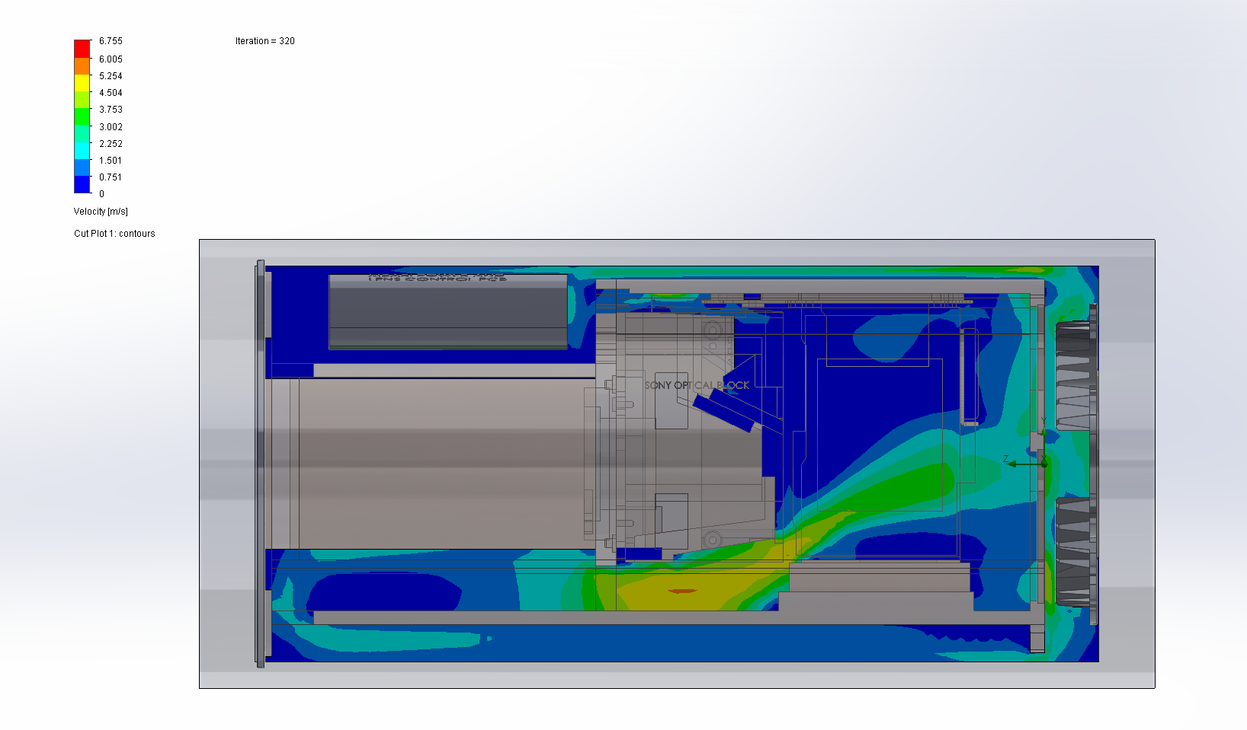
Flow Simulation Internal Forced Convection
Example velocity plot
Plenum circulation
Flow along housing wall

Slide 12
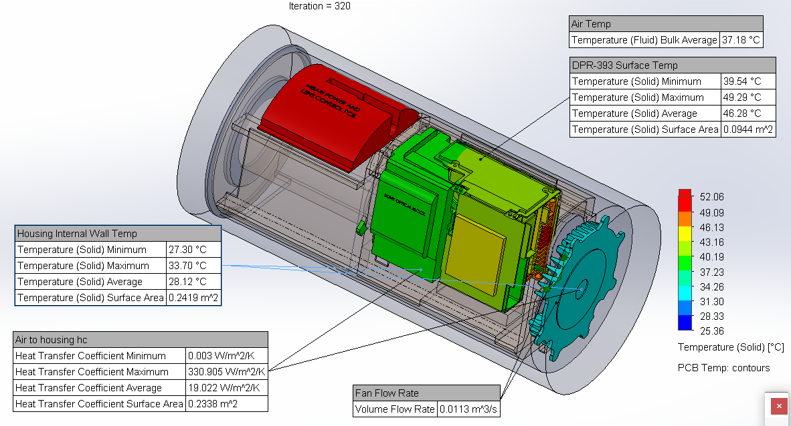
Longitudinal + Free Convection
Conditions:
Housing-to-H2O hc = 236.1 W/m2/°C (best example)
Housing outside wall temp. = 26.90°C (water 25°C)
Flow = Forced longitudinal + free convection

Slide 13
Step 10: Optical Verification Testing of Complete Assembly.
Re-locate the optical axis by repeating step #3 with the fully assembled housing. Retro-reflections from dome and adapter optics centered within < 1mm at aperture.
Attenuator
1mm aperture in white target
1mW Laser
(633nm HeNe)

Slide 14
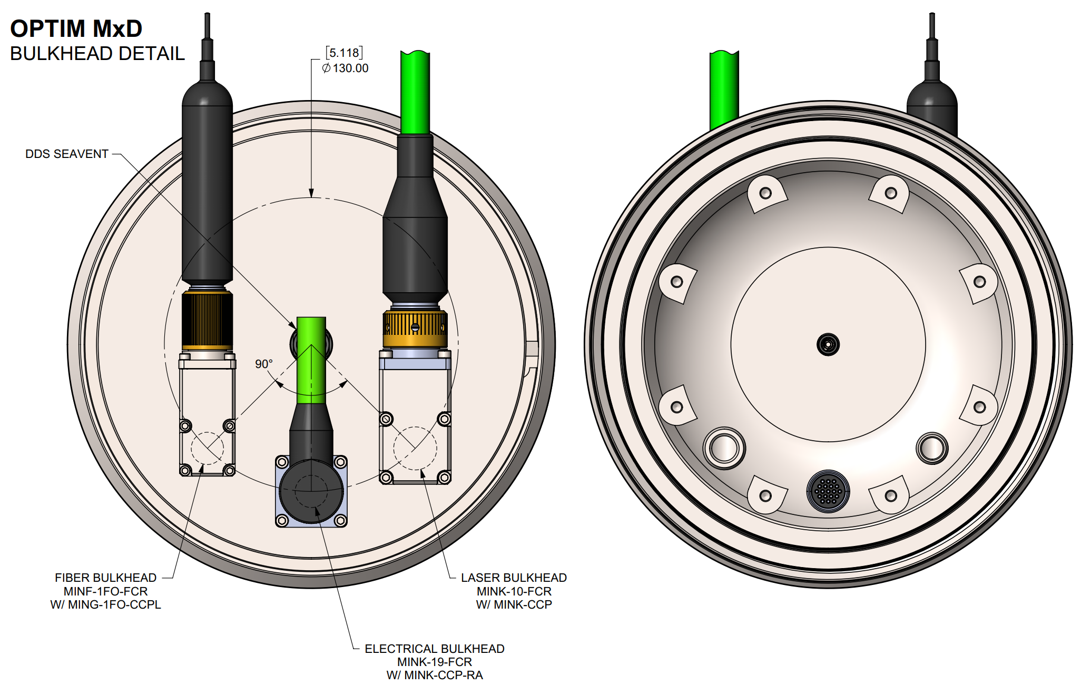
Bulkhead Connector Placement
Fiber:
SEA-CON MINF-1FO-FCR-TI
Camera telemetry & video
Single mode fiber connector compatible with ROV Ventana and Doc Rickets optical connectors
Primary Electrical:
SEA-CON MINK-19-FCR-TI
Primary 24V, 60W power input
Compatible with ROV Ventana and Doc Rickets main camera connectors
Option: scaling/sizing laser output power
Secondary Electrical:
SEA-CON MINK-10-FCR-TI
Secondary 24V, 60W power input
Compatible with ROV Ventana and Doc Rickets science connectors.
Option: scaling/sizing laser output power

