Slide 1
MBARI/DeepSea MXD Camera

Slide 2
What’s different from the Ikegami based Zues Plus:
Low noise – can operate at +3 or +6 gain without visible picture impairment.
2x Extender for greater zoom.
Better “detail” function. Up to +15 detail OK (0-100 settings).
Very good in-camera exposure and focus indicators.
Focus is extremely critical for good 4K images – and harder to get right.
  Recommend that users take full advantage of in-camera focus peaking display on monitor.
We are capturing in “Hybrid Log Gamma” mode or HLG, a form of “high dynamic range” or HDR.
  Greater range of highlights are captured in the picture.
  The picture looks good on a traditional rec. 709 monitor, but really great on a monitor that has an HLG display mode.
  If picture looks a little dark on a rec. 709 monitor or display, increase the brightness.
We are using the BT. 2020 color space.
  Color can look a little flat on rec. 709 monitors. Increase saturation on monitor to restore look.
  More color resolution, better reds and greens on BT. 2020 monitors.

Slide 3
Are you going to “grade” the picture post production or not?
If not grading (most MBARI footage)
  Want camera set to capture the best image for general use.
    Sometimes a mild lowering of the black level control gives the image more contrast and richness – but be careful, you cannot recover the black details later.
    Make sure that the exposure allows both dark areas and highlights to be captured.
If grading the image
  Want to capture the broadest possible image exposure so that you have more flexibility later.
    Do not crush the black or darker areas of the picture with the black level control.
    Make sure that the exposure allows both dark areas and highlights to be captured.

Slide 4
On beginning a dive set the color balance
Need to be below the sunlight illumination zone (unless that’s where you are shooting).
  Use AUTO WB with white card on manipulator arm.
  Use AUTO BB.
Check control to make sure that the command executes fully.
Manually adjust the color balance (white and black painting controls) at your peril. Hard to get right without skill and a color reference.

Slide 5
In-camera focus and exposure aids
Focus peaking shows up as green overlay on in-focus objects in the monitor picture (above the science monitor).
  Try to use the focus aid if you can, it is very difficult to get perfect focus in 4K without having your eyes 12” from the monitor!
  Visual effect is Ok to be out of focus momentarily if image comes into good focus – useable footage. If image goes out of focus the effect is very disturbing on the viewer – not useable footage.
Exposure control.
  Over exposure shows up as diagonal bars on brightest area. This tells you that you are starting to clip the highlights and losing information.
  We have tried to set up the science monitor so that a normal looking picture has the correct exposure.
  Watch the waveform monitor also to try and keep the bulk of the image within the camera capture range i.e. 0-100 i.r.e.

Slide 6
Best technique for midwater
Try to get as close as you can (see Chuck Saltzman guide!).
Bring as much light to bear as possible.
Try to use F 4 or 5 for better depth of field. Use gain of +3 or +6 if necessary.
Gain can increased to as much as +12 if that is the only way to get the shot. Over +6 will start to have visible picture noise.
Experiment carefully with the black level to maintain details you are interested in while generating a little contrast.

Slide 7
Use of the shutter
Good for rapidly moving objects to “freeze” motion blur.
  Vertical transits
  Fast moving critters where you may want to closely examine structure or behavior later.
Shutter increments
  No shutter = exposure ~ 1/60 of a second. (59.94i/59.94P)
  Shutter on, 1/100, 1/125,1/250, 1/500, 1/1000, 1/2000
  Note that i2MAP uses 1/250 shutter speed due to rapid transit speeds.
Turning the shutter on reduces the exposure by a corresponding amount, i.e. 1/125 = - 1 stop, 1/250 = -2 stops.

Slide 8
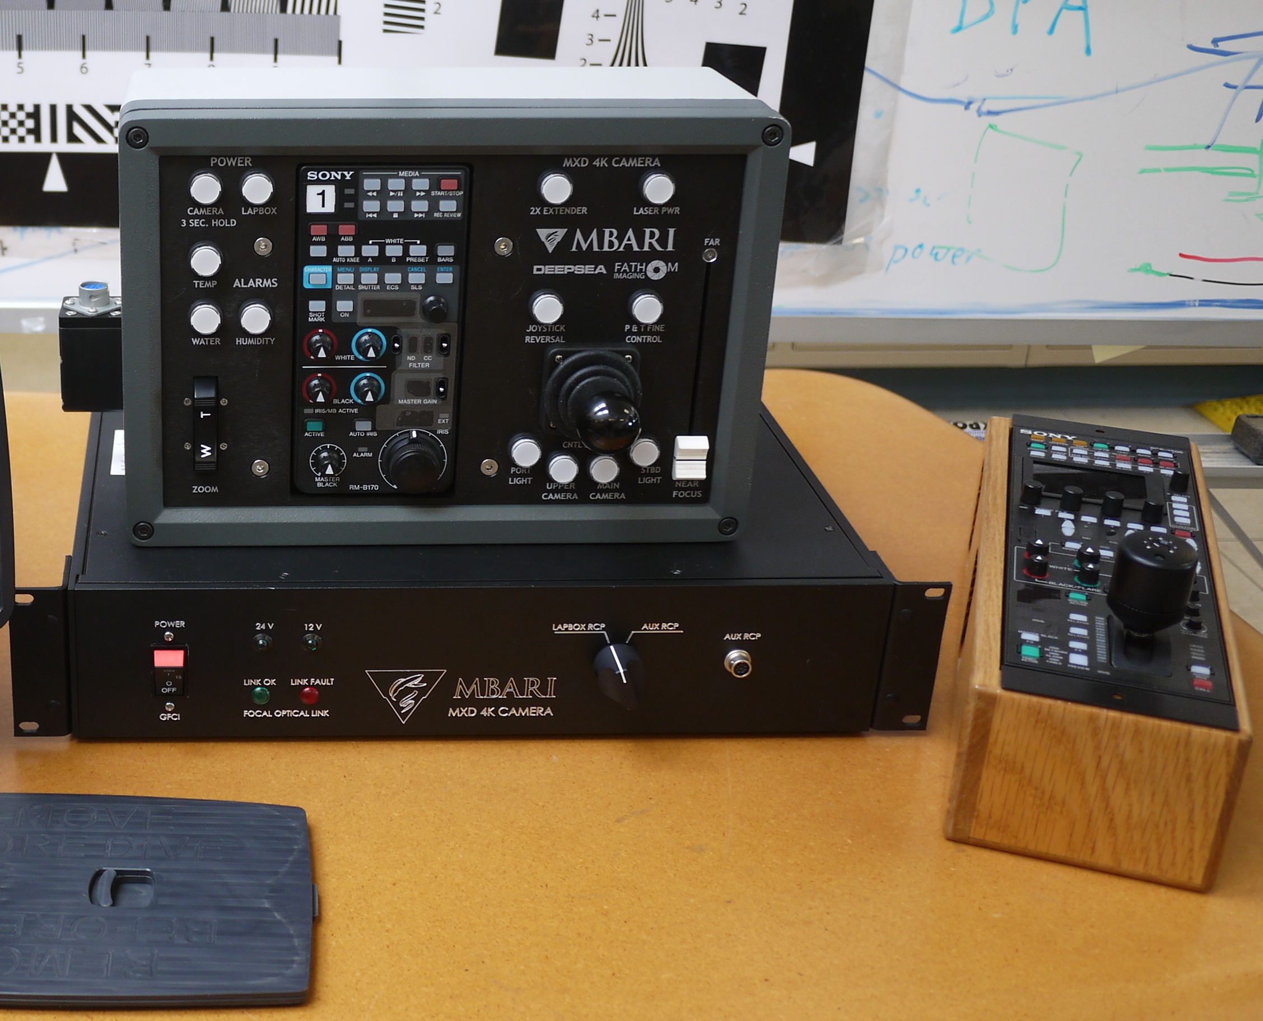
Camera controls
Sony RCP camera controls
MBARI camera controls
Alternate Sony RCP camera control. Can access all of the in-camera menu settings.
MBARI rack box
This switch powers both the lap and rack boxes

Slide 9
Simple RCP camera control
= non supported functions
3200K setting (not used underwater)

Slide 10
Filters
Color temperature conversion filters
A: Cross filter
B: 3200K (clear)
C: 4300K
D: 6300K
ND filters
1: Clear
2: 1/4ND
3: 1/8ND
4: 1/16ND
5: 1/64ND

Slide 11
A potential gotcha – panel active modes

Slide 12
Things to watch out for
Make sure that you have not left the shutter on when not needed. Will reduce exposure quite a bit.
Ditto with gain. If you do not need high gain (> +6) make sure it is not left on.
Watch detail function, when on adds detail, even if level set to 0. You can increase to maximum of maybe +15, but after that it begins to degrade image quality.

