Slide 1
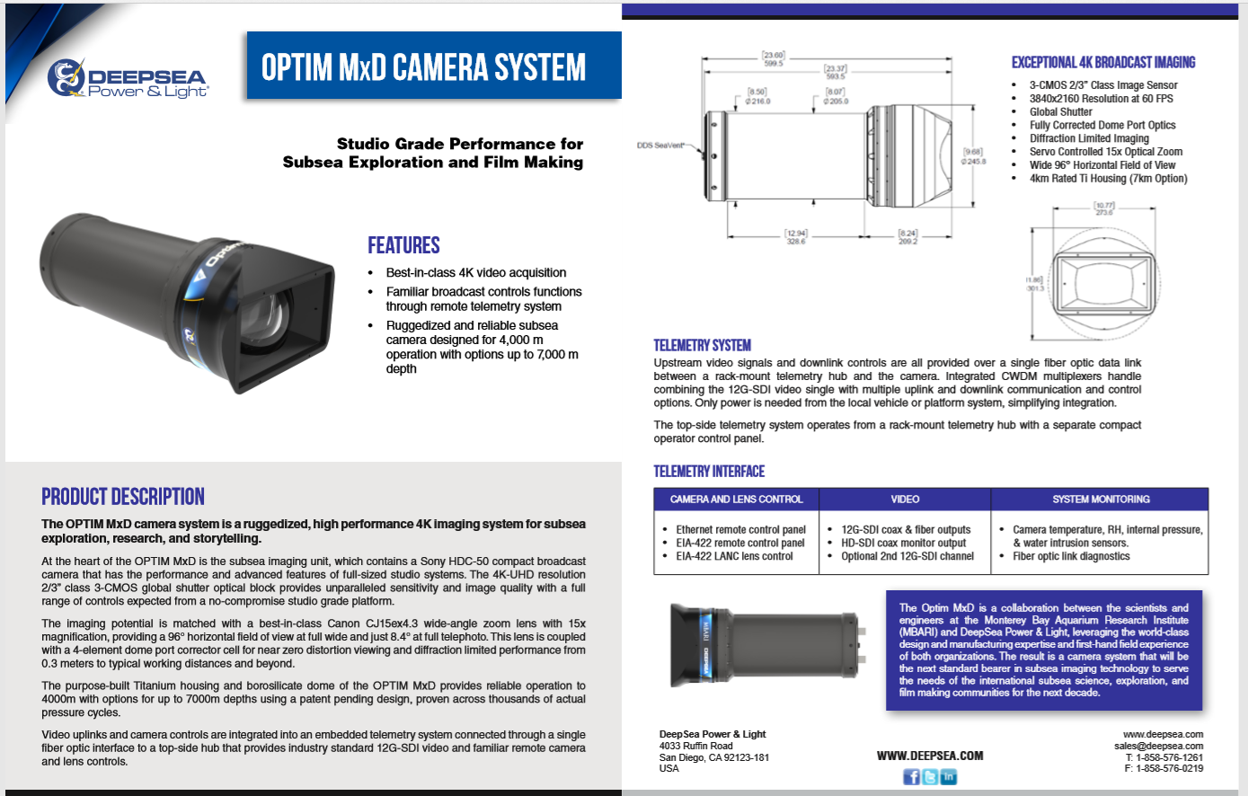
LANC?
Finesse this a little more?

