Slide 1
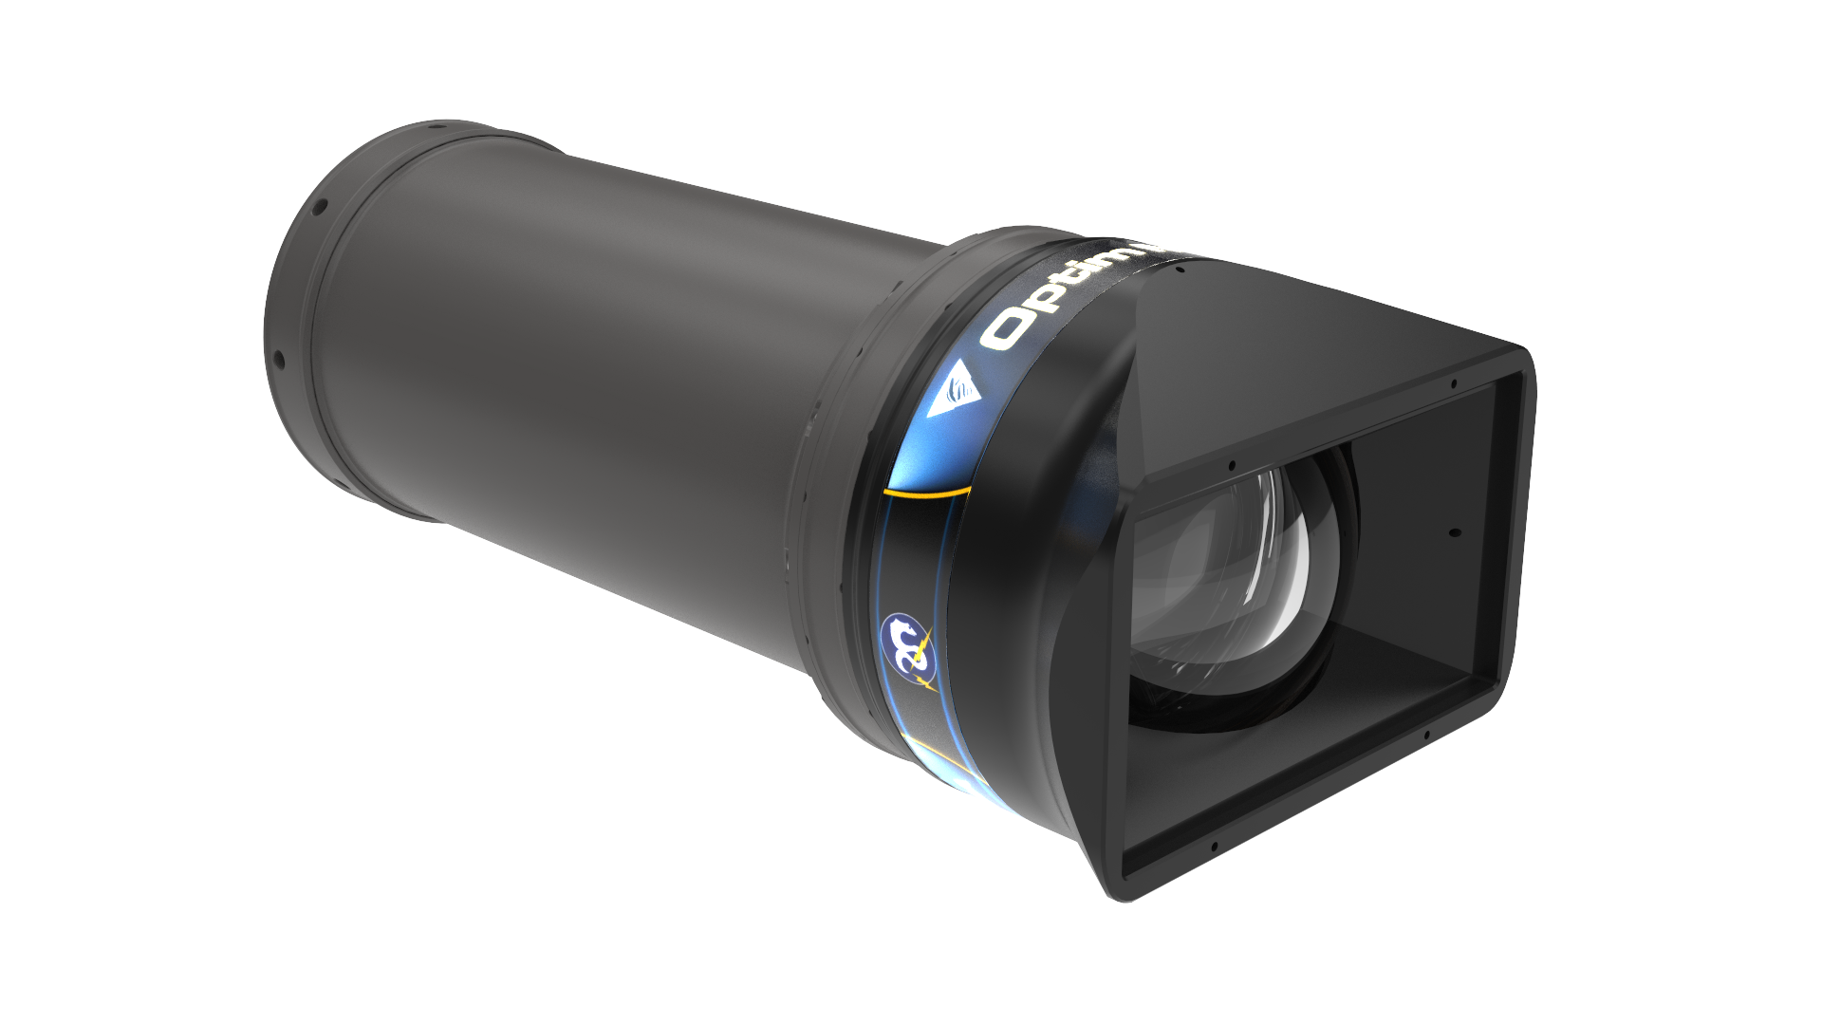
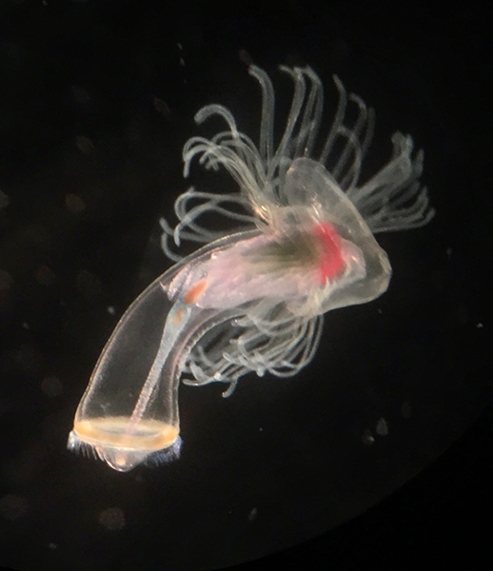
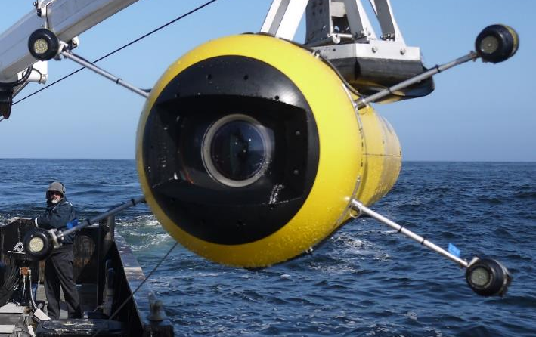
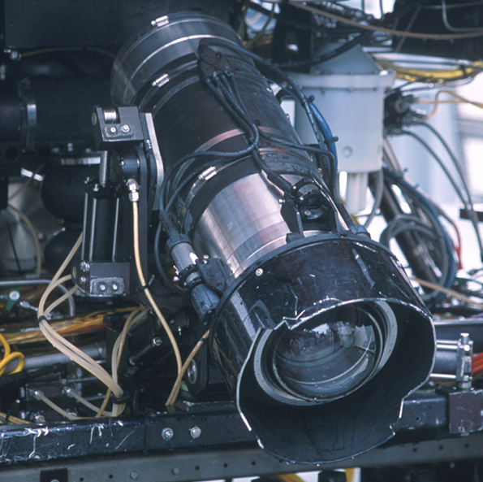
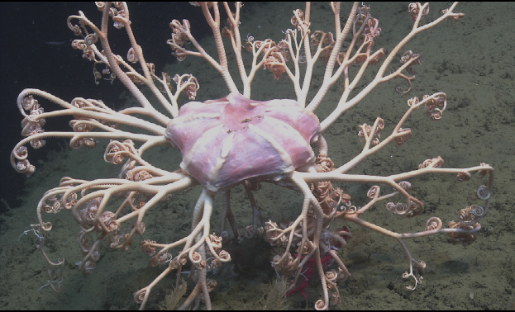
902001 4K ROV Camera
DRAWINGS & SCHEMATICS
Mark Chaffey
chma@mbari.org
(831) 775 1708

Slide 2
902001 4K ROV Camera
Mark Chaffey chma@mbari.org (831) 775 1708

