Slide 1
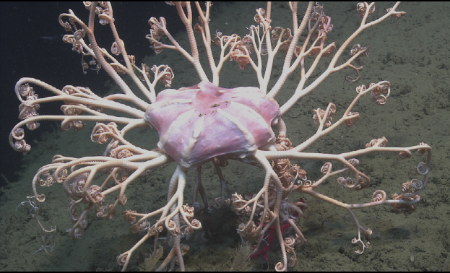
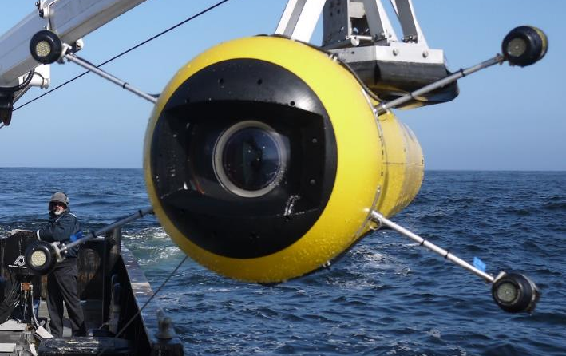
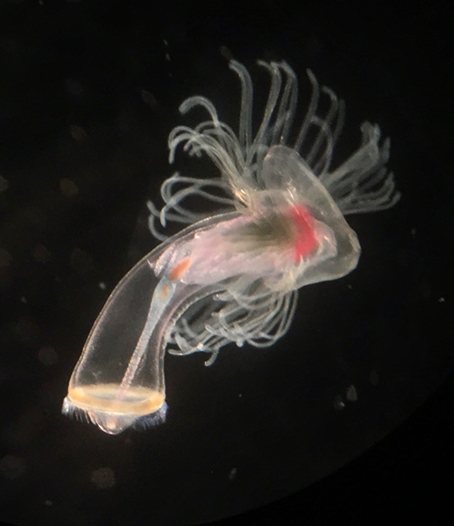
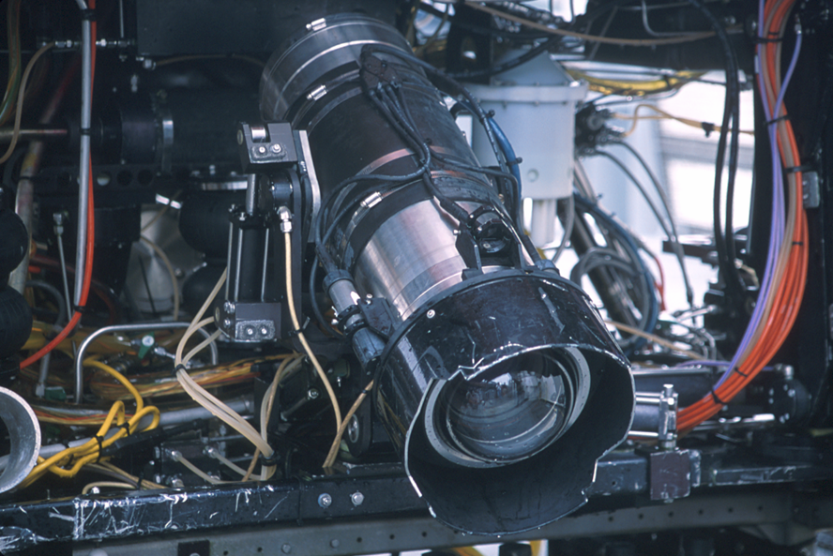
902001 4K ROV Camera
DATA SHEETS
Mark Chaffey
chma@mbari.org
(831) 775 1708

Slide 2
902001 4K ROV Camera
Mark Chaffey chma@mbari.org (831) 775 1708

